Slide 1

Lecture 6
Other Iliads:
Epic and Elegy

Slide 2
Iliad 6.420-426
But come in, rest on this seat with me, dear brother.
You are the one hit hardest by the fighting, Hector,
you more than all—and all for me, whore that I am,
and this blind mad Paris. Oh the two of us!
Zeus planted a killing doom within us both,
so even for generations still unborn
we will live in song.

Slide 3
Iliad 6.585-589
So please go home and tend to your own tasks,
the distaff and the loom, and keep the women
working hard as well. As for the fighting,
men will see to that, all who were born in Troy
but I most of all.

Slide 4
threnos: lament-song
“Hector! Dearest to me of all my husband’s brothers—
….
you with your gentle temper, all your gentle words.
And so, in the same breath I mourn for you and me,
my doom-struck, harrowed heart! Now there is no one left
in the wide realm of Troy, no friend to treat me kindly–
all the countrymen cringe from me in loathing!”
Her voice rang out in tears, and the vast throngs wailed

Slide 5
Simone Weil, Gravity and Grace
“The man who has known pure joy, if only for a moment ... is the only man for whom affliction is something devastating. At the same time he is the only man who has not deserved the punishment. But, after all, for him it is no punishment; it is God holding his hand and pressing rather hard. For, if he remains constant, what he will discover buried deep under the sound of his own lamentations is the pearl of the silence of God.”

Slide 6
Anairesis: Iliad 24.92-95
“Now, would one of you gods call Thetis to my presence?—
so I can declare to her my solemn, sound decree:
Achilles must receive a ransom from King Priam,
Achilles must give Hector’s body back.”

Slide 7
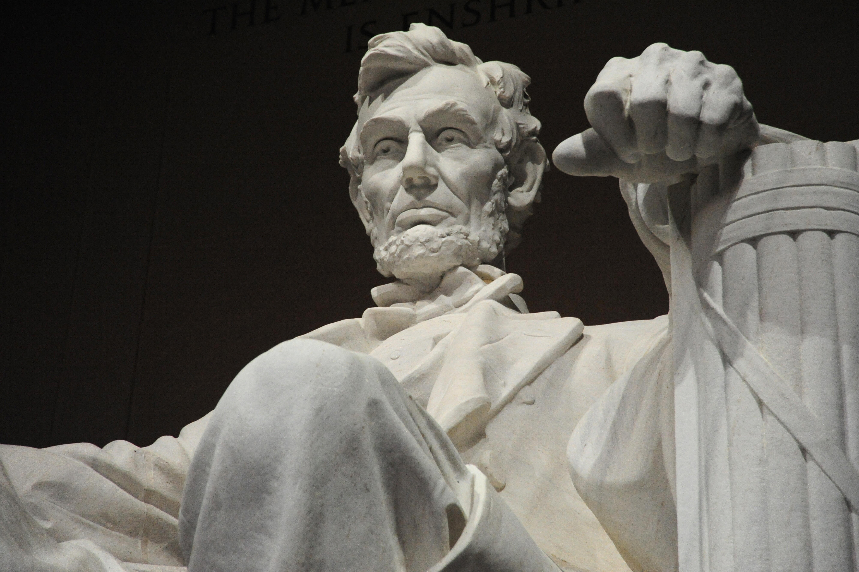
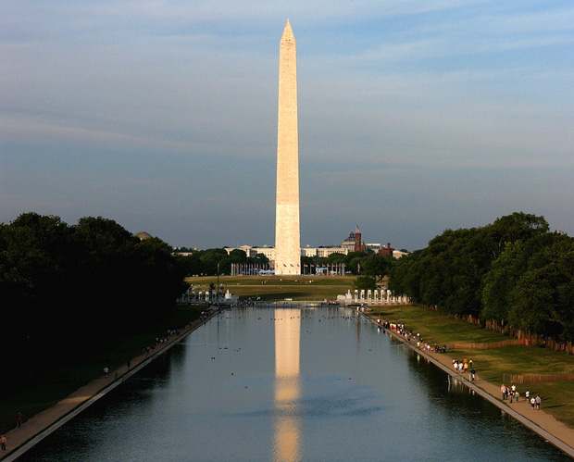
Shapes of Public Remembrance

Slide 8
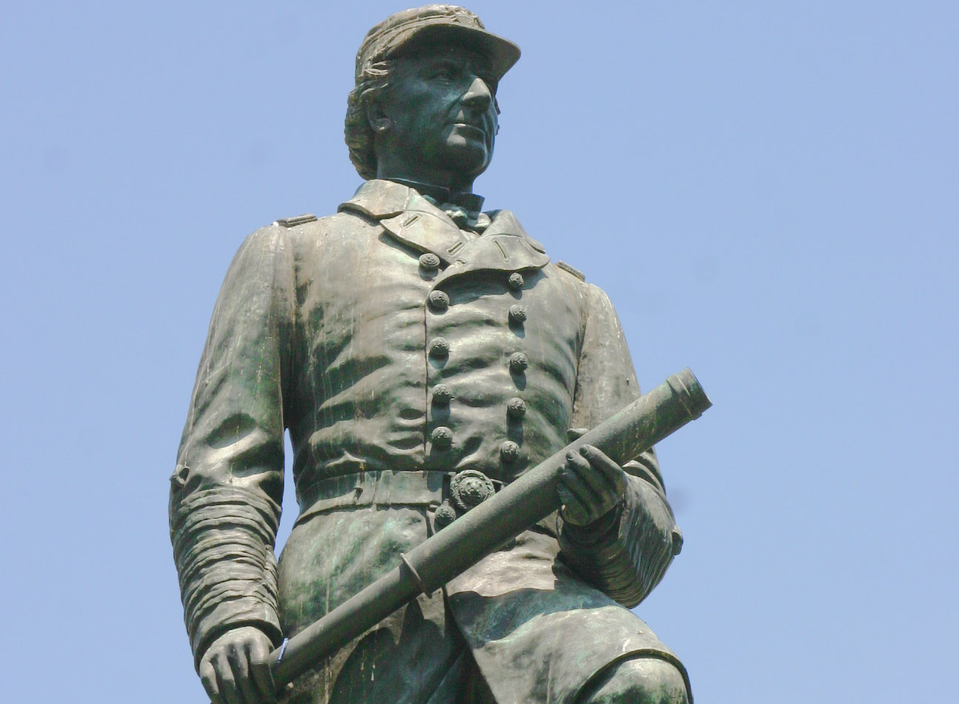
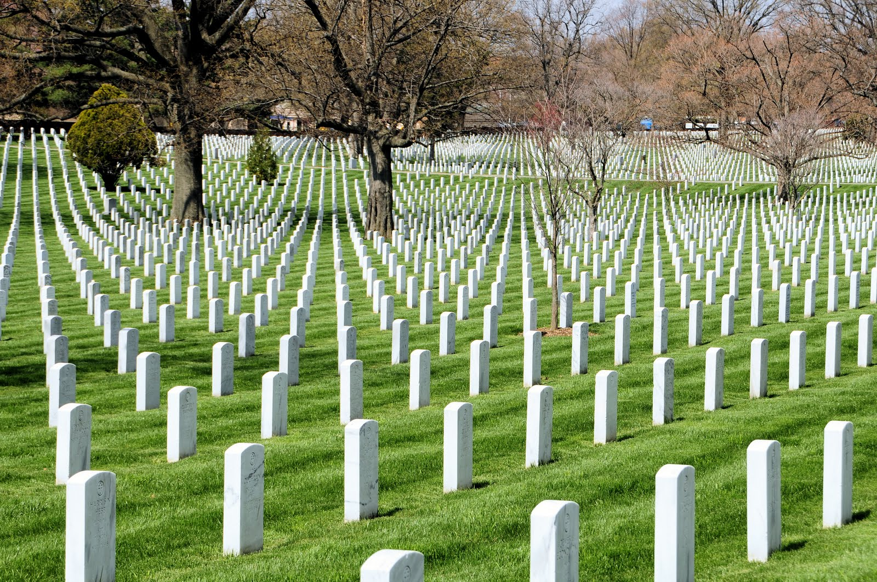
Shapes of Public Remembrance II

Slide 9
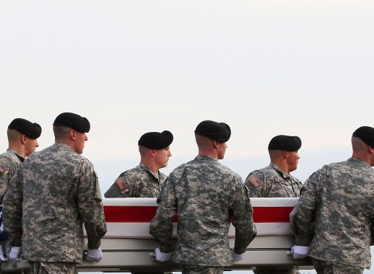
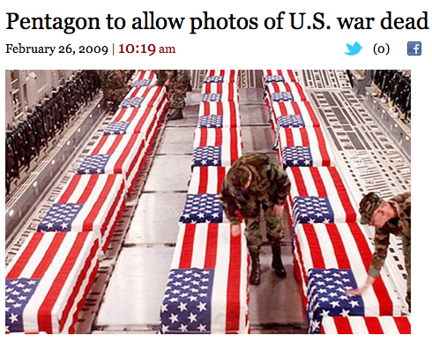
Shapes of Public Remembrance III

Slide 10
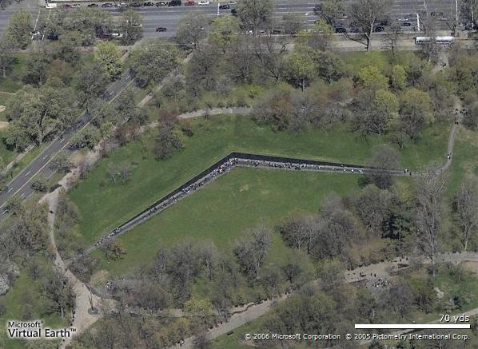
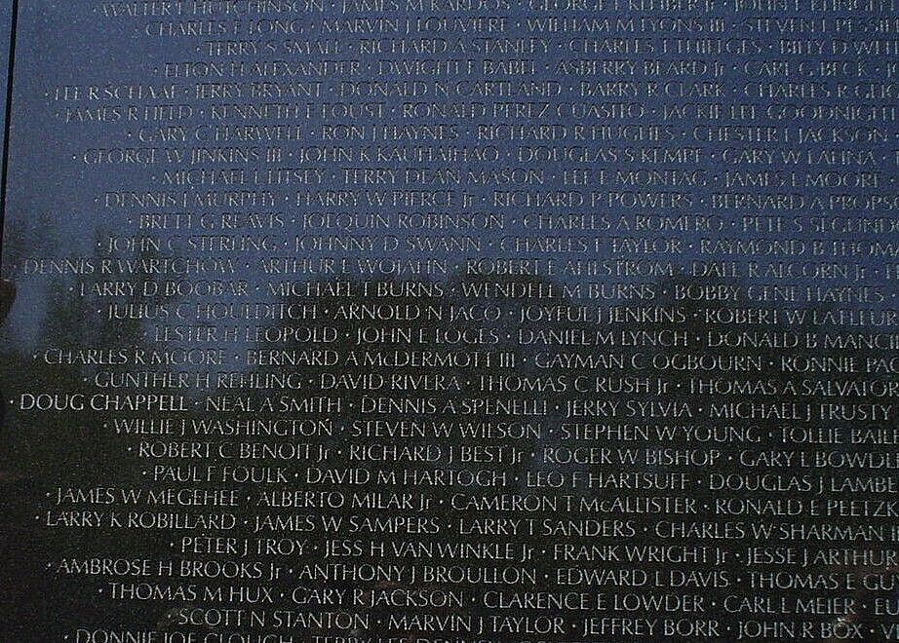
Shapes of Public Remembrance IV

Slide 11
The New Republic, 1981
“It is an unfortunate choice of memorial. Memorials are built to give context and, possibly, meaning to suffering that is otherwise incomprehensible. We do not memorialize bus accidents, which by nature are contextless, meaningless. To treat the Vietnam dead like the victims of some monstrous traffic accident is more than a disservice to history; it is a disservice to the memory of the 57,000.”

Slide 12
from “Lycidas” (1637)
YET once more, O ye Laurels, and once more
Ye Myrtles brown, with Ivy never-sear,
I come to pluck your Berries harsh and crude,
And with forc'd fingers rude,
Shatter your leaves before the mellowing year.
Bitter constraint, and sad occasion dear,
Compels me to disturb your season due:
For Lycidas is dead, dead ere his prime
Young Lycidas, and hath not left his peer:
                —John Milton

Slide 13
from “In Memory of Major Robert Gregory” (1919)
Some burn damp fagots, others may consume
The entire combustible world in one small room
As though dried straw, and if we turn about
The bare chimney is gone black out
Because the work had finished in that flare.
Soldier, scholar, horseman, he,
As ’twere all life’s epitome.
What made us dream that he could comb grey hair?
                —W.B. Yeats

Slide 14
The Logic of Elegy
Death in poetry is the occasion not just for the expression of feeling, but the occasion of the production of meaning.
Untimely death, or death in War, the crisis of meaning is a civilizational crisis.
To be made meaningful is to be made into an artifact—to submerge individual life into exemplary life

Slide 15
PROTOSILAUS
ECHEPOLUS
ELPHENOR
SIMOISUS
LEUKOS
DEMOCOON
DIORES
PIROUS
PHEGEUS
IDAEUS

Slide 16
Iliad 2.430-435
Range your men by tribes, even by clans, Agamemnon,
so clan fights by the side of clan, tribe by tribe.
Fight this way, if the Argives still obey you,
then you can see which captain is a coward,
which contingent too, and which is loyal, brave
since they will fight in separate formations of their own.

Slide 17
And HECTOR died like everyone else
He was in charge of the Trojans
But a spear found out the little patch of white
Between his collarbone and his throat
Just exactly where a man’s soul sits
Waiting for the mouth to open.

Slide 18
LYCAON killed Lycaon unkilled Lycaon
Bending down branches to make wheels
Lycaon kidnapped Lycaon pruning by moonlight
Lycaon naked in a river pleading for his life
Being answered by Achilles No

Slide 19
The first to die is PROTESILAUS
A focused man who hurried to darkness
With forty black ships leaving the land behind
Men sailed with him from those flower-lit cliffs
Where the grass gives growth to everything
Pyrasus Iton Pteleus Antron
He dies in mid-air jumping to be first ashore
There was his house half-built
His wife rushed out clawing her face
Podarcus his altogether less impressive brother
Took over command but that was long ago
He’s been in the black earth now for thousands of years

Slide 20
The first to die is PROTESILAUS
A focused man who hurried to darkness
With forty black ships leaving the land behind
Men sailed with him from those flower-lit cliffs
Where the grass gives growth to everything
Pyrasus Iton Pteleus Antron
He dies in mid-air jumping to be first ashore
There was his house half-built
His wife rushed out clawing her face
Podarcus his altogether less impressive brother
Took over command but that was long ago
He’s been in the black earth now for thousands of years
The men of Phylace, Pyrasus banked in flowers,
Demeter’s closed and holy grove and Iton mother of flocks,
Antron along the shore and Pteleos deep in meadows.
The veteran Protosilaus had led those troops
while he still lived, but now for many years
the arms of the black earth had held him fast
and his wife was left behind, alone in Phylace,
both cheeks torn in grief, their house half-built.
Just as he vaulted off his ship a Dardan killed him,
first by far of the Argives slaughtered on the beaches.

Slide 21
Simoisius born on the banks of the Simois
Son of Anthemion his mother a shepherdess
Still following the sheep when she gave birth
A lithe and promising young man unmarried
Was met by Ajax in the ninth year of the war
And died full tilt running onto his spear
The point passed clean through the nipple
And came out through the shoulderblade
He collapsed instantly an unspeakable sorrow to his parents

Slide 22
And Leukos friend of Odysseus
Little is known of him except his death.
Antiphus hurled at him—
The son of Priam wearing a gleaming breastplate
let fly through the lines but his sharp spear missed
and he hit Leucus instead, Odysseus’ loyal comrade,
gouging his groin as the man hauled off a corpse—
It dropped from his hands and Leucus sprawled across it

Slide 23
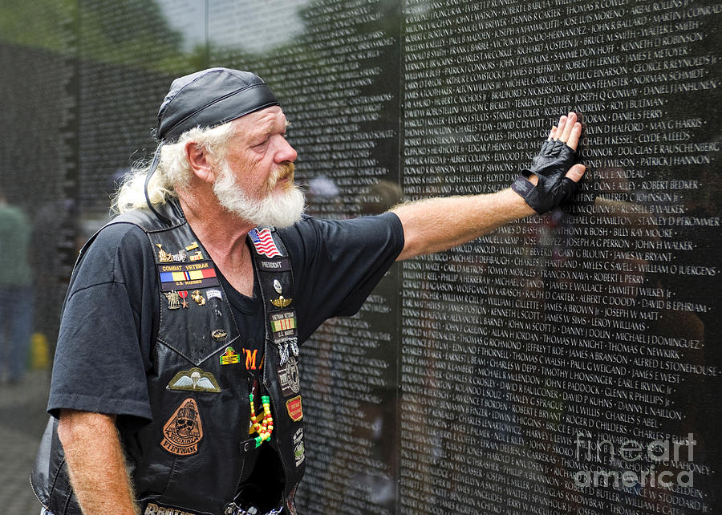
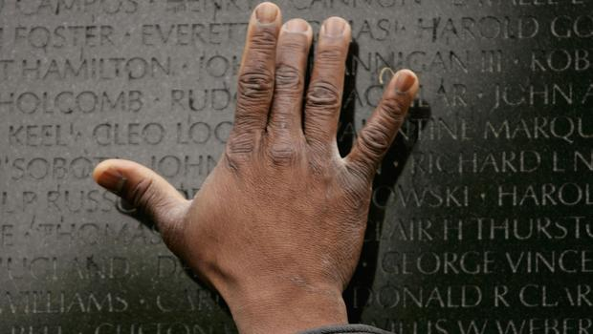
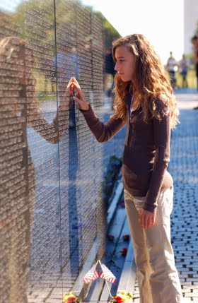
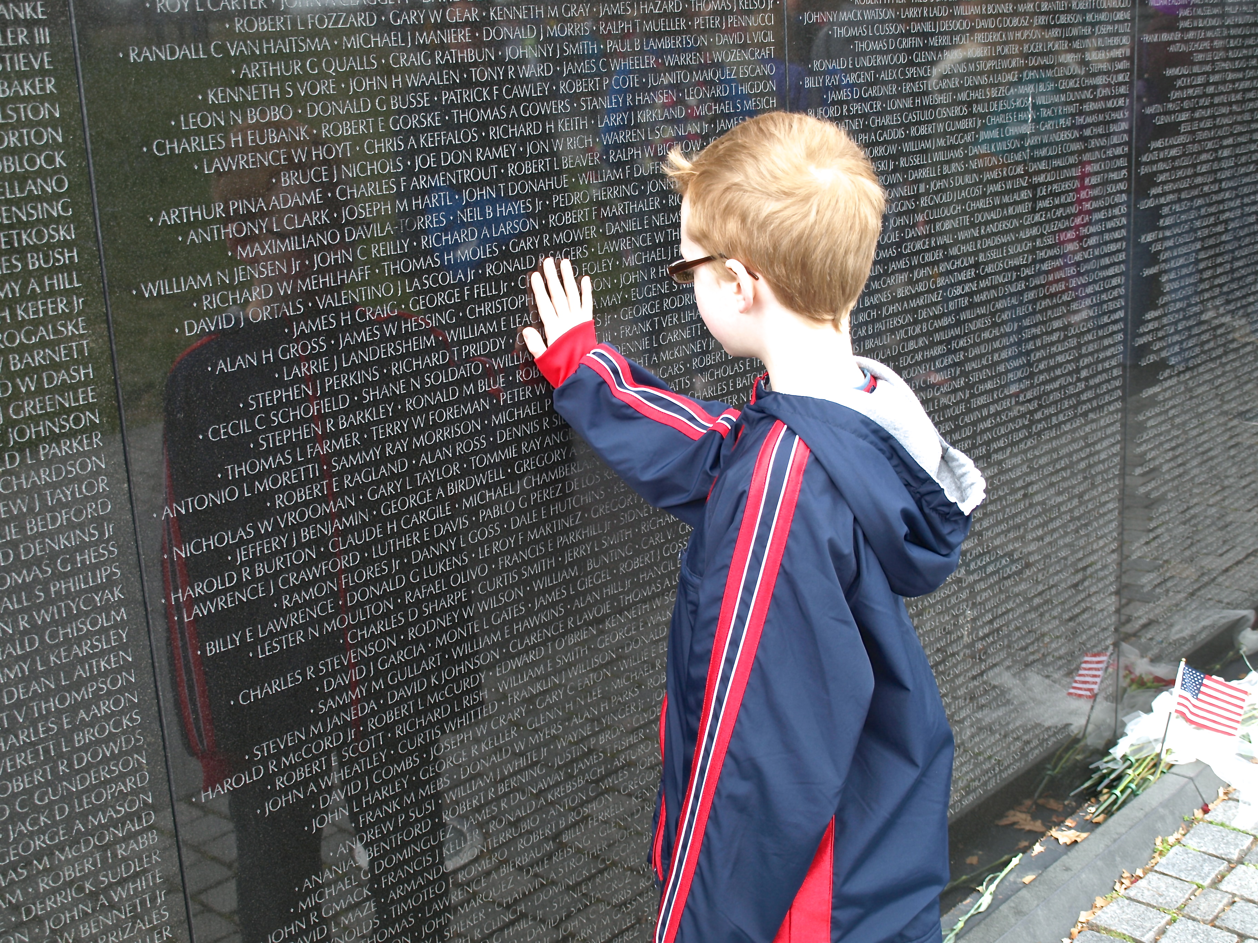
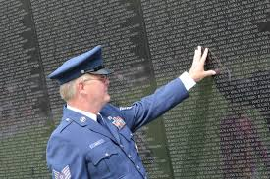

Slide 24
Like thousands of water birds mill and mass in the air
Great gatherings of geese and cranes and long-necked swans
Flaring and settling in those fields where the rain runs down
to the Cayster
Continually shuffling and lifting and loving the sound of their wings
They shriek as they land like a huge birdfair a valleyfull of voices
. . . .
Like wandering tribes of flies that gather in sheds
In shadowy spring when the milk splashes in the buckets

Slide 25
Like thousands of water birds mill and mass in the air
Great gatherings of geese and cranes and long-necked swans
Flaring and settling in those fields where the rain runs down
to the Cayster
Continually shuffling and lifting and loving the sound of their wings
They shriek as they land like a huge birdfair a valleyfull of voices
. . . .
Like wandering tribes of flies that gather in sheds
In shadowy spring when the milk splashes in the buckets
Armies gathering now as the huge flocks on flocks of winging birds, geese or cranes
or swans with their long lancing necks—circling Asian marshes
round the Cayster outflow, wheeling in all directions,
glorying in their wings—keep on landing, advancing, wave on shrieking wave and the tidal flats resound.
So tribe on tribe, pouring out of the ships and shelters,
marched across the Scamander plain and the earth shook
The armies massing. . . crowding thick and fast
as the swarms of flies seething over the shepherd’s stalls
In the first spring days when the buckets flood with milk—
so many long-haired Achaeans swarmed across the plain
to confront the Trojans, fired to smash their lines.

