Slide 1
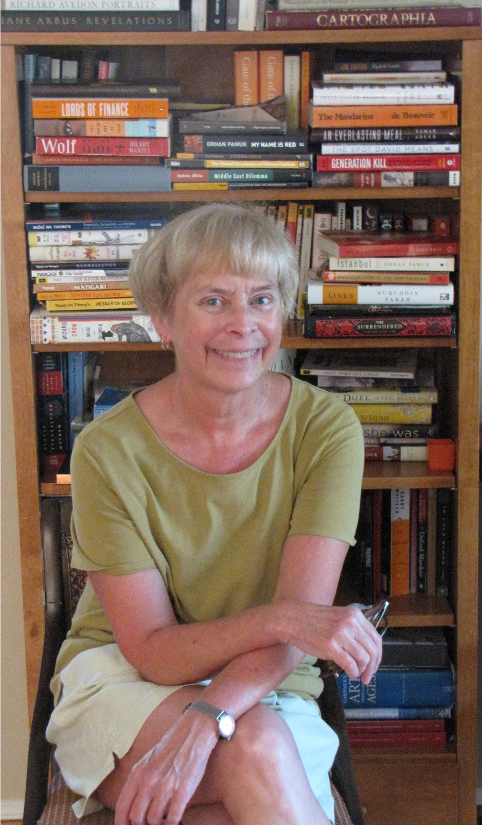
HCC (Fall, 2014): WAR / Transition /
From Weeks 1 - 3 to Weeks 4 - 6 / 7
Exemplary Wars and (Post) War Stories / “Transformations”
  1. Trojan War (c. 1300-1200 b.c.e.)
  Homer, Iliad → WWII and the Trojan War (Weil, “The Iliad, or The Poem of Force” (1940) → A (Un)Trojan War for our Time? (Alice Oswald, Memorial, 2011)
  2. The Thirty Years’ War (1618-1648)
    Grimmelshausen, Simplicissimus
    (1668-69) → Bertolt Brecht,
    Mother Courage and her Children
    (1939) → John Walter, “Theater of
    War” (film) (2008)
  - Two different kinds of war…?
  - A legendary war vs. a “real” war
  - A ‘heroic’ war vs. a ‘modern’ war
  - But both exemplary (as models? as warnings?) (Post-WWII poll in Germany…)
  - And similar in the fact of serial receptions and retellings of them…
Prof. Jane O. Newman, Departments of
Comparative Literature and European
Languages and Studies

Slide 2
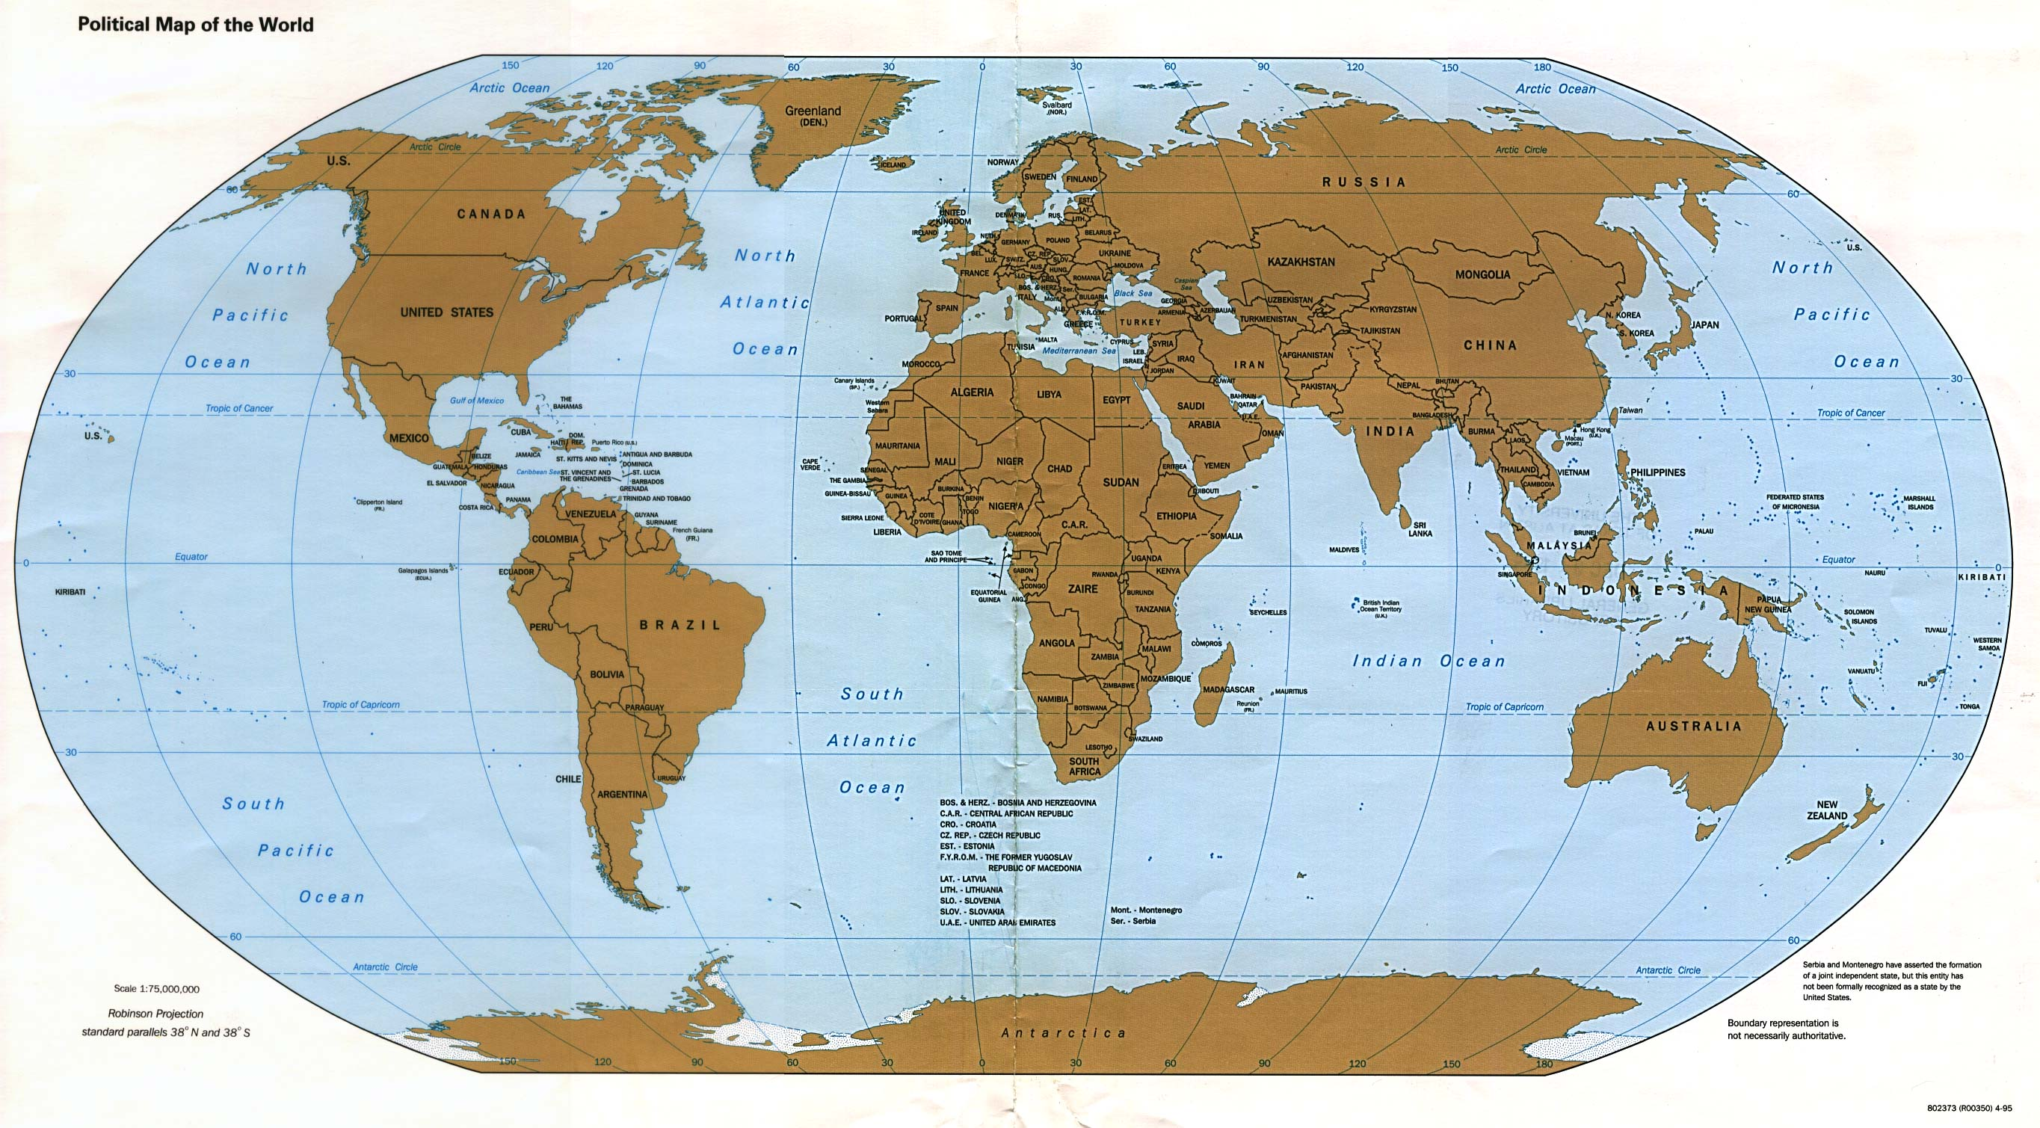
Where have we been and where are we going?
Troy (Iliad) →
France /
Germany
(Weil) →
U.K. (Oswald)
Thirty Years’ War /
Germany
( = Central
Europe) → Germany
(Grimmelshausen
and Brecht) →
U.S. (NYC)
(Walter)
Where was Troy? Where is Germany? Patterns of reception? Movement west?
Inheritances of the past in the contemporary world / in the U.S….

Slide 3
When have we been, and when will we have been by the middle of week 7?
SECOND GULF WAR (2003-11)
FIRST GULF WAR (1990-91) VIETNAM WAR (1954-75)
WWII (1939-45)
WWI (1914-18)
U.S. CIVIL WAR (1861-65)
FRENCH REVOLUTION (1789)
THIRTY YEARS’ WAR (1618-48)
THE CRUSADES (1095-1272)
(CAESAR’S) GALLIC WARS (58-50 b.c.e.)
PELOPONNESIAN WAR (431-404 b.c.e.)
TROJAN WAR (c. 1300-1200 b.c.e)
FUTURE →
← PAST

Slide 4
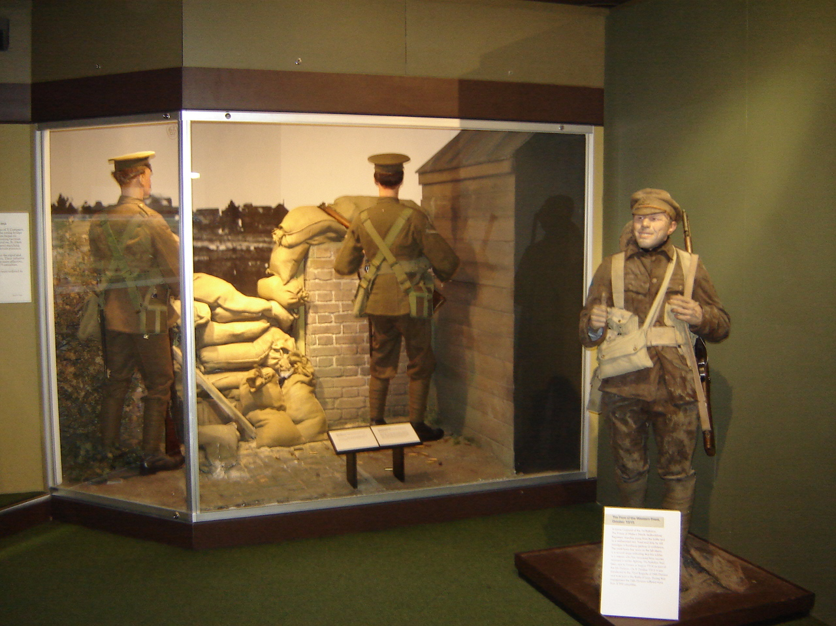
As Professor Izenberg said…
Some of these wars, places, and times seem further away and longer ago than others…
Our job – as humanists engaged in our present and committed to our common future – is not to lock them into their ‘foreign’ “far-awayness,” or into “museal” ( = museum-like) “antiquarian” (like “antiques”...) boxes…
Instead, our job is to interpret the past – and to read re-presentations of the past critically – as a way to understand both those other places and times…
And ourselves…
Don’t get me wrong…
I like museums…
But museums always re-present the past in specific, “made” (artefactual?) ways…
History as ‘story’ is as “made” as poetry, in
other words…

Slide 5
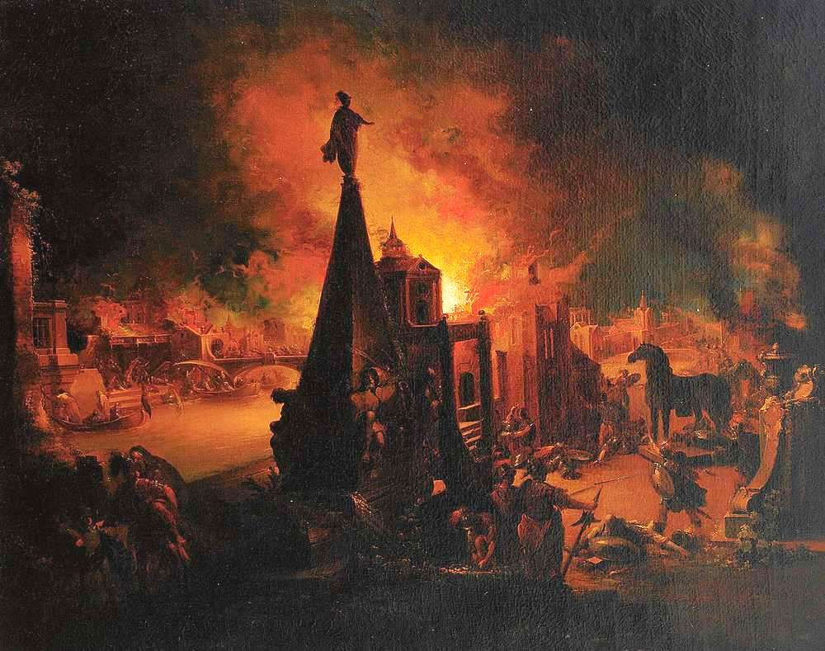
HISTORY as STORY and REPRESENTATION / RE-PRESENTATION
How do we tell the (hi)story of war…?
Res gestae (Latin: the things that happened) vs. historia (Latin: the telling of those things / the story of the res gestae)
As a story of individuals / Individual battles / Individual leaders?
As spectacle / spectacular battles / spectacular innovations in military technology and strategy / spectacular slaughter of civilians who get caught up in the mess?
Who speaks and what do we see in any given re-presentation of the past?
What exactly is being “made present again”? / From whose point of view?
READ my “Representing History” in the HCC Writer’s Handbook
Johann Georg Trautmann (1713-1765),
“Troy Burns”

Slide 6
Shaping the Story
The Power of Genre: Epic (Homer’s Iliad) vs. Picaresque (Grimmelshausen’s Simplicissimus) and the Re-Presentation of War
Genre - The term for any category of literature or other forms of art (painting, music, film) based on some set of stylistic criteria or content-driven classificatory categories.
“Science fiction” is a genre of fiction; the “action film” and the “romantic comedy” are genres of movies.
EPIC - “An extended narrative poem in elevated or dignified language,” celebrating the feats of a “legendary” and usually upper-class / ruling-class “hero.”
PICARESQUE - A prose-fiction narrative / usually satirical / usually humorous (often obscene) / follows a lower-class “hero” (picaro) as he undergoes ‘adventures’ and tries to survive by his wits in a corrupt world…
The picaresque is the “underbelly” of epic / It tells war “from below”…

Slide 7
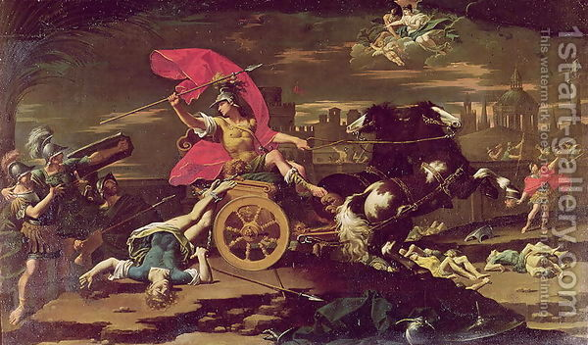
Comparative genres (In another medium):
“History from Above” / “Epic” or “Heroic” (“Iliadic”)
“History Painting” / usually LARGE paintings / usually oil paintings
Donato Creti (1671-1749), “Achilles Dragging Hektor’s Body around the Walls of Troy”
(95 x 56 inches) = 8 feet x 4 and 1/2 feet

Slide 8
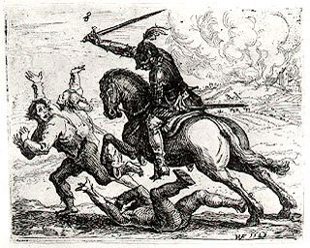
Versus “History from Below”?
Similar scene, but different genre and medium (etching) / Look at both the content and the scale of the figures (and the image) / “un-Iliadic” war /
“Grimmelshausen-ian” war?
Hans Ulrich Franck (1603-75) “Der Geharnischte Reiter” (Knight in Armor) – etching, 11 x 13 cm.

Slide 9
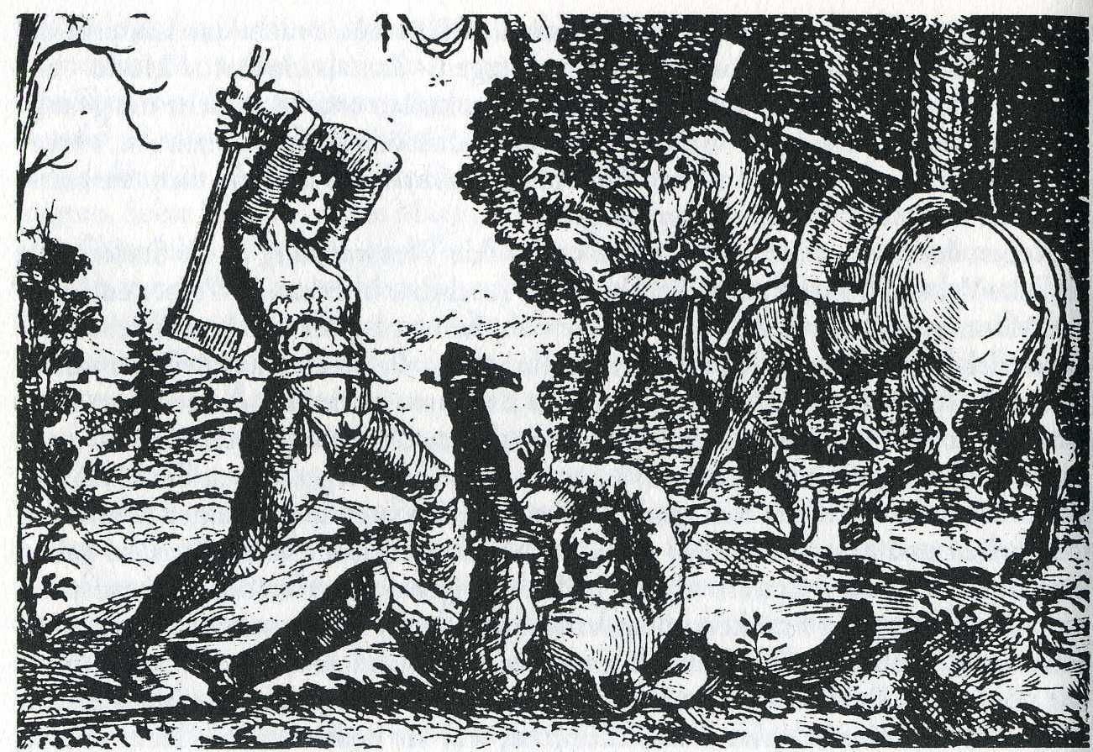
Even further “below” – and reversing the power-authority relation…
Hans Ulrich Franck (1603-75) -“Die Rache der Bauern” (The Revenge of the Peasants) – Even more “un-Iladic” and “Grimmelshausen-ian” (Simplicissimus, Book One, p. 23)

Slide 10
So…
HCC (Fall, 2014): Weeks 1-3 → Week 4
→
Shift in genre / shift in point-of-view / shift in the “world
of war” that we – and the texts – are “judging”…

Slide 11
Another genre and way of re-presenting war:
Example #1: ‘Real-time’ war poetry / Andreas Gryphius,
“Tränen des Vaterlandes” (“Tears Of the Fatherland”) (1636)
(Thirty Years’ War: 1618-1648) / What’s the genre?
“So, now we are destroyed; utterly; more than utterly!
The gang of shameless peoples, the maddening music of war,
The sword fat with blood, the thundering of the guns
Have consumed our sweat and toil, exhausted our reserves.
Towers are on fire, churches turned upside down;
The town hall is in ruins, the strong cut down, destroyed.
Young girls are raped; wherever we turn our gaze,
Fire, plague, and death pierce heart and spirit through.
Here, town and ramparts run with ever-fresh streams of blood.
It's three times six years now, since our mighty river's flow
Was blocked almost by corpses, just barely trickling through.
Yet, I pass over in silence something more terrible than death,
More desperate even than plague, fire and famine;
That so many were bereaved of their soul's treasure too.”

Slide 12
The strict form of the sonnet as poetry “re-presents”– and intensifies, even as it tries to control – the brutality of the Thirty Years’ War (think Achilles’ shield…) as the war invaded Gryphius’ hometown of Glogau…
14 lines / rhyme scheme (in the German…) / From “We” to “I” in the lyric voice / Material vs. spiritual consequences of war in ‘real time’…
“So, now we are destroyed; utterly; more than utterly!
The gang of shameless peoples, the maddening music of war,
The sword fat with blood, the thundering of the guns
Have consumed our sweat and toil, exhausted our reserves.
Towers are on fire, churches turned upside down;
The town hall is in ruins, the strong cut down, destroyed.
Young girls are raped; wherever we turn our gaze,
Fire, plague, and death pierce heart and spirit through.
Here, town and ramparts run with ever-fresh streams of blood.
It's three times six years now, since our mighty river's flow
Was blocked almost by corpses, just barely trickling through.
Yet, I pass over in silence something more terrible than death,
More desperate even than plague, fire and famine;
That so many were bereaved of their soul's treasure too.”
“So, now we are destroyed; utterly; more than utterly!
The gang of shameless peoples, the maddening music of war,
The sword fat with blood, the thundering of the guns
Have consumed our sweat and toil, exhausted our reserves.
Towers are on fire, churches turned upside down;
The town hall is in ruins, the strong cut down, destroyed.
Young girls are raped; wherever we turn our gaze,
Fire, plague, and death pierce heart and spirit through.
Here, town and ramparts run with ever-fresh streams of blood.
It's three times six years now, since our mighty river's flow
Was blocked almost by corpses, just barely trickling through.
Yet, I pass over in silence something more terrible than death,
More desperate even than plague, fire and famine;
That so many were bereaved of their soul's treasure too.”

Slide 13
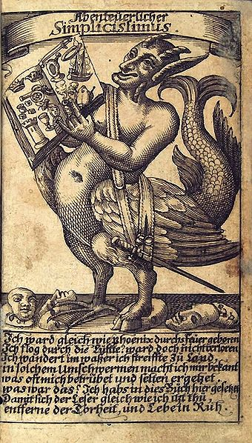
Re-presenting the Thirty Years’ War / Example #2:
From Sonnet to Picaresque
From Gryphius → Hans Jakob Christoffel von Grimmelshausen (1621-76)
- Der abenteuerliche Simplicissimus Teutsch, d.h. die Beschreibung des Lebens eines seltsamen Vaganten, genannt Melchior Sternfels von Fuchsheim = The life of an odd vagrant named Melchior Sternfels von Fuchsheim (1668)
- About the Thirty Years’ War, but written twenty years after the end of the war…
- Die Ertzbetrügerin und Land-störtzerin Courasche = The Life of the Cunning Vagabond, Courage... (1669) – Also about the Thirty Years‘ War...
This second text was one of the texts Bertolt Brecht used to write his play, Mother Courage and her Children (1939), that we‘ll be reading for next week...
Frontispiece illustration of Simplicissimus

Slide 14
What is this creature? (satyr → satire)
What’s in the book he’s
showing us?
Recognize anything from
your reading?
Genre / The Picaresque Novel as the “Un-Sonnet” (and the “Un-Epic”) / Showing the war as a jumble of episodes and events / out of control / “from below”!

Slide 15
Full disclosure: We are reading only part of Grimmelshausen’s novel!
“I was born in fire like the phoenix. I flew through the air, but did not get lost. I travelled over water; I journeyed over the land. In the course of such wanderings, I became acquainted with things that often saddened and seldom pleased me. What then? I have put it all in this book, so that readers, just like me, may abandon folly and live in peace.”
- The “Phoenix” poem accompanying the frontispiece
We are reading:
Books One and Two = the travels and wanderings…
We are not reading (although you could read…):
Books Three, Four, and Five = more travels and wanderings…
Book Six = the “abandonment of folly” and “living in peace”
So the entire novel has a somewhat different shape (or “design” and sense of closure – think the Iliad) than these two books / Remember: It’s a (fictional) autobiography (of Simplicius…). Autobiographies are always ‘shaped’ ‘stories’…

Slide 16
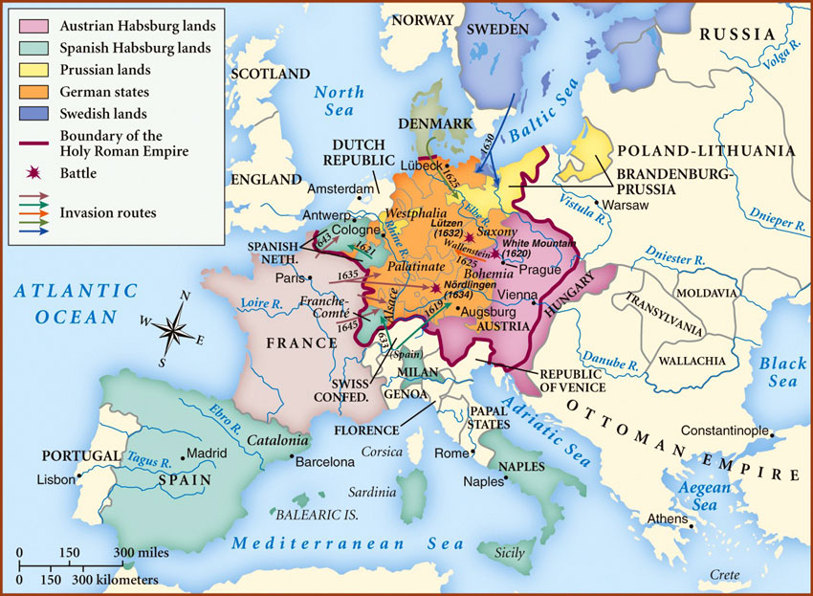
The historical Thirty Years’ War (1618-48) was itself a jumble…
A prolonged and mixed-up – BUT NEVER HUMEROUS – war full of many “episodes,” with many participants, “causes,” and “outcomes”…
A “European” war fought primarily on “German” battlefields…
Actually a “war composed of many wars”…
Each phase known by the name of the main adversary to the CATHOLIC Habsburg Empire (the Holy Roman Empire of the German Nation / HRE) and its ally, CATHOLIC Habsburg Spain, during a given set of years…
The Bohemian-Palatinate War (1618-23)
The Danish-Dutch / Lower Saxon War (1623-9)
Swedish War (1630-35) (LUTHERANS)
Swedish-French War (1635-48) (weird Lutheran-Catholic alliance against the HRE)
This “succession of wars became so dense
that it was perceived at its height and thereafter
as a single war…” (Johannes Burckhardt)

Slide 18
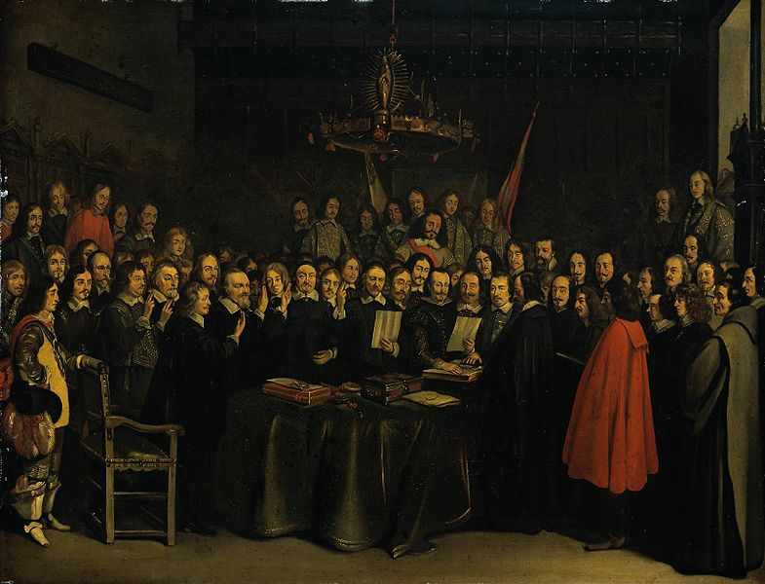
Finally brought to an end by…
The Treaty of Westphalia (1648) (which took 4 years to negotiate…)
109 signatory parties to the Treaty…
Westphalia is often identified as the founding moment of the modern international system of sovereign states / rise of diplomacy as a ‘science’ / beginning of (only) bilateral wars between states…
HUGE milestone in the history of International Law…
Beginning of political modernity!
Professor Newman (me…) is writing a book about this Treaty…
“Ratification of the Treaty of Westphalia”
(Gerard ter Borch, Münster, 1648) -
Negotiating the end of a 30 year-long war also
a jumble?

Slide 19
Back to the Thirty Years’ War…
What was it about (in Prof. Izenberg’s terms: “What were its ‘causes’, its ‘determinations’”)?
Was it:
1. a “war of religion” / conflict between internally homogeneous confessional (religious) Christian states, OR
2. a (German / central European) constitutional war, OR
3. a “war of European state-building”…?

Slide 20
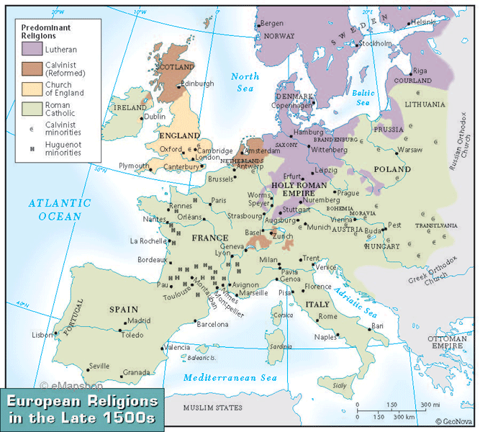
1. A War of Religion?
The Prequel: Pre-
Reformation and
Reformation
Europe
- The Fracturing of
European
“Christendom” by
the German Protestant
“Reformer,” Martin
Luther (1483-1546) /
“95 Theses” (1517)
against Catholic
“indulgences”
Thus, post-1517, there
were two kinds of
“Christianity” (if
not more…) in Europe - Catholic
and Protestant (“Lutheran”)
- As a result, 16th century “Wars
of Religion” within Europe!
- Peace of Augsburg
(1555) / But how long did it last?
What do you think the Ottoman Empire thought about
all this?

Slide 21
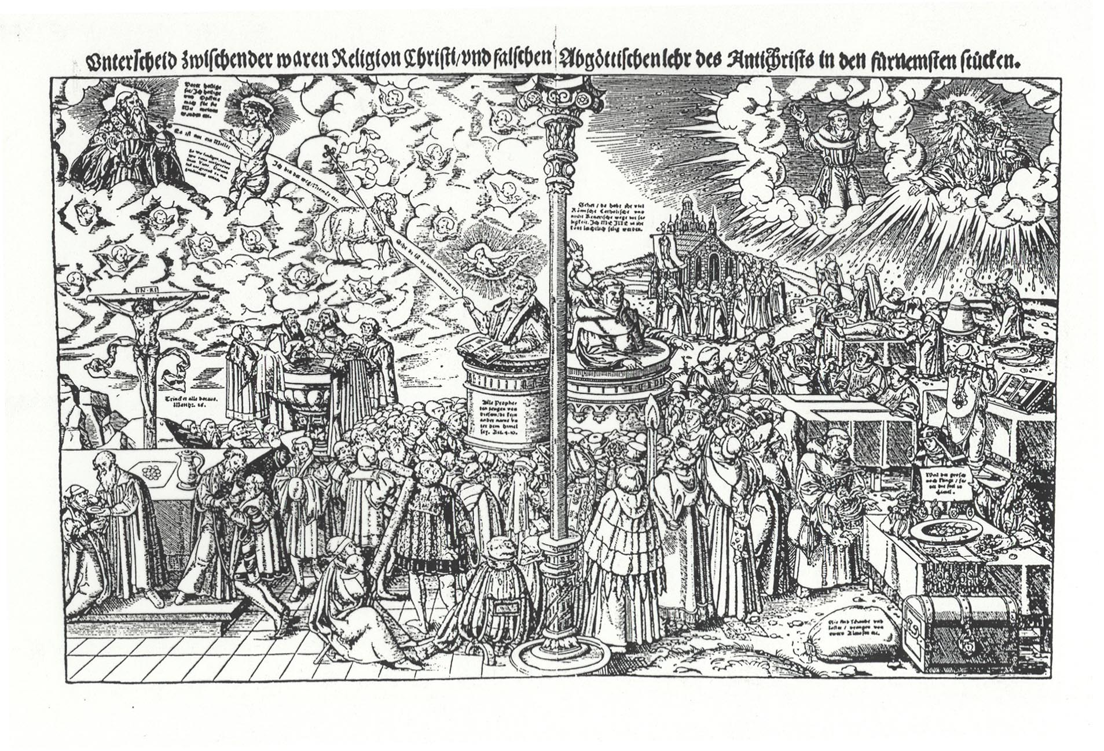
Just 100 years after Luther’s 1517 “95 Theses” and 50 years after Augsburg (1555), in other words, the Lutheran Europeans and Catholic Europeans were at it again in 1618…
Lucas Cranach, “The Difference Between the True Religion of Christ [Protestantism]
and the False Idolatrous Teaching of the [Catholic] Antichrist” (1545)

Slide 22
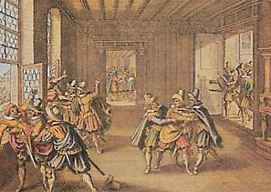
2. SECOND “CAUSE”: The Thirty Years’ War as an internal German (Central European) constitutional war
The “defenestration” in Prague, May 23rd, 1618
“It’s
complicated”…
Come to my
office hours and
I’ll explain the
constitutional
details…
Protestant assembly of lords throws Catholic representatives of the King of Bohemia,
Ferdinand II (who was also the future Emperor of the HRE) out of a window in the Prague
castle to protest the loss of their local freedoms / The Calvinist Frederick of the Pfalz takes
over as King of Bohemia / defeated at the Battle of White Mountain (1620) / war begins…

Slide 23

OR: 3. Third “cause”: The Thirty Years’ War as a war of European state-building
The “nation-states” of France and Sweden vs. the ”universal” Holy Roman Empire
of the German Nation (HRE)

Slide 24
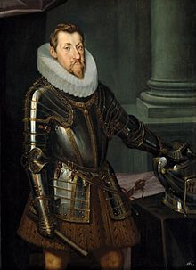
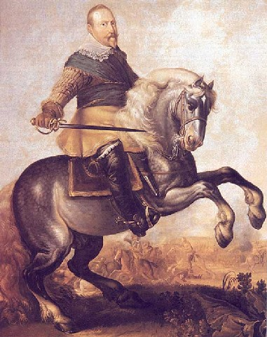
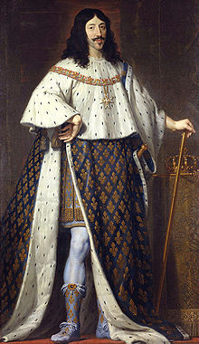
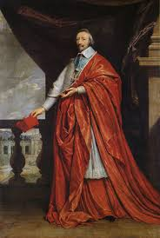
The Major Actors
King
Gustavus
Adolphus
of Sweden
(1594-1632)
Holy Roman Emperor
Ferdinand II
(1578-1637)
Cardinal
Richelieu
(1585-
1642)
King Louis XIII
of France (1601-43)

Slide 25
Do we see any of these guys in Grimmelshausen, Simplicissimus?
Why not?
Genre?
Point of view?
What we don’t see is part of the message! ( = “subtractive” logic of Alice Oswald’s Memorial…)

Slide 26
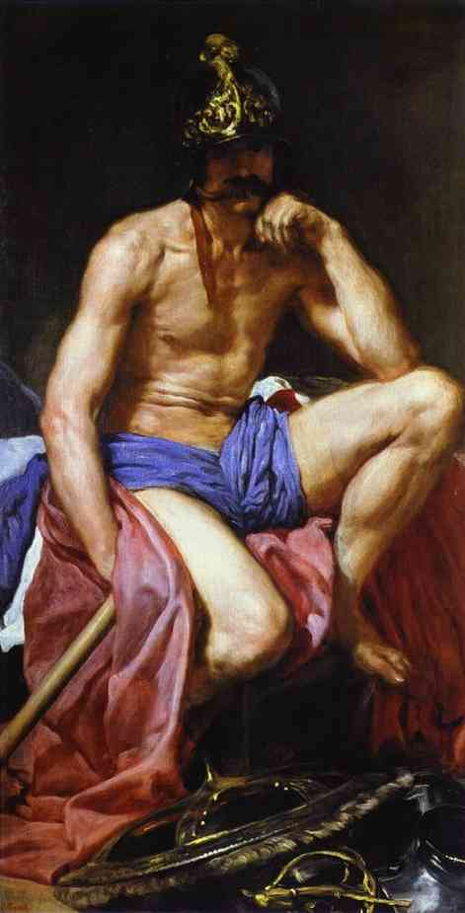
Regardless of how you describe the Thirty Years’ War and its “causes,” it lasted 30 years…
“Mars”
(Diego
Velázquez,
c. 1639-41)
DATES of the
Thirty Years’
War?
DATE OF
THIS
PAINTING?
What do you see?
COMPARE:
Trojan War…
WWI (1914-18)
WWII (1939-
45)
Korean War
(1950-53)
Viet Nam War
(1954-75)
The First Persian Gulf
War (1990-91)
The Second
Gulf War / Iraq War (2003-2011)
The “War on Terror”…?

Slide 27
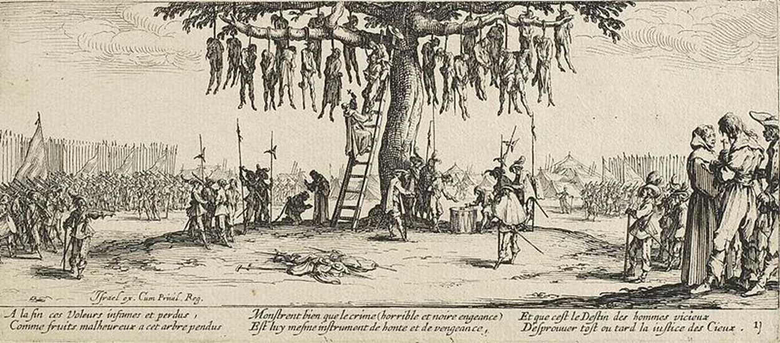
It’s difficult for us to imagine a war that lasted 30 years – but there were lots of images of it created at the time…here: “Heretics”…
Jacques Callot, “The Hanging” (from his series, “The Horrors of War,” 1632-3)

Slide 28
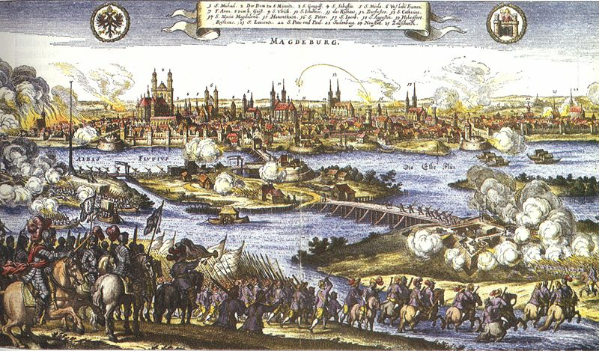
Other images:
Picturing the war at more of a distance…
Sieges / The sack of the Protestant city of Magdeburg by (Catholic) Imperial troops (1631) - Of the 30,000 citizens, only 5,000 survived…
Johann Philipp Abelin, Theatrum Europaeum (1659)

Slide 29
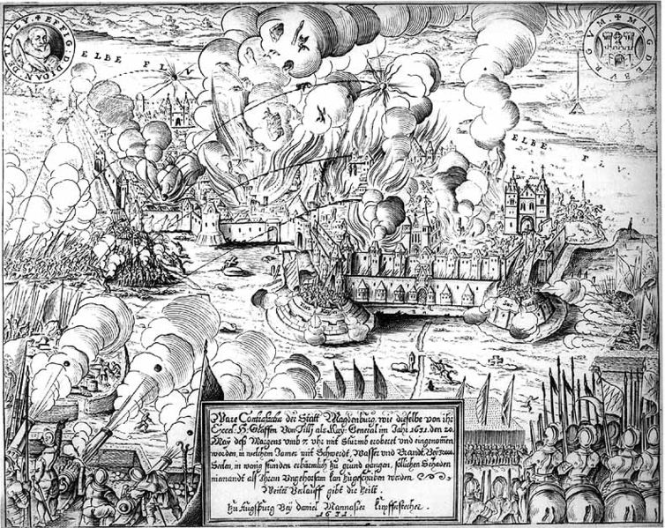
Are such depictions “History from Above?
Engraving of the Sack of Magdeburg by Matthäus Merian (1632) - Compare
the Battle of Wittstock in Grimmelshausen, Simplicissimus, Book Two, chapter 27

Slide 30
Think about it…
How was it possible for the war to last 30 years….?
Scholars say…
The PRE-HISTORY and MEANS of conducting the war (as opposed to its causes) may actually have contributed to its length…
The PRE-HISTORY:
Economic historians say that it was possible for the war to last so long precisely because of central Europe’s “advanced socioeconomic development and long lasting peacetime prosperity” before the war…

Slide 31
The Means…
During the war: Creative financing of the war through taxes and loans from wealthy financiers / war fought on credit
“Coerced payments” / “Contributions” (more on this in a minute)
Labor force for war? - Many mercenary soldiers came from Sweden, where there was little non-agricultural work / they were willing to work for a third of a regular soldier’s pay…
A mercenary: A soldier who is paid by a foreign country to fight in its army and thus fights for money, and not out of patriotism or religious motivation…

Slide 32
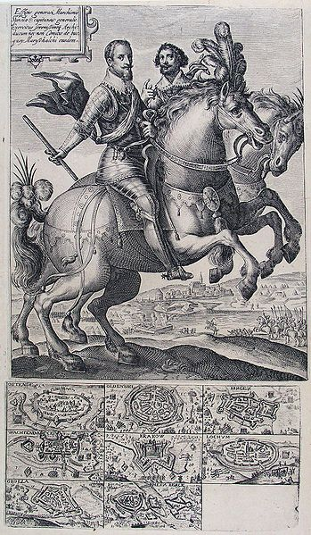
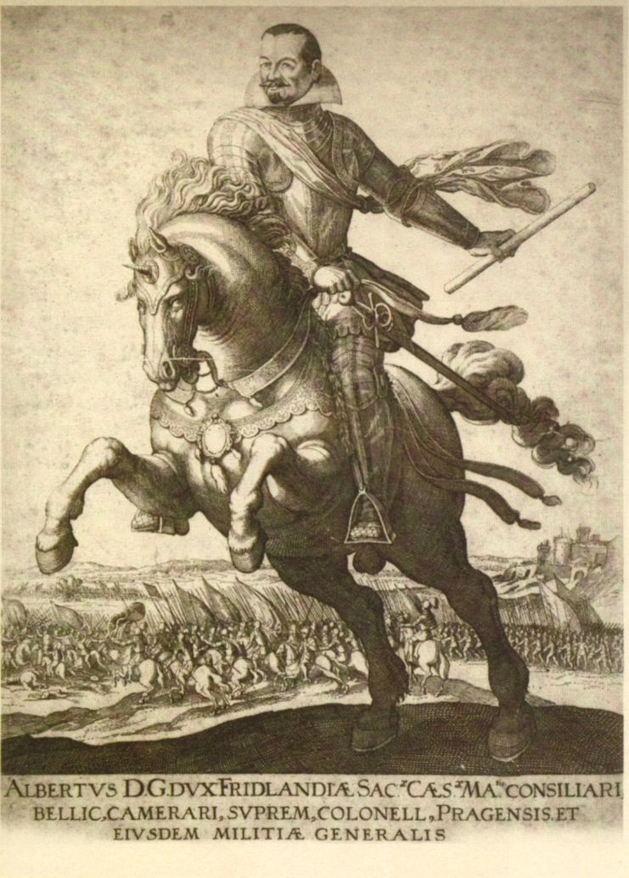
Much of the fighting during the Thirty Years’ War was in fact done by mercenary troops, whose leaders either financed their own armies or thought up ingenious new ways of financing war / The generals of the mercenary armies often became a problem for the political heads-of-state…
Albrecht Wenzel Eusebius von Wallenstein
(1583-1634)
Ambrogio Spinola (1569-1630)

Slide 33
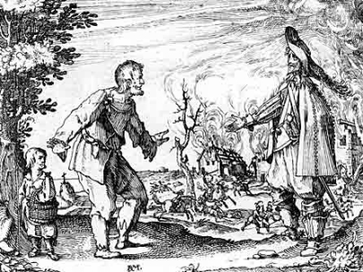
Mercenary soldiering during the
Thirty Years’ War
The principle of bellum se ipsum alet
“The war will feed itself…”
Before the Thirty Years’ War, armies funded primarily by special war taxes. / Larger armies and weapons for the Thirty Years’ War soon exceeded the income from these kinds of taxes…
Bellum se ipsum alet: First, the food supplies needed for the army were derived directly from the territory occupied by this army. Later, the pay for the soldiers was derived from the occupied territory as well.
Territory was divided into "contribution districts,” each of which had to provide certain amounts of food for the soldiers as well as for the horses.
The soldiers were quartered in the houses of ordinary people, who had to provide shelter and food…
A farmer begs for mercy in front of a burning farm
(17th century print)

Slide 34
Do we see these kinds of activities in Grimmelshausen’s Simplicissimus?

Slide 35
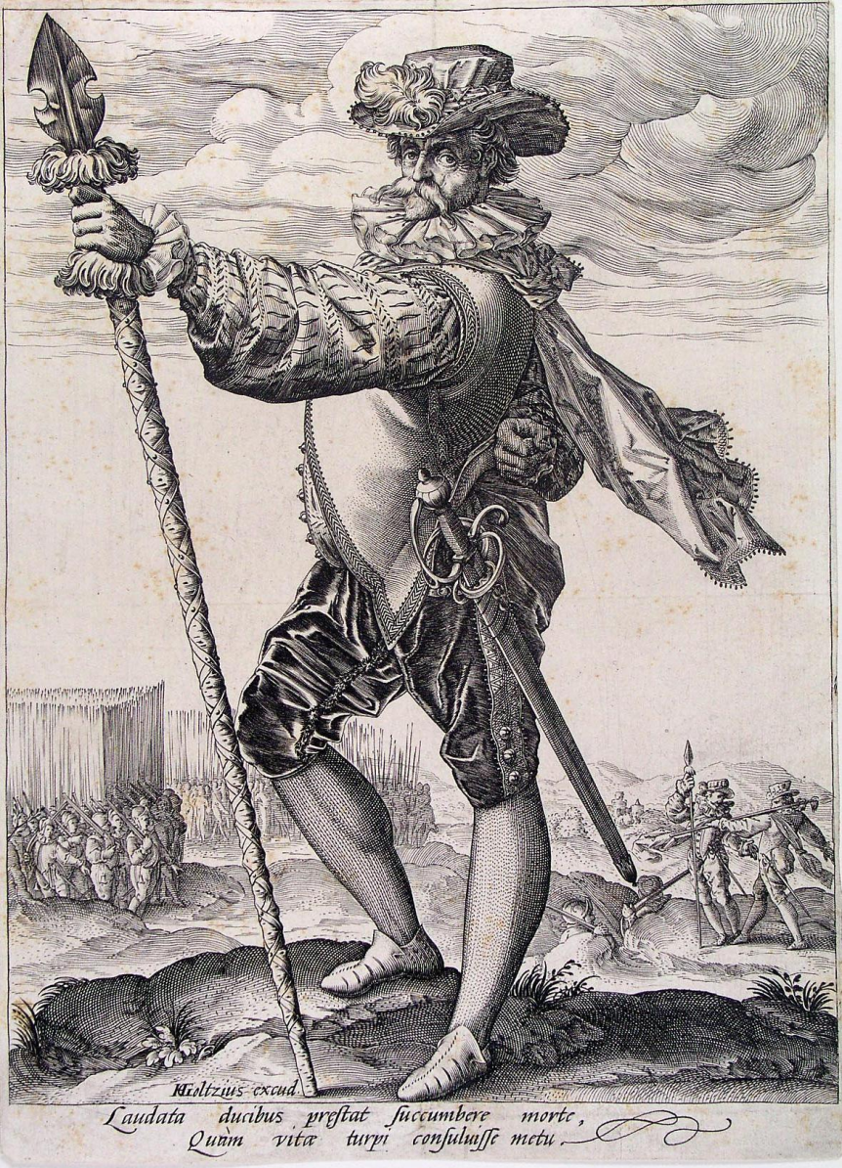
The (ironic) result of mercenary warfare?
Growth in the size of armies and the
‘modernization’ and professionalization of soldiering…
Average size of an army grew from c. 10,000 to 100,000
Example: Sweden / The Swedish army grew from 15,000 to 140,000 between 1618 and 1648…
Although originally mercenaries (troops for hire), these armies became the ‘standing armies’ of the modern nation-state after 1648…
“Renaissance” of ancient Roman military science to train armies…
Notice orderly ranks of pike-men at bottom left…
Hold this thought! → ‘Modern” military institutions and thus the apparatus of “state-sanctioned violence” (Prof. Izenberg on Simone Weil) began to take the shape they have today around 1648…
By the way, are there mercenary armies today?
“Dutch Officer” (Hendrick Goltzius, 1585-89)

Slide 36
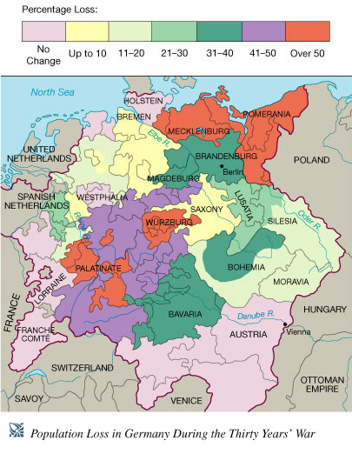
Another (horrific)
result…
Enormous
population losses
during these 30
years due primarily
to famine / starvation
and disease (plague),
as well as in battle…
Think about this…
Over 50% of the
population of a region
dead…
An ‘exemplary’ war
indeed…

Slide 37
Questions…
What / whose “image” (story / version / re-presentation) of the Thirty Years’ War do we see in Grimmelshausen’s picaresque novel?
What version of political and social modernity do we see in this post-Westphalian (post-1648 Treaty of Westphalia) picaresque novel (written in 1668)?
In Prof. Izenberg’s terms: What is the “picture of the world” / what is the “system of values” that the novel, Simplicissimus, has “made” for us to analyze – and to judge?

