Slide 1
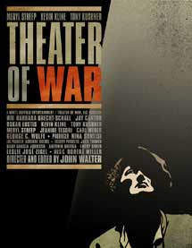
Important Announcement!!!
There will be three (3) screenings this week (week 5) of the movie, “Theater of War” (dir. Walter, 2008) that is assigned for week 6!
TODAY: Mon., Nov. 3, 5:00 p.m., HG 1030
Tues., Nov. 4, 5:00 p.m., HG 1030
Thurs., Nov. 6, 6:30 p.m., HIB 100
Go watch it! Then go watch it again!

Slide 2
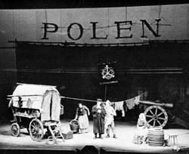
HCC (Fall, 2014) / Week 5, Bertolt Brecht,
Mother Courage and her Children (1939) /
Transitions and Connections
LAST WEEK:
Hans Jakob Christoffel von Grimmelshausen (1621-76) wrote:
- Der abenteuerliche Simplicissimus Teutsch, d.h. die Beschreibung des Lebens eines seltsamen Vaganten, genannt Melchior Sternfels von Fuchsheim = The Adventures of the German Simplicus, that is, the life of an odd vagrant named Melchior Sternfels von Fuchsheim (1668)
AND
- Die Ertzbetrügerin und Land-störtzerin Courasche = The Life of the Cunning Vagabond, Courage... (1669)
Grimmelshausen‘s Mother Courage text was one of the textual sources for Bertolt Brecht‘s play, Mother Courage and her Children (1939)!
Berlin Production of Mother Courage (1949)

Slide 3
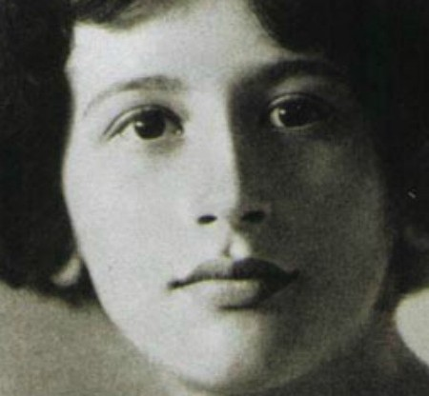
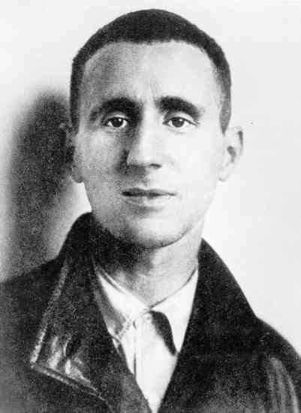
Another connection: Prof. Izenberg (week 1) →
Prof. Newman (me) (week 5)
Izenberg’s Weil → Newman’s Brecht
Just as Simone Weil was looking back to the Iliad and the Trojan War in 1940 in the middle of WWII...
So too was Brecht looking back to Simplicissimus and the Thirty Years‘ War in 1939, also in the middle of WWII...
Simone
Weil
(1909-43)
Bertolt
Brecht
(1898-1956)

Slide 4
From last week, we are thus fast-forwarding 300 years!
1618-48 (Thirty Years’ War) → 1939-45 (WWII)
Right now – in the Fall of 2014 – we are looking back at Weil and Brecht looking back at the Trojan War and the Thirty Years’ War in the middle of WWII…
We are both listening in on and becoming part of the conversation about the worlds of war on which they were commenting…
We are the next generation (after Alice Oswald, Memorial, 2011, and filmmaker Walter, “Theater of War,” 2008) of readers and re-presenters of these two exemplary wars…
That’s a pretty exclusive club to belong to…

Slide 5
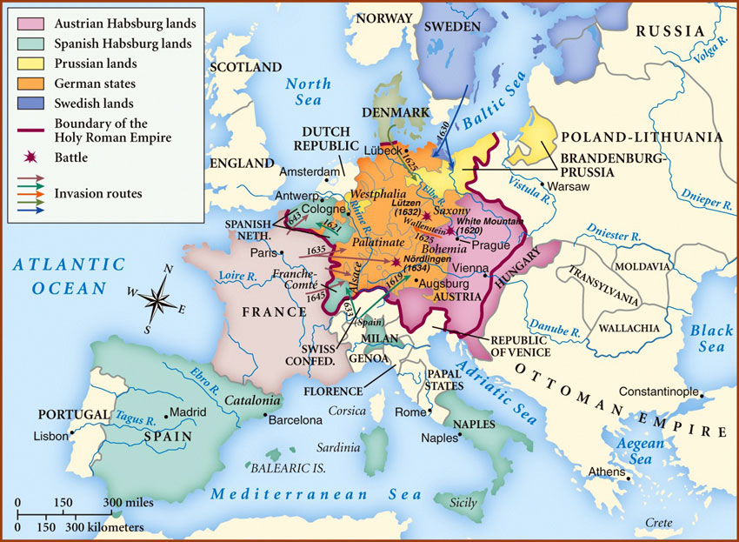
Even as we move forward in time to our present, we are staying in central Europe / Germany, but now a mid-20th century central Europe that looked a bit different than the one we considered last week!
Map of Central Europe / “Germany” during the Thirty Years’ War (1618-48)

Slide 6
What had changed in the meantime?
(between the Thirty Years’ War, 1618-48, and WWII, 1939-45)?

Slide 7
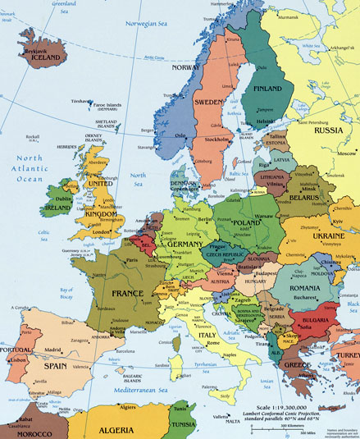
From the Holy Roman Empire to the (German) Nation-State / German history at warp speed / take a course in the Department of History on German / European history!
→
Holy Roman Empire (HRE) came to an
end in 1806 / Napoleonic Wars / HRE defeated
by Napoleon at Austerlitz
“Modern” German state / North German
Confederation under Prussian leadership (1866-67) / another German (a specifically national) Reich
(Empire) (1871) / Predecessor state of modern Germany / 1914-18 (WWI) / 1919-33: The Weimar
Republic / 1933: Hitler and National Socialists (Nazis) come to power

Slide 8
→
“It’s complicated….”
SHORT VERSION:
From the HRE → Germany…
The move from the early modern period of emerging sovereign polities / states in central Europe → the modern
period of “consolidated” and
territorially sovereign
nation-states…
A move enabled (some scholars
say) by the kinds of agreements
made in the Treaty of
Westphalia (1648)!

Slide 9
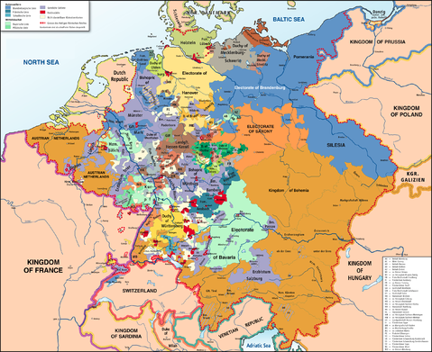
Week 4 → Week 5
From the Holy
Roman Empire
(here, c. 1789)
To the “modern” nation-state
of Germany

Slide 10
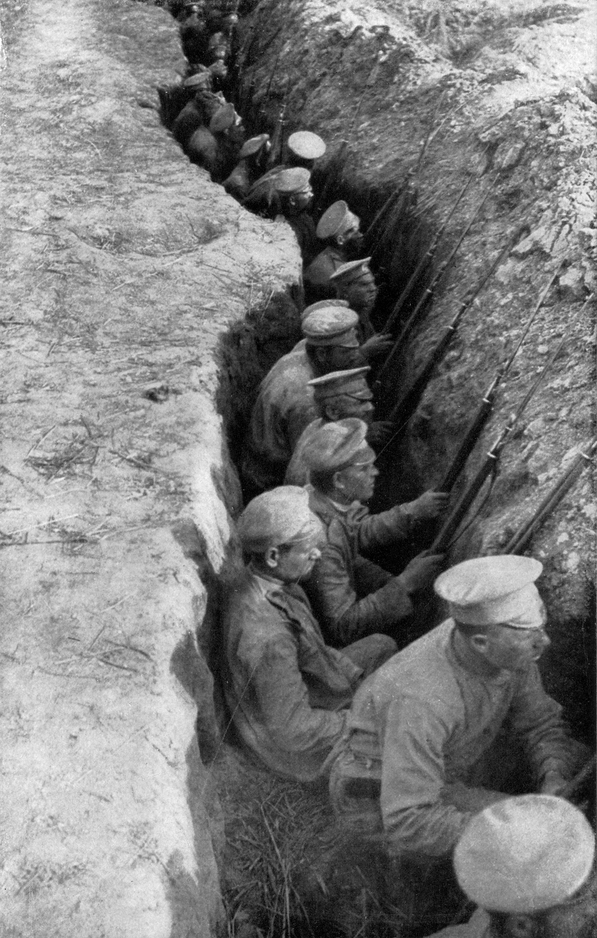
To a “modern” Germany…
That went to war – as a nation-state with many of the other sovereign nation-states of Europe – TWICE in the first half of the 20th century…
WWI (1914-18) / WWII (1939-45)
Invested vast amounts of money and “human capital” (lives…) in these wars…
And developed a “military-industrial complex” that involved millions of people, hundreds of industries, and huge amounts of state and private monies…
Military-industrial complex: “The aggregate of a nation's armed forces and the industries that supply their equipment, materials, and armaments” (U.S. President Dwight D. Eisenhower)
Russian troops dug in in trenches / Awaiting
German attack / 1917

Slide 11
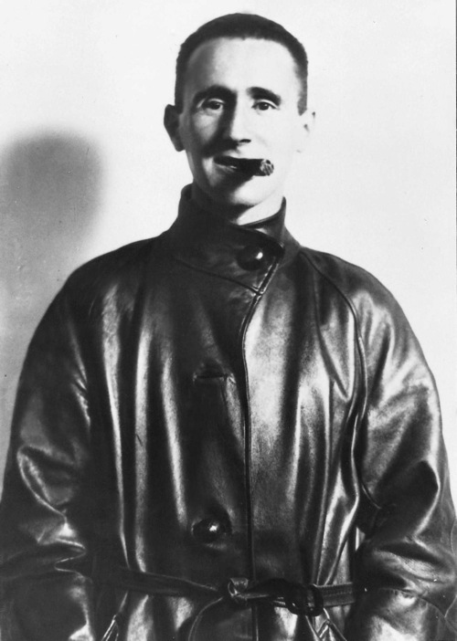
Bertolt Brecht (1898-1956) as a young man…
Brecht came of age during these years…
When the following were the “conditions of determination” within which many people “acted”…
He witnessed the rise and fall – and rise and fall again – of the “modern” state of Germany several times over…
During and after WWI (1914-18), when the German state was at both its highest – and after it lost WWI, also its lowest – point.
Also during the raucous political times of the Weimar Republic (1919-33) / street battles between workers and the army and thugs…
When, in the German Parliament, there were about 40 different parties on the left and the right, leading to political chaos and stalemates...
The rise to power of Hitler and the Nazis / Hitler becomes German Chancellor in 1933
The official outbreak of war in 1939…

Slide 12
The road not taken (by us)…
Brecht’s Troy / a late poem, probably c. 1953 / Responding to “Trojans,” a poem by the Greek poet, C. P. Cavafy (1863-1933), translated into German in 1953, Brecht wrote…
“Bei der Lektüre eines spätgriechischen Dichters”
“In den Tagen, als ihr Fall gewiß war -
Auf den Mauern begann schon die Totenklage
Richteten die Troer Stückchen grade, Stückchen
In den dreifachen Holztoren, Stückchen.
Und begannen Mut zu haben und gute Hoffnung
Auch die Troer also.”
“On Reading a late Greek Poet”
“At the time when their fall was certain -
On the ramparts the lament for the dead had begun -
The Trojans adjusted small pieces, small pieces
In the triple wooden gates, small pieces.
And began to take courage, to hope.
The Trojans too, then.”

Slide 13
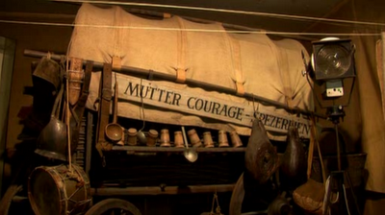
We’re not reading that poem…
Rather, we’re reading Brecht’s 1939 Mother Courage play…
In part, because it is set in the time of ‘our’ (my) war, the Thirty Years’ War…
But also because it is about the issue and question with which I left you last time…
What is the nature of human agency / self-determination in a modern wartime / post-war world?
A modern world whose political forms and social conditions began to take the shape they now have during the early modern period (c. 1500-1700) and especially between 1618-48 and after the Treaty of Westphalia (1648)…
And were exploding around Brecht’s ears (both literally and figuratively speaking) as he wrote his play…
The original wagon stage-prop of Mother Courage’s wagon / Berlin production, 1949

Slide 14
Which “political forms” and “social conditions” again…?
MY THESIS today (connected to my thesis from last time):
The modern political forms of state sovereignty
And the social and economic conditions of individual agency under the authority of that sovereign state …
That had become the dominant ones in Europe during the early modern period (c. 1500-1700)…
Were the forms and conditions of statehood and individual agency that continued to shape the world of a second “Thirty Years’ War”…
The one that lasted from 1914 to 1945…
In this world, autonomous “sovereign” states were responsible for “peace” and “defense” (Hobbes)…
They were bounded territorial states with
absolute control over their own (internal) populations and citizens and
responsibility for defense against enemies from without…
Military-industrial complex?
In this world, the individual subject has agency, but only within the confines of his or her subjection to the “state” and to the socio-economic order that sustains it…

Slide 15
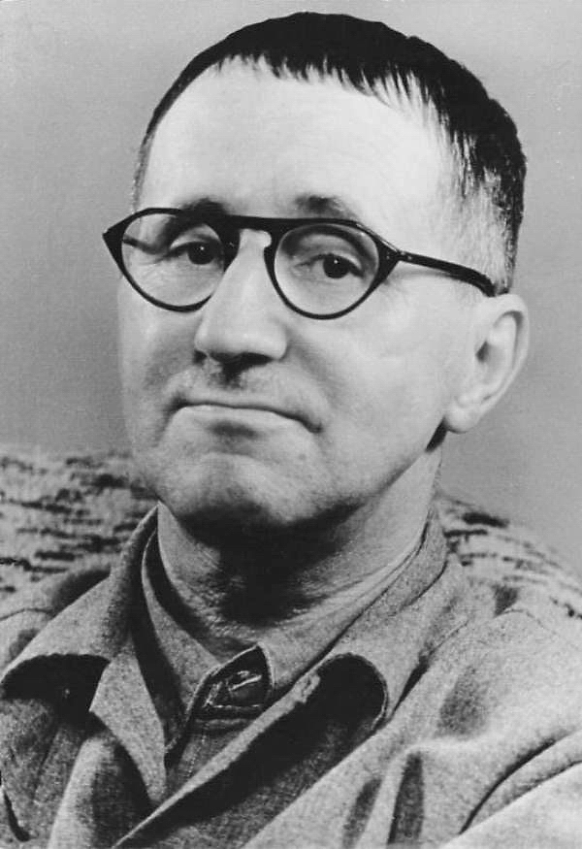
Bertolt Brecht (1898-1956) a bit later in his life
Why Brecht in this context?
AN INCREDIBLY FAMOUS German poet and playwright!
He changed the face of modern drama in the west (and elsewhere in the world as well!)
He was also (famously) a Marxist and Communist sympathizer when that was a really good thing to be in Germany ( = anti-Nazi)
And he resisted the idea that individuals and collectives had to be subjected to such “conditions of determination“!
Although he was from a solid middle-class background, he often sided – in his plays and poems – with the “common man“ / the “small people“ caught up in these “conditions of determination“...
The “view from below“? / The role of
the intellectual in representing “the
people“?

Slide 16
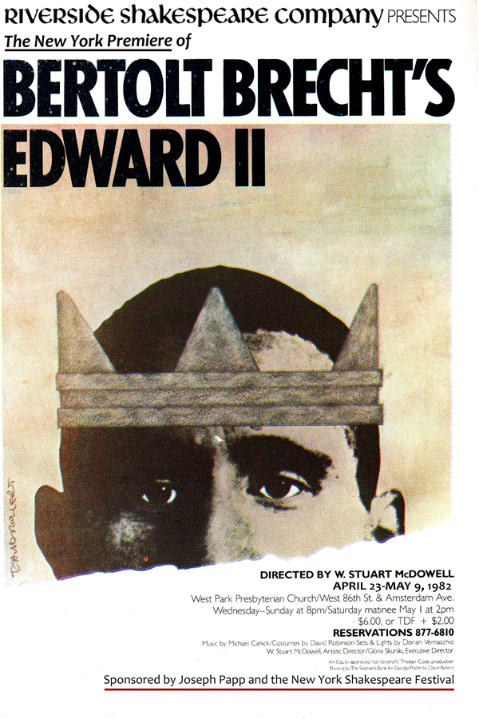
Grimmelshausen’s and Brecht’s Mother
Courage(s) / Brecht’s Inter-Texts
Grimmelshausen‘s Die Ertzbetrügerin und Land-störtzerin Courasche = The Life of the Cunning Vagabond, Courage... (1669)
Was just one of the earlier texts that Brecht reworked for the modern (st)age...
He adapted lots of earlier texts (mostly plays) for modern German audiences...
Christopher Marlowe, Edward II (orig. 1592) → Brecht (and Lion Feuchtwanger), The Life of King Edward II of England (1923)
Sophocles, Antigone (442 b.c.e.) → Brecht, The Antigone of Sophokles (1948)
William Shakespeare, Coriolanus (orig. 1605-8) → Brecht – unfinished adaptation (1951-53)

Slide 17
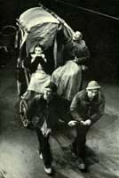
Mother Courage and her Children (1939) –
Re-Presenting the
Early Modern to Modernity
In giving us his version of Grimmelshausen’s Courasche text…
Brecht was interested in re-presenting the early modern past (the Thirty Years’ War) as the birth moment of the kinds of modern structures and constraints which he thought he / we still lived with…
  Brecht thought that in the modern era, these forms of social, economic, and political behavior had become “naturalized” → apparently “natural,” and thus seemingly permanent and unchanging (even though they plausibly had found their origins c. 1648…)
  Mother Courage: “I didn’t see that I had a choice” (Scene One, p. 9)
  Brecht’s play shows the destructive outcomes of a life lived according to ‘modern’ “business-as-usual” norms / when the “choices” are accepted as limited by prevailing political and social conditions…
Mother Courage and her Children –
Scene One - Berlin production, 1949

Slide 18
…so that these behaviors can be changed! → Theater is thus not just “entertainment” / “The stage” must “begin to be instructive” (Brecht)
''Let nothing be called natural
In an age of bloody confusion,
Ordered disorder, planned caprice,
And dehumanized humanity,
lest all things
Be held unalterable!'’
- Brecht, Die Ausnahme und die Regel (The Exception and the Rule), “Prologue” (1937)
“We need a type of theater which not only releases the feelings, insights and impulses possible within the particular historical field of human relations in which the action takes place, but [also] employs and encourages those thoughts and feelings which help transform [that] field [of human relations] itself.”
- Brecht, Kleines Organon für das Theater (Small Organon for Theater) (1948 / 1949) – A theoretical treatise on theater

Slide 19
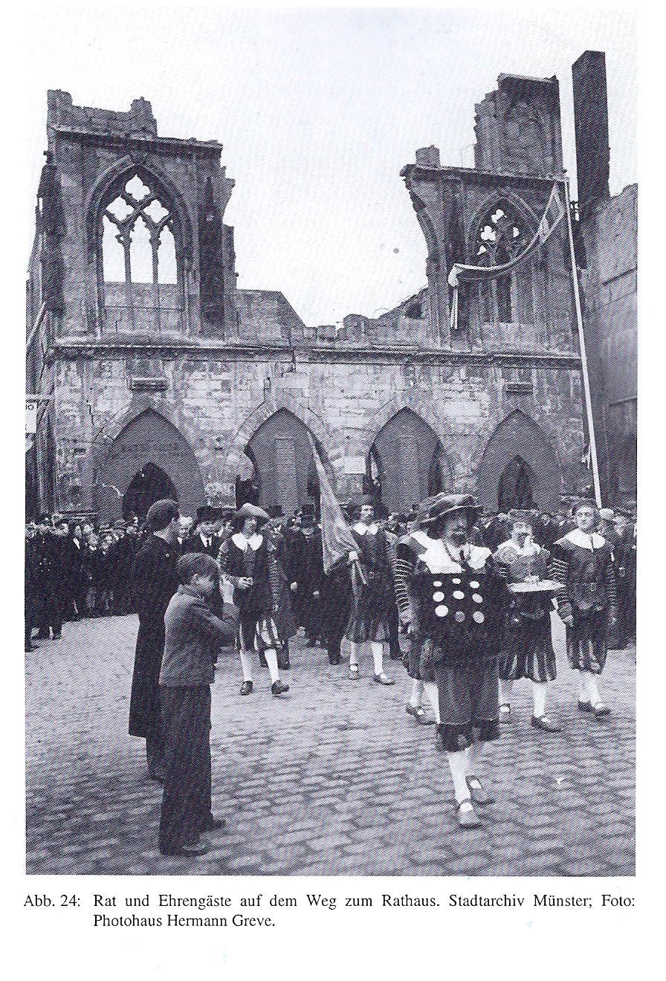
Brecht wasn’t the only one looking back to Early Modernity and the Thirty Years’ War in particular at around this time – especially in Germany…
Treaty of Westphalia Celebration in the town of Münster (north western Germany) where the Treaty of Westphalia was signed / Official Procession of Honored Guests to the Town Hall (1948)
1648 → 1948
300-Year anniversary of the Peace…
Three years after the end of WWII (1945)…
What do you see?

Slide 20
Treaty of Westphalia
Celebration in the
town of Münster
(1948)
What do you see?

Slide 21
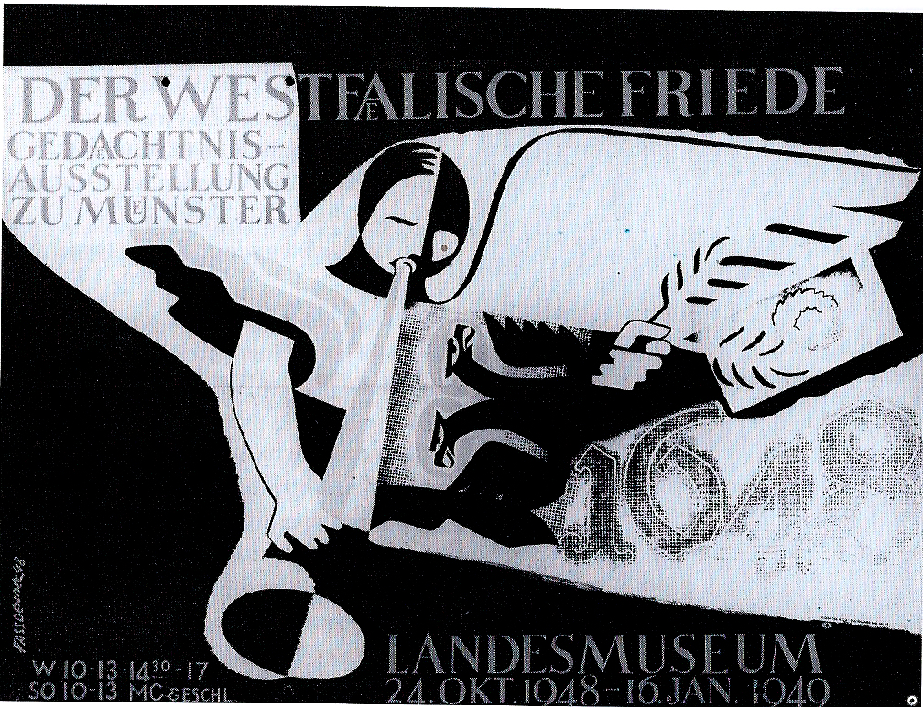
After the six years (1939-45) of brutality on all sides and “total war” in Germany after 1943 (“totaler Krieg” – Josef Goebbels, 1943), remembering the 1648 peace – which of course also meant remembering thirty years of war – must have seemed like a good idea…
Poster (Joseph Fassbänder) for Treaty of Westphalia Exhibit (Münster, 1948)

Slide 22
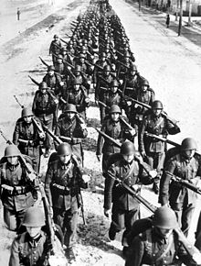
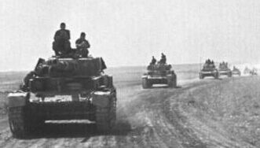
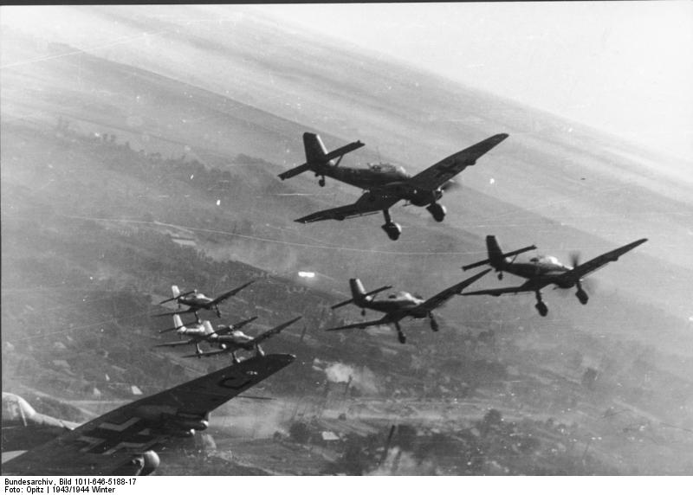
The Brutality of (the more recent) War (1939-45):
From 1939 on → The so-called German “Blitzkrieg” (lightening war) / swift, coordinated mechanized infantry and air attacks against Poland, Belgium, and France / Vernichtungsschlacht (battle of annihilation) / “military-industrial complex”

Slide 23
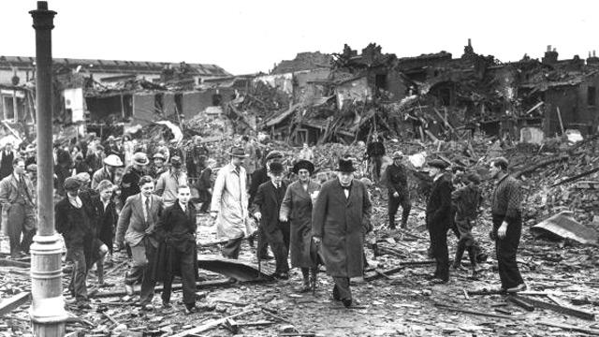
ALSO: The Battle of Britain (Summer / Fall, 1940) / German air force attacks England
Winston Churchill inspecting damage in south London (7 September, 1940)

Slide 24
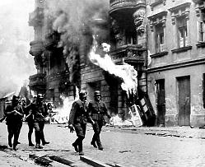
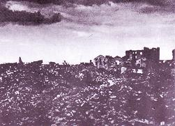
And the German Nazis commit
horrible acts of intense, focused
brutality above and beyond the
“modern” rationalized and
“industrialized” annihilation
of Europe’s Jews in the death camps…
Nazis set fire to and burn
the Warsaw (Poland) Jewish
Ghetto to the ground
(Spring, 1943)

Slide 25
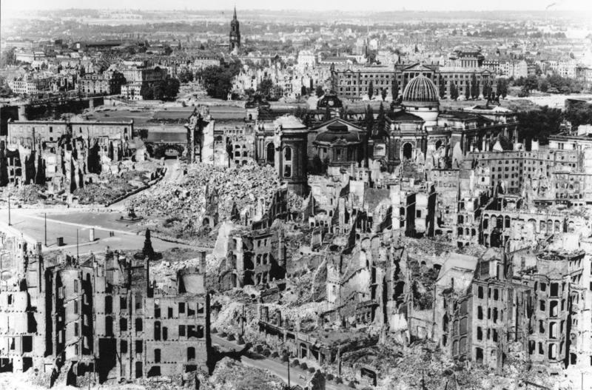
Pretty soon, however, this form of war came home to the Germans themselves / the German city of Dresden / 13-5 February, 1945
Between 22,000 and 25,000 people incinerated on the ground by British and U.S. bombs

Slide 26
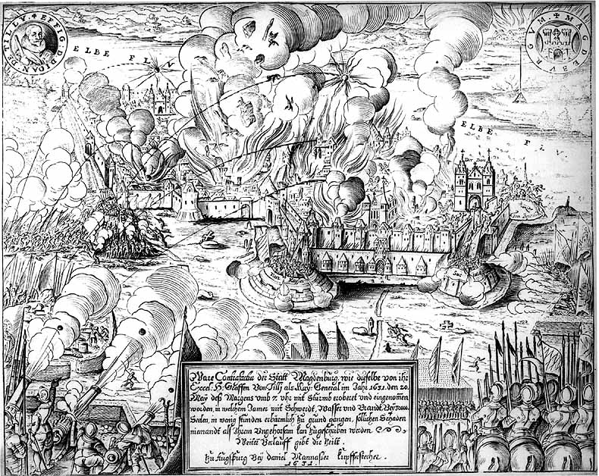
Magdeburg (1631)?
Recalling
the
Thirty
Years’ War
might not
have seemed
strange…

Slide 27
Let me be clear…
Brecht was NOT criticizing the British and U.S. air force for the bombing of Dresden (1945) in Mother Courage and her Children!
He couldn’t have been…
He wrote Mother Courage and her Children in 1939 in Denmark, where he was living on the run from the Nazis / as a Communist-sympathizer, he had had to flee Germany in 1933 when the Nazis came to power…
His wife, the actress Helene Weigel, was Jewish…
He actually ended up living for part of the war in LA, working in Hollywood…
But in 1939, he may have been reading about the Blitzkrieg operations and projecting what happens when a state can “legitimately” use any means possible to “protect itself” (Lebensraum and extermination of the Jews, Roma and Sinti, and gays)
The horrific afterlife of the “sovereign” Westphalian state?

Slide 28
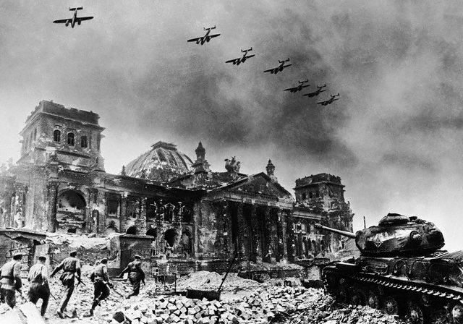
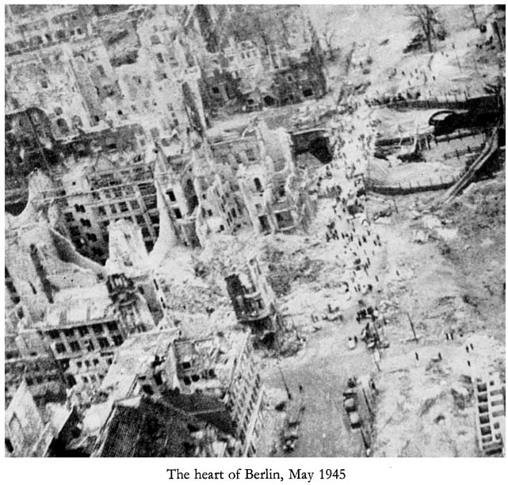
He may also have been asking the Germans to think about their own complicity in allowing the Nazi regime – as a totalitarian form of the modern nation-state – to come to power…
What had they looked away from and in whose interest had they done so?
What activities had they engaged in and what values had they espoused in the build-up to and during the war (and in general…) that led to what they themselves experienced in 1945?
The first production of Mother Courage and her Children (1939) was in neutral Switzerland in 1941…
But the second production – and the first production in Germany – of Mother Courage and her Children was in Berlin in 1949 / This is the one I would like you to think about…
Berlin
(May, 1945)

Slide 29
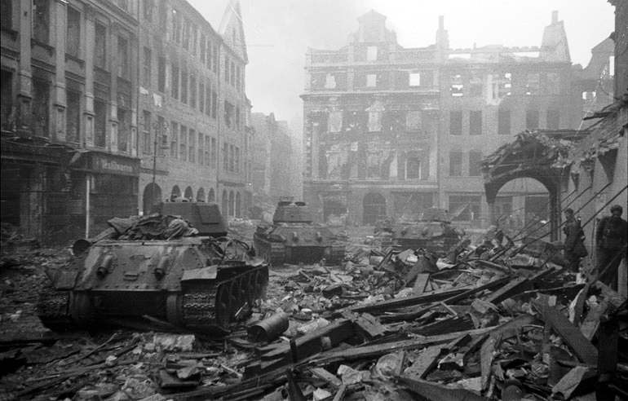
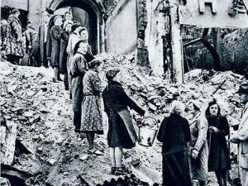
Downtown Berlin, Germany after
the Battle for Berlin, 1945
The “Trümmerfrauen” (“ruins women”)
who salvaged bricks from the bombed
out buildings to reuse / carted the rest
away / “hills” of ruins still in Berlin today…

Slide 30
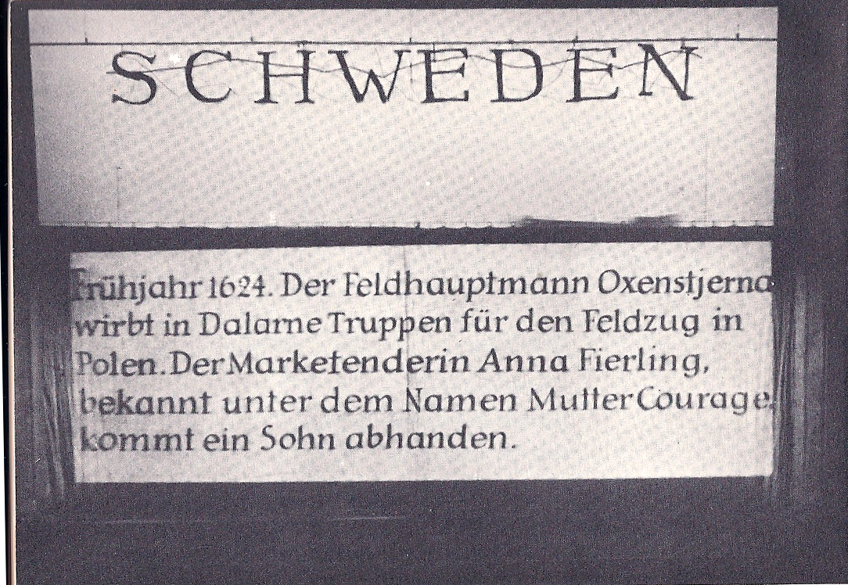
Brecht’s Thirty Years’ War
Does Brecht show us the Thirty Years’ War as a war of religion?
Remember: We are reading a translation! / The “titles” / In Scene One, p. 7, the religious alignments actually not in the original…
But still…The Army Recruiter (to Eilif): “And I’ve heard the enemy propaganda, in the Swedish Army it’s Bible study and hymn singing night and day, but between us, the army’s the army and once you’re in you’re washed clean of sin, and you can sing any song that you like” (Scene One, p. 15)
The General (to Eilif): “You massacred the farmers and now my brave boys’ll bite down on a bit of real red meat…And how could God gripe about that?” (Scene Two, p. 23)
The Cook: “But God told our King to fight…and it’s a good thing the King’s got God going for him. Or else people might suspect that he’s in for it for what he can take out of it.” (Scene Three, p. 34)
Banner “title” suspended over stage
in Scene One – Mother Courage and her
Children / Berlin production / 1949

Slide 31
Brecht’s “Religious War”? / The Chaplain
Eilif: “Necessity trumps the commandments. Right?”
The General: “Want to rule on that, you pious pedant?”
The Chaplain: ”There’s no such exception in the Bible, in the literal sense, but back then Our Lord could take five loaves of bread and make five hundred, so there was no necessity per se…That was then and this is now.” (Scene Two, p. 23)
The Chaplain: “Any soldier who falls in a religious war (“Glaubenskrieg”) will go straight to heaven, where he can have all the brandy he wants” (Scene Three, p. 32)
But, as for himself personally: “I need a big cloak for camouflage.” (p. 36)
Mother Courage: “I’m taking the Chaplain to buy a Catholic flag and some meat.” (Scene Three, p. 39)

Slide 32
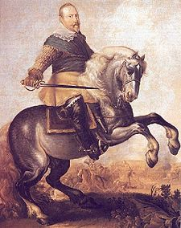
Does Brecht show us the Thirty Years’ War as a war of state-building?
“His Majesty” (King Gustavus Adolphus) of Sweden
Eilif: “I saw him once, distantly. He kind of gives off light. I want to be just like him.” (Scene Two, p. 24)
The characters experience the “war of state building” (literally) at something of a distance…
How much of the grand strategies (or even military tactics) of the war is Mother Courage shown as understanding?
Mother Courage: The chicken is “practically a turkey, it’s so big. And in the middle of a siege.”
The Cook: “We’re not in the middle of a siege…we’re the besiegers. Try to keep it straight.” (Scene Two, p. 19)
Yet, she and the others experience the war head on…
Gustavus Adolphus, (1594-1632) – King
of Sweden

Slide 33
Whereas the “main stage” of the political and military “realities” of the Thirty Years’ War is nearly invisible to the characters…
The “realities” of the “margins” of the war and its impact on the “small people” (“die kleinen Leute” – Brecht’s term) are not!
The Army Recruiter / The Sergeant (Scene One) / Mercenary soldiering
“Contributions”: Eilif’s “requisitioning of twenty head of cattle from some farmers” (Scene Two, p. 22)
The Impact of the War on the ‘Homefront’: The Cook: “But it’s expensive, liberty, especially when you start exporting it to other countries” (Scene Three, p. 33)
Rape: Mother Courage: “A soldier sees a girl with a clean face, watch out! When’s he done raping her, he calls for his buddies” (Scene Three, p. 37)
What about the young soldiers in Scene 11? / Watch for them…
Are they as confused as the non-combatants? / Again: How do the “small people” (Brecht) – peasants and middle-class entrepreneurs like Mother Courage – experience war?

Slide 34
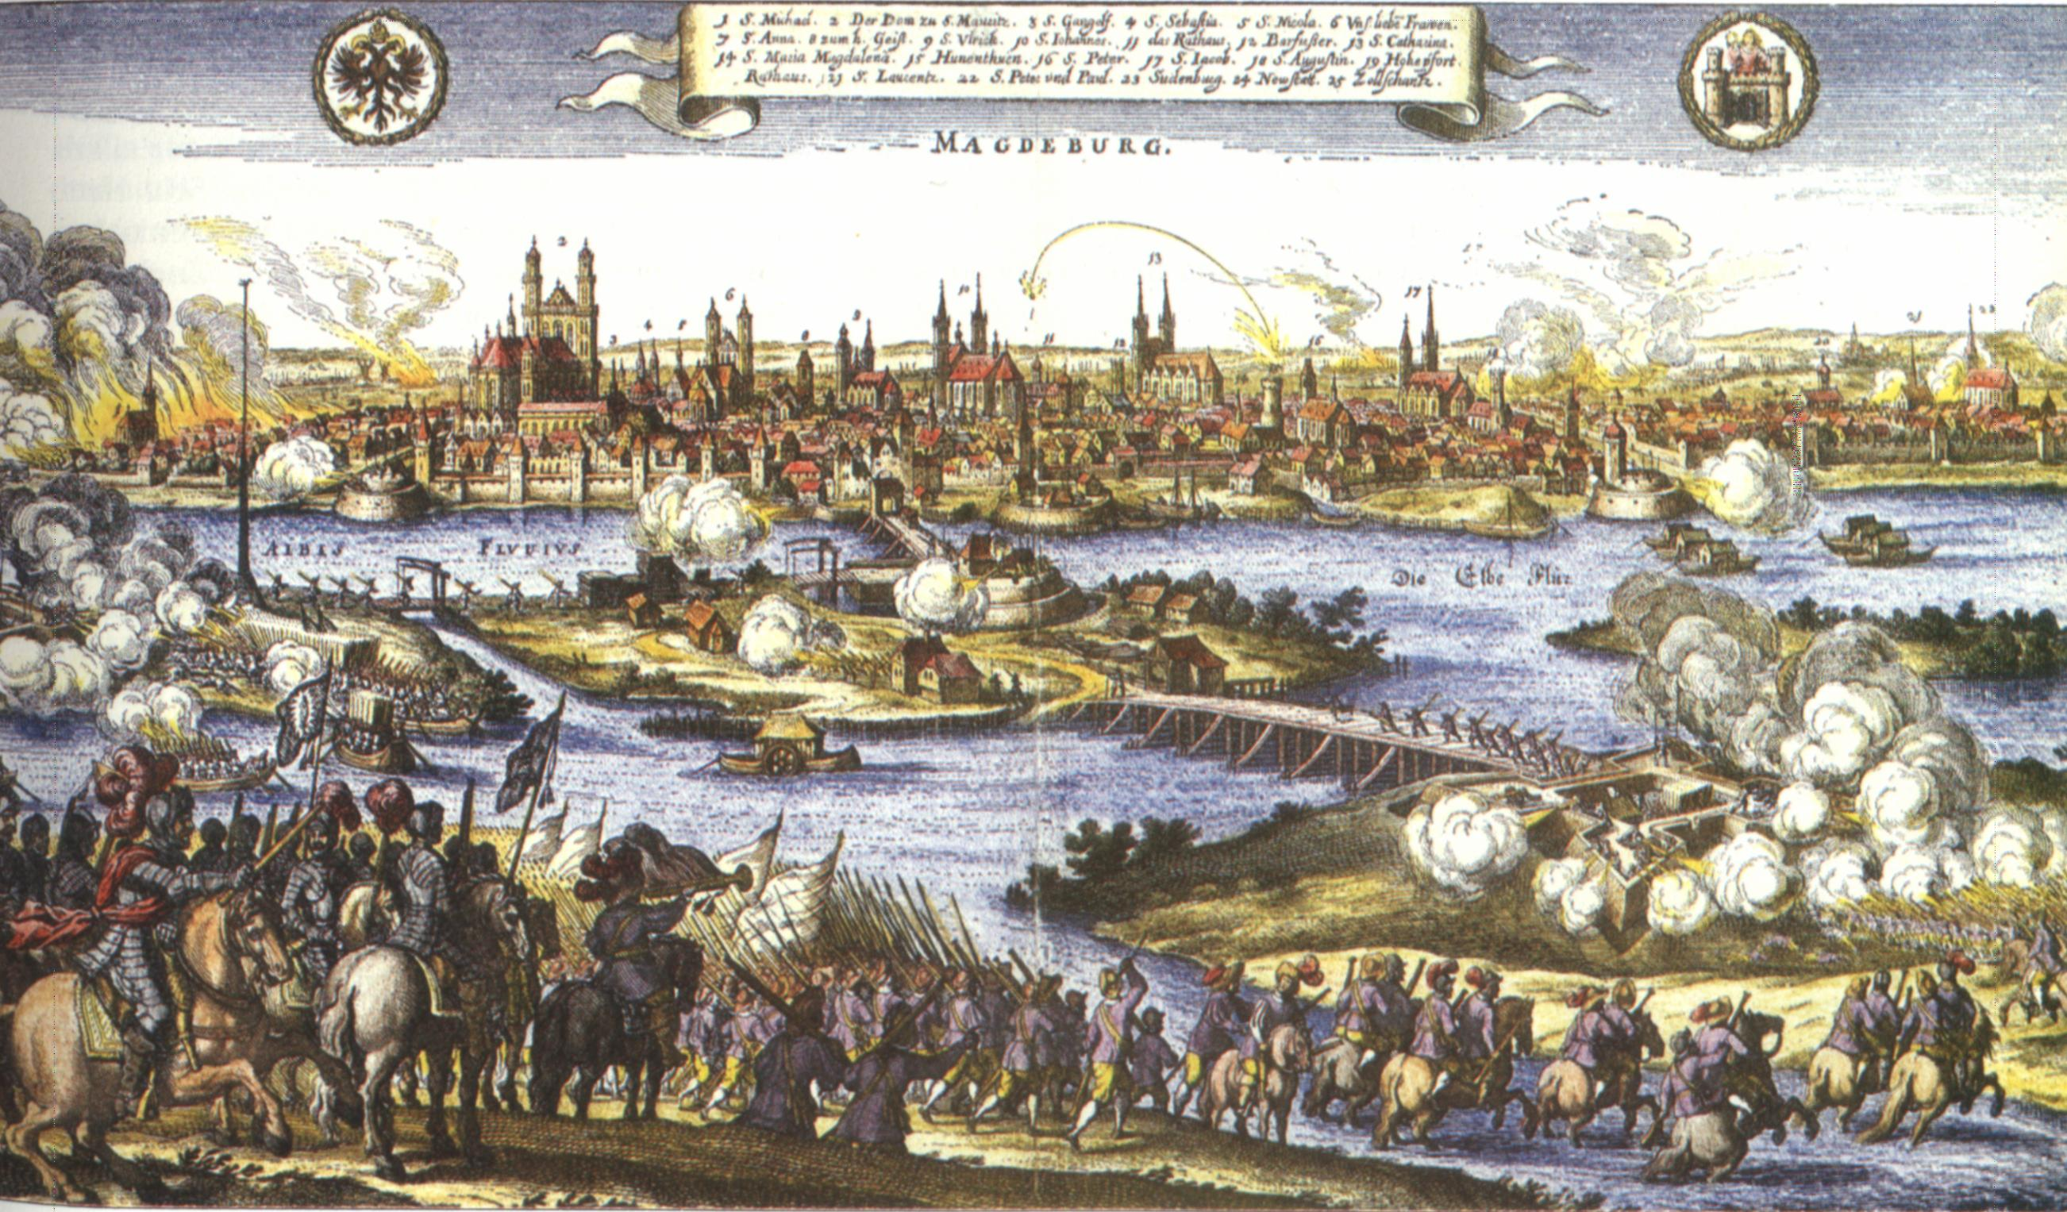
Thus, even when the play seems quite historical…
It is not a “realistic” theatrical re-presentation of the “high politics” of the Thirty Years’ War…
Sometimes it’s just not even true about the events…
The Sack of Magdeburg (Scene Five, pp. 58-60)
What is Brecht doing here by re-presenting Magdeburg in this way?
How and why does he draw the audience’s attention to the “made-ness” / the story of (hi)story?
What’s the message of re-presenting the Thirty Years’ War in this way?
The Sack of Magdeburg (1631)

Slide 35
In spite of its anti- / un-realism, the play does offer a commentary on the ‘realities’ of the “modernity” re-presented in this play /
Mother Courage as a ‘modern’ picaro (actually, a picara)
The new normal is to survive by one’s wits and turn a profit for oneself…
We all just do our best to get by in a world in which the needs of the war pre-determine most things and especially our “choices”…
Mother Courage: “…in general everything’s OK, the war’s going well, every other day fresh countries are joining in, it’ll last four or five years easily.” (Scene Three, p. 29)
“If it’s business, it makes sense.” (p. 34)
The “business” of war…
This way of thinking is precisely the problem for Brecht…
Mother Courage acts, but she does not have agency…
Her “choices” are determined by the circumstances…
Brecht is calling our attention to real dangers of being determined in one’s actions by conditions around one – including war, business, and war as “business” (p. 29) – and seeing them as “natural” / inevitable…
Mother Courage is autonomous / has her own business…
But she is employed by the war…
The Sergeant: “If off the war you hope to live, Take what you can. You’ll also give.” (Scene One, p. 18)
Brecht’s challenge to the Germans in 1939?

Slide 36
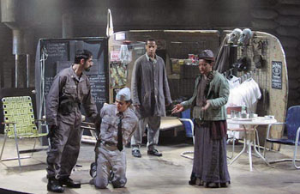
What does Brecht want his audience to think about Mother Courage’s agency / her “choices”?
My Thesis: Brecht does not want us to pity Mother Courage…
Rather, he wants us to think about how and why she acts!
Of course, he makes it difficult not to pity her / EXAMPLE: Swiss Cheese’s death (Scene Three, pp. 43-52)
Why does he die?
His “honesty” and compassion? – “She said she isn’t sleeping. I should take the cash box someplace else…” (Scene Three, p. 41)
Her “haggling” (p. 51)?
Brecht asks: Does he have to die?
What are the “conditions of determination” under which he dies and Mother Courage “despairs” (p. 50)?
Brecht wants us to think about these conditions – and not just get swept up in her and our grief…
Mother Courage and her Children – Production
by the Classical Theater of Harlem (2004) –
Mother Courage: “Why should I know him?”
(p. 43)

Slide 37
Interrupting your Pity and Grief:
Epic Theater and the V-Effekt (Verfremdungseffekt) = “alienation effect”
Brecht’s theory of epic theater…
Confusing! → “epic” “theater”?
What kind of a genre is that?!?
Not Brecht’s innovation… / Precedents in earlier political theater and cabaret in Europe / in Asian and revolutionary Soviet theater / in Charlie Chaplin and U.S. silent film…
Not fourth-wall, “dramatic theater”
The Alienation Effect: The audience should not identify with the characters / Emotions should not just be stimulated by theater, but also examined…
Epic theater “turns the spectator into an observer” and “arouses his capacity for action” (Brecht)
Epic theater is episodic : “Three Years later…” (Scene Three, p. 27) / “Two years have gone by…” (Scene Five, p. 58)
Its character development is discontinuous: Mother Courage is both a sentimental ‘mother hen’ worrying about Swiss Cheese’s “Woolies” (Scene Three, p. 28), but also his life (Scene Three, p. 49), AND she can’t keep herself from “haggling too long” (p. 51)
Unrealistic staging / set design
And constant interruptions in the action (the songs / ballads)

Slide 38
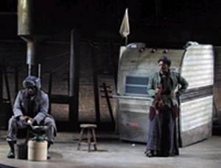
The Ballads
Mostly (but not always) interruptions…
“The Song about the Soldier and his Wife” (Eilif, Scene Two, pp. 24-5 – sort of oddly motivated…) vs. “The Song of Fraternisation”: (Yvette, Scene Three, pp. 30-1) and “The Song of the Great Capitulation” (Scene Four, pp. 55-7)
According to Brecht, the songs are also supposed to be sung in an ‘unpretty’ / un-melodic way so that they will be “drug free,” not full of “expressive” emotion that lulls the listener into passivity…
Partly spoken, partly sung / voice and music sometimes at odds….
For this reasons, the ballads can contain a grain of truth / a lesson / an insight…
That the audience must ponder…
Mother Courage and her Children - Production
by the Classical Theater of Harlem (2004) –
“The Song of the Great Capitulation” –
Mother Courage: “I’ve thought it over: I’m
not complaining.” (p. 57)

Slide 39
Epic Theater as Pedagogical Theater
One of Brecht’s main goals was thus to interrupt our pity by de-naturalizing the dramatic event going on on stage…
By making Mother Courage’s and her children’s experiences of the war and their reactions to it un-real and un-realistic, the play allows us to analyze the causes of the events (of war) being re-presented…
And thus analyze the ‘making’ of an un-natural world of war…
In order to “un-make” that world…

Slide 40
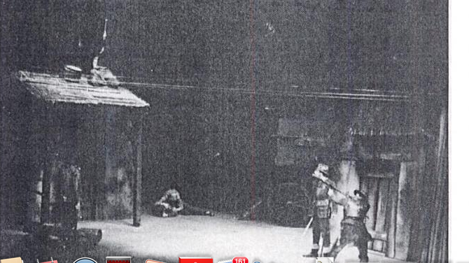
Questions…
Do “Virtues” kill in the “modern” world of war…
Individual Agency: What are heroism, honesty, compassion, and empathy in Mother Courage and her Children?
Collective Action: The Audience’s Response in 1941 / 1949
Our response today…
Brecht’s Agency? Brecht’s Heroism? → Surviving the War / Surviving the Peace
Mother Courage and her Children / Berlin
production (1949) – Scene Eleven

Slide 41
Remember!!!
There will be three (3) screenings this week (week 5) of the movie, “Theater of War” (dir. Walter, 2008) that is assigned for week 6!
TODAY: Mon., Nov. 3, 5:00 p.m., HG 1030
Tues., Nov. 4, 5:00 p.m., HG 1030
Thurs., Nov. 6, 6:30 p.m., HIB 100
Go watch it! Then go watch it again!

