Slide 1
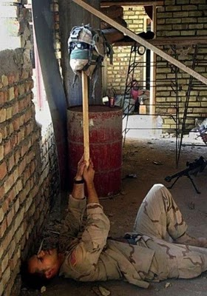
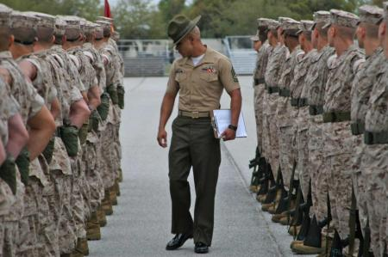
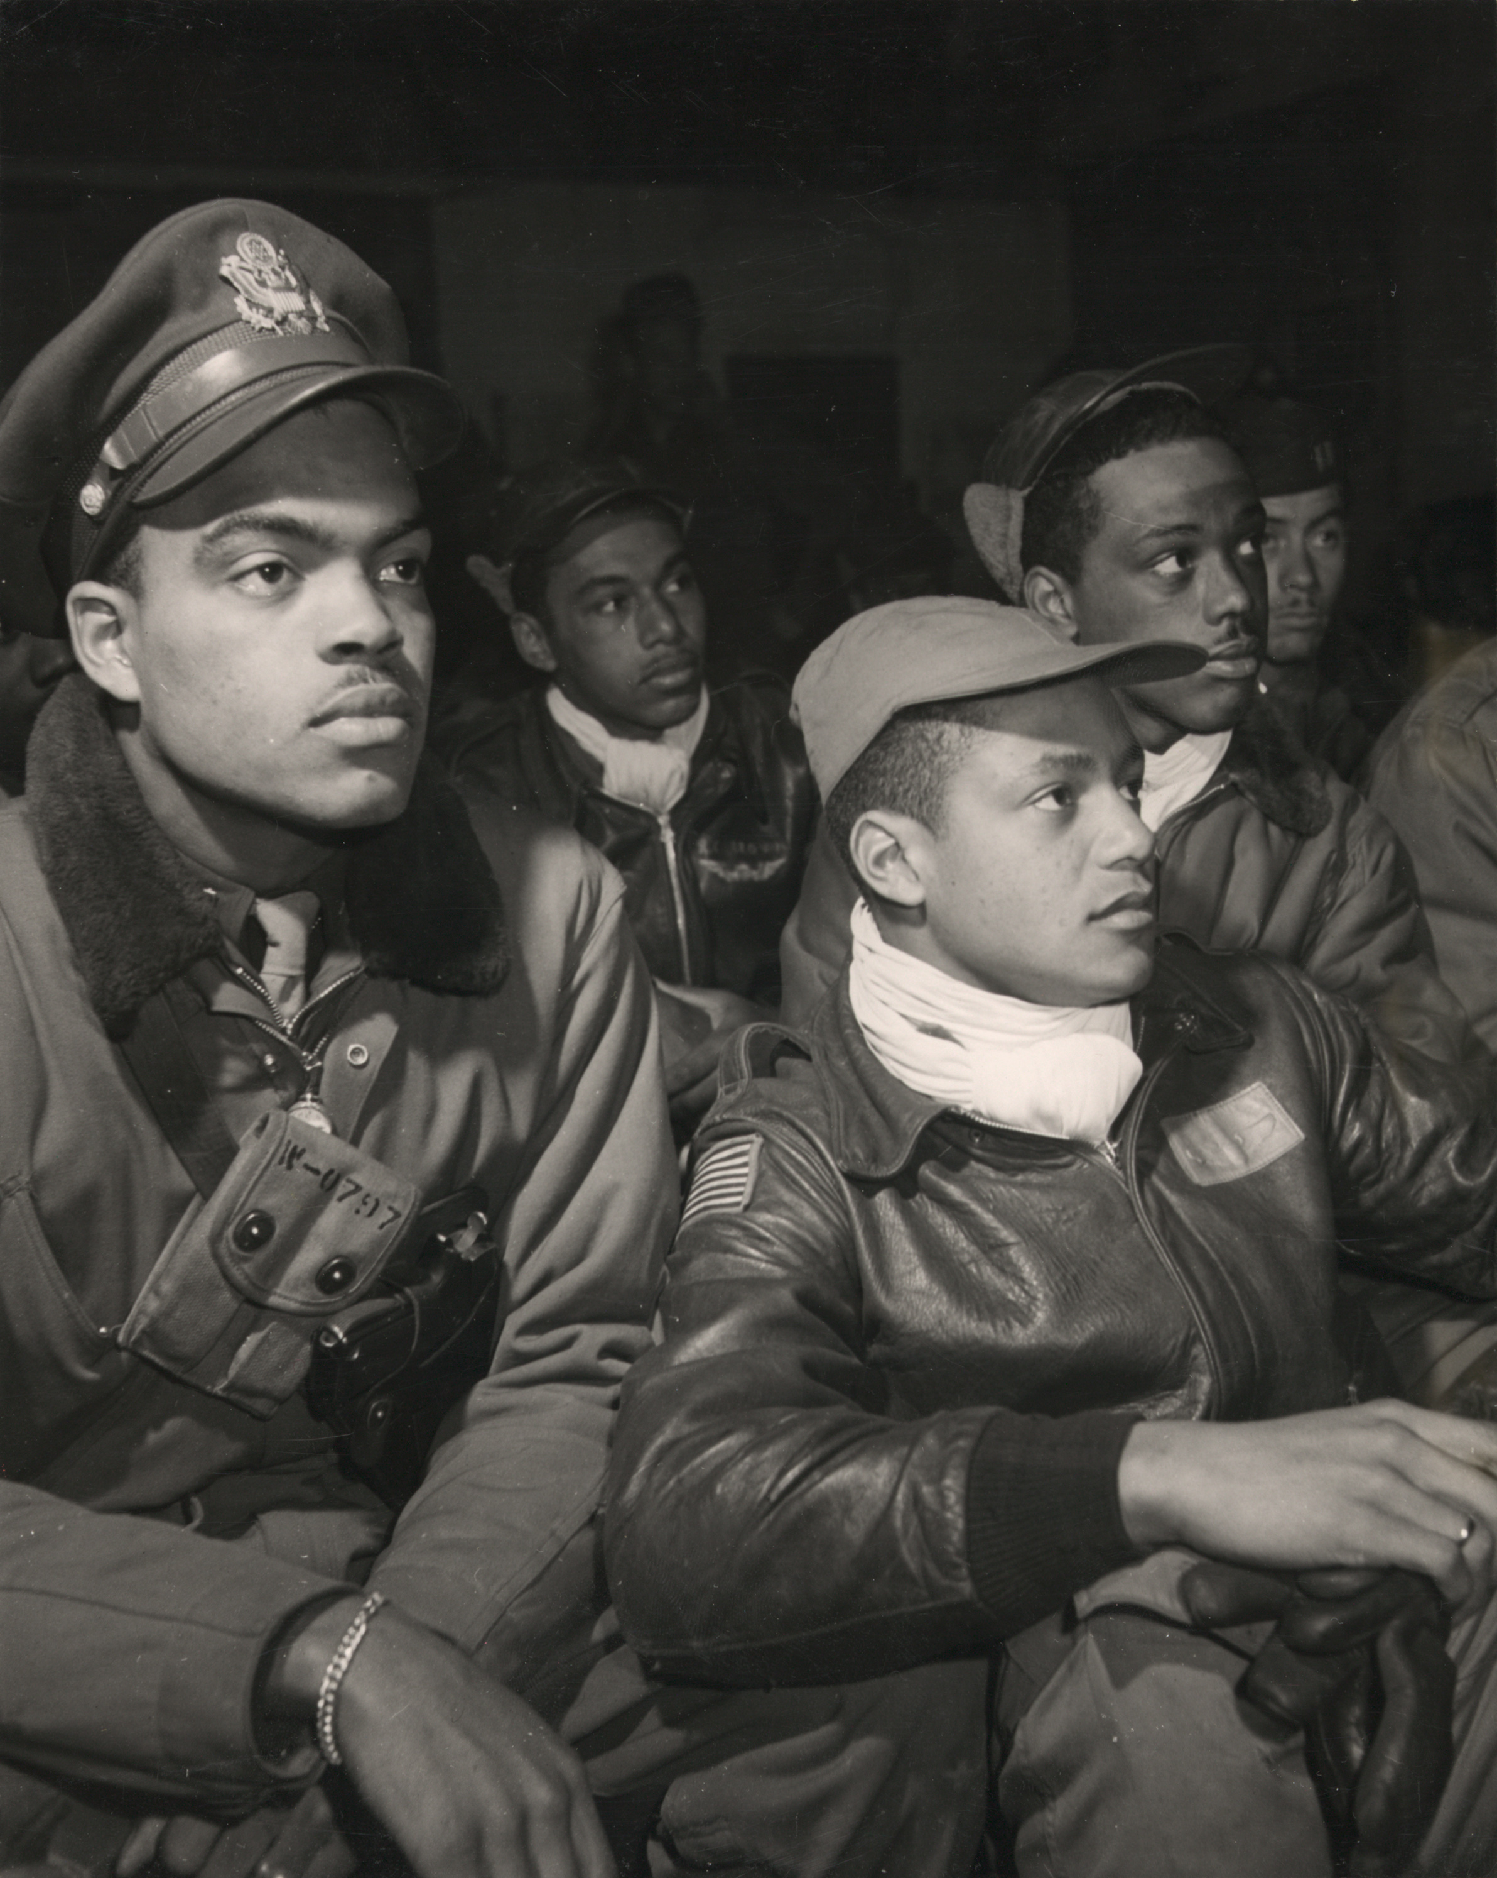
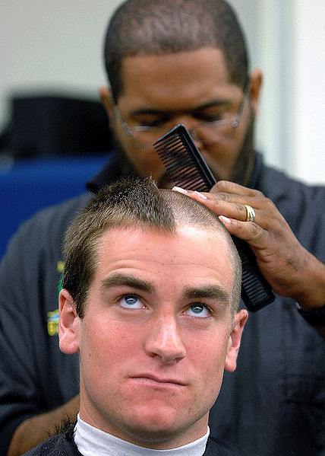
Military Culture
Lecture two

Slide 2
Last Lecture
I asked you to think about how our proximity in time and space to the events of a war might affect the accounts we offer about that war.
Every account of a war or an event in a war is an interpretation and every interpretation a simplification.
A war that we find see ourselves fighting or a past war alive in the minds’ of those who were personally affected by it might be interpreted in different ways by those who fought in the war, by those who volunteered, by those who were drafted, by those who made money from the war, by those who stayed at home, and by those civilians forced to flee the violence.

Slide 3
Today I will argue that basic training is a military rite of passage that involves the suppression of individuality and the inscription of a new collective identity, one that will allow its members to execute violence on command in the name of the state, one puts the preservation of unit, squad, platoon, or company before the preservation of the self.
I will also discuss the institutional purpose served by the scapegoat and the importance of gender.

Slide 4
Disclaimer
The language of soldiers, sailors, and Marines can be offensive, sometimes sexist, sometimes scatological.
I may quote something that disgusts, not to shock you but to illustrate the kinds of texts one encounters in my discipline. If you have concerns about this, please come and see me. I am happy to discuss this further.
My job, as a scholar, is to move beyond the discomfort and to think about what function/s these examples of military culture might serve.
I caution you that Invisible War is an Academy Award nominated film that presents victims of military sexual assault who recount the difficulties they have faced in the aftermath of such violence. If you find it overwhelming, please speak either with your section leader, with me, or with someone at our Counseling Center.

Slide 5
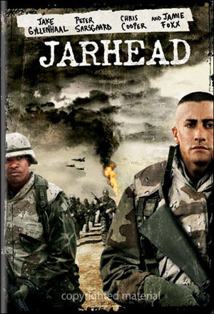
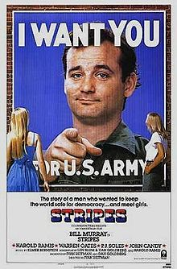
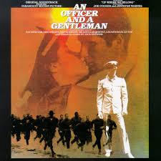
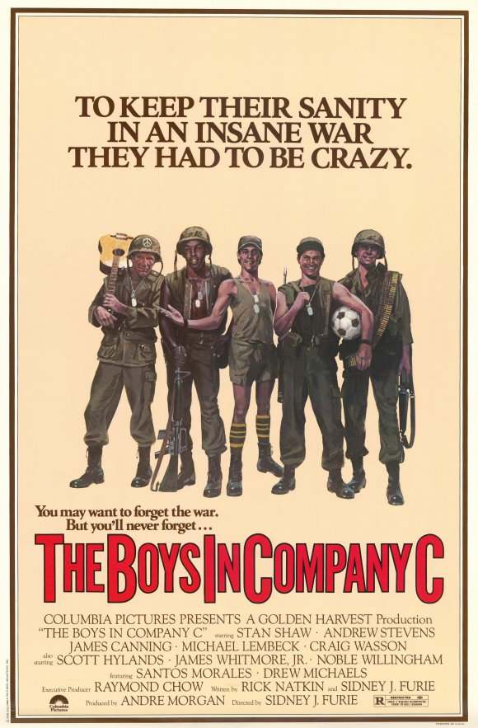
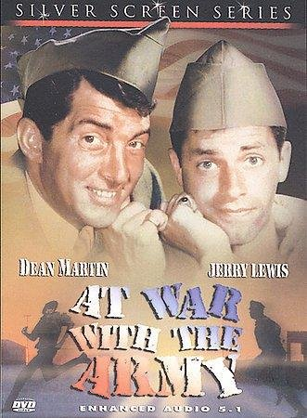
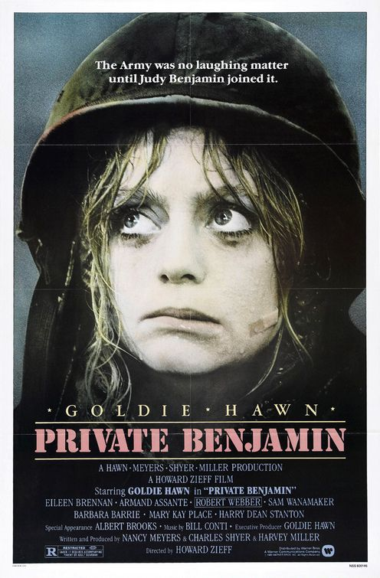
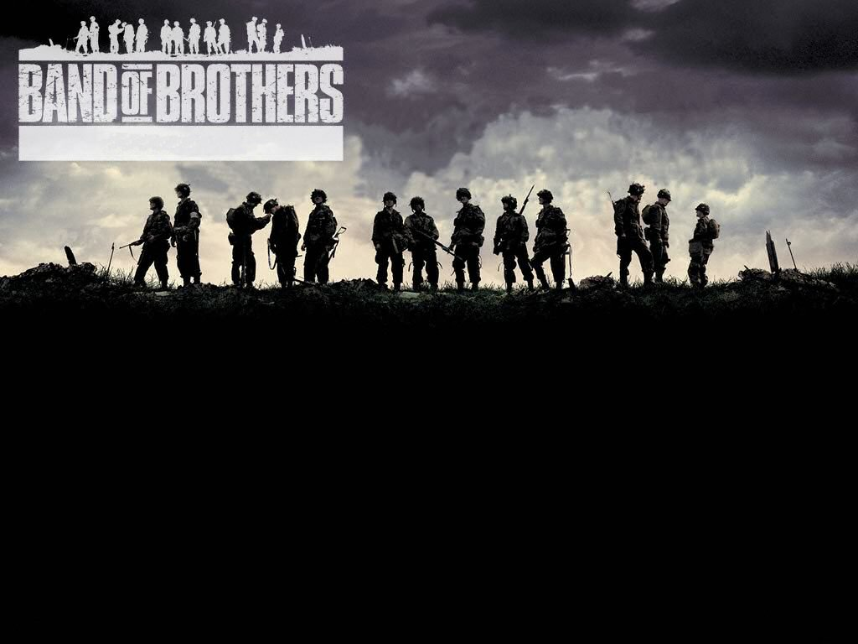
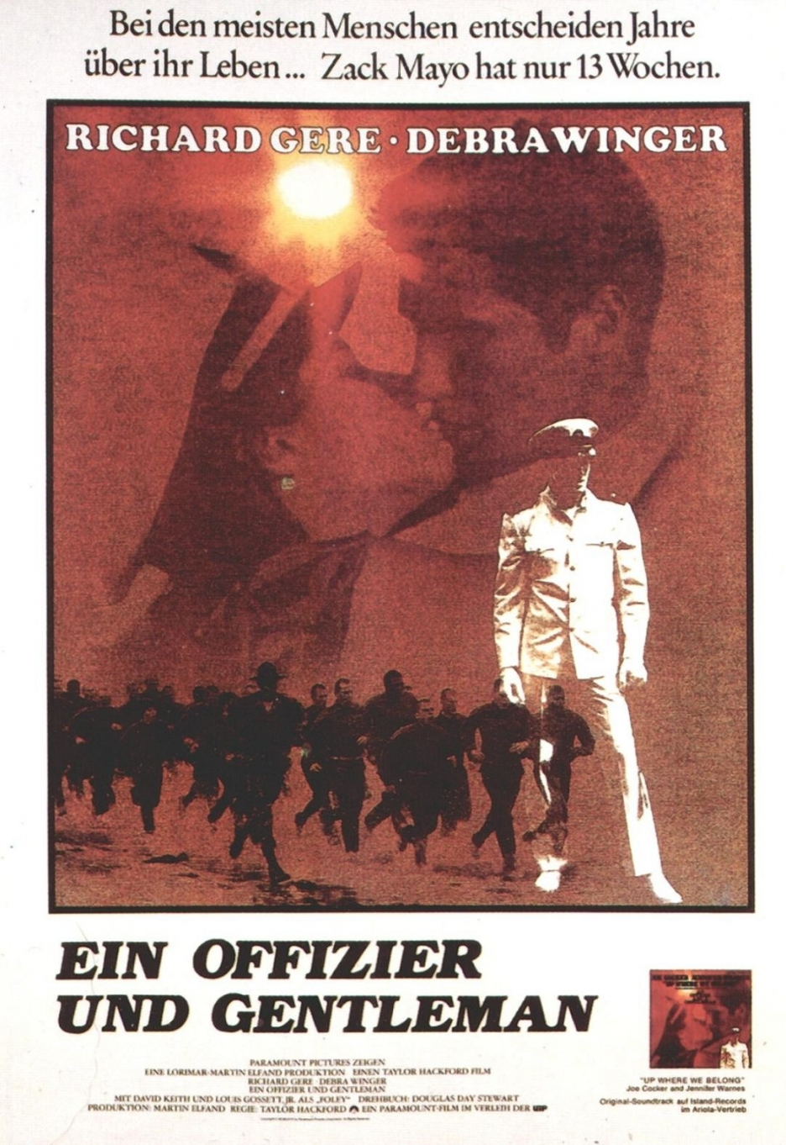
Basic

Slide 6
Erving Goffman, Presentation of Self in Everyday Life
“When an individual enters the presence of others, they commonly seek to acquire information about him or to bring into play information about him already possessed. They will be interested in his general socioeconomic status, his conception of self, his attitude toward them, his competence, his trustworthiness, etc. Although some of this information seems to be sought almost as an end in itself, there are usually quite practical reasons for acquiring it. Information about the individual helps to define the situation, enabling others to know in advance how best to act in order to call forth a desired response from him. (1)

Slide 7
Liminality
In his 1908 classic work, Rites de Passage, Arnold van Gennep defines liminality as the middle stage in initiation rituals. The initiate has not arrived at his new status, nor is he situated in his old state; he is between. (e.g. neither civilian nor Marine)
Liminality can be a state of confusion; what one thought one knew no longer pertains.
In The Ritual Process (1969), Victor Turner further refines the concept:
The neophyte in liminality must be a tabula rasa, a blank slate, on which is inscribed the knowledge and wisdom of the group, in those respects that pertain to the new status. The ordeals and humiliations…to which neophytes are submitted represent partly a destruction of the previous status and partly a tempering of their essence in order to prepare them to cope with their new responsibilities and restrain them in advance from abusing their new privileges. They have to be shown that in themselves they are clay or dust, mere matter, whose form is impressed upon them by society. (103)

Slide 8
Or according to a former commander of Parris Island:
Training was designed at Parris Island to break the umbilical cord between military and civilian life, designed to break him down to his fundamental self, take away all that he possesses and get him started out in a way that you want him to be. Issue him all new clothes, cut his hair, send his possessions home and tell him he doesn’t know a damn thing, that he’s the sorriest thing you’ve ever seen, but with my help you’re going to be worthwhile again.

Slide 9
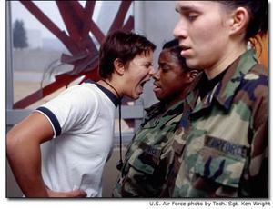
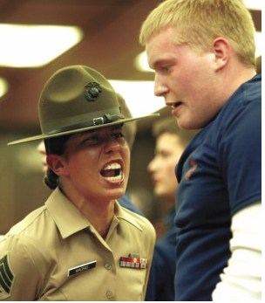
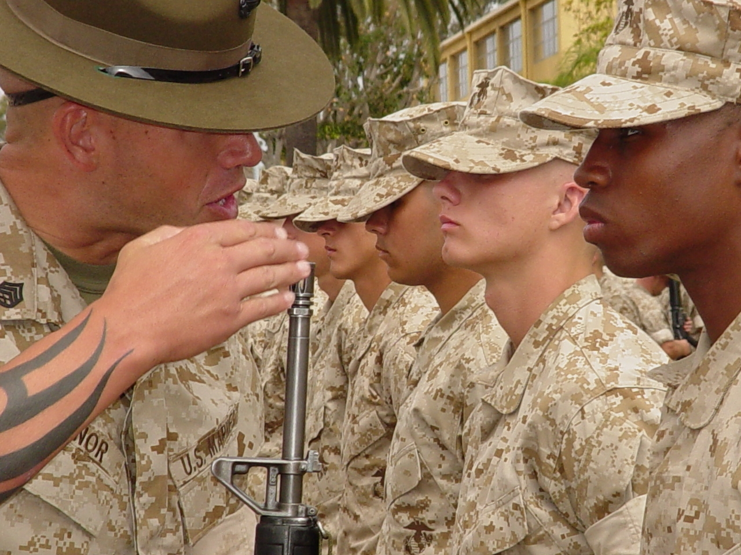
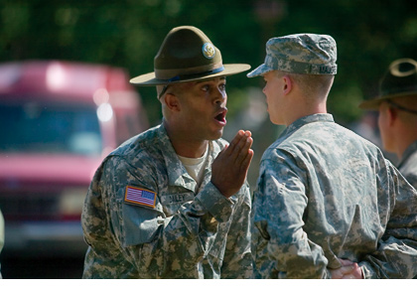

Slide 10
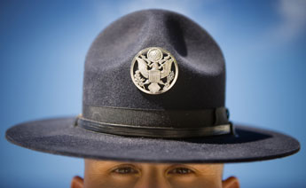

Slide 11
From Thomas Ricks’ The Making of the Corps. NY: Simon & Schuster 2007
“The reason we do this [simulate confusion] the way we do is to create uncertainty….From the recruit’s perspective, it appears to be chaos. War is chaos. And then they see this drill instructor—this magnificent creature who brings order to chaos. They learn that if they follow orders, their life will be calmer…The recruits aren’t the enemy—don’t get me wrong. The enemy is their values—their un-Marinelike values.” (57)

Slide 12
From Chaim Shatan’s “Bogus Manhood, Bogus Honor” Psychoanalytic Review 64.
“Far from promotion self-reliance, this aspect of basic combat training means giving up responsibility for one’s own well-being and for the consequences of one’s own actions. It means becoming dependent upon a higher power—becoming a boy again. The recruit has become a tool, a blind instrument to enforce another’s aims and purposes.” (605)”
“Recruits embrace their punisher and are renewed with a sense that they are part of something larger, the Corps, a union of not only all Marines but all former and future ones. Their true lineage is not a family line but a professional one, they enjoy fraternity with Chesty Puller.”

Slide 13
Deindividuation
Self-awareness is eclipsed by the powerful sense of belonging to a group.
One is no longer acting as a single moral agent solely responsible for one’s actions.
One may be willing to commit acts with others that would be unthinkable to do alone.
Dissociation can erase prohibitions that normally exist against aggression towards others.

Slide 14
Experiments by Psychologist Stanley Milgrim in the 1960’s
Looked at obedience to authority
Experiment concerns the willingness to administer electric shock to another under the watchful eye of an authority figure
65% of the men in the study continued to administer shocks even after they heard screams
Related experiments have shown:
a) a moral disengagement that facilitates tolerance to inflict pain
b) a displacement of responsibility onto the victim
c) those most willing tend to be fearful of a dangerous world & have stricter moral code
d) one experiment revealed privates less likely to administer the high levels of shocks than LT Colonels

Slide 15
From Robert Lifton’s Home From the War. NY: Basic Books, 1973.
The predominant tone is one of all encompassing absurdity and moral inversion. The absurdity has to do with a sense of being alien and profoundly lost, yet at the same time locked into a situation as meaningless and unreal as it is deadly…the men were adrift in an environment not only strange and hostile, but offering no honorable encounter, no warrior grandeur. (282)

Slide 16
Review
Basic training transforms individuals into standard “government issue” soldiers by:
- prohibiting contact with the civilian world
- dressing everyone the same
- shaving their heads, or if women requiring exacting standards
- depriving them of sleep
-exhausting them physically
- prohibiting personal possessions
- measuring success not according to individual standards but by the success of the group
- infantilizing
- controlling every minute of their time
- simulating confusion
- prohibiting a recruit from referring to herself or himself in the first person:
  “Private Jones reporting for duty, Sir”
  “Midshipman Smith requests permission to ask a question sir.”
- keeping them in a liminal, deindividualized state
- forcing them to suppress anger and frustration
- bullying and humiliating

Slide 17
Vietnam War Facts
World War II backdrop
July, 1945 – the Germans are defeated
August, 1945 – the Japanese surrender and remove troops from Vietnam
September 2, 1945 – Declaration of Independence
September 22, 1945 – Colonial French troops reasserted their control of Vietnam

Slide 18
American involvement
1956 – 64 “Advisory Period of the War”
1965 – 1975
2.7 million Americans served in Vietnam (25% were draftees—in WWII it was 65%)
3.5 million Americans served in the greater S E Asian theater (Vietnam, Cambodia, Laos and Thailand)
North Vietnam – backed by China and the Soviet Union
Soutn Vietnam – by America (joined by forces from Australia, New Zealand, Korea, Philippines, and Spain)
(http://www.va.gov/opa/publications/factsheets/fs_americas_wars.pdf)

Slide 19
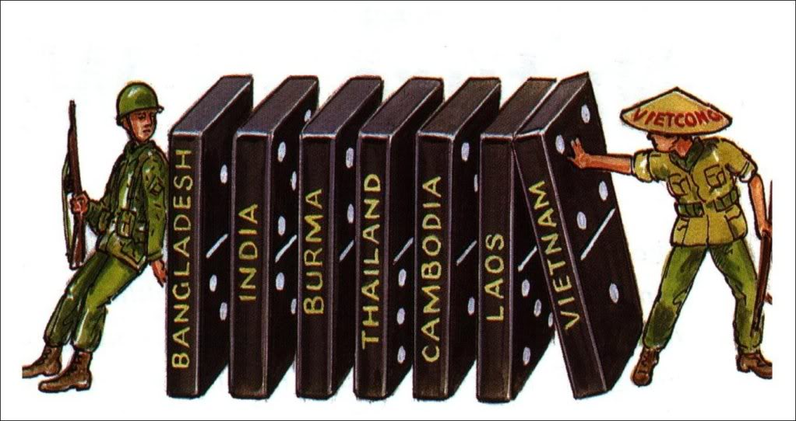
“domino theory”

Slide 20
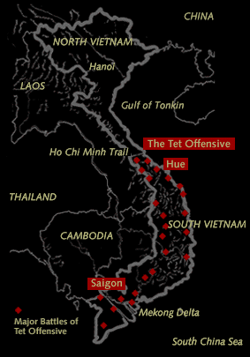
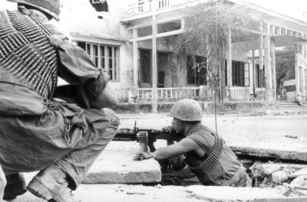
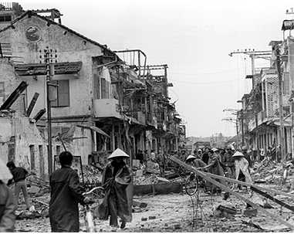
Tet Offensive, 1968

Slide 21
When it was all over….
58,202 American soldiers killed
2-3 million Vietnamese killed
6.7 million tons of ordnance dropped on Indochina
2.5 million tons on neighboring Laos alone
(compare with WWII – 1.6 million tons dropped by American planes)
3.5 million acres sprayed with 19 million gallons of defoliants
140,000 Vietnamese had evacuated in April 1975. That number escalated in the 2 decades following the war to 2 million.
(http://www.va.gov/opa/publications/factsheets/fs_americas_wars.pdf)

Slide 22
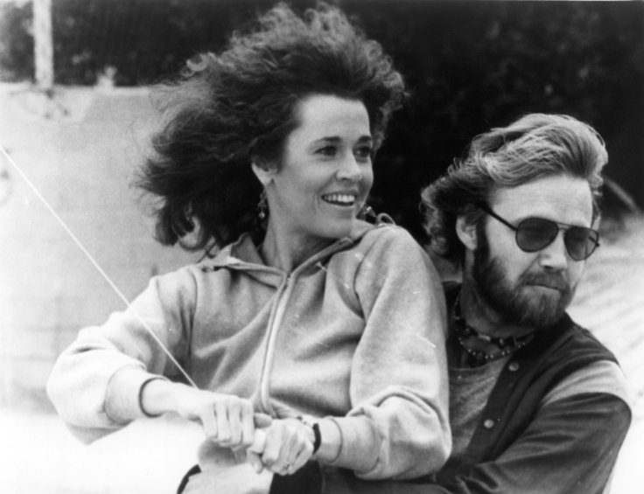
Coming Home
What transformations take place in the film?
How is masculinity defined?
Why do real veterans play
themselves?
What does it mean to come
home?
What’s a “jody?”

