Slide 1
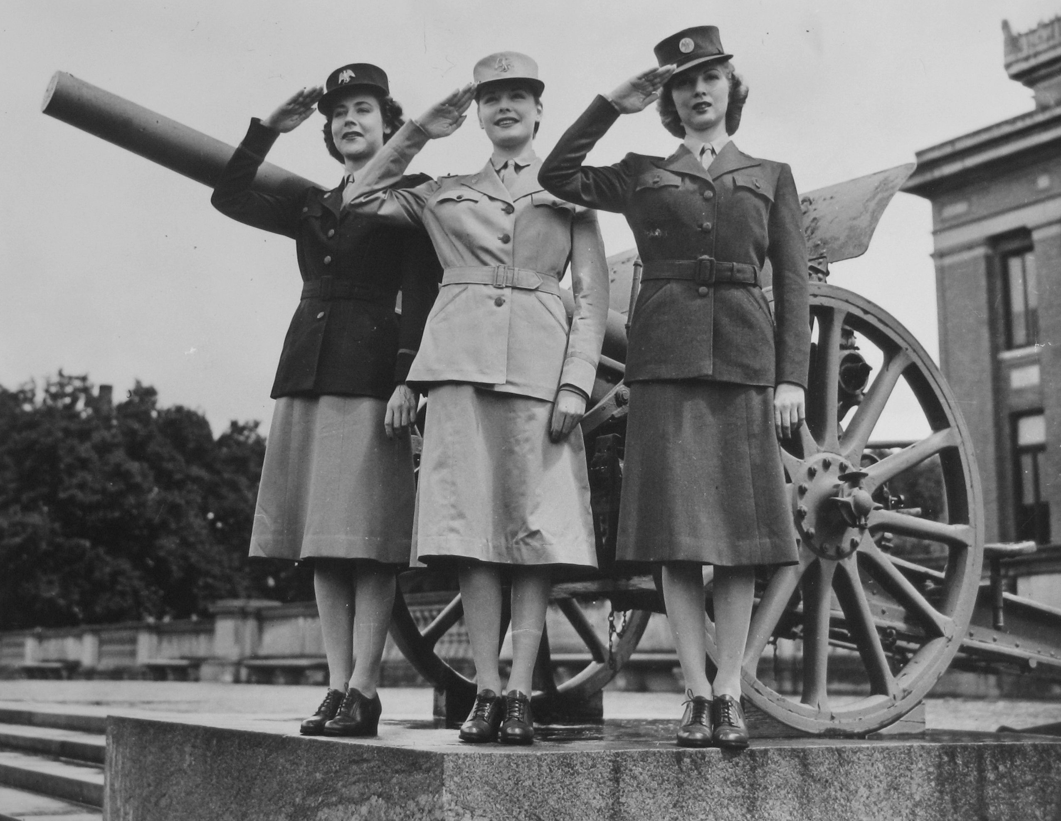
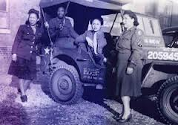
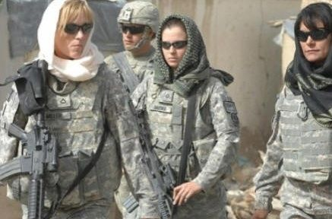

Women in the Military
Week Three

Slide 2
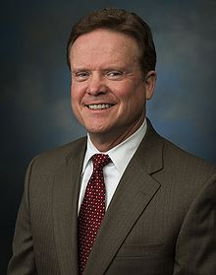
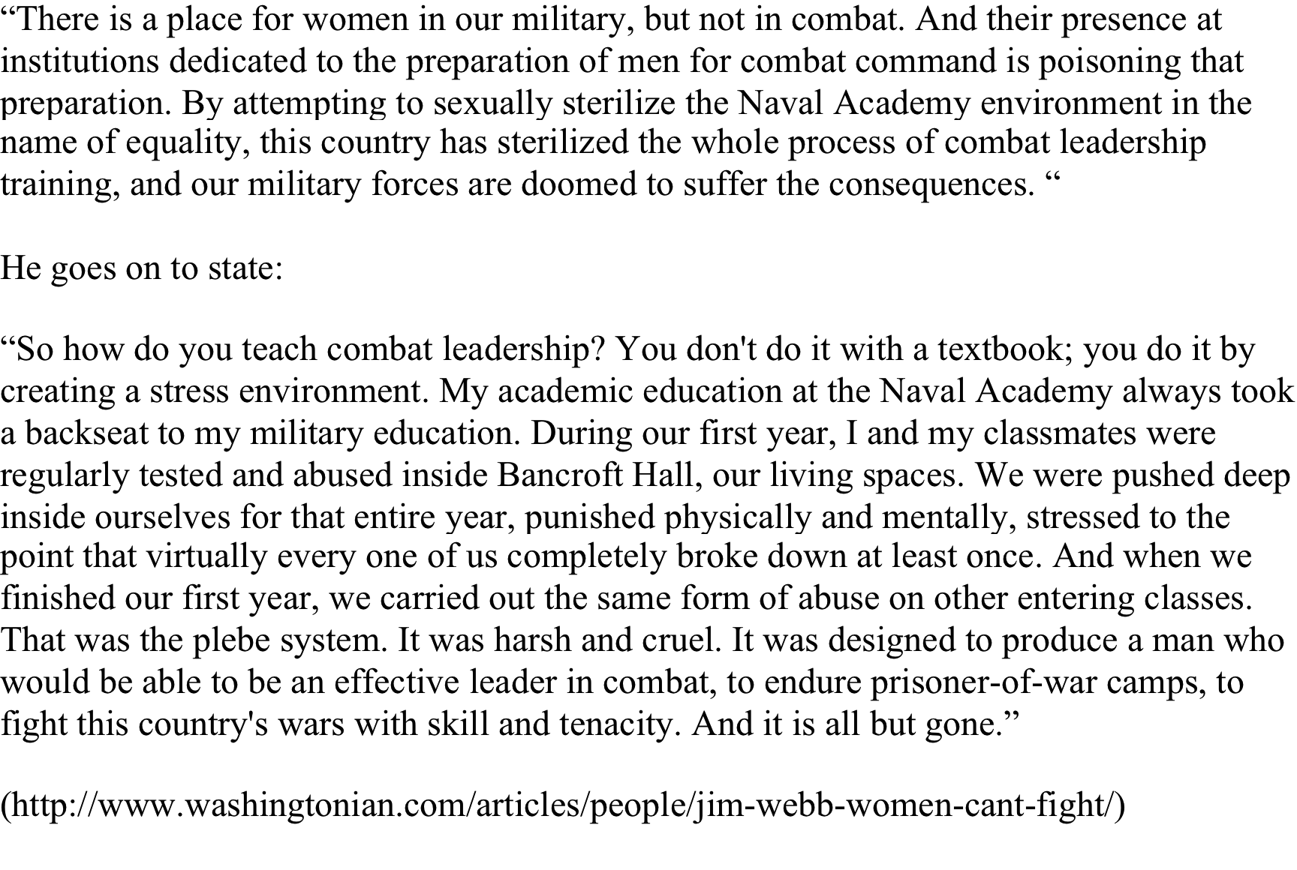
James Webb, former Sec. Navy and U.S. Senator

Slide 3
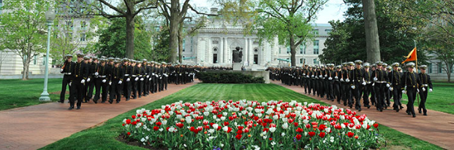
Reactions to Webb
- Supporters argue that women at the Service Academies were “feminizing” the Pentagon, that their very presence was corrosive to the essential esprit de corps or male bonding necessary for forging warrior leaders.
- Critics called his stress-is-fungible thesis simply wrong.
- Still others staged their own protest.

Slide 4
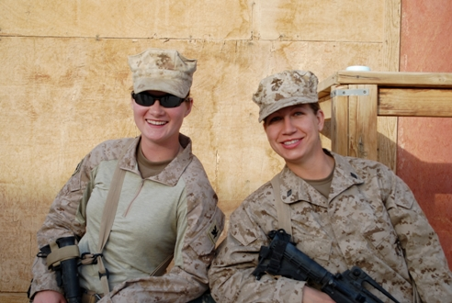
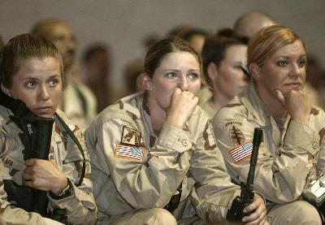
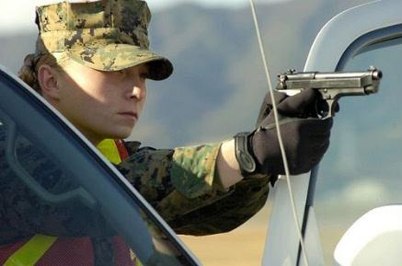
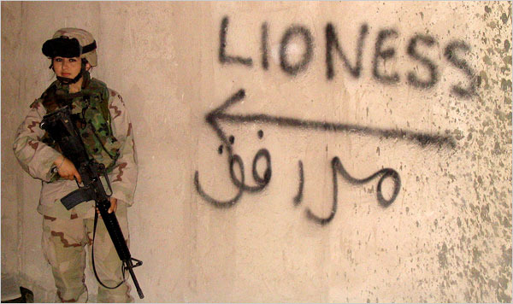
More than 280,000 women deployed in recent wars in Iraq and Afghanistan

Slide 5
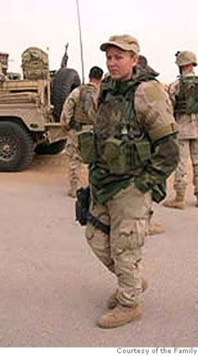
Suzanne Swift
Deployed to Iraq in 2004-05
66th MP Company
James Klimaski: “In the civilian world, it’s all about relief for the victim. In the military, it’s about punishing the transgressor. Nothing is done to make them [the victims] whole again. If victims get a bad performance review by a superior who sexually harassed them, if they fail to get a promotion, it’s their job to clear it up.” (phone interview with C. Burke, April 2006)

Slide 6

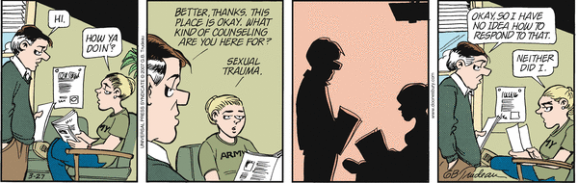
Suzanne Swift
Doonesbury, March 27, 2007
http://www.gocomics.com/doonesbury/2007/03/27#.U032Aq1dU08 http://www.gocomics.com/doonesbury/2007/03/27#.U032Aq1dU08

Slide 7
Veterans’ Administration Data
- 70% of women say they have experienced sexual harassment while serving
- One in 5 women suffer from military sexual trauma
One in 100 men
Only 10-13% report
http://www.mentalhealth.va.gov/docs/mst_general_factsheet.pdf

Slide 8
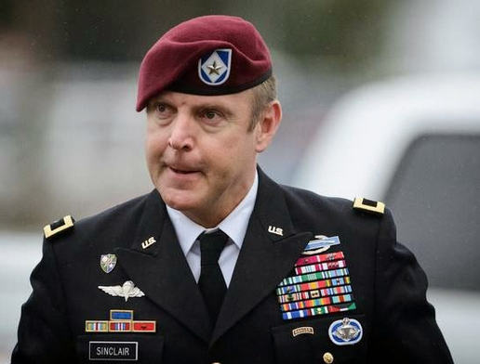
More Bad News
Commander of the 82nd Airborne charged with forcible sodomy, indecent action and violating orders. He pleaded guilty to lesser changes and received a fine of $20,000 and demotion to Lt.Col.
Brig. Gen. Sinclair
Commander of the 173rd Airborne pleaded guilty to bigamy and fraud.

Slide 9
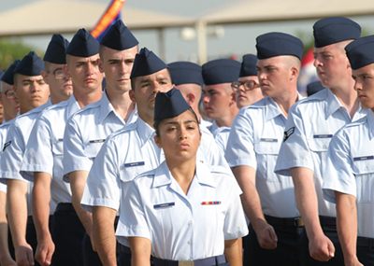
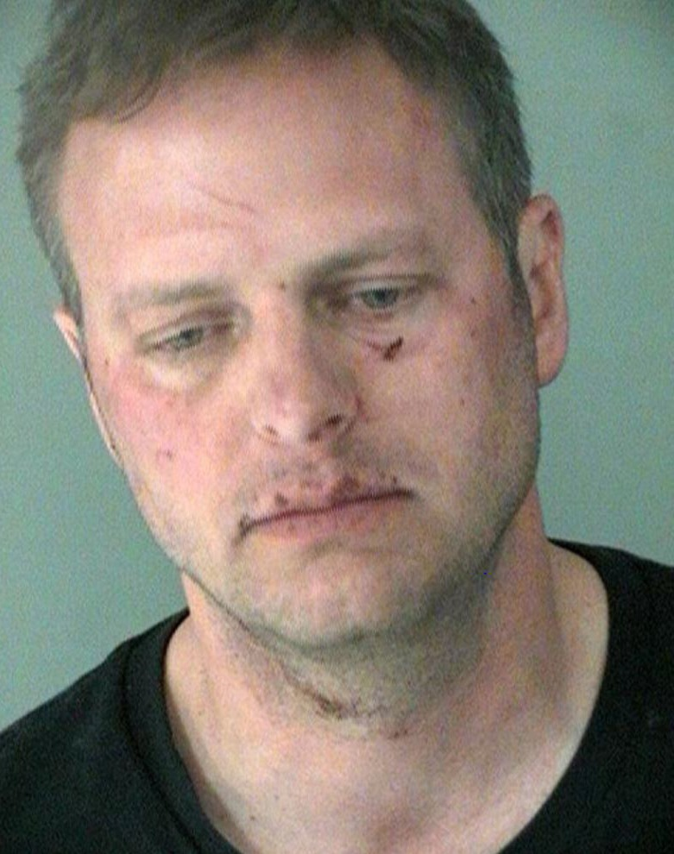
62 recruits assaulted by 33 drill instructors at Lackland AF base
Lt Col in charge of the Sexual Harassment and Assault Prevention program at Ft Campbell, KY charged with stalking an ex-wife and sending her threatening emails in violation of a restraining order
Lt Col heading the AF Sexual Assault
Prevention Program charged with sexual
battery
Lt Col Krusinski

Slide 10
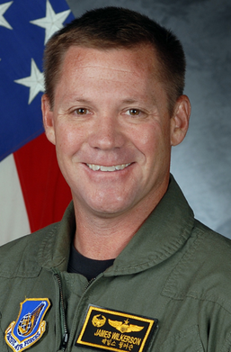
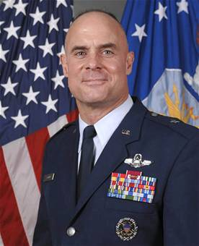
Lt Gen Craig Franklin overturns Lt Col James Wilkerson’s conviction for sexual assault
Wilkerson had flown in the same unit as Gen Franklin
Franklin explained his decision to overturn the conviction of Wilkerson, a man he saw as someone “who adored his wife and his 9-year old son,” someone “who had been selected for promotion to full colonel, a wing inspector general, a career officer”

