Slide 1
Zombies and War
Max Brooks: World War Z (2006)
The Zombie Survival Guide (2003)
Taking Zombies seriously
A zombie's digestive tract is completely dormant. The complex system that processes
food, extracts nutrition, and excretes waste does not factor into a zombie's
physiology. Autopsies conducted on neutralized undead have shown that their "food”
lies in its original, undigested state at all sections of the tract. This partially chewed,
slowly rotting matter will continue to accumulate, as the zombie devours more
victims, until it is forced through the anus or literally bursts through the stomach
or intestinal lining (ZSG 11-12)
SOMETIMES A ZOMBIE IS JUST A ZOMBIE

Slide 2
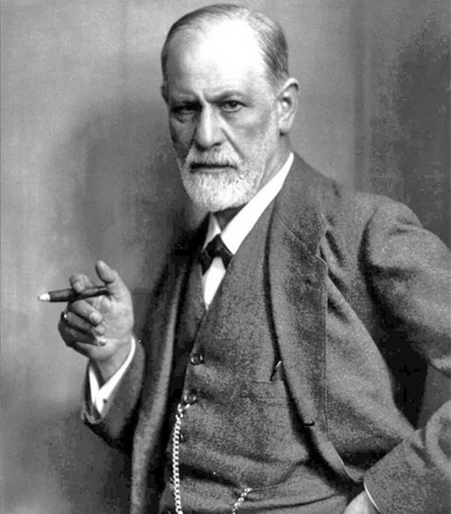
Sometime a cigar is just a cigar/sometimes a quotation is apocryphal

Slide 3
As Brooks’ zombies gain in detail and specification, their suggestive
resemblance to other figures and other contexts diminishes
Max Brooks 1972-
Wrote World War Z in the manner of Studs Terkel’s
“The Good War:” An Oral History of World War II
WWZ: Reflections on War
Film 2013
Organized around action hero Brad Pitt
Omits the interviews, most of the politics, changes the zombies

Slide 4
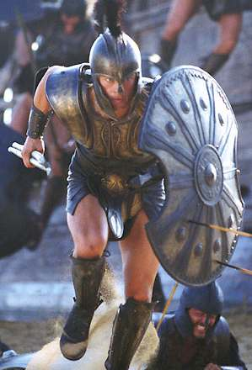

Troy 2004 World War Z 2013

Slide 5
Zombie interventions in the human culture of war
--weapons
--tactics
hand-held weapons; Redecker Plan
The Human Spirit and the “human factor”
“Patient Zero” China conceals the outbreak
US and Canada suppress information: Bob Archer of the CIA,
Stanley McDonald of Canada
Travis D’Ambrosia: Supreme Allied Commander in Europe
Breck Scott and Phalanx, vaccine for “African rabies”

Slide 6
Israel institutes “voluntary quarantine” for “any foreign-born Jew,
Any foreigner of Israeli-born parents, any Palestinian living in the
formerly occupied territories, and any Palestinian whose family
had once lived within the borders of Israel” (p. 37).
Jürgen Warmbrunn
Saladin Kader
More geopolitics:
“Cuba won the zombie war” (p.228 [not assigned])

Slide 7
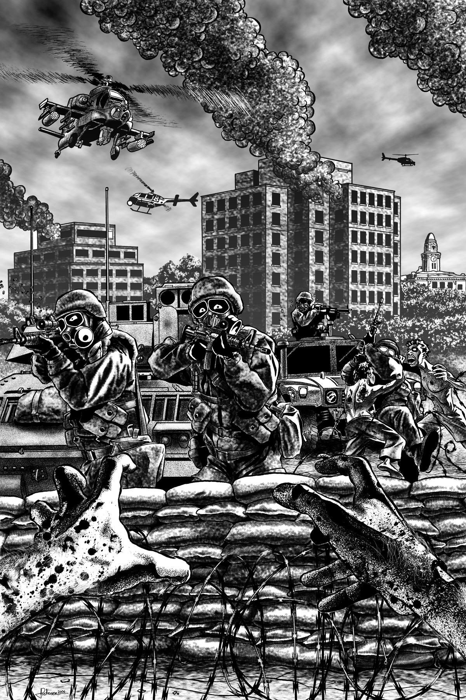
The Battle of Yonkers and Todd Wainio

Slide 8
Monument/Memorial to World War Z?
The Mural in the Denver Train Station

