Slide 1

“Ever since words existed for fighting and playing, men have been wont to call war a game.”
Johan Huizinga, Homo Ludens (Beacon Press, 1955), 89
The ancient Greek word aethlos means the fight of warriors and the contest of athletes.
“Sport is war, minus the shooting”
                George Orwell
“Sports is the human activity closest to war that isn’t lethal.”
                Ronald Reagan

Slide 2
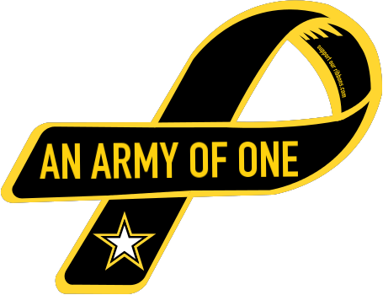
“The true mission of American sports is to prepare young men for war.”
Dwight D. Eisenhower
“In the logics of the War on Terror, civilians displace armies as the target of choice, and it is this everyday body that signifies the ‘front line.’”
              Roger Stahl, Militainment, Inc. (New York: Routledge, 2010), 55
“Since the expanse of the world is progressively being reduced to nothing [by communication technologies] . . . The individual becomes his own training ground.”
              Paul Virilio, Desert Screen: War and the Speed of Light (New York: Bloomsbury, 2005), 30

Slide 3
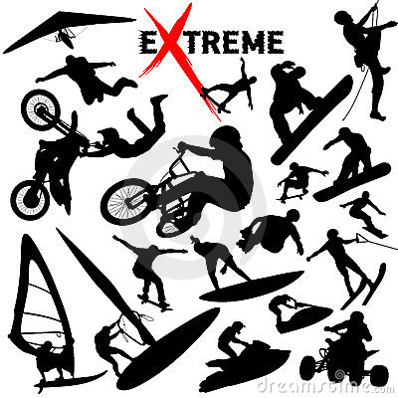
Extreme Sport
Fleshwound Films:
https://www.youtube.com/watch?v=qjx9zeigybcde
“I can’t wait to hop in my Jeep Liberty, drink some Mountain Dew, and go waterboarding.”
          John Stewart, The Daily Show
Extreme sports derives “its primary pleasures not from watching but rather being in virtual proximity to pain and danger. In colonizing discourses of recruiting, war journalism, terrorism, and others, the metaphor has given birth to the rhetoric of the ‘battlefield playground.’ Such a relationship to war is a vital aspect of the virtual citizen-soldier. Put simply, extreme sports discourse has been put to use as an entry point through which the citizen has been invited to play soldier.”
          Roger Stahl, Militainment, Inc., 54.

Slide 4
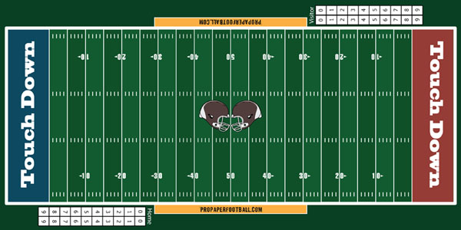
War ←→ Sport
Implications of metaphor :
1) Sport and war are fair, two sided contests
2) The contest is conducted according to rules
3) The contest is linear, and goal-oriented: one side wins, another loses.
Football in particular?
Players speak of “going to war for each other” and “fighting in the trenches” together
The game involves an “aerial attack” and “ground attack” as the offense “drives into enemy territory”
The defense “blitzes” the quarterback (from “Blitzkrieg”: Lightning War) in an effort to “sack” him (as armies do a city)

Slide 5
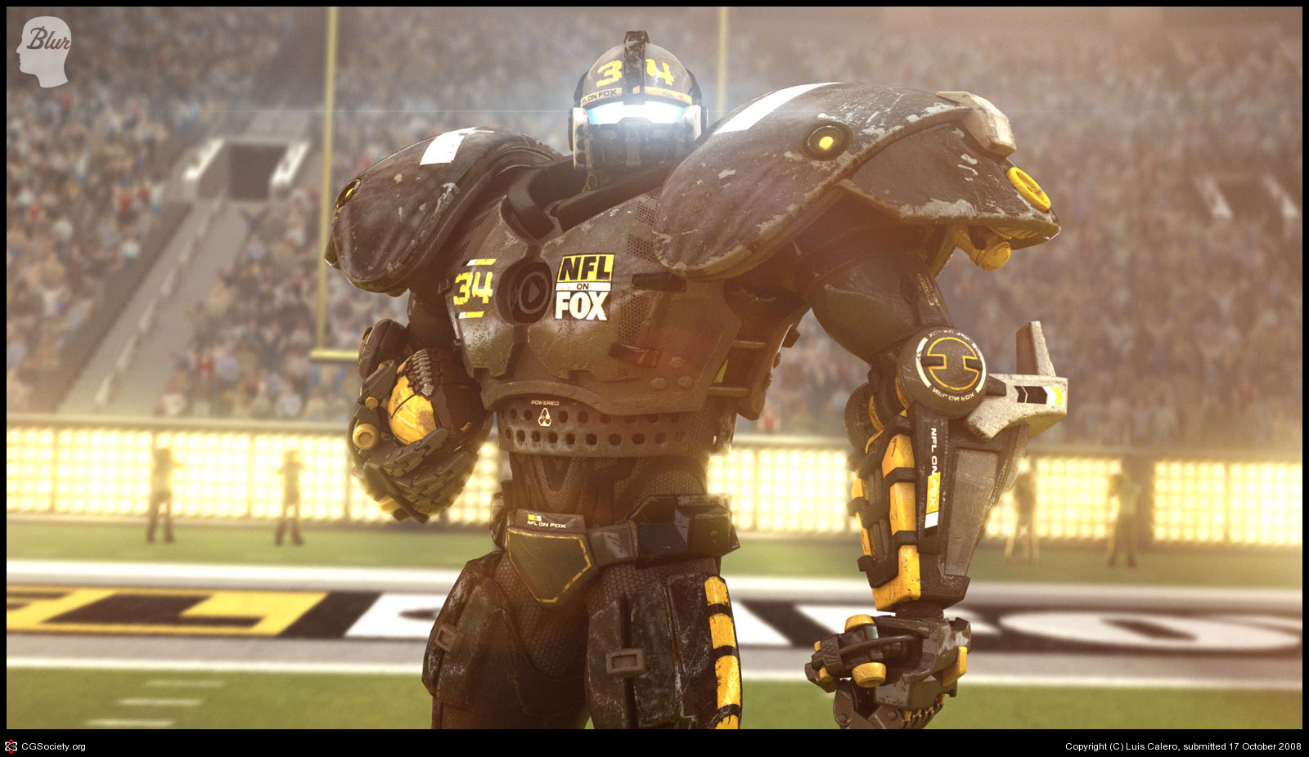
“When United States troops invaded Iraq and Afghanistan, the resulting surge in patriotic sentiment was a boon for football and television. NFL Commissioner Paul Tagliabue “was insistent from the start that the whole mood of Super Bowl 36 become intensely patriotic.” He succeeded. Besides the usual pageantry, the game in New Orleans became a “midwinter version of the Fourth of July, a national pep rally wrapped in red, white and blue.” With the help of Fox Sports, the network that televised the contest, the pre-game show featured cut-away shots of United States troops stationed in Afghanistan, archived footage of the Vietnam War, a reading of the Declaration of Independence, and a re-enactment of the flag raising at Iwo Jima that morphed into the iconic flag from the World Trade Center.”
Andrew McGregor, “Patriot Games.” “ussportshistory.com,” 2/2/15
Super Bowl 36, Pregame Show:
https://www.youtube.com/watch?v=moaHS2wrWW0

Slide 6
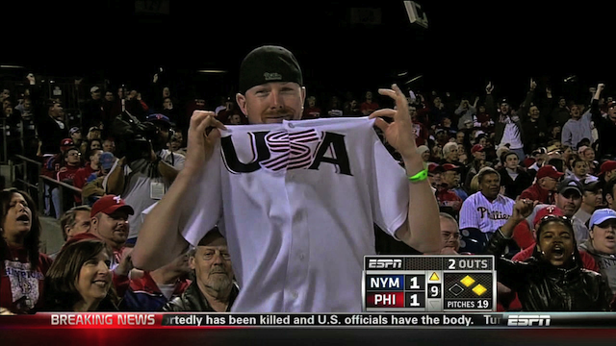
Sports Nationalism and Brand Patriotism
“‘U-S-A!’ a cheerleader yells, and the rest take up the chant, ‘U-S-A! U-S-A! U-S-A!’ and Norm is chanting and clapping, rocking with the beat”
Ben Fountain, Billy Lynn’s Long Halftime Walk, 128.
Phillies vs. Mets: https://www.youtube.com/watch?v=k97wq0953UU
Iowa State: https://www.youtube.com/watch?v=GzThMAyFK6Q

Slide 7
Hidden Costs (and “blowback”?)
“Every thinking fan must, in order to enjoy any NFL game, consent to participate in a formidable suspension of disbelief. We must put aside our knowledge that nearly every current NFL player can expect to suffer from chronic traumatic encephalopathy, a degenerative disease that leads to memory loss, impaired judgment, depression, and dementia.
“Football players are also four times more likely both to die from ALS (a fact that Goodell, despite participating in this past year’s ALS ice-bucket challenge, refuses to acknowledge) and to develop Alzheimer’s disease. An NFL player can expect to live twenty years less than the average American male. The average NFL career lasts 3.3 years. By that measure, each season costs an NFL player about six years of his life. Football fans, in other words, must ignore the fact that we are watching men kill themselves.”
Nathaniel Rich, New York Review of Books, 3/5/2015

Slide 8
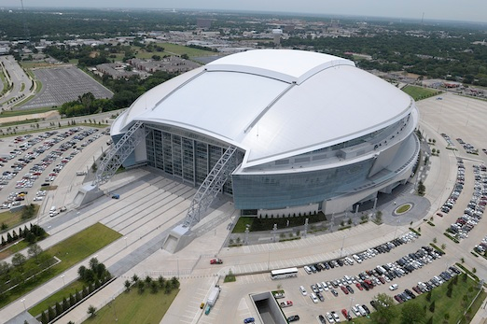
Back to Billy Lynn (and to the latest “theater of war”)
“Years and years of carefully posed TV shots have imbued the place with intimations of mystery and romance, dollops of state and national pride, hints of pharaonic afterlife such as always inhere in large-scale public architecture, all of which render the stadium of Billy’s mind as the conduit or portal, a direct tap-in, to a ready-made species of mass transcendence, and so the real-life shabbiness is a nasty comedown” (10).

Slide 9
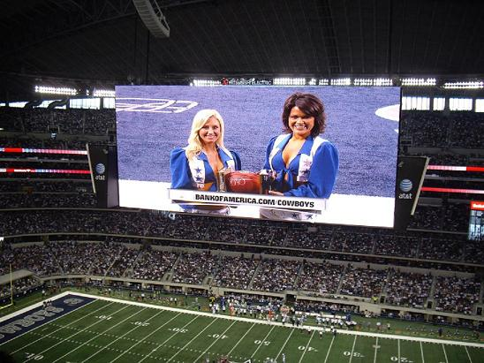
“So what do you believe in? Billy doesn’t so much wonder as feel the question thrust upon him. . . . How about . . . reality. Billy decides the war has made him a convert to the Church of What It Is. . . .”
“For several minutes he tries to concentrate on the game, but it’s too slow, like riding an elevator that stops on every floor. It’s not like you’re supposed to watch the actual game anyway, no, you watch the Jumbotron, which displays not just the game in real and replay time but a nonstop filler of commercials, a barrage of sensory overload that accounts for far more content than the game itself. Could it be that advertising is the main thing? And maybe the game is just an ad for the ads” (220).

Slide 10
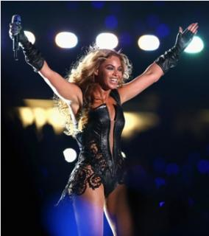
“Maybe the halftime show is as real as anything; what if some power or potent agency lives in it? Not a show but a means to something, something conferred or evoked. A ceremony. Something religious, so long as ‘religious’ extends to such cold-blooded concepts as mayhem, chance, nature out of control” (235).
“Carrying the show in front of 40 million people makes her one of the top human beings on the planet, and what strength of nerve that must take, what freakish concentrations of soul and energy” (237)

Slide 11
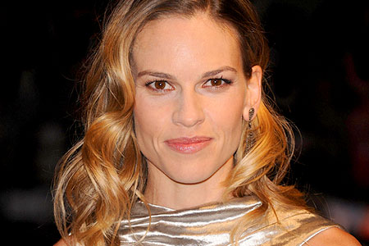
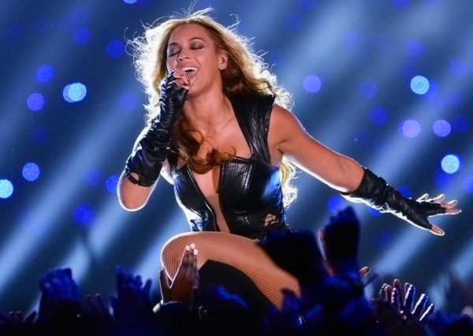
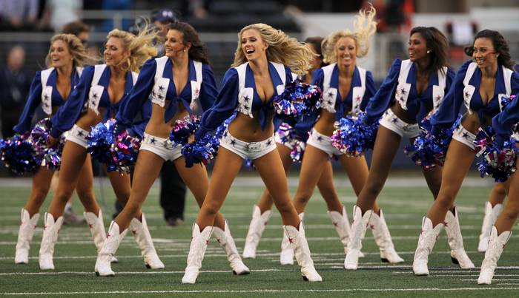
“The entire stage has become a blowup of foreplay aerobics, rocket-thrusting, dancers are twurking Bravo and not a damn thing you can do except stand at attention and get pole-danced in front of forty million people. It’s not right. Nobody said anything about this. What might be merely embarrassing in real life is made obscene and hostile by TV” (239).

Slide 12
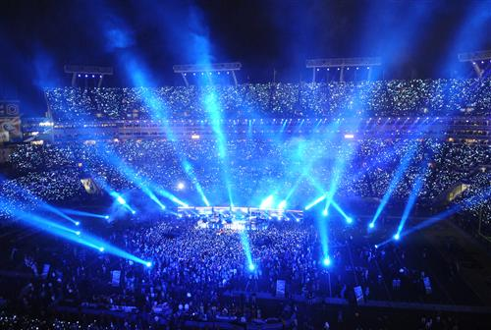
“ . . . the disco lights get going, rows of blue and white strobes trimming the steel-pipe frame and everything flashing all at once, electro-visual spaz-pulse and epileptic overload, retinal scarring, frontal lobes blown to caterpillar fuzz” (229)
“If there was ever a prime-time trigger for PTSD, you couldn’t do much better than this” (230)
Differences between the traditional theater of war and the media theater of war disappear…
“Later, watching the performance on YouTube, Billy will start to piece together the enormous scale of it. . . . The proverbial cast of thousands” (229).

Slide 13
“It started to seem false to me to have this extended flashback where I take the reader through that battle step by step. The thing I was resisting was, the Bravos don’t have that. They don’t have that coherent experience. And even when they read accounts of battle after the fact, it doesn’t come together for them. They don’t recognize the battle. And so I thought to myself, I’m not going to give us, the reader, the satisfaction of that coherent experience.”
Ben Fountain, Wall Street Journal Book Club, April 18, 2014
“I had to keep telling myself this is real, these are real American soldiers fighting for our freedom, this is not a movie” (44)

Slide 14
The Fox News footage “is so real it looks fake.”
“Nothing looks so real as a fake, apparently, though ever since seeing the footage for himself Billy has puzzled over the fact that it doesn’t look like any battle he was every in. Therefore you have the real that looks fake twice over, the real that looks so real it looks fake and the real that looks nothing like the real and thus fake, so maybe you do need all of Hollywood’s craft and guile to bring it back to the real” (289).

Slide 15
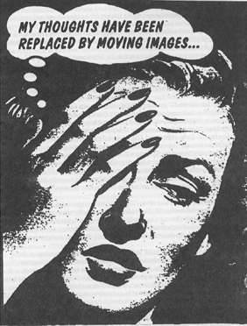
Guy Debord
Society of the Spectacle (1967)
Thesis 1) “In societies where modern conditions of production prevail, all of life presents itself as an immense accumulation of spectacles. Everything that was directly lived has moved away into a representation.”

Slide 16
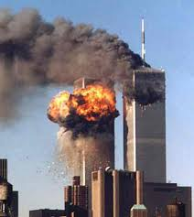
“The spectacle of terrorism forces the terrorism of spectacle upon us.”
Baudrillard, The Spirit of Terrorism
“at the same time [that images] exalt the event, they also take it hostage. . . . the image consumes the event. . . . in this Manhattan disaster movie, the twentieth century's two elements of mass fascination are combined: the white magic of the cinema and the black magic of terrorism; the white light of the image and the black light of terrorism.”
Baudrillard, The Spirit of Terrorism

Slide 17
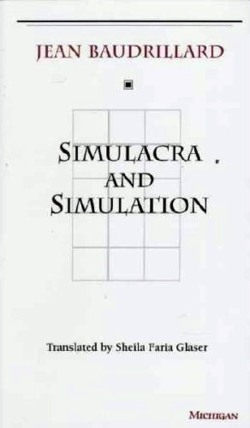
“We might almost say that reality is jealous of fiction, that the real is jealous of the image.”
Baudrillard, The Spirit of Terrorism
“The territory no longer precedes the map, nor does it survive it. It is nevertheless the map that precedes the territory . . . that engenders the territory”
“It is no longer a question of imitation, nor duplication, nor even parody. It is a question of substituting the signs of the real for the real”
Baudrillard, Simulacra and Simulation (1981), 1, 2

Slide 18
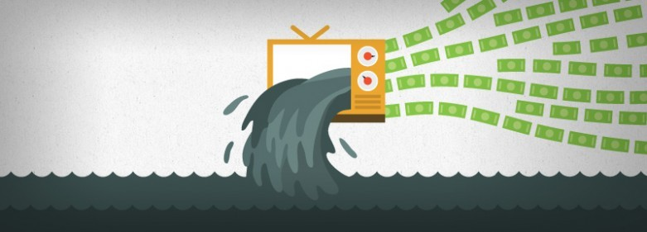
That’s not the end of the story.
Debord, Society of the Spectacle
“Thesis 4) The spectacle is not a collection of images, but a social relation among people, mediated by images.”
“Thesis 34) The spectacle is capital to such a degree of accumulation that it becomes an image.”

Slide 19
Inside a particular accumulation of images: the Fox Universe (what kind of a place is this?)
The battle footage
“At dinner that night Bill O’Reilly raged on the TV…” (103).
“Billy heard somewhere that she is the latest American Idol, and like all the American Idols pint-sized or not she is blessed with a huge barrel of a mouth” (204).
“Meg Ryan was the lead in that chopper flick [Courage Under Fire], the one she did with Denzel a couple of years ago. . . . Hillary won a goddam Oscar playing a guy [in Boys Don’t Cry]. Well, playing a girl playing a guy, but whatever” (6).
“JAMIE LEE CURTIS MADE A SHITTY MOVIE [True Lies]” (156).
“Billy flashes on the palace orgy scene [of Conan the Barbarian], James Earl Jones playing the snake king
Bravo Company (Homeland)!

Slide 20

Ben Fountain works for Fox and Rupert Murdoch (sort of)…

Slide 21
What is “Autonomous Art”?
“Once [art objects] become commodities in the market place, they exist for nothing and nobody in particular, and can consequently be rationalized . . . as existing merely and gloriously for themselves.”
          Terry Eagleton, The Ideology of the Aesthetic, 9.
Autonomous art flourishes in the marketplace. Beholden to no single patron, autonomous art dramatizes contradictions between the world as it is and the world as it might be.
Recall: “Money makes us real”

Slide 22
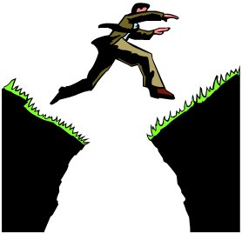
Chasms and Contradictions
We’ve said that Billy is a bridge, between “here” and “there.” But we’ve also said that that “here” and “there” might mean multiple things.
U.S.A. / Iraq
the printed page / the story’s imagined world
Billy’s consciousness (immediate speech) / the narrator’s consciousness
What other contradictions does Billy bridge? The world as it is and the world as it might be?
“A kind of abyss separates the war over here from the war over there, and the trick, as Billy perceives it, is not to stumble when jumping from one side to another” (197).

Slide 23
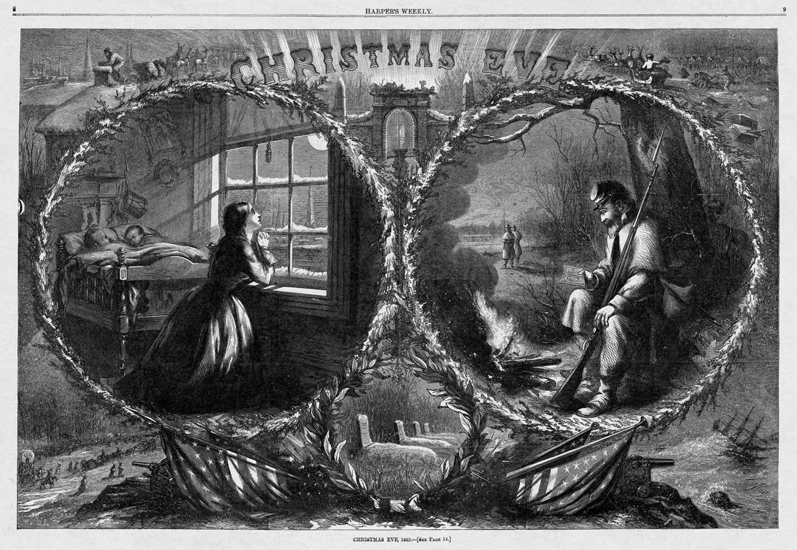
“Sentimental Domesticity” reconciles the home front and the war front; this image erases contradictions between the two..

Slide 24
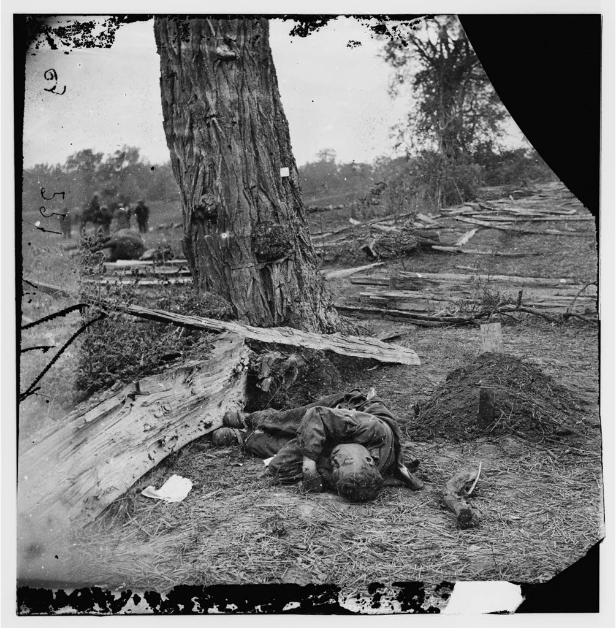
These photographs disrupt the sentimental imagination
Art can produce a critical distance in us. Instead of asking us to disappear into an imaginary world (perhaps in the name of immediacy), it can ask us to think skeptically about itself, and about our own world and our place in it.
Recall Brecht and the alienation effect…

Slide 25
Billy Lynn leaves us with a conflict or contradiction between different versions of reality. It cannot or will not reconcile those versions…
“. . . it dawns on Billy that these smiling, clueless citizens are the ones who came correct. For the past two weeks he’s been feeling so superior and smart because of all the things he knows from the war, but forget it, they are the ones in charge, these saps, these innocents, their homeland dream is the dominant force. His reality is their reality’s bitch; what they don’t know is more powerful than all the things he knows. . .” (306).
“Their reality dominates, except for this: It can’t save you” (306)
“How much reality can unreality take?” (307).

Slide 26
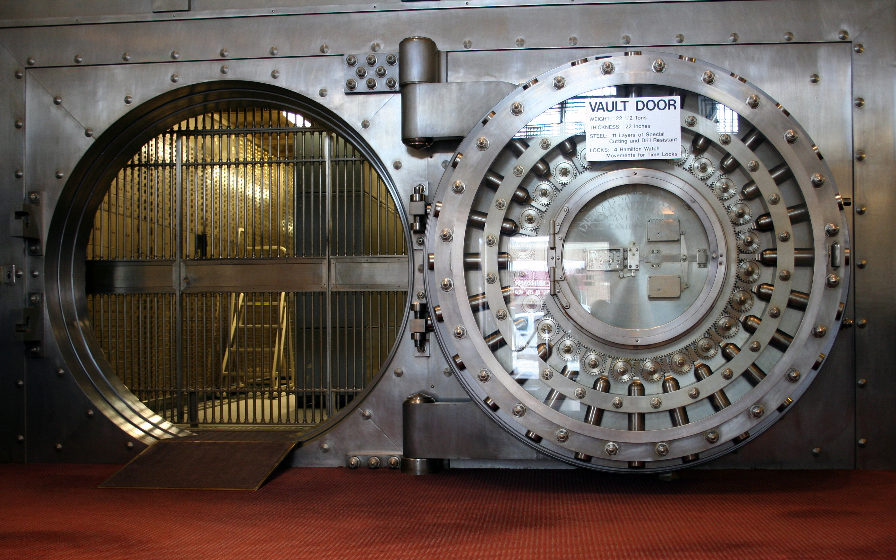
“And yet he knows, at least he thinks he knows, he feels it seeded in the purest certainty of his grief as he finds his seat belt and snaps it shut, that snick like the final lock of a vast and complex system. He’s in. Bound for the war. Good-bye, good-bye, good night, I love you all. He sits back, closes his eyes, and tries to think of nothing as the limo takes them away” (307).

