Slide 1
Op/Eds and Blogs
Opinion and Voice in Writing

Slide 2
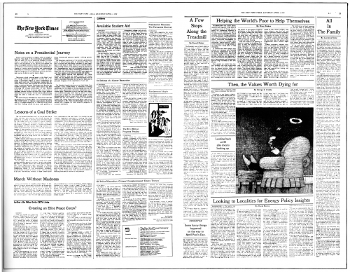
Op/Ed
Op/Ed is short for “opposite the editorial page” in newspapers.
Offers opinion on a topic. Not an editorial (by the board) or a letter from a reader.
Has an argument or point and strong voice for that position.

Slide 3

Audience
Op/Eds in a newspaper are written for a broad audience. It could be anyone reading the newspaper.

Slide 4

Elements of an Op/Ed
Position is stated clearly early in the piece.
Opens with an interesting scene or statement.
Short sentences present information and draw from research.
Closes with a strong point. (Sometimes called a kicker.)
Sometimes draws on a captivating voice of the author.
600-900 words

Slide 5

It’s very last century
Op/Ed pages became popular in the 20th century.
Major newspapers edited aggressively – patrol what is included
In some cases certain opinions tended to dominate

Slide 6
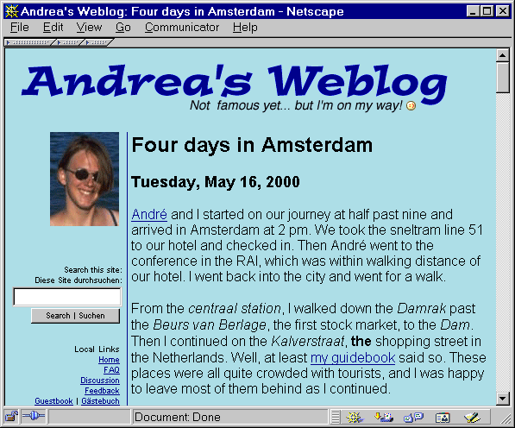

People started logging

Slide 7

And Blogging

Slide 8

Not far from Blob

Slide 9
How to write a blog?
Purpose? – Business, news, issue driven, share information, logging experiences, exhibitionism, etc.
Some Types of Blogs:
    The Loud Voice (or rogue) - individual
    The Host – features guest bloggers
    Niche – recipes, specific topics
    Advice – provides guidance, including religious
    Long Form – articles are thousands of words
    Live Blog - website devotes time to an issue

Slide 10
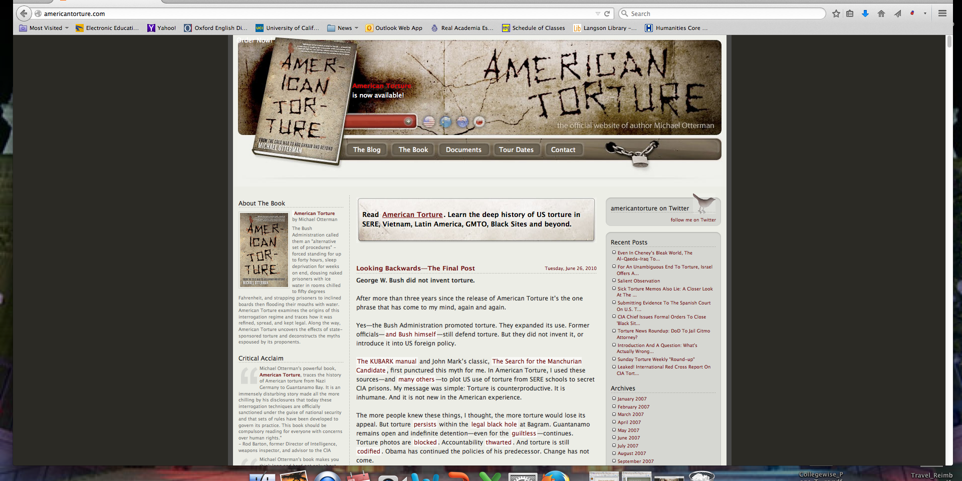
Connected to a book?

Slide 11

Finding your voice…
Consider your audience (your classmates?) How would you talk to them rather than writing for your teacher.
Be passionate about your topic.
You can avoid formal prose.
Play with length. Are shorter blogs more effective?
Have fun.

