Slide 1
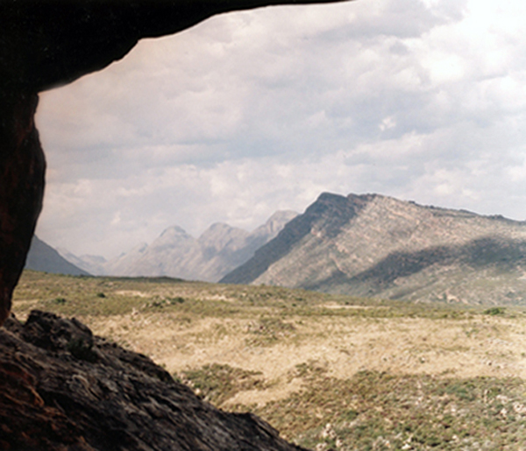
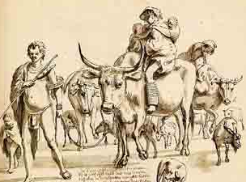
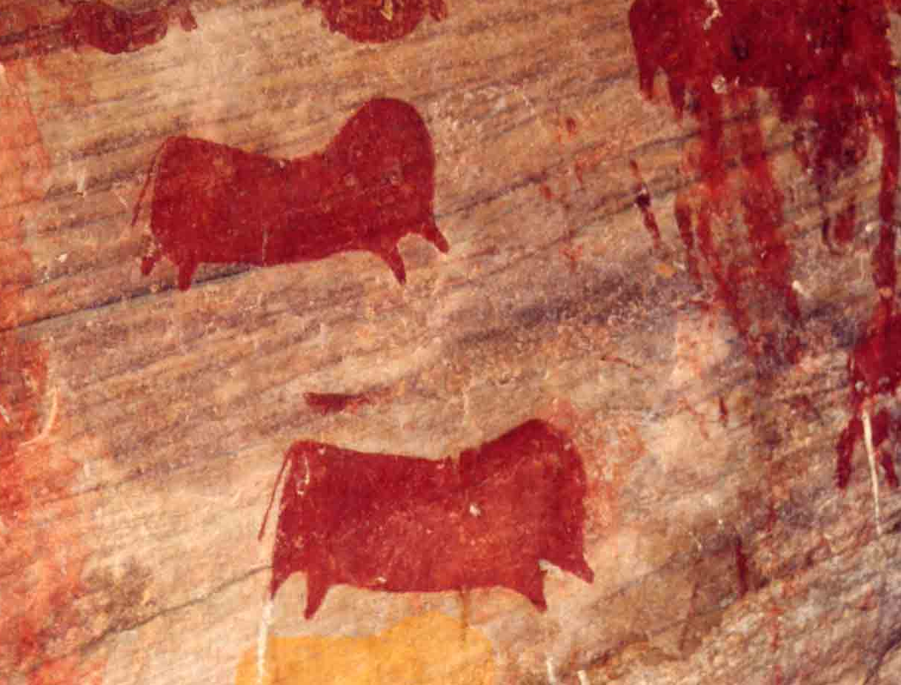
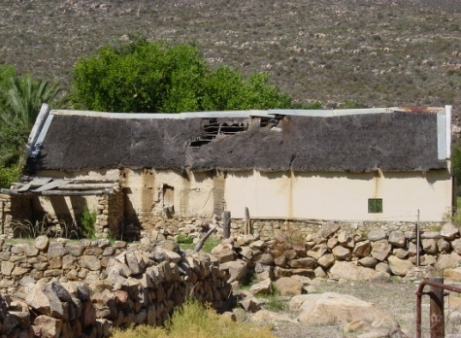
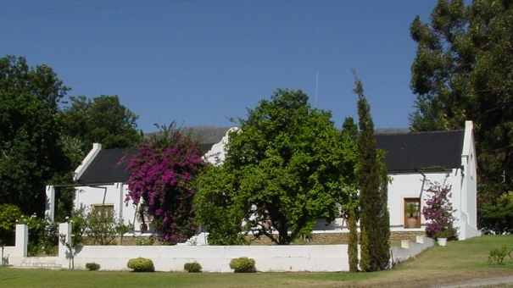
1 Biome
2 Moral Economies

Slide 2
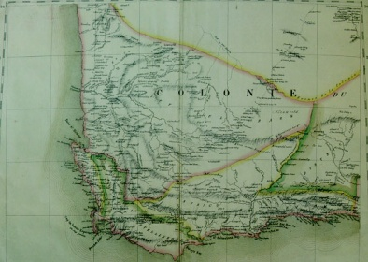


Today’s Lecture
Research Methods
Historical Content
Components of a historical argument
Interpreting primary sources
  6 C’s worksheet
Specific terms of conflict in the Olifants River Valley, 1725 – 1780s

Slide 3
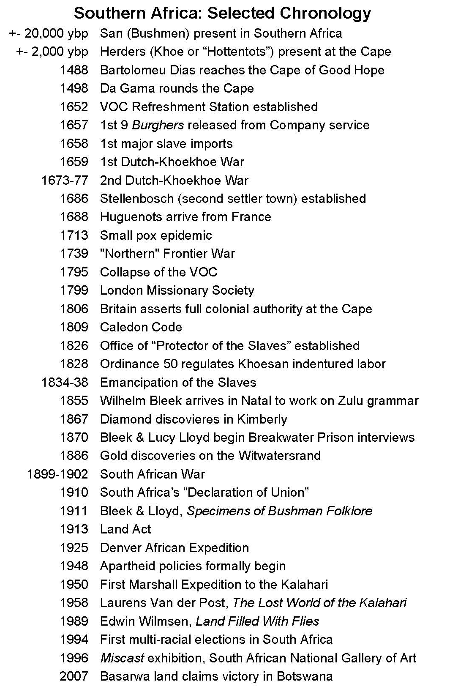
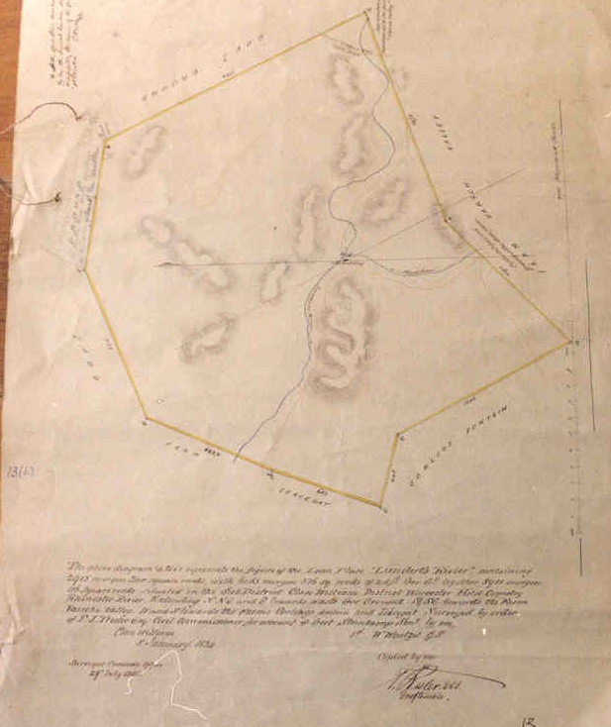
Components of a historical argument
Chronology
  What happened? Who was there?
  Sequence of events
Evidence
  How do we know about these events?
Causality
  What can account for continuity, or change?
Significance
  So what?? Why should we care about these people or events?

Slide 4
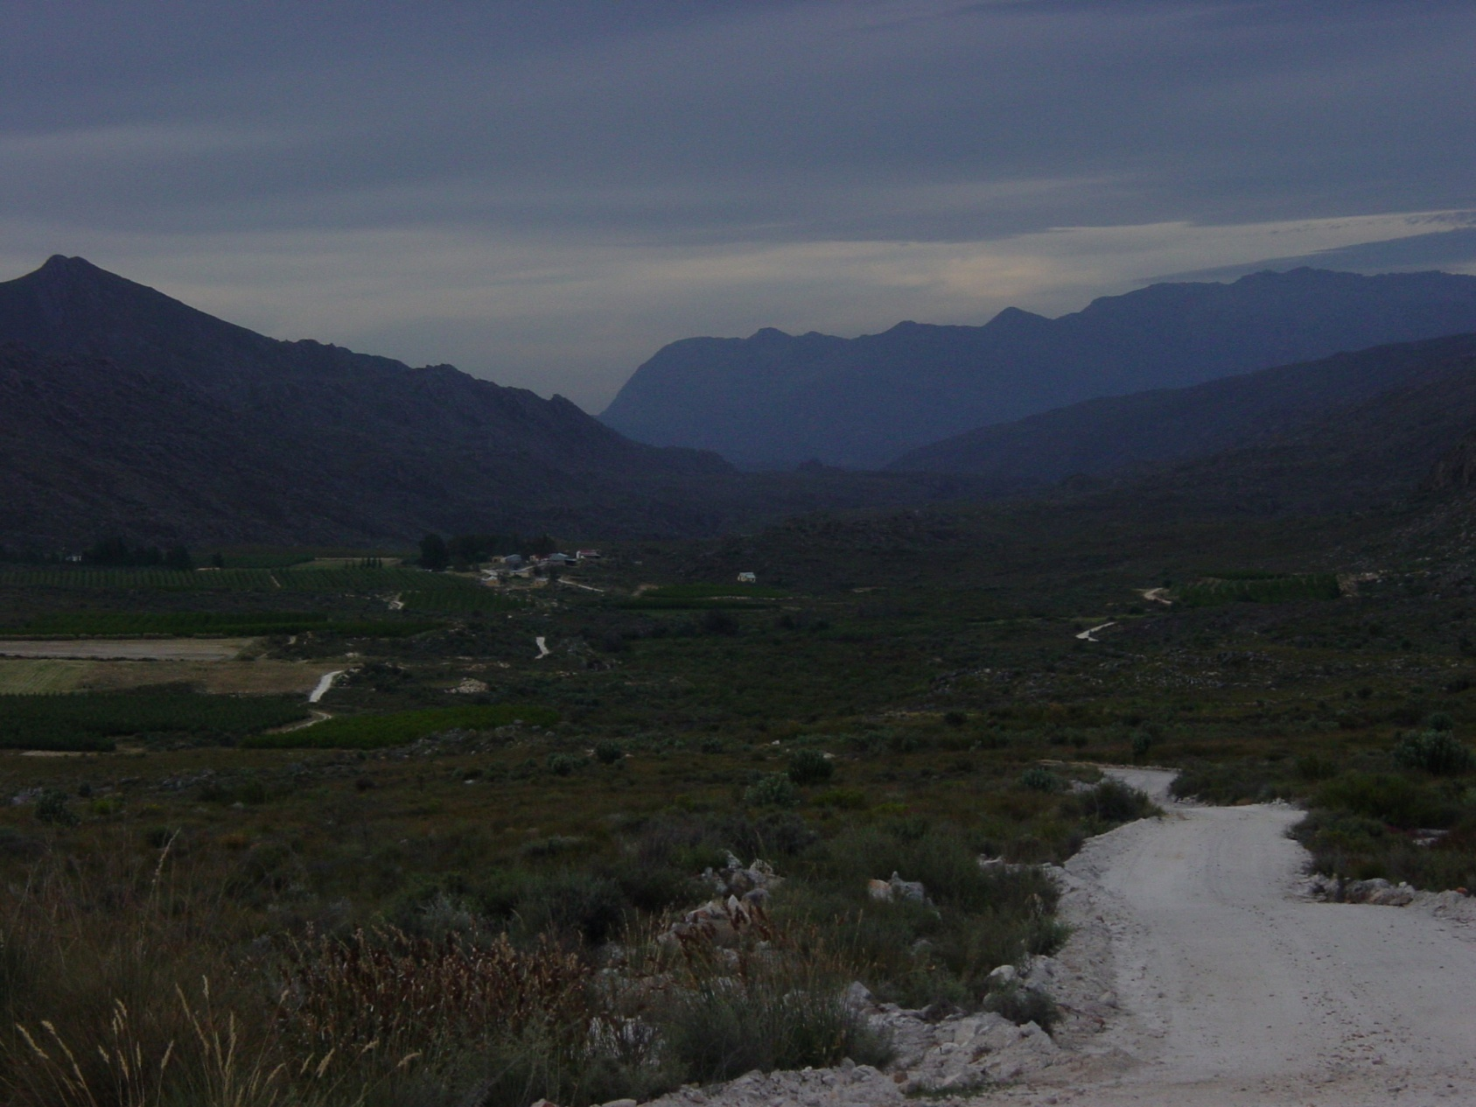
The Olifants River Valley Biome

Slide 5
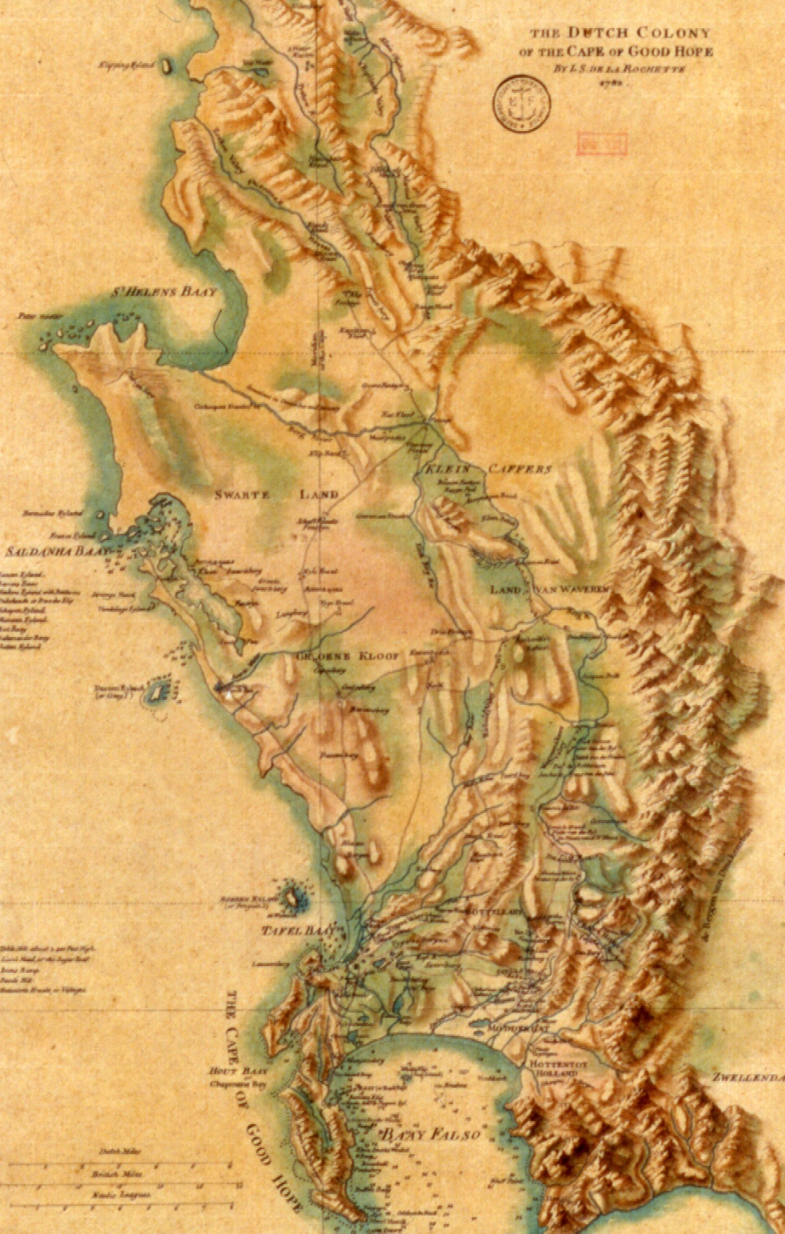
The Dutch Colony of the Cape of Good Hope
1786
Biblioteque Nationale de France
GE SH 18 PF 114 Div 6 P 47

Slide 6
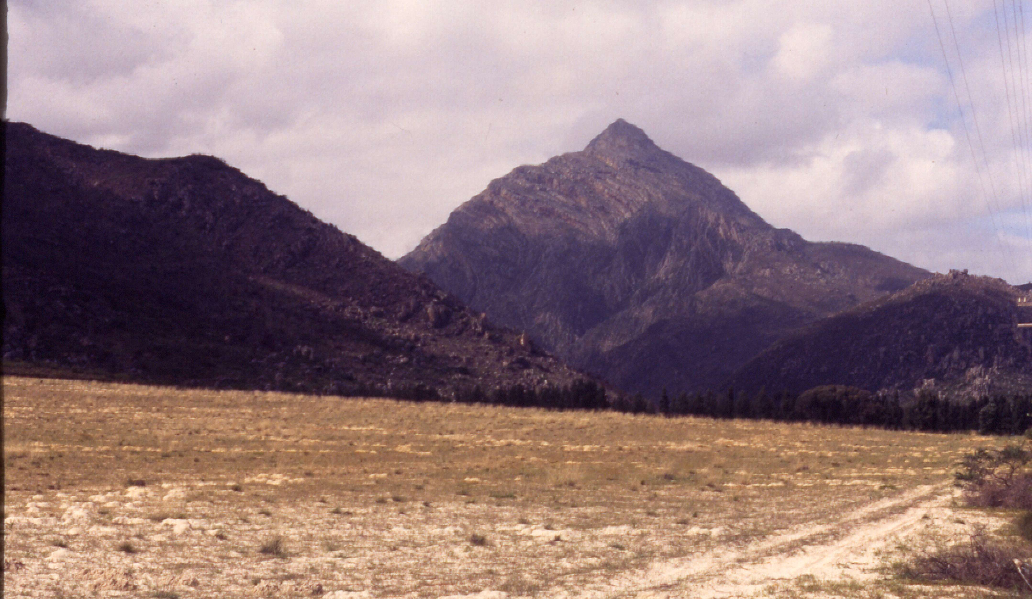
Wolfberg, Olifants River Valley
Notes:
ljm slide OR 3:12

Slide 7
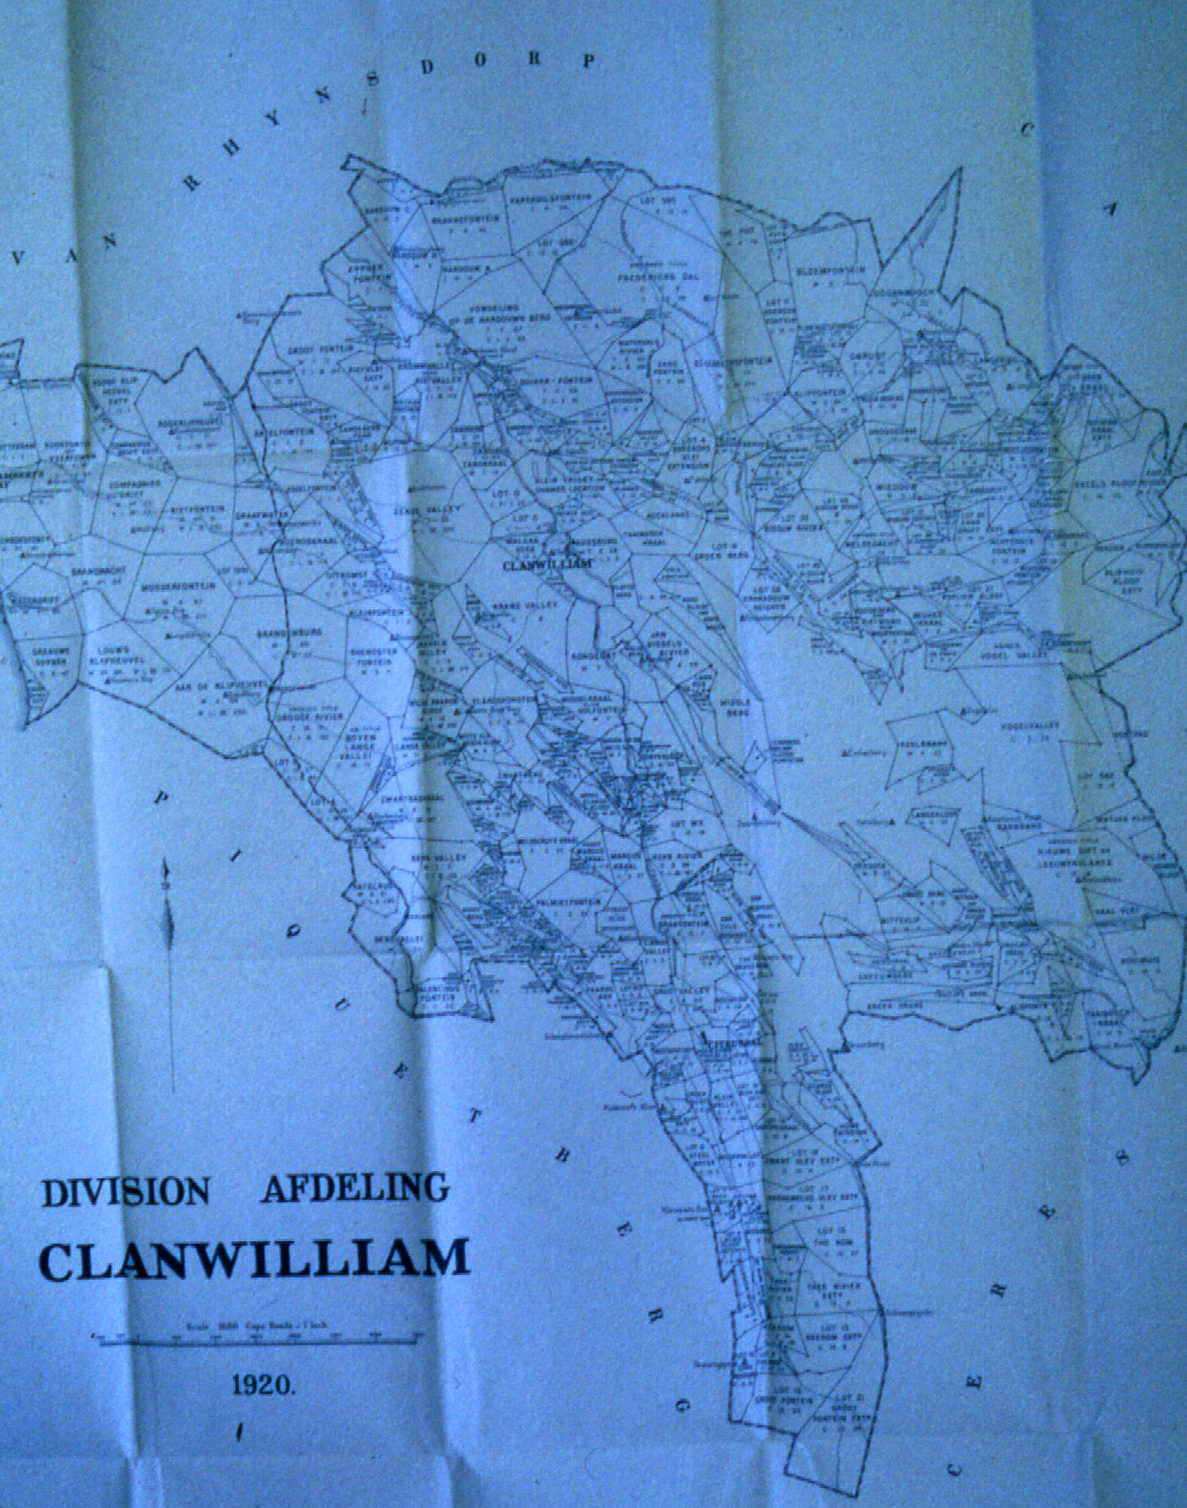
Clanwilliam
Magisterial
District, 1920
A
A
A
A
A
A
A
A
A
A
A
A
A
A
A
A
Cape Archives: M3/4772, 1920
Notes:
ljm slide CA 7: 17

Slide 8
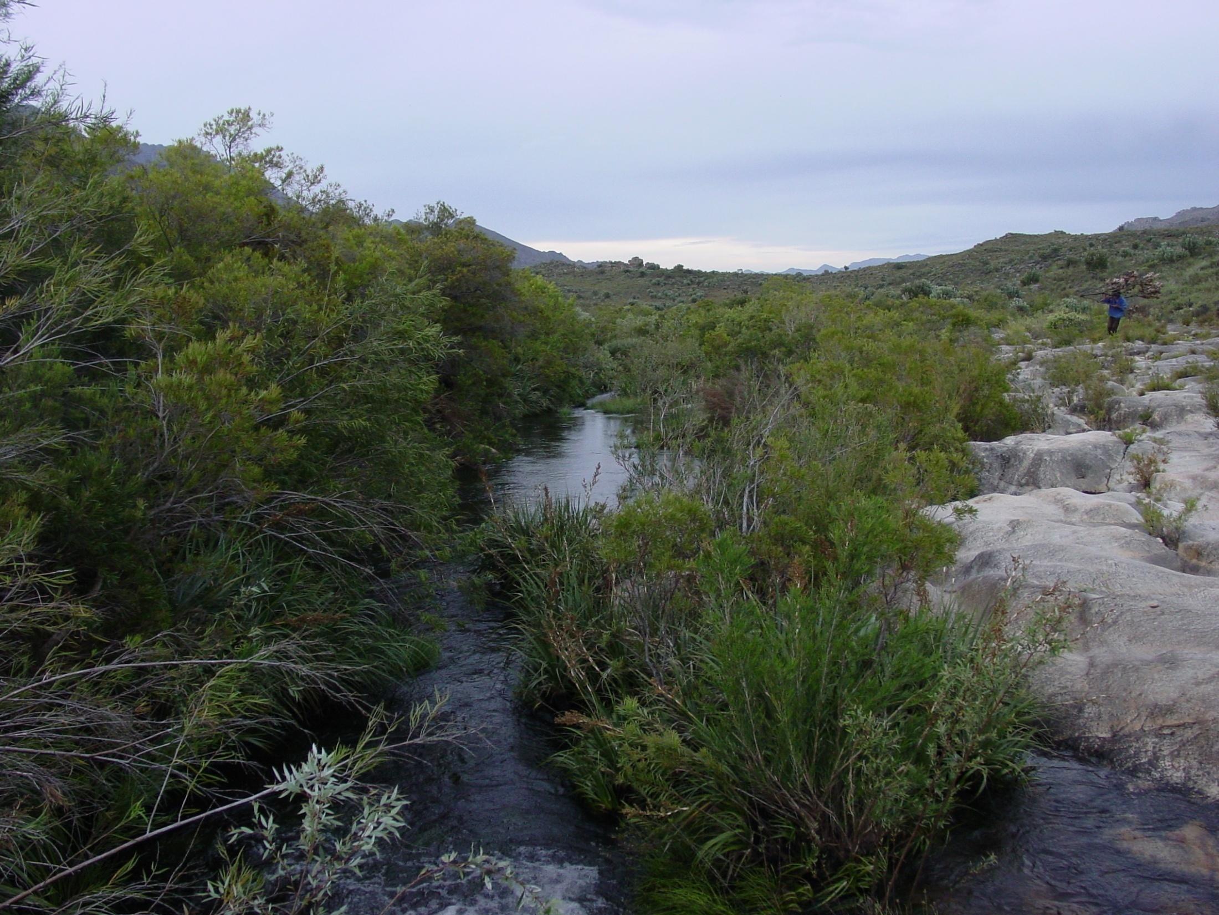
The Olifants River near the headwaters

Slide 9
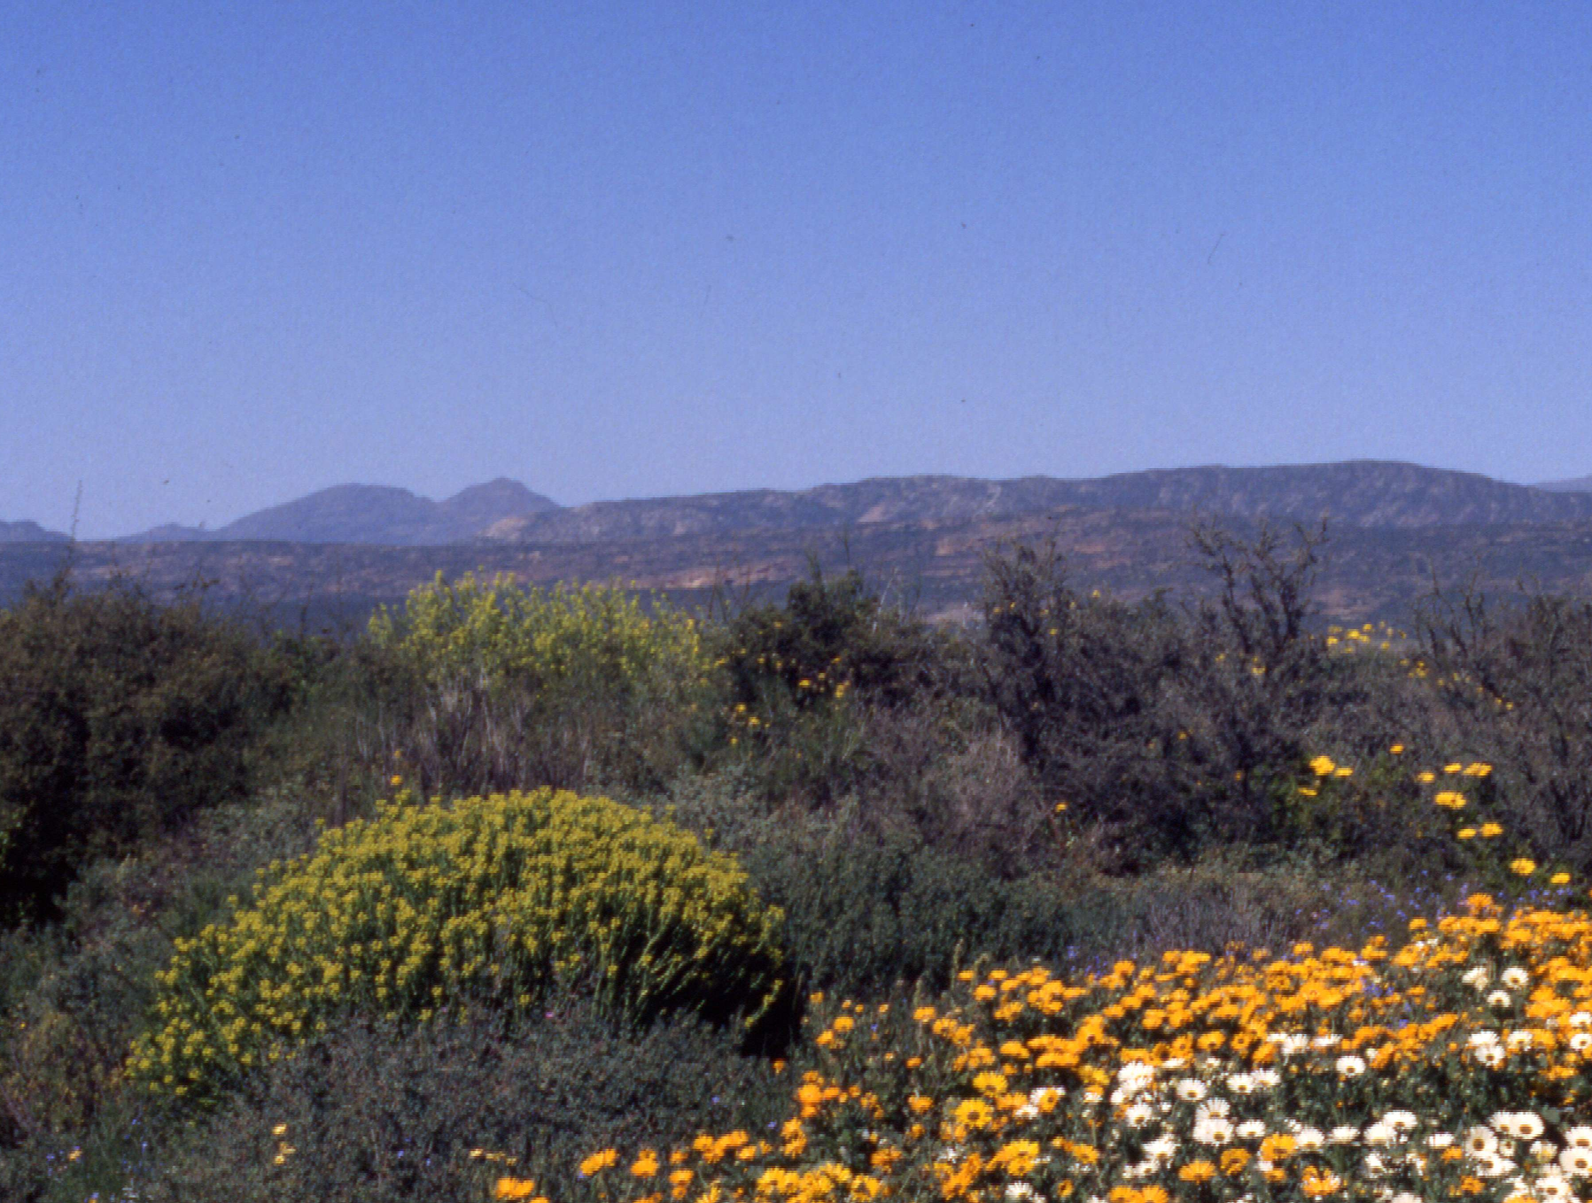
Fynbos, Protea, Euphorbia,
Asters
Notes:
Ljm slide OR 3:24

Slide 10
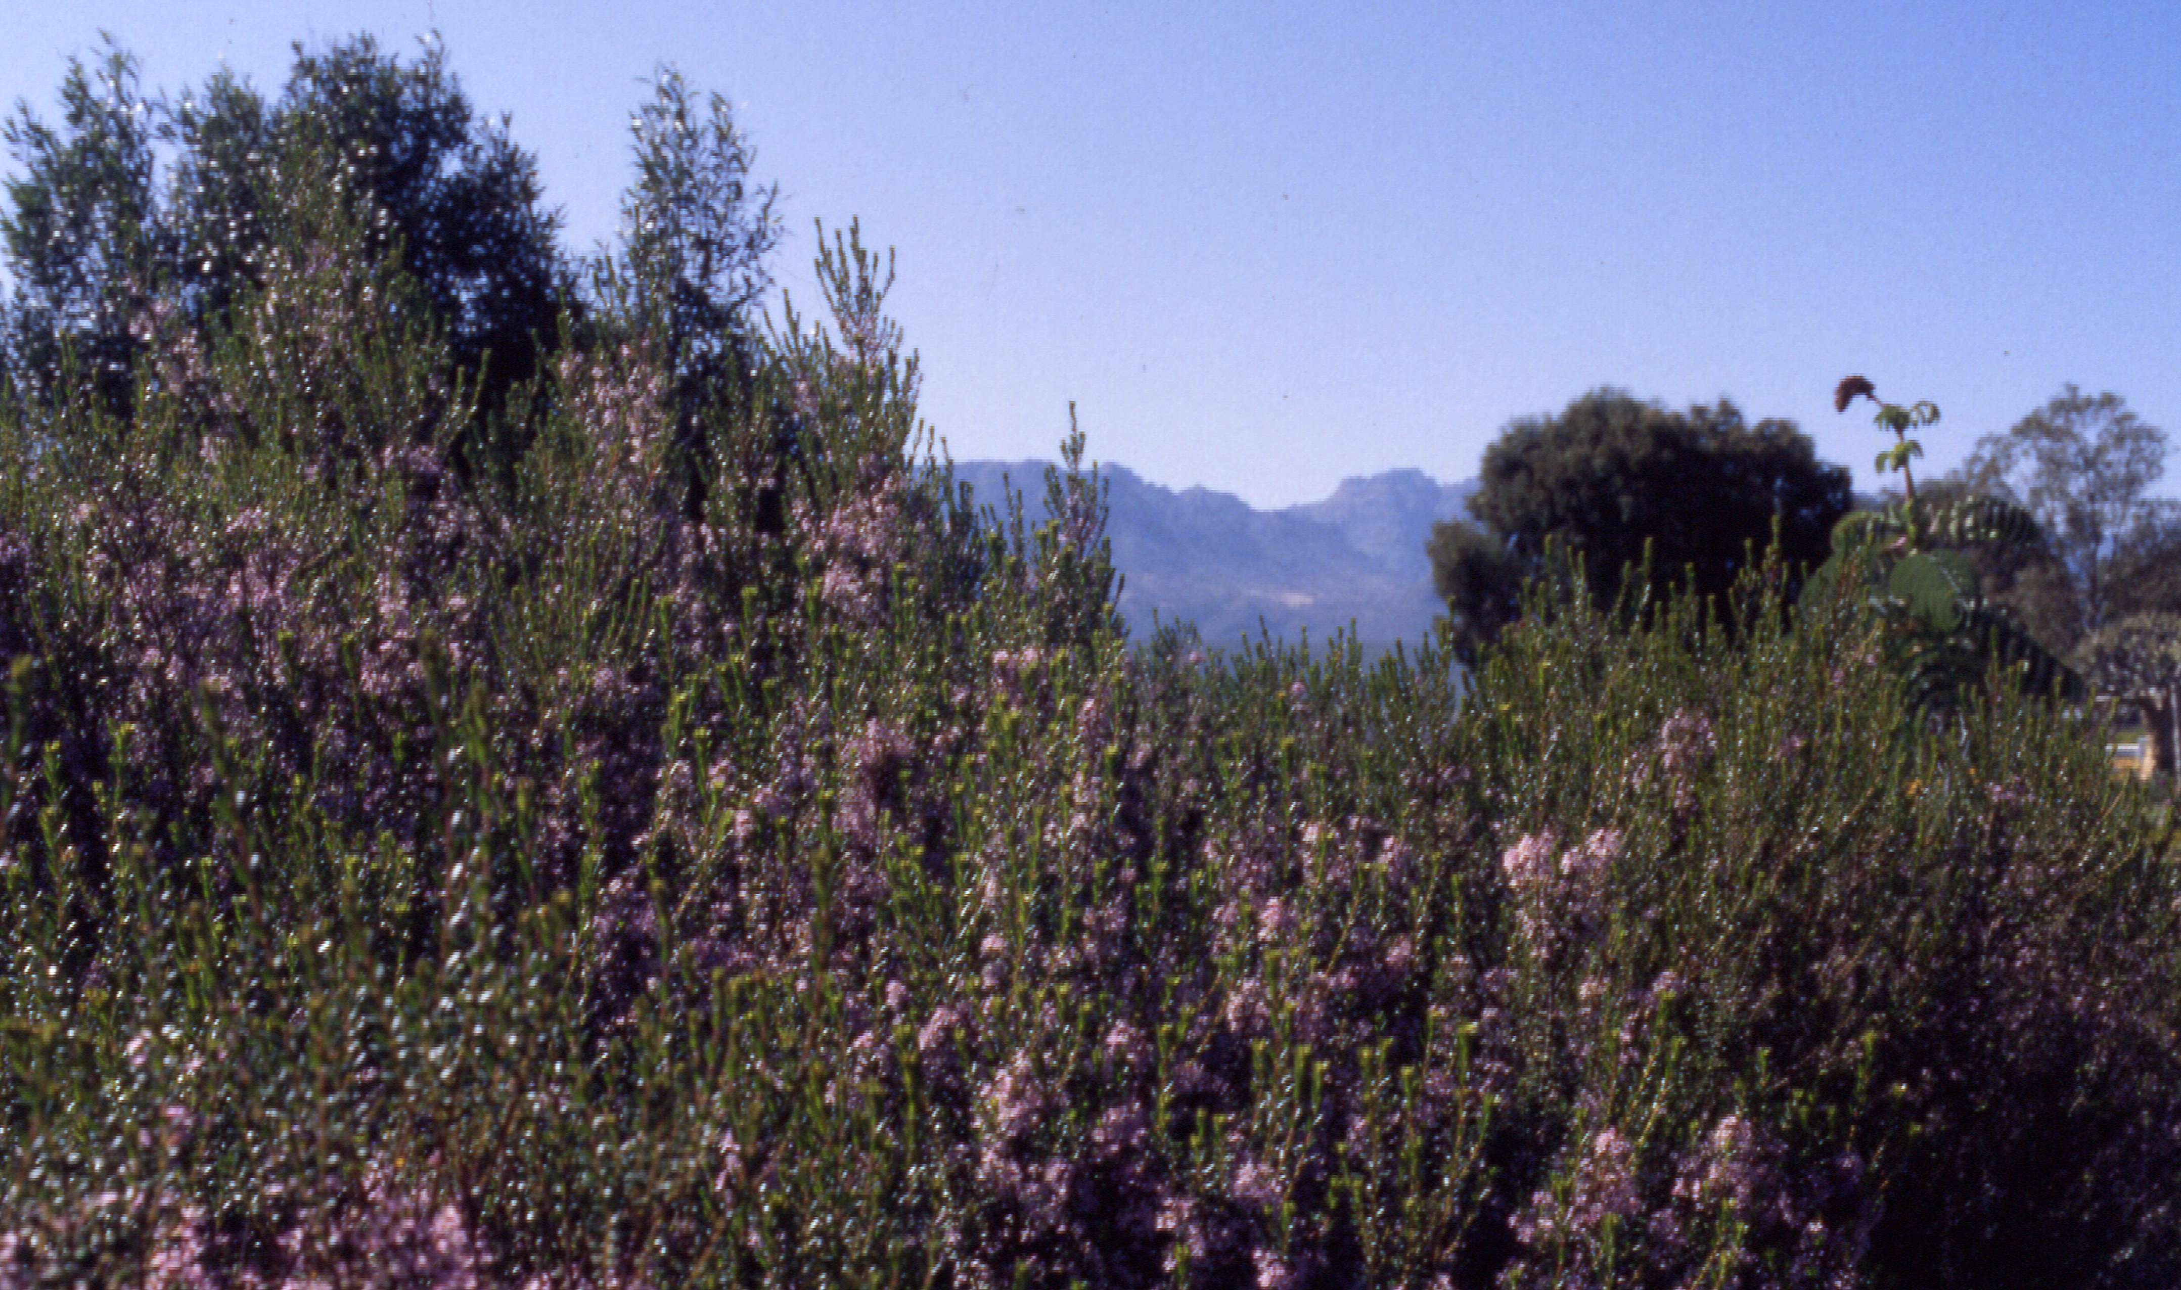
Erica (heather)
Notes:
Ljm slide OR 3:25

Slide 11
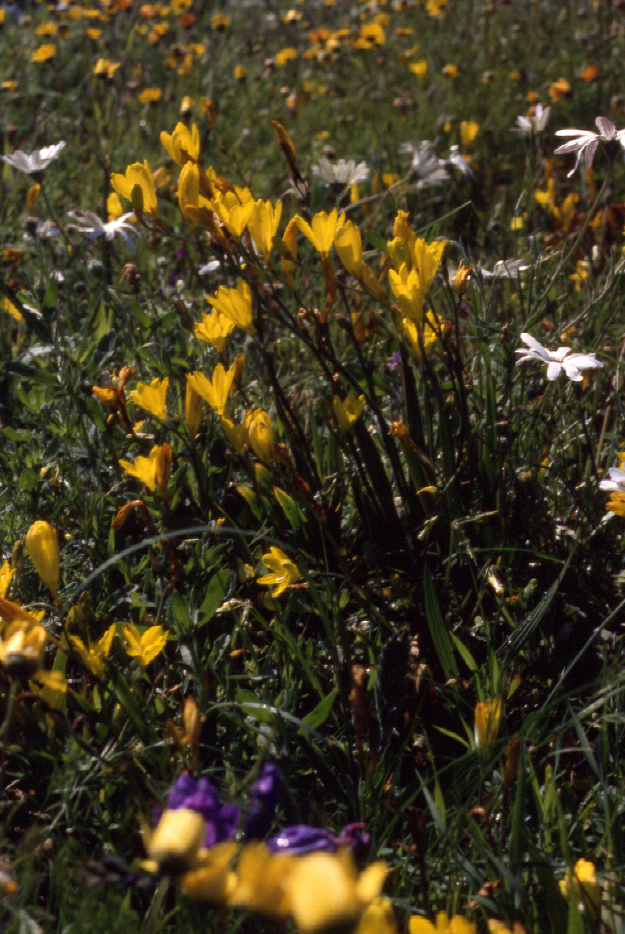
Iracidea (Iris family)
Notes:
Ljm slide OR 3:26

Slide 12
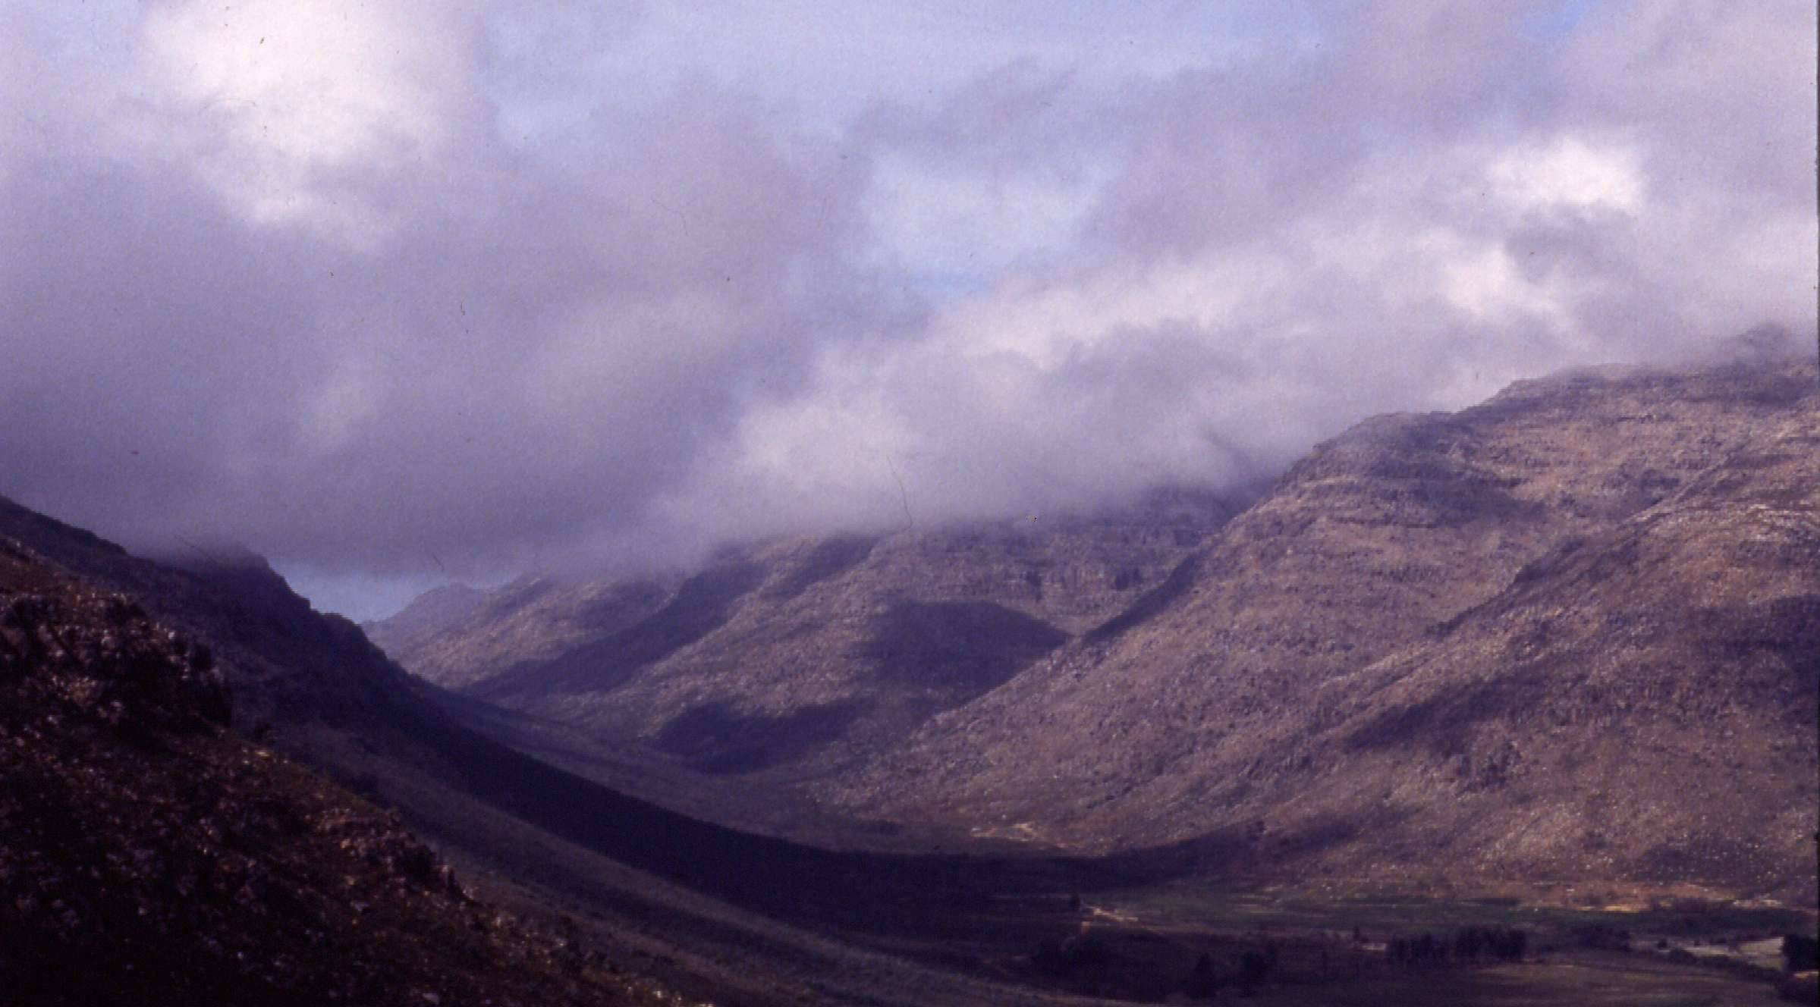
Cedarberg Landscape
Notes:
ljm slide OR 3:1

Slide 13
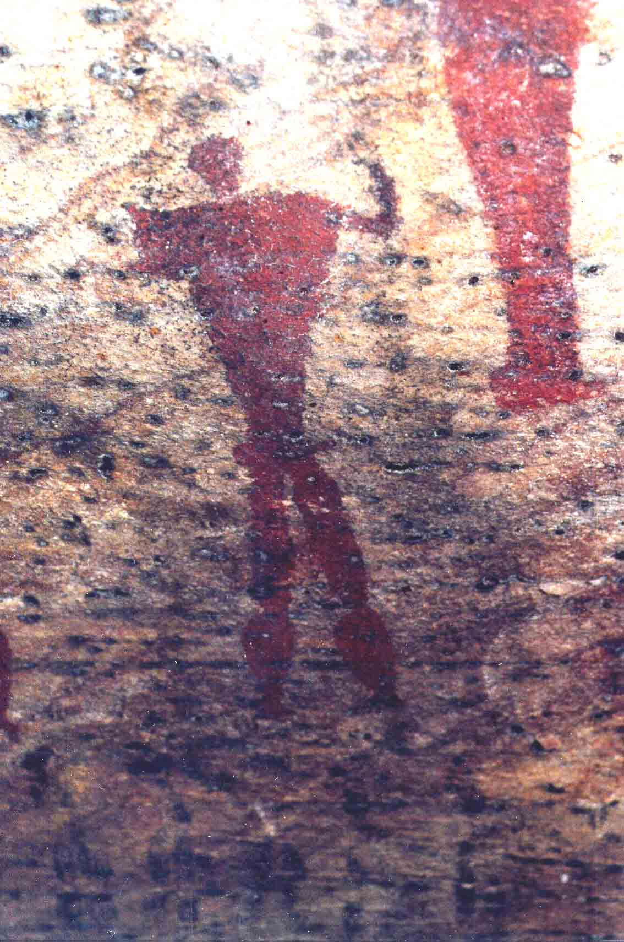
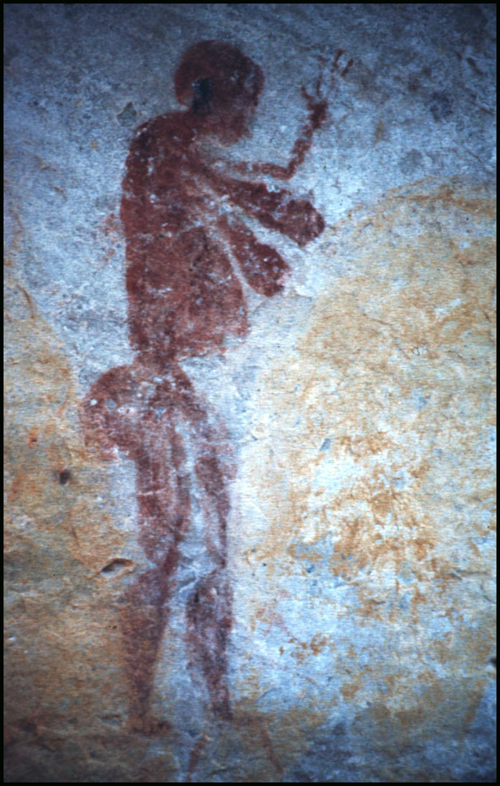
Early Inhabitants

Slide 14
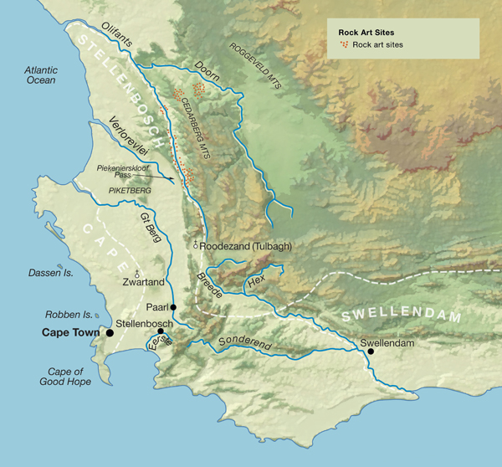
Rock Art Sites

Slide 15
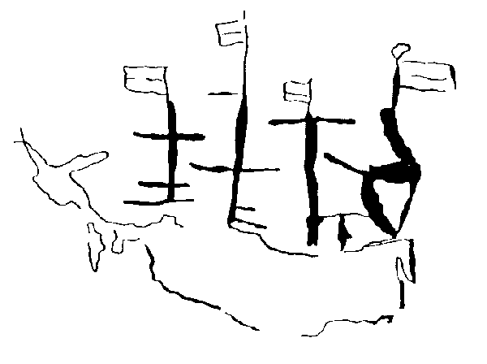
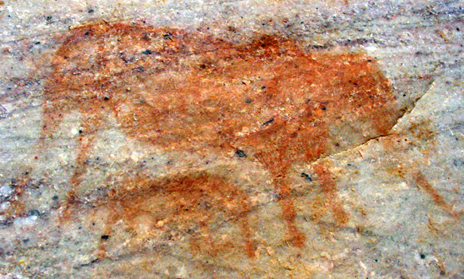
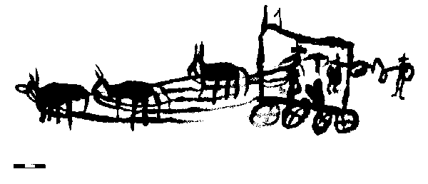
Colonial Presence

Slide 16
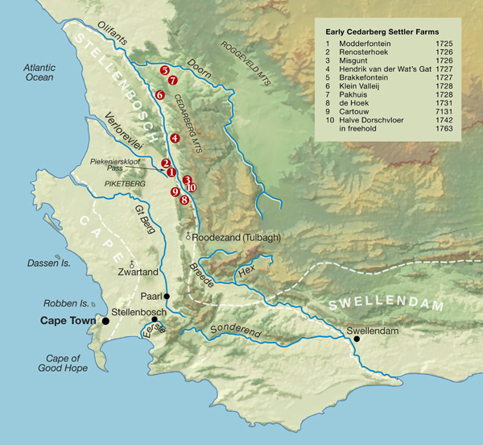
Colonial Settlement

Slide 17
First Five Years of Cedarberg Loan Farm Claims
Permit Holder |  | Year | Farm
Johannes | Ras | 1725 | Lange Valleij
Francois | Smit | 1725 | Klein Valleij
Jurgen | Hanekoom | 1725 | Modder Fontein
Arnoldus Johannes | Basson | 1725 | Groote Valleij
Willem | Burger | 1726 | Misgunt
Pieter Willemsz | van Heerden | 1726 | Ratel Fontein
Daniel | Pfeil | 1726 | Zeekoe Valleij
Alewijn | Smit | 1726 | Thien Rivieren
Jan | Steenkamp | 1726 | Groene Valleij
Jan | Dissel | 1726 | Renoster Hoek
Daniel Sr. | Pfeil | 1727 | Brakkefontein
Johannes L. Pieters | Putter | 1727 | Halve Dorschvloer
Jochem | Koekemoer | 1727 | Hendrik van der Wats Gat
Hendrik | de Vries | 1727 | Zeekoe Valleij
Andries | Kruger | 1728 | Lange Valleij
Jan Andries | Dissel | 1728 | Groote Zeekoe Valleij en Klein Valleij
Hendrik | Cloete | 1728 | Klein Valleij
Alewijn | Smit | 1728 | Thien Rivieren
Francois | Smit | 1728 | Lange Fontien
Jacob | Mouton | 1729 | Berg Valleij
Andries | Krugel | 1729 | Lange Valleij
Johannes | Bota | 1729 | Breede Rivier
Guilliam | Visagie | 1729 | Gonjemans Kraal
Juff Anna | de Koning | 1729 | Sonquas Cloof en het Kley Gat

Slide 18
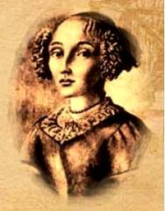
Angela of Bengal
Angela of Bengal
Johannes Basson
Arnoldus Johannes Basson
Anna de Koning
Arnoldus Willemsz Basson

Slide 19
Working with historical evidence
Through this is permitted to the burgher [citizen] Ensign Jan George Lochner and the burgher Louis Almero Pisani for the period of a whole year that they may graze with their cattle on the farm named Brakfontein, which lies to the south of the loan farm of Willem Meyer, provided first that the political secretary shall knowingly have registered in the Honorable Company’s cashbooks a recognition payment to the Honorable Company a sum of 16 Spanish ducats or 72 Stuiyvers or 24 Rijxdollars. This permission must be renewed within the time of one month from the expiration or a penalty of one tenth of the sum in grain must be brought to the Lords of the Honorable Company. This agreement was brought before the Landdrost [Magistrate] Anthony Alexander Faure.
Signed in the Castle of Good Hope 11 October 1792
By
J.I. Rhenius [Acting Governor]
The Lord Cashier J. Ackerveld
Witnessed by P.H. Faure
Expires 6 July 1793
Loan Farm Permit for Jan Georg Lochner on Brakfontein.
South African National Archives, Western Cape Depot. Receiver of Land Revenue 37/2:157 (old p. 311); original Wildschutte Boeke folio 154. 11 October 1792

Slide 20
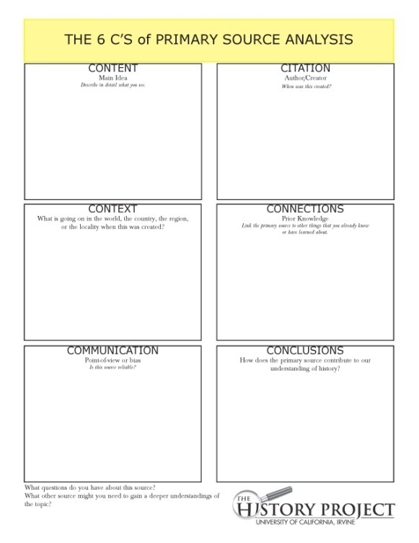
6 C’s Source Analysis
Content
  Describe in detail what you see
Citation
  Who created this, and when? Why?
Context
  What else was happening when this was created?
Connections
  Your prior knowledge: where does this fit?
Communication
  Point of view: is this source reliable?
Conclusions
  What can this source tell us?
6 C’s worksheet

Slide 21
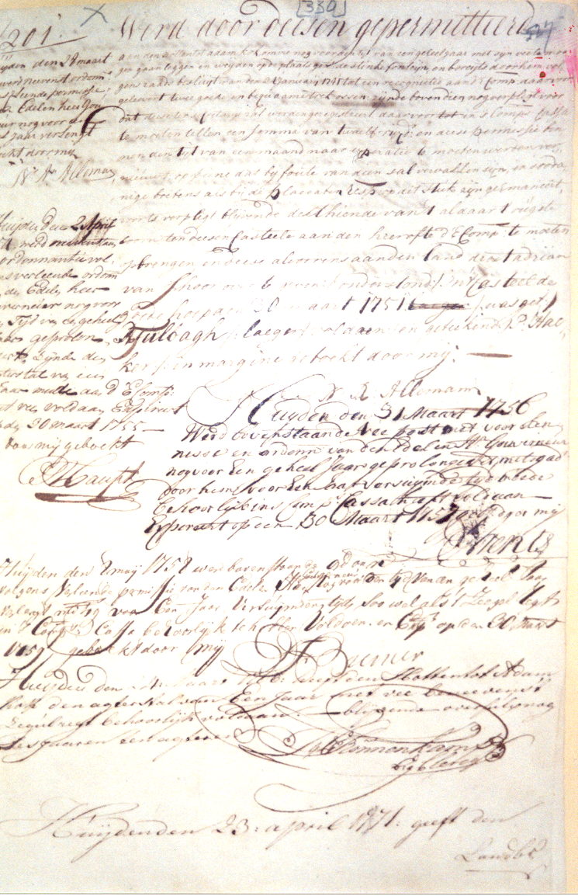
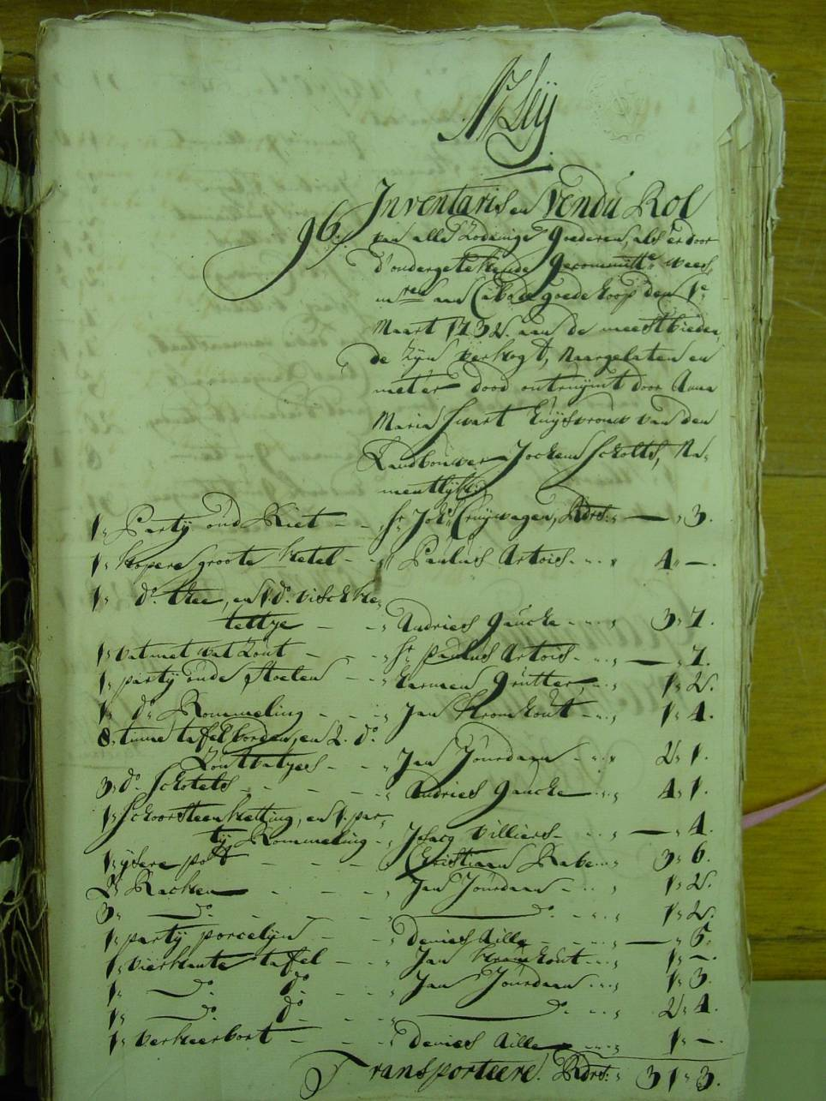
In the Archives

Slide 22
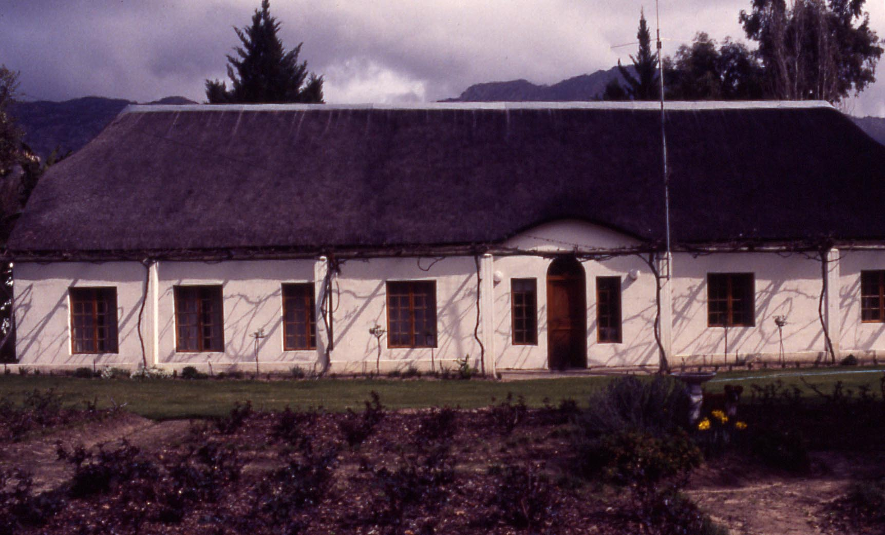
Halve Dorschvloer

Slide 23
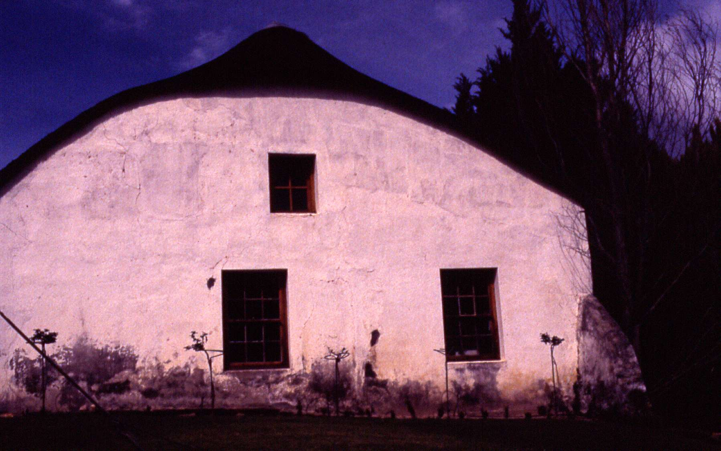
Colonial Land Use
Halve Dorschvloer house on Karnemelksvlei
Notes:
Ljm slide OR 3:18

Slide 24
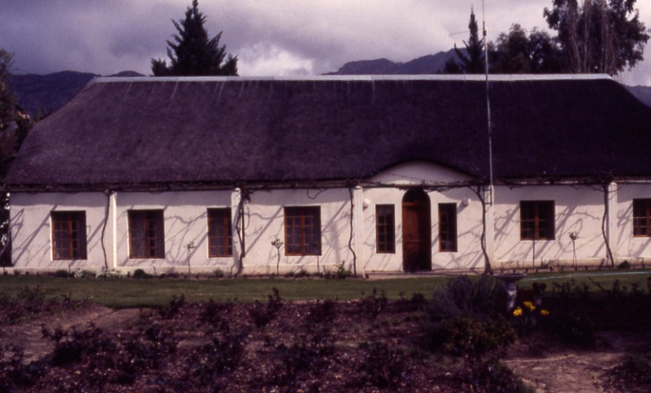
Loan Farm & Freehold Claims
HALVE DORSCHVLOER
1727 | - | 1742 | Johannes Lodewijk | Putter | 15
1742 | - | 1742 | Hendriek | Krieger | 0
1744 | - | 1763 | Schalk Willemz. | Burger | 19
1797 | - | 1804 | Jacobus Stephanus | Burger | 7

Slide 25
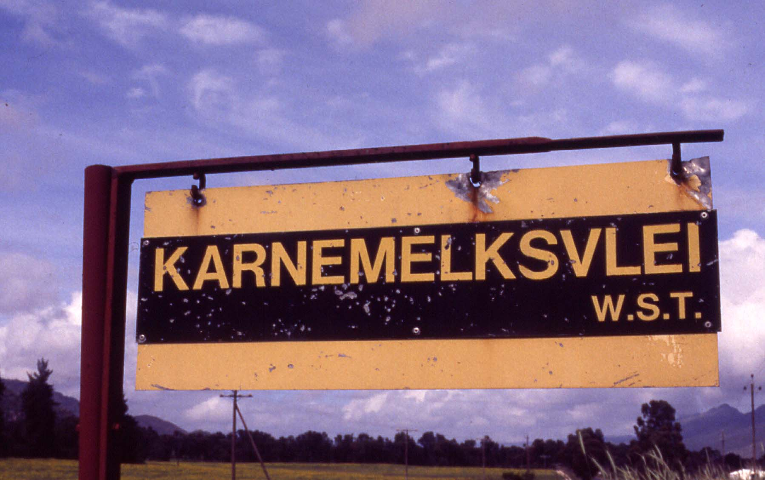
Karnemelksvlei

Slide 26
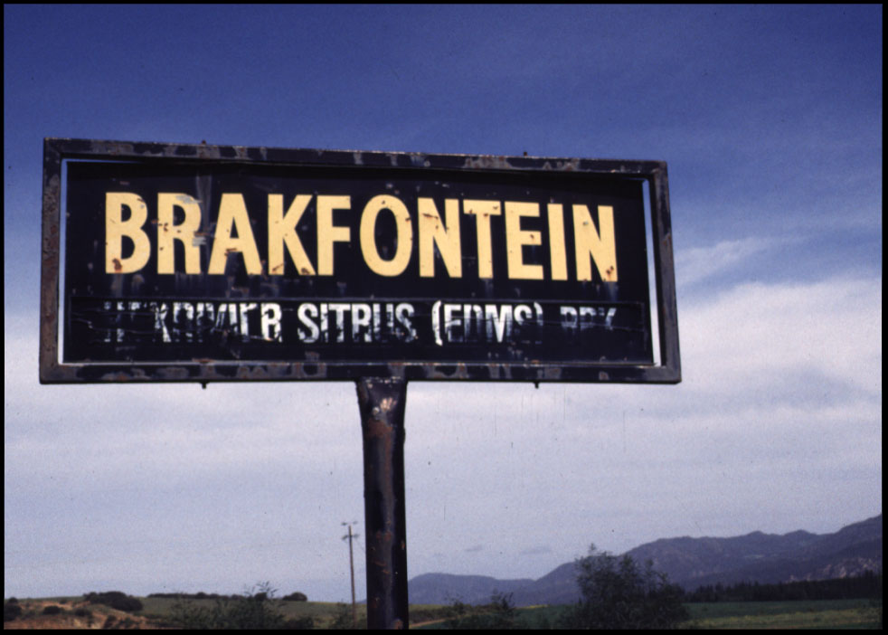
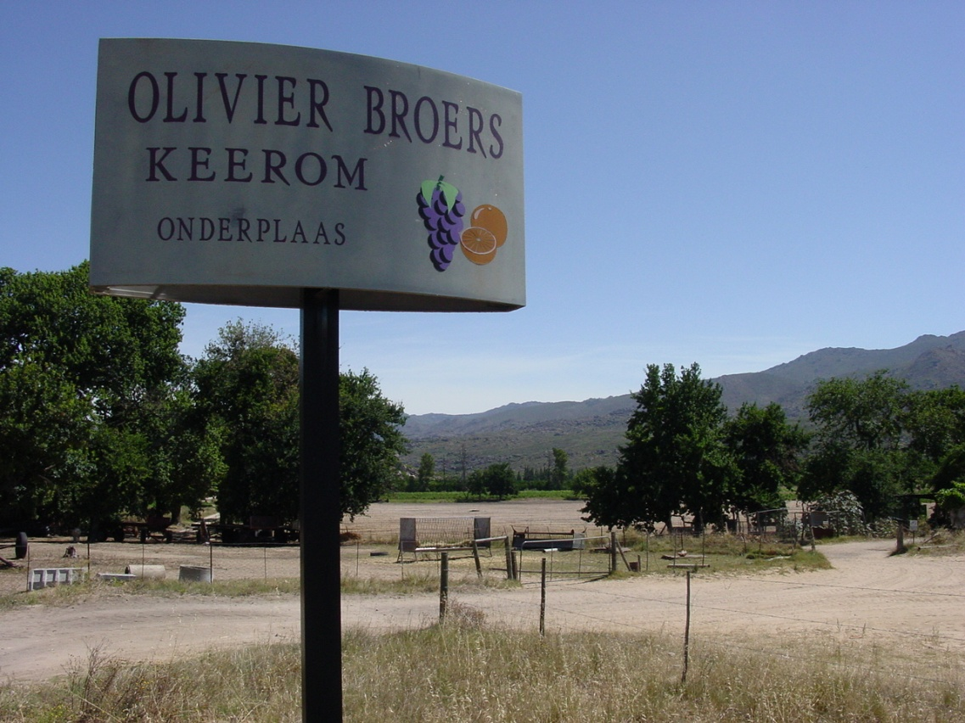
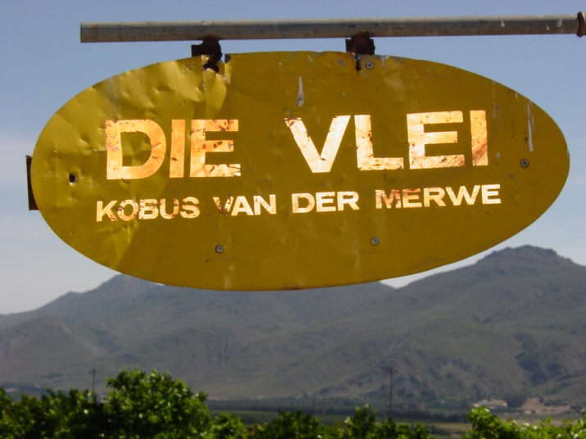
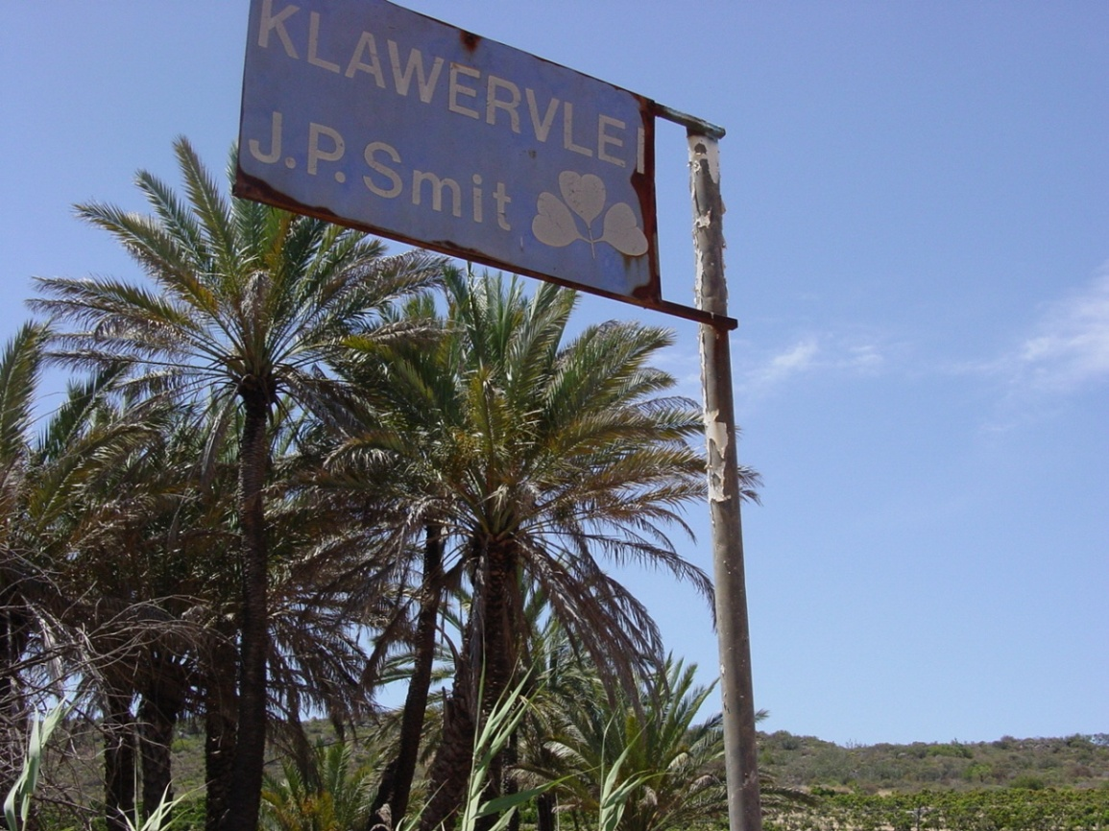
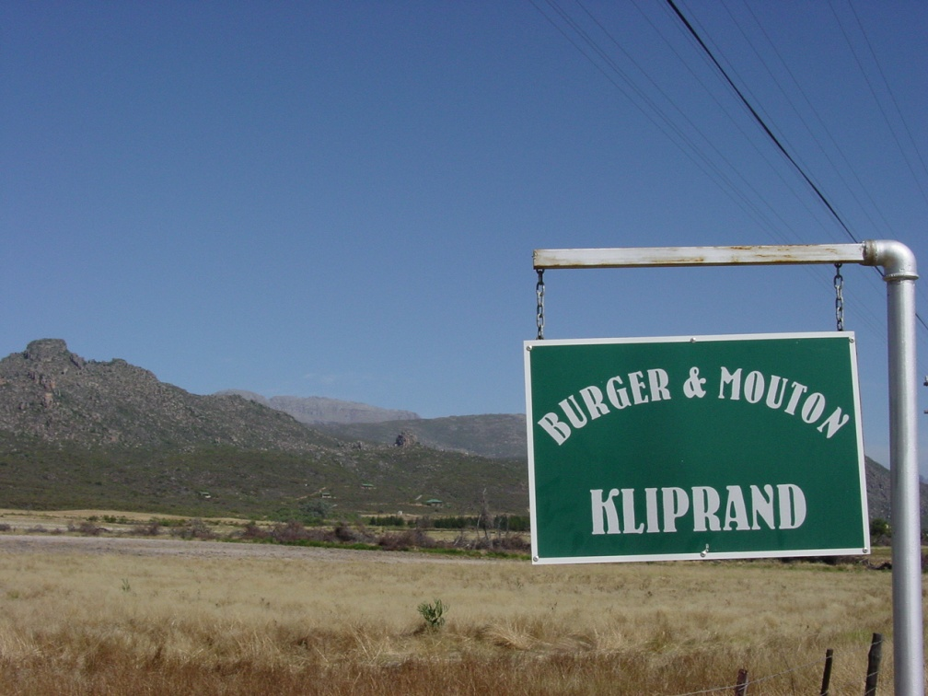
Signs of
Occupation

Slide 27
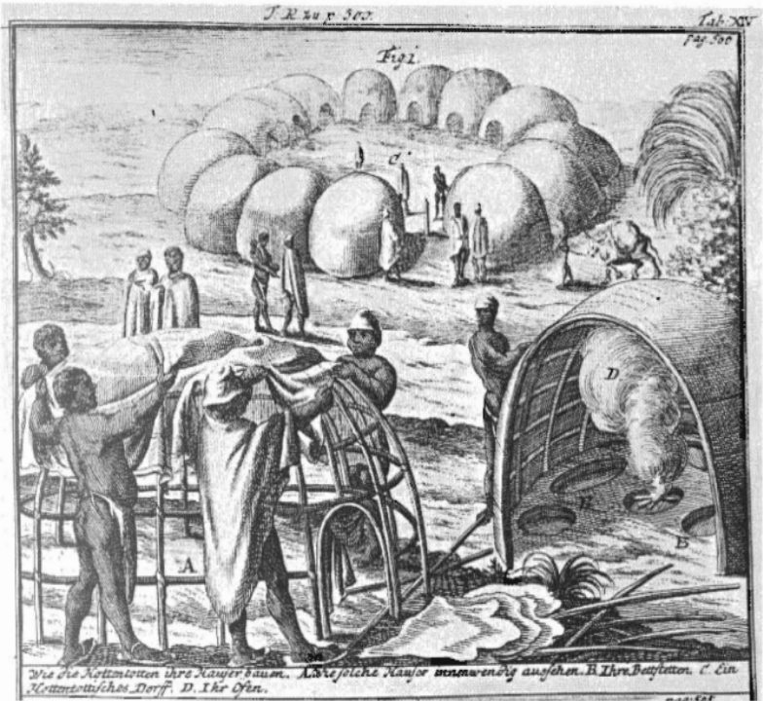
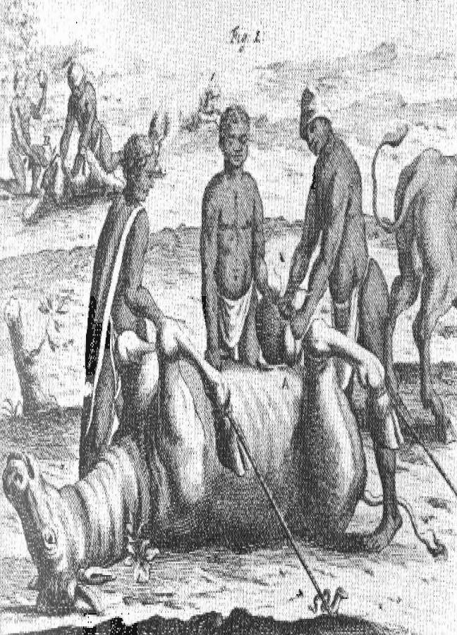
Pastoralist Life
“The Kraals and Hutts [sic] of the Hottentots” (Kolb, v. 1, “Tab. VII, fig. 1, p. 219”)
“The Hottentots Method of Gelding their Bulls and Rams” (Kolb v. 1 “Tab. V, fig. 1. p. 170”)

Slide 28
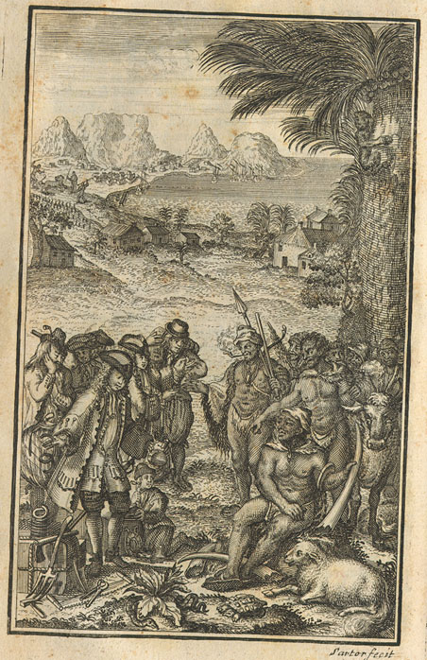
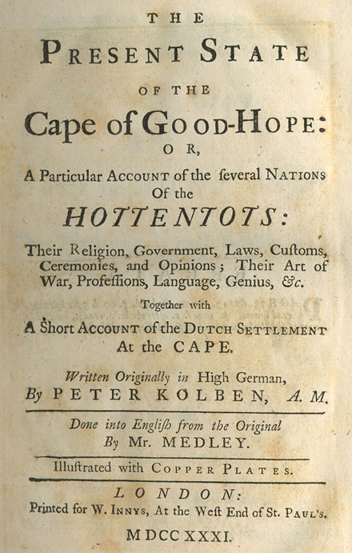
Peter Kolb
(1675 – 1725)

Slide 29
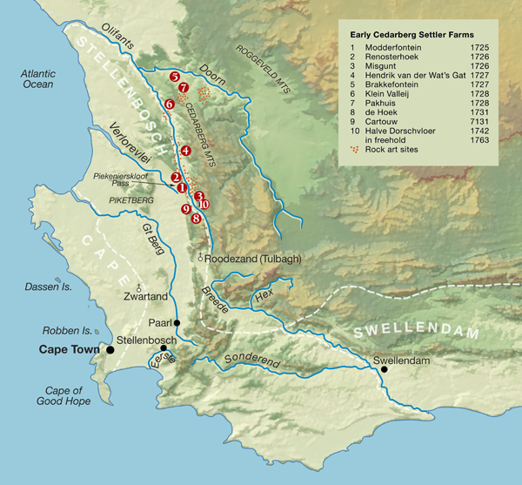
Contested Terrain

Slide 30
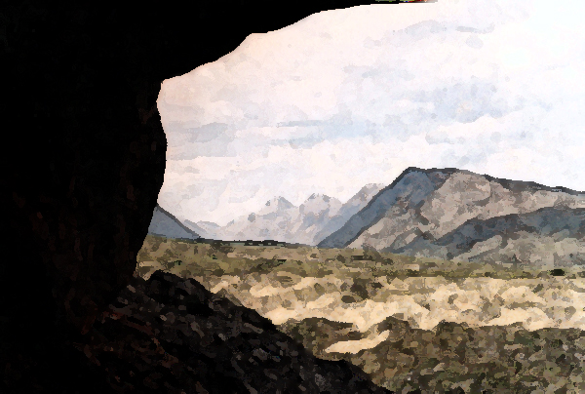
The Shape of South African History
Struggles over the use and meaning of natural resources

Slide 31
Chronology
  What happened? Who was there?
  Sequence of events
Process of settler land claims in the Olifants River Valley
Pastoralist settlers displace Khoikhoi pastoralists and San hunters

Slide 32
Evidence
  How do we know about these events?
Loan Farm Permits
Rock art and
material culture remains

Slide 33
Causality
  What can account for continuity, or change?
Individual land tenure precluded multiple access to resources and
ritual sites

Slide 34
Significance
  So what??
  Why should we care about these people or events?
Overlap between settler and Khoisan pastoralism
  Two-way cultural exchange on the frontier
Khoisan losses were twofold: material and cultural
  Cultural dislocation facilitated Khoisan being enfolded in colonial society
Mutually incompatible views of nature foreclosed options for co-existence

Slide 35
1 Biome
2 Moral Economies

