Slide 1
Humans & Nature:
Some Reflections

Slide 2
Conceptions of Nature
Spiritual or religious
Source of sustenance
Source of knowledge
Subject of knowledge
At the service of people (so controllable)
Dangerous (so beyond control)
Multiple understandings of nature can be in play at once
— in other cultures and in our own

Slide 3
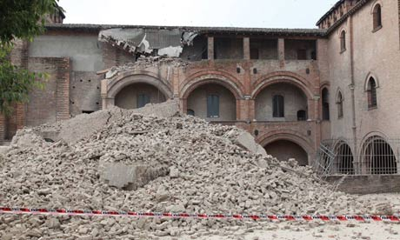
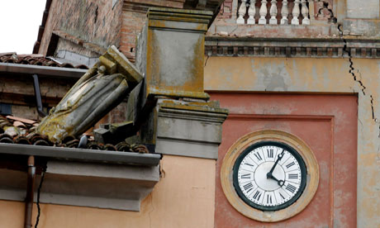
Italy: Earthquake May 2o
A society’s relationship to nature is not static

Slide 4
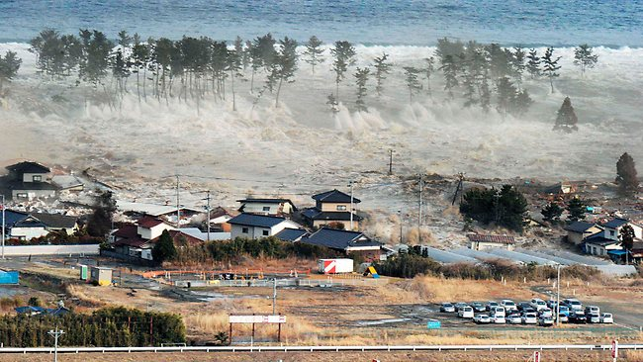
Japan: Earthquake & Tsunami,
April 7, 2011

Slide 5
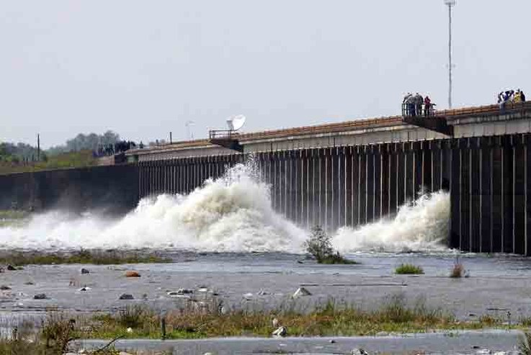
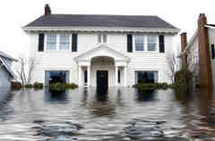
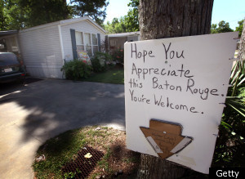
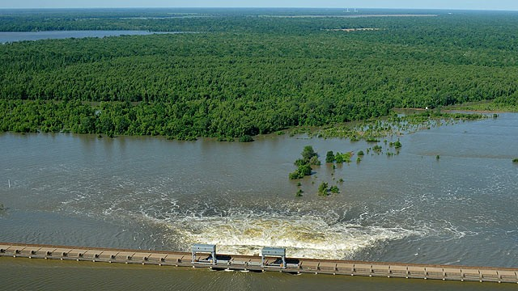
Morganza Spillway opened 18 May 2011

Slide 6
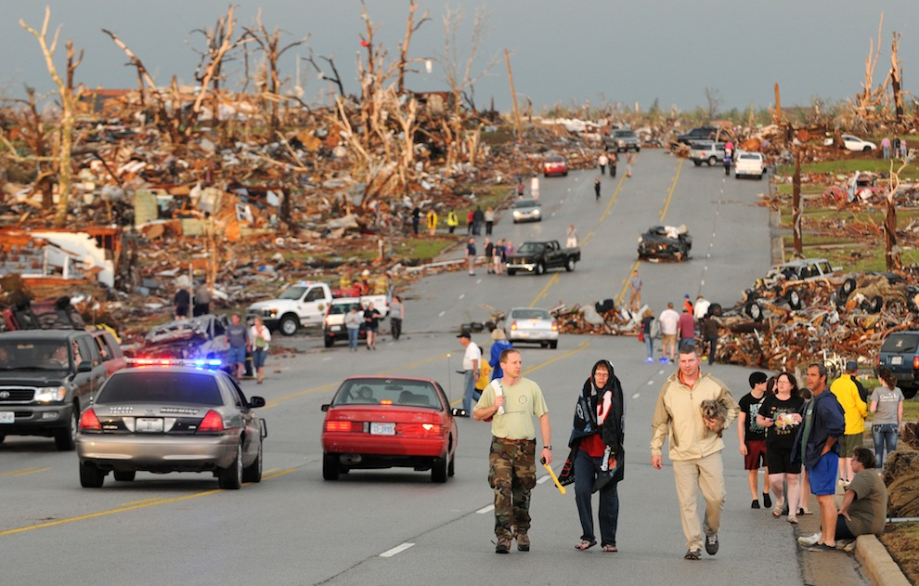
Joplin, MO: Tornado, 22 May 2012
The most devastating tornado on record

Slide 7
Foundational
Relationships
Nature
Divinity
Society

Slide 8
Describe relationships between people and nature
Time/place specific (not universal)
  Greek men and Greek women in the Bacchae
  Early modern European/Christian
  Western scientific approach of Galileo & Heisenberg
  Khoisan
Contingent
Dynamic (not static)

Slide 9
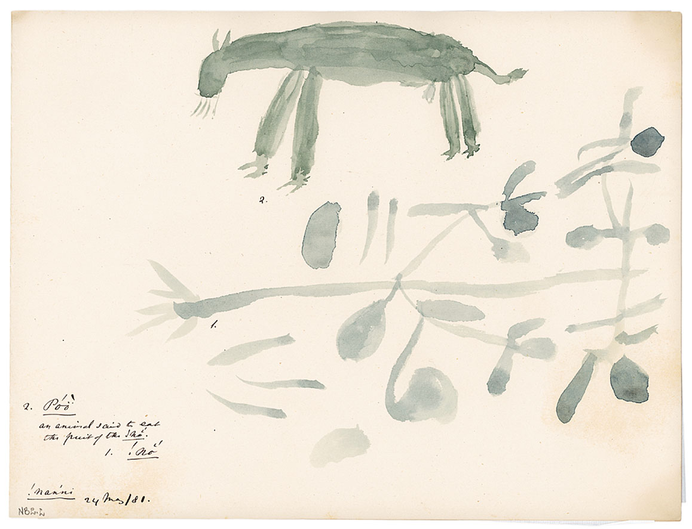
The Lion and the Jackals
Spirituality
Sustenance
Uneven control
Danger
Change
1) !no, 2) Poo, an animal said to eat the fruit of the !no.
Drawing by !nanni. 5/24/1881. Bleek & Lloyd Collection, UCT

Slide 10
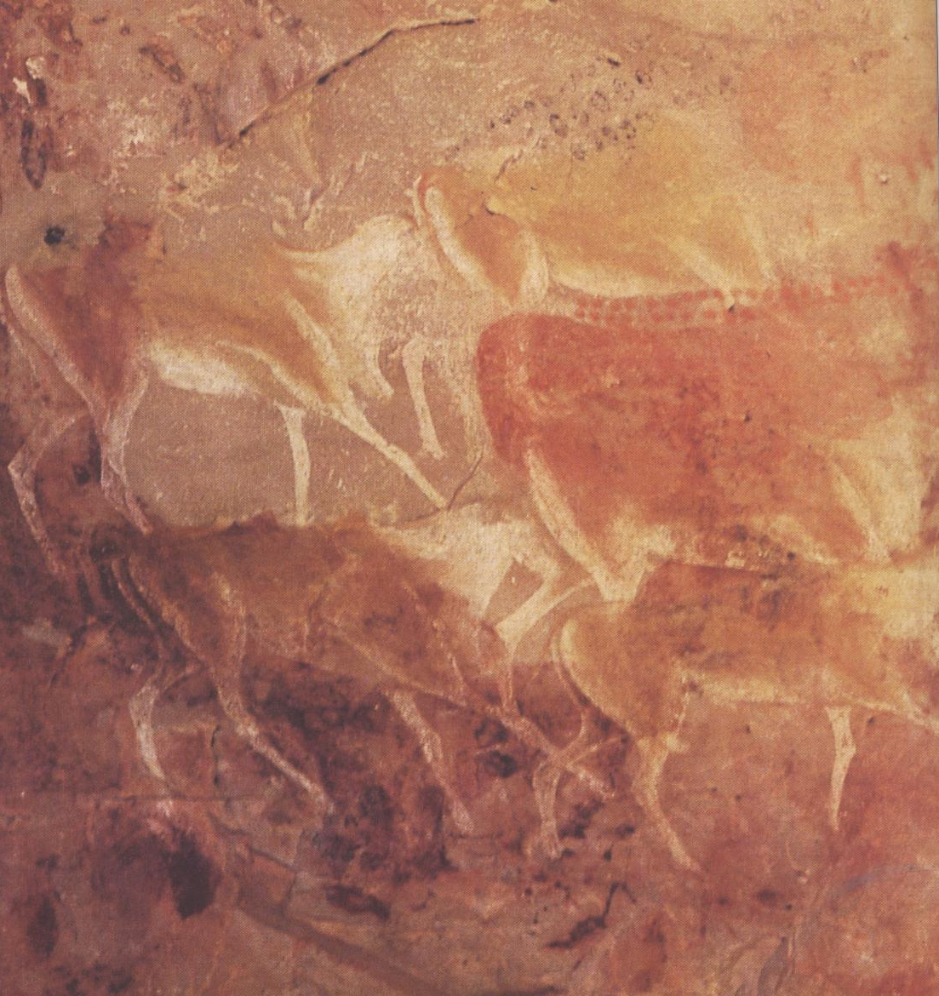
Song of the Broken String
Consequences of rupture in a society’s relationship with nature

Slide 11
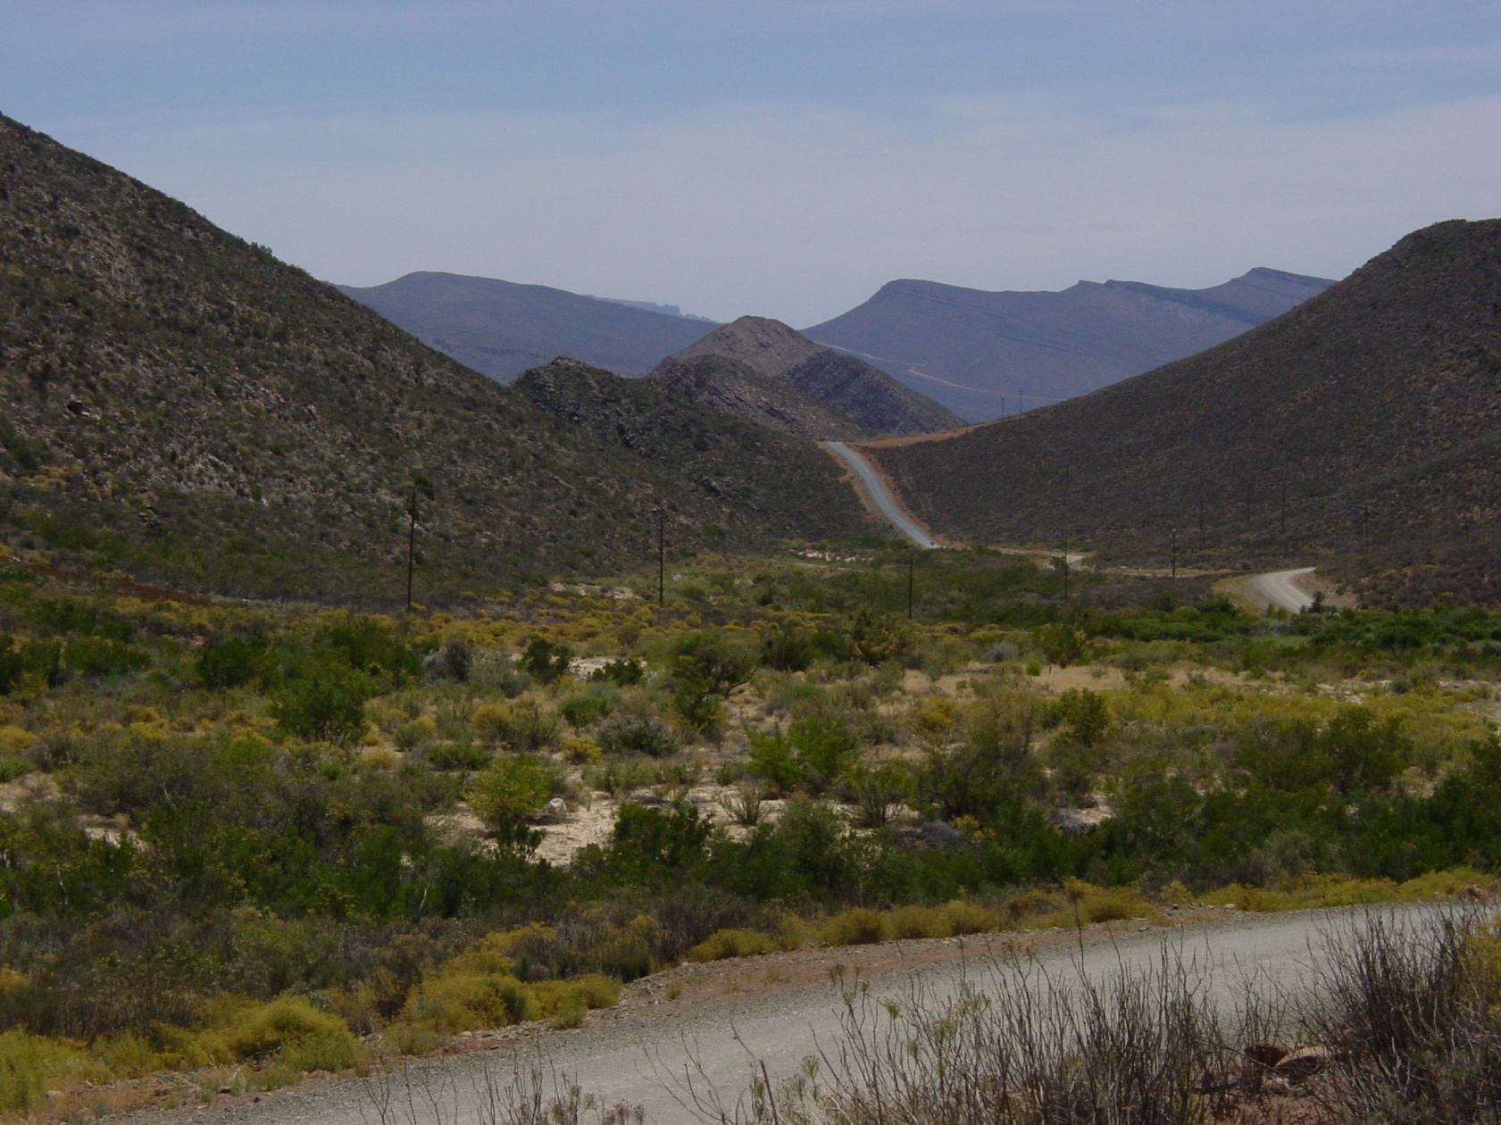

Making meaning with nature
The place does not feel to me
As the place used to feel to me

