Slide 1
Hunters | Herders | Farmers Nature

Slide 2
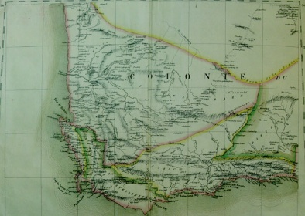

Today’s Lecture
Research Methods
Historical Content
Approaches to history
  Historical Materialism
Reading sources
Khoisan cosmology & land use
Christian settler cosmology and land use

Slide 3
Historical Materialism
One Example
“Unable to change the arid climate, Europeans, like the indigenous hunting and population, were forced to supplement herding with hunting and to move their livestock in search of water. And, while many settler families acquired…trappings of respectable domesticity…[most settlers preferred] (like the Khoe) to keep their wealth in cattle.”
Iris Berger, South Africa in World History (Oxford University Press, 2009), reprinted in David T. Pan, Humanities Core Course Guide and Reader (Pearson, 2010), 309.

Slide 4
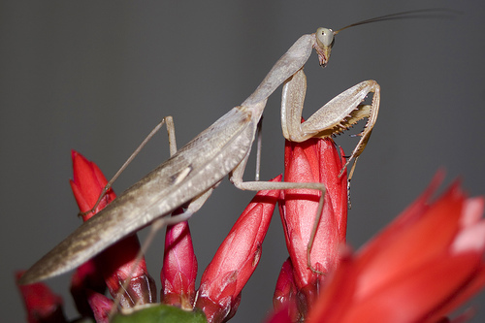
Kaggen | The Mantis

Slide 5
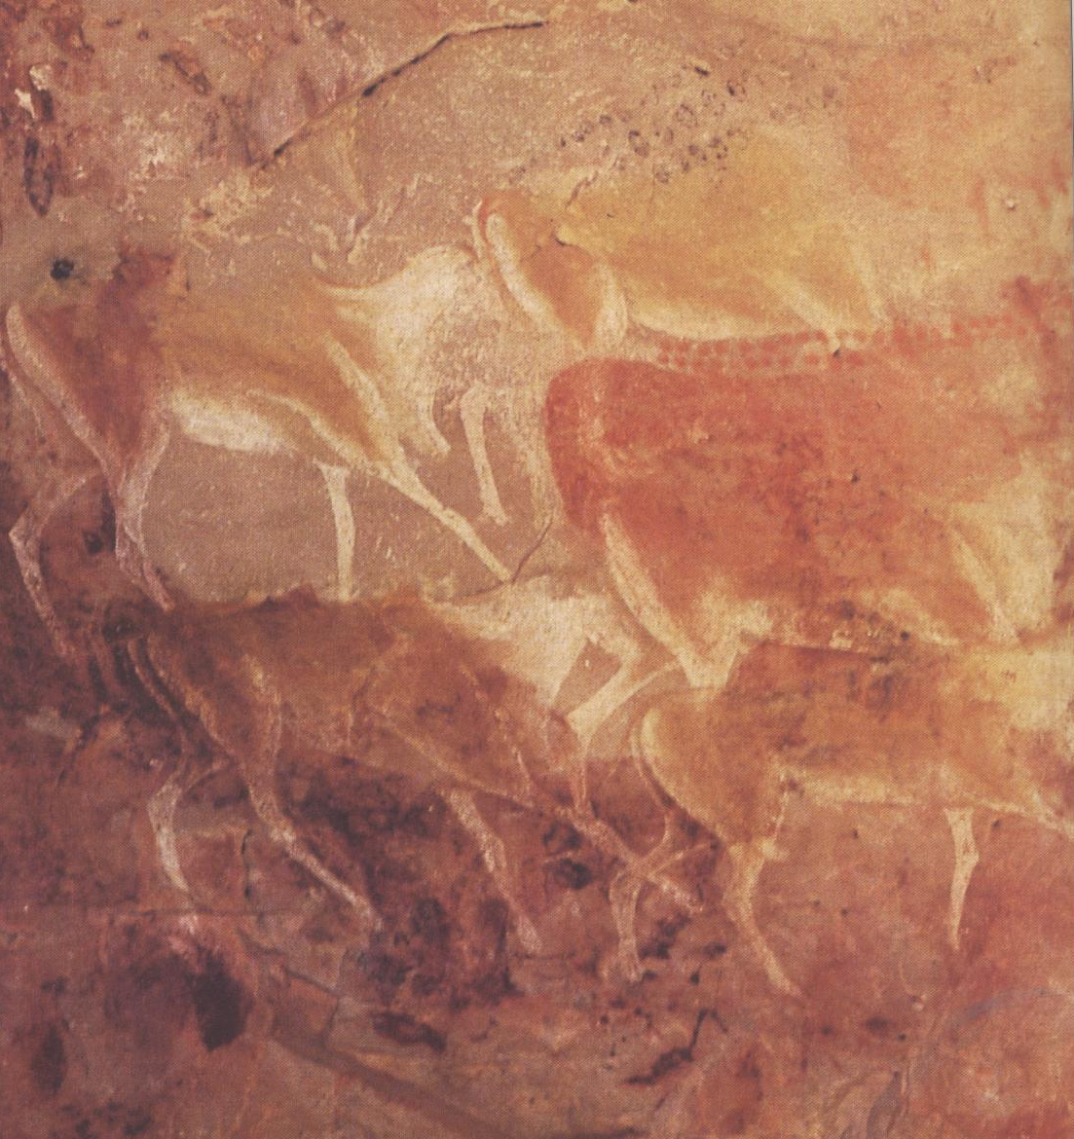
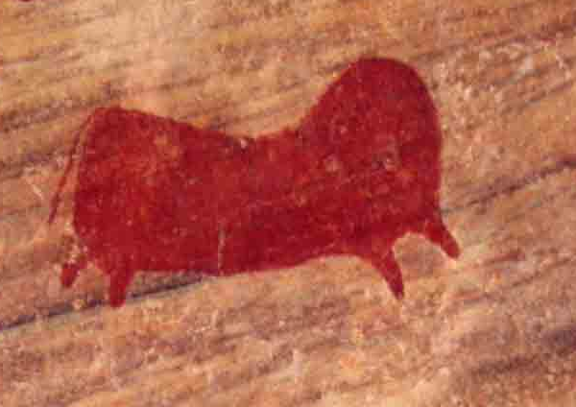
Eland

Slide 6
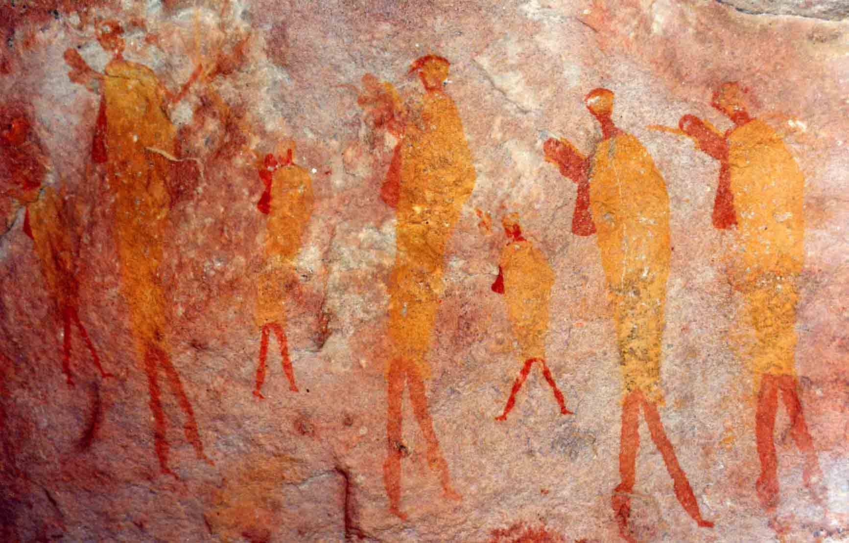
Eland Hunters | Initiated Men

Slide 7
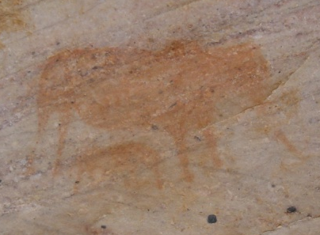
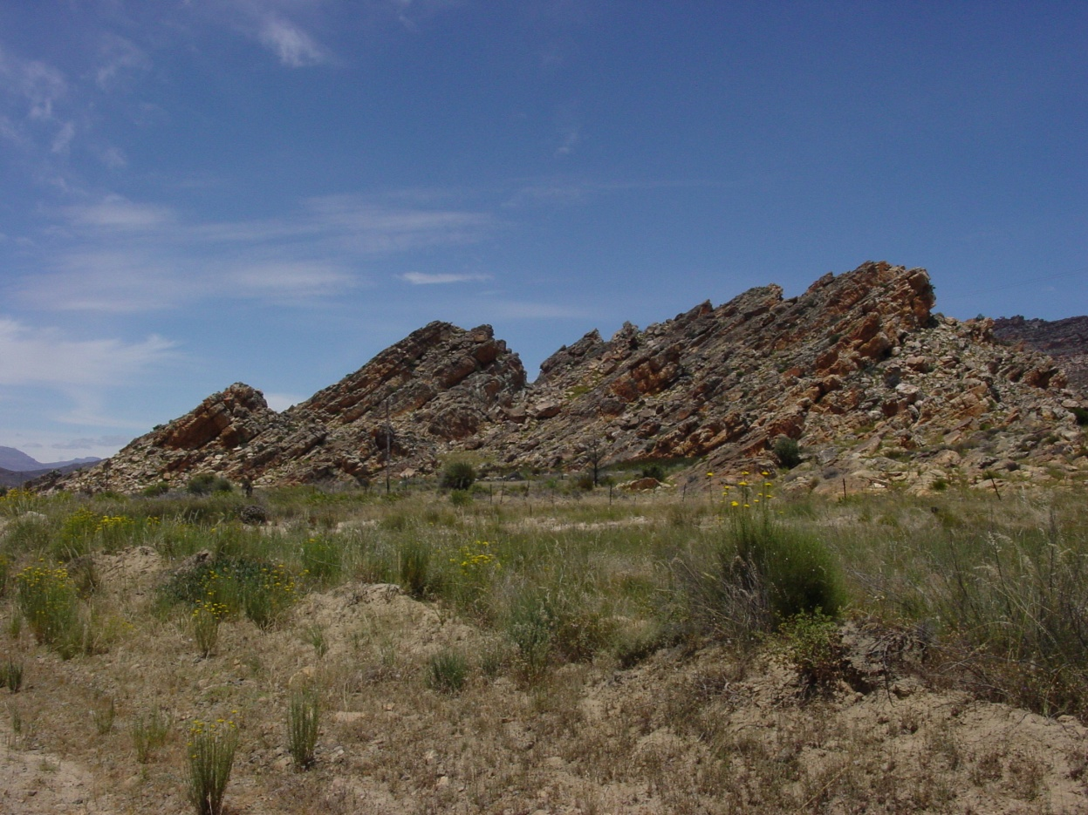
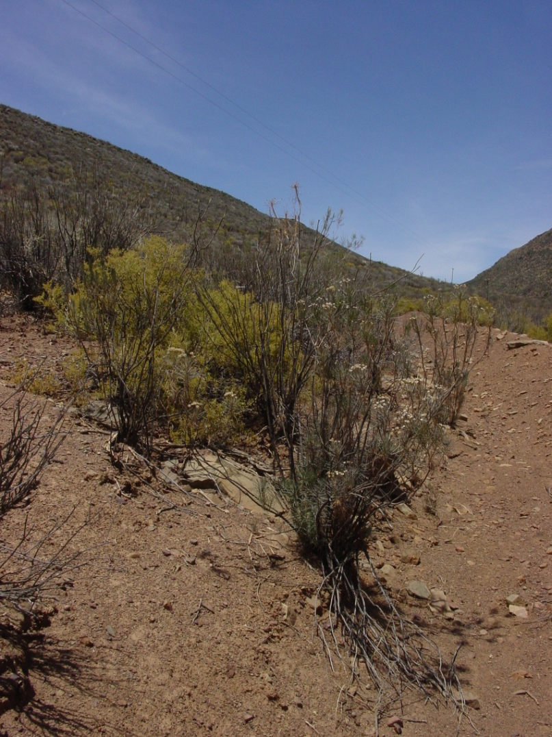
The Great Thirst

Slide 8
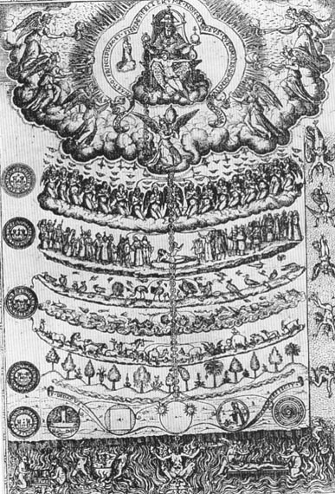
Great Chain of Being, 1579

Slide 9
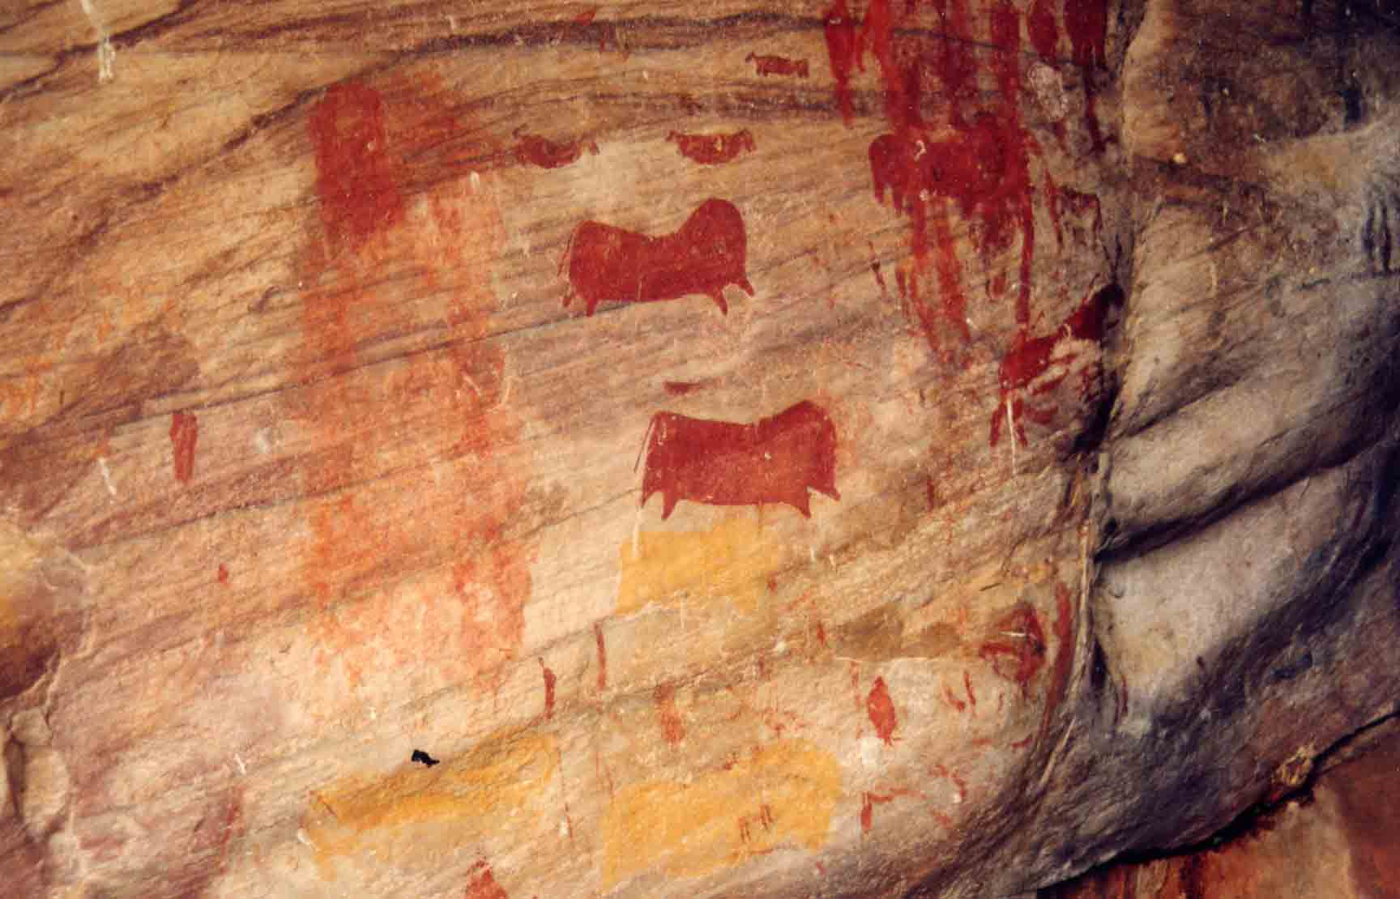
Khoisan Land Use
Evidence of repeated use of rock shelters and other sites

Slide 10
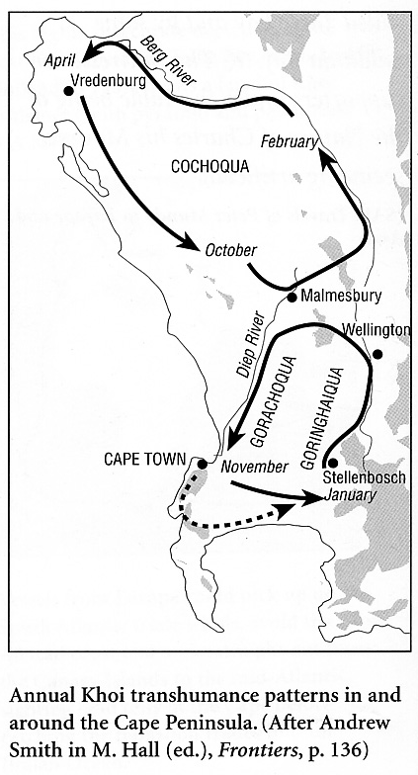
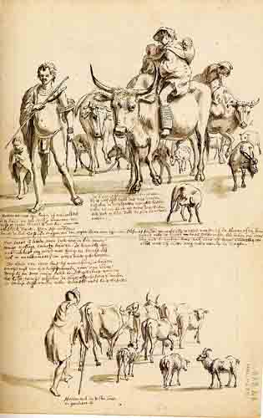
Pastoral Transhumance

Slide 11
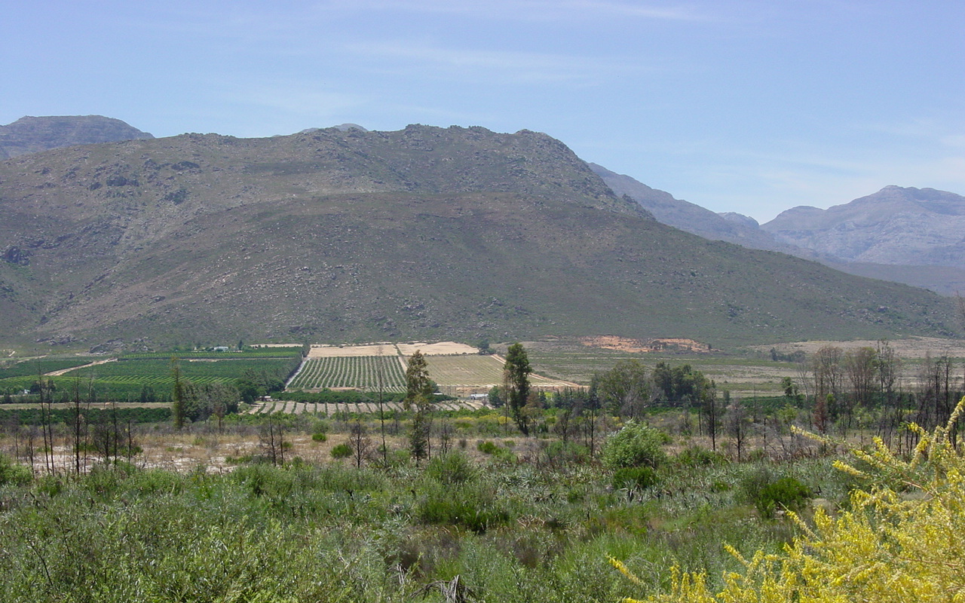
Settler Land Use
Extensive grazing and settled agriculture

Slide 12
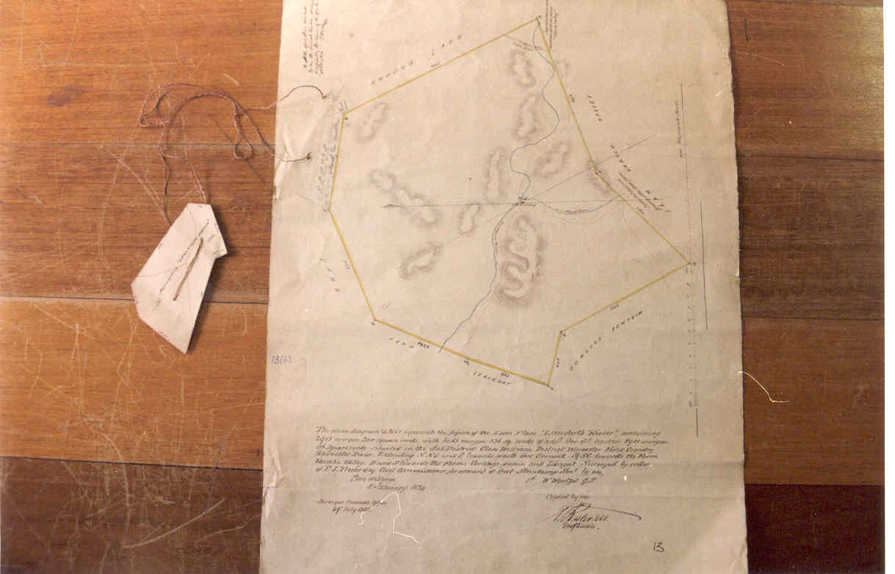
Dutch Property Rights
Demarcated
Permanent
Alienable

Slide 13
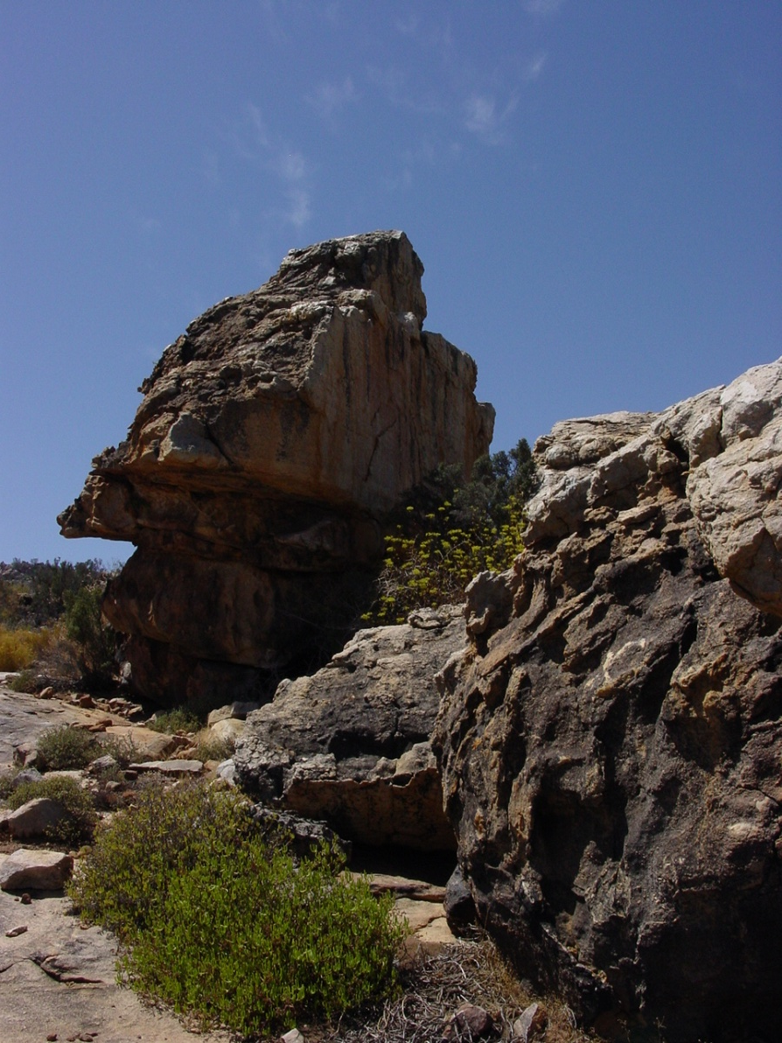
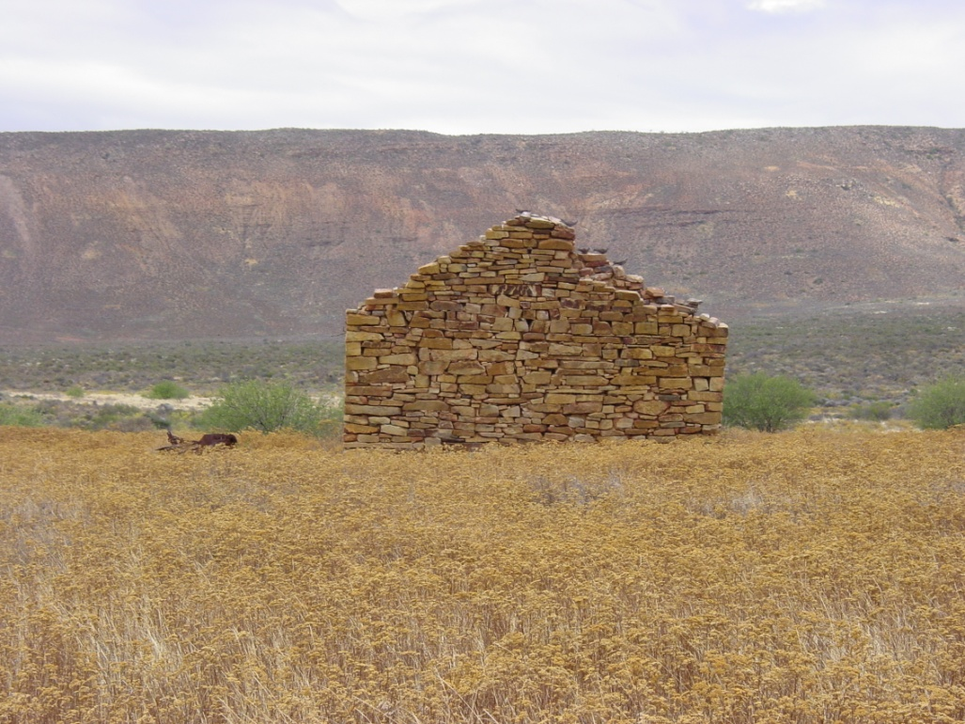
Shared Sustenance

Slide 14
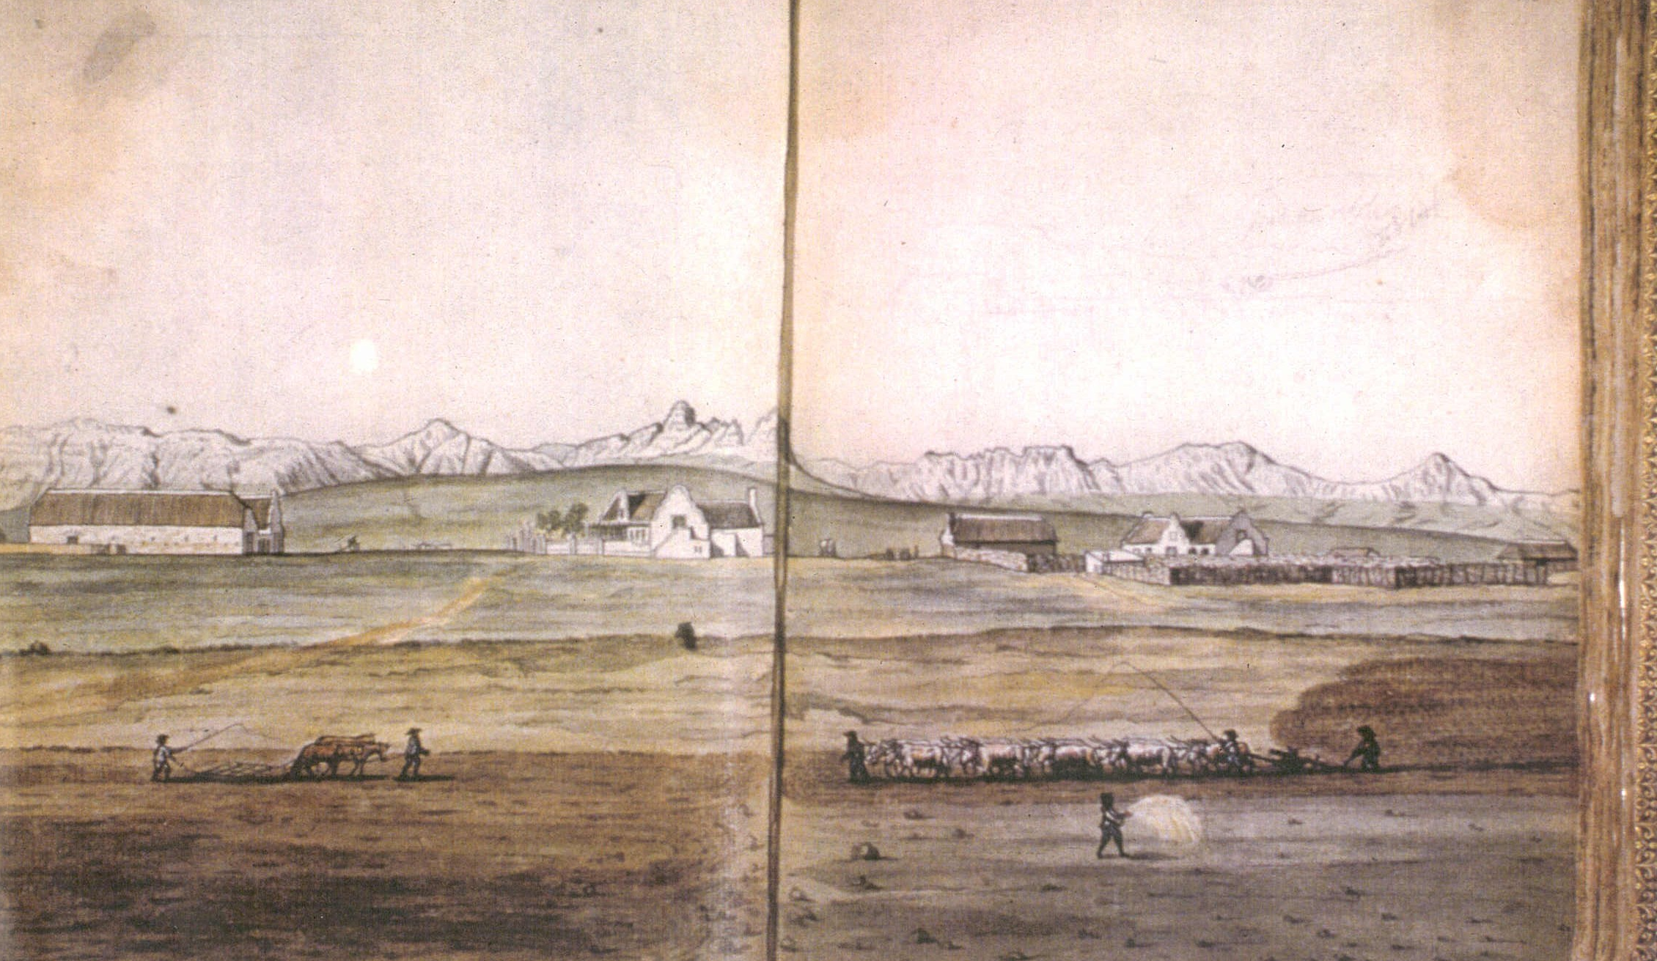
Differentiated Wealth
Jan Brandes, 1786

Slide 15
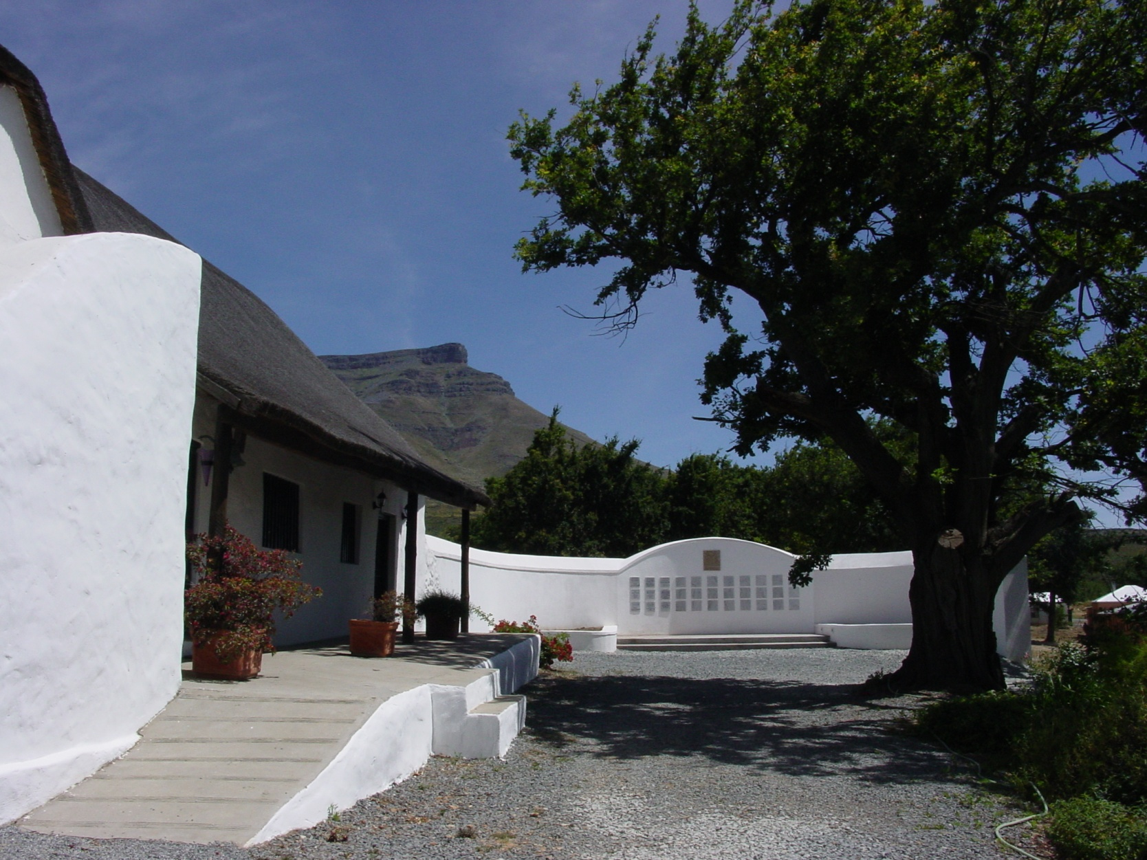
Shaping South African History

