Slide 1
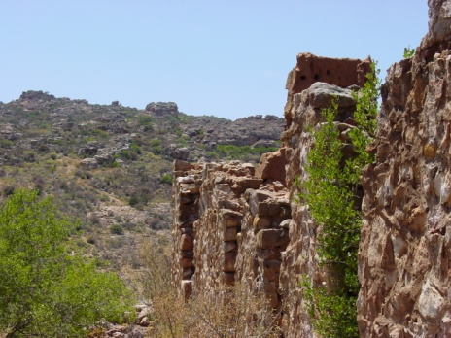
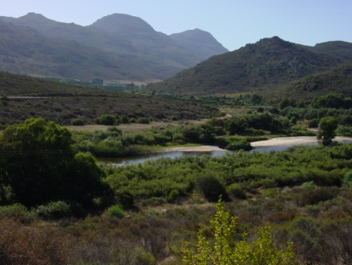
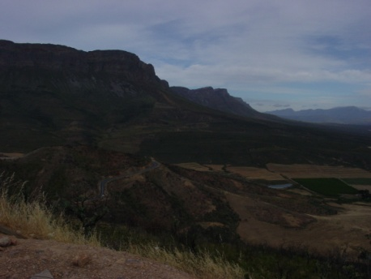
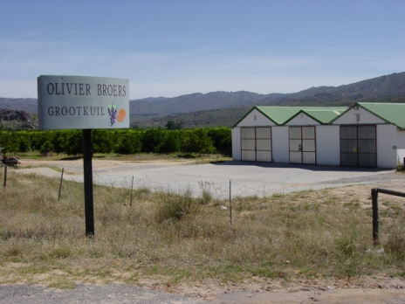
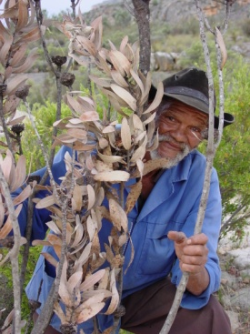
Reading Colonial Landscapes

Slide 2
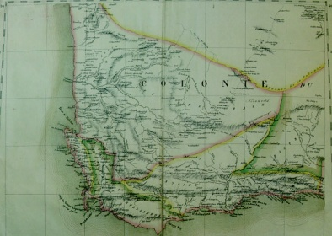

Today’s Lecture
Research Methods
Historical Content
Using rock art as evidence
Asking humanities research questions
Changes in the practice of Colonial science
Interrogate the boundary between people and nature
Archaeology (as science) in the Western Cape

Slide 3
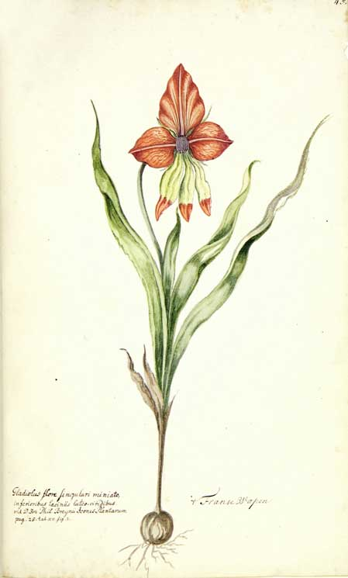
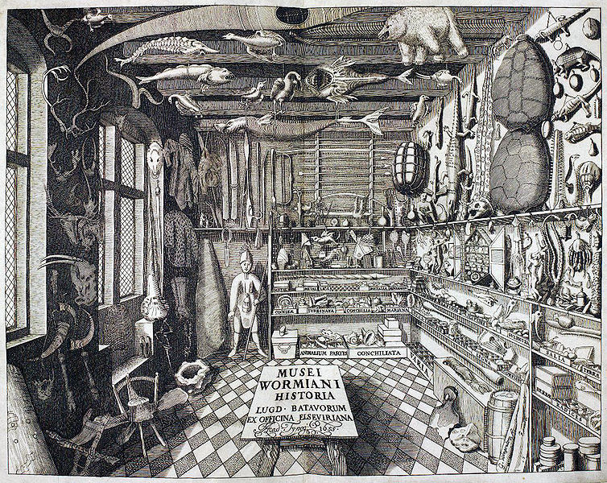
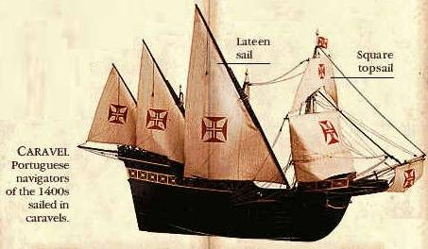
Colonial Science

Slide 4
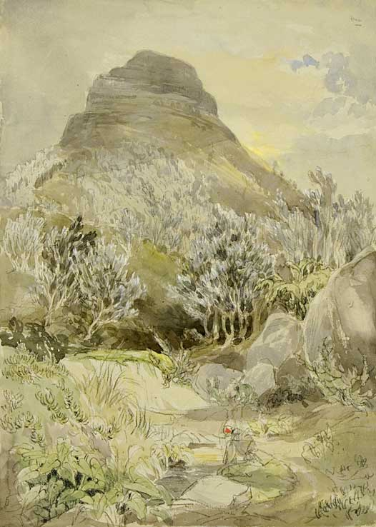
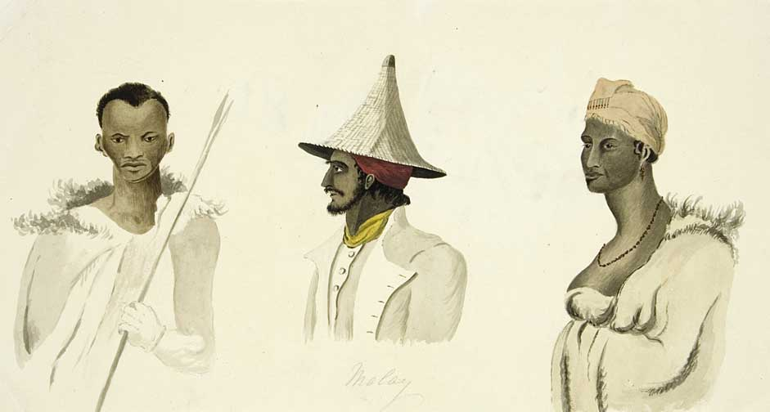
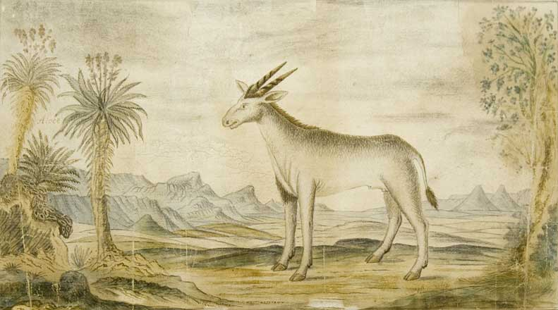
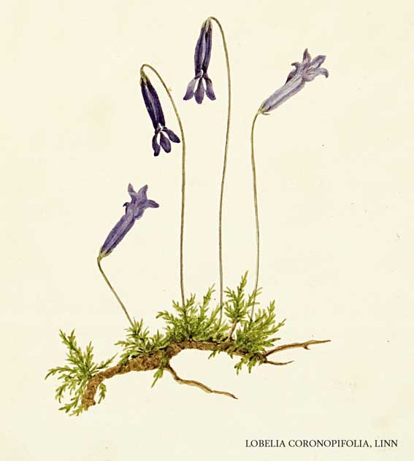
Pursuit of knowledge

Slide 5
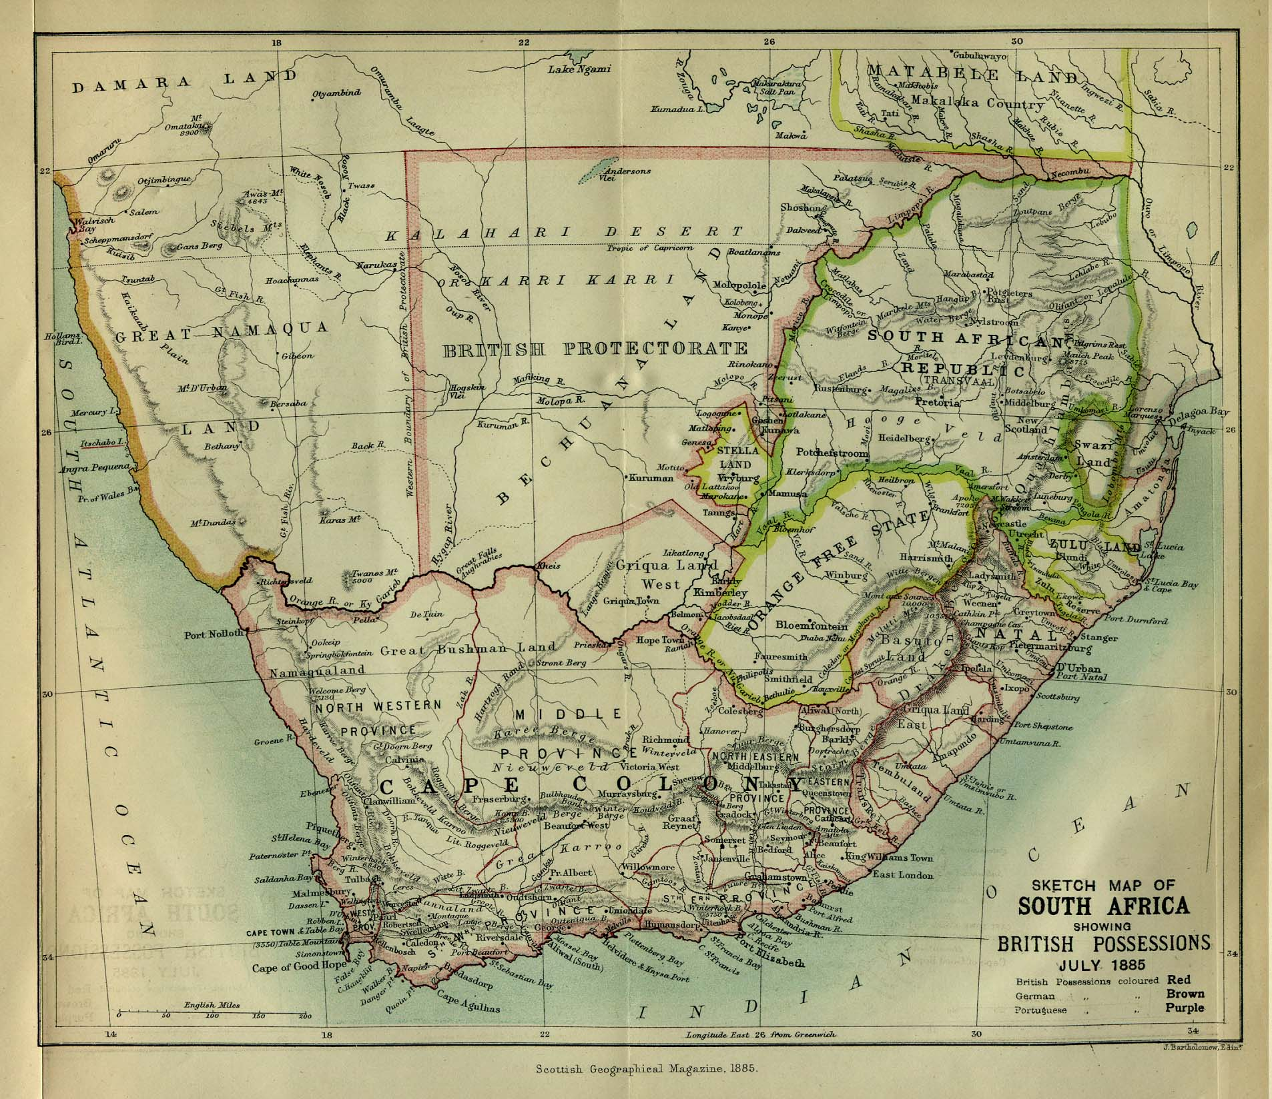
South Africa 1885
Notes:
"Sketch Map of South Africa showing British Possessions July 1885" from the Scottish Geographical Magazine. Published by the Scottish Geographical Society and edited by Hugh A. Webster and Arthur Silva White. Volume I, 1885
Perry Castaneda Map Collection, UT Austin
http://www.lib.utexas.edu/maps/south_africa.html

Slide 6
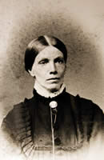
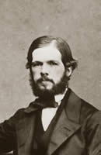
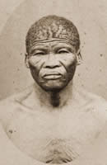
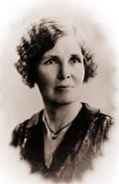
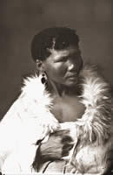
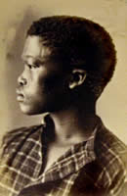
Bleek & Lloyd’s work
Lucy Lloyd
Wilhelm Bleek
||kabbo
|a!kunta
Dorothea Bleek
!kweiten ta ||ken
Notes:
Images from UCT Lloyd-Bleek collection
http://lloydbleekcollection.cs.uct.ac.za/

Slide 7
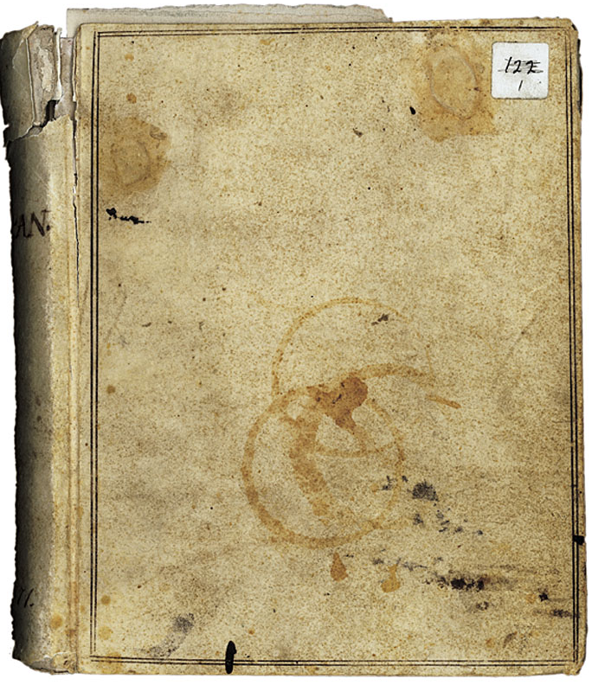
The notebooks
193 notebooks
127 by Lucy Lloyd
Others by
Wilhelm Bleek,
Jemima Lloyd Bleek
Dorothea Bleek
Cover of one of Wilhelm Bleek’s notebooks
UCT Lloyd & Bleek Collection
BC 151 A1 4 001
Notes:
UCT Lloyd and Bleek collection
Image File: A1_4_1_FUCOV.JPG
Book: BC_151_A1_4_001
http://lloydbleekcollection.cs.uct.ac.za/stories/1/index.html

Slide 8
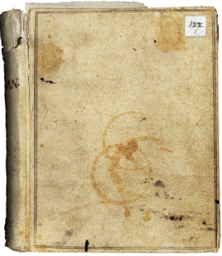
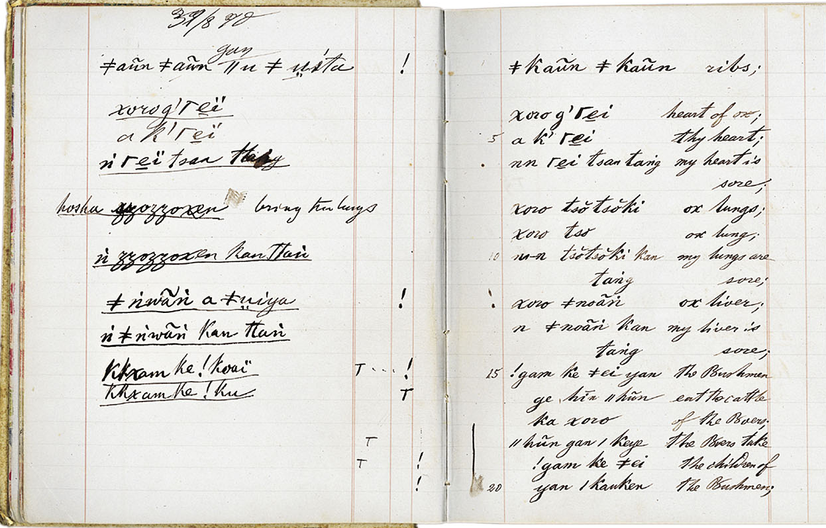
Words and Sentences
Wilhelm Bleek | Adam Kleinhardt
Notes:
Ribs
Heart of ox
Thy heart
My heart is sore
Ox lungs
Ox lung
My lungs are sore
Ox liver
My liver is sore
The Bushmen eat the cattle
Of the Boers
The Boers take the children
Of the Bushmen
UCT Lloyd and Bleek collection
Image: A1_4_1_00001.JPG
Book: BC_151_A1_4_001
http://lloydbleekcollection.cs.uct.ac.za/stories/2/index.html

Slide 9
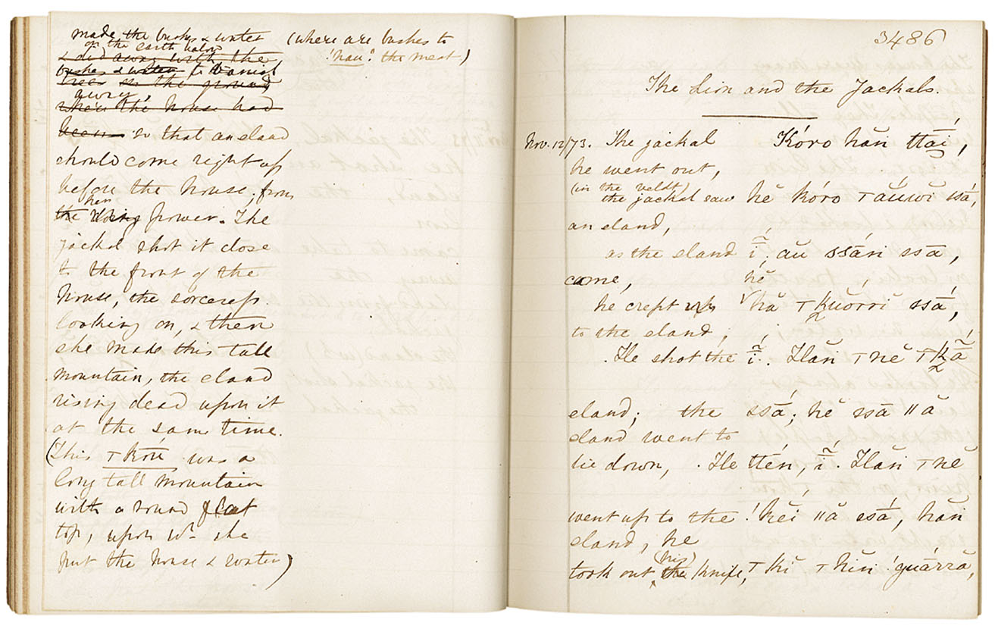
The Lion and the Jackal
Lucy Lloyd | ≠kasin
Notes:
UCT Lloyd & Bleek Collection
Image File: A2_1_44_03486.JPG
Book: BC_151_A2_1_044
http://lloydbleekcollection.cs.uct.ac.za/stories/342/index.html

Slide 10
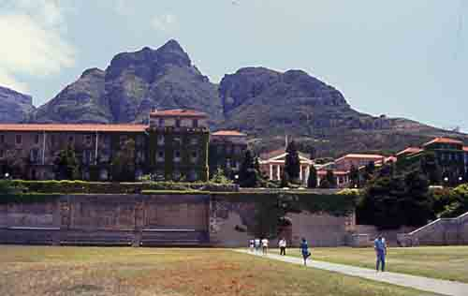
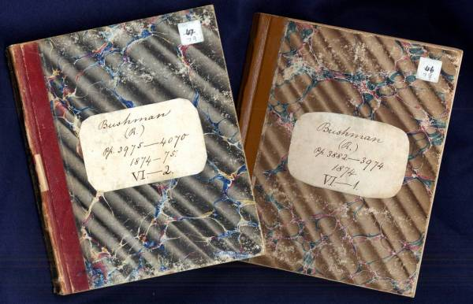
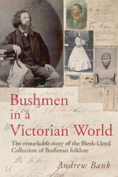
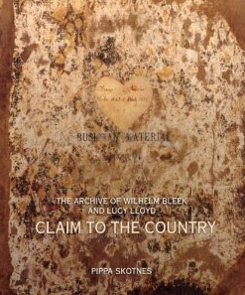
What makes an archive?
Andrew Banks,
Bushmen in a
Victorian World,
Double Storey
Books
2008
Lucy Lloyd’s Notebooks
University of Cape Town
Lloyd & Bleek Collection
The Digital Bleek & Lloyd
UNESCO Memory of the World Project
Pippa Skotnes, Claim to the Country
Ohio University Press, 2007

Slide 11
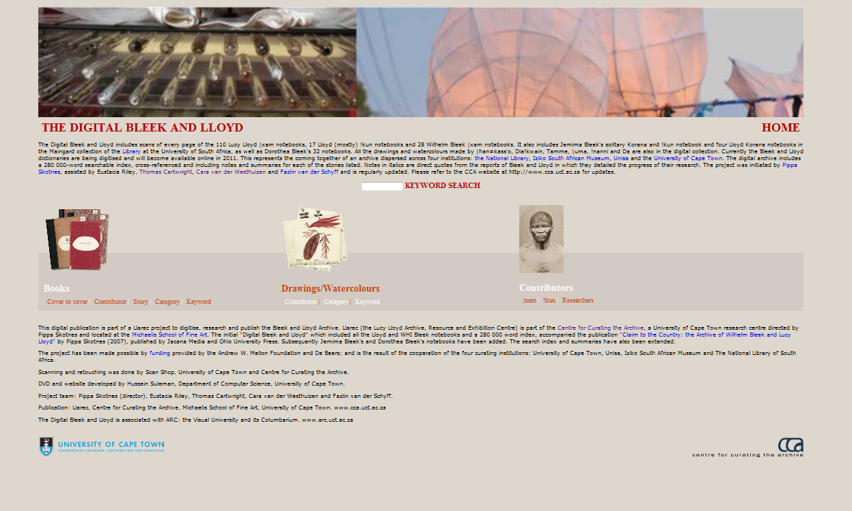
Getting Access
http://lloydbleekcollection.cs.uct.ac.za/index.html

Slide 12
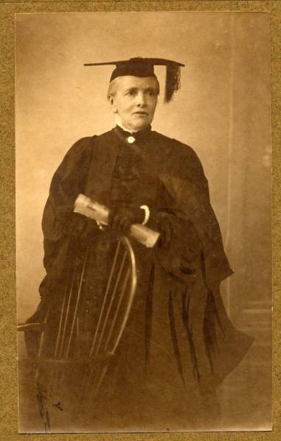
Lucy Lloyd
Honorary Doctorate, 1911
University of the Cape of Good Hope
Notes:
Citation for honorary degree (first woman to receive this in SA)
…an original production worthy of the highest praise. It is not only a masterly exposition of the folklore of a vanishing race that has remained primitive, but the philological value of the work is greater still, and the work will remain an authority on the language of the “Bushman and kindred races.
Photo: UNESCO Memory of the World
http://www.unesco-ci.org/photos/showphoto.php/photo/4968/title/lucy-lloyd/cat/957

Slide 13
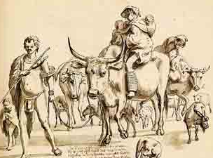
Research intermediaries and facilitators
||kabbo
!kweiten ta ||ken

Slide 14
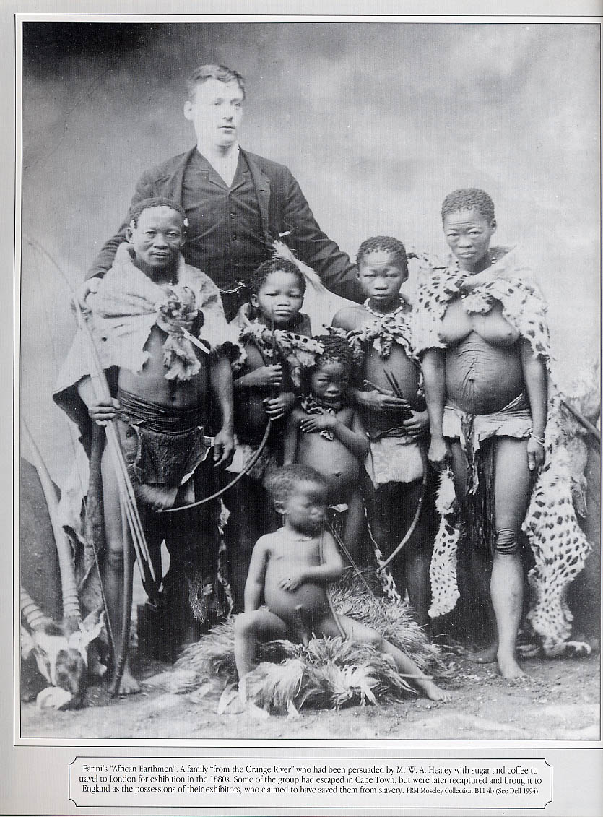
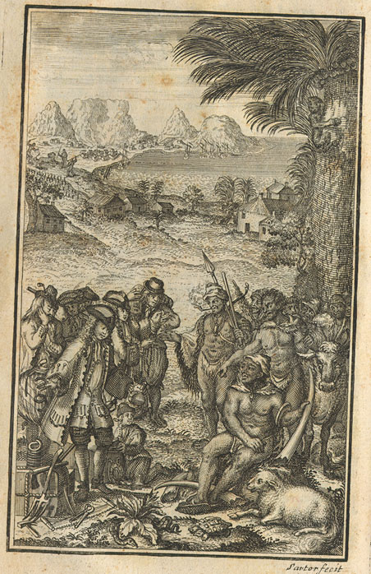
Research intermediaries and facilitators
Notes:
Farini’s “African Earthmen.” A Family “from the Orange River” who had been persuaded by Mr. W.A. Healey with sugar and coffee to travel to London for an exhibition in the 1880s. Some of the group had escaped in Cape Town, but were later recaptured and brought to England as the posessions of their exhibitors, who claimed to have saved them from slavery. [From Miscast]

Slide 15
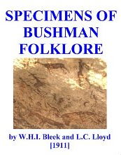
Research Hierarchies
The book’s dedication:
“To All Faithful Workers”

Slide 16
Observers at the Cape
 | Life dates | Cape dates | Publication dates | Publication titles
Peter Kolb | 1675-1725 | 1707-1713 | 1715, 1716, 1719 | The Present State of the Cape of Good Hope…
Anders Sparrman | 1748-1820 | 1772, 1775-76 | 1776 | A Voyage to the Cape of Good Hope…
François le Vaillant | 1753-1824 | 1781-1784 | 1790, 1796, 9 others through 1808 | Voyage in the Interior of Africa…
John Barrow | 1764-1848 | 1797-1804 | 1806 | Travels into the Interior of South Africa
Henry Lichtenstein | 1780-1857 | 1802-1806 | 1810 | Travels in Southern Africa
William Burchell | 1781-1863 | 1810-1815 | 1822 | Travels in the Interior of Southern Africa
Wilhem Bleek | 1827-1875 | 1855-59, 1860-75 | 1862 (and many others) | A Comparative Grammar of South African Languages
Lucy Lloyd | 1834-1914 | 1862-1883, 1884-87 1905, 1907 1912-1914 | 1911 (w/ Bleek) | Specimens of Bushman Folklore

Slide 17
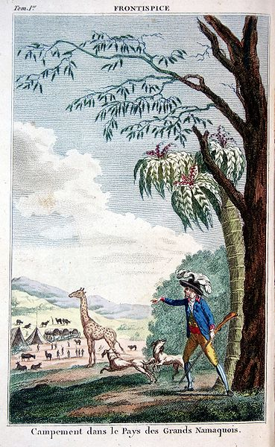
Capturing Colonial
Landscapes
F. Le Vaillant, Voyage dans l'intérieur de l'Afrique par le cap de Bonne Espérance , 1790
Notes:
Frontispice du Voyage de F. Le Vaillant dans l'intérieur de l'Afrique par le cap de Bonne Espérance nouvelle édition, Desray, An VI.

Slide 18
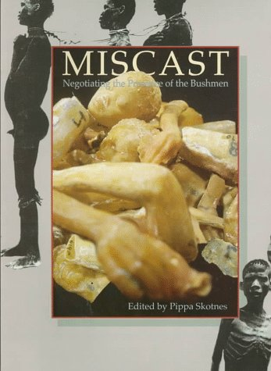
Cataloging Colonial Bodies
P. Skotnes, Miscast, 1998

Slide 19
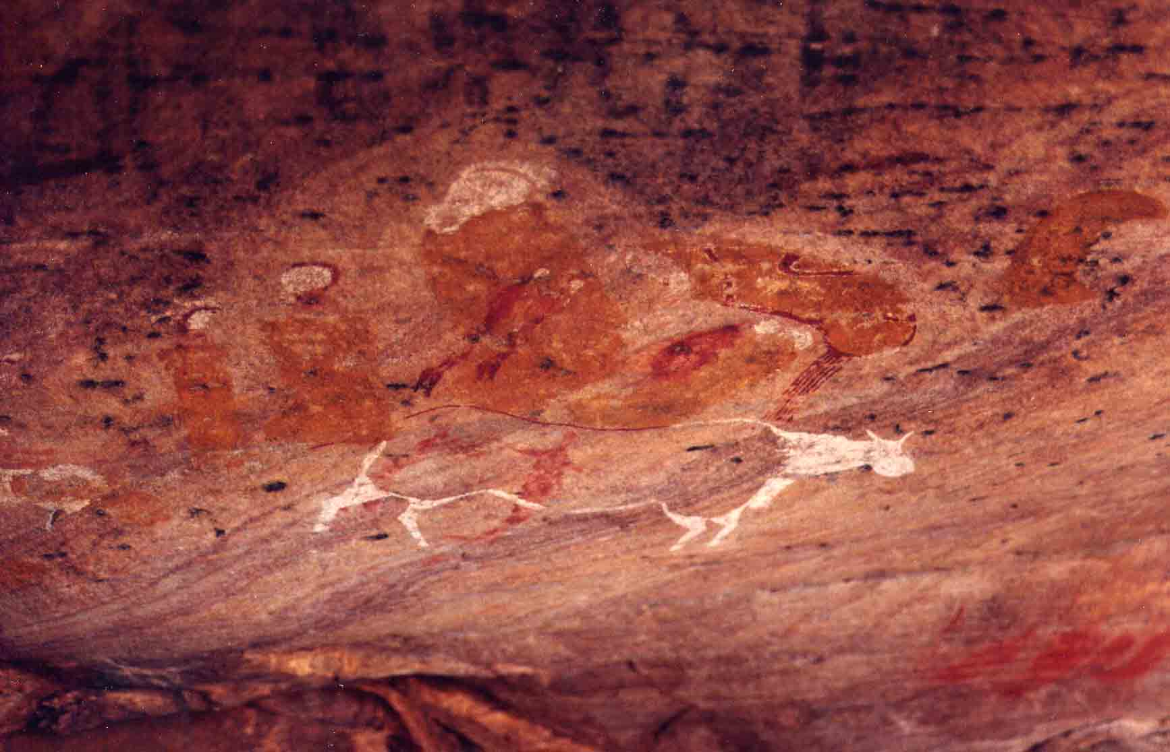
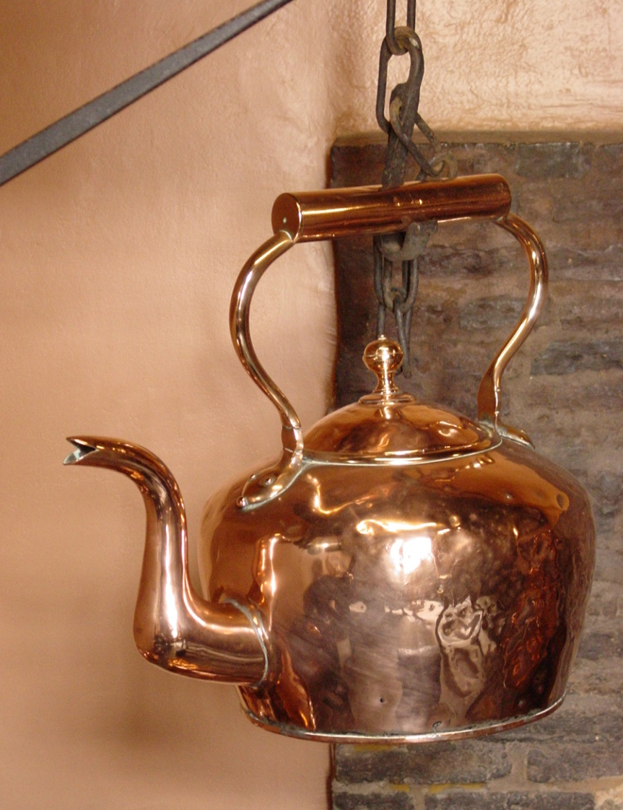
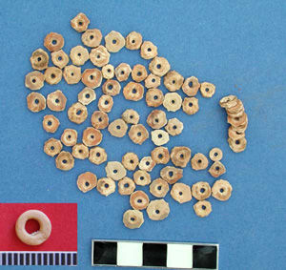
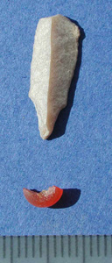
Archaelogy
Kridouw Krans Shelter, Cedarberg
Ostrich eggshell beads & micro-drill
Koopmans-DeWet House, Cape Town

Slide 20
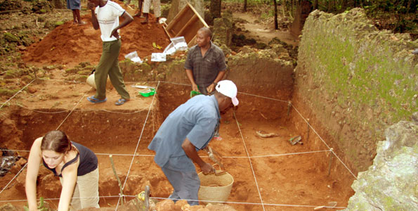
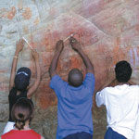
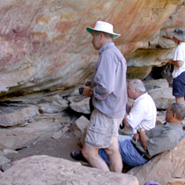
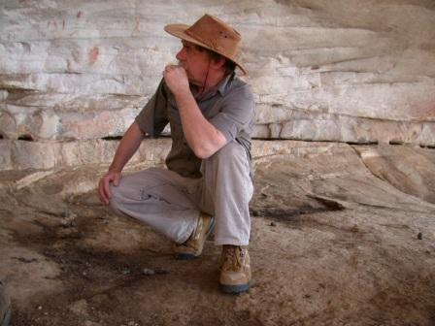
Research methods
Conserving Rock Art
Cedarberg, South Africa
Dr. Chap Kusimba, Field Museum (Chicago) in Mtwapa, Kenya
John Parkington in a
shelter with rock art
Cedarberg, South Africa
Examining Rock Art
Cedarberg, South Africa
Notes:
Chap Kusimba, Mtwapa, Kenya
http://sambali.blogspot.com/2009/09/new-evidence-of-cinnamon-route-from.html
Clanwilliam Living Landscape
http://www.cllp.uct.ac.za/index.htm
John Parkington
http://web.uct.ac.za/depts/age/people/parking.htm

Slide 21
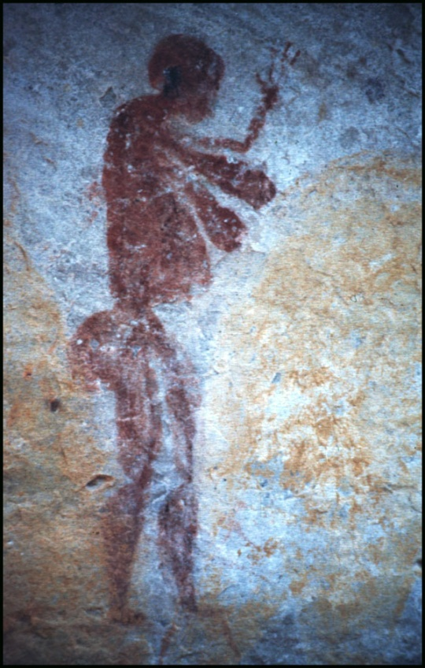
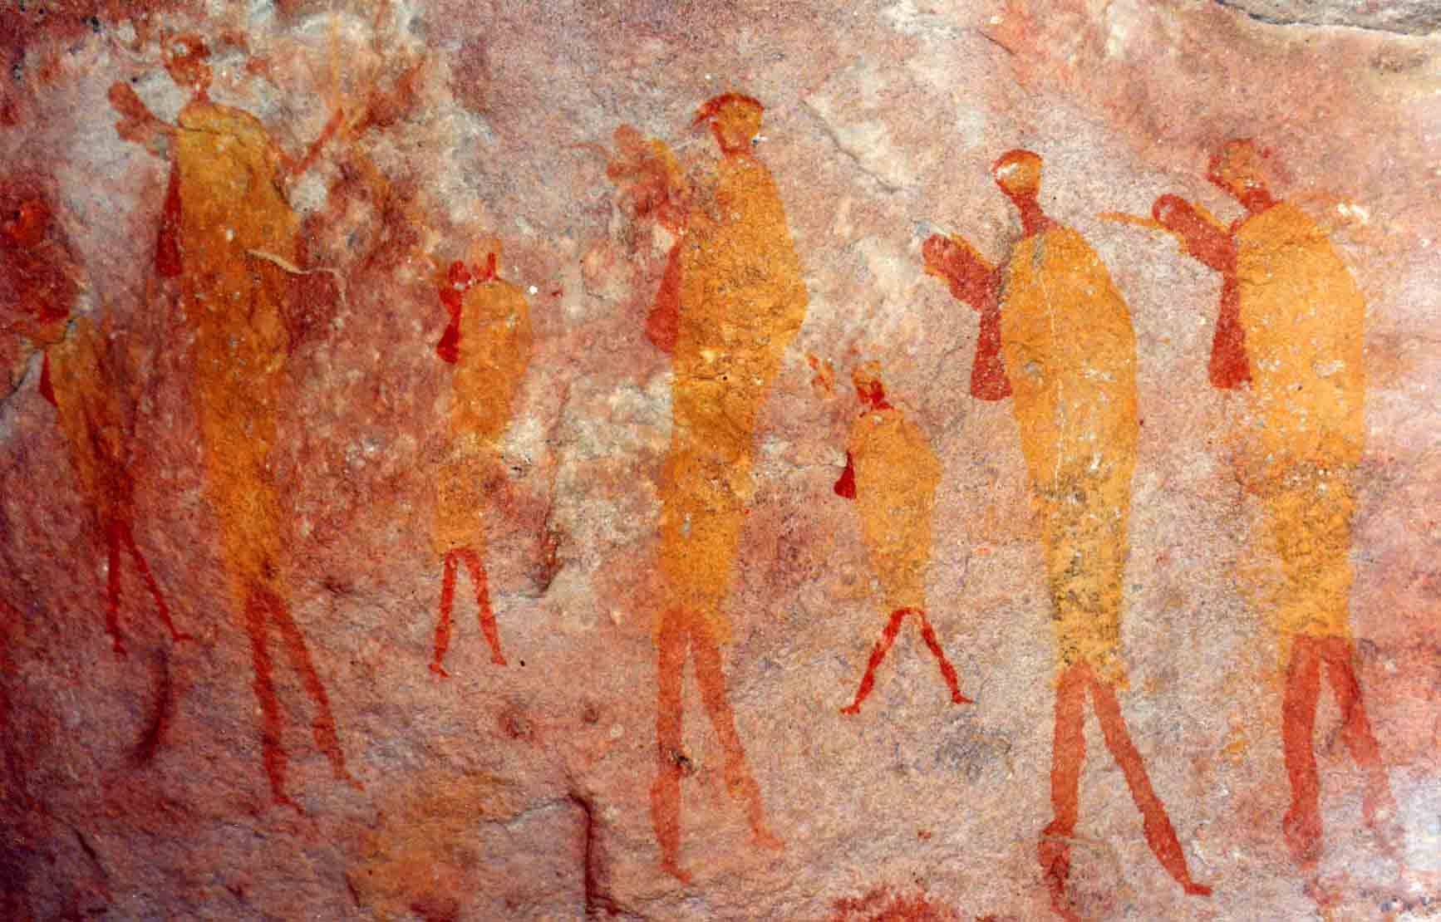
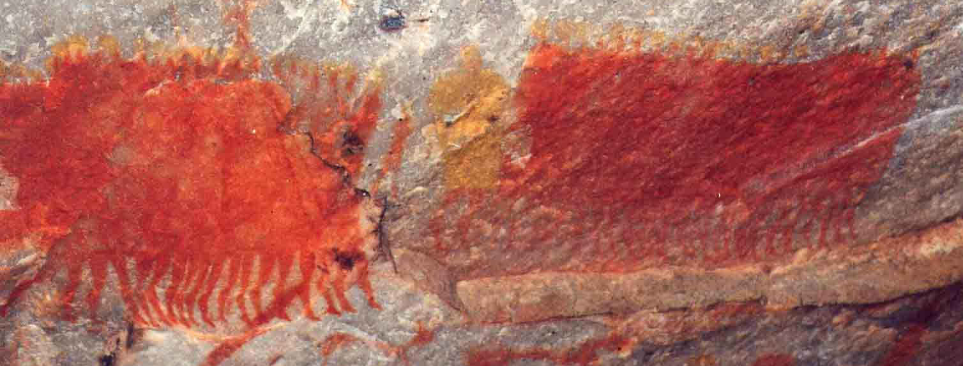
Material? | Ritual?
Notes:
Hunters, Warmhoek
Karos Procession, Keurbos
Woman, Salman’s Lagter

Slide 22
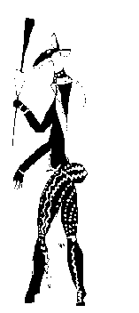
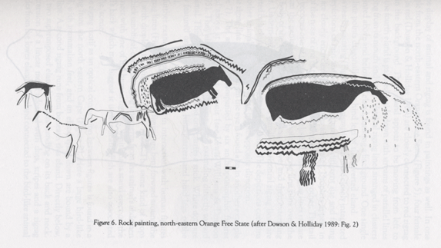
Trance images?
Entoptic lines
Therianthrope

Slide 23
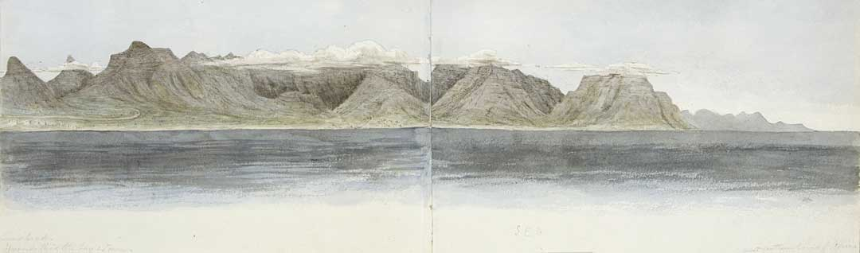
Colonial Landscapes
With or without people?

Slide 24

Colonial Landscapes

Slide 25

Colonial Landscapes

Slide 26

Colonial
Landscapes

