Slide 1
“Primitives”, Progress & the Conquest of Nature

Slide 2
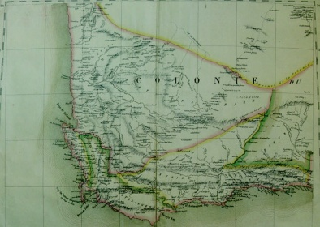

Today’s Lecture
Research Methods
Historical Content
Review:
  5 definitions & concepts
  5 skills
Changing perceptions of Khoisan peoples as a subject of study
The place of “Bushmen” in modern society
Interrogate the boundary between people and nature

Slide 3
Methods
Definitions & Concepts
Skills
Interpreting source material:
  primary + secondary, textual + visual, historical + contemporary
Components of a historical argument
  chronology | evidence | causality | significance
“Change over time”
Scale / unit of analysis
Posing humanities research questions
Working definition of History
Historical materialism
Time/place specificty
Contingency
Causality

Slide 4
Study for HumCore, then study abroad
Application deadlines May 24
http://www.cie.uci.edu/prospective/deadlines.shtml
South Africa, Ghana, Botswana, Tanzania

Slide 5
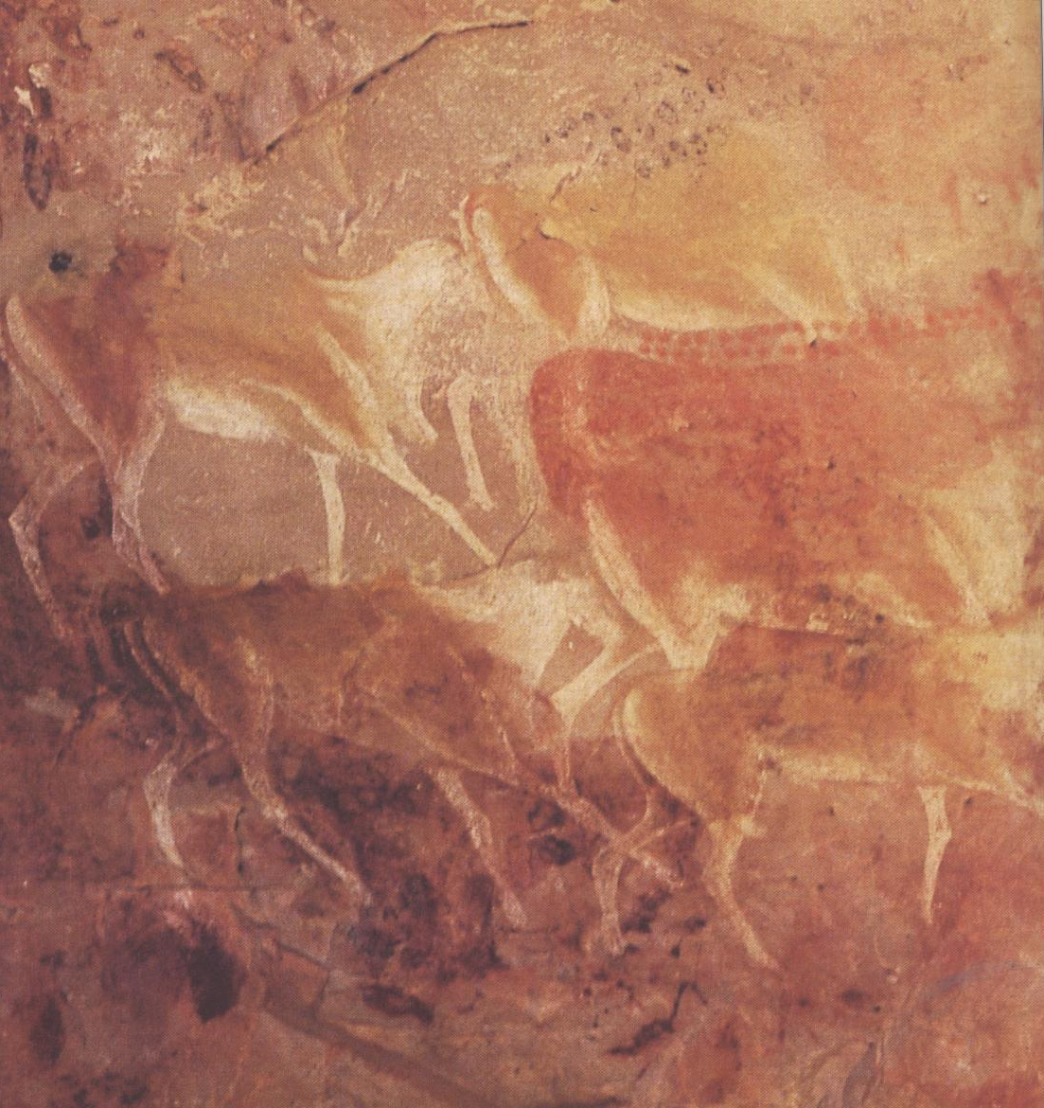
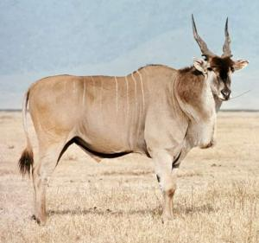
Perceptions of Nature
Learning Objective : There are multiple ways for human societies to understand “nature.”

Slide 6
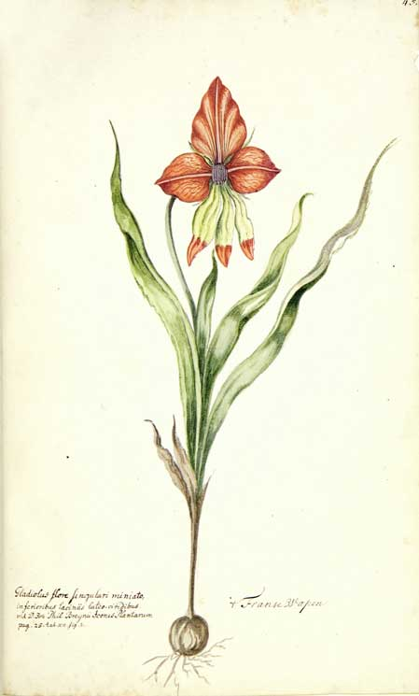
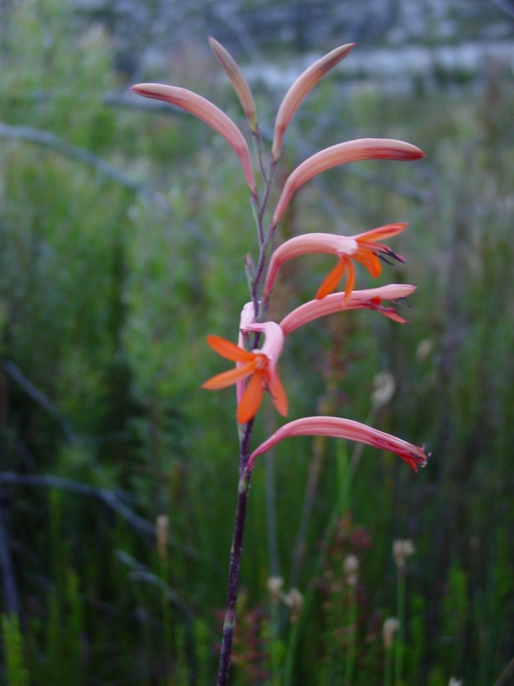
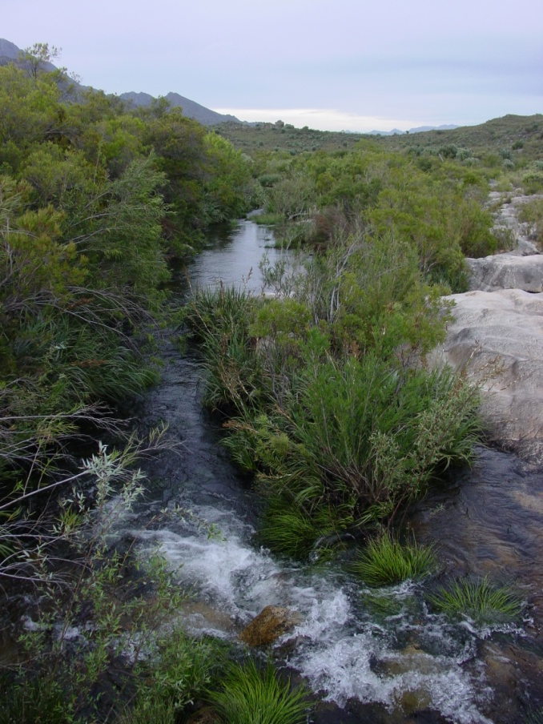
Perceptions of Nature
Learning Objective : There are multiple ways for human societies to understand “nature.”

Slide 7
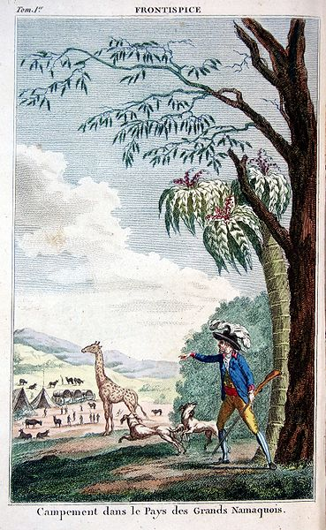
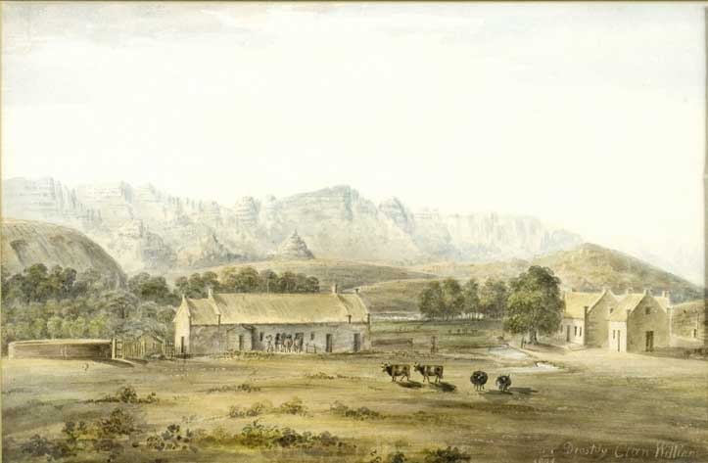
Nature is Culturally Constructed
Learning Objective : Differentiation between humans and the natural world is historically specific
Notes:
F. Le Vaillant, Voyage dans l'intérieur de l'Afrique par le cap de Bonne Espérance , 1790

Slide 8
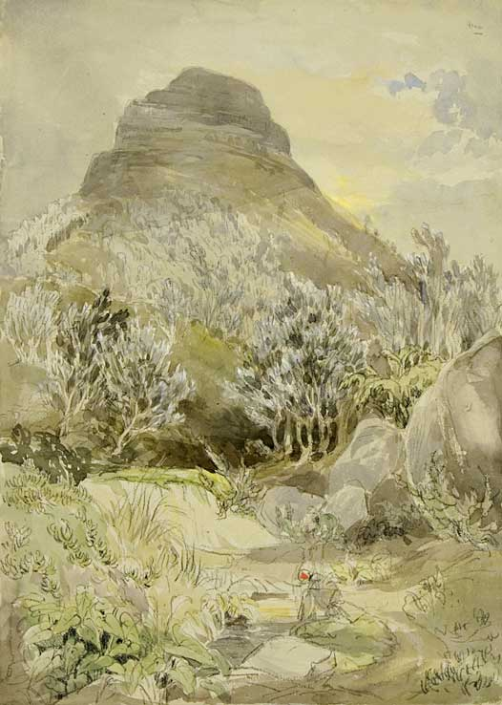
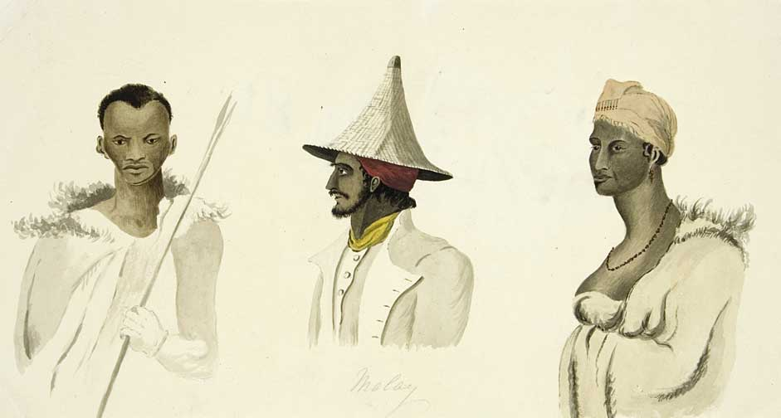
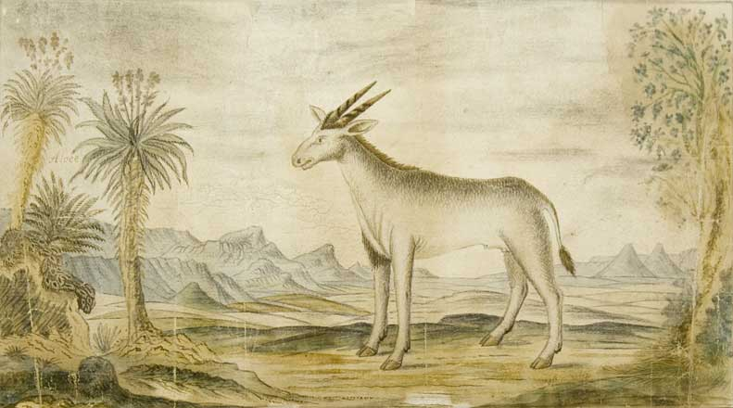
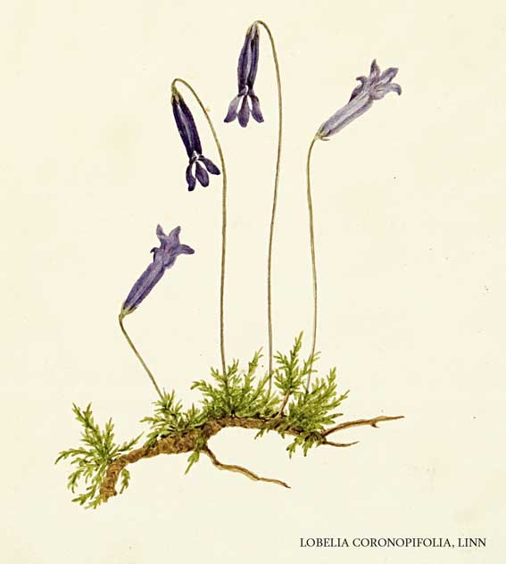
Pursuit of knowledge

Slide 9
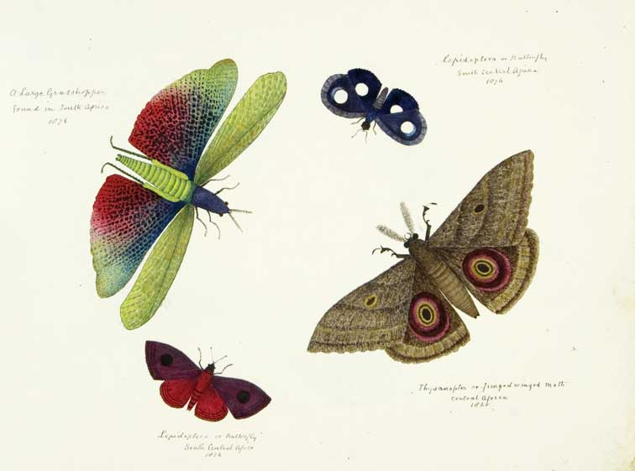
Cataloging knowledge

Slide 10
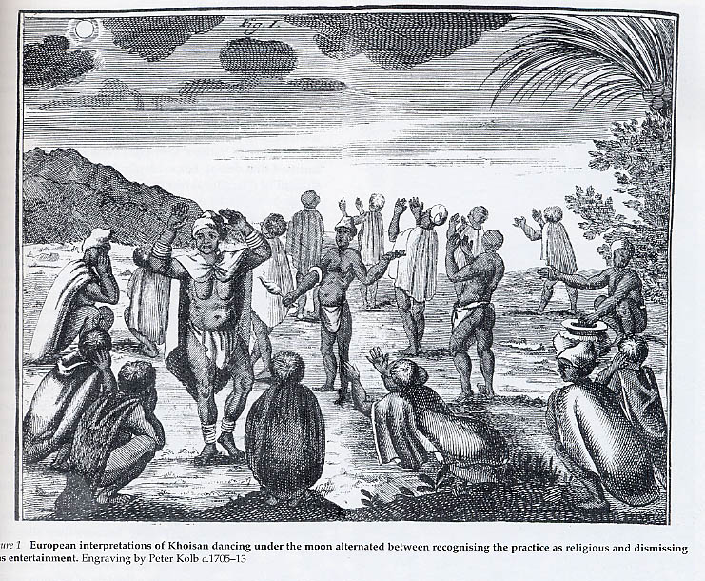
Khoisan moon dance
Peter Kolb, 1719

Slide 11
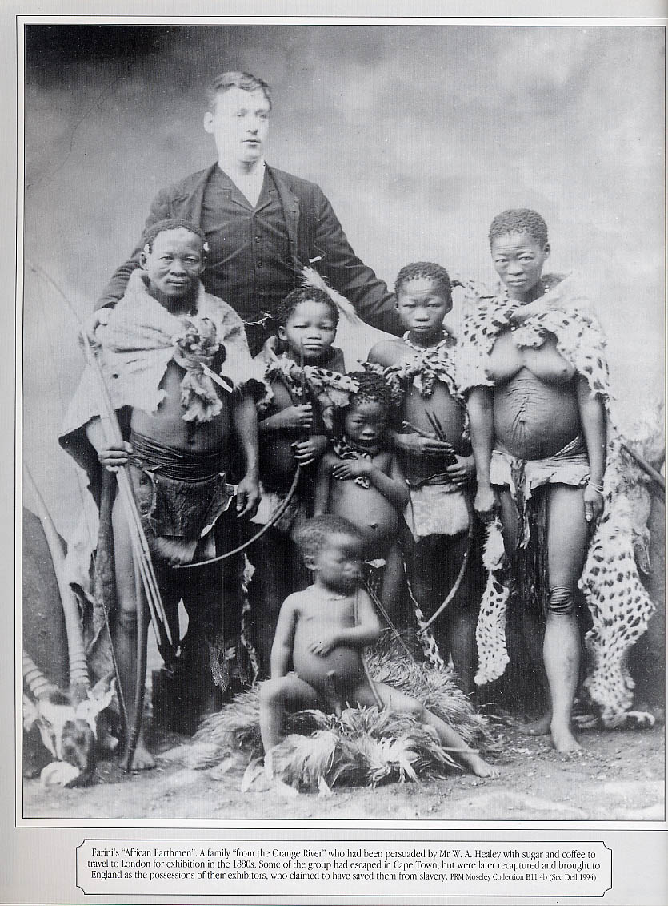
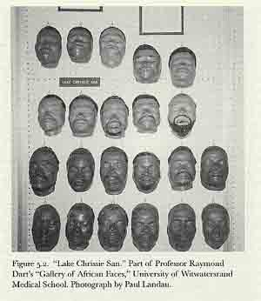
Physical objectification

Slide 12
Khoisan moon dance
Peter Kolb, 1719

Slide 13
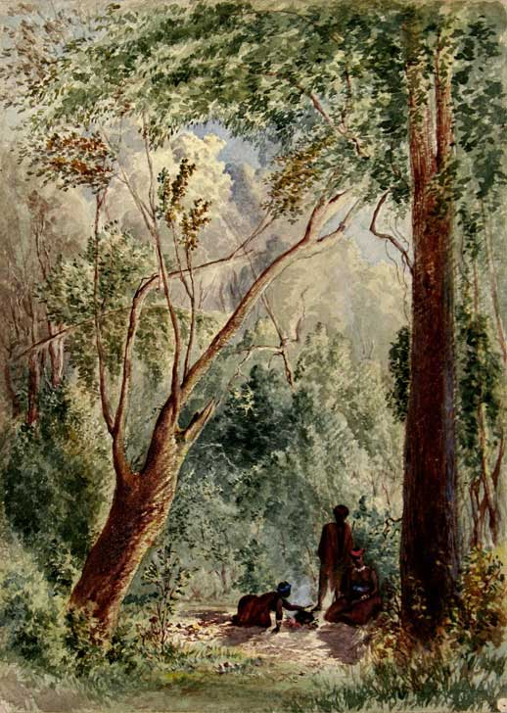
Colonial
Landscapes

Slide 14
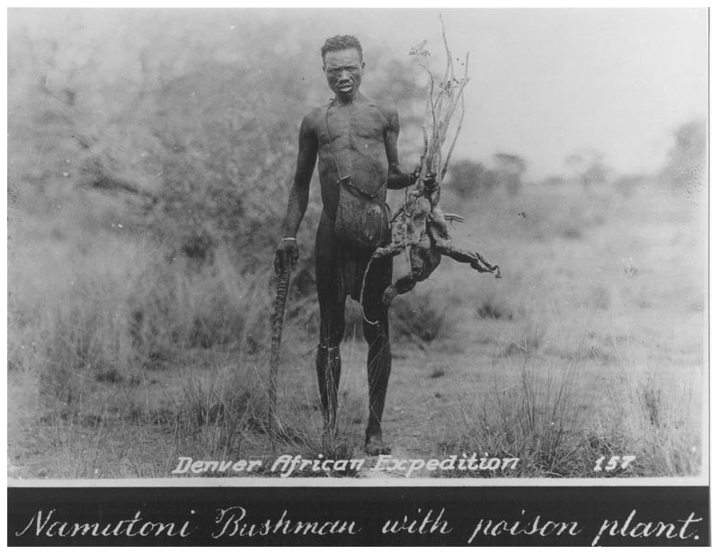
Denver Expedition, 1925

Slide 15
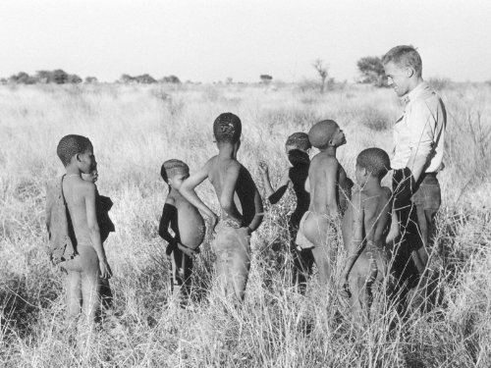
The Marshalls, 1950 – 2000s
Ju/’hoansi
Kalahari Desert

Slide 16
Reminders of Persistent Stereotypes
He has no religion, no laws, no government, no recognized authority, no patrimony, no fixed abode. A soul, debased, it is true, and completely bound down and clogged by his animal nature. Morally, as well as physically, his aspect is dark and discouraging.
Henry Tindall, 1856
I only know that from that morning I have been pursued by a vision of those hills as a great fortress of once living Bushman culture, a Louvre of the desert filled with treasure...All in all, [Nxau] had a wild beauty about him. Even his smell was astringent with the essences of unnamed earth and wild-animal being...I feel myself in the presence of an ever-recurring mystery, which for the European has its most authoritative expression in the New Testament: "The stone which the builders rejected is become the headstone of the corner." Men are renewed through what they have despised and rejected...All this became for me, on my long journey home by sea, an image of what is wanted in the spirit of man today. We live in a sunset hour of time.
Sir Laurens van der Post, 1965.

Slide 17
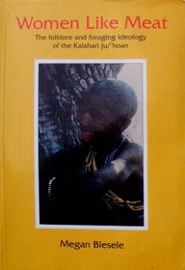
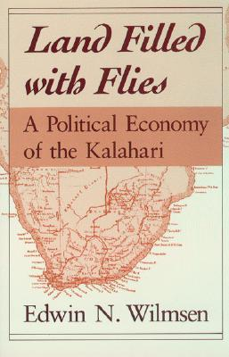
More recent scholarship
Megan Biesele
Edwin Wilmsen
1993
1989
Learning Objective : Western science is one among many ways of approaching/understanding nature, and not a universal truth

Slide 18
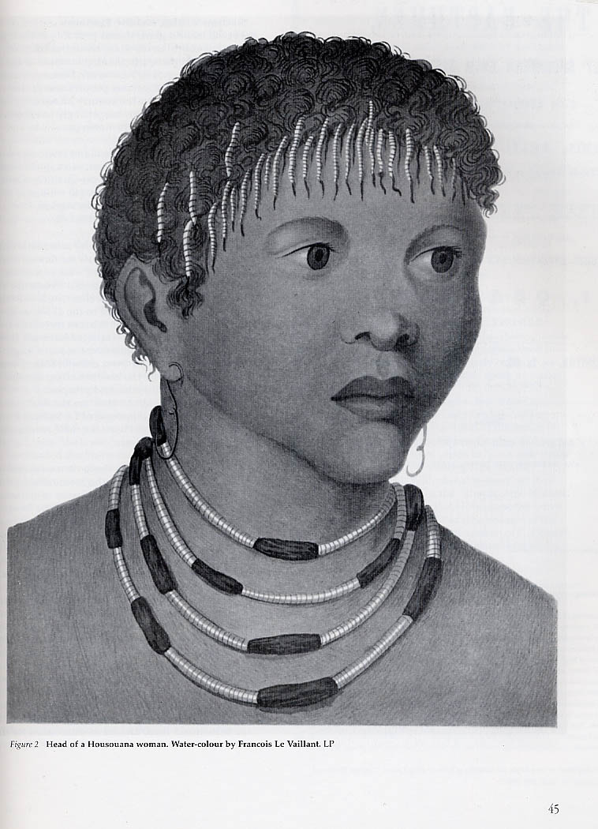
Posing a research question
How have Western (European) perceptions of Khoisan peoples changed over time?
Learning Objective: Students should be able to describe how historians ask questions and gather evidence to construct answers.

Slide 19
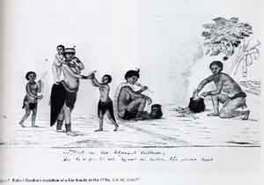
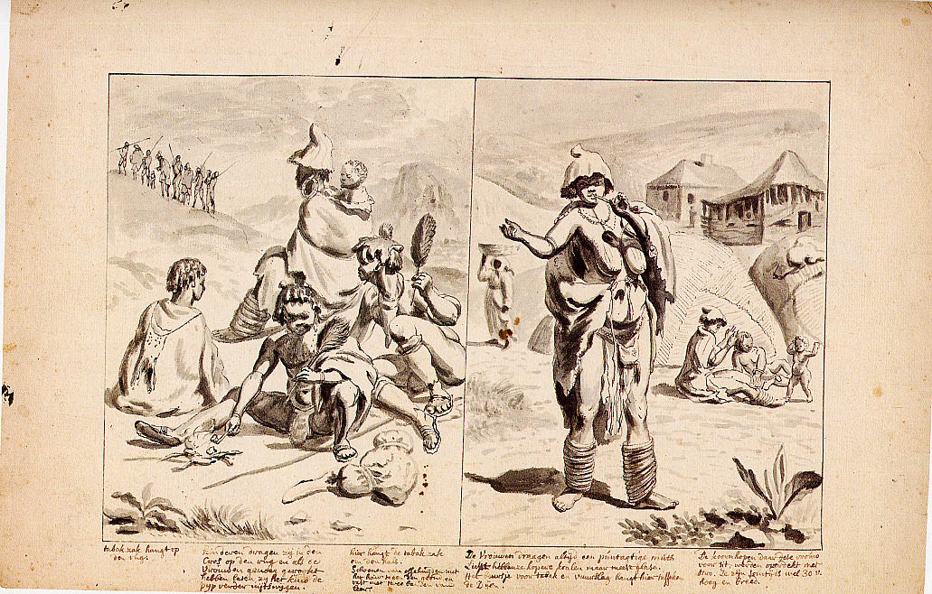
Noble Savage

Slide 20
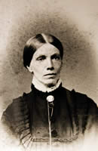
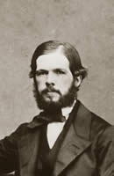
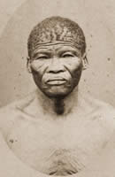
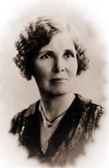
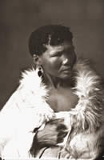
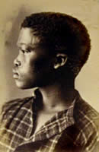
“Vanishing” People
Lucy Lloyd
Wilhelm Bleek
||kabbo
|a!kunta
Dorothea Bleek
!kweiten ta ||ken
Notes:
Images from UCT Lloyd-Bleek collection
http://lloydbleekcollection.cs.uct.ac.za/

Slide 21
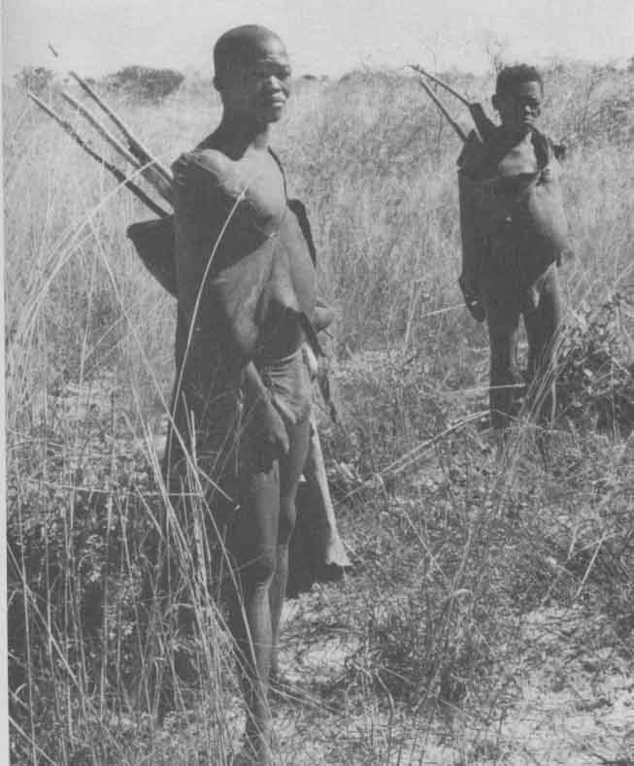
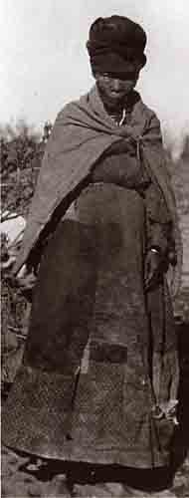
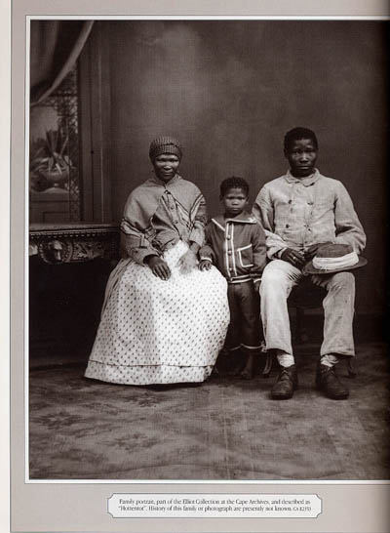
“Primitive” people?

Slide 22



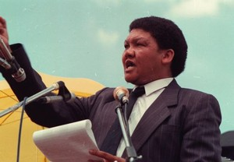
Who speaks for Krotoa?
Trudie Bloem, 1999
c. 1642 - 1674
Khoisan X (Benny Alexander)
1955 - 2010
2005

Slide 23
Baswara land claims
1990s forced relocation in Botswana
2006 Botswana Supreme court ruling
Jan. 2011 Basarwa win court appeal

Slide 24
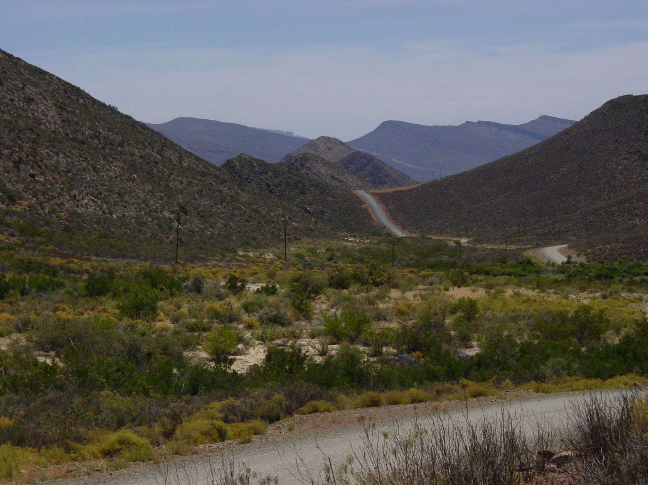

Making meaning with nature

