Slide 1
Dionysus (Bacchus, Bromius, Evius)
A multifaceted god

Slide 2
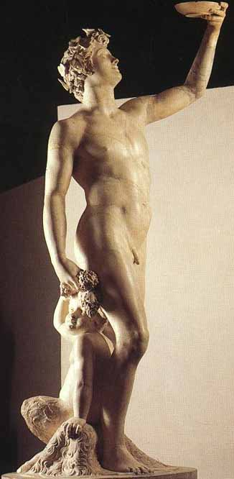
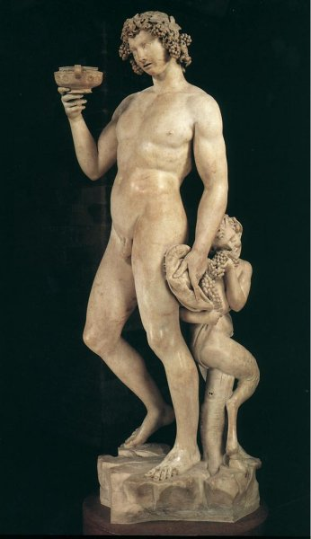
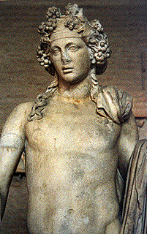

Slide 3
Who is Dionysus?
Son of Zeus and Semele
God of vegetation (the male equivalent of Demeter), esp. of the vine and the grape
Represents ecstasy and madness
Associated with the theater

Slide 4
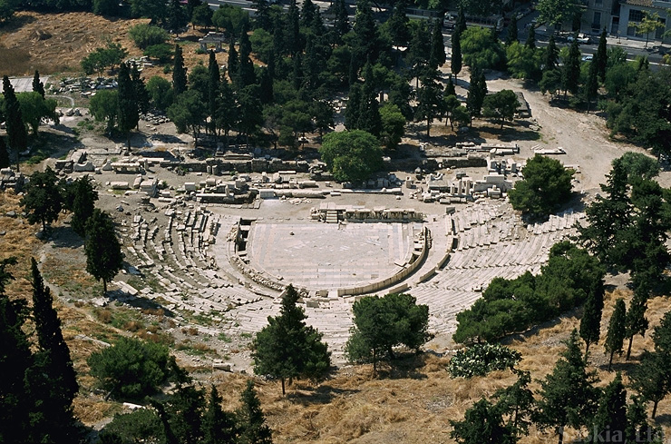
Theater of Dionysus

Slide 5
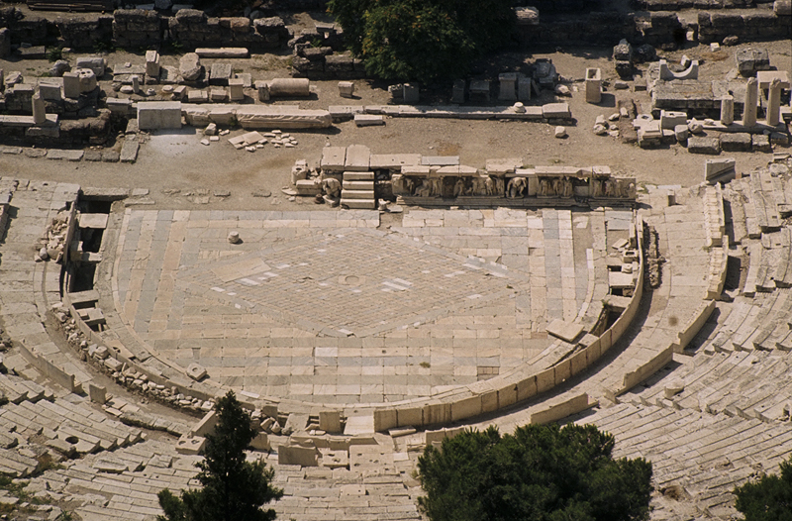
Theater of Dionysus

Slide 6
Characteristics of Dionysiac religion
Spiritual release through music and dance
Possession of the god by his followers
Sparagmos
Omophagy

Slide 7
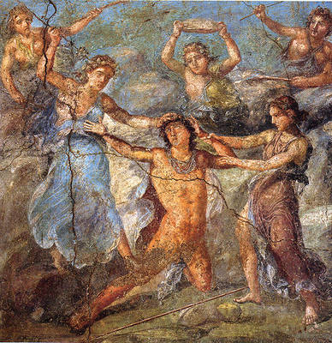
Sparagmos

Slide 8
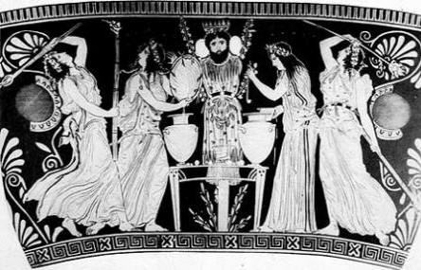
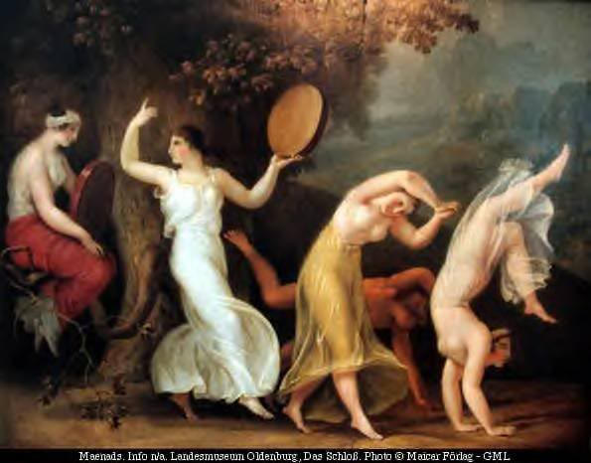
Maenads

Slide 9

Dionysus and the Dissolution of Boundaries
Psychologically, D. signifies free emotional life unimpeded by the restrictions of family, society, religion, and morality. (Physis vs. Nomos)
Culturally, he confuses distinctions between city and wild, mortal and immortal, man and beast, male and female.
In the Dionysiac performance/theater, the actor fuses with the character whom he represents. The spectator identifies with the masked figure before him/her. (Symbolic identification of the self with the other)

Slide 10
Divinity | Beast
At the center of the civic religion | Worshipped on the mountains
Male god | Soft and sensual, like a woman
Greek | Arrives from Asia
Neither child nor man | An eternal adolescent
Brings wine to men | Drives women to madness
Thyrsus: opens channels of fluids from the earth | A dangerous weapon, a ’shaft’ or ‘missile’

Slide 11
Euripides’ Bacchae
Written in the last year of Euripides’ life
Produced in Athens after the author’s death, which occurred in 406 BCE.
Won a posthumous first prize
Has the wildest and most original choral odes in Euripides’ corpus

Slide 12
Why the Bacchae?
Humans refuse to worship a god. Why and how do they pay for their ‘sin’?
A god is deemed inimical to society. Why?
Nature hosts activities that upset social norms. How?
A god is worshiped in nature. Why?
Human rationality impedes understanding of the divine. Measure is pitted against what is immeasurable.
Divine wrath is excessive and implacable.

Slide 13
Dionysus and Doubling in the Bacchae
Two worlds/worldviews: the supposedly rational, civic world of Pentheus and the irrational, ecstatic worldview of Dionysus.
Two sets of maenads: the Asian maenads who follow the god, and the constrained maenads of Thebes.
Two Dionysuses: the god disguised as the Stranger and the god who asserts his power over Thebes in his own person in the prologue and exodus (deus ex machina).
Two scenes of the constrained maenads: one in which the women behave in peaceful ways, and one in which they turn murderous.

Slide 14
Structure of an ancient Greek tragedy
Prologue
Episodes followed by choral odes, the first one of which is called parodos
Exodus

Slide 15
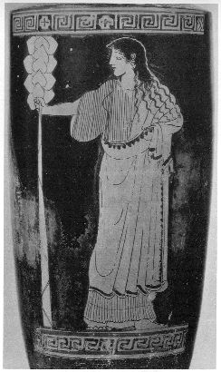
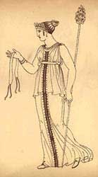
Thyrsus

Slide 16
What has happened to the Theban Women?
‘I bound the fawn-skin to the women’s flesh and armed their hands with shafts of ivy’ (24-25)
‘I have stung them with frenzy, hounded them from home up to the mountains where they wander, crazed of mind, and compelled to wear my orgies’ livery. Every woman in Thebes—but the women only—I drove from home, mad’ (32-36).
‘There they sit … beneath the silver firs on the roofless rocks’ (38)
They wait and engage in ‘whirling dances’ (63)

Slide 17
Men’s action(s) and Dionysus’ reaction(s)
He ‘revolts against divinity, in me; thrusts me from his offerings; forgets my name in his prayers’ (45-47).
‘Therefore, I shall prove to him and every man in Thebes that I am god indeed’ (47-48).
But if the men in Thebes attempt to force my Bacchae from the mountainside by threat of arms, I shall marshal my Maenads and take the field’ (51-53).

Slide 18
Dionysus’ Birth
‘So his mother bore him once in labor bitter;
Lightning-struck, forced by fire that flared from
Zeus, consumed, she died, untimely torn, in
Childbed dead by blow of light! Of light the son
Was born!
Zeus it was who saved his son; with speed
Outrunning mortal eye, bore him to a private place,
Bound the boy with clasps of gold; in his thigh as in a
Womb, concealed his son from Hera’s eyes’ (88-99)

