Slide 1
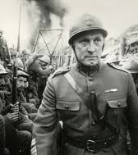
Paths of Glory
1935 novel by Humphrey Cobb
1957 film, United Artists
Directed by Stanley Kubrick
Featuring Kirk Douglas
as Colonel Dax

Slide 2
Thomas Gray, "Elegy Written in a Country Churchyard” (1751)
  The boast of heraldry, the pomp of power,
  And all that beauty, all that wealth e'er gave,
  Awaits alike the inevitable hour.
  The paths of glory lead but to the grave.

Slide 3
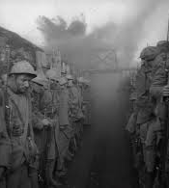
Context: First World War
Western Front, France
Unbearable conditions of trench warfare
Virtual stalemate
Thousands of casualties
fighting over mere yards
Many never even saw the enemy
BUT, also first filmed war,
and most frequently represented war in cinema history from J’accuse (1919) to War Horse (2011)

Slide 4
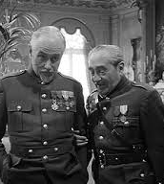
Jus in bello?: View from above
Command responsibility
Ethical treatment of one’s own combatants
War as profession for officer corps
    Class differences
    Cynical careerism?
Generals Mireau (George Macready) and Broulard (Aldophe Menjou)

Slide 5
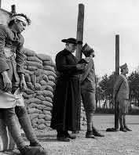
Jus in bello?: View from below
Enlisted men pay for general’s failed leadership
Injustice of three soldiers “selected” to be executed as example
  Petty vengeance
  Drawing of lots
  Social perception

Slide 6
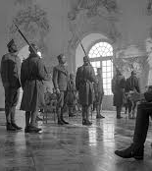
Jus in bello?
Court martial
  Military justice
    vs. civil trial
  Trial by peers or by superiors
  Rules of evidence?
  Col. Dax as mediator
    (was attorney prior to military service)

Slide 7
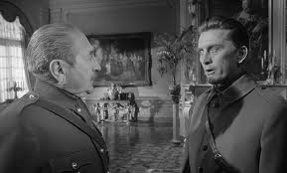
Jus in bello?
Command hierarchy
  someone always responsible
Or, bureaucracy?
  - no one ever responsible
Where is Dax?
Rewards for moral heroism? Or not?

Slide 8
What no one wants to hear?

Slide 9
Value of representation?
Does fiction allow for truth to be told that could not otherwise be said?
Confusion between particular example and general observation?
  French reaction to Paths of Glory
Or, return to the Iliad as epic depiction of strife between combatants on same side as well as on opposite sides?
Or, more generally, the tragic realization of our subjection to force and circumstance?

Slide 10
Simone Weil
“… the sense of human misery is a pre-condition of justice and love. He who does not realize to what extent shifting fortune and necessity hold in subjection every human spirit, cannot regard as fellow-creatures nor love as he loves himself those whom chance separated from him by an abyss. . . . Only he who has measured the dominion of force, and knows how not to respect it, is capable of love and justice.” (p. 45)

Slide 11
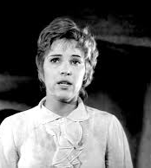
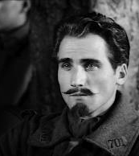
Alternative to the paths of glory
(that lead but to the grave)?

Slide 12
Der Treue Hussar (The Faithful Hussar)
Es war einmal ein treuer husar
Der liebt sein mädchen ein ganzes jahr
Ein ganzes jahr und noch viel mehr
Die liebe nahm kein ende mehr
Und als man ihm die botschaft bracht
Dass sein herzliebchen am sterben lag
Da liess er all sein hab und gut
Und eilte seinem herzliebchen zu
Once there was a faithful hussar
Who loved his maiden for a whole year
A whole year and even more
His love won't ever cease
And when he received the message
That his sweetheart dear was dying
All his goods and chattels he left behind
And hastened to his sweetheart dear
Crossing of gender and national divide yields alternative view of peace and love.
At human level (from below), no war; only what is imposed from above by ambition and greed of the mighty?

Slide 13
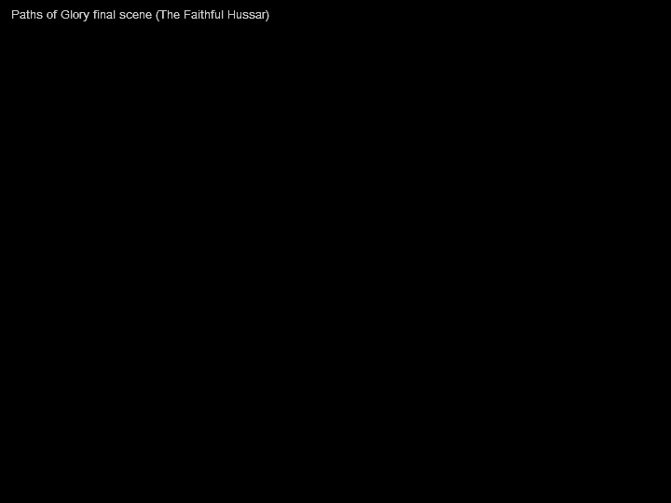
Notes:
Video will play in Slide Show view.

