Slide 1
Epic Theater as
Pedagogical Theater
Last time…
One of the goals of EPIC THEATER is to interrupt our pity, doing so by de-naturalizing the dramatic event going on on stage…
By making Mother Courage’s and her children’s experiences of the war and their reactions to it un-real and un-realistic, the play allows us to analyze the causes of the events (of war) being re-presented…
The role of the state / the role of the “military-industrial complex”…
The audience should think about its own role in the ‘making’ of this un-natural world of war…
Be provoked to “un-make” that world – which is their world…
Helene Weigel (Brecht’s wife) as Mother
Courage / Berlin production (1949)

Slide 2
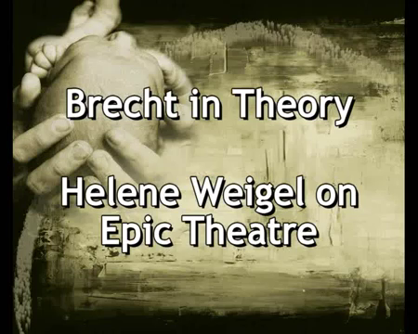
The World of the Play:
The Audience Should Become a Collective of “Thinking Human Beings”…

Slide 3
The audience of the play becomes a collective of “thinking human beings” by thinking about – and “casting [their] vote” (Brecht on Theater, p. 39) – the world in the play and the values of this world…
Think about the material determinants of the world in the play (politics, finance, war)…
And the values such a world produces…
And the reproduction of those values in their world…
“It’s got to stop!” (Brecht on Theater, p. 71)
De-naturalizing / non-dramatic and un-realistic “epic theater” thus distances the audience from what’s going on on stage so that the audience can think about what it is observing and judge it!
It “interrupts” the audience’s immediate relationship to the world in the play so that the audience can take action in its world…
One small problem…

Slide 4
Epic theater in Translation / Un-realism and 21st-century Cussing
Tony Kushner’s English translation contains quite a bit of profanity…
Intensified even over Brecht’s profanity…
Cussing updated…
The Young Soldier (Scene Four, p. 57): In German: “Leck mich am Arsch” → Kushner’s version?
Brecht’s German → → →
Is there a problem with making the language of the play sound more “real” / bringing it closer to us, even “flattening” it out?
Isn’t this exactly the opposite of Brecht’s epic theater?
Or is this Kushner’s re-presentation of Brecht’s re-presentation of the Thirty Years’ War…for his world!
Brecht’s original German is a mix of
  Regional, southern German dialect (he was from southern Germany)
  Anglicisms (English-derived or -based words when there were perfectly good German words to use / “Fakt” for “Tatsache” (“fact”)
  Anti-metaphorical speech / concrete images
  Bureaucratic jargon
  Brecht’s “popular style seeks to imitate less the reality than the ‘idea’ of natural speech” and is thus “popular only idealiter” (an illusion of “the people’s” diction) (Mennemeier)

Slide 5
The Values of Mother Courage’s / Mother Courage’s World in the play

Slide 6
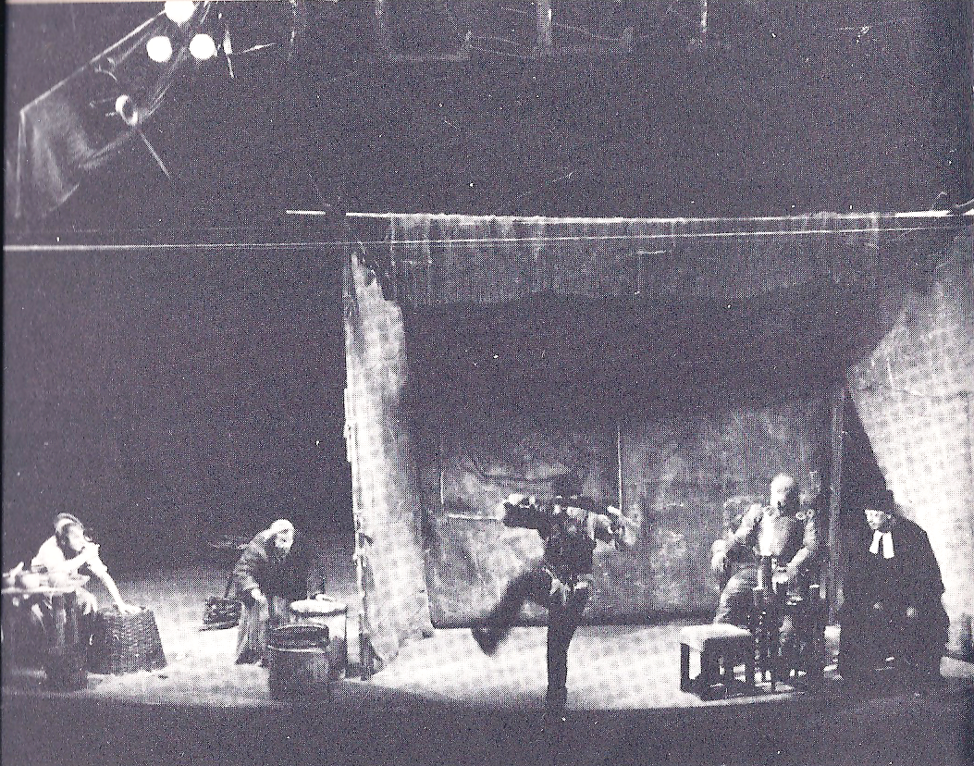
“Fatal” Values / Fatal “Virtues”:
Virtue #1: “Heroism” in Mother Courage and her Children
Brecht: “What is a performance of Mother Courage and her Children primarily meant to show?” / “That war is a continuation of business by other means, making the human virtues fatal even to those who exercise them.” (Couragemodell, 1949).
The General (to Eilif): “You’re a hero…” (“Heldentat,” the act of a hero)
Eilif: “You really work up an appetite, butchering peasants” (Scene Two, pp. 20-21)
Mother Courage asks the Cook about Eilif: “Any more heroism?” (“Heldentaten,” Scene Eight, p. 84)
Eilif Dancing and Singing “The Song
About the Solider and his Wife” (Scene
Two, p. 25) / Berlin production, 1949

Slide 7
Is this heroism?
For Brecht, even this problematic “heroism” is in fact merely boldness …
Commentary in the ballads…
“The Ballad of the Famous”
The Cook: “A lecture in the form of a song, the Song of Solomon, Julius Caesar and other men possessed of a gigantic spirit (“große Geister”), which proved to be of little use” (Scene Nine, pp. 88-91)
Solomon / Julius Caesar / Socrates / St. Martin
Second stanza → → →
“Then Julius Caesar, mighty one, //…So brave (“kühn”) he tore the world apart, // So they voted and changed their Caesar to a God, // Then drove a dagger through his heart, //… So brave, but screaming out in fear he ends. // Brave hearts (“Kühnheit”) are grand! We’re fine with none” (p. 89)
“Our virtues led us to our wretched ends. // And folk do better who have none.” (p. 91)

Slide 8
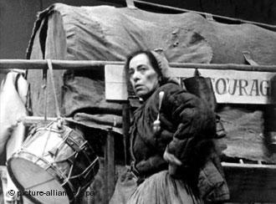
No need for any kind of “heroism” when war is a “continuation of business by other means”...
Political “business as usual”
Mother Courage: “Think the war will end now?”
The Chaplain: “There will be brief pauses…But the Emperor or the King or the Pope reliably provides what’s necessary to get it going again. This war’s got no significant worries as far as I can see…” (Scene Six, pp. 62-3)
Business “business as usual”
Mother Courage: “What else is war but a profit-making competition, / A profit-building enterprise” (Scene Seven, p. 70)
Helene Weigel as Mother Courage (Berlin
production, 1949)

Slide 9
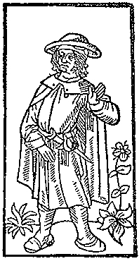
Sidebar: Brecht’s Hidden Inter-Texts and the Politics of Cribbing
“The Ballad of the Famous”
Based on a ballad by the late medieval poet, François Villon (1431-c.1463)…
Villon wrote mostly about men destined for the gallows, indulged in parody and lewd jokes; some of his poems use Parisian thieves' slang. / His verse is mostly about his own life, a life of poverty and run-ins with the authorities…
Good choice by Brecht? / “Small people”?
German translation of Villon by K.L. Ammer (1879-1956) – Des Meisters Werk (1907)
Brecht basically plagiarized Ammer’s work…
Ammer only got royalties after the ‘borrowings’ had been pointed out in reviews..
Woodcut illustration from Le Grand Testament
de Maistre François Villon (Paris, 1489)

Slide 10
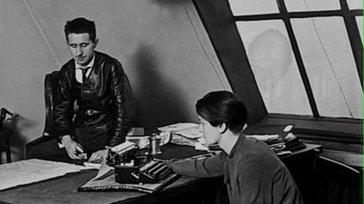
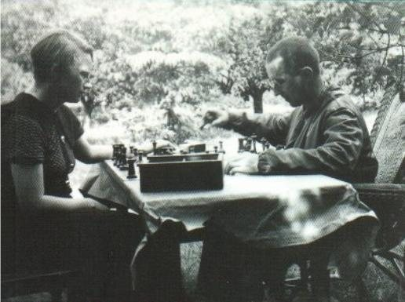
Brecht notoriously
used the work of many
authors under his
own name, most
prominently scenes and
songs written by his
lovers, Elisabeth
Hauptmann (1897-1973)
and Margarete Steffin
(1908-41), without giving
them credit…
Brecht and Elisabeth Hauptmann
Brecht and Margarete Steffin

Slide 11
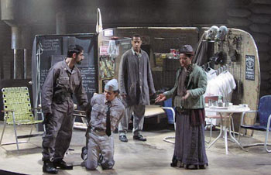
Virtue #2: (Real) Honesty in Mother Courage and her Children
Swiss Cheese and the cash box (Scene Three)
Mother Courage: “They made you paymaster because you’re honest, you’re not brave like your brother, they like it that you’re too feeble-minded to get your mind around the idea of stealing it.” (p. 28)
Swiss Cheese: “It’s the regimental cash box…It’s my responsibility.” (p. 37)
The wages of honesty in the world of Mother Courage and her Children?
Mother Courage and her Children – Production
by the Classical Theater of Harlem (2004) –
Mother Courage: “Why should I know him?”
(p. 43)

Slide 12
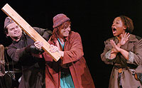
Virtue #3: Compassion in Mother Courage and her Children
Mother Courage: “You can’t be so kind, Kattrin” (Scene One, p. 16)
Stage directions: “Kattrin emerges from the rubble, carrying an infant.”
Mother Courage: “Oh what luck, who’s found herself another suckling to haul around? You give it back to its mother one-two-three before you get attached and I have to spend hours pulling it away, do you hear?” (Scene Six, p. 60)
Compassion as a viable value in this world?
Kattrin threatens Mother Courage (Scene Five,
p. 59) – Cal Poly Pomona production of Mother
Courage and her Children (2006)

Slide 13
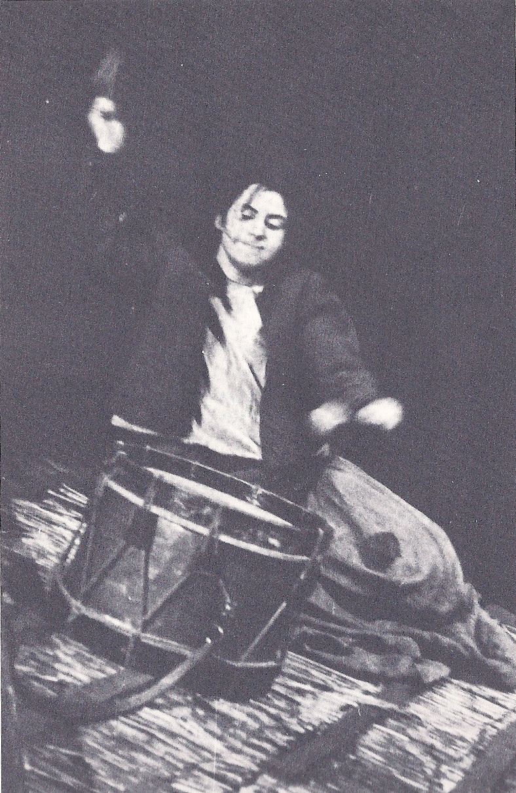
Doubling up the “Fatal Virtues”:
Kattrin’s Compassionate Heroism
Scene Eleven / The Attack on Halle
“The stone begins to speak” (p. 93)
The Farmer’s Wife: “Remember her mother, Lord, who’s gone there…and protect my brother-in-law and the four kids my late sister’s left him…save the four kids who never did nothing wrong.” (p. 96)
First Soldier: “Listen. It worked. She did it.” (p. 102)
Did it “work”? / What are the wages of compassion in the play?
Mother Courage and her Children /
Berlin production (1949) / Scene Eleven

Slide 14
Even in this scene, however, our compassion as spectators…
…is interrupted by Brecht via comedy…
The Lieutenant (calling up to Kattrin): “You don’t believe him, you aren’t stupid, you know we’re not friends and anyway, who’d trust someone with a face like his?” (p. 99)
Look for how Carl Weber describes the additional “comedy” of this scene in the Berlin production of 1949 in the film, “Theater of War”…
Epic theater…

Slide 15
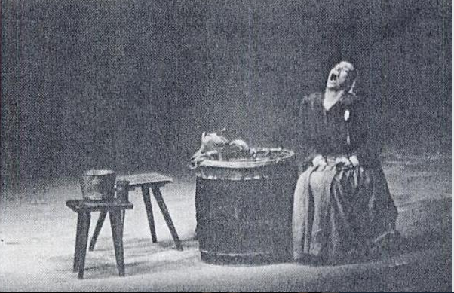
Virtue #4: Empathy in
Mother Courage and her Children
Brecht: “The scene with the drum [Scene Eleven] particularly stirred the spectators…Members of the audience may identify themselves with dumb Kattrin in this scene; they may get into her skin via empathy and enjoy feeling that they have the same latent strength...” (Couragemodell, 1949)
But do they have empathy with Mother Courage in the next scene (Scene Twelve)?
“The Lullaby” (p. 102)
But Mother Courage has no empathy with “the poor people”…
Mother Courage: “Only poor people need courage…but it’s a perverted courage…” (Scene Six, p. 65)
Do we empathize with the woman who says this later in Scene Twelve? / Does Brecht allow us to? /“The Lullaby” vs. “I have to get back in business” (pp. 102-3)
Helene Weigel as Mother Courage /
Mother Courage and her Children /
Berlin production (1949)

Slide 16
These “virtues” are “fatal” in the play (sometimes they are not even “virtues”…) – and pointless
Is the problem here one of individual virtuous actions?
Scene Eleven and Individual Agency in the Play
The Farmer’s Son: “Cut my throat. I won’t help you.” (p. 95)
The Farmer: “I dunno, maybe if we could…you know, we could hoist one of the tall tree trunks somehow and use one end to sort of shove her off and – “ (p. 98)
The Farmer’s Son: “Keep drumming! They’ll kill them all! Drum! Drum! Drum!” (p. 101)
Stage Directions: “The First Soldier…clubs him brutally.” (p. 101)

Slide 17
Brecht is thus arguing that in a world in which the state and the military-industrial complex are in bed together (so to speak), individual actions are not enough…
There must be collective resistance to the conditions that enable war…
Or at least this is one of the theses of “Theater of War” (dir. Walter) (2008)…
Do you agree that this is Brecht’s message?

Slide 18
The Individual’s “Despair”:
Mother Courage Caught between an Ethics of Care and a Politics of Self-Interest / Survival
Mother Courage: “I don’t care if I’m ruined. At least two of my children survived the war, I saw to that.” (Scene Eight, p. 73)
vs.
“Peace is finished! The war’s been back on three whole days…Thank God!” (Scene Eight, p. 83)
In the play, Brecht leaves her “without any alternative”… (Couragemodell, 1949)
She is to be a “warning” / “Courage has learnt nothing.” - (Brecht, Theaterarbeit, 1952)
So that the audience can learn → EPIC THEATER!

Slide 19
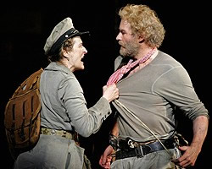
Pure Self-Interest: The Cook
Yvette: “The nastiest fish ever to wash up on the Flanders shore” (Scene Eight, p. 80)
Indeed…
The Cook: “[Y]ou can’t bring [Kattrin to Utrecht]…who’d want to look up from supper and see that waiting to clear the table?” (Scene Nine, p. 89)
Brecht leaves him alone both on stage and in the world in the end (p. 92)…
Meryl Streep as Mother Courage / Kevin Kline
as The Cook / Mother Courage and her
Children / NYC production (2006)

Slide 20
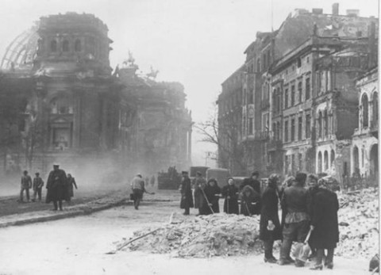
Back to Epic Theater…
Does the Audience Always Learn?
1941 / 1949
The “conditions of determination” were different for the two different audiences…
As they are for all audiences and agents…
Zurich, Switzerland (1941) – Swiss neutrality / still during the war
Berlin, Germany (1949) / four years after the Battle for Berlin
These conditions are both physical and psychological…
The Rape(s) of Kattrin / Mother Courage: “No husband for her now” / Scene Six, pp. 68-70
Mass Rape of German Women by Soviet and French Soldiers and U.S. GIs in 1945…
Most widespread in Berlin…
The women in the 1949 audience would have remembered…
Can epic theater always distance the audience from the action?
Berlin, Germany / May, 1945 / Streets
around the Reichstag

Slide 21
Brecht’s Response to the Audience’s Responses in 1941 (Zurich) / 1950 (Munich)
“It sounds from the press notices and spectators’ reports as if the Zurich premiere, while attaining a high artistic level, simply represented a picture of war as a natural disaster, an unavoidable blow of fate…[and] Courage’s business activity, her keenness to get her cut…as ‘perfectly natural’…”
- Brecht, Theaterarbeit, 1952)
The Munich production appears to have elicited the same response…
So, in 1950, Brecht added the line: “I must get back into business” (Scene Twelve, p. 103) to interrupt and de-naturalize that audience response…

Slide 22
Your / Our Response to Brecht’s Response?
Heartless? Cold?
Yet, his point was that such things should not happen!
Pedagogical theater as an instrument of the greater good, no matter what it takes?

Slide 23
Brecht’s Heroism:
Surviving the War → Surviving the Peace

Slide 24
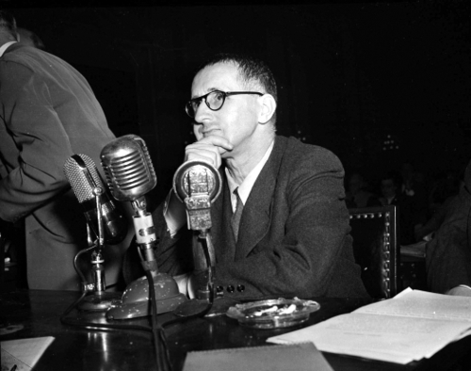
Brecht in the post-war U.S.
The Intellectual in the Face of Authority / Deceit and Deception /
Watching out for himself…
A committed Socialist, Brecht fled Hitler’s Germany for the U.S. (via Denmark , Sweden, Finland, Moscow) in 1933, arriving in U.S. in 1941…
Brecht then fled the U.S. the day after he is interrogated by the House Un-American Activities Committee (HUAC) in 1947 as a suspected Communist sympathizer
The Cold War-era McCarthy Hearings / Hollywood Blacklist hearings / The “Hollywood Ten” refuse to testify…he does / And denies that he was ever a communist…
Brecht returns to Communist East Berlin, East Germany, after 1949, but keeps his Swiss citizenship…
- Produces Mother Courage and her Children in 1949 partially to curry favor with the Communist East German government, that was suspicious about his political reliability…
Brecht testifying in front of HUAC, 1947

Slide 25
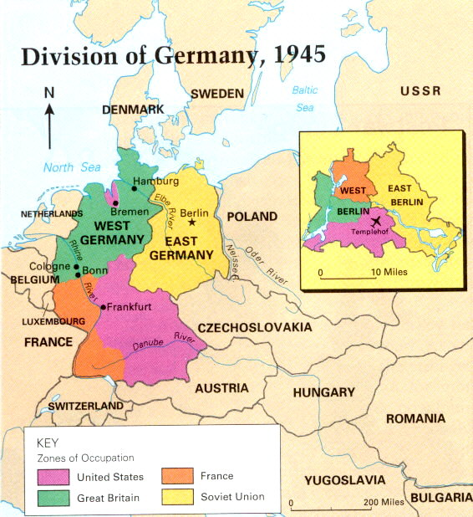
Two Germanies
(1945-1989)
- East Germany
(under Soviet
Russian
influence)
- West Germany
(under western
European /
NATO influence)
German
- Reunification
(1989/90)

Slide 26
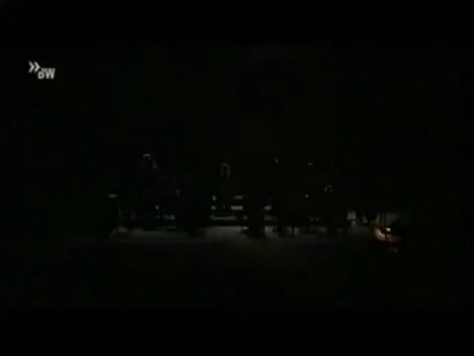
Brecht as Simplicius in the 1947 Cold War U.S.
The HUAC Hearings…
Deceit and / or Prudence?

Slide 27
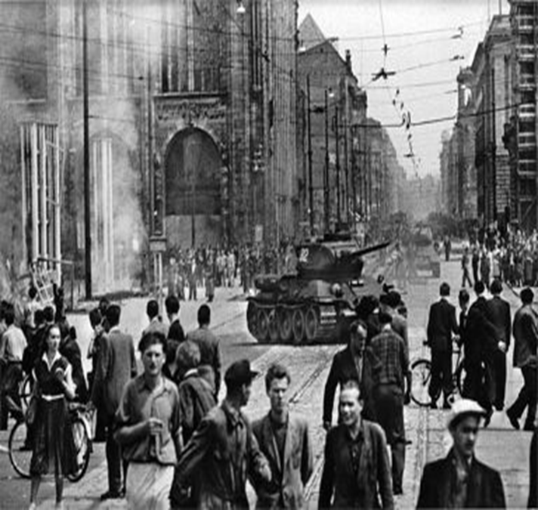
Fast forward…
Hero or Villain? Bertolt Brecht in Cold War East Berlin, East Germany /
Workers’ Uprising (June, 1953)
Popular uprising against the East German government because of increased work hours / quotas imposed by the central government under pressure from the Soviet Union
400,000 people demonstrated
150-1,000 casualties (still debated) as a result of the government’s response
Brecht publicly supports the crackdown of the regime!!!!
Theodor Adorno called the Brecht who moved back to East Germany / East Berlin a “eulogist for complicity” who “championed” not an “imperfect socialism but a tyranny”
An intellectual traitor who had abandoned the very workers / “small people” for whom he claimed to speak…

Slide 28
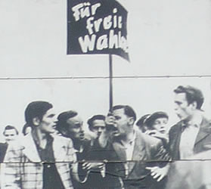
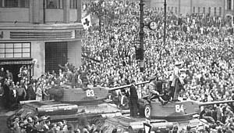
Brecht’s Reaction to the Workers’ Uprising, East Berlin, 1953 / Surviving the Post-War Peace…
Brecht:
"History will pay its respects to the revolutionary impatience of the Socialist Unity Party of Germany. The great discussion [exchange] with the masses about the speed of socialist construction will lead to a viewing and safeguarding of the socialist achievements. At this moment I must assure you of my allegiance to the Socialist Unity Party of Germany.“
- published in East German newspaper, Neues Deutschland (New Germany) 1953
Still too risky – or too risky again in
Germany, as it had been in the U.S. - to say the truth?

Slide 29
Or was Brecht merely dedicated to the survival of his theater, the Berliner Ensemble, as an institution of Pedagogical / Epic Theater in the Post-War World that the East German government had allowed him to establish and that it supported…

Slide 30
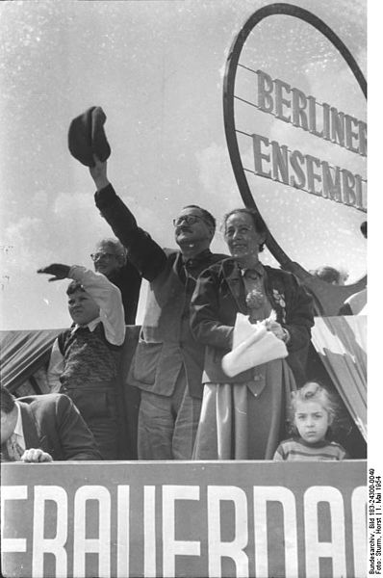
In his defense…
Brecht’s later poetic commentary on the uprising…
“The Solution” (1953)
“After the uprising of the 17th of June
The Secretary of the Writers’ Union
Had leaflets distributed in the Stalinallee
Stating that the people
Had forfeited the confidence of the government
And could win it back only
By redoubled efforts. Would it not be easier
In that case for the government
To dissolve the people
And elect another?”
Brecht and Weigel on roof of Berliner Ensemble
theater on 1 May, 1954 (International Workers’ Day)

Slide 31
In any case: Brecht’s Agency as a “Cultural Worker” in a wartime / post-war world was to re-present the past from a specific point of view…
According to Brecht, what are we to remember about the Thirty Years’ War?
The “Heroes” “from above” – Field Marshall Tilly’s death and the King Gustavus Adolphus of Sweden’s death (Scenes Six and Eight)?
Yes, for the State’s sometimes “invisible” (yet sometimes very visible) but crucial role in the war…
But also the war’s enabling conditions on the ground…
Mother Courage herself as the “supply train” (Scene Twelve, p. 103)
“Hopefully I’ll manage to pull the wagon alone…”
“I have to get back into business.”
The “military-industrial complex” and the individuals involved in it at every level…

Slide 32
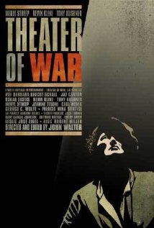
Next time
Re-Presentation as Politics
Re-Presenting the Thirty Years’ War in New York City in 2006…
Memory and Agency / Generations of War
The Cultural Work of Genre in an Era of War: Plays, Documentaries, and the Essay Film
Individual vs. Collective Action
in the Face of War

