Slide 1
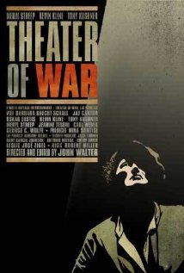
Important announcement!
The film for which you are responsible THIS WEEK, “Theater of War” (dir. Walter) (2008) is on Netflix!
Get together with classmates and watch it (more than once?)
It will also be shown TODAY, Monday, 4 November, in HIB 135 at 5 p.m., for HCC students!

Slide 2
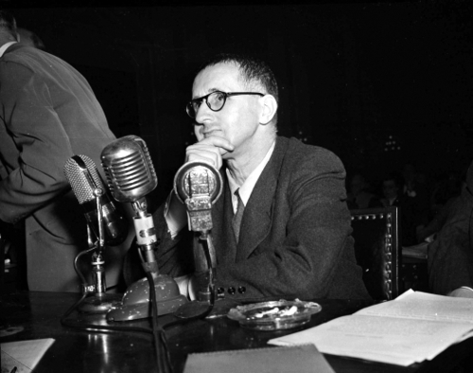
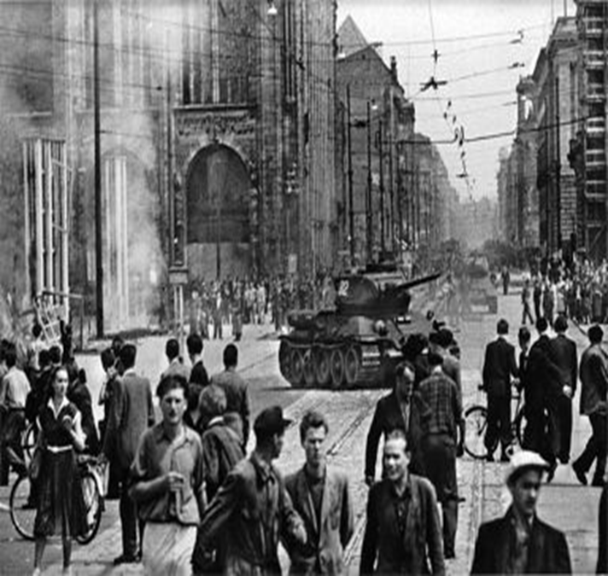
Transitions / Comparisons
Week 5 / Epic Theater → Week 6 / The Essay Film
Brecht’s “epic theater” as a pedagogical theater
And thus also as political theater!
MY PROPOSAL LAST TIME: The political impact of epic theater – its power to make the audience into a collective of “thinking” and ACTING “human beings” off stage – may have been worth the apparently deceptive / devious behavior in which Brecht engaged – in 1947 and in 1953 in the U.S. and in East Germany…
Canny “performance” in his testimony (HUAC / 1947) …
And the editorial and the poem after the workers’ uprising in 1953…
Double-talk in the interest of continuing to produce “epic theater” in Berlin?
As a provocation to thought…
And to action!
Brecht
testifying
In front of
HUAC / in
1947
Brecht’s
“doubled” response
to the 1953 workers’
uprising in East Berlin

Slide 3
Brecht’s “political theater” in 1947 (HUAC) and 1953 (East Berlin) /
Performing “Simplician” Double-Talk as a Form of Not-Just-Personal Survival in the Post-war World
Brecht’s 1953 Editorial
"History will pay its respects to the revolutionary impatience of the Socialist Unity Party of Germany. The great discussion [exchange] with the masses about the speed of socialist construction will lead to a viewing and safeguarding of the socialist achievements. At this moment I must assure you of my allegiance to the Socialist Unity Party of Germany.“
- published in East German newspaper, Neues Deutschland (New Germany) 1953
Brecht’s 1953 Poem / “The Solution”
“After the uprising of the 17th of June
The Secretary of the Writers’ Union
Had leaflets distributed in the Stalinallee
Stating that the people
Had forfeited the confidence of the government
And could win it back only
By redoubled efforts. Would it not be easier
In that case for the government
To dissolve the people
And elect another?”

Slide 4
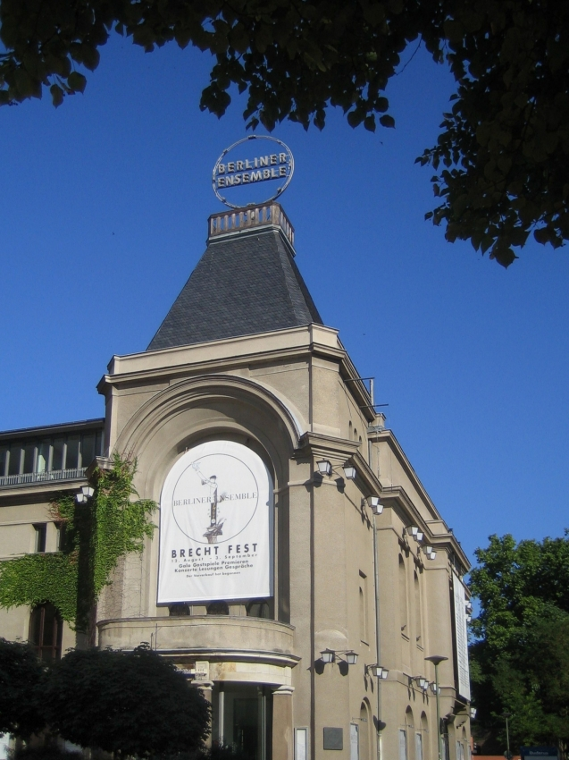
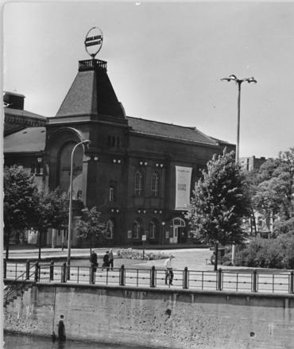
Rather…
The Survival of Brecht’s Theater →The Berliner Ensemble / Company established, with the support of the East German government, in 1949 / move into Theater am Schiffbauerdamm in 1954 / Where it still is today!
Berliner Ensemble today / Most recent
performance of Mother Courage and her
Children / Thursday, 31 Oct., 2013!
Theater am Schiffbauerdamm / 1964

Slide 5
From Week 5: Brecht’s “Epic Theater” (1930s-1950s) → Week 6: John Walter’s “Essay Film,” “Theater of War” (2008)
LAST WEEK:
“We need a type of theater which not only releases the feelings, insights and impulses possible within the particular historical field of human relations in which the action takes place, but [also] employs and encourages those thoughts and feelings which help transform [that] field [of human relations] itself.”
- Brecht, Small Organon for Theater (1948 / 1949)
Where is political agency in the case of epic theater?
Idealiter (ideally…) → off-stage = in the audience’s agency (rather than in the characters in the play…)
OUR QUESTIONS THIS WEEK:
Where is – and what is – (political) agency in the essay film?
NB ( = nota bene; Latin: “Take good note” / “Pay special attention!”) → Our answer may be related to issues of genre and to the location of agency (in collectives or individuals)
Remember: I said I was interested in the agency of the “cultural worker”
(the playwright / poet / film maker / the student)…
2. What kind of history do we see in the essay film? / Whose history? / From which point of view?
Is the act of thinking critically about history ‘agency-enhancing’, so to speak…?

Slide 6
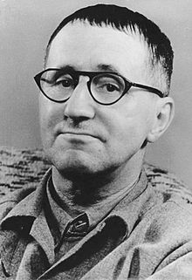
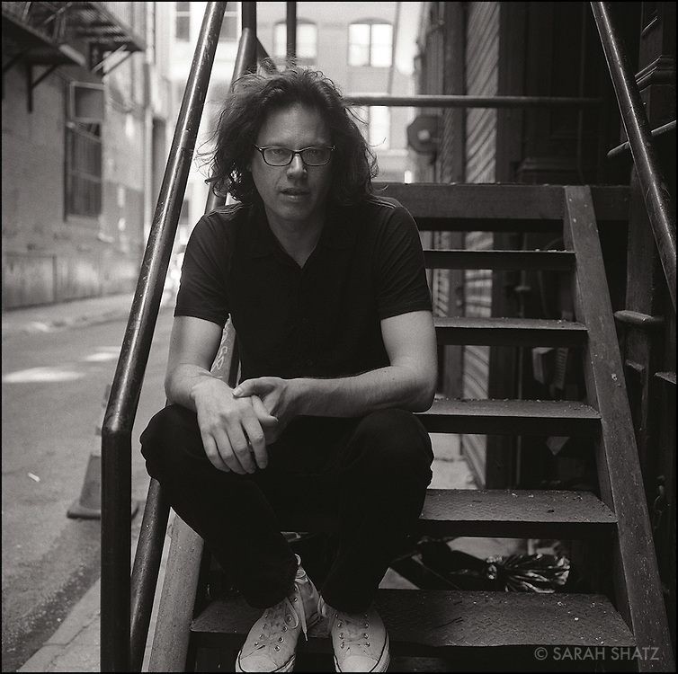
The Cultural Worker: From Brecht to Walter /
Is filmmaker / director John Walter difficult to see in this film?
→
Bertolt Brecht (1898-1956)
John Walter (b. 1961)

Slide 7
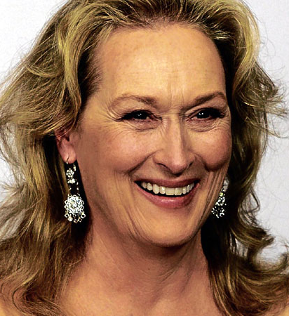
Yes!
The Problem of Star Power….
→
Bertolt Brecht
(1898-1956)
→
MERYL STREEP (b. 1949)
John Walter (b. 1961)

Slide 8
Thus, we have to pay special attention to Walter’s ‘shaping hand’ in “Theater of War” (2008) / To the “dialogue” between productions of Mother Courage and her Children (1949 → 2006), between the theater and the streets, and to the “histories” (of war and the state) being told both in and by this essay film!
“I was trying to create a dialogue between the 21st century production and the 1949 production, between what’s going on inside the theater and outside the theater, between the ideas that influenced Brecht and Brecht influencing other artists, the balance between learning and entertaining. Also, for myself, I was wanting to explore what I could do as a filmmaker, how much could I fit into a movie.”
- JOHN WALTER, “Interview,” Filmmaker Magazine (December, 2008)
“Those protests were happening a couple of blocks away from the theater. We would shoot a rehearsal and then walk two or three blocks to Union Square, so they were happening on the street right outside the theater. I’d always imagined in the film that we’re watching what’s happening inside the theater and then we would go to the window and see what’s happening on the streets too. What’s happening on stage is in dialogue with what’s happening off stage.”

Slide 9
By this time, you’re all thinking…
“What the heck is an ‘essay film’?”

Slide 10
From Stage Play → Cinema (Film / Movies)
STEP #1: READ “Analyzing Film” (Kurt Buhanan) in HCC “Writer’s Handbook”! / Then (step #2) think about…
Brecht, Mother Courage and her Children (1939 / 1941 / 1949 / 2013)
As “epic theater,” the play is staged with actors in front of (or, in innovative productions, down in and among) a live audience…
It is thus the audience that often has the privileged point of view…
From which to “think about” the history in the play and the history of the play (the history of the context in which it is produced)
Remember the German women in the audience of the 1949 Berlin production…
Cinema / film / the movies
Also actors (in “narrative cinema”) and for an audience (or multiple audiences) / also produced and “consumed” (viewed) in specific contexts and times…
But a different medium → and thus a different “mediation” of the story…
The camera can often see things – and show us things – that we could not see without it / things that could not be re-presented on a stage…
A high-speed car chase / flashbacks / the interior of a dark, closed space / a fly-over of the bombed out city of Berlin (historical footage used by Walter → see Buhanan’s cool reading of this shot in “Theater of War”!)

Slide 11
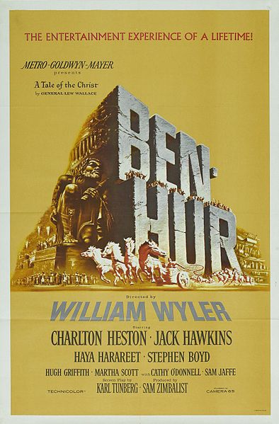
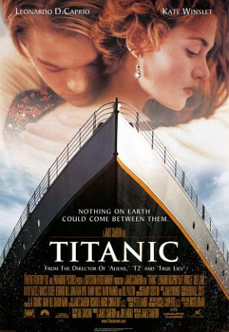
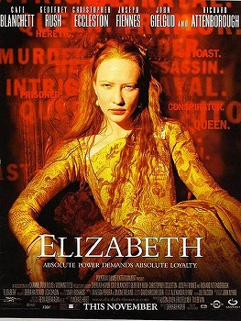
Film Genres #1
Just as there are different genres of literary texts (epic, elegy, picaresque, “epic theater”), there are different film genres…
You know them → action films, romantic comedies, science fiction, anime, the western, horror, noir, the musical…
There are also several “historical” film genres that “mediate” our access to the res gestae of the past…
“Epic historical drama” - “Ben Hur” (dir. Wyler) (1959)
“Epic romantic disaster” - “Titanic” (dir. Cameron) (1997)
“Biopic” – “Elizabeth” (dir. Kapur) (1998)

Slide 12
Film Genres #2
“Epic historical drama” / “Epic romantic disaster” / “Biopic”…
These are all forms of narrative cinema in which the events of the past unfold as part of a coherent plot in which the characters act with clear motivation in a given context / cause-and-effect structure / the action articulates a theme in an apparently “realistic” way, “as if” this were really how these events played themselves out on the ground…
“Illusionism”…
In these kinds of “history” films, (hi)story really does appear as story (usually dressed up in period dress, thus “costume drama”)
Mostly studio films / commercial feature films…

Slide 13
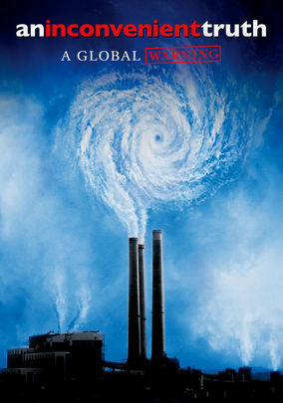


Another genre of history film → Documentary
Documentaries “aim to present factual information about the world”
Via direct filming of events / additional stagings of events / “charts, maps, and other visual aids”
In order to “take a stand, state an opinion, or advocate a solution to a problem” (Bordwell and Thompson, Film Art)
“Facts” are re-presented from a specific point of view – both cinemagraphically and politically / ideologically!
Still, audiences can and do debate the nature of these political / ideological points of view in their reception of such films / “March of the Penguins” (2005) (dir. Pacquet) / “Family values” vs. “Evolution” as the message…
“An Inconvenient
Truth” (2006)
(dir. Guggenheim)
“The Cove” (2009)
(dir. Psihoyos)
“March of the Penguins”
(2005) (dir. Pacquet)

Slide 14
The “Essay Film” as History Film
Disclaimer: You can read an interview with John Walter about the making of the film…
http://filmmakermagazine.com/1348-john-walter-theater-of-war/
His claims there (and in other interviews) notwithstanding…
And the Wikipedia article on “Theater of War” notwithstanding…
And Jay Cantor’s explanation to his students in “Theater of War” (2: 22 = 2 minutes, 22 seconds) and Streep’s reference to the film as a “documentary” (19: 31) not- withstanding…
I would situate this film – “Theater of War” – not just in the genre of documentary, but also in the genre of the “essay film”…

Slide 15
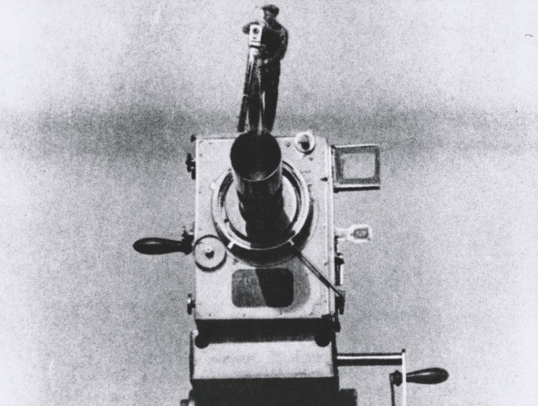
The “Essay Film”
A newly ‘invented’ film genre...
That has created its own canon out of films of the past…
“Elastic” and “porous” genre that is “cheerfully impure” and “poaches on the territory of other…forms of film”
It has its roots in Russian montage films: “random, yet concentrated” focus, with “forceful instruction”... (Brechtian epic theater also montage…)
But the essay film is more “digressive” and “playful” and contains “multi-angled perspectives” (Andrew Tracy, “The Essay Film,” 2013)
Like documentaries, essay films are guided by a “directing intelligence” / but here, by a “meandering intelligence that tries to multiply the entries…into the material it has elected” (Jean-Pierre Gorin)
“Man with a Movie Camera” (still)
(dir. Vertov) (1929)

Slide 16
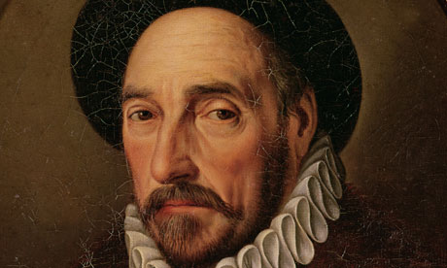
Michel de Montaigne, Essais
(Essays) (1580 / 1588)
One of the founders of the genre of the “essay” understood in this way…
The 16th century French philosopher, Michel de Montaigne
My hero…
His Essays are…
A mix of serious intellectual reflection with numerous anecdotes...
A mix of political, social, and philosophical observations…
Often prompted – and supplemented – by what he had read…
Usually a skeptical analysis of what Montaigne himself saw as men’s (and women’s) motivations for action in a difficult and complex world / a 16th century France consumed by Wars of Religion and political and class strife…
Montaigne’s own “intelligence” was the “mediator” of what he saw, read, analyzed, and assessed…
His Essays provided multiple “entries” into the issues of his day…
Montaigne (1533-1592)
“I am myself the matter of my book.”

Slide 17
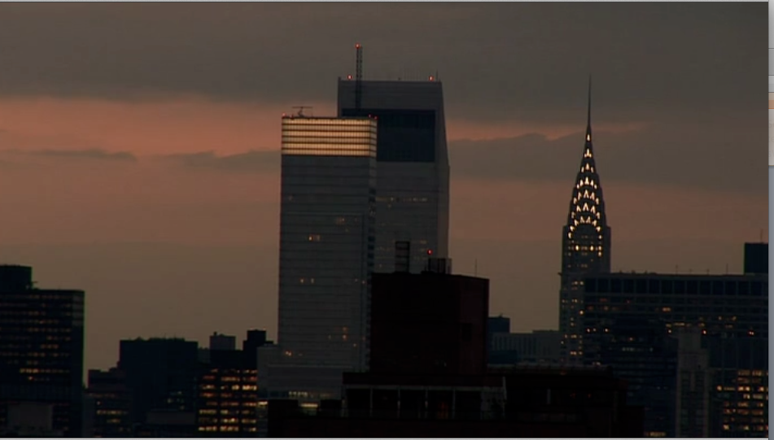
“The Theater of War” as seen through John Walter’s
“essayistic” eyes and his “directing intelligence”…
Which “theaters” of war?
Most obviously, the rehearsals and production of Tony Kushner’s new translation of Brecht’s Mother Courage and her Children (1939) / Staged in NYC in the summer of 2006
But to reduce the film to just a “the making of”-film would leave quite a bit of the movie unexamined…
And neglect both its “made-ness,” its “artifactuality,” and Walter’s “directing intelligence”…
And the multiple “entries” into its “material” (the “theater of war”) that he models for us as a way of understanding hi(story)…
“Theater of War” → The area where military operations are “staged” on the ground / Weird overlap of theater vocabulary and words used to talk about the conduct of war… →
War as theater? Theater as politics?
Jeanine Tesori (Composer) (47: 07)
“The cloak of fear lay over the city” / “The
actors were depleted” / the heat wave /
“We were on our own death march.”

Slide 18
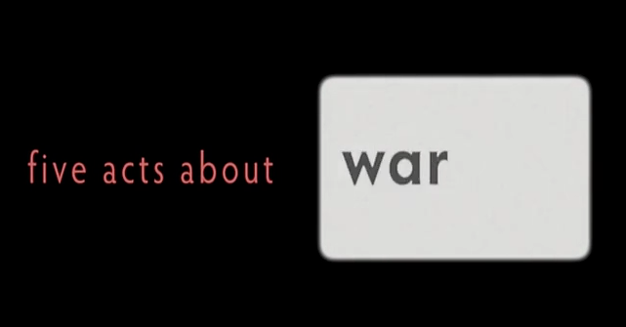
But also → Walter’s film as “theater of war”!
A Film in Five Acts
act 1: “Theater”
act 2: “Marx and Coca Cola”
act 3: “War Stories”
act 4: “In Search of Bertolt Brecht”
act 5: “The Triumph of Death”
What kind of “theater” is this film?
Is it a tragedy? A comedy?
Rising action? Resolution?
What is its shape? / Is its shape its message?
To discern a pattern in the “acts” or a pattern in the many wars the film examines or a message about this kind of re-presentation of war, we have to SLOW DOWN our “reading” of this film – and of films in general!
Films are (obviously) made objects / artifacts / Attend to their made-ness / And take a course in the Department of Film and Media Studies!
Five Acts about…
Children
Art
Politics
Brecht
Theater
Death
Courage

Slide 19
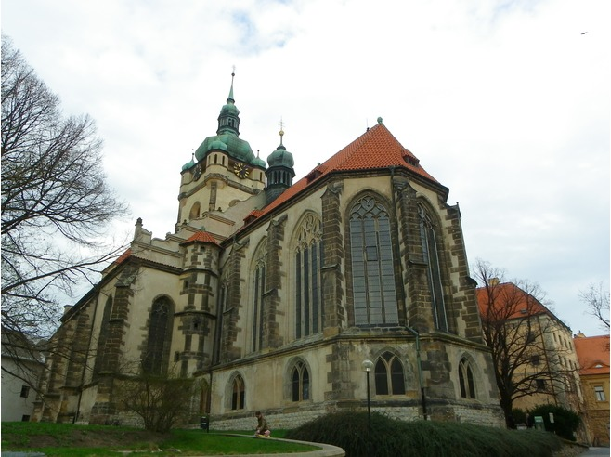
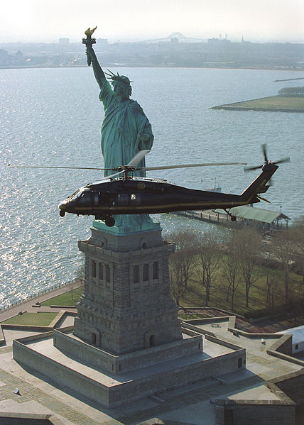
Slowing it Down
Which wars? / “Theater of War” (2008) as History?
The wars in historical sequence…
“Our” (my…) “exemplary” war: The Thirty Years’ War (1618-48) (Streep’s trip to Mēlník / Czech Republic)
WWII (1939-45) (Brecht / Carl Weber / archival footage of battles / Berlin in 1945 / The Holocaust)
The Cold War (1946-89) (HUAC hearings / FBI files on Brecht / archival footage of 1949 production / “Duck-and-cover” school drill for Jay Cantor)
Viet Nam War (1955-75; U.S. troops deployed after 1965) (archival footage / anti-war protests)
The “War on Terror” (2001 - ) (helicopters over NYC)
Israeli-Lebanon (July) War (2006) (Protests / Kushner’s despair)
Iraq War (Second Gulf War) (2003-2011) (anti-war protests / “July 21, 2006”)
Church of St. Peter
and St. Paul (Mēlník,
Czech Republic) –
with Ossuary in
crypt
Bureau of
Immigration and
Customs
Enforcement
Office of Air and
Marine
Interdiction / NYC
(2003)

Slide 20
Are these wars actually presented sequentially in the film?

Slide 21
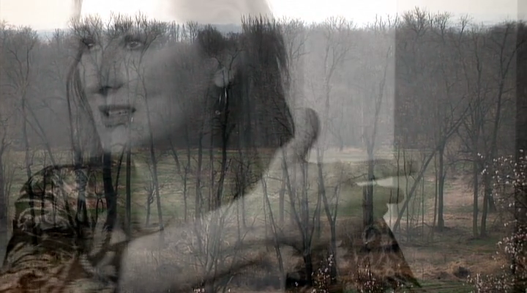
Many of the sequences of archival war footage in particular follow what is called the
“montage technique”…
Cf. ( = Latin: “conferre,” “bring together,” thus: “compare to”) Carl Weber’s use of the term “montage” in “act 1” (20: 41)…
Montage is the process of selecting, editing, and piecing together separate sections of film to form a continuous whole.
“A technique in film editing in which a series of short shots are edited into a sequence to condense space, time, and information.”
A relatively rapid succession of different shots…
HERE: Which wars? Which sequence? Black and white vs. color? Thirty Years’ War (Streep) / WWII / Viet Nam War →
“Theater of War” (dir. Walter) ( 2008) –
Opening Titles / Montage Sequence

Slide 22
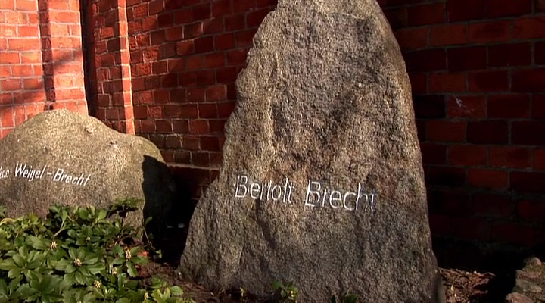
Editing as the Message:
What is the impact on the audience of this montage technique, especially in the “selecting” and “piecing together” of the montage sequences?
Are all wars the same?
Is that the message?
Or are they all different (color / black and white)?
As you watch the 2006 production – and the 2008 film -- think about the production of Mother Courage and her Children in Berlin in 1949…
Where Brecht asked his audience to see the parallels between the Thirty Years’ War and WWII, and act differently…
Is this what Walter is asking his viewer to do?
What does Meryl Streep see in this (endless?) sequence of wars? →
The “universality” of maternal suffering → the inevitability of war (“Over and over…”) That’s not Brechtian (to see war as inevitable)!
Does Walter want us to think about war the same way Streep does?
Streep’s final speech, “Theater of War”
(dir. Walter) (2008)

Slide 23
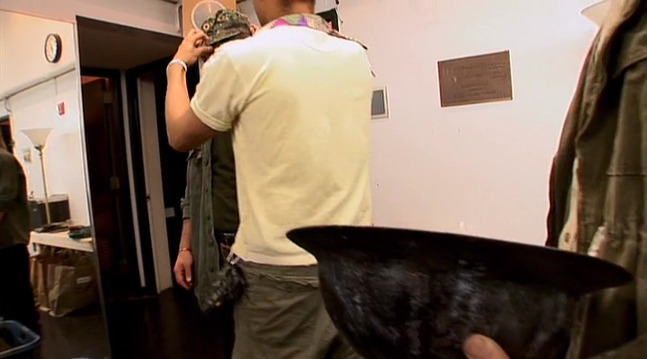
My general question: Does filmmaker Walter share / agree with the way his “witnesses” read Brecht’s play? / Does he follow Director George Wolfe’s direction / production lead in his depiction of war(s), for example?
Wolfe to Costume Designer, Marina Draghici: “We shouldn’t make any specific references” / “Fuse everything” (27: 35-38) →
Here again the “message” might be: “All wars are interchangeable” / “all the same”…
War is inevitable!
Or is that just the position of this particular (stage) production in 2006?
Walter’s 2008 film may actually be saying something else about how we understand war…
And about how the essay film tells / how we tell history in the post-modern age…
Marina Draghici / Costume Designer / Mother
Courage and her Children (NYC production, 2006)

Slide 24
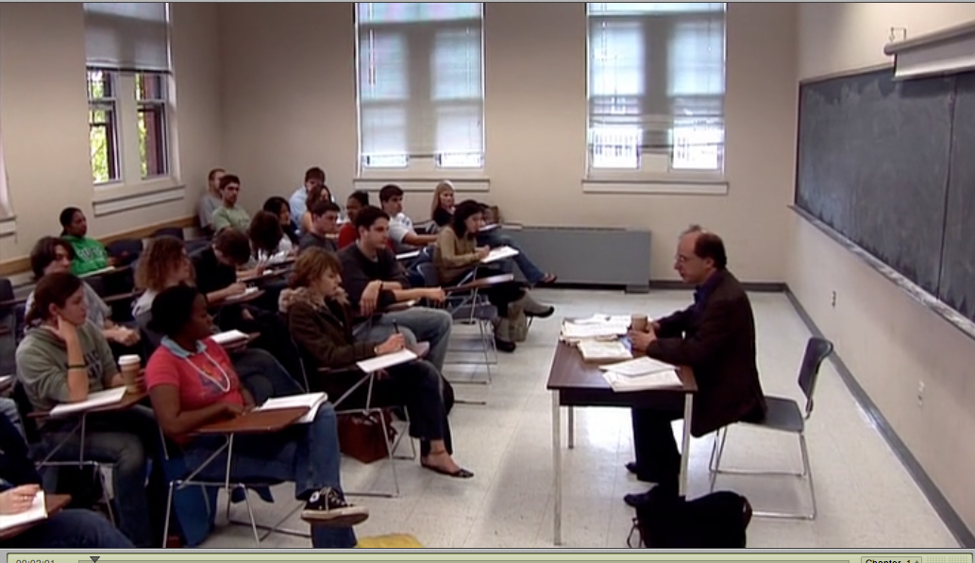
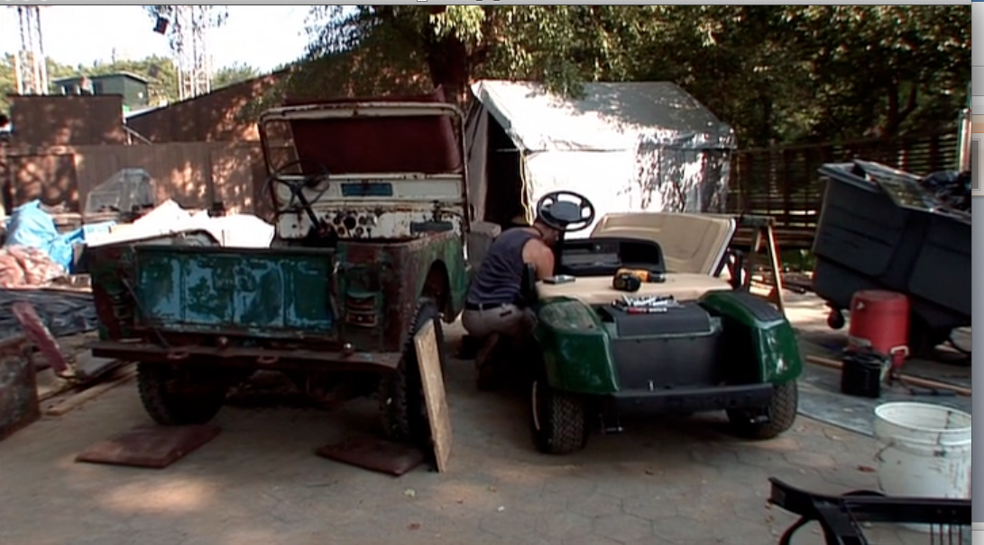
Are the medium and the genre thus the message of this film?
Teaching in “Theater of War” (2008)
act 2: “Marx and Coca Cola”
Jay Cantor / Novelist / Teaches in the Department of English / Tufts University (Boston, MA)
Teaching Marx / Class: “How you earn your living” / “What forces make the personality”
1. Literal teaching (Cantor in the classroom)
2. But the film also teaches us Marx / Marina Draghici (Costumes) Jeremy Lydic (Props) / labor theory of value in the world of the production of the play in 2006…
3. The scenes of teaching draw our attention figuratively to the kind of teaching that the essay film can do…
Understood this way, it is an “epic” essay film / like “epic theater,” it is “pedagogical”…
But as much about war as about class…

Slide 25
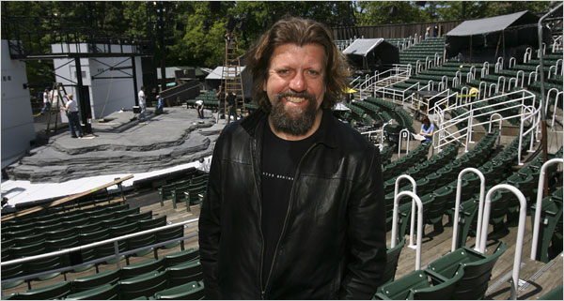
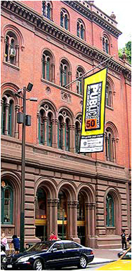
Public Theater as Teaching in “Theater of War”
Oskar Eustis (b. 1958) / Artistic Director / The Public Theater (NYC)
He “teaches” us (his version of) the lesson of Brecht and of the play…
Walter in fact films Eustis articulating a very strong interpretation of Brecht (via Marxism) “putting himself in the service of something much larger than himself…” (33: 01 - 35)
This is certainly Eustis’ view of the historical Brecht…
It also his (Eustis’) view of his own commitments in his work in theater in the contemporary U.S.
“Theater that matters” / That “addresses the biggest and most important issues facing us” today / “Offering that up to the widest and most diverse audience” / Only then is “theater fulfilling its job” (9: 02 – 9: 24)
Eustis is channeling a certain version of Brecht / compare his version to the version we get in act 4: “In Search of Bertolt Brecht”…
What about 1953?!?

Slide 26
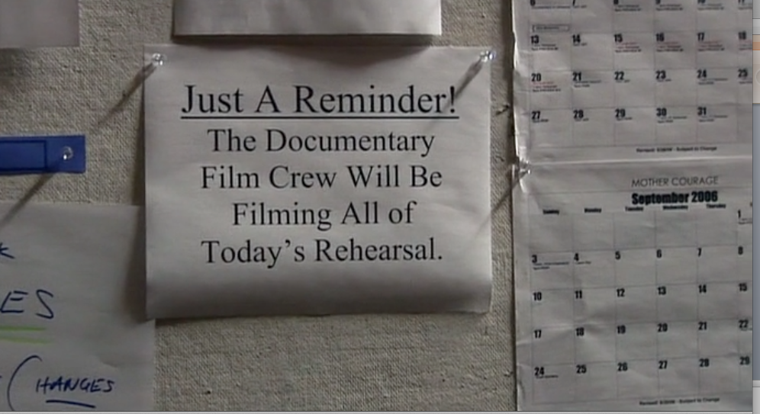
MY THESIS about Jay Cantor’s Teaching, Oskar Eustis’ and the Public Theater’s Teaching, and the Teaching Done by the Essay Film, “Theater of War” (dir. Walter) (2008)…
By showing us so many versions of teaching, the “Theater of War” film wants us to know that the film is pretty self-conscious about what it is doing…
It knows that it is “staging” history – indeed, creating history – from a particular point of view…
In order to teach…
Part of the lesson the film wants us to learn concerns how we as individuals can undertake the project of understanding the (hi)story of war – and the re-presentation of the past – in our world today…
And thus also concerns how each individual understands him- or herself as embedded in the complexities of history…
Complexities that it may be the task of the post-modern cultural worker to re-present in a particular way…

Slide 27
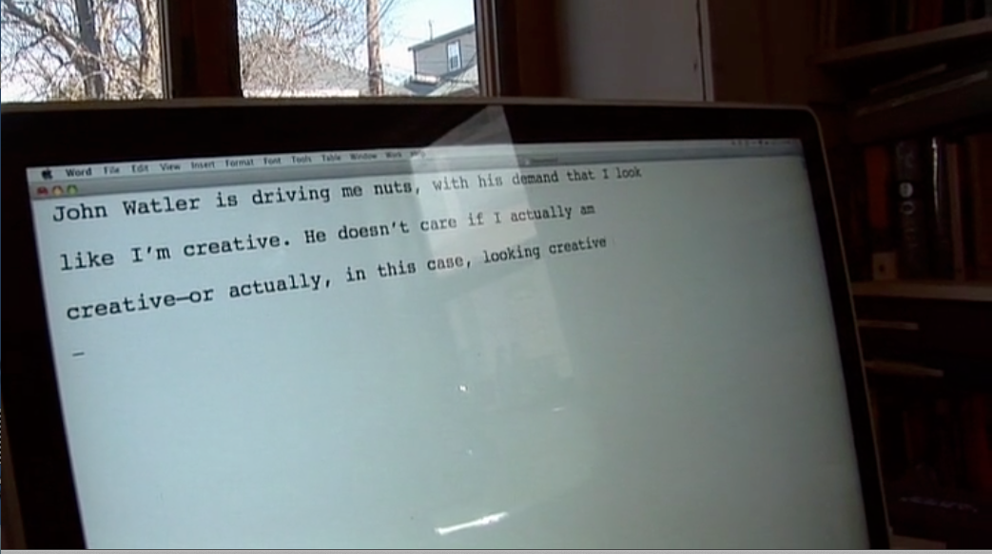
Think, then, about John Walter’s individual “Mediating Intelligence” as it is (in)visible in “Theater of War” (2008)…

Slide 28
What kind of work does the work of understanding (hi)story / understanding re-presentations of war entail?
And how is this work of understanding modeled in the film?

Slide 29
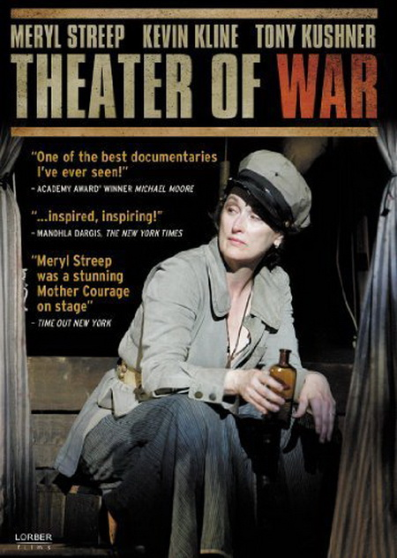
Next time…
Resisting War / Resisting the State: History as Repetition / History as Change
Whose History?
- Whose Brecht?
- Black-and-White vs. Color and the Authority of “Talking Heads”
The Agency of the Cultural Worker in Times of War: Brecht, Streep, Kushner, and Walter
The Essay Film: Pathos, Humanistic Inquiry, and Understanding War
Watch the film!
Then watch it again!
MONDAY NIGHT, 4 Nov., 5 p.m. / HIB 135

Slide 30
Remember!
The film for which you are responsible THIS WEEK, “Theater of War” (dir. Walter) (2008) is on Netflix!
Get together with classmates and watch it (more than once?)
It will also be shown TODAY, Monday, 4 November, in HIB 135 at 5 p.m., for HCC students!

