Slide 1
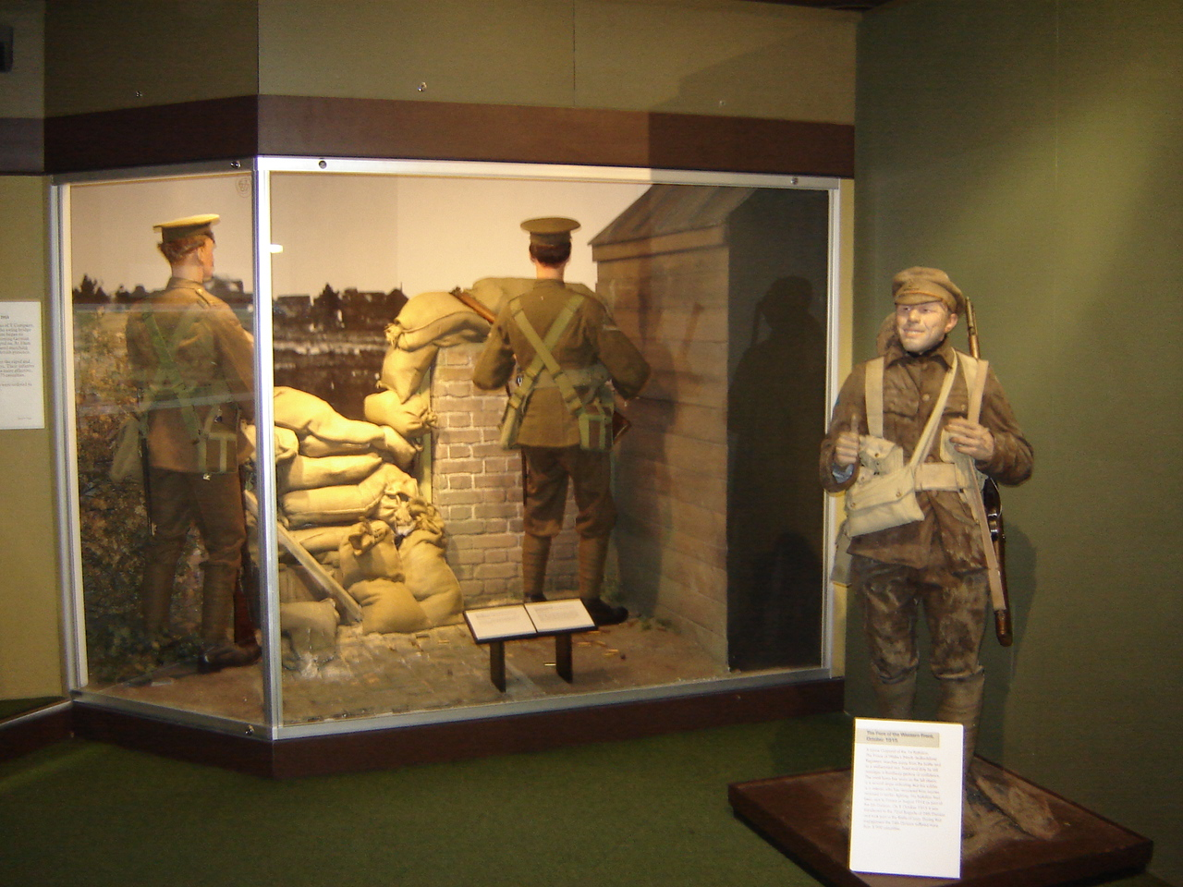
HCC: Weeks 4 – 6 /
Re-Presenting History /
Re-Presenting the Thirty Years’ War
Three versions of the Thirty Years’ War (1618-48)
Grimmelshausen, Simplicissimus (1668) → Brecht, Mother Courage and her Children (1939 / 1949) → Walter, “Theater of War” (2008)
From the Early Modern → Modern → Post-Modern periods…
One of our jobs as humanists is to understand the way that the past moves into our present as part of the multiple “conditions of determination” that shape our agency and our acts.
Avoid locking the past (of the Thirty Years’ War / of war in general) away into any kind of “museal” ( = museum-like) box…
Rather, interpret the Thirty Years’ War – and read the re-presentations of past wars that continue to swirl around us – as a way of understanding both their pasts…And how they have entered our present and continues to form our world!

Slide 2
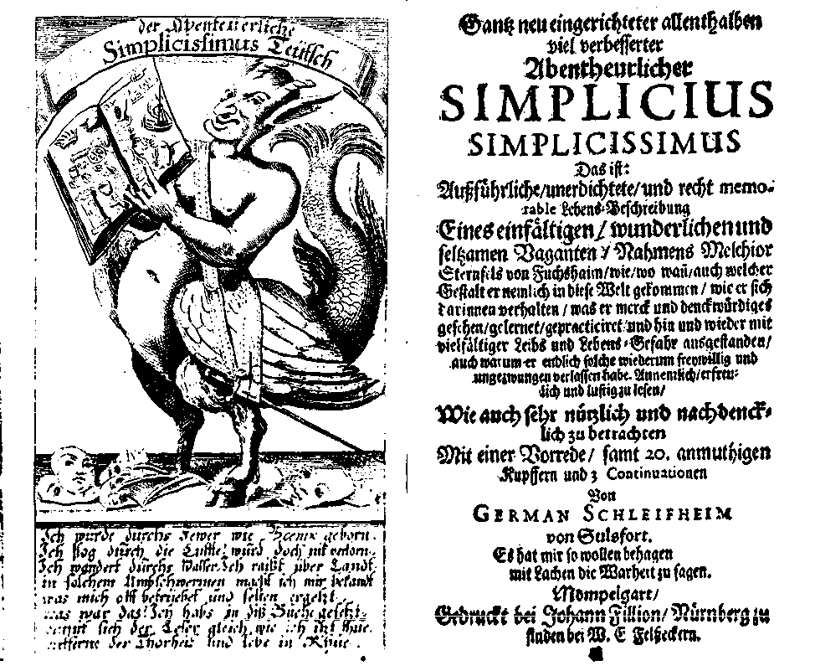
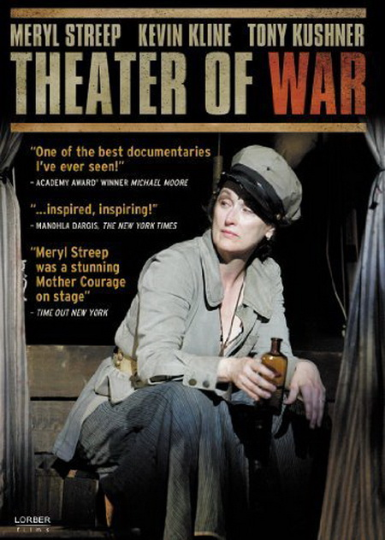
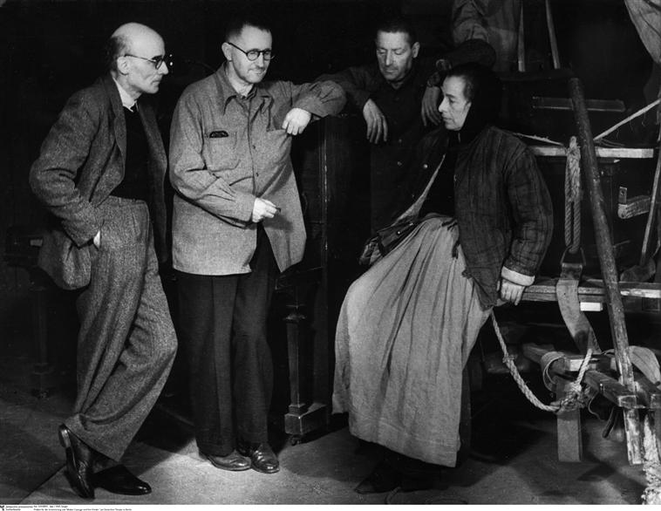
Point of View / Genre / Medium
One of my main interests has been to examine the extent to which point of view / genre / medium all shape the ways in which the res gestae of the past become historia / (hi)story…
The events of the Thirty Years’ War are not “immediate” to us. They are, rather, re-presented to us / “mediated” to us…
enabled by a particular set of medium-specific norms… →
shaped by a particular set of genre-specific norms, and
and always from a particular point of view…

Slide 3
Sometimes the point of view from which the res gestae of the past are seen and re-presented as (hi)story is actually the message!
History from Above
History from the point of view of the elites…
Political history that focuses on the actions of governments, leaders, states…
History from the point of view of institutions (the Church, the legal system, the army / the military, for example)
History from Below
History of ordinary people, the everyday, “social history” / “popular history”
The people caught up in the legal system, the people who fight or are the victims of wars…
The history of those “not on the winning side” (David Hitchcock, “Why ‘History from Below’ Matters Now More than Ever” (August, 2013)

Slide 4
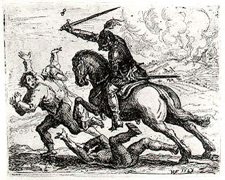
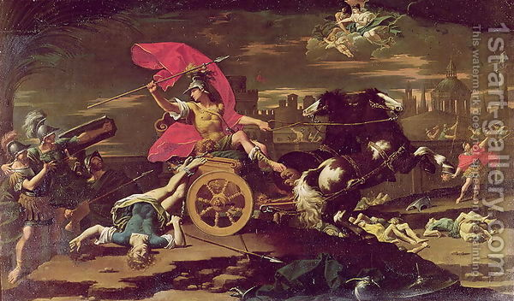
Likewise, medium and genre are also often part of the message because of the way they “shape” the story / Remember this juxtaposition from week 4?
→
Donato Creti (1671-1749), “Achilles
dragging Hektor’s Body around the Walls
of Troy” (95 x 56 inches) = 8 feet x 4 and
1/2 feet / “history painting” / oil
Hans Ulrich Franck (1603-75),
“Der Geharnischte Reiter”
(Knight in Armor) / etching,
11 x 13 cm.

Slide 5
Genre and medium are thus expressive “conditions of pre-determination” (different than political or economic “conditions of pre-determination”)…
They give the author / playwright / film maker a “vocabulary” of forms and a set of material constraints (print / stage / film) within which he or she works to express / communicate a certain version of (hi)story…

Slide 6
At the same time, one of the main themes in which I have been interested has been how we might think about the “conditions” of both individual and collective “agency” and “self-determination” created by the rise of the apparatus of territorial state sovereignty that in principle guarantees “peace” and “defense”… as that form of the state began to emerge around 1648 – thus after the Thirty Years’ War and the Treaty of Westphalia – and then travelled forward in time…
The development of a full-fledged and nation-state identified “military-industrial complex” by means of which the state guarantees “defense”…
You will be hearing a lot more about the “military-industrial complex” in the winter quarter (2014) from Professor Szalay!
In wartime, this “apparatus” includes the military…
So we’ve been tracking the move from mercenary armies and mercenary warfare to the rise of the standing armies of the modern state on through to…

Slide 7
Finally: I’ve also been asking a second thematic question…
Just how much are the actions of early modern / modern / post-modern “small people” – Simplicius, Mother Courage, all of a state’s citizenry and population – ‘determined’ by these political structures and economic “conditions”?
There are, of course, other ‘determining’ factors, including one’s age, ethnicity, religious beliefs, and political convictions…
To what extent did people of 1618-48 and during and after WWII / do people today have agency → the ability to resist such determinations / to shape their own lives?

Slide 8
Last time…
I began to pose some of these questions to the film, “Theater of War” (dir. Walter) (2008)...
And focused primarily on the conventions of the “essay film” as a film genre – as opposed to the stage play we see being produced in the film…
The film relies heavily on the technique of montage / the editing together of a series of short shots into a sequence to condense space, time, and information…
In “Theater of War,” this medium-specific (film) technique is actually used to ask us to consider a thematic question, namely: Are all wars the same?

Slide 9
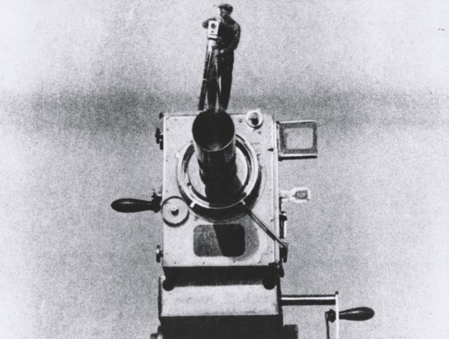
A bit of a review…
The “Essay Film”
A newly ‘invented’ film genre...
An “elastic” and “porous” genre that is “cheerfully impure” and “poaches on the territory of other…forms of film”
The essay film is usually “digressive” and “playful” and contains “multi-angled perspectives” (Andrew Tracy, “The Essay Film,” 2013)
It is nevertheless usually guided by a “directing intelligence” / a “meandering intelligence that tries to multiply the entries…into the material it has elected” (Jean-Pierre Gorin)
“Man with a Movie Camera” (still)
(dir. Vertov) (1929)

Slide 10
Theme #1: Are all wars the same?
Theme #2: The Visibility of the State in “Theater of War” / The State as a Determinant of Action
At first, it might seem difficult to see the “state” in this film…
But the “state” is there in the film…
And is represented by those agencies responsible for “defense” and the “peace” (Hobbes)
- Armies in “Theater of War”
- Police in “Theater of War”
- And the additional internal “security apparatus” of the state in “Theater of War” / Homeland Security / Helicopter fly-overs during the rehearsals
We also see some very problematic versions of the hand of the “state” in “Theater of War”:
- Nuclear explosions (“defense”)
- Hitler’s death camps (“internal policing” / “keeping the peace”)

Slide 11
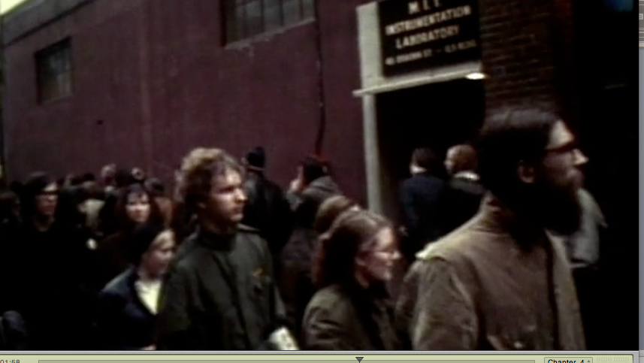
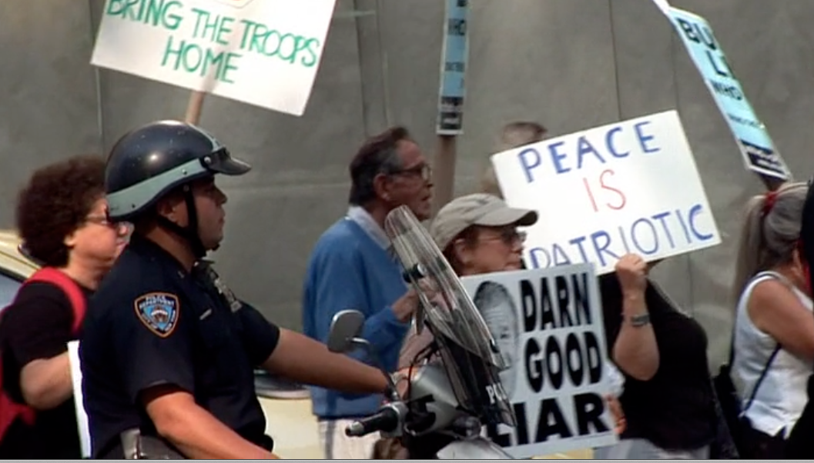
In response to the hand of the state that we see in the world in the film, we are also invited to consider several forms of (collective) “agency” that resist these “determining conditions” (as they are associated with the state)…
- MIT labs / student protests against the implication of university lab-research in the Viet Nam War (1969) (1: 01: 04)
- street protests against the politics of the War on Terror / Israeli-Lebanon (July) War / Iraq War (2006) (5: 05)

Slide 12
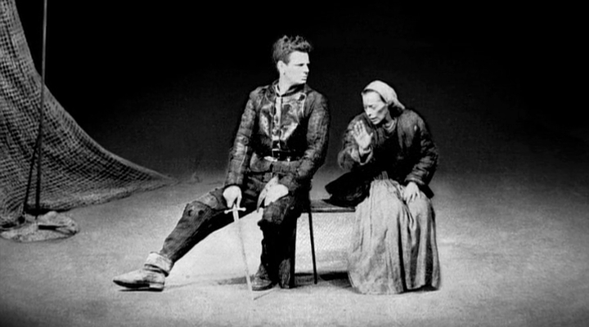
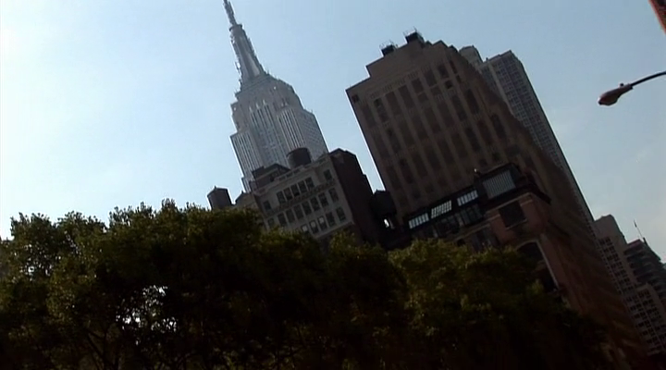
Via the juxtaposition of 1969 to 2006, Walter is asking us to think about the historical variation in the forms used to resist the state and in the forms that the state’s response to such resistance takes!
Look for forms of resistance…
Look for the state’s response…

Slide 13
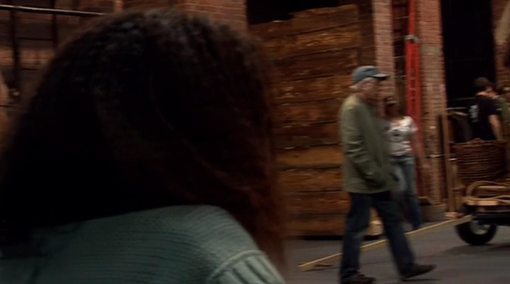
From 1969 → 2006 / Two different kinds of “security,” right? / From police batons to traffic cops…
Has the state actually just rolled over and played dead?
Or is it just fulfilling its “duties” differently? / The War on Terror / The Homeland Security Helicopter Fly-overs / the crew and cast response…

Slide 14
Is Walter trying to get us to think about how the “cultural work” of putting on a play (in 2006) – or making a film (in 2008) – could or could not be understood as an act of resistance to the wars in which the state engages ‘in our names’ (wars of “defense” to the outside and wars to guarantee the peace within)?
REMEMBER: For Brecht, putting on a play was as act of resistance → resistance to unthinking compliance with / support of conditions that will ultimately destroy you!

Slide 15
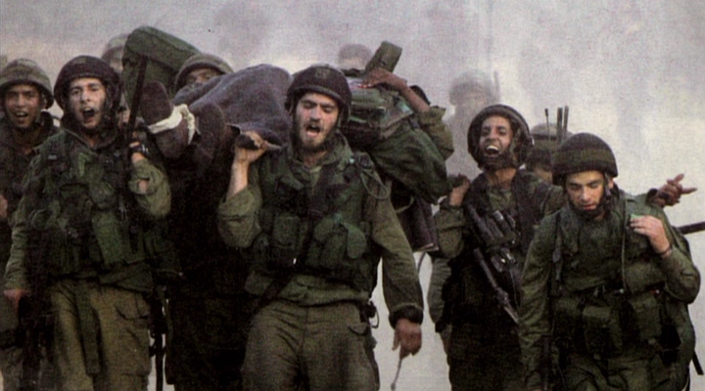
Kushner’s Take and Walter’s Take (via montage) on the Cultural Work of the Playwright or Poet as Resistance / Theater and the Streets

Slide 16
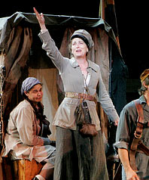
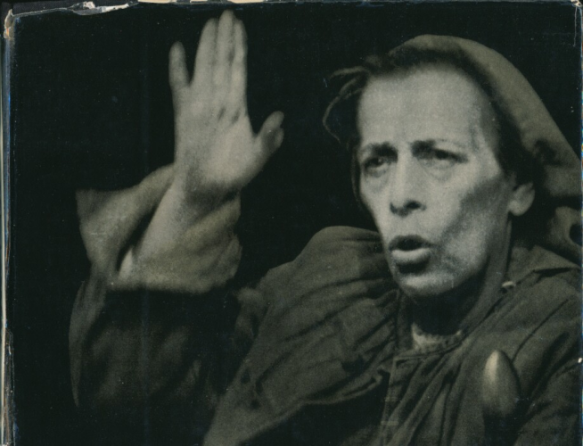
Thus: Just as Walter’s “Theater of War” almost relentlessly asks us – via cross-cutting and editing – to compare the two productions of Mother Courage and her Children in 1949 and 2006, so too does it ask us (via the same techniques) to compare the presence of the state and collective vs. individual complicity with or resistance to that state in 1939 / 1949 → 1969 → 2006 → 2008 (the time of the film…)

Slide 17
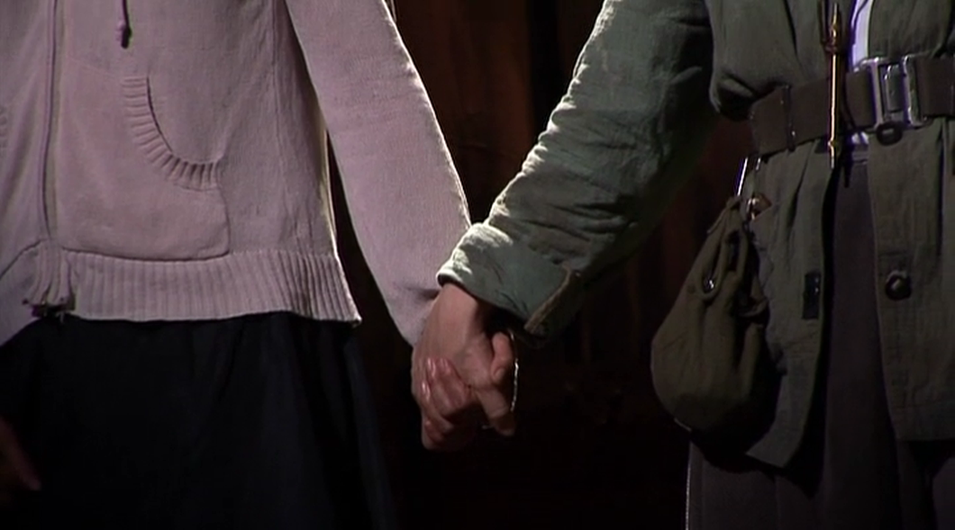
And it asks us to think whether, and if so, how forms of the state – and of resistance to it – have changed…
History as Repetition vs. History as Change…
Showing change has a “de-naturalizing” effect…
By showing how the ways the state “provides defense” and “secures the peace” change, Walter shows us that these ways can also be changed!
Again, this de-naturalization often occurs in the film by means of the technique of montage
“The Bomb and the Holocaust” sequence / One of the oddest montage sequences in the film…/ Analyze the sequence of images…
What do the Bomb and the Holocaust have to do with one another? →

Slide 18
The Bomb and the Holocaust and the State
What I am not suggesting….
That Walter’s film thinks the state that detonates an atom bomb in the interest of “self defense” is the same as the state that relies on death camps to “keep the peace”…
Nor that the film might be advocating resistance to either one of these states (although it might be…).
But the film definitely is asking its viewer to take a step back and consider the different forms that state power can take…
It thus asks that the viewer become a “thinking human being” (Helene Weigel)!
When read as a film that de-naturalizes the ways the state keeps control both within and to the outside, Walter’s “Theater of War” can be read as an “epic” essay film…
NB: “Epic” here refers to Brecht’s “epic theater,” NOT to Homer’s epic, the Iliad

Slide 19
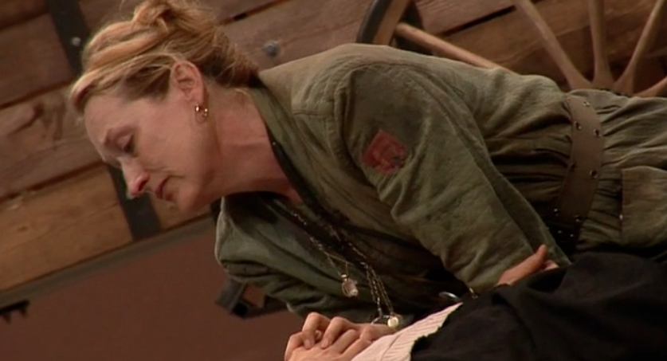
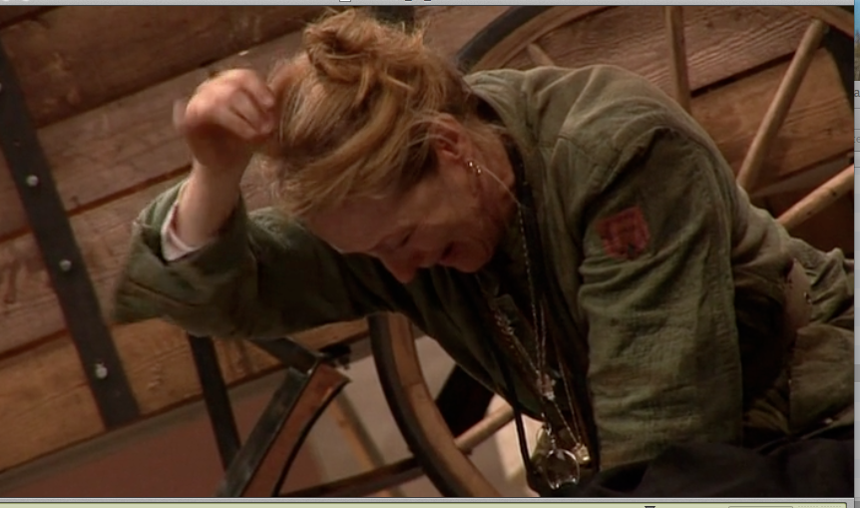
Thinking vs. Feeling?
The essay film nevertheless also shows people feeling (Streep’s final speech: “Why? Why?”)
And it is difficult not to feel pity when we watch Streep as Mother Courage deny Swiss Cheese and sing “The Lullaby” →
But the film also repeatedly juxtaposes Streep’s feelings (on stage and off stage…) and our feelings (responding to her acting) to a welter of people whom we see thinking in the film…

Slide 20
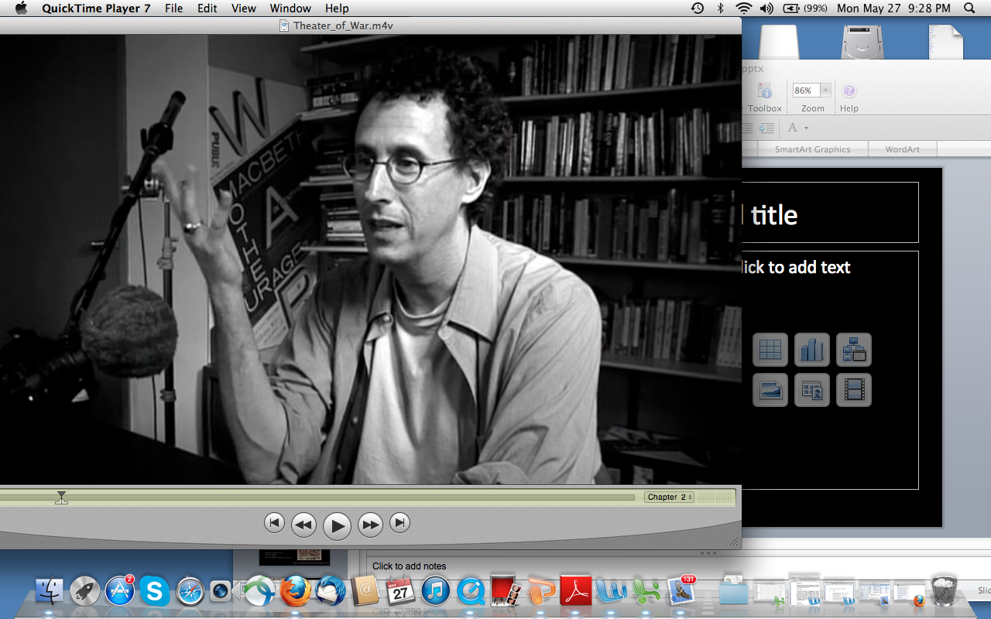
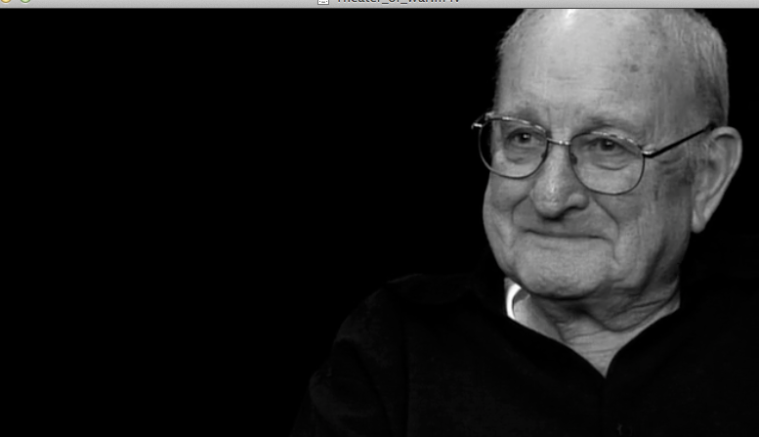
Thinking in the Film, “Theater of War” vs. the Thinking of the Film, “Theater of War” /
Whose History and the Question of Talking Heads
In Walter’s film, there are lots of “talking heads” / the “witnesses” who “think out loud” about Brecht and his play (both the 1949 and the 2006 production)…
By juxtaposing these “talking heads” to one another, Walter asks us to think about what kind of “authority” each of these individuals has to tell his or her version of the “story” of Brecht and his play AND OF THE TWO PRODUCTIONS!
Oskar Eustis: Artistic Director / NY Public Theater / Tony Kushner: Playwright / George C. Wolfe: Stage Director / Jay Cantor: Professor and novelist / Carl Weber: Brecht collaborator / “Historical witness” / Meryl Streep: Actress / Marina Draghici: Costume Designer / Jeanine Tesori: Composer

Slide 21
The proliferation of “talking heads” and – through them – the proliferation of versions of Brecht and his play suggest that the film itself is “thinking through” what the “truth” of Brecht’s play might be from a number of different points of view…
Remember…
The Essay Film “tries to multiply the entries…into the material it has elected”
- Jean-Pierre Gorin

Slide 22
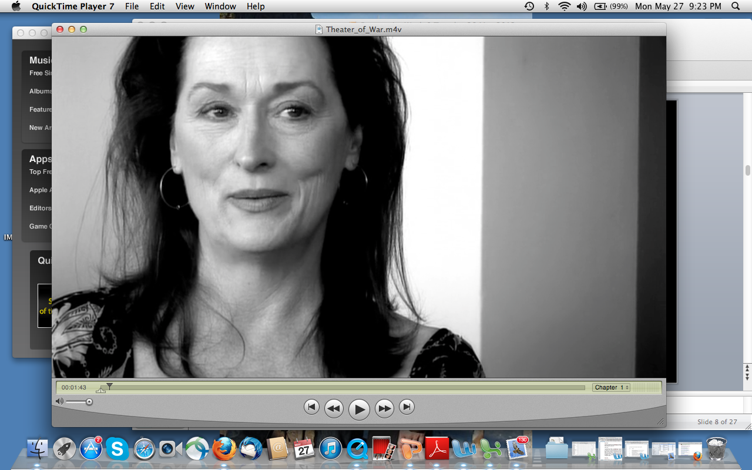
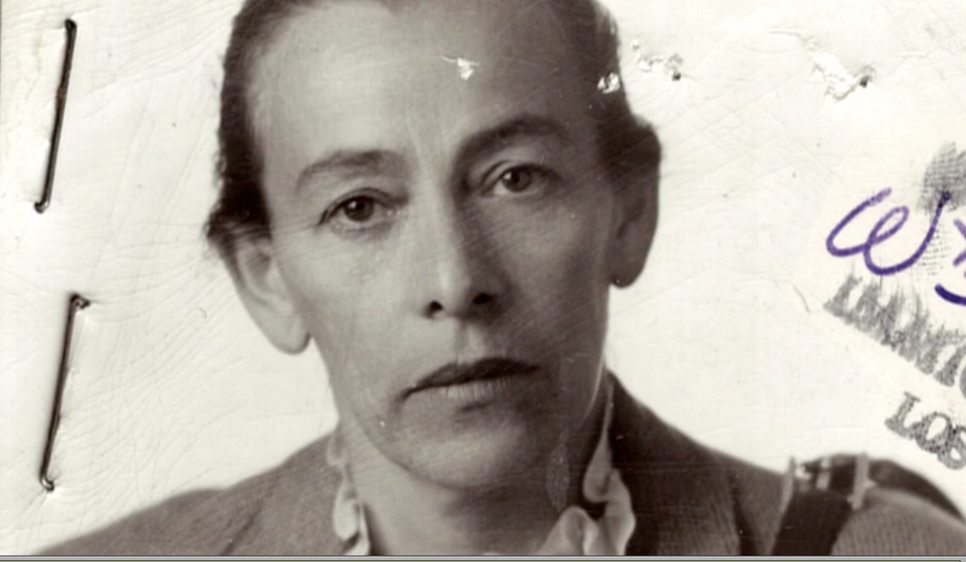
How Many “Entries”?
How many truths…?
#1: “Truth” in Black-and-White
Is the “truth” of the play its historical origin – and Brecht’s “intention”?
As this (complex) origin is visible in the historical war footage / post-1945 Berlin / the 1949 production / the Brecht family’s “home movies” / the HUAC hearings…
When the “talking heads” are filmed primarily in black-and-white, they appear to be channeling these “origins”...
The authority of the ‘modern’ “talking heads” thus appears to be enhanced and their statements appear to become more “authentic”/ “truer” by being filmed in black-and-white…
But the juxtaposition may also allow us to compare them (the ‘moderns’) to their “originals” as cultural workers and as “thinking human beings”…
Two Mother Courages / Two amazing actresses /
Weigel’s activism / Streep’s pathos…

Slide 23
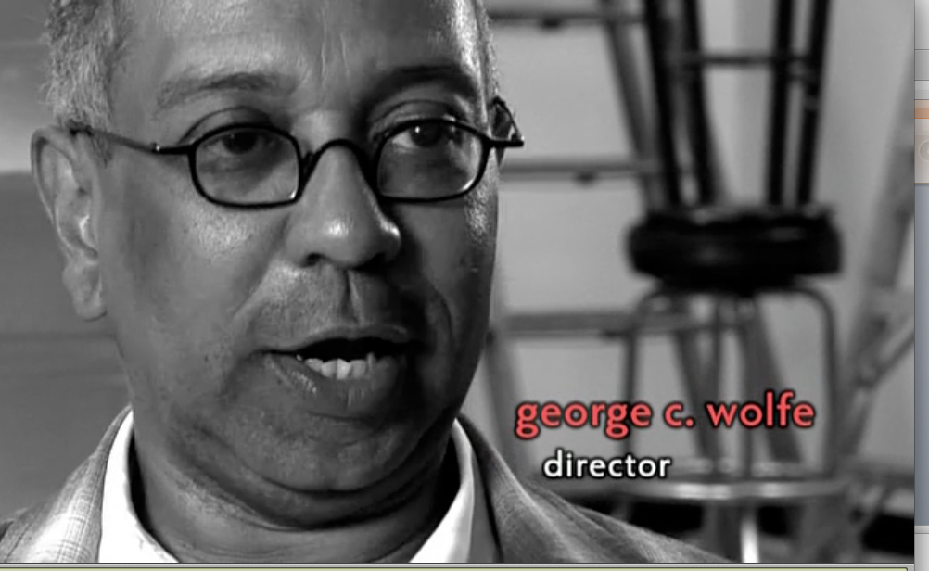
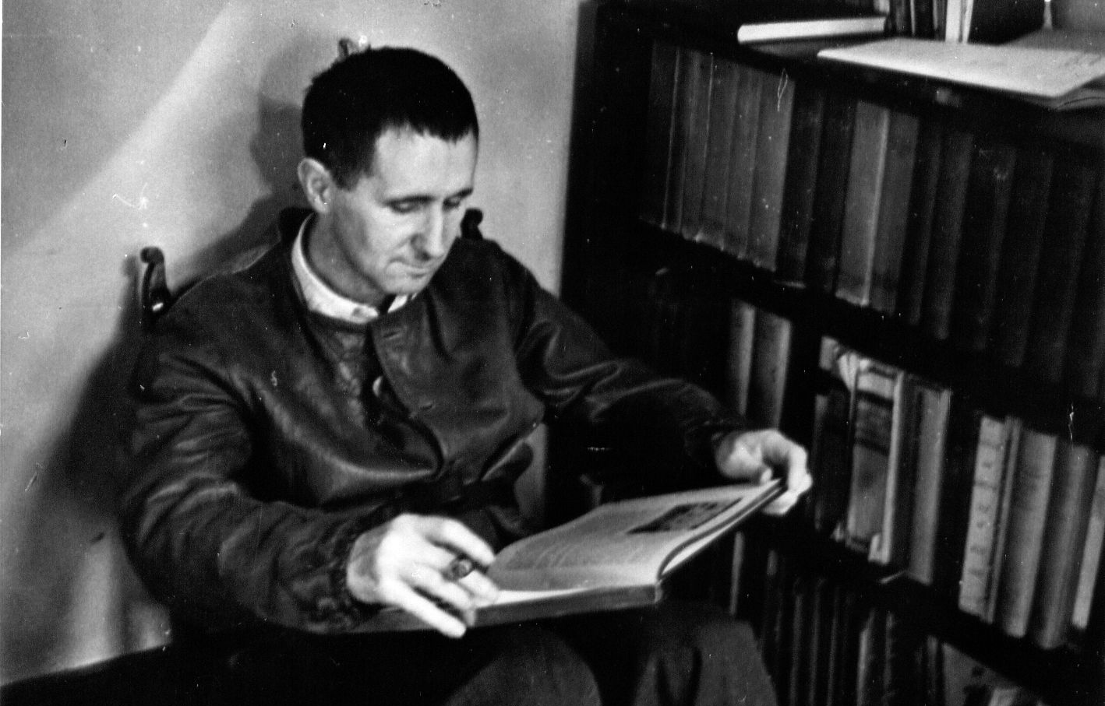
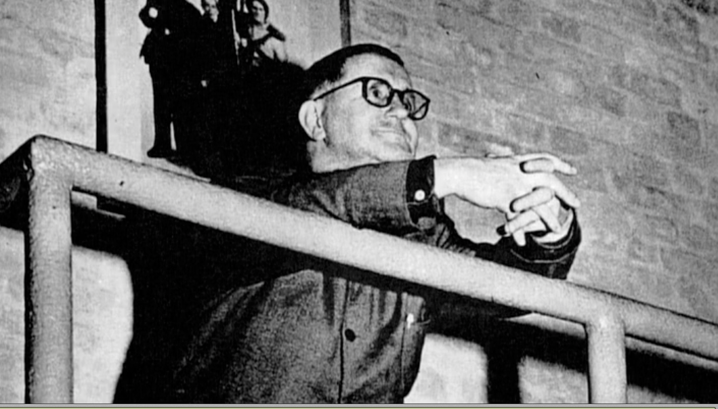
More doubles / the playwrights (Brecht and Kushner) / the directors (Brecht and Wolfe) → Are the ‘moderns’ doing the same kind of cultural work that their “original(s)” did?

Slide 24
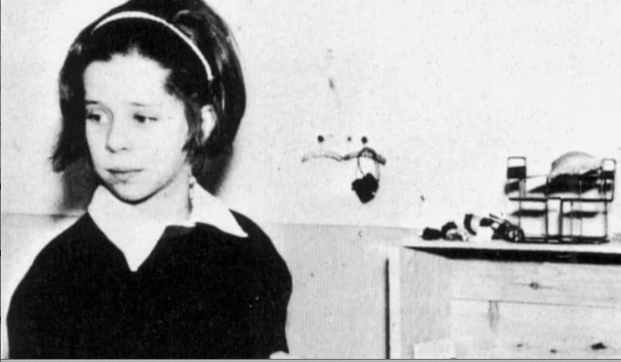
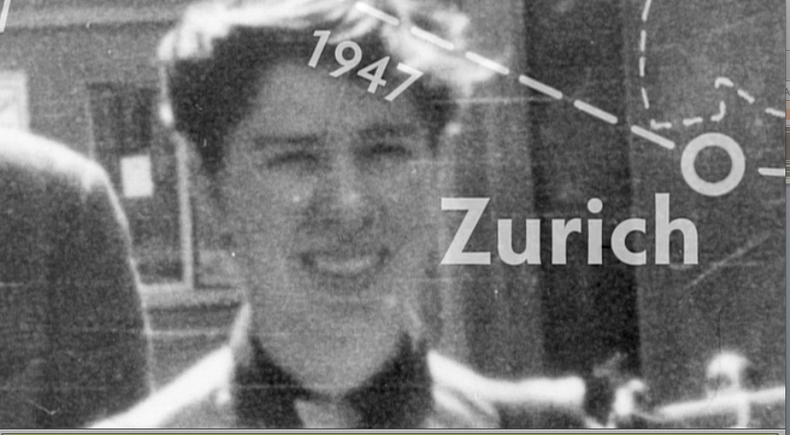
NB: There are also other forms of (both literal and figurative) black-and-white representation in “Theater of War” / Barbara Brecht-Schall’s Bertolt Brecht
Barbara Brecht-Schall’s account of her father, her mother, and their lives is pretty one-sided…
No Elisabeth Hauptmann or Margarete Steffin, for example..
No 1953 editorial endorsing the crackdown of the East German state on the workers…
No “borrowings” or “plagiarism”…
Such a re-presentation is to be expected when a daughter is talking about her father…
But again…
We know better!
Hagiography → A biography of saints or venerated persons / thus: an idealizing or idolizing biography /a biography that praises someone too much
DOES WALTER ALSO KNOW BETTER?

Slide 25
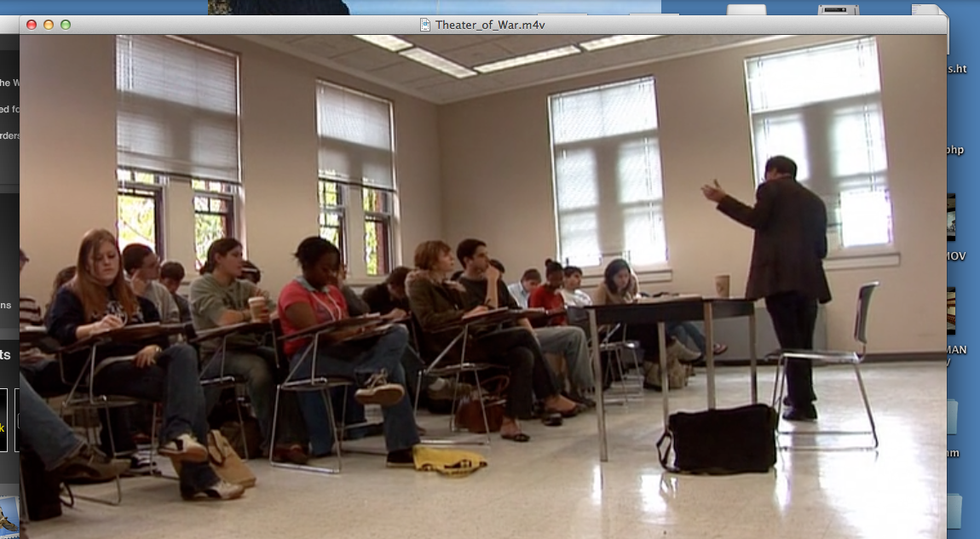
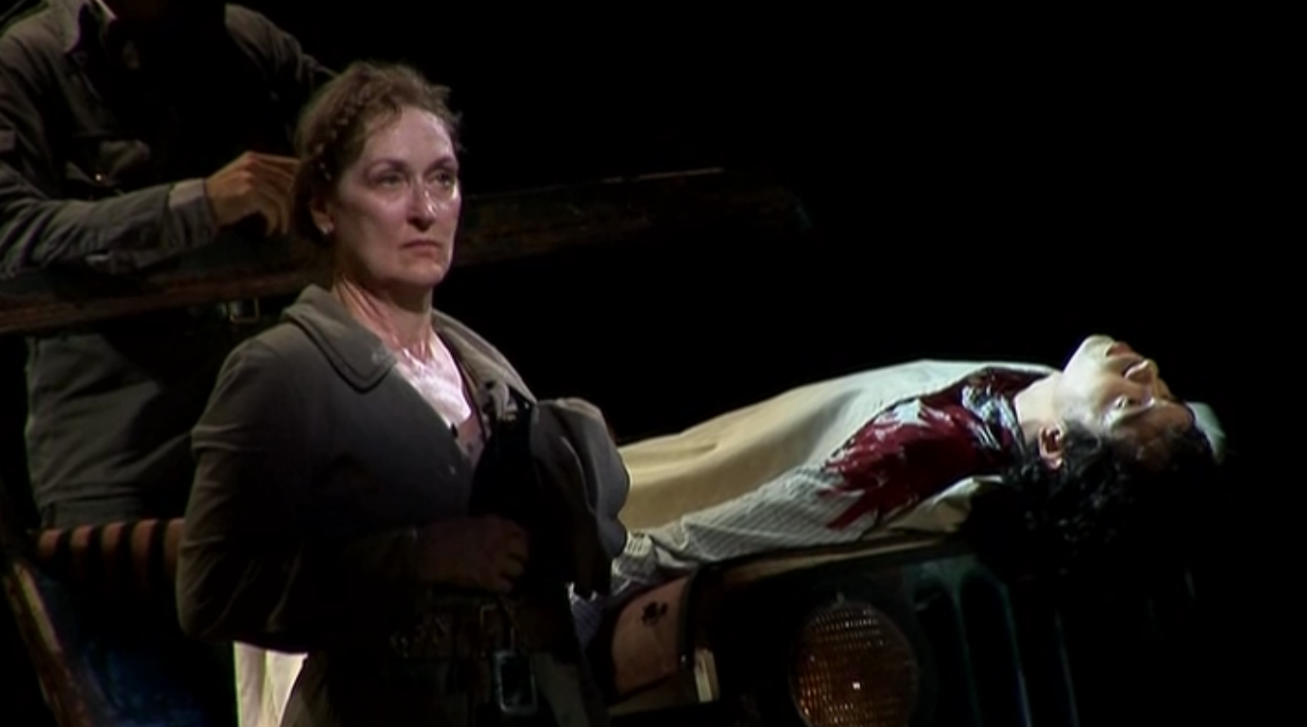
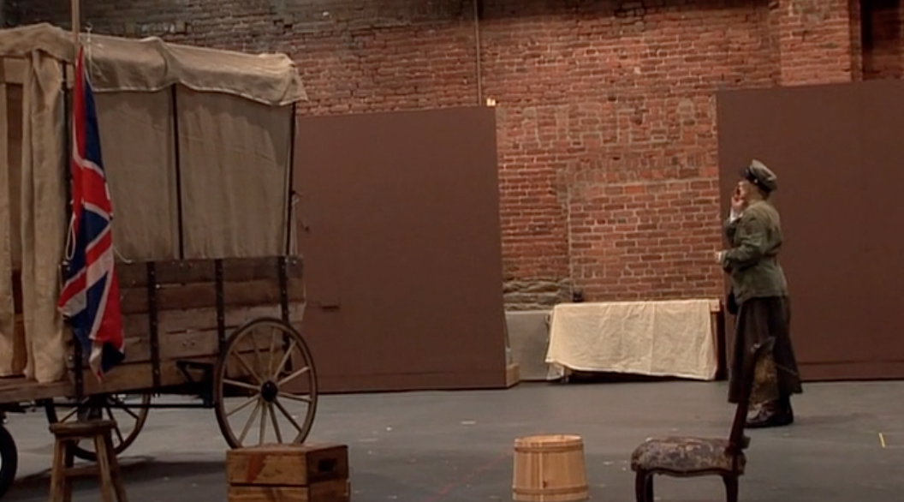
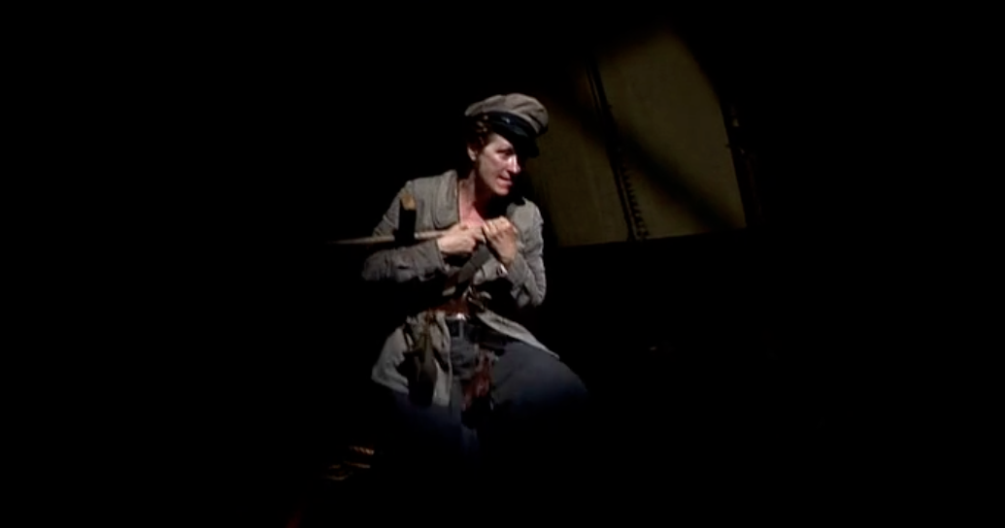
“Entry” #2:
“Truth” (#2) in Color?
Here, the “real” truth of Brecht’s play
would lie in its reception / the ideas it
generates, but also the feelings it
provokes…

Slide 26
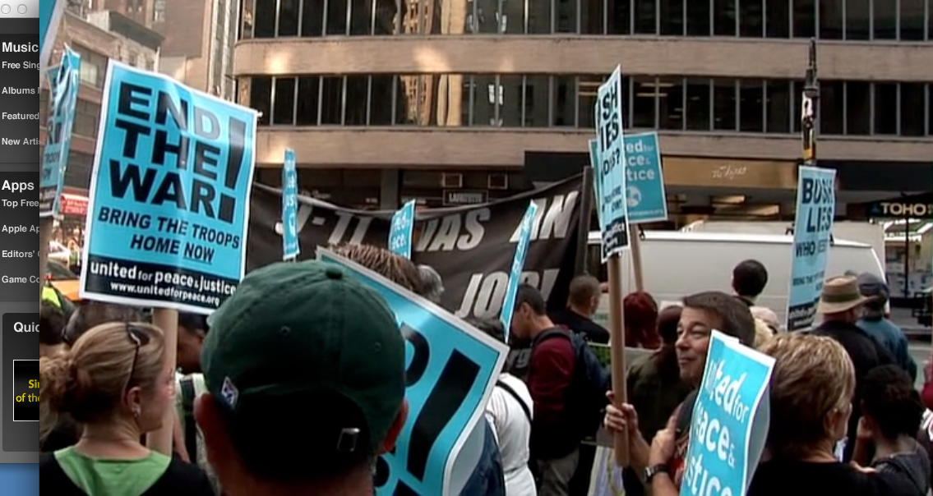
Or (“entry” #3): Is the “truth” of Brecht’s ideas to be found on the streets?
Also in color…

Slide 27
The film, “Theater of War” (dir. Walter) (2008) makes the viewer aware of the mediated nature of “truth” in history – who was Brecht really, and what did he really believe? – by juxtaposing black-and-white scenes to scenes in color…
It thus uses its mediality to create a pattern of black-and-white vs. color shots so that the audience can think about what is considered “true” in this movie – and in (hi)story in general…

Slide 28
“Theater of War” relies not only on its “medium,” however, to do this work – the work of making the viewer think – but also on its genre…
The Essay Film…
Again:
“Elastic” and “porous” genre that is “cheerfully impure” and “poaches on the territory of other…forms of film”
A “digressive” and “playful” genre that contains “multi-angled perspectives”…
And guided by a “meandering intelligence that tries to multiply the entries…into the material it has elected”…

Slide 29
MY THESIS: John Walter’s essay film, “Theater of War” (2008), asks each of its viewers to be his / her own “directing intelligence” as he or she engages the “material elected” – here, the “theater of war” (both the 2006 production and in general) – by modeling for us how one individual (Walter) has sorted through / selected / organized / shaped a number of different “stories” about that “theater”…

Slide 30
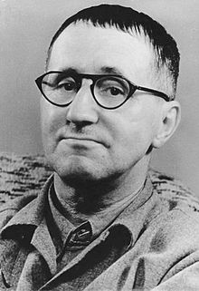
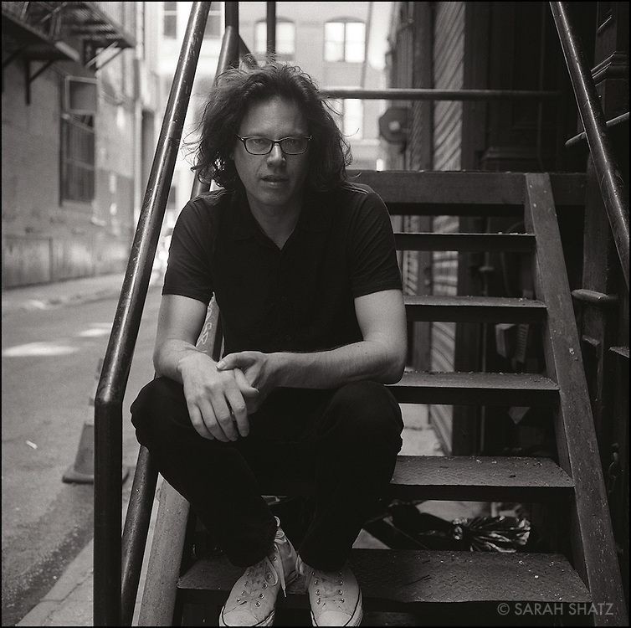
From: Collective Action → Promoting the Agency of Each Individual’s Directing Intelligence / From “Epic Theater” to the “Essay Film”
→
Bertolt Brecht (1898-1956)
John Walter (b. 1961)

Slide 31
The Essay Film as a Model for Thinking about War…
Rather than espousing a particular “ideological affiliation,” the essay film performs “humanistic inquiry” (Andrew Tracy)
It represents itself inquiring into its “material,” “entering” that material from a variety of different directions and at a number of different levels…
What would you have to understand to understand the 2006 production (with Streep starring) of Brecht’s 1939 play, that was produced in 1949, in a city (Berlin) brought to its knees by a rogue sovereign state (Nazi Germany), in a city (NYC) paralyzed by anti-war demonstrations that themselves had precedents in another wartime era (Viet Nam War / 1969) when the state security apparatus looked different…?
Theater: 2006 NYC production / rehearsals / performance of a play about the Thirty Years’ War
1949 Berlin production / post-1945 / WWII / the Holocaust / the Cold War
Brecht / the “communist”/ the director / the father / the husband
The Viet Nam War / the military-industrial complex (MIT labs) / Resistance, 1969
Meryl Streep and her pathos / her star power
Street protests and 21st century wars / Cantor’s class / Marx / the production (costumes and props)
Theater as Resistance?
And its multiple “determinations” and the
possibility of agency…

Slide 32
HCC (Fall, 2013):
Weeks 4-6
- We started with the Thirty Years’ War / then we looked at several re-presentations of that war (1668 → 1939/1949 → 2006 → 2008)…
- Each re-presentation embedded in a dense set of “determining” networks that we have to “essay” (from French: “essayer,” to try) to understand…
MY HYPOTHESIS: You may look differently at the Thirty Years’ War now after you’ve thought about Brecht’s and Walter’s re-presentations…
Was it a “war of state-building” that led to the totalitarian state?
- Maybe we should look for forms of resistance to that state back then / HINT: In religion (the hermit)…
Brecht and Walter pay scant attention to the role of religion as an act of resistance to – or as fomenting -- war…
- We do…So maybe we should actually start again and take another look at the role of religion in the Thirty Years’ War and the Peace…
Thirty Years’ War (1618-48)
Grimmelshausen, Simplicissimus (1668)
Brecht, Mother Courage and her Children (1939 / 1949)
John Walter, “Theater of War” (2008)
HCC (Fall, 2013)

Slide 33
But we – and you – have to move on…
Remember: There is NO LECTURE next week on Monday or Tuesday!
Beginning on Wednesday / Thursday, you will be in the good hands of Prof. Georges van den Abbeele, reading Sun Tzu, Machiavelli, and Michael Walzer…
These will be more theoretical texts about leadership in war, war’s strategies and means, and definitions of “just” and “unjust war”…

Slide 34
But I’ll be there – here! – listening with you!
So we can talk!
Thanks for listening…
And thanks for thinking!

