Slide 1
“. . . war is just for those for whom it is necessary, and arms are pious where there is no hope save in arms.”
Livy, quoted by Machiavelli,
BOTH in Il Principe (p. 120) and in Discorsi

Slide 2
Political Theory of War
Realism
Thucydides
Machiavelli
Hobbes
Hans Morgenthau
States driven by self-interest (reason of state,
Realpolitik)
Just War
Cicero
St. Augustine
St. Thomas Aquinas
Michael Walzer
States must justify their actions on moral as well as political grounds

Slide 3
Just War Theory
Jus ad bellum
Right to engage in war
When?
Where?
For what reason?
To what end?
Jus in bello
Right conduct in war
How?
Who?
With what means?
In what way?

Slide 4
Just War?
Jus ad bellum
Right to engage in war
When?
Where?
For what reason?
To what end?

Slide 5
Just War?
Jus ad bellum
Right to engage in war
When?
Where?
For what reason?
To what end?
AGGRESSION
by another state
= crime
(legalist paradigm of international relations)

Slide 6
What Realism and Just War Theory hold in common:
Domestic Analogy
International relations between states modeled on relations between individuals within a state
Does this makes sense?
Where does this analogy break down?
If the model is that of crime and punishment, then who is the police? Who is the judge? And who has the authority to enforce the law?

Slide 7
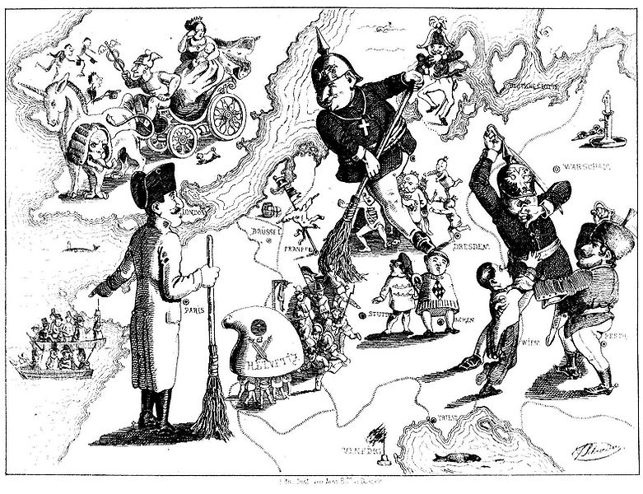
Ferdinand Schröder, “Tidying Europe,” 1849

Slide 8
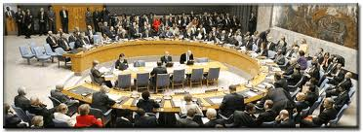
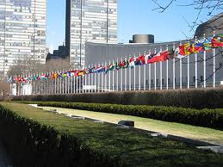
Attempts at International Organization
1648 Peace of Westphalia (state sovereignty)
1815 Congress of Vienna (balance of power)
1919 League of Nations
1945 United Nations

Slide 9
Legalist Paradigm
(Walzer, pp. 61-63)
There exists an international society of independent states.

Slide 10
Legalist Paradigm
(Walzer, pp. 61-63)
There exists an international society of independent states.
This international society has a law that establishes the rights of its members:
    1) Territorial Integrity (land follows people)
    2) Political Sovereignty (self-determination)
    “The right of a nation or people [political community] not to be invaded [and to resist invasion forcefully] derives [historically and culturally] from the common life its members have made on this piece of land . . . and not from the legal title they hold or don’t hold.” (p. 55)

Slide 11
Legalist Paradigm
(Walzer, pp. 61-63)
There exists an international society of independent states.
This international society has a law that establishes the rights of its members:
Any use of force or imminent threat of force by one state against the political sovereignty or the territorial integrity of another constitutes aggression and is a criminal act.
    Corollary: principle of nonintervention in the “domestic affairs” of another state

Slide 12
Legalist Paradigm
(Walzer, pp. 61-63)
There exists an international society of independent states.
This international society has a law that establishes the rights of its members:
Any use of force or imminent threat of force by one state against the political sovereignty or the territorial integrity of another constitutes aggression and is a criminal act.
Aggression justifies two kinds of violent response:
1) A war of self-defense by the victim
2) A war of law enforcement by the victim and by any other member of the international society

Slide 13
Legalist Paradigm
(Walzer, pp. 61-63)
There exists an international society of independent states.
This international society has a law that establishes the rights of its members:
Any use of force or imminent threat of force by one state against another constitutes aggression and is a criminal act.
Aggression justifies two kinds of violent response: (war of self-defense and war of law enforcement)
Nothing but aggression can justify war.
    Corollary: principle of nonintervention (again)

Slide 14
Legalist Paradigm
(Walzer, pp. 61-63)
There exists an international society of independent states.
This international society has a law that establishes the rights of its members:
Any use of force or imminent threat of force by one state against another constitutes aggression and is a criminal act.
Aggression justifies two kinds of violent response: (war of self-defense and war of law enforcement)
Nothing but aggression can justify war.
Once the aggressor state has been militarily repulsed, it can also be punished.
    Subject of Rights ➔ (Potential) Object of Punishment

Slide 15
Michael Walzer
1935 –
BA History, Ph.D. Government
Professor Emeritus, Institute for Advanced Study
    Princeton, NJ
Dissent magazine, co-editor
Political Philosophy
Communitarianism
Skepticism toward abstraction and universalism
Theory must be grounded in the particular
(significance comes from context)
A Moral Argument with Historical Illustrations

Slide 16
Just and Unjust Wars
Defense of Just War Theory against Realists
“No government will send young men into battle to kill and be killed without offering some justification for what they are doing.”
Vs.
Pure reason of state, or realpolitik (p. 63)

Slide 17
Just and Unjust Wars
But need to reexamine validity of the legalist paradigm (“Doing justice, in the legalist sense, isn’t always the right thing to do” [p. 117]) by analyzing limit cases of that paradigm both
in the abstract (logical, legal, moral)
and in the particular (specific thoughts and actions taken in specific historical situations)

Slide 18
Limit Cases
Anticipating aggression?
Exceptions to principle of nonintervention?
When should war end?

Slide 19
Limit Cases
Anticipating aggression?
    When does the mere threat of aggression justify preventive war, or pre-emptive strikes?
    Question of “moral security” (p. 80)
    Are there not threats with which no nation can be expected to live? (p. 85)
Exceptions to principle of nonintervention?
When should war end?

Slide 20
Limit Cases
Exceptions to principle of nonintervention?
    Civil war? Secession?
    Counter-intervention
    Humanitarian
When should war end?

Slide 21
Limit Cases
When should war end?
    “The right of nations, even of enemy nations, to continued national existence and, except in extreme circumstances, to the political prerogatives of nationality” (p. 123)

Slide 22
Now, HOW should war be waged?
Jus in Bello

Slide 23

Film Screening Options
Monday, Dec. 2, 5-6:30pm and Wednesday, Dec. 4, 5-6:30pm in McCormick Screening Room (HG 1070)

