Slide 1
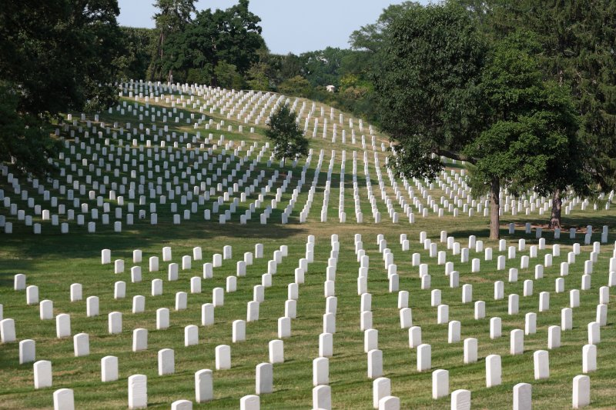
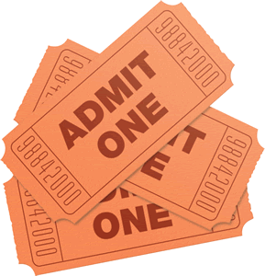
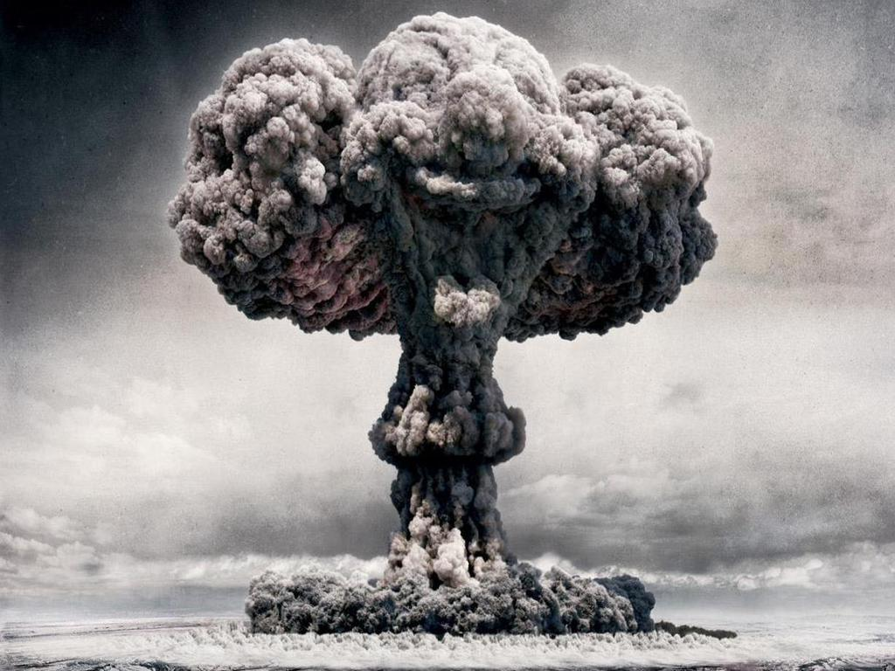
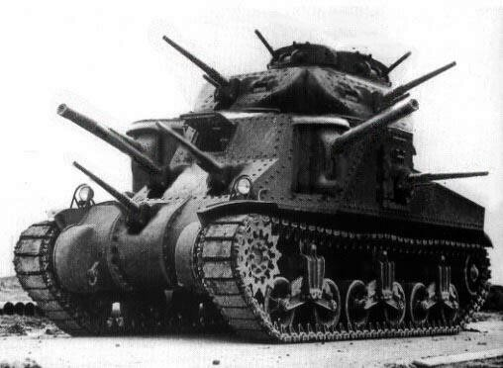
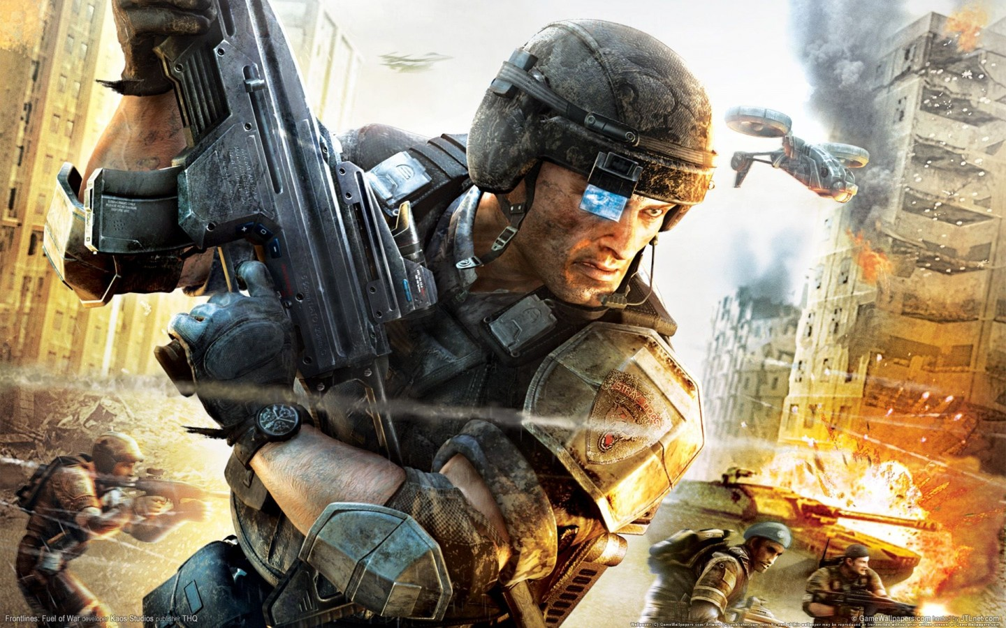
Selling War
Michael Szalay
Humanities Core, Winter 2014

Slide 2

“Ever since words existed for fighting and playing, men have been wont to call war a game.”
Johan Huizinga
The ancient Greek word aethlos means the fight of warriors and the contest of athletes.
“Sport is war, minus the shooting”
                George Orwell
“Sports is the human activity closest to war that isn’t lethal.”
                Ronald Reagan

Slide 3
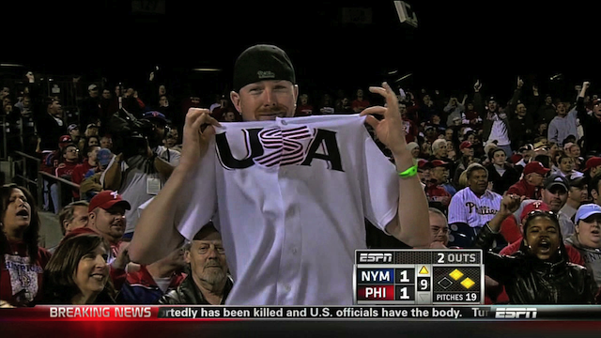
“‘U-S-A!’ a cheerleader yells, and the rest take up the chant, ‘U-S-A! U-S-A! U-S-A!’ and Norm is chanting and clapping, rocking with the beat”
Ben Fountain, Billy Lynn’s Long Halftime Walk (New York: HarperCollins, 2012), 128.
Sports Nationalism
Phillies vs. Mets
https://www.youtube.com/watch?v=k97wq0953UU
Iowa State
https://www.youtube.com/watch?v=GzThMAyFK6Q

Slide 4
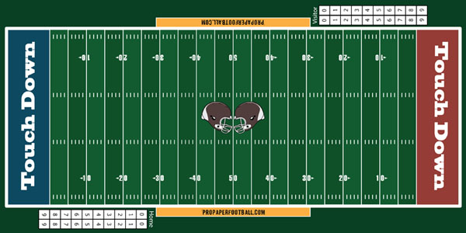
War ←→ Sport
Implications of metaphor in the case of traditional team sports:
1) Sport and war are fair, two sided contests
2) The contest is conducted according to rules
3) The contest is linear, and goal-oriented: one side wins, another loses.

Slide 5
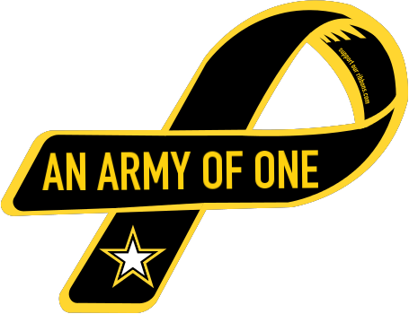
“The true mission of American sports is to prepare young men for war.”
Dwight D. Eisenhower
“In the logics of the War on Terror, civilians displace armies as the target of choice, and it is this everyday body that signifies the ‘front line.’”
              Roger Stahl, Militainment, Inc. (New York: Routledge, 2010), 55
“Since the expanse of the world is progressively being reduced to nothing [by communication technologies] . . . The individual becomes his own training ground.”
              Paul Virilio, Desert Screen: War and the Speed of Light (New York: Bloomsbury, 2005), 30

Slide 6
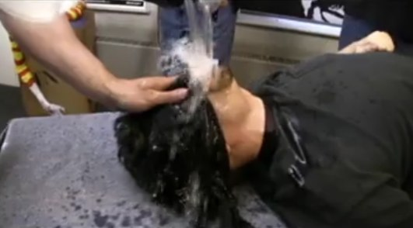
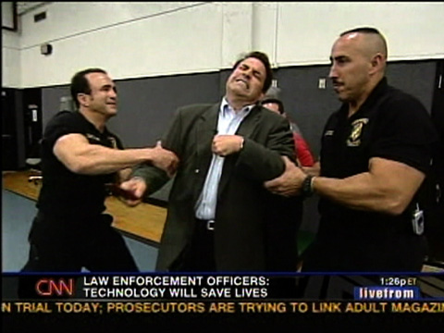
Steve Harrigan, Waterboarding
Rick Sanchez, Tasering
https://www.youtube.com/watch?v=Hy5p9xvprFM
“The consumption of violence here is not the spectacular variety of the Roman coliseum, where pain is inflicted upon an other, a criminal or scapegoat. Instead, a stand-in for the viewer undergoes the drama. As such, the primary metaphor is more akin to a human sacrifice than a public execution in that one is encouraged to identify with the victim.”
            Roger Stahl, Militainment, Inc., 59

Slide 7

Can the same be said of this?

Slide 8
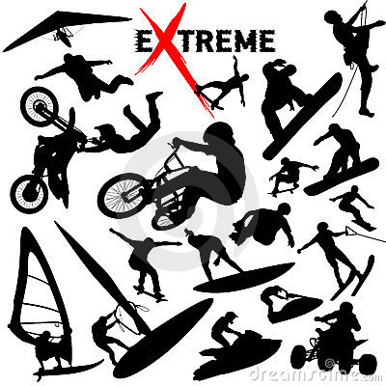
Extreme Sport
Fleshwound Films:
https://www.youtube.com/watch?v=qjx9zeigybcde
“I can’t wait to hop in my Jeep Liberty, drink some Mountain Dew, and go waterboarding.”
          John Stewart, The Daily Show
The spectacle of extreme sports derives “its primary pleasures not from watching but rather being in virtual proximity to pain and danger. In colonizing discourses of recruiting, war journalism, terrorism, and others, the metaphor has given birth to the rhetoric of the ‘battlefield playground.’ Such a relationship to war is a vital aspect of the virtual citizen-soldier. Put simply, extreme sports discourse has been put to use as an entry point through which the citizen has been invited to play soldier.”
          Roger Stahl, Militainment, Inc., 54.

Slide 9
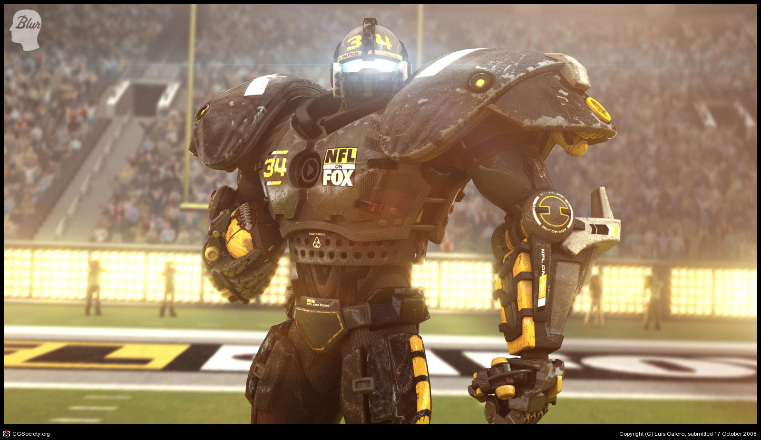
“But I firmly believe that any man's finest hour, his greatest fulfillment of all he holds dear, is the moment when he has worked his heart out in a good cause and lies exhausted on the field of battle - victorious.”
~ Vince Lombardi
Super Bowl 36, Pregame Show:
https://www.youtube.com/watch?v=moaHS2wrWW0

Slide 10
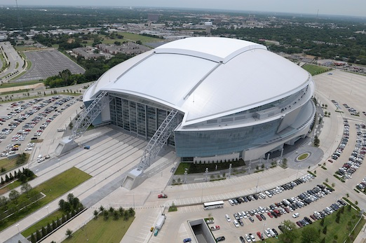
Back to Reality…
“Years and years of carefully posed TV shots have imbued the place with intimations of mystery and romance, dollops of state and national pride, hints of pharaonic afterlife such as always inhere in large-scale public architecture, all of which render the stadium of Billy’s mind as the conduit or portal, a direct tap-in, to a ready-made species of mass transcendence, and so the real-life shabbiness is a nasty comedown.”
Ben Fountain, Billy Lynn’s Long Halftime Walk (New York: HarperCollins, 2012), 10

Slide 11
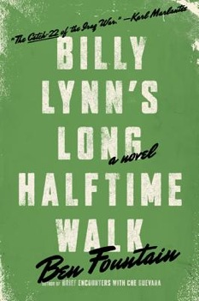
“ . . . A kind of sickly sweet emo funk that’s almost pleasurable . . .”
“Without ever exactly putting his mind to it, he’s come to believe that loss is the standard trajectory. . . . The war is fucked? Well, duh. Nine-eleven? Slow train coming. They hate our freedoms? Yo, they hate our actual guts! Billy suspects his fellow Americans secretly know better, but something in the land is stuck on teenage drama, on extravagant theatrics of ravaged innocence and soothing mud wallows of self-justifying pity” (11).

Slide 12

“There’s something harsh in his fellow Americans, avid, ecstatic, a burning that comes of the deepest need. That’s his sense of it, they all need something from him, this pack of half-rich lawyers, dentists, soccer moms, and corporate VPs, they’re all gnashing for a piece of a barely grown grunt making $14,800 a year. For these adult, affluent people he is mere petty cash in their personal accounting, yet they lose it when then enter his personal space. They tremble. They breathe in fitful, stinky huffs. Their eyes skitz and quiver with the force of the moment, because here, finally, up close and personal, is the war made flesh…” (38-39).

Slide 13
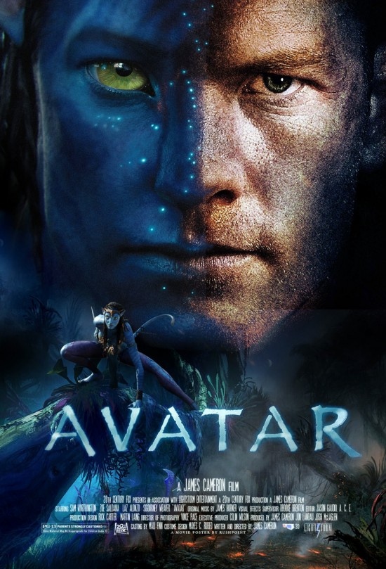
“Americans fight the war daily in their strenuous inner lives. Billy knows because here at the contact point he feels the passion every day. Often it’s in their literal touch, a jolt arching across as they shake hands, a zap of pent-up warrior heat. For so many of them, this is the Moment: His ordeal becomes theirs, and vice versa, some sort of mystical transference takes place and it’s too much for most of them, judging from the way they choke up in the clutch” (39).
“Either we fight them over there or we fight them over here, that’s the way most Americans see it” (88).

Slide 14
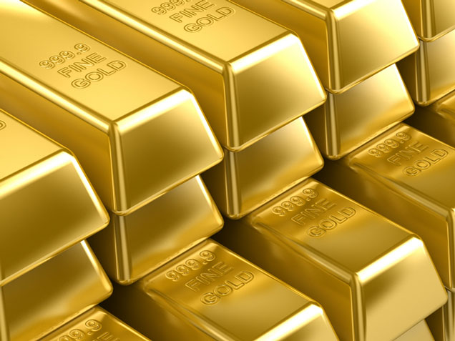
Keep Your Eye on the Ball…
“One of the Swedes opened his calfskin attaché case and showed Billy the gold stash he’d acquired in Baghdad, several pounds’ worth of chains and ropes and coins, of such purity that they glowed more orange than gold” (5).

Slide 15
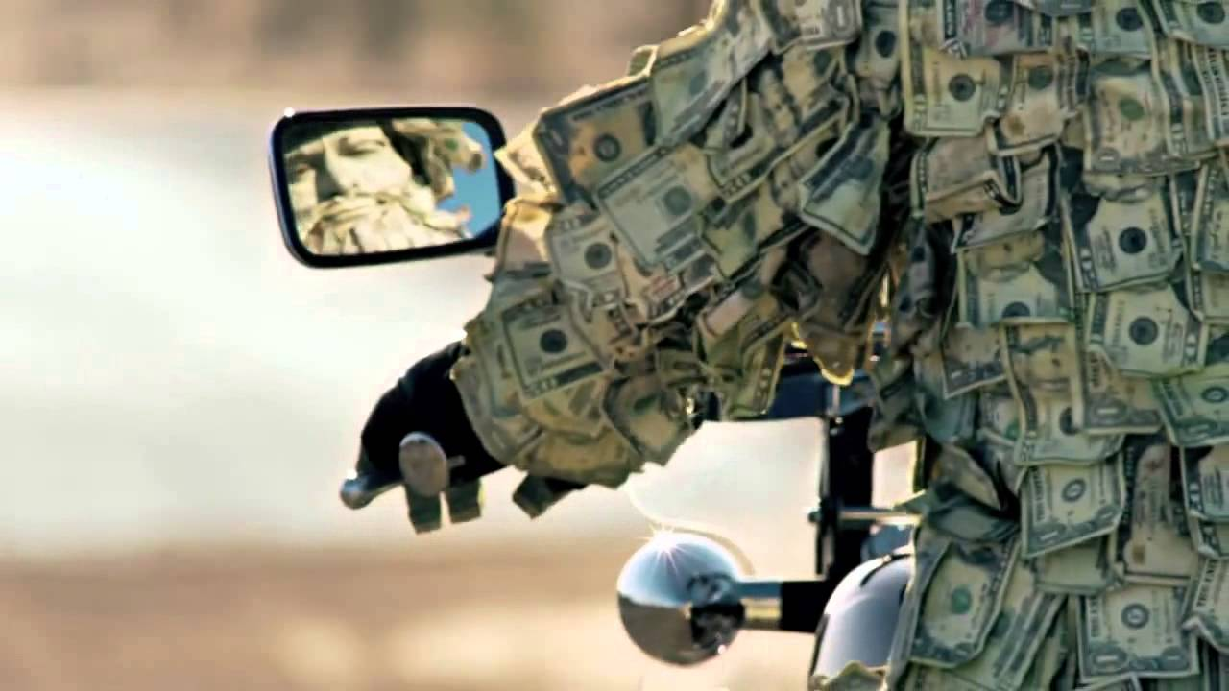
“For these adult, affluent people he is mere petty cash in their personal accounting.”
“As for the rest of Bravo, they might as well be so many shares of corporate stock that happen to talk and walk and drink a lot of beer” (34).
“Four. Hundred. Thousand. It was like God appearing in all his nuclear glory, omnipotent, all-consuming, incomprehensible” (95).

Slide 16
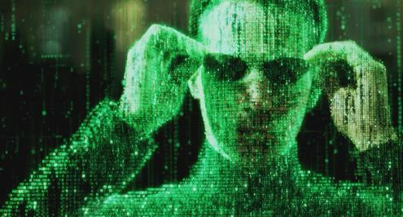
“Stadiums, for example. Airports. The interstate highway system. Wars. He wants to know how it is paid for, where do the billions come from? He imagines a shadowy, math-based parallel world that exists not just beside but amid the physical world, a transparent interlay of Matrix-style numbers through which flesh-and-blood humans move like fish through kelp. This is where the money lives, an integer-based realm of code and logic, geometric modules of cause and effect. The realm of markets, contracts, transactions, elegant vectors of fiber-optic agency whereby mind-boggling sums of mysterious wealth shoot around the world on beams of light. It seems the airiest thing there is yet the realest, but how you enter that world he has no idea… (121).

Slide 17
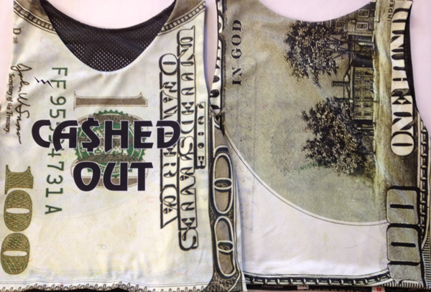
Cashed Out
“Bravo’s talk these days is so much about money, money-moneymoney like a bug on the brain or a hamster spinning its squeaky wheel, a conversation going nowhere at tremendous speed. Billy would just as soon move on to other subjects, but he won’t call his fellow Bravos on it. The way they obsess, it’s as if a big payday involved more than more buying power, as if x amount of dollars cooling in the bank could bring your ass safely through the war. He intuits the spiritual logic of it, but for him the equation works in reverse: The day the money comes through, the actual day his check clears, that will be the very day he gets smoked” (34).

