Slide 1
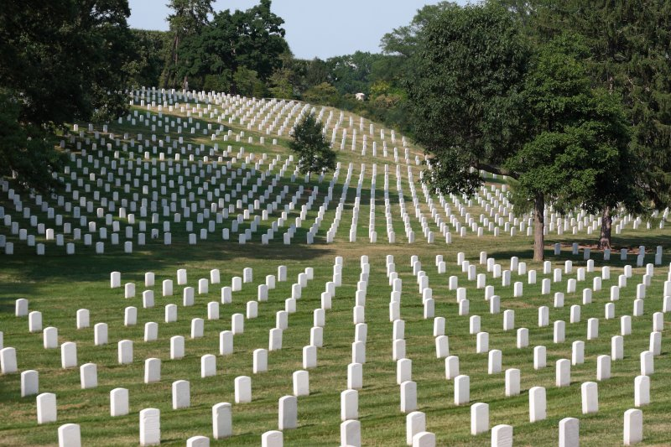

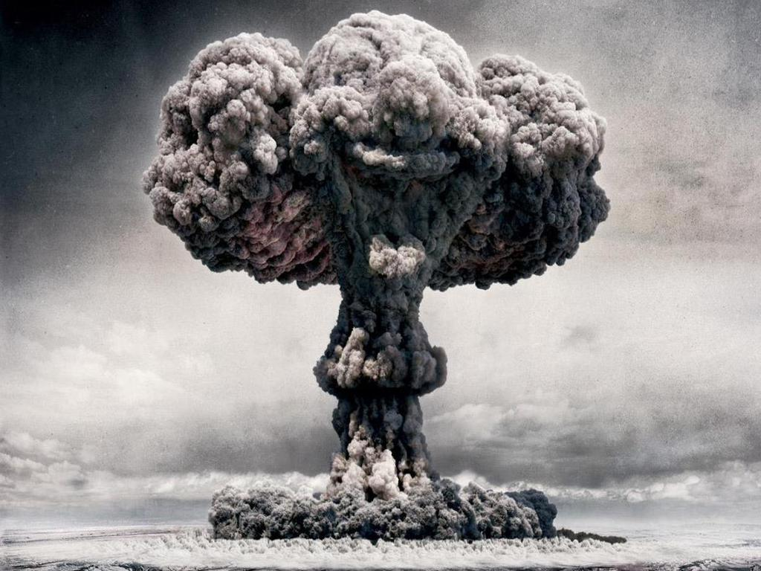
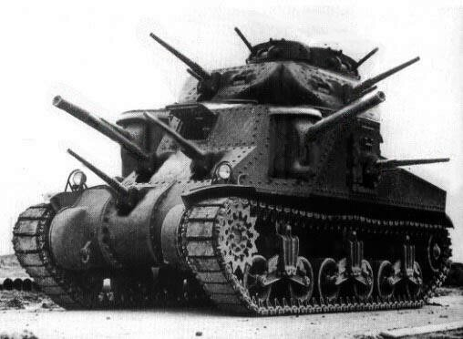
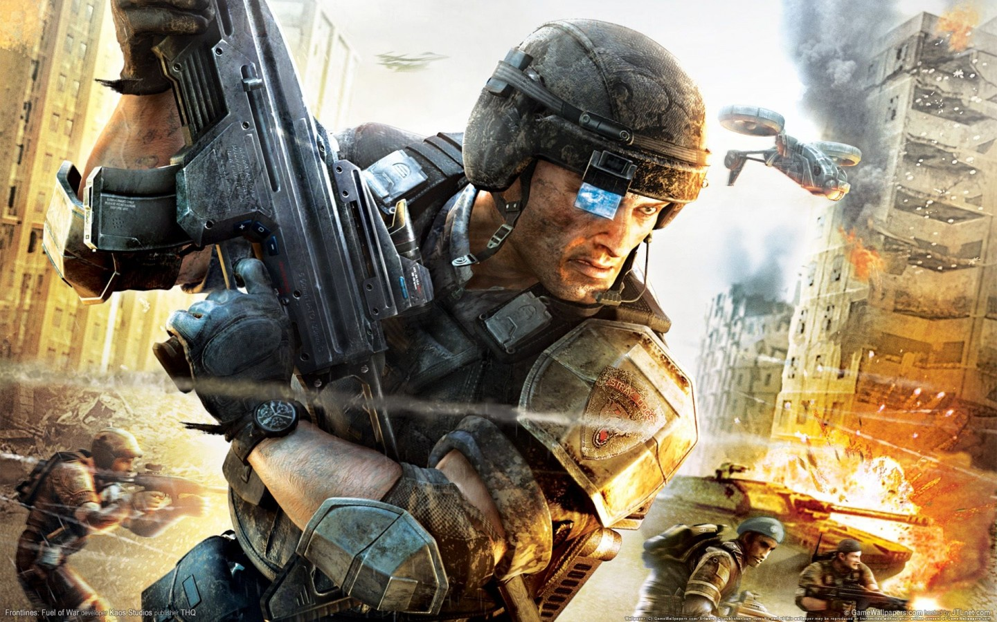
Selling War #1
Michael Szalay
Humanities Core, Winter 2014

Slide 2
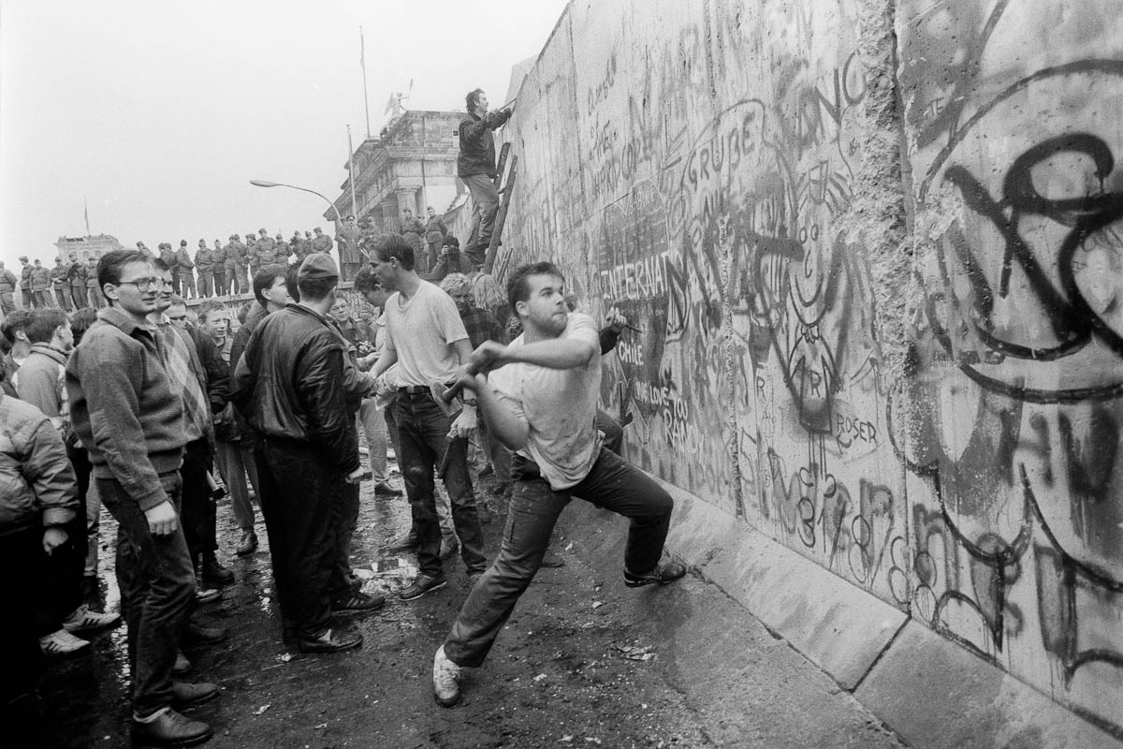
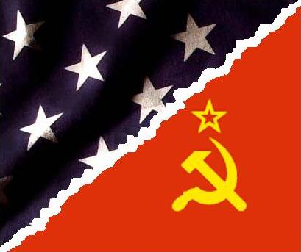
“The End of History”
“We are far beyond ideology and politics now.”
Baudrillard
Contexts
The fall of the Berlin Wall, 1989
Notes:
What does the terrorist believe?

Slide 3


“triumphant globalization battling against itself”
Baudrillard
“Globalization can be defined as the intensification of worldwide social relations which link distant localities in such a way that local happenings are shaped by events occurring many miles away and vice versa.”
Anthony Giddens
“Fundamentally, all this — causes, proof, truth, rewards, ends and means — is a typically Western form of calculation. We even evaluate death in terms of interest rates, in value-for-money terms.” The terrorist event, however, is a “symbolic act” that “restores an irreducible singularity to the heart of a system of generalized exchange.”
Baudrillard
Notes:
If there is only one unified world order, where do terrorists come from?

Slide 4
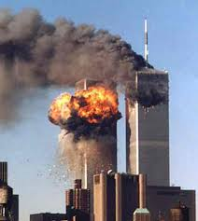
“The spectacle of terrorism forces the terrorism of spectacle upon us.”
Baudrillard
“at the same time [that images] exalt the event, they also take it hostage. . . . the image consumes the event. . . . in this Manhattan disaster movie, the twentieth century's two elements of mass fascination are combined: the white magic of the cinema and the black magic of terrorism; the white light of the image and the black light of terrorism.”
Baudrillard

Slide 5
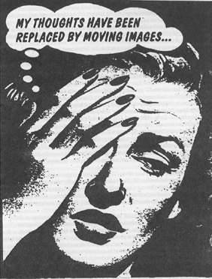
Guy Debord
Society of the Spectacle (1967)
Thesis 1) “In societies where modern conditions of production prevail, all of life presents itself as an immense accumulation of spectacles. Everything that was directly lived has moved away into a representation.”

Slide 6

Debord, Society of the Spectacle
What is it?
Thesis 4) The spectacle is not a collection of images, but a social relation among people, mediated by images.
Thesis 34) The spectacle is capital to such a degree of accumulation that it becomes an image.

Slide 7
Reality itself has begun merely to imitate the model, which now precedes and determines the real world: "The territory no longer precedes the map, nor does it survive it. It is nevertheless the map that precedes the territory—precession of simulacra—that engenders the territory.”
“It is no longer a question of imitation, nor duplication, nor even parody. It is a question of substituting the signs of the real for the real” . . . . His point is that we have lost all ability to make sense of the distinction between nature and artifice.
Contemporary media (television, film, magazines, billboards, the Internet) are concerned not just with relaying information or stories but with interpreting our most private selves for us, making us approach each other and the world through the lens of these media images.
Dino Felluga, "Modules on Baudrillard: On Simulation."

Slide 8
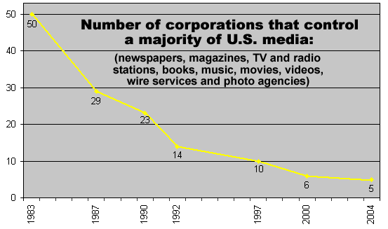
Media Concentration
“The eventual ability to align the media as an extension of military public relations was made possible through changes in the economic landscape already in motion during the 1980s.”
Roger Stahl

Slide 9
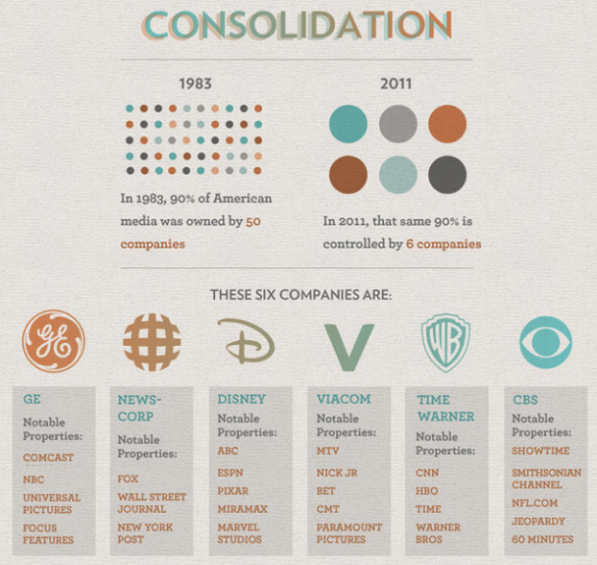

Slide 10
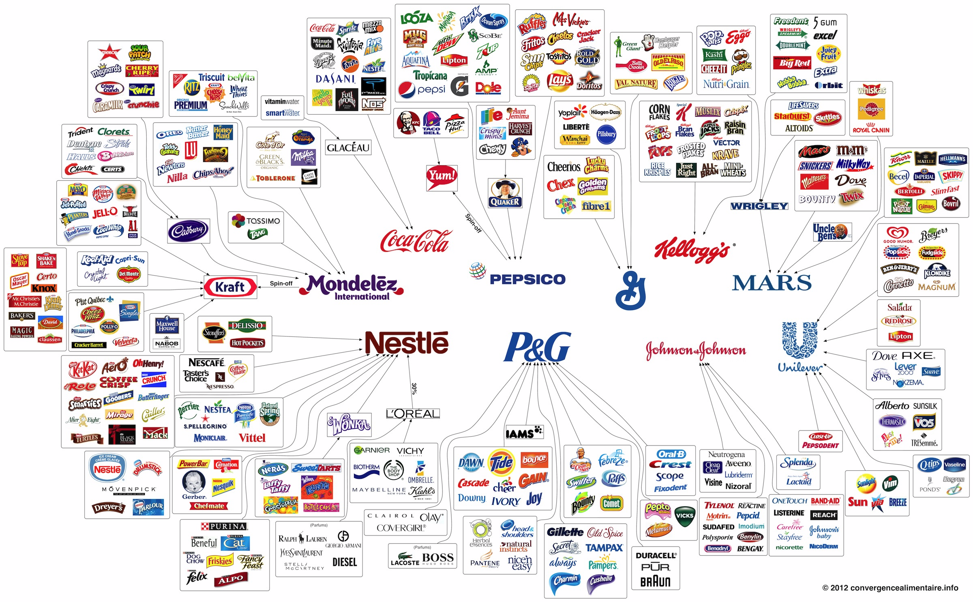
What’s the difference between media monopolies and monopolies on other consumables?

Slide 11
Rupert Murdoch's Fox network is among the US media giants accused of tailoring its war coverage to curry favor with Michael Powell, the George Bush-appointed chairman of America's media regulator.
Powell, the son of US secretary of state Colin Powell, is under intense lobbying pressure from the US broadcasting industry to abolish safeguards that restrict limits on the number of TV and radio stations a company can own in a market.
"It is likely that decisions about how to cover the war on Iraq - especially on television - may be tempered by a concern to not alienate the White House," said Jeffrey Chester. "These media giants stand to make untold billions if the FCC safeguards are eliminated or weakened.”
The Guardian, 14 April 2003
By then too late? Were media companies motivated to believe in the existence of “Weapons of Mass Destruction”? That Iraq was behind 9/11?

Slide 12
Hollywood and the Pentagon
One of the first war films, Birth of a Nation, used artillery pieces loaned from West Point to give it the air of authenticity. The first Academy Award for Best Picture went to 1929's Wings, a movie about aerial combat during World War I that used Army Air Corps pilots to shoot all its dogfights.
During World War II, film stars like Ronald Reagan and Clark Gable enlisted in the army to make recruitment films in motion picture units.
“In 1948, the Pentagon formally set up a special movie liaison office, as part of the Office of the Assistant secretary of Defense for Public Affairs. Filmmakers who wanted access to military equipment, locations, personnel, or Department of Defense archival footage, had to agree to their work being vetted by the Pentagon”
        Daya Thussa

Slide 13
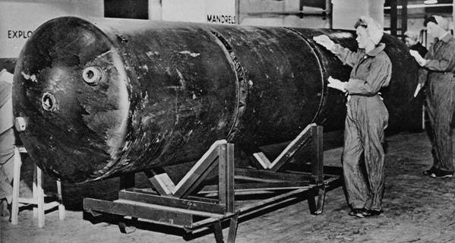
“The Blockbuster”
‘The term began to appear in the American press in the early 1940s, describing the largest of aerial bombs: single bombs capable of destroying a city block, also known as “cookies” during the firebombing of Hamburg. Later figurative use referred to anything making a public impact: "Broadway reacted to the request of War Mobilization Director Byrnes to close all places of entertainment by midnight Feb. 26 as if a blockbuster had landed on Manhattan.” Some entertainment histories cite it as originally referring to a play that is so successful that competing theaters on the block are "busted" and driven out of business, but the OED cites a 1957 use which is simply as a term of "biggest", after the bombs.’
      from Wikipedia
A 12,000 lb. blockbuster used in WWII, minus the tail unit.

Slide 14
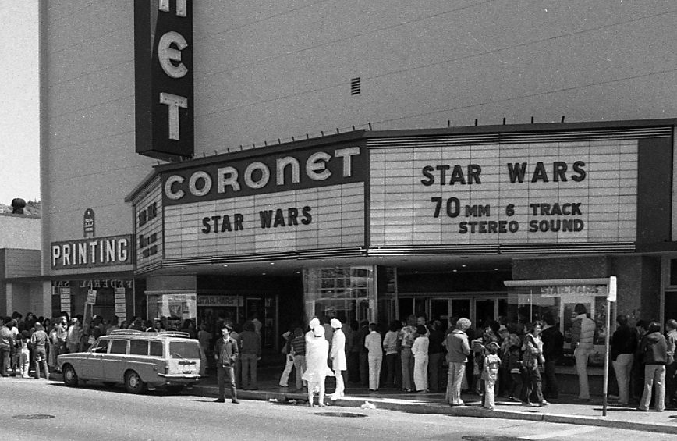
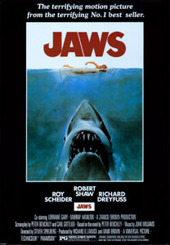
After the success of Jaws (1975), Hollywood attempted to create similar "event films" with wide commercial appeal. Companies began green lighting increasingly high budgeted films and relying extensively on massive advertising blitzes leading up to their theatrical release.
These films tended toward the violent and the spectacular…
Notes:
20 minutes

Slide 15
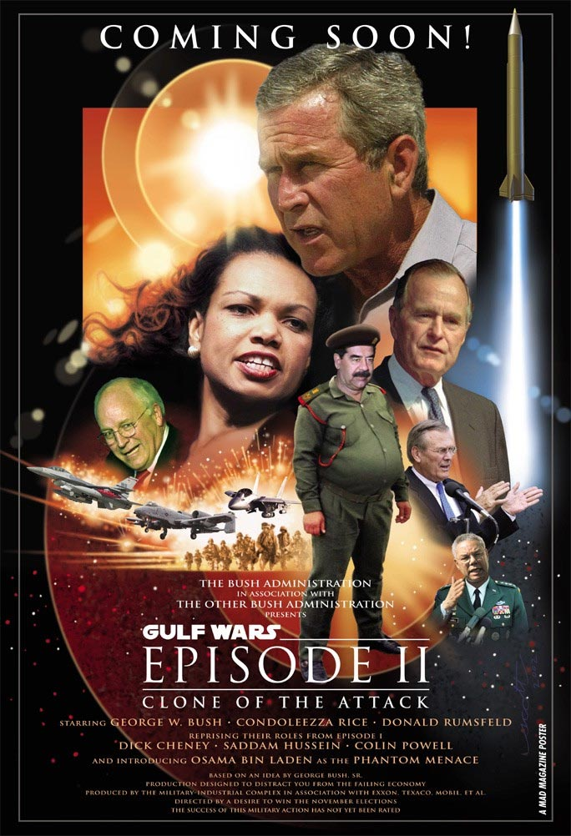
In 1978, Aviation Week proposes equipping space stations with lasers able to shoot down missiles launched at the U.S. The magazine calls this weapon system “the battle system,” which is what George Lucas names the Death Star in Star Wars (1977).
In 1983, Reagan borrows the phrase “Evil Empire” from the Star Wars Trilogy and uses it to characterize the Soviet Union.
He soon thereafter proposes a missile defense system that will bring the world “a new hope” (the title of the first Star Wars film). The system comes to be known as “Star Wars.”
In 2002, President George W. Bush describes Iraq, Iran, and Korea as “the Axis of Evil.”

Slide 16
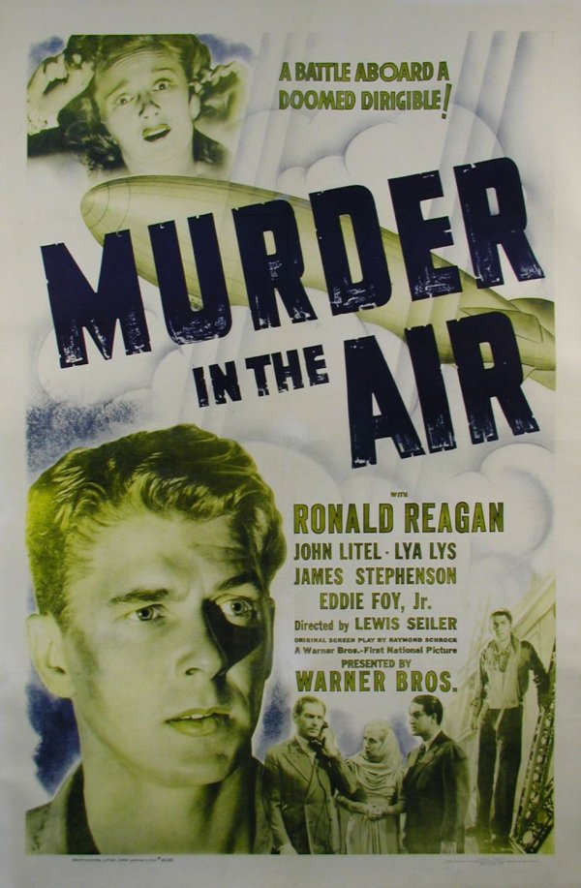
Origins?
“In his psycho-biographical study Ronald Reagan, the Movie, Michael Rogin traces Reagan's vision of missile defense back to the 1940 Warner Brothers movie Murder in the Air. In this film, Reagan plays a Secret Service agent who prevents a foreign spy from stealing the plans for a powerful new defensive weapon. By being able to stop and destroy any attacking vehicle or missile, this weapon will, according to one of the film's characters, `make America invincible in war and therefore be the greatest force for peace ever invented'. Rogin's central thesis is that the future president was 'made' in 1940s Hollywood.”
Peter Kramer, “Ronald Reagan and Star Wars”

Slide 17
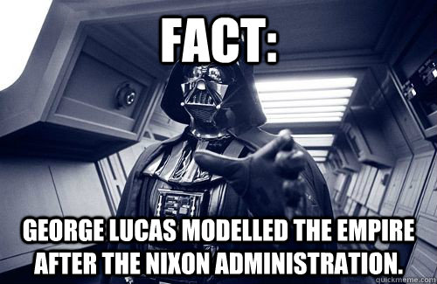

Slide 18
“The fact that we have dreamt of this event, that everyone without exception has dreamt of it — because no one can avoid dreaming of the destruction of any power that has become hegemonic to this degree — is unacceptable to the Western moral conscience. Yet it is a fact, and one which can indeed be measured by the emotive violence of all that has been said and written in the effort to dispel it.
“At a pinch, we can say that they did it, but we wished for it. If this is not taken into account, the event loses any symbolic dimension. It becomes a pure accident, a purely arbitrary act, the murderous phantasmagoria of a few fanatics, and all that would then remain would be to eliminate them. Now, we know very well that this is not how it is. Which explains all the counterphobic ravings about exorcizing evil: it is because it is there, everywhere, like an obscure object of desire. Without this deep-seated complicity, the event would not have had the resonance it has, and in their symbolic strategy the terrorists doubtless know that they can count on this unavowable complicity.”
Jean Baudrillard, “The Spirit of Terrorism”

Slide 19
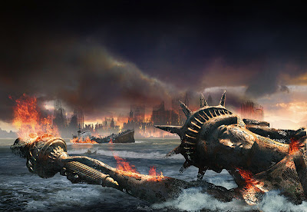
Goodbye, New York
According to film.com, New York has been destroyed on film 61 times (as of 2012), the most of all cities.
Notes:
40 MINUTES IN: ASK: WHAT CITY WAS SECOND???

Slide 20

Star Wars (1977)
Notes:
30 SECONDS

Slide 21
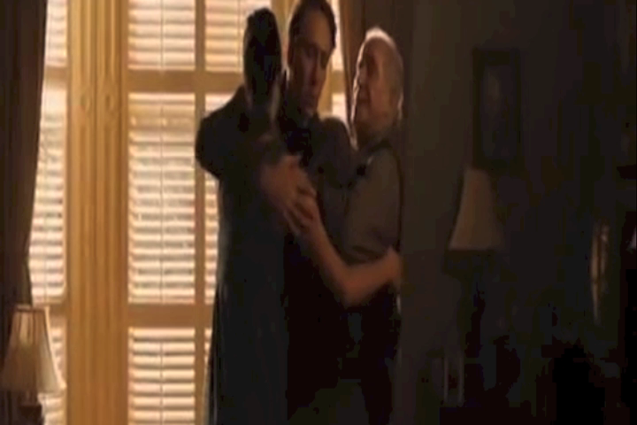
Knowing (2009)
Notes:
ONE MINUTE

Slide 22
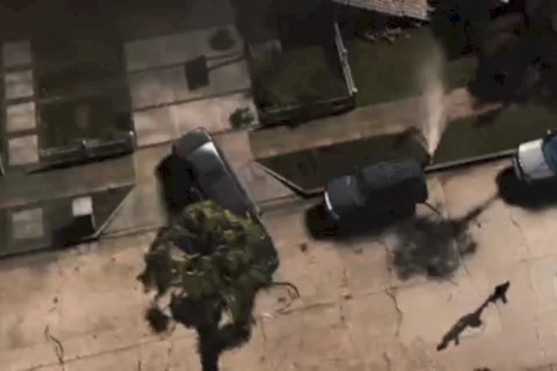
2012 (2009)
Notes:
ONE AND A HALF MINUTES

Slide 23
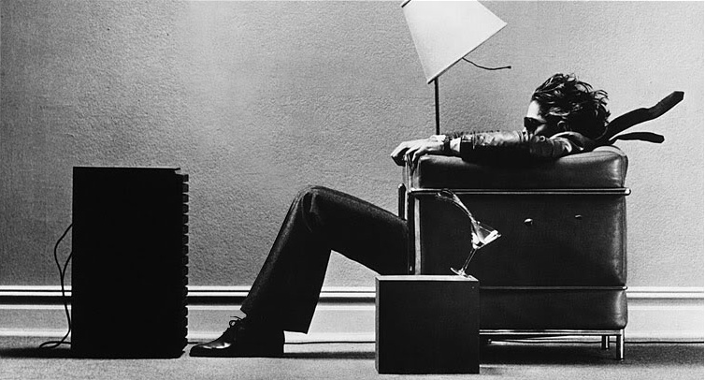

Lean Back vs. Lean Forward

Slide 24
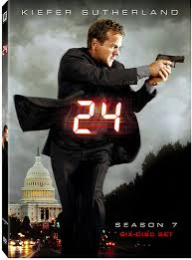
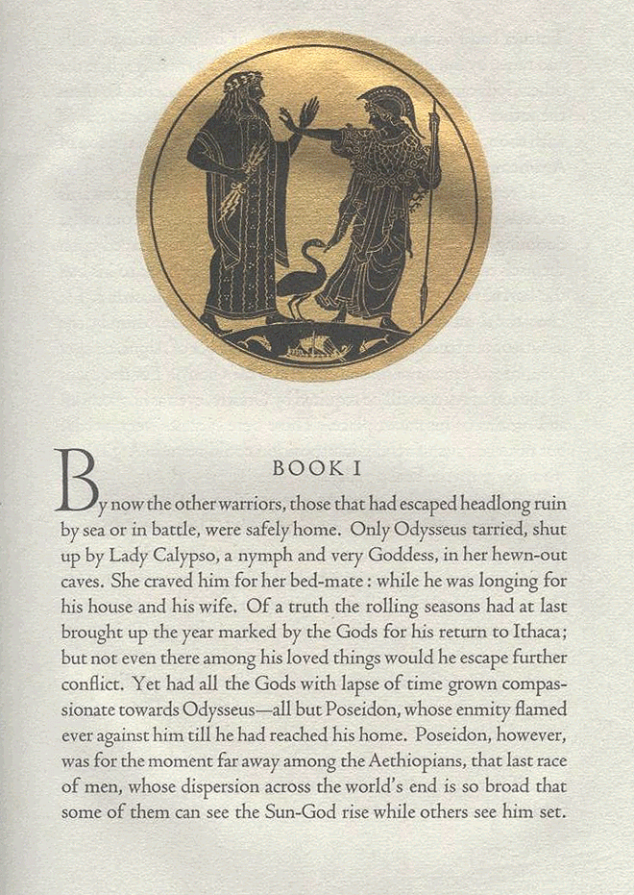
Medium Specificity?
vs.
"24" is — was — nothing more or less than an epic poem, with Jack Bauer in the role of Odysseus or Beowulf.
            The Los Angeles Times

