Slide 1


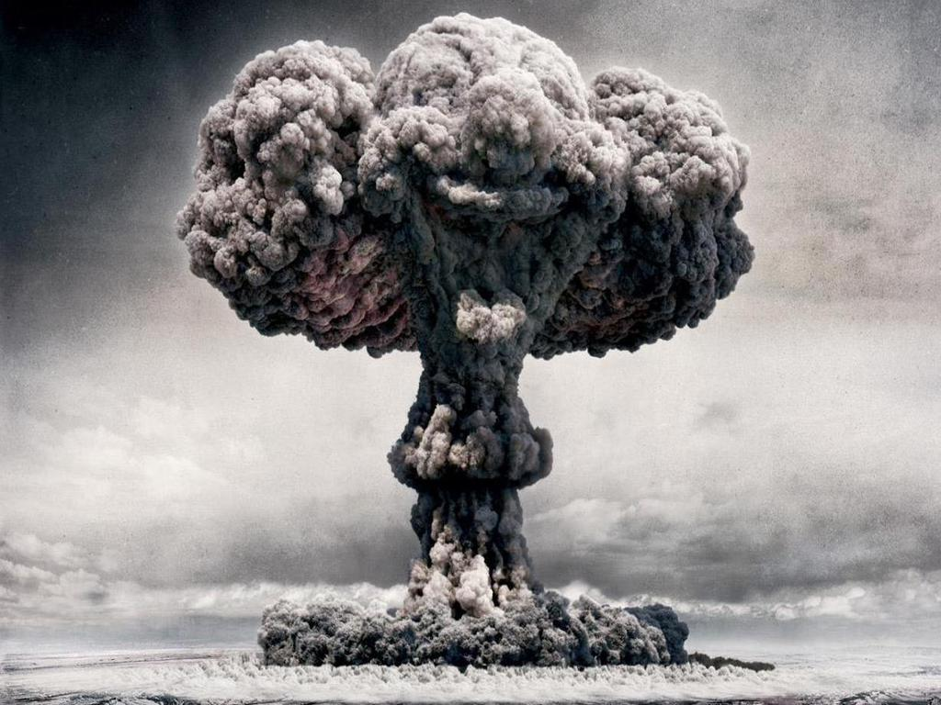
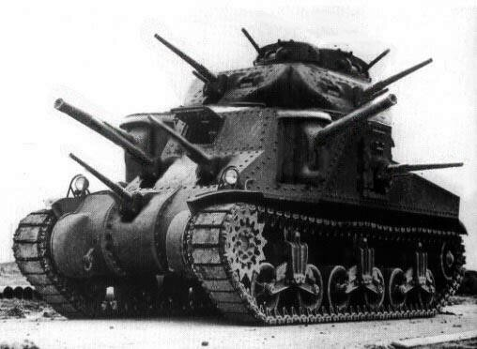

Selling War
Michael Szalay
Humanities Core, Winter 2014

Slide 2
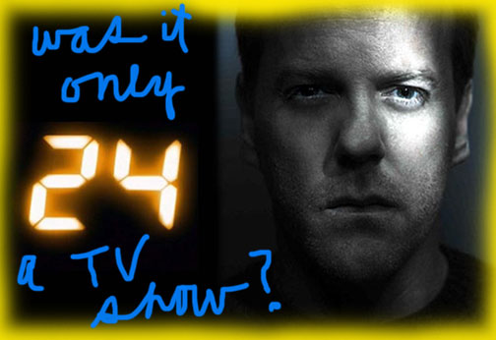

Slide 3
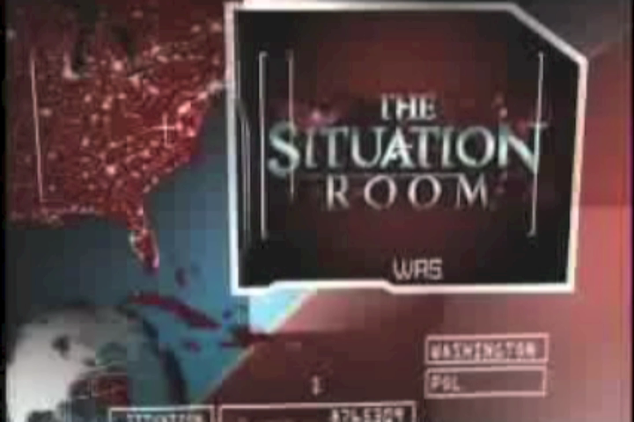
Impact and Influence
The cultural impact of “24 was absolutely stunning. Everyone from Rush Limbaugh to Bill Clinton would talk about it, and we knew they were among our fans. I guess when people used it as propaganda for their own ideas—you know, when Justice Scalia mentioned Jack Bauer—that would make me feel uncomfortable.”
Howard Gordon, Executive Producer
Wikipedia

Slide 4
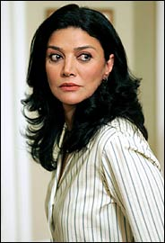
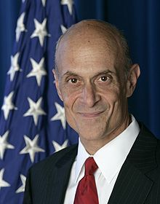
"My only concern when I was playing this role was, God forbid if they do not feel comfortable in my home anymore and won't eat my food. But they can tell the difference between real life and fiction. They are smart kids.”
Shohreh Aghdashloo, Oscar-nominated Actress and Women’s Rights Advocate, on watching 24 with her 16-year-old daughter, Tara Jane, and a group of her daughter's friends.
24 "reflects real life.”
Michael Chertoff (Secretary of Homeland Security, 2005-2009), at a panel discussion on 24 organized by the Heritage Foundation

Slide 5
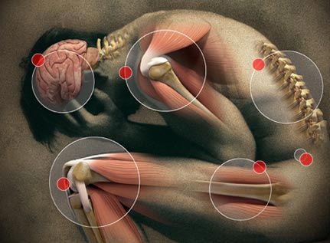
What is “the real”?
“We might almost say that reality is jealous of fiction, that the real is jealous of the image.”
            Baudrillard
The Body in Pain

Slide 6
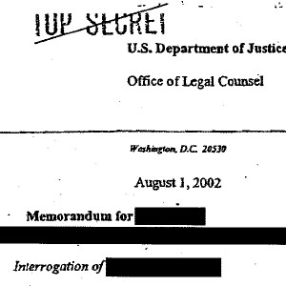
“The most influential legal thinker in the development of modern American interrogation policy is not a behavioral psychologist, international lawyer, or counterinsurgency expert. . . . [but] none other than the star of Fox television's 24: Jack Bauer.”
Bauer “was an inspiration at early "brainstorming meetings" of military officials at Guantanamo in September of 2002.
“Diane Beaver, the staff judge advocate general who gave legal approval to 18 controversial new interrogation techniques including water-boarding, sexual humiliation, and terrorizing prisoners with dogs, told [Philippe] Sands that Bauer ‘gave people lots of ideas.’”
“John Yoo, the former Justice Department lawyer who produced the so-called torture memos—simultaneously redefining both the laws of torture and logic—cites Bauer in his book War by Other Means. “
Dahlia Lithwick, Slate Magazine, July 26, 2008

Slide 7
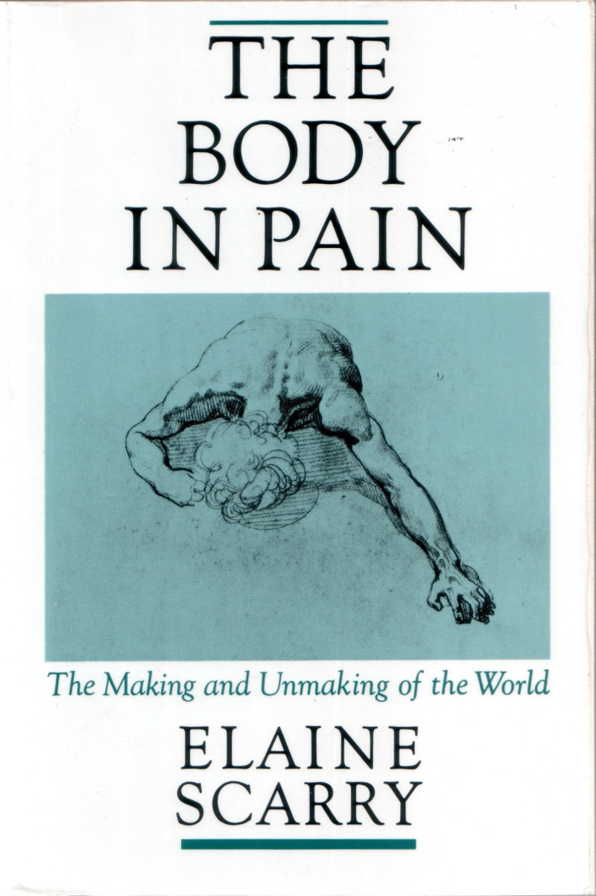
“In the very processes it uses to produce pain within the body of the prisoner, it bestows visibility on the structure and enormity of what is usually private and incommunicable, contained within the boundaries of the sufferer’s body. It then . . . converts the vision of suffering into the wholly illusory but, to the torturers and the regime they represent, wholly convincing spectacle of power.”
Torture produces “Insignia of power”; it constitutes “the conversion of the enlarged map of human suffering into an emblem of the regime’s strength.”
Elaine Scarry, The Body in Pain (New York: Oxford University Press, 1985), 27, 56.

Slide 8








Insignia of Power

Slide 9
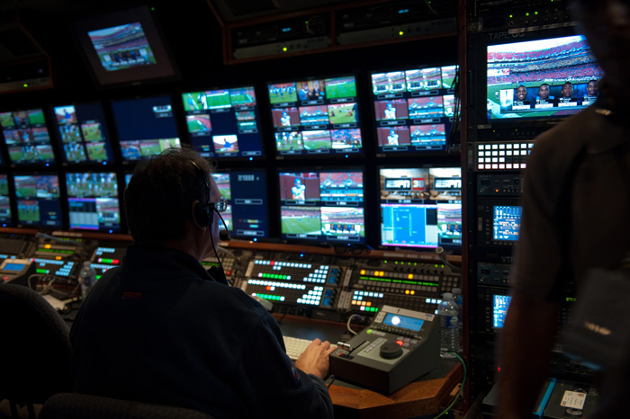
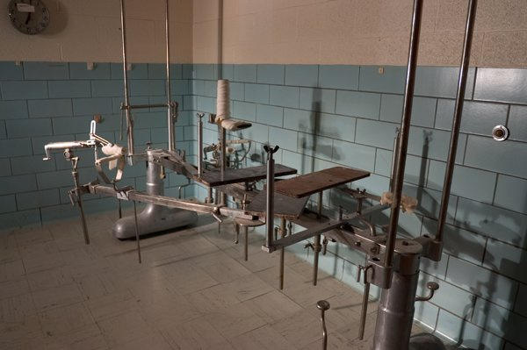
from The Body in Pain
“It is not accidental that in the torturer’s idiom the room in which the brutality occurs was called ‘the production room’ in Philippines, the ‘cinema room’ in South Vietnam, and the ‘blue lit stage’ in Chile: built on these repeated acts of display and having as its purpose the production of a fantastic illusion of power, torture is a grotesque piece of compensatory drama” (28).

Slide 10
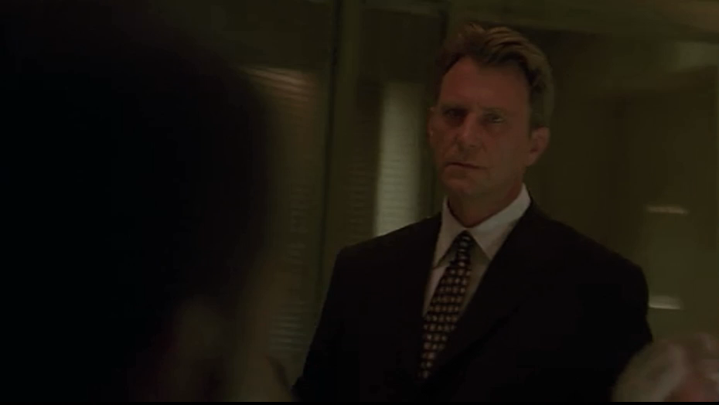
Vision and Power

Slide 11
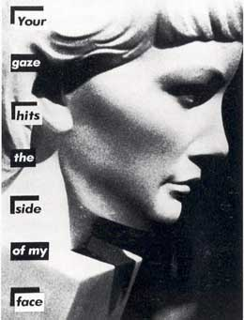
The Male Gaze
Laura Mulvey argues that the cinema is the medium for male subjects to further exert their mastery over female objects, identifying with the dominant gaze of the camera. “The male gaze projects its fantasy upon the female figure” who becomes simultaneously idealized and immobilized. Women are to be looked at and put on display; both the camera apparatus and the male gaze regulate their gaze and thus women can only identity with the self as an object.
      Jennifer Reinhardt
      http://csmt.uchicago.edu/glossary2004/gaze.htm
Barbara Kruger

Slide 12
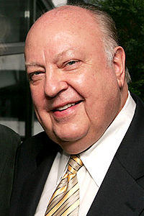

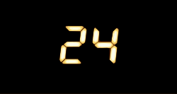
Party Propaganda (Insignia of State Power)?
“The Republican Party is being run out of News Corp headquarters, masquerading as a cable channel.”
Jeff Zucker, CEO of CNN
Roger Ailes, pictured right, served as the media consultant for Richard Nixon, Ronald Reagan, and George H. W. Bush, before being made the President of Fox News Channel
  Season One premiers on November 6, 2001
Season Two premiers on October 29, 2002

Slide 13
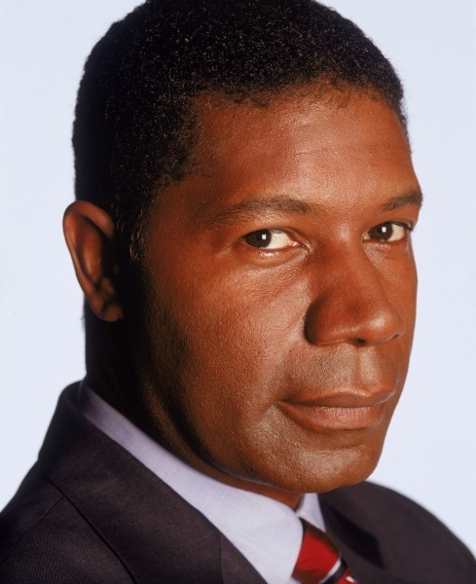
But . . .
David Palmer is a Democrat. Do we sympathize with him?
The ultimate source of treason and tyranny lies within:
1) the U.S. government—those attempting to unseat Palmer
2) an international Oil Cartel

Slide 14
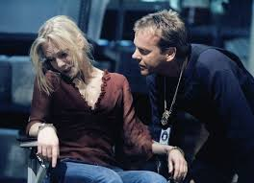
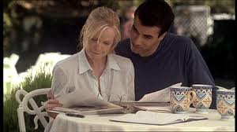
Maria Warner, Terrorist

Slide 15
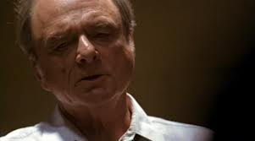
Roger Stanton, Director of NSA and … Terrorist

Slide 16


“The industry used to produce films, TV programs, books, and music. Now it makes brands.”
The Economist, 1998
Brand Propaganda (Insignia of Corporate Power)?

Slide 17
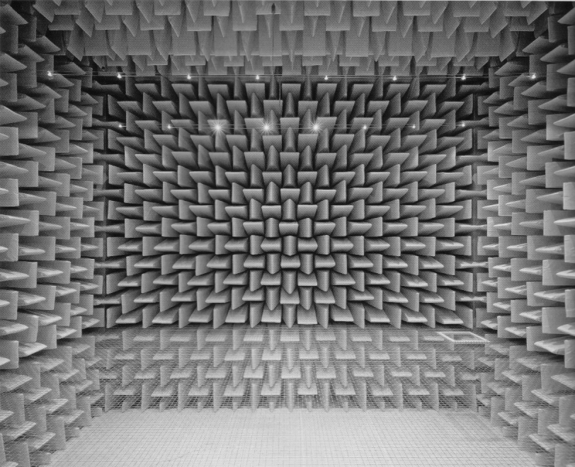
The Fox News Echo Chamber
“At a [2007] debate among prospective Republican candidates for the presidency, Fox anchor Brit Hume asked [the candidates to] imagine a scenario in which hundreds of Americans had been killed in three major suicide bombings, but a fourth attack had been averted. The attackers had been captured alive and taken to Guantanamo. U.S. intelligence believes that another attack is planned. “How aggressively would you interrogate” the subjects?
“It was an unusual moment in American political debate, maybe even postmodern watershed. A real-life group of presidential candidates was asked by a Fox news anchor, on a Fox hosted debate, to comment on a hypothetical question torn almost directly out of the script of Fox’s TV show, 24. No wonder, perhaps, that the replies ended up invoking Jack Bauer…”
Burstein et. al., Secrets of 24: The Unauthorized Guide, 143

Slide 18

“The ticking clock, perhaps the brand feature most associated with 24, . . .has a subtle connection to “Big FOX” brand identity. It is a brand identifier not just for the individual FOX series, but also for FOX News, as the cable channel makes the claim that it is ‘on the clock’ 24 hours a day” (Gillan, Television and New Media, 90).
“Jack Bauer’s office, for the first seven seasons the CTU situation room, exceeds even the loftiest fantasies of the most imaginative federal employee, looking much more like the studio of a post-MTV cable news channel, with its urban chic, concrete and exposed beams, and modern-minimalist furniture” (Shawn Shimpach, Television in Transition [New York: John Wiley, 2010], 132).
On “Breaking Ground,” a 24 season four DVD featurette, production designer Jeff Hodges explains that the original set of the CTU office was modeled on the FOX Sports set and that the second was modeled on the FOX News set.

Slide 19

“With all its focus on impending threats, 24 parallels the FOX News audience retention strategy of keeping viewers in a heighted state of alert and a constant state of anxiety. . . . As the screen splits into quarters on the series as well as on the news, viewers become aware of the simultaneity of threats in a post-9/11 world, but the promise is that Jack Bauer and News Corp, of which he is a part, will be vigilant on the viewers behalf.”
Jennifer Gillan, Television and New Media: Must-Click TV (New York: Routledge, 2011), 115.

Slide 20
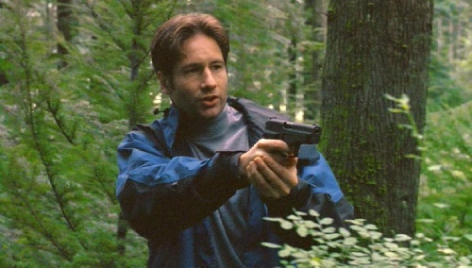
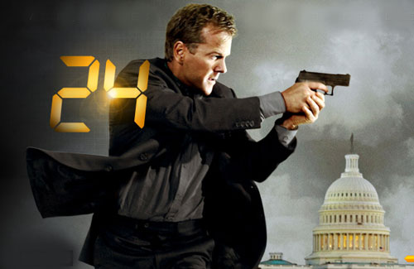
News Corp. Incarnations
“So when Fox Mulder was reincarnated on Fox News, it was like discovering that my first love, who had seemed so sophisticated and had taught me so much about myself and the world, was actually a skeevy, none-too-bright loser.”
Inkoo Kang, “How Fox News, Terrorists, and Truthiness Ruined the X-Files for Me,” Vulture, 9/10/2013
“the promise is that Jack Bauer and News Corp, of which he is a part, will be vigilant on the viewers behalf”
Gillan (from previous slide)

Slide 21
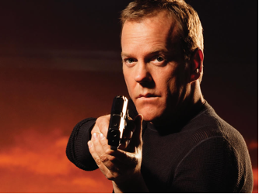
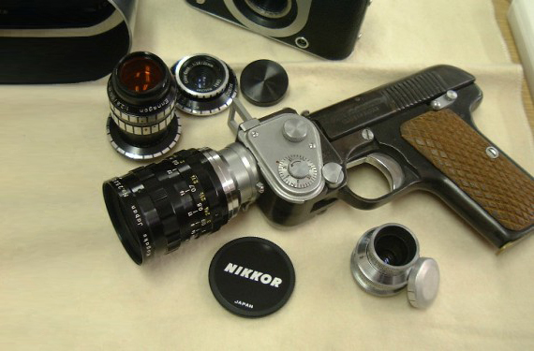
Jack Bauer . . .
TV Reporter Extraordinaire

Slide 22
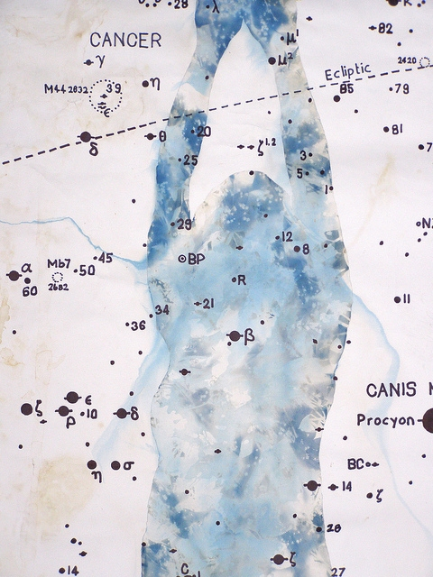
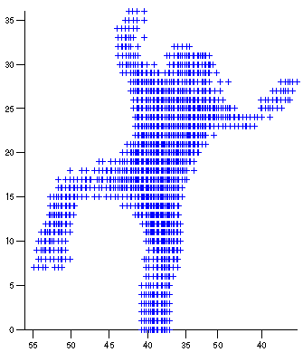
“ . . . the body in 24 is construed not so much as flesh and blood but as an informatic database. Perhaps the single most emblematic scenario in the show, the one motif that returns with most regularity and which sums up the entire signature of 24 in a single gesture, is the interrogation scene. . . . The 24 interrogation scene always carries a single goal, to extract information from organic bodies. Interrogation is merely the technique used for information retrieval. The body is a database, torture a query algorithm.”
            Alexander Galloway,
            The Interface Effect
            (New York: Polity, 2012), 112
The Body in Numbers

Slide 23
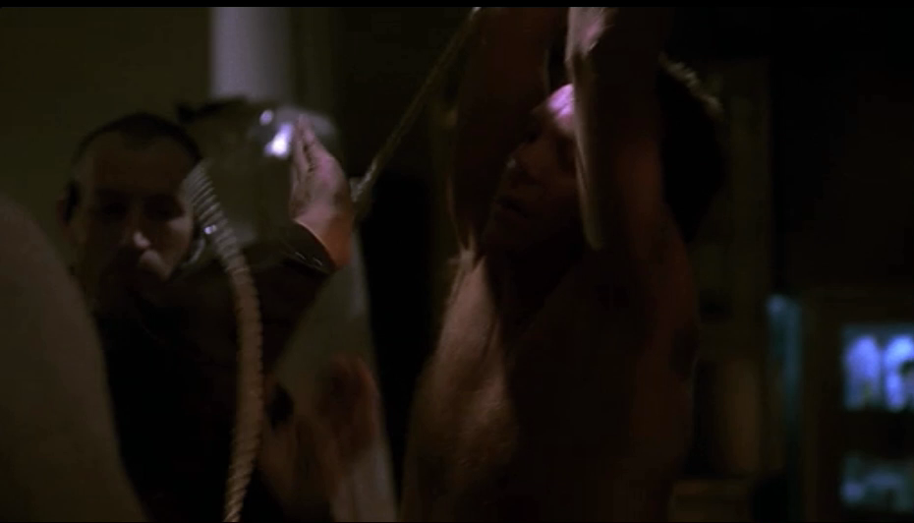
Torture and Price

Slide 24
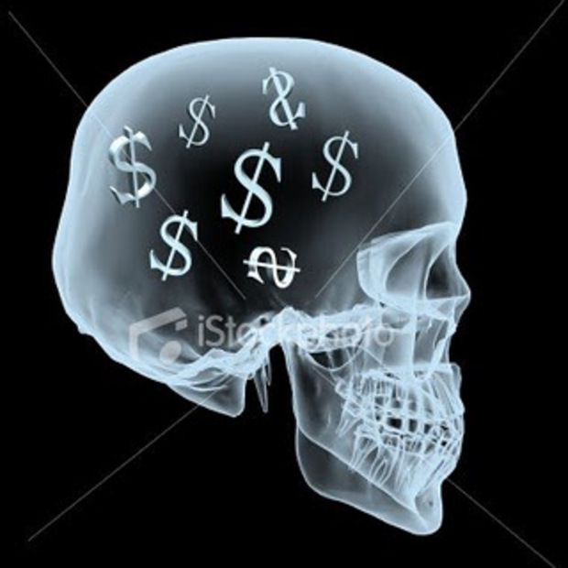
On 24
“The fixity of specific economies and flows, the logical destiny that this or that must happen no matter what the injury, the militarization of everyday life, the alienation of the here and now in exchange for some profiting to be realized later—such is the ideological framework of millennial American capitalism saturating the show’s moral infrastructure. Fundamentally it concerns the inability to think in a non-economic manner.”
            Alexander Galloway
Study Question: Does 24 support any “higher value”?

Slide 25
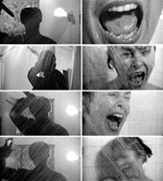
The Oxford English Dictionary defines montage as “the process or technique of selecting, editing, and piecing together separate sections of films to form a continuous whole; a sequence or picture resulting from such a process.” Another definition it gives for montage is “the act or process of producing a composite picture by combining several different pictures or pictorial elements so that they blend with or into one another; a picture so produced.”
Montage

Slide 26
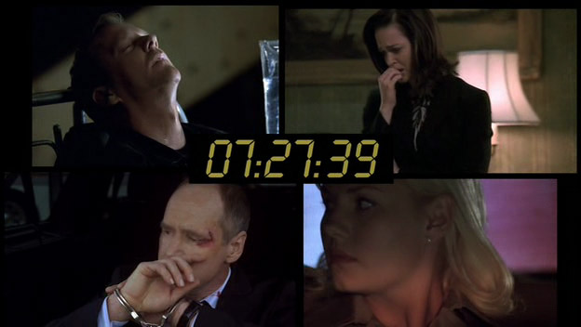
From Montage to Windowing
“ . . . Important for the waning of montage is the logic of ‘windowing’ whereby more than one image appears framed within the entire screen. This is one of the great aesthetic leaps of the graphical user interface beyond the example set by the cinema: no longer will the viewer experience montage cuts over time, proceeding from shot to shot, one must now ‘cut’ within any given frame, holding two or more source images side by side which themselves will persist montage free over much longer ‘takes’ than their cinematic predecessors. This phenomenon is evident in the windowed personal computer interface, but also in the gaming interface...”
Alexander Galloway, The Interface Effect, 114-15.

Slide 27
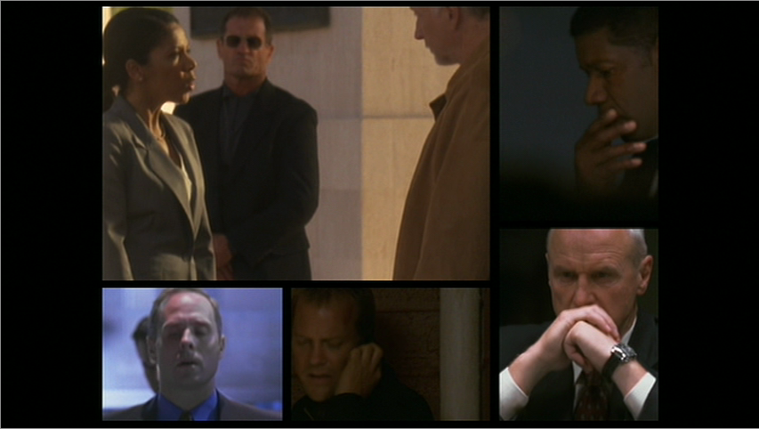
Live and Simultaneous Feed…
VP: “Have we confirmed we’re live?”

