Slide 1

Lecture 1
The Iliad and the Meaning of the Humanities

Slide 2
Kesh Temple Hymn (Sumerian,
2600 BCE)
Epic of Gilgamesh (Akkadian, 2100 BCE)
Enûma Eliš (Akkadian, 1800 BCE)
Book of the Dead (Egyptian, 1550 BCE)
Torah [Pentateuch] (Hebrew, 1400 BCE)
Rigveda (Sanskrit, 1200 BCE)
I Ching (Chinese, 1000 BCE)

Slide 3
(the GENRE of) EPIC
1) A long narrative poem of heroic action
→ Epic of Gilgamesh (Babylonian) 18th-10th century BCE
→ The Iliad (Ancient Greek) 8th c BCE
→ The Mahābhārata (Sanskrit) 4th c BCE
→ Beowulf (Old English) 8th-11th c CE
→ Beowulf (Old English)
2) Written in elevated language
3) With some foundational significance for the culture to which it belongs

Slide 4
EPIC— a genre of intensification
A long narrative poem of heroic action
→ Beowulf (Old English)
2) Written in elevated language
3) With some foundational significance for the culture to which it belongs

Slide 5
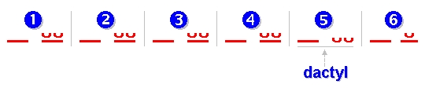
EPIC (from epos– word or song)
4) For Classical epic (Greek and Latin), epic also names a characteristic meter:
Dactylic Hexameter
→ Dactylic Hexameter

Slide 6
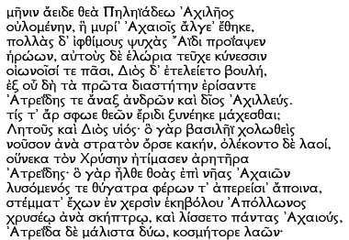

Iliad I.1-16 (read by Gregory Nagy)

Slide 7
_ _ / _ u u / _ u u /_ u u / _ u u / _ _
Sing now, Goddess, the wrath of Achilles the scion of Peleus
_ u u / _ _ / _ u u / _ u u / _ u u / _ _
Ruinous rage which brought the Achaians uncounted afflictions.
Many the powerful souls it sent to the dwelling of Hades –
Those of the heroes. And spoil for the dogs it made of their bodies,
Plunder for all of the birds; and the purpose of Zeus was accomplished.

Slide 8
“Traduttore, traditore”— Translator, traitor
“Traduire c'est trahir”—To translate is to betray
“Poetry is what gets lost in translation” (Robert Frost)

Slide 9
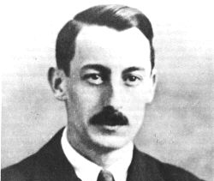
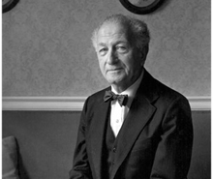
Parry-Lord Hypothesis
1. No “original text”– every performance is an invention
2. Composition is for an audience: speed and artistry matter; thus, repetition of formulas, scenes, and themes
3. Performances are sensitive to their audience, which can be expected to know the tradition

Slide 10
Evidence for Orality in the Iliad
Arming Scenes:
Paris arms for the duel with Menelaos (Il. 3.330-339)
Agamemnon arms for battle (Il.11.16-46)
After having his bow smashed, Teukros arms for regular battle (Il.15.479-482)
Patroklos puts on the armor of Achilles (Il.16.130-144)
Achilles puts on the armor Hephaistos has made for him (Il.19.367-391)
Odysseus arms after running out of arrows (Od.22.122-125)
Epithets:
Rosy fingered dawn ῥοδοδάκτυλος Ἠώς
wine-dark sea οἶνοψ πόντος
Achiles:
son of Peleus
swift-footed
breaking through men
lion-hearted
like to the gods
shepherd of the people
son of sleek-haired Leto

Slide 11
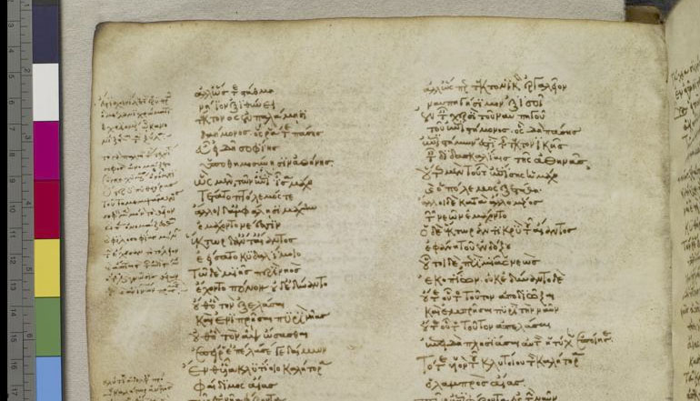
Venetus A Homer (10th Century CE) —homermultitext.org

Slide 12
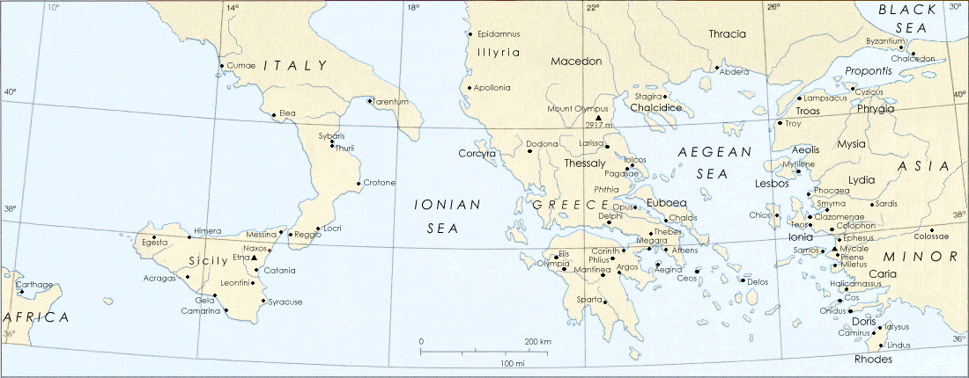
Timeline of Ancient Greece
Mycenaean Period (1600-1100 BCE) : “Heroic Age”
Dark Age (1100-700 BCE) : The Iliad
Archaic Period (700-480 BCE)
Classical Period (480-336 BCE)
Hellenistic Period (336-146 BCE): Roman invasion of Greece

Slide 13
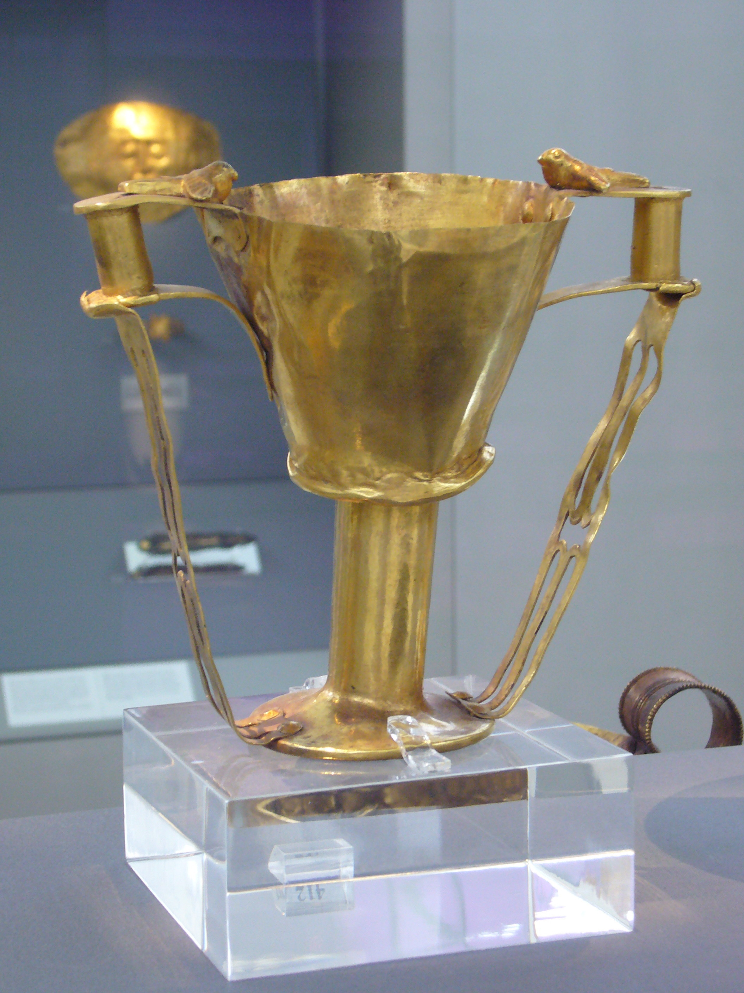
Nestor’s cup, Iliad 11.745-752
And there in the midst
the grand, glowing cup the old king brought from home,
studded with golden nails, fitted with handles,
four all told and two doves perched on each,
heads bending to drink and made of solid gold
and twin supports ran down to form the base.
An average man would strain to lift it off the table
when it was full, but Nestor, old as he was,
could hoist it up with ease.

Slide 14
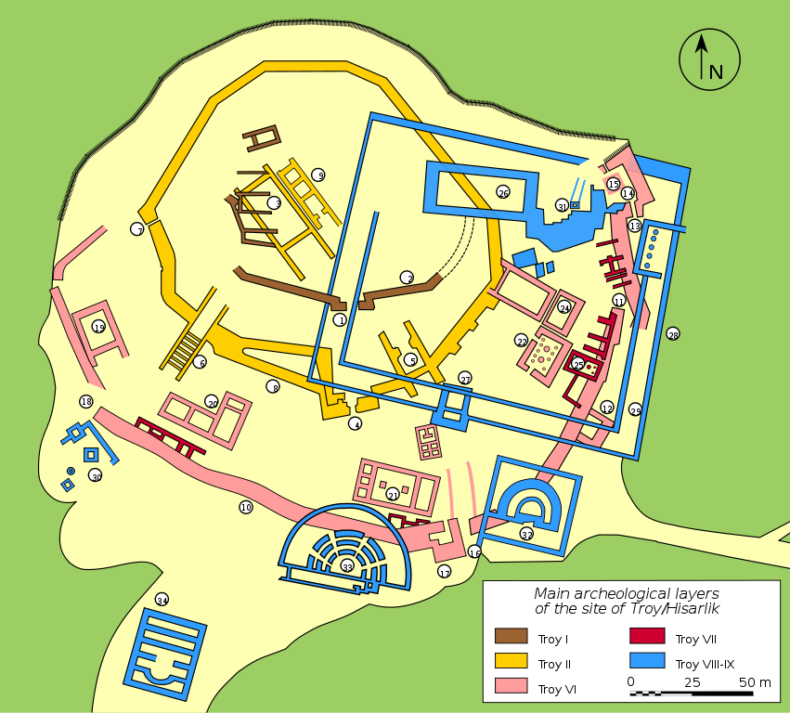
The Excavations of Troy
Excavated by Heinrich Schliemann in 1870 in Hisarlik, Turkey
Site is a “tell”—an artificial hill built of up layers of settlement
Most likely candidate for Troy of the Iliad: Troy VIIa, destroyed by war circa 1300 BCE

Slide 15
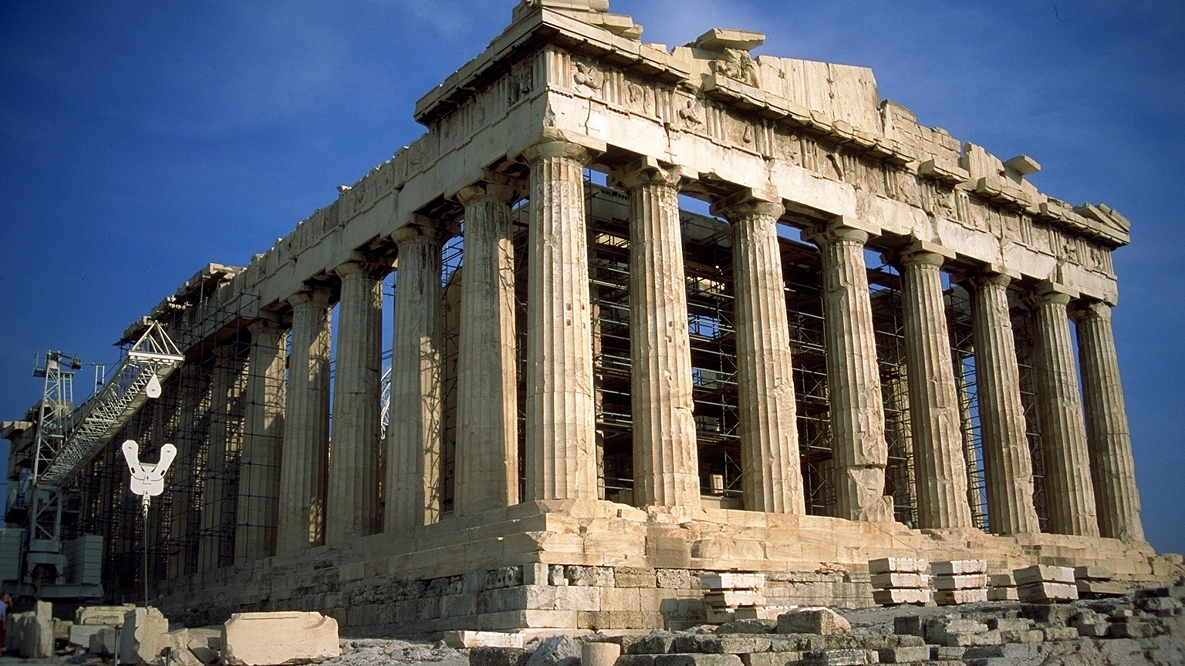
The Parthenon: 438 BCE, Athens, Greece

Slide 16
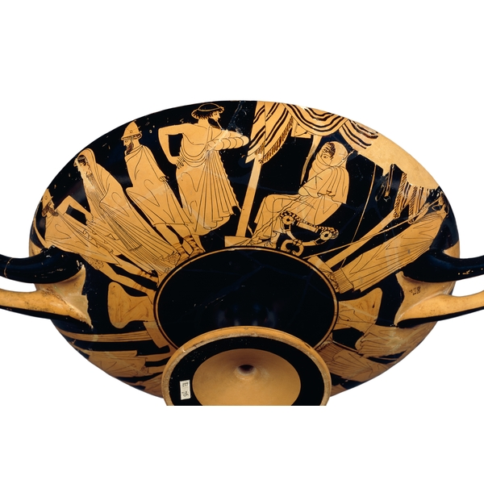
Cup, made in Athens, about 480 BCE: Briseus Taken (British Museum)

Slide 17
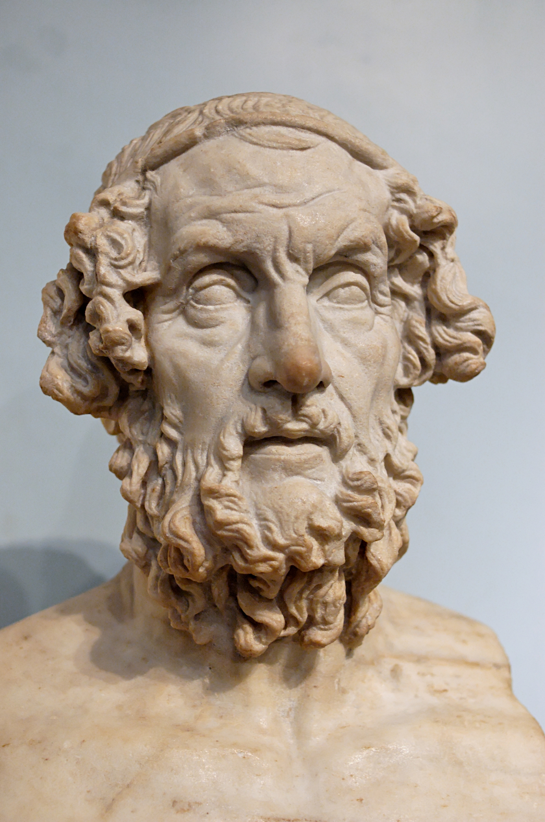
Homer
→ Might have lived 8th century BCE
→ Possible birthplaces: Salamis, Cyme, Ios, Colophon, Thessaly, Smyrna, Thebes, Chios, Argos, and Athens
→ Mythographically blind
Bust of Homer: 1st-2nd Century BCE

Slide 18
Forms of Difficulty
Practical/Formal: establishing and accessing the text
→ What is The Iliad?
Practical/Generic: determining the context
→ What (when) is The Iliad about?
Theoretical/Conceptual:
→ Who (what) are these people? These events?
"Those who cannot remember the past, are condemned to repeat it”
vs.
"The past is a foreign country: they do things differently there"

Slide 19
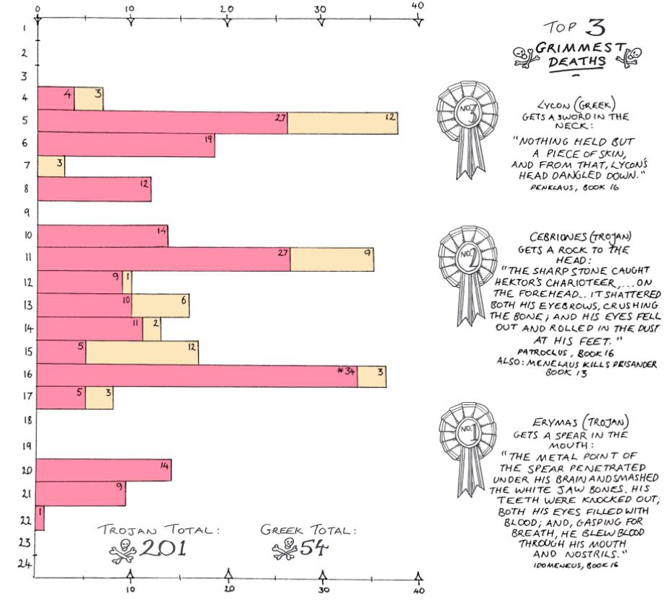
Deaths in the Iliad https://greekmythcomix.wordpress.com/comic/deaths-in-the-iliad-a-classics-infographic/

Slide 20
Iliad, IV.599-609
                Now Amariceus’ son
Diores—fate shackled Dires fast and a jagged rock
struck him against his right shin, beside the ankle.
Pirous son of Imbrasus winged it hard and true,
the Thracian chief who had sailed across from Aenus…
the ruthless rock striking the bones and tendons
crushed them to a pulp—he landed flat on his back,
slamming the dust, both arms flung out to his comrades,
gasping out his life. Pirous who heaved the rock
came rushing in and speared him up the navel—
his bowels uncoiled, spilling loose on the ground
and the dark came swirling down across his eyes.

Slide 21
Iliad, VI.171-175
Like the generations of leaves, the lives of mortal men.
Now the wind scatters the old leaves across the earth,
now the living timber bursts with the new buds
and spring comes round again. And so with men:
as one generation comes to life, another dies away.

Slide 22
Forms of “Ease”:
The Iliad as a template for the present
Existential: “Like the generations of leaves, the lives of mortal men.”
Civilizational: “A free market, democracy, military dynamism, technology, free speech, and individualism, for better or worse, are what most on this earth desire. And what they desire started with the Greeks and the Greeks alone.”
—Victor Davis Hanson, Who Killed Homer (1998)
Social Psychological: “I want to claim that the code of the streets, the heroic code, and the rules of Homeric society are nearly identical….[T]the epics allow us to see basic drives that exist within all of us, which Homeric society simply attempts to regulate rather than to disguise and suppress.”
—Erwin Cook, “The Contemporary Relevance of the Iliad” (2013)

Slide 23
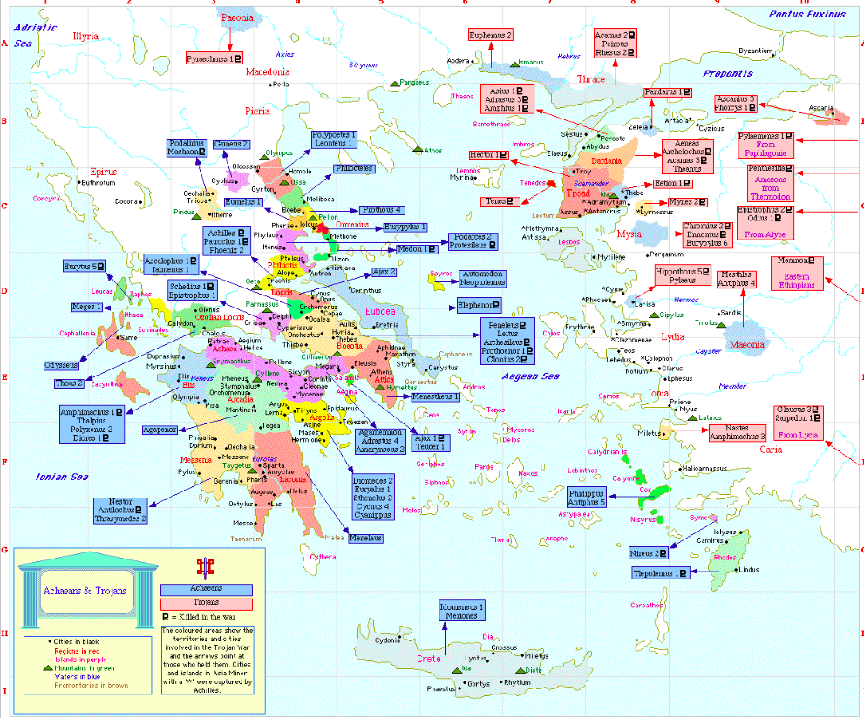

Slide 24
The Iliad, or the Poem of Force
Force: “that x that turns anybody who is subjected to it into a thing”
“….while he is still alive.”
“Force is as pitiless to the man who possesses it, or thinks he does, as it is to his victims; the second it crushes, the first it intoxicates.”

Slide 25
The Iliad, or the Poem of Force
“But, after all, for him it is no punishment; it is God holding his hand and pressing rather hard. For, if he remains constant, what he will discover buried deep under the sound of his own lamentations is the pearl of the silence of God.”

Slide 26
Iliad I.1-8
Rage—Goddess—sing the rage of Peleus’ son Achilles,
murderous, doomed, that cost the Achaeans countless losses,
hurling down to the House of Death so many sturdy souls,
great fighters souls, but made their bodies carrion,
feasts for the dogs and birds,
and the will of Zeus was moving towards its end.
Begin, Muse, when the two first broke and clashed,
Agamemnon lord of men and brilliant Achilles.

