Slide 1
Just War Theory
Jus ad bellum
Right to engage in war
When?
Where?
For what reason?
To what end?
Jus in bello
Right conduct in war
How?
Who?
With what means?
In what way?

Slide 2
Leon Tolstoy, War and Peace
“And what is war, what is needed for success in war, what are the morals of the military world? The object of warfare is murder, the means employed in warfare – spying, treachery, and the encouragement of it, the ruin of a country, the plunder of its inhabitants . . . trickery and lying, which are called military strategy; the morals of the military class – absence of all independence, that is, discipline, idleness, ignorance, cruelty, debauchery, and drunkenness.”

Slide 3
Walzer: Cynicism or Indignation?
“War is so awful that it makes us cynical about the possibility of restraint, and then it is so much worse that it makes us indignant at the absence of restraint. Our cynicism testifies to the defectiveness of the war convention, and our indignation to its reality and strength.” (p. 44)

Slide 4
Conceptual Challenges to
Just War Theory
Right vs. Might
  “Right, as the world goes, is only in question between equals in power, while the strong do what they can and the weak suffer what they must.” (Thucydides, History of the Peloponnesian War, 395 BCE.
  “Right without might is powerless; might without right is tyranny.” (Blaise Pascal, Pensées, 1669)
Paradox of waging war to achieve peace
  “We do not seek peace in order to be at war, but we go to war that we may have peace.” (St. Augustine, Letter clxxxix, 410)
  “This is a war to end all wars” (Woodrow Wilson, 1917)

Slide 5
Simone Weil, “The Iliad, or the Poem of Force”
“Thus war effaces all conceptions of purpose or goal, including even its own “war aims.” It effaces the very notion of war’s being brought to an end….Consequently nobody does anything to bring this end about. In the presence of an armed enemy, what hand can relinquish its weapon? The mind ought to find a way out, but the mind has lost all capacity to so much as look outward.”

Slide 6
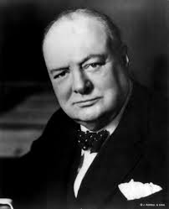
Changing Definitions of War?
“It is a joke in Britain that the War Office is always preparing for the last war”
Winston Churchill,
British Prime Minister, 1941-1945

Slide 7
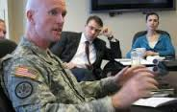
Changing Definitions of War?
“The most tragic error a general can make is to assume without much reflection that wars of the future will look much like wars of the past”
Lt. Col Paul Yingling, “A Failure in Generalship”
Armed Forces Journal, 2007

Slide 8
What is War?
External vs. internal conflicts?
  Iliad: Achaeans vs Trojans
  Iliad: Achilles vs. Agamemnon
  Thucydides: both internal and external
View from above vs. view from below?
  Who is fighting whom?
War is _X (diplomacy, business, ??) conducted by other means?
Pragmatics vs. Ethics
  Suspension of rules of war? When? Why?

Slide 9
Changing Definitions of War?
“Armies do not fight wars; nations fight wars. War is not a military activity conducted by soldiers, but rather a social activity that involves entire nations.
“The passion of the people is necessary to endure the sacrifices inherent in war. Regardless of the system of government, the people supply the blood and treasure required to prosecute war. The statesman must stir these passions to a level commensurate with the popular sacrifices required. When the ends of policy are small, the statesman can prosecute a conflict without asking the public for great sacrifice. Global conflicts such as World War II require the full mobilization of entire societies to provide the men and material necessary for the successful prosecution of war.”
Lt. Col Paul Yingling, “A Failure in Generalship”
Armed Forces Journal, 2007

Slide 10
Who can question the statesman?
Who must question the passions of the nation and of the state?
Yingling, Sun-Tzu: the generals?
Machiavelli: the “virtuous” prince?
Brecht , Kushner, Streep, Walzer: the cultural worker (artists, intellectuals)
Homer: Nestor as wisdom of age/experience
You?
Human agency and responsibility as defined by conditions of determination

Slide 11
“. . . war is just for those for whom it is necessary, and arms are pious where there is no hope save in arms.”
Livy, quoted by Machiavelli,
BOTH in Il Principe (p. 120) and in Discorsi

Slide 12
Historical/Political Challenges to
Just War Theory
“Nations fight wars,” but are they the only ones?
  Society of independent, sovereign nation-states?
Sovereign states vs non-state agents
  Dysfunctional states, failed states, resistance/separatist movements, social/political/religious organizations, private militias
Reason of state vs. state of reason vs. realm of passions (revenge, anger, humiliation)?
Breakdown between what is inside/outside
  Military activity as “police action”
  Policing as internal militarization?
Violence vs. civility?

Slide 13
Technological Challenges to
Just War Theory
Drones, and other “smart” weaponry
  Ultimate surveillance, view from above
  Invulnerable assailant
  Physical and emotional distance from violence
Improvised Explosive Devices (IEDs)
  Impossible surveillance, view from below
  Ultimate and pervasive vulnerability, chaos
  Randomness of potential violence (terrorism)

Slide 14

Geneva Conventions
Amendment Protocols
Protocol I (1977): Protection of Victims of International Armed Conflicts
      Includes “undeclared” wars
      Defines armed conflict against colonial domination or foreign occupation as an “international” conflict
Protocol II (1977): Protection of Victims of Non-International Armed Conflicts
      Armed conflicts within borders of a single nation-state (government vs. insurgency; rival insurgent groups)
Protocol III (2005): Additional Distinctive Emblem
    Red Crystal

Slide 15
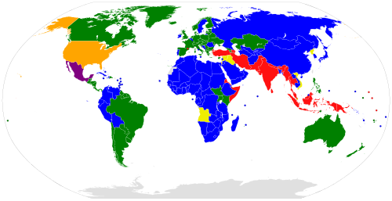
Signatories to Geneva Conventions and Protocols
Notes:
Green: Parties to GC I-IV and P I-III Blue: Parties to GC I-IV and P I-II
Purple: Parties to GC I-IV and P I and III Yellow: Parties to GC I-IV and P I
Orange: Parties to GC I-IV and P III Red: Parties to GC I-IV and no P

Slide 16
Jus Post Bellum
Justice after (in the wake of) war?
  Just or unjust peace/settlement of war
    Terms for cessation of hostilities
  What the aggressor owes the victim(s)
    Reasonable and fair compensation
    Elimination of unjust gains, advantages
    Security against future aggression
    “Smart sanctions”
    Political rehabilitation, demilitarization
    War crime trials (leaders and soldiers)

Slide 17
Jus Post Bellum
Justice after (in the wake of) war?
  What the victor owes the vanquished
    -Establish public and legitimate authority
  -Proportionality (avoid extreme or vengeful peace terms)
  -Civilian immunity (including from excessive socio-economic harm
  -Truth and reconciliation

Slide 18
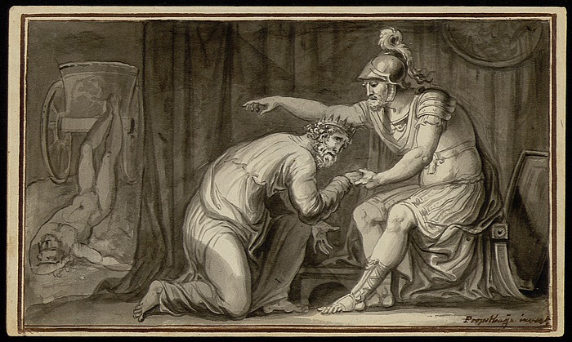
Jus Post Bellum
Achilles and Priam (Carl Probstayn, 1804)

Slide 19
Jus Post Bellum
Michael Walzer on Iraq War
  Fervent opponent of intervention as unjust jus ad bellum
  Critic of abuses of jus in bello (Abu Ghraib, etc.)
  But opposes US withdrawal from Iraq on grounds of jus post bellum
      US has obligation to reestablish functioning and stable civil society (public and legitimate authority)
      Prevent potential massacres of minorities (Kurds, Shiites)

Slide 20
Jus Post Bellum?
  ALL wars, even just wars fought justly, have damaging and long-term consequences for victor and vanquishes alike.
  “There is no instance of a country having benefited from prolonged warfare.” (Sun Tzu)
  Post-war traumas (collective and individual)
  “Force is as pitiless to the man who possesses it, or thinks he does, as it is to his victims; the second it crushes, the first it intoxicates.” (Simone Weil)

Slide 21
Thank you!
Have a happy holiday
And
See you in 2016!

