Slide 1

Lecture 5
The Ends of The Iliad

Slide 2
Some aspects of poesis: poetic craft (technê)
Eloquence– rhetorical force and verbal form
“I am not the man to order men”
Pathos—the orchestration of feeling
“and one day let them say, ‘He is a better man than his father!’”
Narrative design—narrative repetition and conceptual pattern

Slide 3
What is an artifact?
An artifact is a made thing (from arte and facere)
An artifact has a specific form, or shape (eidos)
An artifact has a purpose or function (ergon)
An artifact has a meaning

Slide 4
Iliad 11.31-42
Then over his shoulder Agamemnon slung his sword,
golden studs at the hilt, the blade burnished bright
and the scabbard sheathed in silver swung on golden straps,
and he grasped a well-wrought shield to encase his body,
forged for rushing forays—beautiful emblazoned work.
Circling the center, ten strong rings of bronze
with twenty disks of glittering tin set in,
at the heart a boss of bulging blue steel
and there like a crown the Gorgon’s grim mask—
the burning eyes, the stark, transfixing horror—
and round her strode the shapes of Rout and Fear.

Slide 5
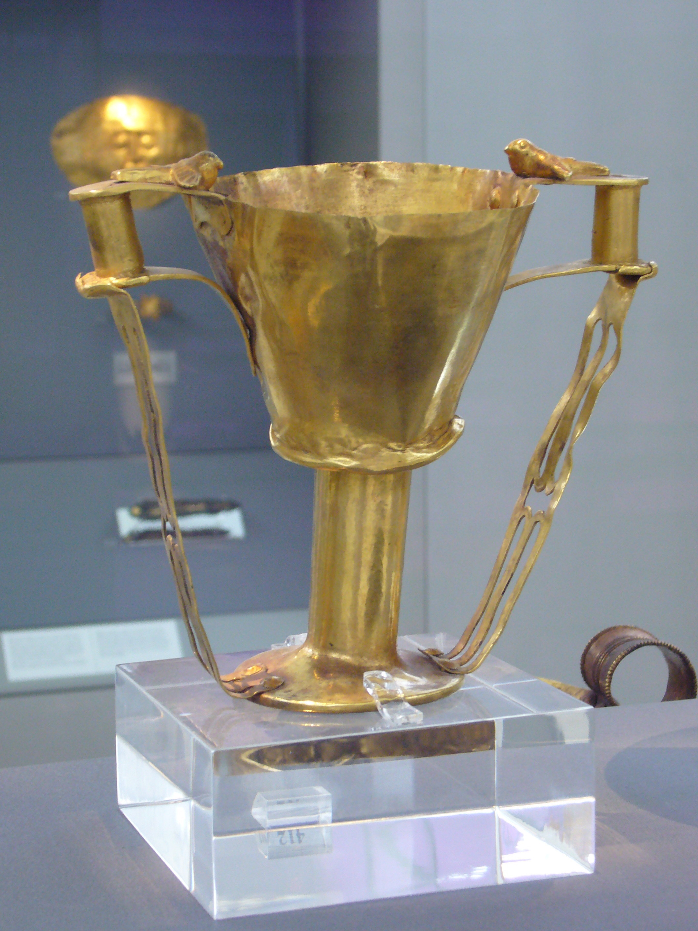
Nestor’s cup, Iliad 11.745-752
And there in the midst
the grand, glowing cup the old king brought from home,
studded with golden nails, fitted with handles,
four all told and two doves perched on each,
heads bending to drink and made of solid gold
and twin supports ran down to form the base.
An average man would strain to lift it off the table
when it was full, but Nestor, old as he was,
could hoist it up with ease.

Slide 6
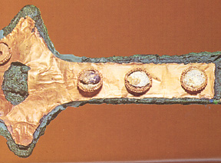
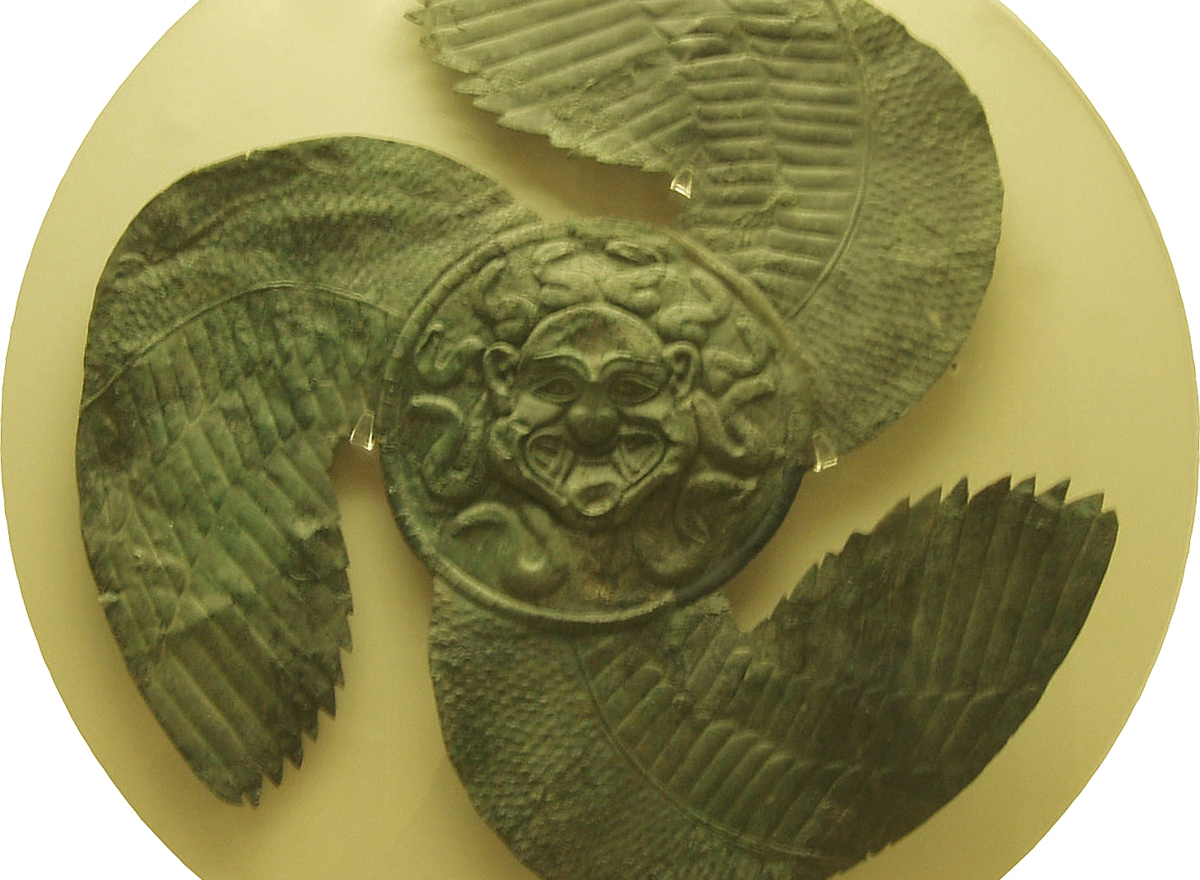
The material and symbolic culture of the Iliad
Sword hilt, Mycenae (13th c. BCE)
Gorgoneion Shield, (6th c. BCE)

Slide 7
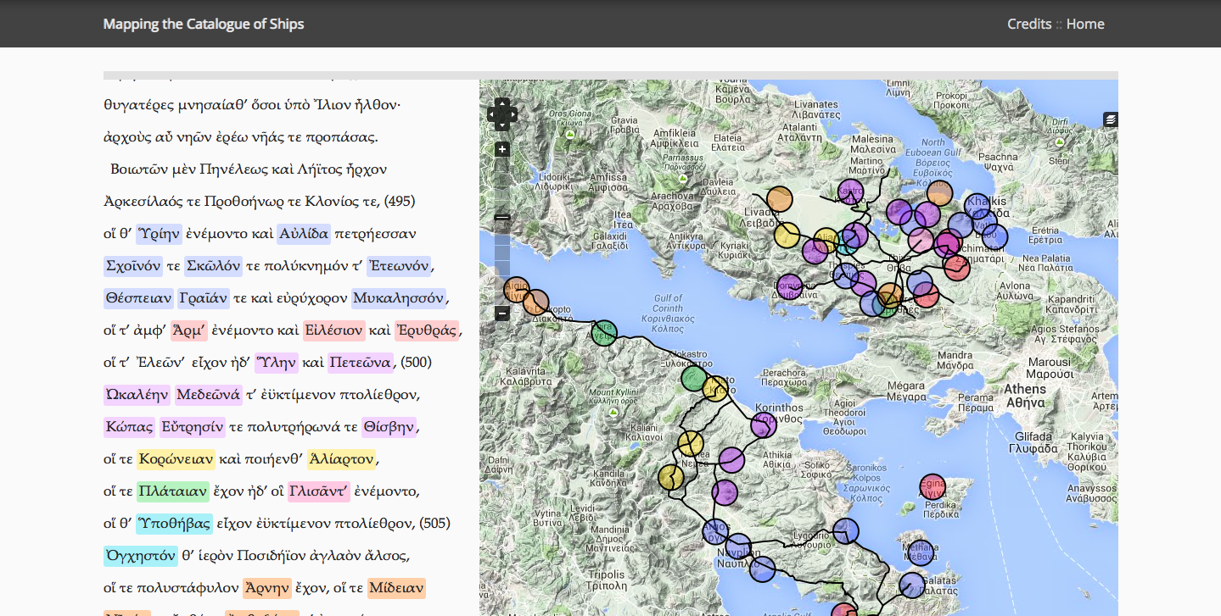

Slide 8
Iliad 11.31-42
Then over his shoulder Agamemnon slung his sword,
golden studs at the hilt, the blade burnished bright
and the scabbard sheathed in silver swung on golden straps,
and he grasped a well-wrought shield to encase his body,
forged for rushing forays—beautiful emblazoned work.
Circling the center, ten strong rings of bronze
with twenty disks of glittering tin set in,
at the heart a boss of bulging blue steel
and there like a crown the Gorgon’s grim mask—
the burning eyes, the stark, transfixing horror—
and round her strode the shapes of Rout and Fear.

Slide 9
Sappho, fragment (7th century BCE): technology for the production of kleos
When you lie dead there will be no memory of you,
no one missing you afterward, for you have no part
in the roses of Pieria. Unnoticed even in the house
of Hades, too, you’ll wander, flittering after faded corpses.

Slide 10
Sonnet 55 (1609)
Not marble, nor the gilded monuments
Of princes, shall outlive this powerful rhyme;
But you shall shine more bright in these contents
Than unswept stone besmear'd with sluttish time.
When wasteful war shall statues overturn,
And broils root out the work of masonry,
Nor Mars his sword nor war's quick fire shall burn
The living record of your memory.
'Gainst death and all-oblivious enmity
Shall you pace forth; your praise shall still find room
Even in the eyes of all posterity
That wear this world out to the ending doom.
So, till the judgment that yourself arise,
You live in this, and dwell in lovers' eyes.
—William Shakespeare

Slide 11
Iliad 2.573-584
Sing to me now, you Muses who hold the halls of Olympus!
You are goddesses, you are everywhere, you know all things—
all we hear is the distant ring of glory, we know nothing—
who were the captains of Achaea? Who were the kings?
The mass of troops I could never tally, never name,
not even if I had ten tongues and ten mouths,
a tireless voice and the heart inside me bronze,
never unless you Muses of Olympus, daughters of Zeus
whose shield is rolling thunder, sing, sing in memory
all who gathered under Troy. Now I can only tell
the lords of the ships, the ships in all their numbers!

Slide 12
Iliad 18.558-564
And that famous crippled Smith replied, “Courage!
Anguish for all that armor—sweep it from your mind.
If only I could hide him away from pain and death,
that day his grim destiny comes to take Achilles,
as surely as glorious armor shall be his, armor
that any man in the world of men will marvel at
through all the years to come—whoever sees its splendor.”
….
And first Hephaestus makes a great and massive shield,
blazoning well-wrought emblems across its surface,
raising a rim around it, glittering, triple-ply
With a silver shield-strap run from edge to edge
And five layers if metal to build the shield itself,
And across its vast expanse with all his craft and cunning
The god creates a world of gorgeous immortal work.

Slide 13
Iliad 18.558-564
And that famous crippled Smith replied, “Courage!
Anguish for all that armor—sweep it from your mind.
If only I could hide him away from pain and death,
that day his grim destiny comes to take Achilles,
as surely as glorious armor shall be his, armor
that any man in the world of men will marvel at
through all the years to come—whoever sees its splendor.”
….
And first Hephaestus makes a great and massive shield,
blazoning well-wrought emblems across its surface,
raising a rim around it, glittering, triple-ply
With a silver shield-strap run from edge to edge
And five layers if metal to build the shield itself,
And across its vast expanse with all his craft and cunning
The god creates a world of gorgeous immortal work.

Slide 14
Iliad 18.558-564
And that famous crippled Smith replied, “Courage!
Anguish for all that armor—sweep it from your mind.
If only I could hide him away from pain and death,
that day his grim destiny comes to take Achilles,
as surely as glorious armor shall be his, armor
that any man in the world of men will marvel at
through all the years to come—whoever sees its splendor.”
….
And first Hephaestus makes a great and massive shield,
blazoning well-wrought emblems across its surface,
raising a rim around it, glittering, triple-ply
With a silver shield-strap run from edge to edge
And five layers if metal to build the shield itself,
And across its vast expanse with all his craft and cunning
The god creates a world of gorgeous immortal work.

Slide 15
Iliad 18.547-557
With that he left her there and made for his bellows,
turning them on the fire, commanding, “Work—to work!”
And the bellows, all twenty, blew on the crucibles,
breathing with all degrees of shooting, fiery heat
as the god hurried on—a blast for the heavy work,
a quick breath for the light, all precisely gauged
to the god of fire’s wish and the pace of the work in hand.
Bronze he flung in the blaze, tough durable bronze
and tin and priceless gold and silver, and then,
planting the huge anvil upon its block, he gripped
the mighty hammer in one hand, the other gripped his tongs.

Slide 16
Iliad 18.558-564
And that famous crippled Smith replied, “Courage!
Anguish for all that armor—sweep it from your mind.
If only I could hide him away from pain and death,
that day his grim destiny comes to take Achilles,
as surely as glorious armor shall be his, armor
that any man in the world of men will marvel at
through all the years to come—whoever sees its splendor.”
….
And first Hephaestus makes a great and massive shield,
blazoning well-wrought emblems across its surface,
raising a rim around it, glittering, triple-ply
With a silver shield-strap run from edge to edge
And five layers of metal to build the shield itself,
And across its vast expanse with all his craft and cunning
The god creates a world of gorgeous immortal work.

Slide 17
There he made the earth and there the sky and the sea
and the inexhaustible blazing sun and the moon rounding full
and there the constellations, all that crown the heavens

Slide 18
Images of Troy and Achaea
Iliad 18.571-583
Iliad 18.593-597
And he forged on the shield two noble cities filled
with mortal men. With weddings and feasts in one
and under glowing torches they brought forth the brides
from the women’s chambers marching through the streets
….
And the people massed streaming into the marketplace
where a quarrel had broken out and two men struggled
over the blood price for a kinsman just murdered.
….
Two bars of gold shone on the ground before them
a prize for the judge who’d speak the straightest verdict.
But circling the other city camped a divided army
gleaming in battle gear, and two plans split their ranks:
to plunder the city or share the riches with its people,
hoards the handsome citadel stored within its depths.
But the people were not surrendering, not at all.

Slide 19
Iliad 18.646-653
And there in the midst the king,
scepter in hand at the head of the reaping-rows
stood tall in silence, rejoicing in his heart.
And off to the side, beneath a spreading oak,
the heralds were setting out the harvest feast,
they were dressing a great ox they had slaughtered,
while attendant women poured out barley, generous
glistening handfuls strewn for the reapers’ midday meal.

Slide 20
Iliad 18.689-690
And the crippled smith brought all his art to bear
On a dancing circle…

Slide 21
Iliad 18.674-679
And the golden drovers kept the herd in line,
four in all, with nine dogs at their heels,
their paws flickering quickly—a savage roar!—
a crashing attack—and a pair of ramping lions
had seized a bull from the cattle’s front ranks—
he bellowed out as they dragged him off in agony.

Slide 22
Iliad 18.708-709
And he forged the Ocean River’s mighty power girdling
round the outmost rim of the welded indestructible shield

Slide 23
Iliad 409-413
Oh, how I wish
that first day my mother brought me into the light
some black whirlwind had rushed me out to the mountains
or into the surf where the roaring breakers crash and drag
and the waves had swept me off before all this had happened!

Slide 24
Iliad 24.600-614
Then when brilliant Achilles had had his fill of tears
and the longing for it had left his mind and body,
he rose from his seat, raised the old man by the hand
and filed with pity now for his gray head and gray beard,
he spoke out winging words, flying straight to the heart.
Poor man, how much you’ve borne—pain to break the spirit!
What daring brought you down to the ships, all alone,
to face the glance of the man who killed your sons,
so many fine brave boys? You have a heart of iron.
Come, please, sit down on this chair here. . .
Let us put our griefs to rest in our own hearts,
rake them up no more, raw as we are with mourning.
What good’s to be won form tears that chill the spirit?
So the immortals spun our lives that we, we wretched men
live on to bear such torments—the gods live free of sorrows.

Slide 25
Iliad 24.764-774
“Sleep outside, old friend.
in case some Achaean captain comes to visit.
They keep on coming now, huddling beside me,
making plans for battle—its their duty.
But if one saw you here in the rushing dark night
he’d tell Agamemnon straightaway, our good commander.
Then you’d have a real delay in ransoming the body.
One more point. Tell me, be precise about it—
how many days do you need to bury Prince Hector?
I will hold back myself
And keep the Argive armies back that long.”

Slide 26
The End
Then they collected the white bones of Hector
all his brothers, his friends at arms, mourning,
and white tears came streaming down their cheeks.
They placed the bones they found in a golden chest,
shrouding them round in soft purple cloths.
They quickly lowered the chest in a deep hollow grave
and over it piled a cope of huge stones closely set,
then hastily heaped a barrow, posted lookouts all around
for fear the Achaean combat troops would launch their attack
before the time agreed.
….
And so the Trojans buried Hector breaker of horses.

