Slide 1
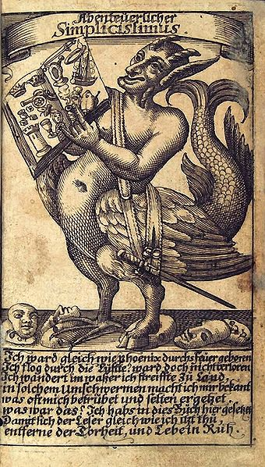
Grimmelshausen’s Simplicissimus as a figurative representation of the birth pangs of modern Europe out of the Thirty Years’ War

Slide 2
Some review
What’s the “take away” from Lecture 1?
(1) There were big events going on in the 17th century—the techtonic plates of politics, religion, and individuality were shifting.
(2) Grimmelshausen tells a “story from below” in the genre of the “picaresque.” It captures the chaos, but not as an “unmediated” representation.

Slide 3
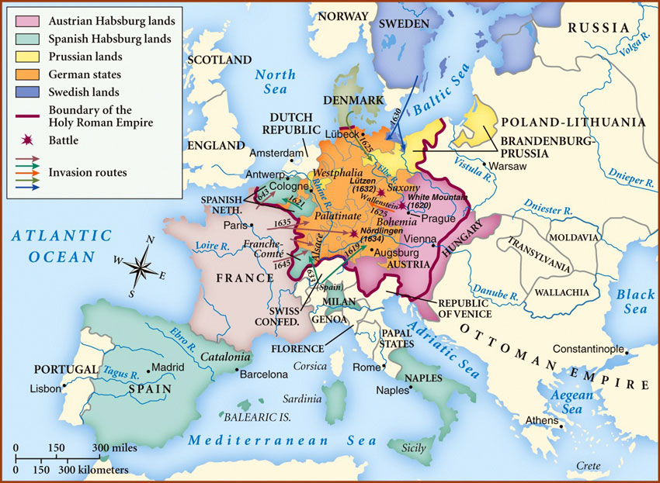
Thirty Years’ War (1618-48)…
CAUSES: (1) War of Religion; (2) German / Central European Constitutional War between levels of power; (3) War of (Nation)-State Building, Sweden and France emerge victorious to the detriment of the internally divided Holy Roman Empire
Last time, I told the “story” of the history of
the Thirty Years’ War as “history from above”…

Slide 4
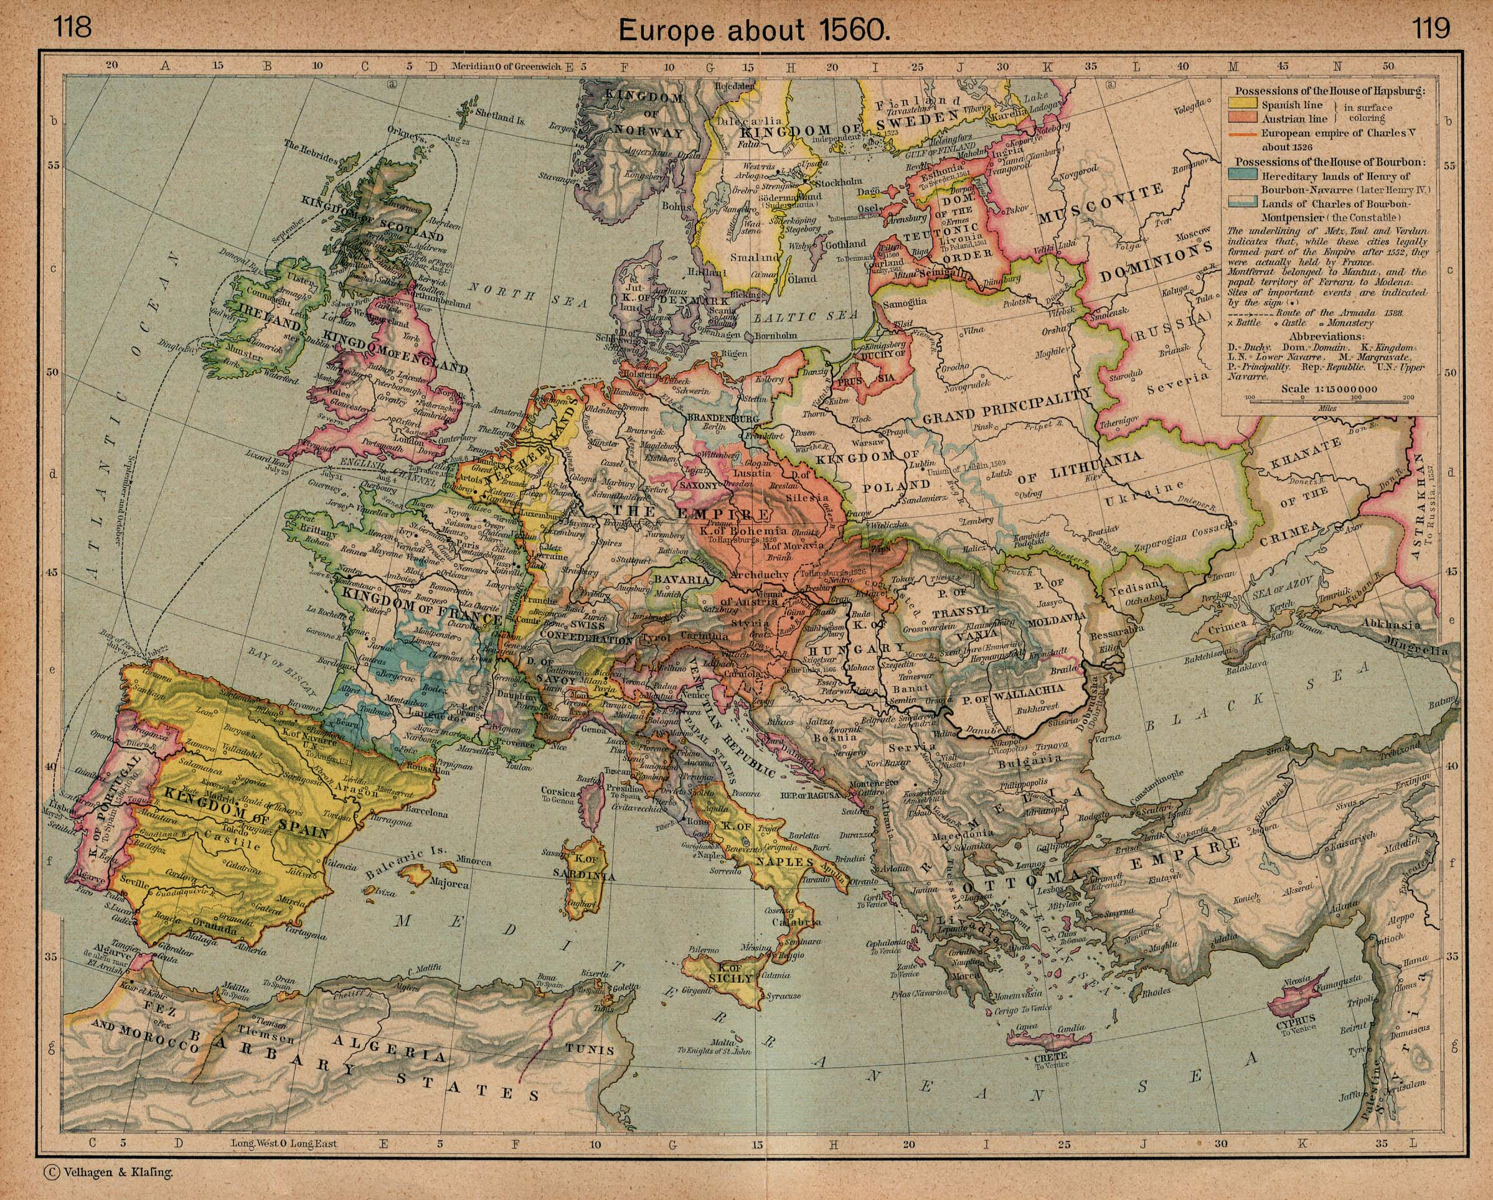

Slide 5
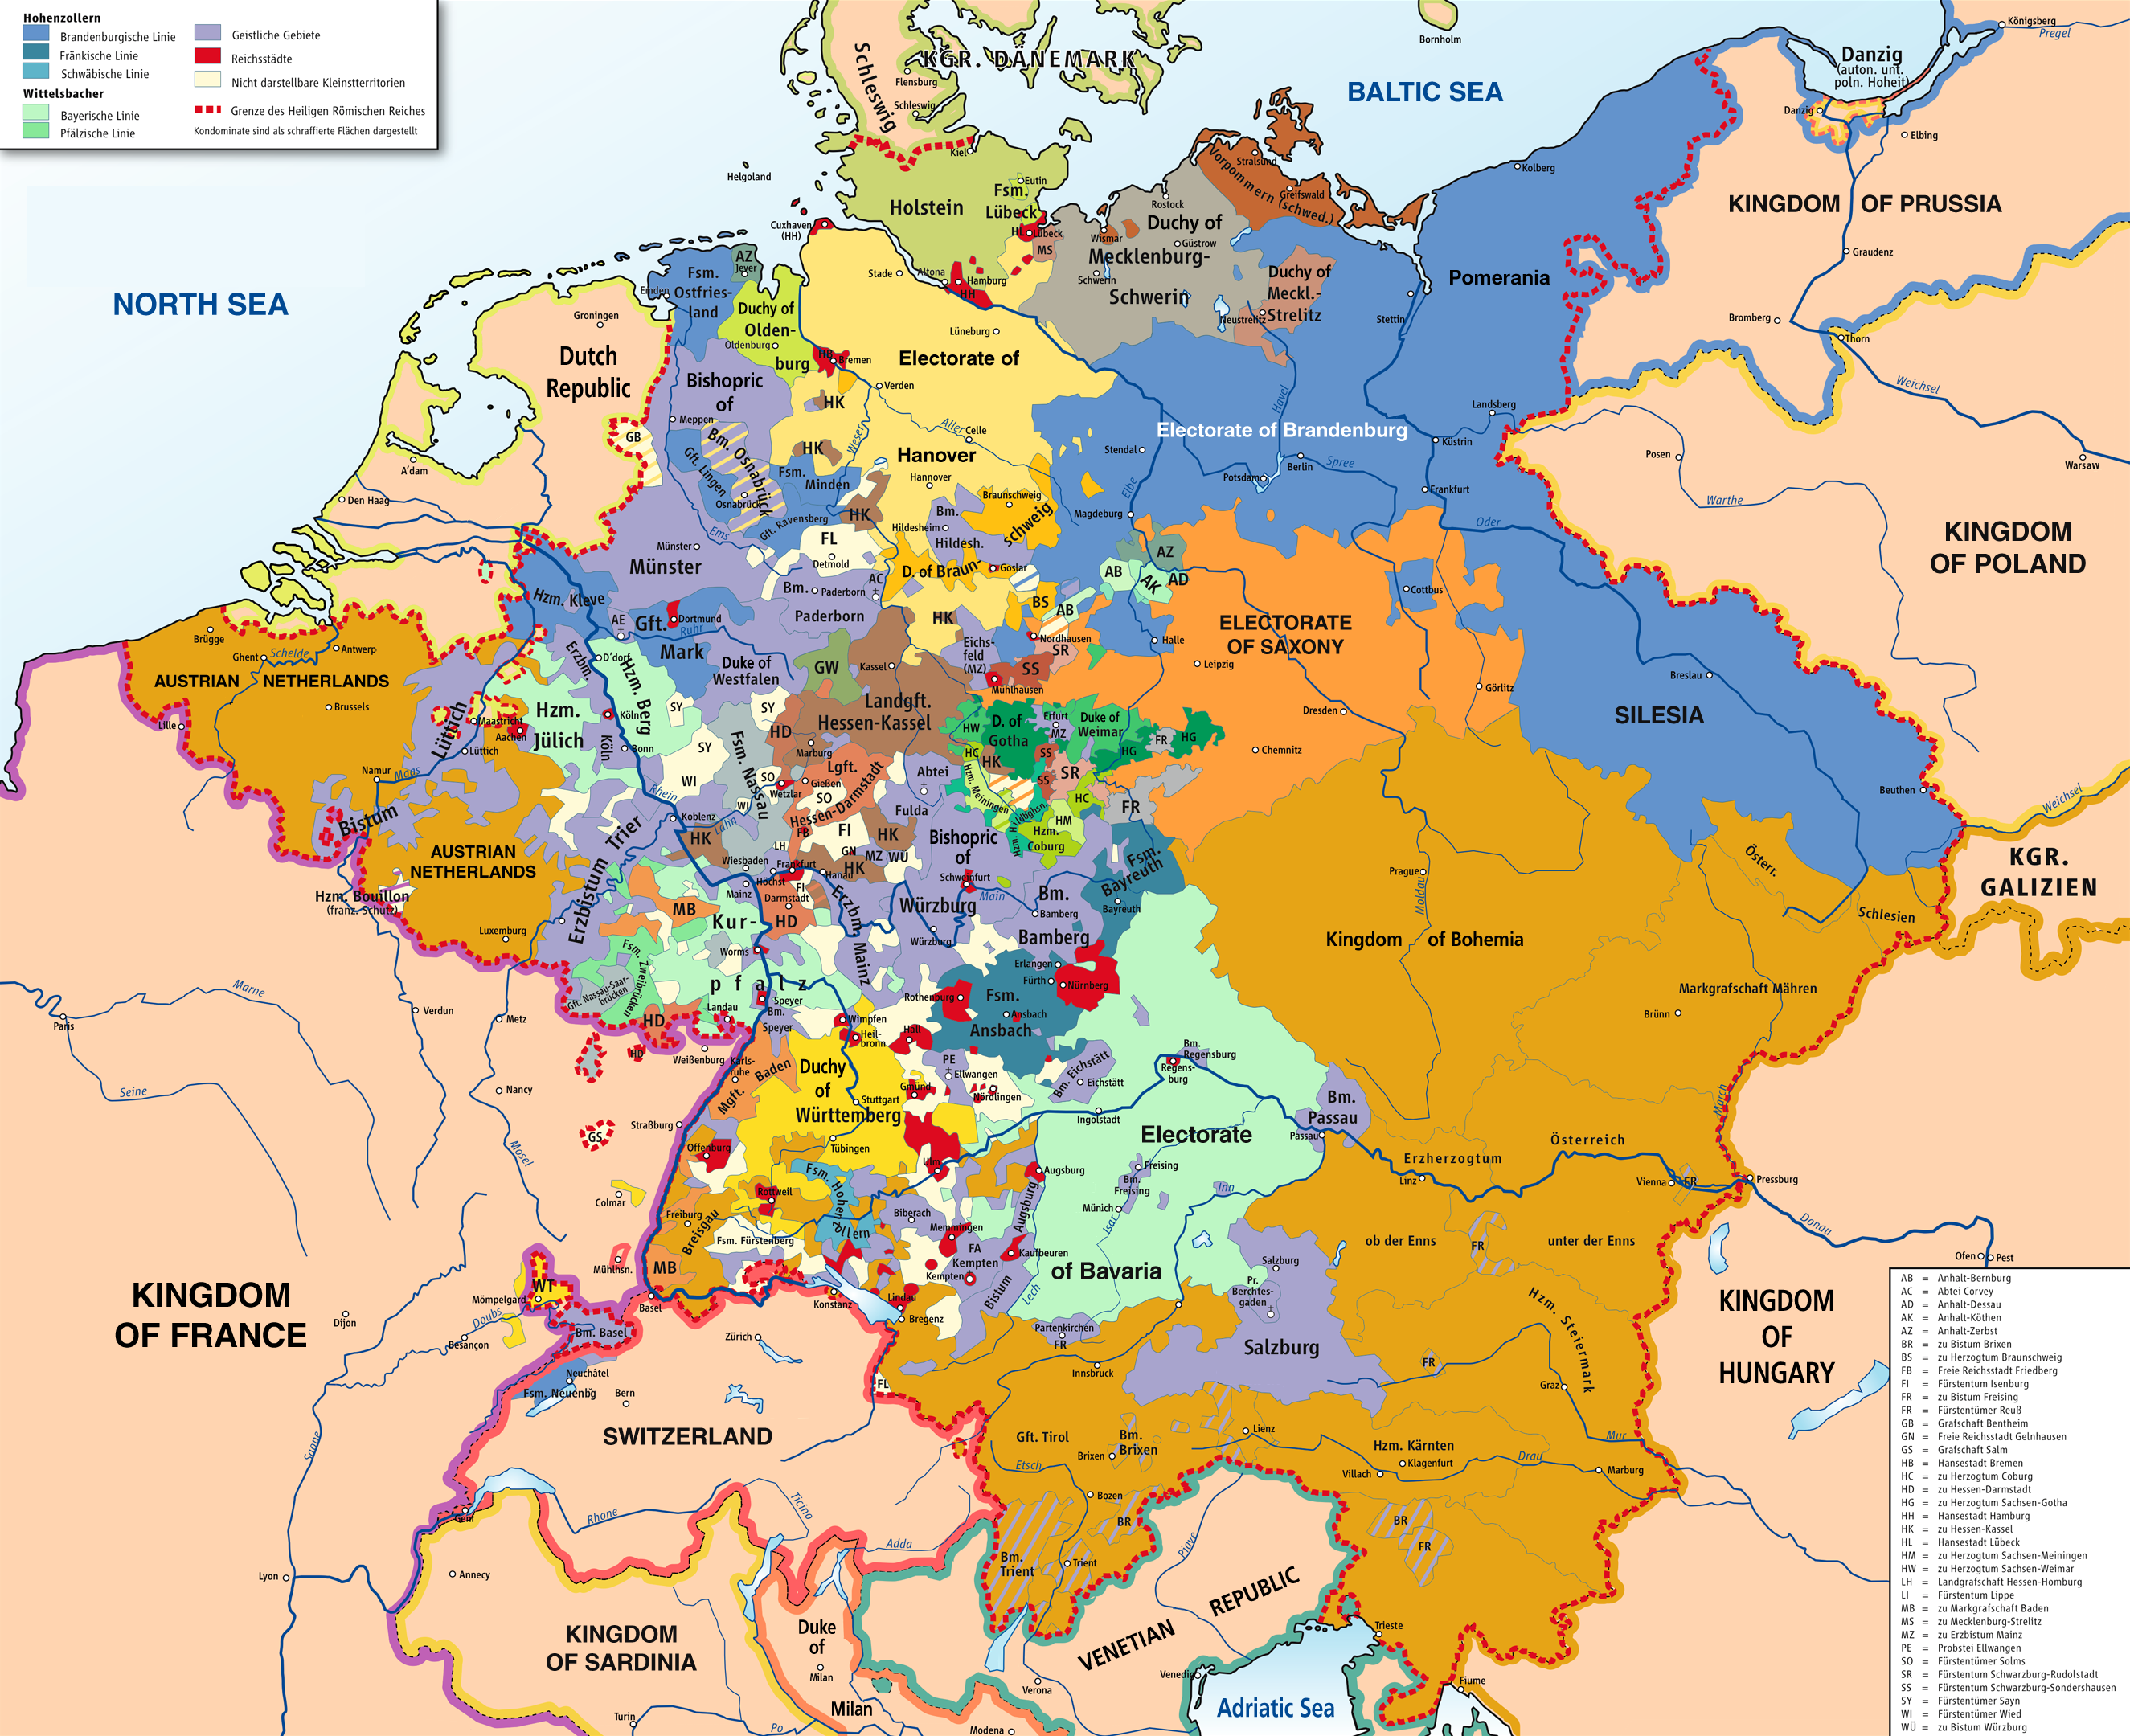

Slide 6
The political form that we know as the homogeneous (nation) state “won” over the HRE and became the dominant form of the modern “state” thereafter.
This process of nation building didn’t happen overnight. The HRE does hobble along, weakened, until 1806 when Napolean’s French troops defeated the Russian and Imperial armies at the Battle of Austerlitz.
And it’s not that this system of nation states puts an end to war. But it is a new political order. With some minor exceptions, Europe does not experience religious wars again, but, rather, wars between nations.

Slide 7
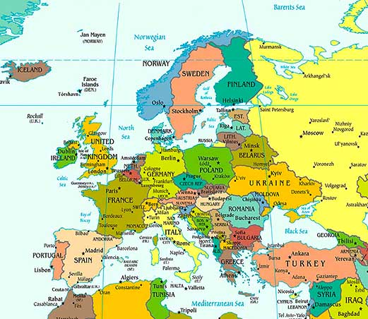
Our world….

Slide 9
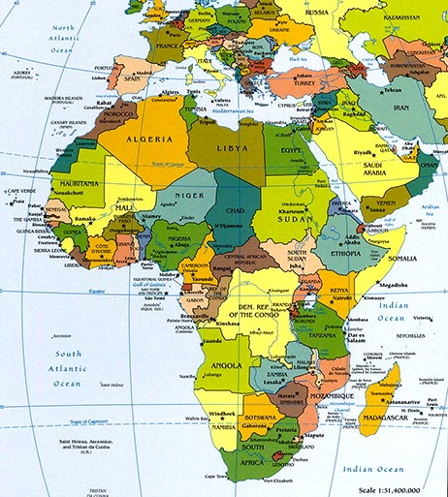
Our world….

Slide 10
Momentous developments….
For many scholars of international relations, the 17th century gave rise to the “Westphalian system” of nation states that determined the course of modern Europe and, considering the colonial wars of liberation in the 20th century, the world.
Question for you to ponder: Are we entering a “post-Westphalian” age, where the nation state is no longer the main political model? (European Union and “non-state actors”)

Slide 11
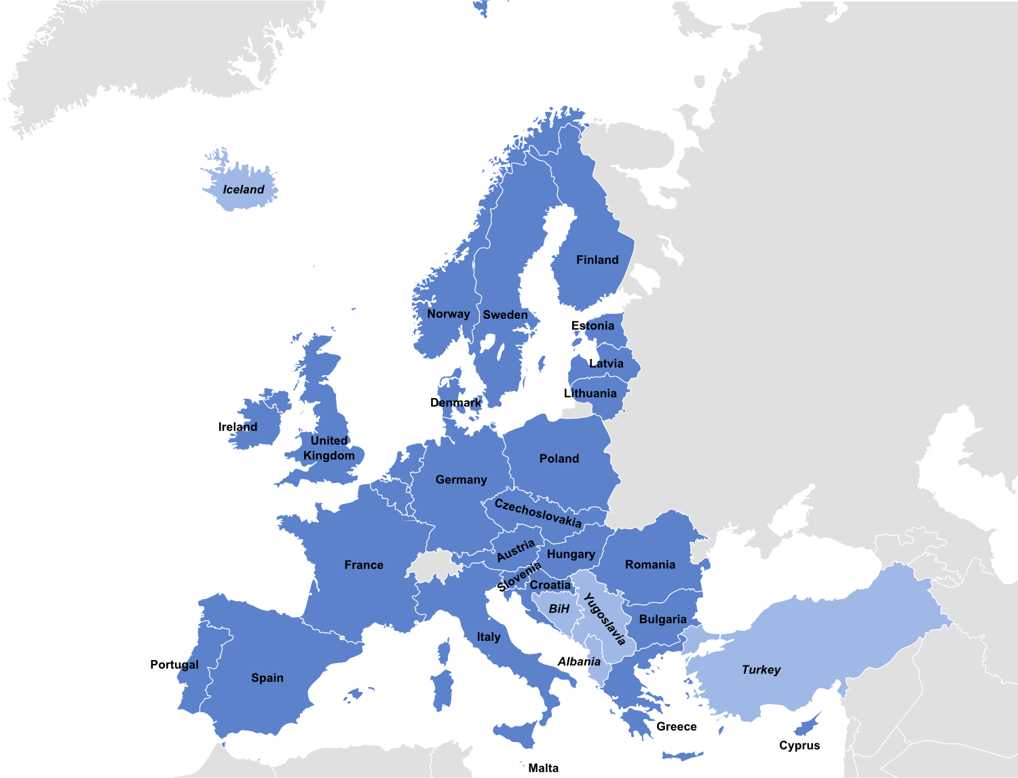
The European Union
A Humongous HRE?

Slide 12
Also, the “picaresque” as a new genre
Developed in 17th century Spain
A “hero” (not with a capital “H”) who is the antithesis of the epic hero. He has to figure out his way in a confusing world.
Lower-class, perspective of events “from below,” often concerned with things of the body.
A great question discussed in a section:
Does Achilles ever fart?
Simplicius sure does….

Slide 13
The picaro as a new kind of individual
This might be harder to grasp.
Weren’t there always individual human beings? Aren’t human beings by nature adaptable creatures?
Yes, but at a particular juncture of history in Europe, this capacity became crucial for individuals to survive in the changing environment.

Slide 14
Pico della Mirandola—Oration on the Dignity of Man (1486)
A classic (Italian) “Humanist” text.
He praises “man” for being the only of God’s creatures who is flexible and not fixed in his ways.
https://umdrive.memphis.edu/jjsledge/public/1102%20-%20Fall%202012/03%20-%20Pico%20-%20On%20the%20Dignity%20of%20Man.pdf

Slide 15
MY QUESTIONS TODAY:
Given the political – and social and existential – “modernity” ushered in by the Thirty Years’ War and the Peace (the Treaty of Westphalia), what do we see of it in Simplicissimus?
How do we read this novel in light of this history?

Slide 16
How to we tell the (hi)story of these events?

Slide 17
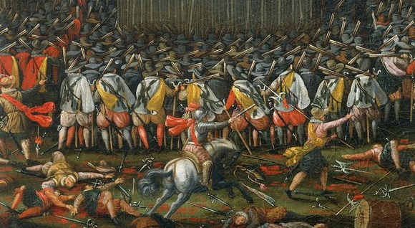
Reading (Hi)story
Res gestae (Latin: the things that happened) vs. historia rerum gestarum (Latin: the telling or story of the events)
Events are not “immediate” to us. They are, rather, “mediated” to us from a particular point of view.
This includes the events of the Thirty Years’ War.

Slide 18
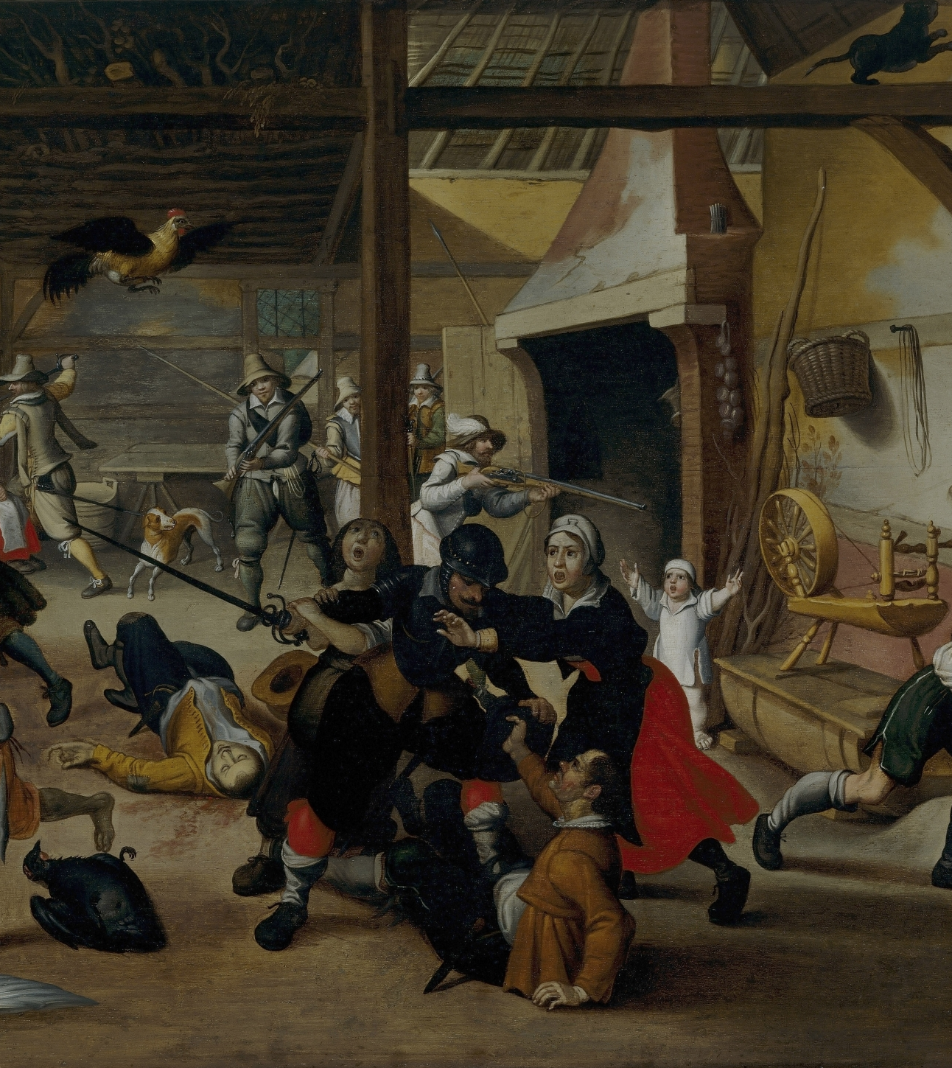
Or a peasant-eye view of the war?
Soldiers Plundering a Farm by Sebastian Vrancx

Slide 19
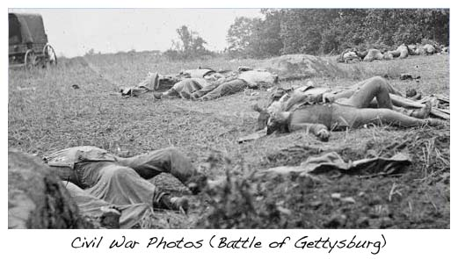
Next quarter you’ll look photographs of the Civil War that for the first time will give a view of the battlefield….

Slide 20
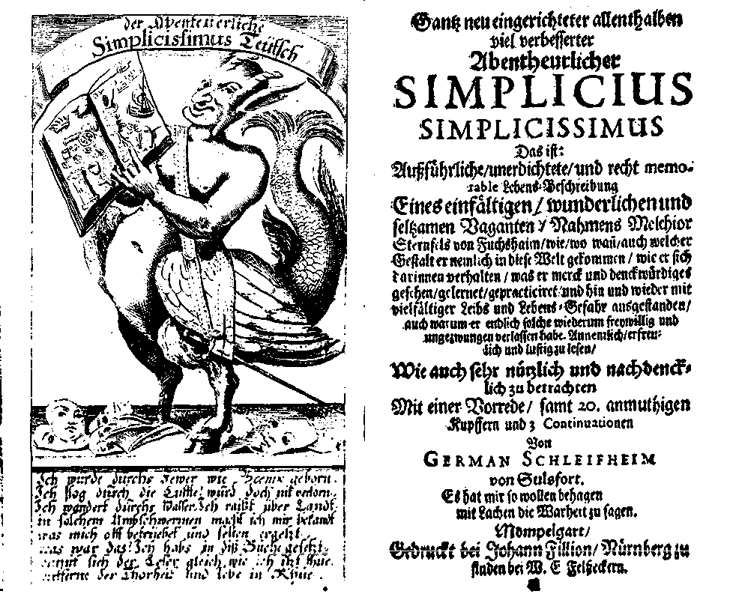
In a literary or historical text, what you see depends on linguistic / textual mediation
The material form of the book “mediates”…
And its language “mediates”…
This frontispiece sends a signal to us to read the book as…
…a satire.

Slide 21
It’s important to take this fact of mediation into account
For example: This book is a translation from 17th-century German into English in 1993.
The editorial choices of the translator-editor, George Schulz-Behrend…
EXAMPLE: “I was very careful to take mincing steps” (Book Two, p. 88)
Schulz-Behrend disappears an important part of the original: “Macht so enge Schrittlein, als etwan Achilles getan, da ihn seine Mutter dem Lycomedi rekommendierte” – “I took the same kind of mincing little steps that Achilles took when his mother sent him to Lycomedes…”
What’s missing??

Slide 22
Learn German!!

Slide 23
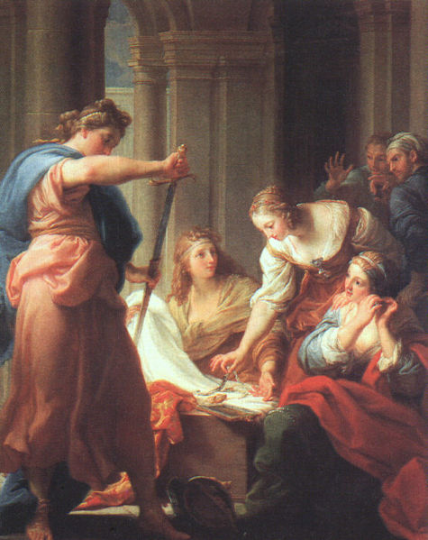
Simplicius as Achilles?!?
“Mincing”
Achilles?!?
According to an alternative tradition of stories, at the request of his mother, Thetis, Lycomedes concealed Achilles in female disguise among his own daughters to save him from going to Troy.
Odysseus drew Achilles out of his disguise and took him to Troy.
Pompeo Batoni, “Achilles at the Court of
Lycomedes” (1745) (oil on canvas)

Slide 24
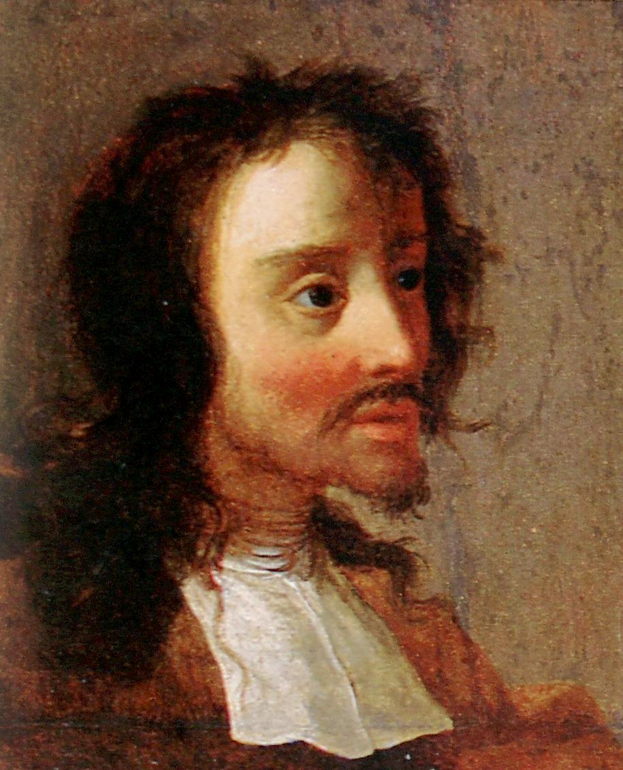
Had Simplicius read the
Iliad and know the Greek tradition?
Grimmelshausen certainly had…
Compare Book Two, p. 101: Simplicius: “I often wished for the Trojan War”
Simplicius is worried about his kleos (“Ruhm,” reputation) (p. 101) - “Making a name for myself…”
By raiding villages / stealing bacon…
He also proves himself a ‘warrior’ in a “Mock Epic.” What does he defeat so valiantly?
The Lice on his body! (Book Two, p. 95)
Grimmelshausen (1621/22 – 76)

Slide 25
This little reflection on mediation allows us to consider the relation of Grimmelshausen’s novel to the epic tradition
How does he “translate” it?
Picaresque as the underbelly of epic-- the picaresque knows the ancient epic and is reflecting on the usefulness of its “world” and its “values” in modern times…
We might also ask: How does Grimmelshausen “translate” the big “history from above”?

Slide 26
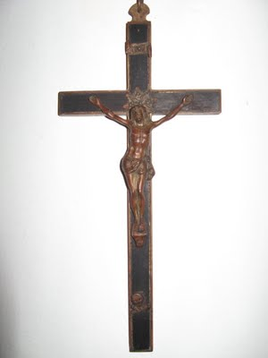
The Visibility of “Cause” #1:
In Grimmelshausen’s Simplicissimus, do we see the Thirty Years’ War as a war of religion?
A. “Concerning theology, there was no one like me in all Christendumb” (Book One, p. 3)
“Our Lord God…hung in the corner behind the kitchen door” (Book One, p. 14)
B. Most of the characters do not either self-identify or identify the enemy by religion (as Protestant or Catholic). They don’t care (Book One, p. 24: The fifth peasant)
17th century French crucifix

Slide 27
THE EXCEPTION(S):
The Hermit (Book One, pp. 9-20). But what “religion” is he? What’s his “creed” (Book One, p. 19)?
It’s just not clear what denomination he is. We see here the beginnings of a “natural” piety beyond institutional religions.
The novel not interested in this particular “cause.”

Slide 28
“Cause” #3: In Grimmelshausen’s Simplicissimus, do we see the Thirty Years’ War as a war of (nation-state) building / Swedes (and the French) against the HRE?
Sort of, if you know where to look…
References to the German Prince Bernhard of Weimar tangling with the “imperial” (HRE) troops (Book One, p. 29) / Prince Bernhard was an ally of the Swedish, and so was helping them build their nation-state…
The “Commissioner” sent by the Swedish war council to inspect Hanau (Book Two, pp. 58-9)
“Our general, von Hatzfeld” (Book Two, p. 87) – Hatzfeld was an imperial general
“Banér’s army and ours started fighting” (Book Two, p. 92) – Banér was a Swedish general
Yet still and all…
There is not too much evidence of political developments.
Simplicius sees “one of our men, who had previously served on the emperor’s side…” (Book One, p. 44)
This is mercenary warfare, no real loyalties.
Simplicius himself seems to change sides a lot.
And eventually becomes something like a free agent as the “Hunterboy” at the end of Book Two.

Slide 29
Why doesn’t Grimmelshausen tell us very often which political side the various soldiers are on? → Is he employing a “subtractive” technique (Prof. Izenberg)? He is not providing a uniting principle.
“[M]y flock and I were surrounded by a troop of heavy cavalry” (Book One, p. 5)
“Some forty or fifty musketeers surrounded me” (Book One, p. 22)
Which cavalry? Whose musketeers?
Would it have mattered “from below”?
It may well not have mattered to most of the people swept up by the conflict
The state-aligned details would have been invisible to them…
By not identifying the sides, the novel is giving us the “view from below”…

Slide 30
The novel certainly seems to capture the brutality and chaos of the war realistically
- Pillaging / Sacking (Book One, pp. 6-9, 21, 29)
- The “Knife” of “Forced Contributions” (p. 27) – “All my firewood, my utensils, and all the paltry food…completely gone” (Book One, p. 24) ; Simplicius takes part in “foraging raids” for the Croats (Book Two, p. 71)
- Torture? (Book One, pp. 7 and 22-4) - The Soldiers and the Peasants

Slide 31
However, even though Grimmelshausen’s picaresque novel is a “historical text” (almost contemporary with the war itself), and even though it’s highly realistic in places, we shouldn’t read it as describing the literal res gestae of the war…
It’s a story (a fictional narrative) and as such it creates a world for us to judge. But the world of “History” (with a capital H) is not really present directly in the story.

Slide 32
So, what’s the relation between this story and the “big history” going on? How are we to read this novel in relation to this history?
Three possibilities:
1. Could just be entertainment, a funny story about a simplisitic person, a simpleton. Slapstick.
But the hints at the epic tradition and the constructed nature of the narrative makes this solution unsatisfactory.

Slide 33
2. We could read it as a literal depiction of the realities of the Thirty Years’ War.
It’s certainly realistic and matter-of-fact in its descriptions of brutality. And many people continue to read it this way.
But again, the constructed and mediated nature of the narrative should warn us not to take it literally.

Slide 34
And finally we arrive at my thesis, which I hinted at in the title of the lecture:

Slide 35
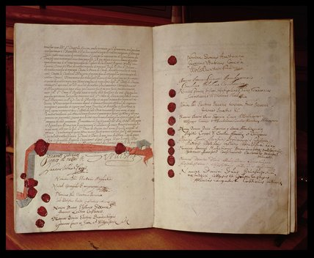
MY THESIS: The novel is not just entertainment, and is not a literal depiction of the war but is, rather, a figurative, allegorical, satirical post-war commentary on the values of the world that the war and the peace Treaty of Westphalia had created…
The Treaty of Westphalia
(1648)

Slide 36
That is, in a kind of allegory Grimmelshausen shows us from the perspective of one individual the chaos of the war and movement toward a new order that grew out of the Treaty of Westphalia.

Slide 37
The rest of the lecture will offer some textual evidence for this claim.
But first, I need to be clear on my terms.

Slide 38
Literal vs. Allegorical (“figurative”) Reading
Allegory
The representation of abstract ideas or principles by characters, figures, or events in narrative, dramatic, or pictorial form.
2. A symbolic representation: The blindfolded figure with scales is an allegory of justice.

Slide 39
A literary “figure” is a form of speech that expresses something indirectly, or in terms of something else.
You saw lots of metaphors and similes.
“X is like Y”– “My love is like a rose.”
To say that Simplicissimus is a “figurative representation” means that it gives us a picture of history in other terms.

Slide 40
We’ve already seen a specific “artifact” that can serve as a figurative, allegorical representation of Grimmelshausen’s world:

Slide 41
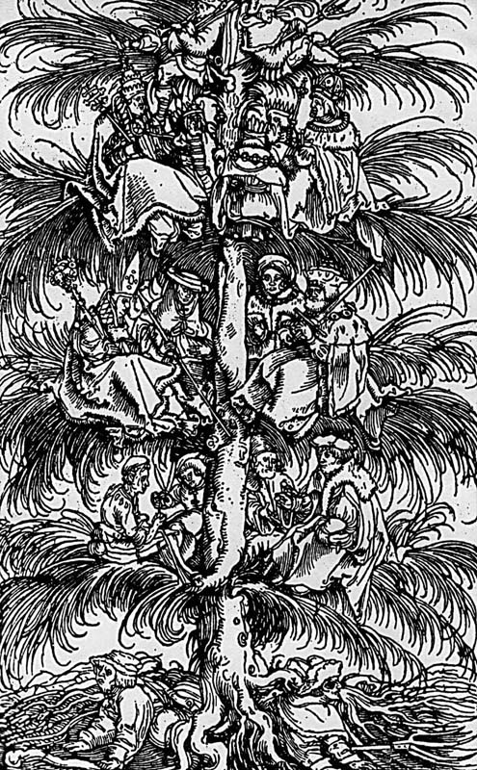

Slide 42
Reading the Trees of the Estates as an Allegory of the Condition of the “Modern” post-Westphalian (post-1648) Self (pp. 24-7)
“The sight was a pleasure to look at, for everything was divided by rank.”
“The roots of these trees had sheer wretchedness to contend with, but the men on the lowest branches had to endure even greater trouble, hardship, and discomfort. And though the branch-dwellers were jollier, there were also more defiant, tyrannical, and for the most part ungodly.”
“But above them there were some still a little higher, and they also aspired to grandeur.”
“Above these the tree had a kind of a break or separation, a smooth section without branches which was greased with the soap of envy…”
“A little further up sat still higher ones…”
“[T]here was constant wrangling and climbing in this tree, for every one wanted to sit in the highest, most blessed place…”
“The struggle was fiercest and least rewarding in the slippery section…”
“It seemed as if all the trees were only one tree and on its top sat Mars, the god of war.”
“He was covering all of Europe with the branches of this tree.”

Slide 43
An allegorical depiction (a TREE) of the hierarchical world of the past feudal order: kings, rulers, nobles on top, peasants on the bottom (the roots).
BUT, it is a world in flux. People are trying to move up and down.
The chaos introduced into the world by the Protestant Reformation and ensuing wars demands (1) a new order and (2) a wily individual who can navigate in it.

Slide 44
Proving my thesis…
Reading beyond the Literal:
Brutality, Sex, and Bathroom Humor in Grimmelshausen, Simplicissimus

Slide 45
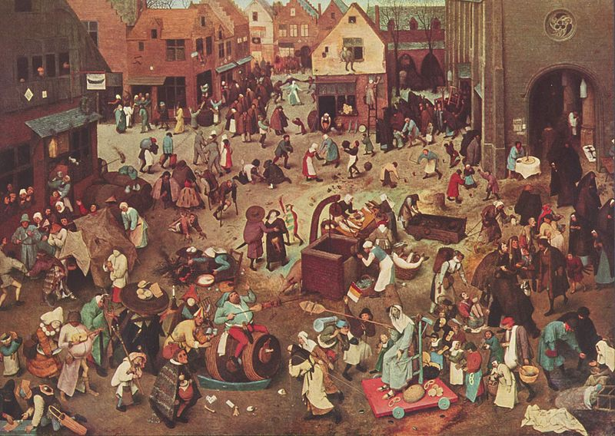
The “Goose Jail” and the Goose and the Gander (Book Two, pp. 53-4)
Of “Fiendish Farts” (Book One, pp. 45-46), “Tornados” (p. 49), and Self “Soiling” (Book One, p. 52, Book Two, p. 61)
Simplicius: “I didn’t think it at all bad to let nature take her course” (Book One, p. 46) .
Read literally, these scenes are over the top, funny, and gross.
But read “allegorically”/ “figuratively,” they suggest we think about the “the abstract idea” of what happens when humans give in to or are controlled by their ‘natural’ appetites and bodily needs.
Man in a “state of nature.” Hold that thought….
Brueghel, “The Battle between Carnival and
Lent” (1559)

Slide 46
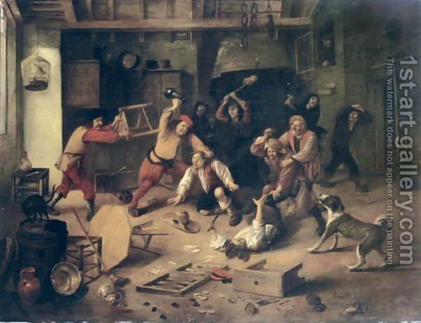
In the novel, giving in to “natural” appetites (for booze and sex) and other natural “forces” that you think you control (“je pète, je pète,” pp. 47, 49) creates a “war of all against all”!
The Banquet (Book One, p. 50)
“Toward the end serious fighting broke out; they were throwing glasses, tumblers, plates, and dishes, using their fists, chairs and chair legs, swords, and other handy objects to strike at each other, and quite a few were wounded.”
LITERALLY – A massive food fight?
But read FIGURATIVELY – a “state of nature” of all-against-all, every man for himself…
Abraham Diepraaem (1622-70), “Peasants
Brawling in a Tavern Interior”

Slide 47
An important point: Grimmelshausen was not the first to think of this. One of the founders of modern political theory, Thomas Hobbes, saw this phenomenon as the grounds of the modern state.

Slide 48
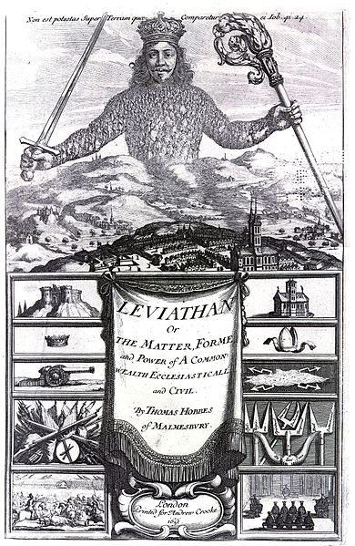
Thomas Hobbes (1588-1679) / English political philosopher / Leviathan (1651)
In his “natural” state (before civil and political society), it’s every man for himself…
“Hereby it is manifest that during the time men live without a common Power to keep them all in awe, they are in that condition which is called Warre; and such a warre as is of every man against every man; [this is a condition of] continuall Feare, and danger of violent death; And the life of man [is] solitary, poore, nasty, brutish, and short.”
Because of this “Feare,” men submit to a “sovereign” authority to protect themselves – both from one another and from themselves!
This “sovereign” has “sovereign power; and every one besides [is] his subject.” (chapter XVII)
Frontispiece of Leviathan (1651)

Slide 49
Note how Hobbes also depicts the state allegorically as an individual body!
We also sometimes speak even today of “the body politic.”

Slide 50
In the Treaty of Westphalia – designed to end the Thirty Years’ War as (an apparently unending) state of “war of all against all” – “sovereign authority” was indeed given over into the hands of the “state” (both lots of smaller polities and the emerging territorial (nation) states of Sweden and France)
The Treaty of Westphalia (1648) – 109 signatories

Slide 51
In Grimmelshausen’s novel, we don’t see actual “states” all that often. Rather, we see “authorities” who control the “state of nature” by taking charge, often in brutal and authoritarian ways, within their jurisdictions…
The ‘War” of the Banquet (in the walled city of Hanau): “My master soon quelled the riot” (Book One, p. 50)
Punishment of the Drunk “Lieutenant” who murders Old Heartbrother in the imperial camp: “Our general immediately had him hanged by his precious neck” (Book Two, p. 87)
- Such episodes may be read as allegories (“figures”) of the top-down, state-imposed discipline for post-Westphalian (post-1648 peace treaty) times that people accepted (or that was accepted for them on their behalf) to (finally) establish peace…

Slide 52
So, what kind of individual has this new world order (OUR world order?) created?

Slide 53
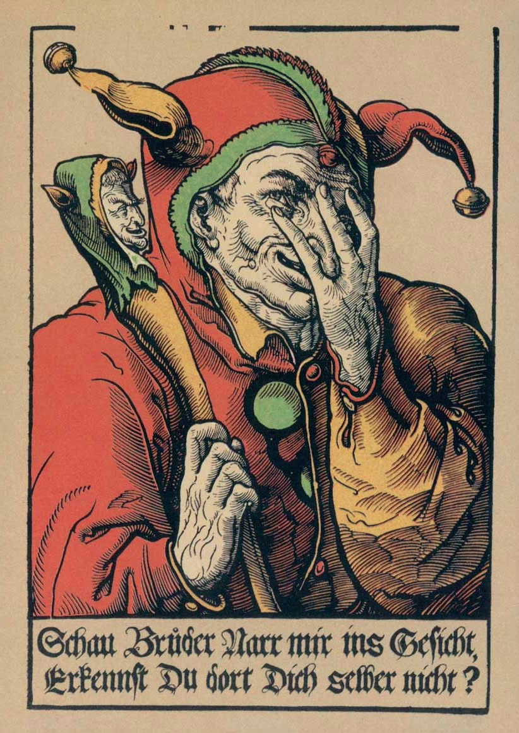
How does the individual
(‘from below’) survive in this “modern” world of state-controlled violence
(‘from above’)?
Dissemblance and “Prudence”
“Purposeful Pretending”: Simplicius becomes The Calf / the “court” jester (Book Two, p. 60)
(Again): Simplicius’ kleos – “You will have glory enough if you…can pull the wool over the eyes of three experienced hags” (p. 61)
“It wasn’t till I was supposed to have turned foolish that I became prudent and more guarded in my speech” (p. 65)
Prudence: Caution, foresight, but also the ability to be flexible in the face of variable conditions in the interest of a successful (political?) outcome (for oneself?)
→ Machiavelli!
Heinrich Vogtherr, “Der Schalksnarr” (The
Fool) (c. 1540): “Look at me, brother fool;
don’t you recognize yourself?”

Slide 54
In this “Westphalian world”…
…an individual must be many things in order to survive.
…the sovereign nation-state becomes the guarantor of order.
…and so such an individual lives in a world that gives him (or her) limited agency.
We see all this played out allegorically on and with the picaro’s body.

Slide 55
Why “him (or her)”?
Because, as I mentioned last time, this novel was very successful and Grimmelshausen created many spin-offs.
One was the tale of a woman during the war. Her name was “Courage.”
And that story inspired Bertold Brecht’s play, Mother Courage and Her Children, about the Thirty Years’ War, but written in a world at war in the 20th century.

Slide 56
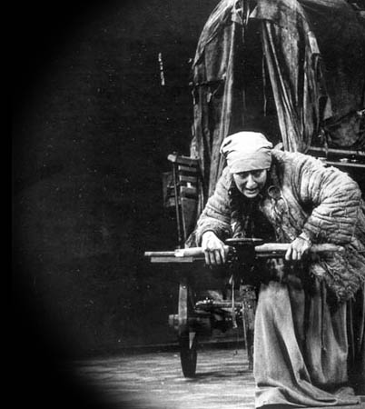
Next time…
We’ll explore Bertold Brecht’s “view from below” and his representation of one individual’s agency, or lack of agency, in a time of war—World War II.

