Slide 1
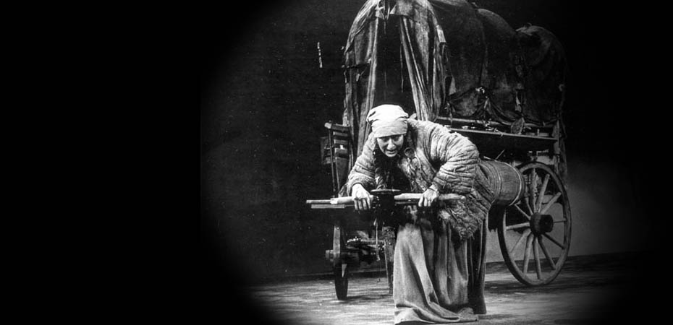
Brecht’s Mother Courage (1939)—A New Kind of Theater to Represent Agency and the “Business” of War

Slide 2
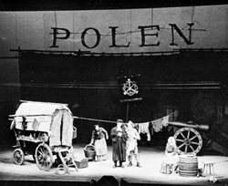
HCC (Fall, 2015) / Week 5, Bertolt Brecht,
Mother Courage and her Children (1939) /
Transitions and Connections
LAST WEEK:
Hans Jakob Christoffel von Grimmelshausen (1621-76) wrote:
- Der abenteuerliche Simplicissimus Teutsch, d.h. die Beschreibung des Lebens eines seltsamen Vaganten, genannt Melchior Sternfels von Fuchsheim = The Adventures of the German Simplicus, that is, the life of an odd vagrant named Melchior Sternfels von Fuchsheim (1668)
A picaresque novel…
AND another picaresque:
- Die Ertzbetrügerin und Land-störtzerin Courasche = The Life of the Cunning Vagabond, Courage... (1669)
Grimmelshausen‘s Mother Courage text was one of the textual sources for Bertolt Brecht‘s play, Mother Courage and her Children (1939)!
Berlin Production of Mother Courage (1949)

Slide 3
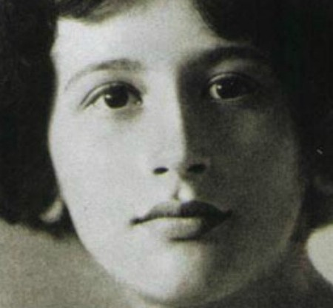
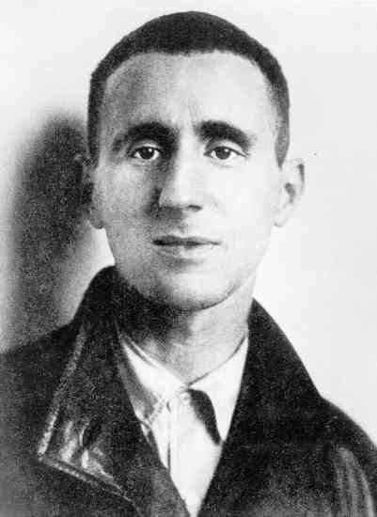
A parallel: Prof. Izenberg (week 1) and
Prof. Smith (me) (week 5)
Izenberg’s Weil → Smith’s Brecht
Just as Simone Weil was looking back to the Iliad and the Trojan War in 1940 in the middle of WWII...
So too was Brecht looking back to Grimmelshausen and the Thirty Years‘ War in 1939, at the outbreak of WWII...
Simone
Weil
(1909-43)
Bertolt
Brecht
(1898-1956)

Slide 4
If Simone Weil finds in the Iliad a conception of “force” that has great explanatory power, then what (we can ask) does Brecht find looking back to Grimmelshausen and the Thirty Years’ War?
Hint: It will have to do with the (limited) agency of the “new individual” living in a new socio-political order of the state.

Slide 5
Moving through time….
The humanities (and certainly the Humanities Core Course) shows the importance of time travel. That means back and forth.
We started about 3000 years ago with Homer. Then we fast forwarded to the 17th century and the Thirty Years War. Now we jump to World War Two (1939-1945).
And yet, each move forward is accompanied by retrospective looks back.

Slide 6
Moving forward by looking back…
Weil and Oswald tried to make sense of the present by thinking anew about the Trojan War.
Grimmelshausen turned the Ancient epic upside down to tell a figurative history of his present from below.
Now Brecht returns to Grimmelshausen to see what he still has to tell us about agency in a time of total war.
And next week we’ll see a 2008 film during the Second Gulf War looking back at Brecht!

Slide 7
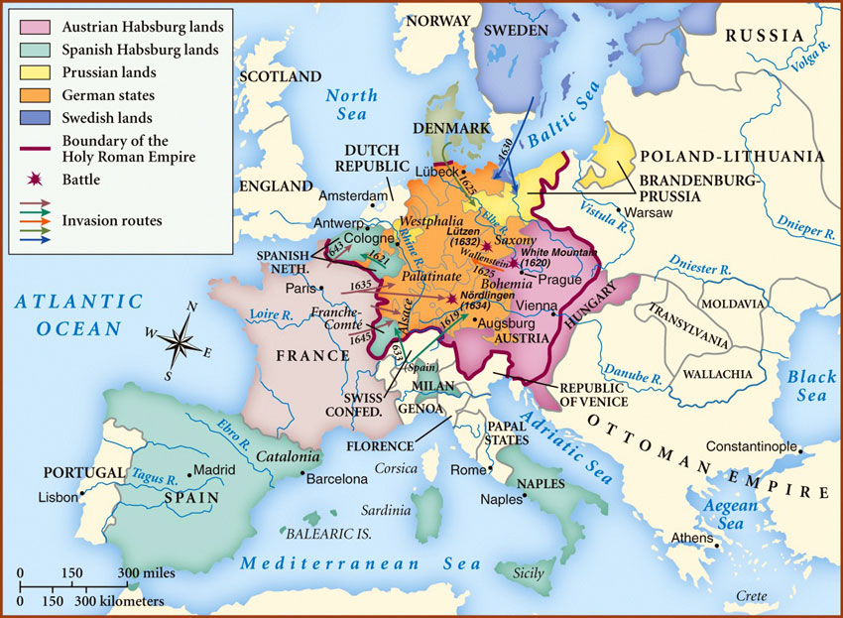
Even as we move forward in time to our present, we are staying in central Europe / Germany, but now a mid-20th century central Europe that looked a bit different than the one we considered last week!
Map of Central Europe / “Germany” during the Thirty Years’ War (1618-48)

Slide 8
What had changed in the meantime?
Between the Thirty Years’ War (1618-48) and WWII (1939-45)?

Slide 9
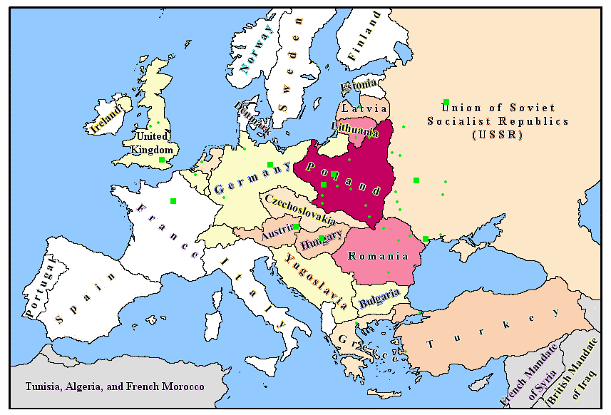
We know from last time that the momentous change came after the Thirty Years’ War with the rise of the nation state.
→
A Europe that looked like this….
Became a Europe that looked like this (in 1939).
Recall: The Holy Roman Empire was weakened by the French and Swedish victories in the Thirty Years’ War, but it was dissolved only in 1806 after Napoleon’s troops swept across Europe.

Slide 10
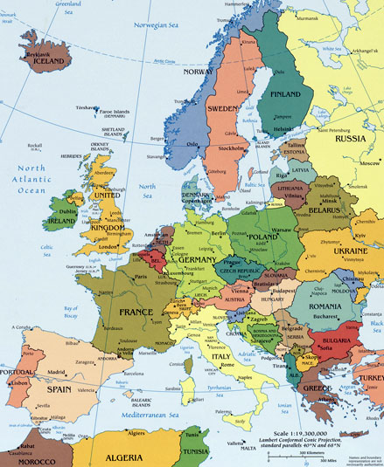
An abbreviated history….
We saw that Grimmelshausen’s Simplicissimus could be read as an allegory of the beginning consolidation of the “Westphalian” order of nation states.
One of the major players, beginning with its unification in 1866, was Germany.
Contemporary Europe

Slide 11
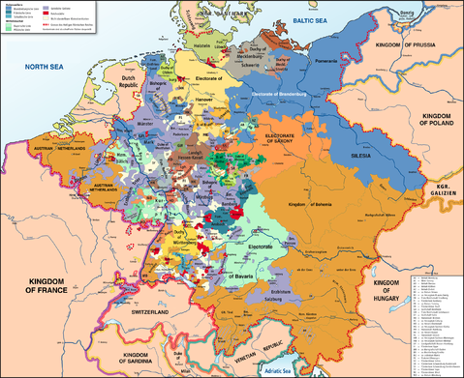
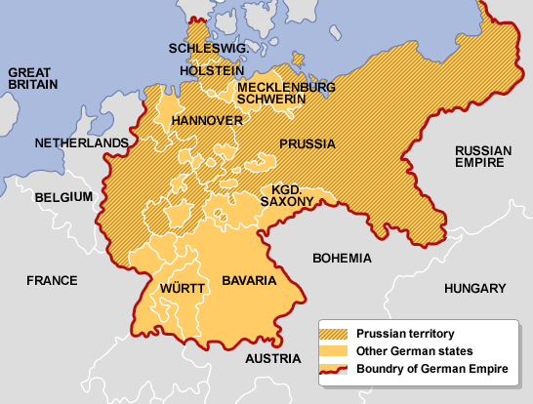
Week 4 → Week 5
From the Holy
Roman Empire
(here, c. 1789)
To the “modern” nation-state
of Germany; looks similar, but it’s
radically different

Slide 12
Although there are still “states” within Germany, they are all subordinated to the central power of the nation, in this case Prussia and its capital, Berlin.

Slide 13
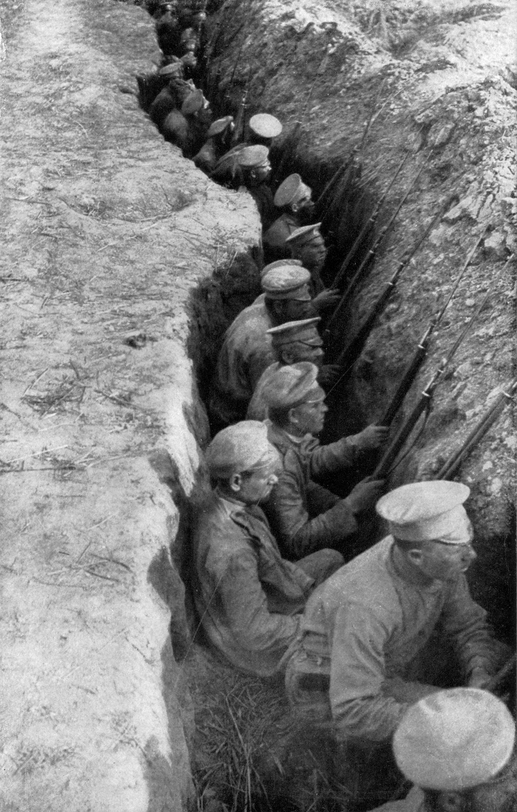
The 20th century was then a time of wars waged by these nation states against each other
World War I (1914-1938)
“trench warfare”
The general statistics are 17 million deaths and 20 million wounded.
Left a lasting scar on an entire generation.

Slide 14
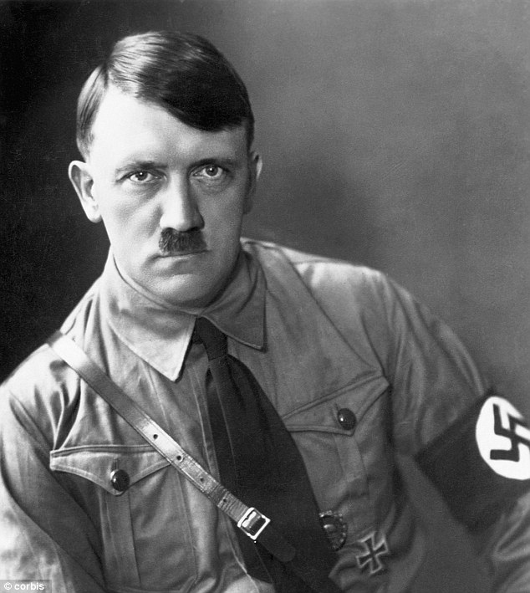
Rise of National Socialism (Nazis)
Hitler rises to power in 1933.
Rearms Germany
Invades Poland in 1939
Propaganda minister Joseph Goebbels calls for “total war” (the mobilization of the entire society) in 1943. (In fact, the entire society had been completely organzed for the war effort already.)

Slide 15
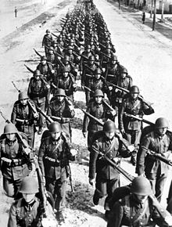
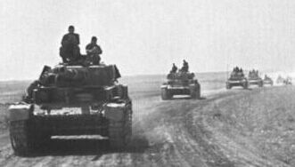
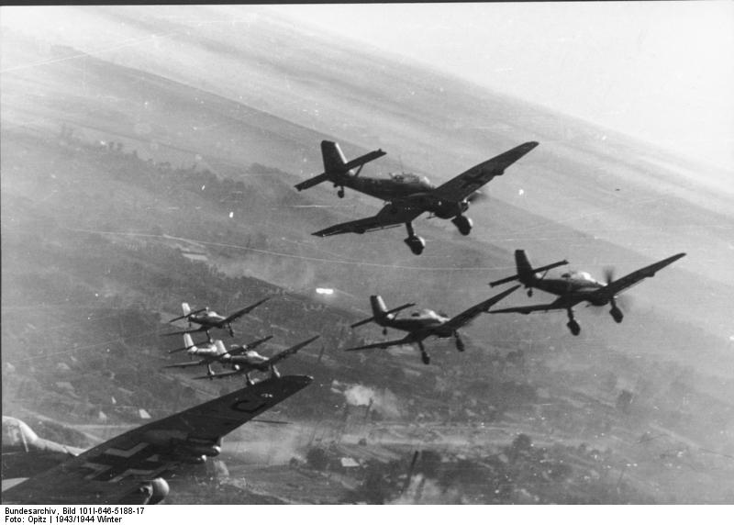
The Brutality of War (1939-45):
From 1939 on → The so-called German “Blitzkrieg” (lightening war)--swift, coordinated mechanized infantry and air attacks against Poland, Belgium, and France
Beginning in 1941, eastern front against the Soviet Union

Slide 16
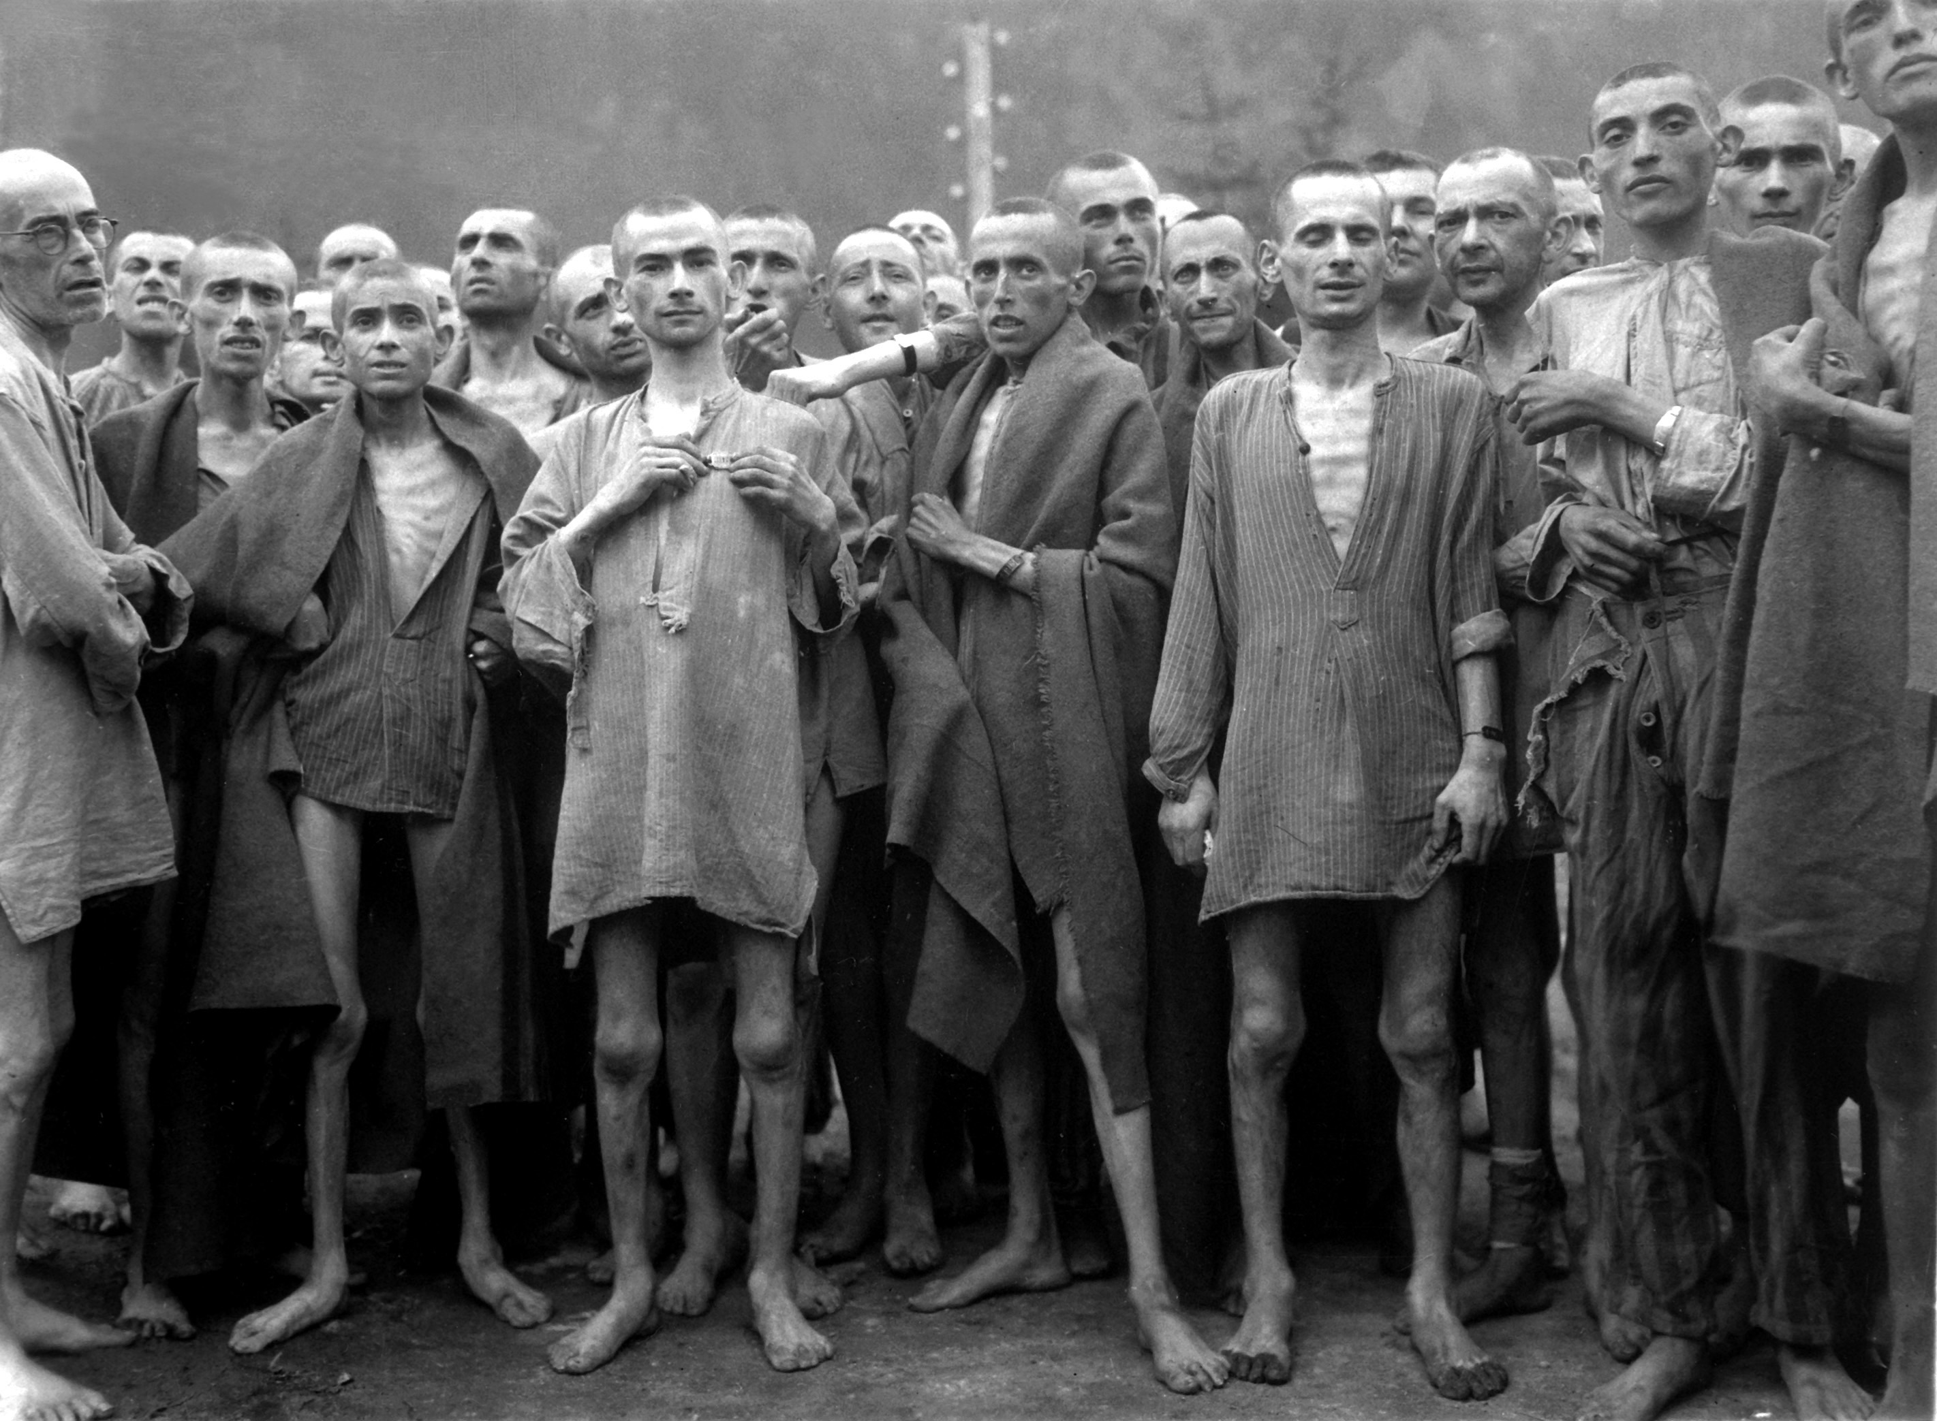
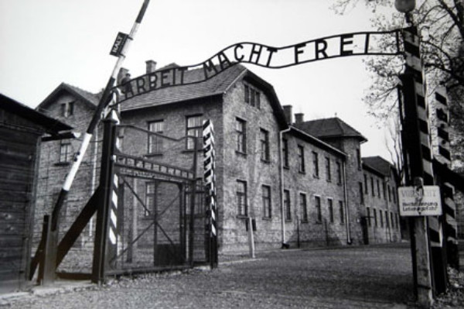
Call for the total annihilation of the Jews of Europe
In concentration/death camps
Like the one in Auschwitz, Poland

Slide 17
The result….
Unprecedented destruction….

Slide 18
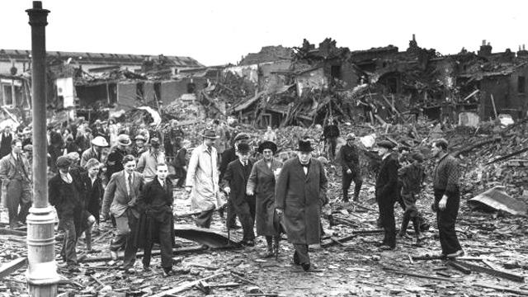
The Battle of Britain (Summer / Fall, 1940) / German air force attacks England
Winston Churchill inspecting damage in south London (7 September, 1940)

Slide 19
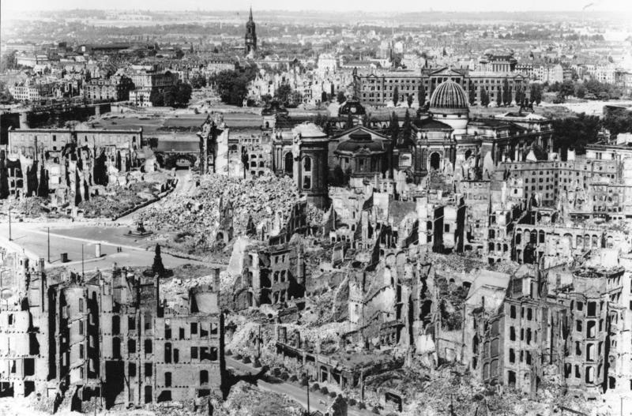
Pretty soon, however, this form of war also came home to the Germans themselves…
The German city of Dresden – 13-15 February, 1945
Between 22,000 and 25,000 people incinerated on the ground by British and U.S. bombs

Slide 20
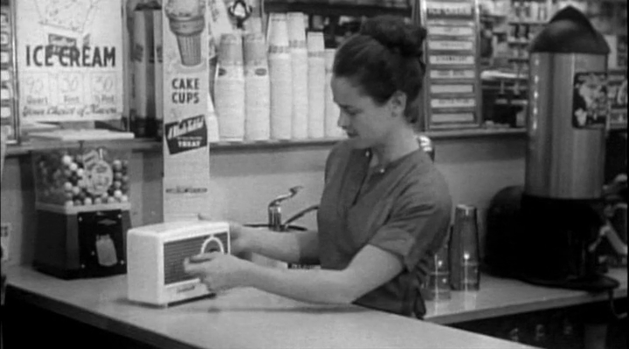
Berlin in ruins

Slide 21
https://uci.kanopystreaming.com/video/theater-war

Slide 22
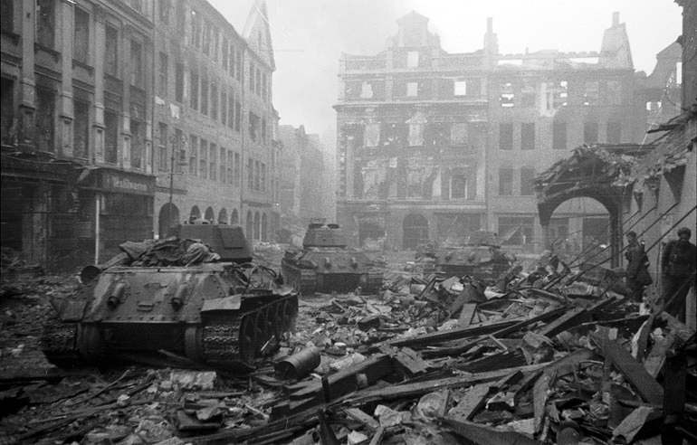
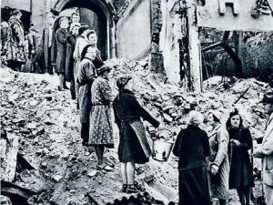
Downtown Berlin, Germany after
the Battle for Berlin, 1945
The “Trümmerfrauen” (“rubble women”)
who salvaged bricks from the bombed
out buildings to reuse , carted the rest
Away, creating “hills” of ruins still in Berlin today…

Slide 23
…and death
Assumed to be approx. 60 million world wide.
Over 7,000,000 Jews exterminated.
400,000 American troops
8 – 11 million Soviet troops
7 – 9 million Soviet civilians
A short graphic video that makes the overwhelming numbers somewhat visualizable.
https://vimeo.com/128373915

Slide 24
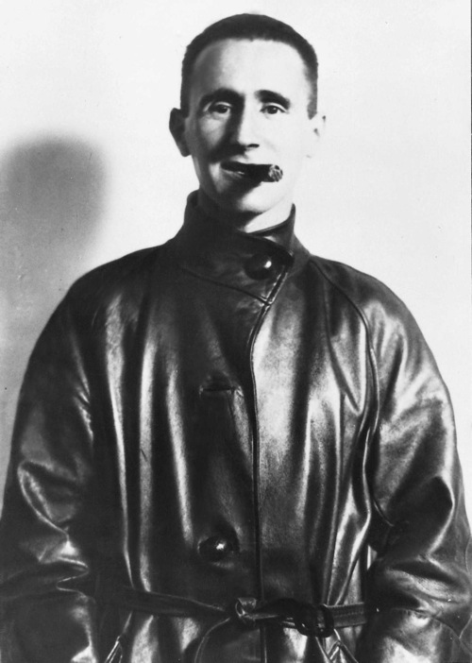
Bertolt Brecht (1898-1956) as a young man… (born Eugen Bertold)
Brecht came of age during these years…
He witnessed the rise and fall – and rise and fall again – of the “modern” state of Germany several times over…
During and after WWI (1914-18), when the German state was at both its highest – and after it lost WWI, also its lowest – point.
Also during the raucous political times of the Weimar Republic (1919-33), street battles between workers (esp. communists) and the army and Nazi thugs…
The rise to power of Hitler and the Nazis, the appointment of Hitler as German Chancellor in 1933
The official outbreak of war in 1939…

Slide 25
To Those Born After Us—Bertolt Brecht (1939)
Really, I live in dark, dark times!
The naïve word is foolish. A smooth forehead
Is a sign of insensitivity. One who laughs
Just hasn’t received yet
The terrible news.
What times are these, when
A conversation about trees is almost a crime,
Because it passes over in silence so many evil deeds.
…

Slide 26
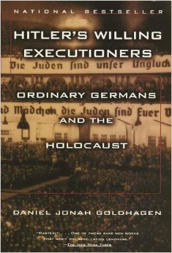
(1996)
He was asking the Germans to think about their own complicity in allowing the Nazi regime – as a totalitarian form of the modern nation-state – to come to power…
What had they looked away from and in whose interest had they done so?
What activities had they engaged in and what values had they espoused in the build-up to and during the war (and in general…) that led to what they themselves experienced in 1945?

Slide 27
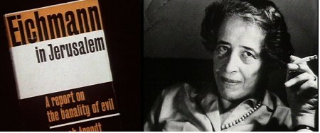
Another famous study of the kind of attitude that could account for the atrocities of the Nazis— “the banality of evil”
1963

Slide 28
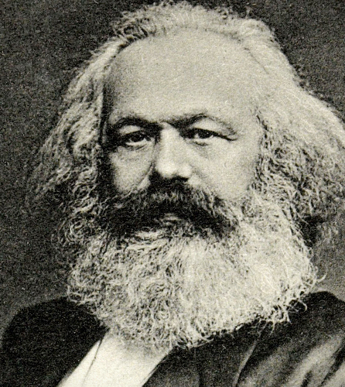
Karl Marx (1818-1883)
Brecht was a Marxist and communist sympathizer.
This has two important consequences for our immediate purposes:

Slide 29
1. Exile
Brecht, like many Jewish and left-wing intellectuals, was forced to flee Germany.
He left in February, 1933, right after Hitler came to power.
Spent time in Prague, Zurich, Paris, Denmark, Sweden, and Finnland before traveling by train across the Soviet Union and settling in the United States (Los Angeles!).

Slide 30
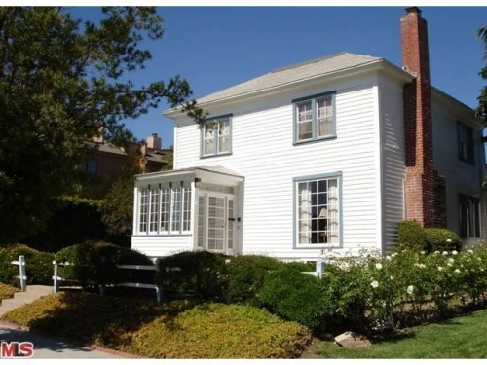

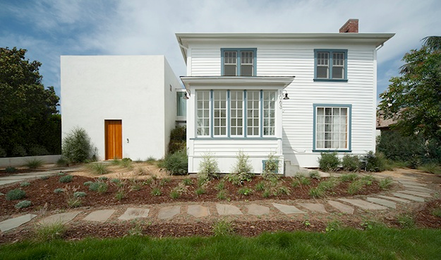

Slide 31
Wrote Mother Courage in Denmark in 1939 (during those “dark, dark times”).
After fleeing the US in 1949 during the McCarthy “red scare” he spent the rest of his life in the German Democratic Republic, communist “East Germany.”

Slide 32
2. Economic foundations
One of the key tenets of Marxist thought is that the economic “substructure,” the “means of production,” of a society and age shapes other aspects (social forms, culture, system of justice, individual consciousness, etc.).
Thus, for example (and this is a very crass formulation), the feudal economic system underlay and formed the hierarchical political order of the Middle Ages; and it’s not by chance that ideas about individual freedom emerged in the 17th and 18th centuries, just as the capitalist market system was becoming dominant in the West.

Slide 33
Put another way: Economic factors—who gets to own what in a society—help shape individual and social identities.
Recall the “Tree of Estates” “divided by rank.”
In capitalism, the major means of production are in the hands of a minority.
Under communism/socialism the means of production are in the hands of the workers/State.
A burning issue today: Is capitalism itself threatened by increasing disparity (i.e., a larger amount of wealth controlled by the “1%”)?

Slide 34
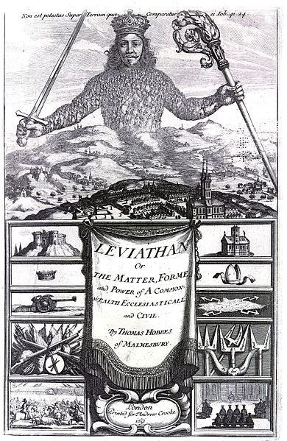
What about modern war?
We saw that the modern nation state developed in the aftermath of the Thirty Years’ War.
Each one had absolute (“sovereign”) authority over its citizens, was autonomous, and had the responsibility to protect them.
The sovereign imposes order, ends the “state of nature.”

Slide 35
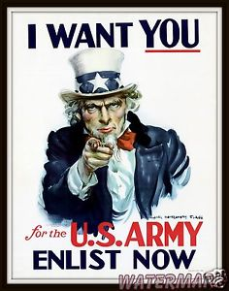
A change in the military
How did the troops in Simplicissimus support themselves?
Looting and plundering
Who pays soldiers now?
The State

Slide 36
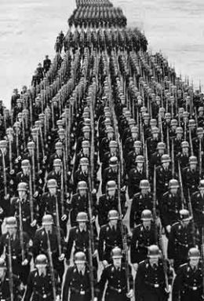
The maintenance of a standing army became a fundamental function of each state.
Mercenaries, esp. foreign ones (as we saw in Simplicissimus), became rarer.

Slide 37
Combine with this function of the nation state to maintain a permanent army the incredible economic forces unleashed by the capitalist modes of production—the industrial revolution, new modes of rapid transportation, banking and financial systems—and you get what came to be called “the military-industrial complex.”

Slide 38
President Dwight D. Eisenhower’s speech from January 21st, 1961
https://www.youtube.com/watch?v=8y06NSBBRtY

Slide 39
NOTE!
This speech was given by a US president (as he was stepping down from office), nearly 8 years after Brecht died, and some 20 years after the first performance of Mother Courage.
But my point is that it was precisely this phenomenon, which had its origins in the developments after the Thirty Years War and a horrendous culmination in Hitler’s “total war,” that was on Brecht’s mind.
Which brings us to…

Slide 40
My thesis (or, rather, Brecht’s thesis underlying the play—for, we’ll see, Brecht has a point to make)
In this world, the individuals have agency, but only within the confines of their subjection to the “state” and to the socio-economic order that sustains it—and if these confines are the “military-industrial complex” that developed since the 17th century, then agency and the values on which we act, are fundamentally corrupted.

Slide 41
Note, there will be a corollary to this thesis that will emerge: If we question the limited or corrupted agency provided by these conditions, then we must change the conditions.

Slide 42
What? Brecht, a playwright, had a thesis?
It is a part of my broader insterest that Brecht has a thesis in mind, a point to make. That is, Brecht is trying to teach us something.

Slide 43
Epic Theater as Pedagogical Theater
One of Brecht’s main goals was thus to interrupt our pity, doing so by de-naturalizing the dramatic event going on on stage. We are reminded that we’re watching something on a stage.
By making Mother Courage’s and her children’s experiences of the war and their reactions to it un-real and un-realistic, the play allows us to analyze the causes of the events (of war) being re-presented.
And thus analyze the ‘making’ of an un-natural world of war.
In order to “un-make” that world.

Slide 44
Interrupting your Pity and Grief:
Epic Theater and the V-Effekt (Verfremdungseffekt) = “alienation effect”
Brecht’s theory of epic theater…
Confusing! → “epic” “theater”? (coined by Erwin Piscator, whom Brecht knew in Berlin)
Later Brecht preferred the term “dialectical theater.”
Not Brecht’s innovation… Actually there were precedents in earlier political theater and cabaret in Europe, in Asian and revolutionary Soviet theater, in Charlie Chaplin and U.S. silent film…
Not fourth-wall, “dramatic theater”
The Alienation Effect: The audience should not identify with the characters / Emotions should not just be stimulated by theater, but also examined.
Epic theater “turns the spectator into an observer” and “arouses his capacity for action” (Brecht)

Slide 45
https://uci.kanopystreaming.com/video/theater-war
(Scene 1)

Slide 46
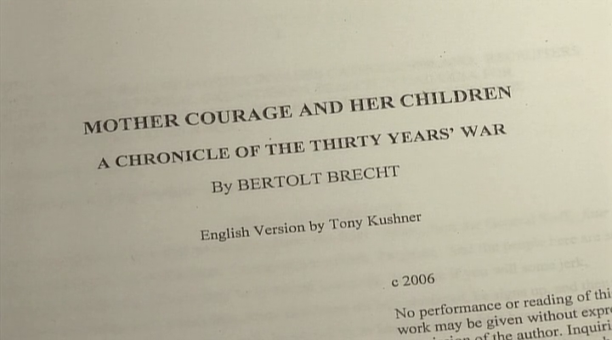
Scene 1

Slide 47
Examples:
The soldier comes out and talks to us about the action on the stage. As if to say: “Hey, audience, THIS IS A PLAY!”

Slide 48
A typical Brechtian moment: When she’s wielding the knife against the army recruiters, what’s she feeling and trying to convey?
But what does she say at the end with the knife in hand?
What’s our reaction?
Brecht produces a disconnect, a kind of cognitive dissonance as if to say: “Don’t identify too much with her. Think about what’s happening.”

Slide 49
Note: Next week we’ll discuss the Brechtian techniques used in the film.

Slide 50
Epic theater is episodic : “Three Years later…” (Scene Three, p. 27) / “Two years have gone by…” (Scene Five, p. 58) – Hence his interest in Grimmelshausen!
Its character development is discontinuous: Mother Courage is both defending her family, but also she can’t pass up a deal (or later, keep herself from “haggling too long” (p. 51).
Unrealistic staging / set design in which we see the stage machinery

Slide 51
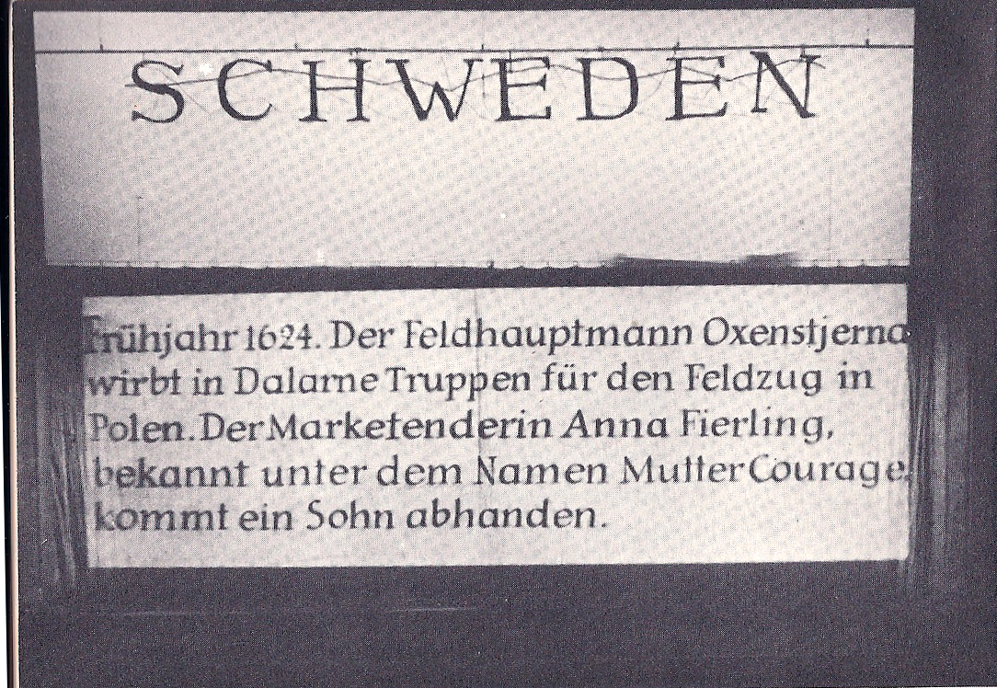
Banner “title” suspended over stage
in Scene One – Mother Courage and her
Children, Berlin production, 1949 – Intended to “break the illusion” and highlight the “made-ness” of the play. Tells us the action.

Slide 52
And constant interruptions in the action (the songs / ballads)

Slide 53
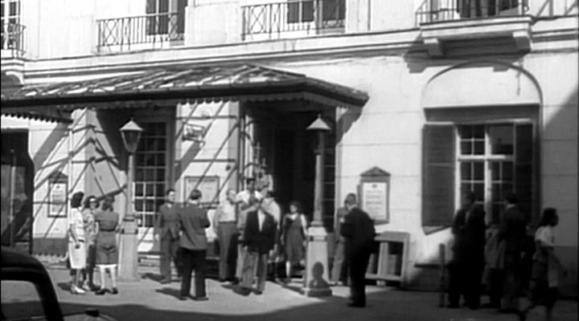
An East German newsreel

Slide 54
https://uci.kanopystreaming.com/video/theater-war
(on the 1949 performance)

Slide 55
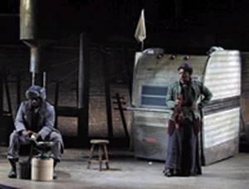
The Ballads
“The Song about the Soldier and his Wife” (Eilif, Scene Two, pp. 24-5 – seems motivated) vs. “The Song of Fraternisation” (Yvette, Scene Three, pp. 30-1) and “The Song of the Great Capitulation” (Scene Four, pp. 55-7)
Even if “motivated” by plot, still interruptions.
According to Brecht, the songs are also supposed to be sung in an ‘unpretty’ or un-melodic way so that they will be “drug free,” not full of “expressive” emotion that lulls the listener into passivity…
Partly spoken, partly sung…
Voice and music sometimes at odds….
For this reasons, the ballads can contain a grain of truth / a lesson / an insight that the audience must ponder…
Mother Courage and her Children - Production
by the Classical Theater of Harlem (2004) –
“The Song of the Great Capitulation” –
Mother Courage: “I’ve thought it over: I’m
not complaining.” (p. 57)

Slide 56
So, we can assume that Brecht does have a thesis. He’s engaged in pedagogical theater.
Now, can I argue that this thesis really is about the limitations and corruption of human agency and values in an age dominated by something we could call “the military-industrial complex”?

Slide 57
For now, a few quotes as evidence (just write page references):
Mother Courage: “War! A great way to make a living!” (69)
Mother Courage (sings): “What else is war but competition,/ A profit-building enterprise?” (70)
The Cook: “The war needs men, and men must eat” (85).
The Cook: “All virtues are dangerous in a world like this….” (89).
The soldiers (sing): “You march in line, but never wonder/ How it began and where it ends” (104).

Slide 58
Your task is to look for other lines that could support—or challenge—this thesis about agency and values in an age when war and business are intertwined. And to think up alternative theses of your own….
This lecture, after all, is also a version of “pedagogical theater”….
See you next time for the next act.

Slide 59
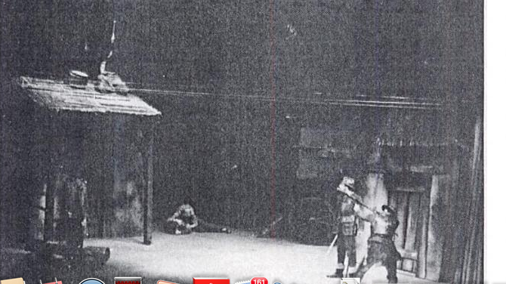
Next time…
The Virtues that Kill in the “Modern” World of War…
Individual Agency: Heroism, Honesty, Compassion, and Empathy in Mother Courage and her Children
Collective Action: The Audience’s Response in 1941 / 1949
Our response today…
Brecht’s Agency? Brecht’s Heroism? → Surviving the War / Surviving the Peace
Mother Courage and her Children / Berlin
production (1949) – Scene Eleven

