Slide 1
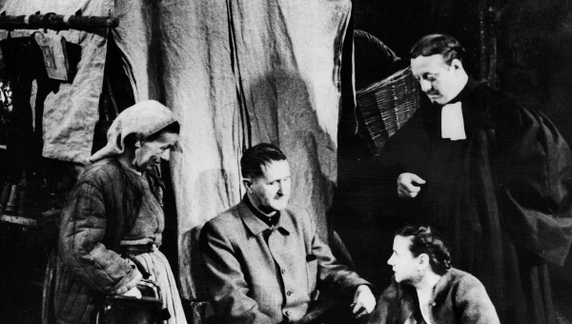
Mother Courage, Brecht, and Agency: A Lesson about War and Business

Slide 2
Last time…
We did some work on a thesis about the play, a thesis I claimed was Brecht’s:
In this world, the individual subject has agency, but only within the confines of his or her subjection to the “state” and to the socio-economic order that sustains it—and if these confines are the “military-industrial complex” that developed since the 17th century, then the individual’s agency and values are fundamentally corrupted.

Slide 3
My argument grows out of this thesis:
(1) I had to explain what “in this world” could mean. Namely, a “post-Westphalian” political order under the conditions of capitalism, what Eisenhower called the “military-industrial complex.”
(2) I had to make a case that Brecht’s approach to theater is didactic or pedagogical, that he has a point to make, that he would have a “thesis.”
(3) I need to provide textual evidence about the problems with agency in this world.

Slide 4
Today I’ll be working more with this thesis, but also nuancing it and making the situation a bit more complex and ambivalent.

Slide 5
What perspective does Brecht give?
Not by chance that he has chosen a text by Grimmelshausen for the basis of his play.
If he’s interested in our limited agency, he gives us a picaresque perspective, a “view from below.”
The “little people” don’t get to choose the situation they are in. Simplicissimus shows us, figuratively through the body of an individual, what it’s like to live in a post-Westphalian world. And Brecht, too, looks at what this world has become in the intervening 300 years and places a woman into those conditions.
He places Courage at the beginning of these developments to ask questions about where they lead.

Slide 6
Whereas the “main stage” of the political and military “realities” of the Thirty Years’ War are nearly invisible to the characters…
…the “realities” of the “margins” of the war and its impact on the “small people” (“die kleinen Leute” – Brecht’s term) are visible!
Theirs is a world of “total war.”
The Army Recruiter / The Sergeant (Scene One) / Mercenary soldiering
“Contributions”: Eilif’s “requisitioning of twenty head of cattle from some farmers” (Scene Two, p. 22)
This isn’t yet a “modern” army, but watching it from a later perspective makes us think of what it’s like in our world (1939, 2006, 2015…).

Slide 7
The Impact of the War on the ‘Homefront’:
The Cook, The Preacher, and Mother Courage talk politics: Scene Three, pp. 32-33*
How do they experience the war? How do they analyze the war? How is the scene constructed?

Slide 8
Alienation effects: a “split stage” (we need to recognize multiple things happening at once); interruptions; irony (“a peaceful invasion”; liberty like salt).
Their perspective of events: Things sweep over them; suddenly back in Sweden the taxes of the poor go up to support the war.
Recall: “Simplicius lets himself drift, like a piece of reed on a pond” (21).

Slide 9
The socio-economic conditions impact all aspects of life. Here we can see Brecht’s Marxist view of the world.
This is crucial if we are to understand and evaluate Courage’s “limited agency” as Brecht wants us to. It’s not about her as an individual (ultimately) but the conditions under which she can operate.

Slide 10
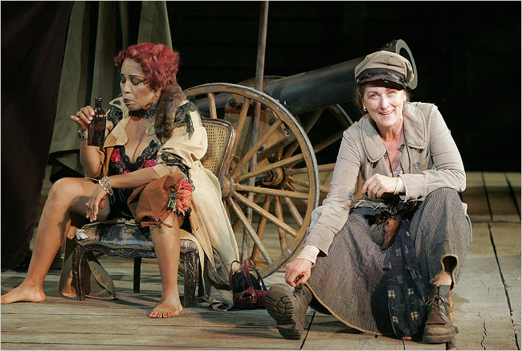
Through its anti- / un-realism, the play does offer a commentary on the ‘realities’ of the “modernity” re-presented in this play /
Mother Courage as a ‘modern’ picaro (actually, a picara)
The new normal is to survive by one’s wits and turn a profit for oneself…
We all just do our best to get by in a world in which the needs of the war pre-determine most things and especially our “choices”…
Mother Courage: “…in general everything’s OK, the war’s going well, every other day fresh countries are joining in, it’ll last four or five years easily.” (Scene Three, p.29)*
“If it’s business, it makes sense.” (p. 34)

Slide 11
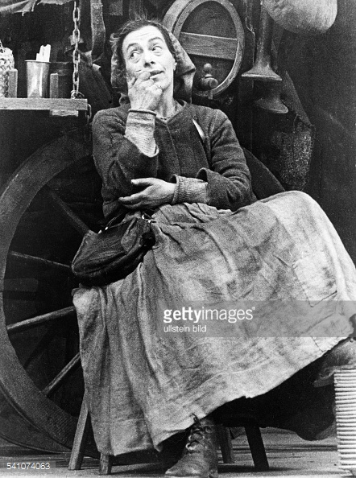
Courage is caught up in the “business” of war…
But this way of thinking is precisely the problem for Brecht…
Mother Courage acts, but she has limited agency…
Her “choices” are determined by the circumstances…

Slide 12
Brecht is calling our attention to real dangers of being determined in one’s actions by conditions around one – including war, business, and war as “business” (p. 29) – and seeing them as “natural” / inevitable…
Mother Courage is autonomous / has her own business…
…but she is employed by the war… and it takes its toll.
The Sergeant: “If off the war you hope to live, Take what you can. You’ll also give.” (Scene One, p. 18)
Brecht’s challenge to the Germans in 1939?
Why were they complicitous?

Slide 13
The Values in the play
Values: “a person's principles or standards of behavior; one's judgment of what is important in life”
Where do they get the individual characters in the world of the play? How are they perverted?
NOTE: I emphasized individual because we will need to contrast individual from collective agency….

Slide 14
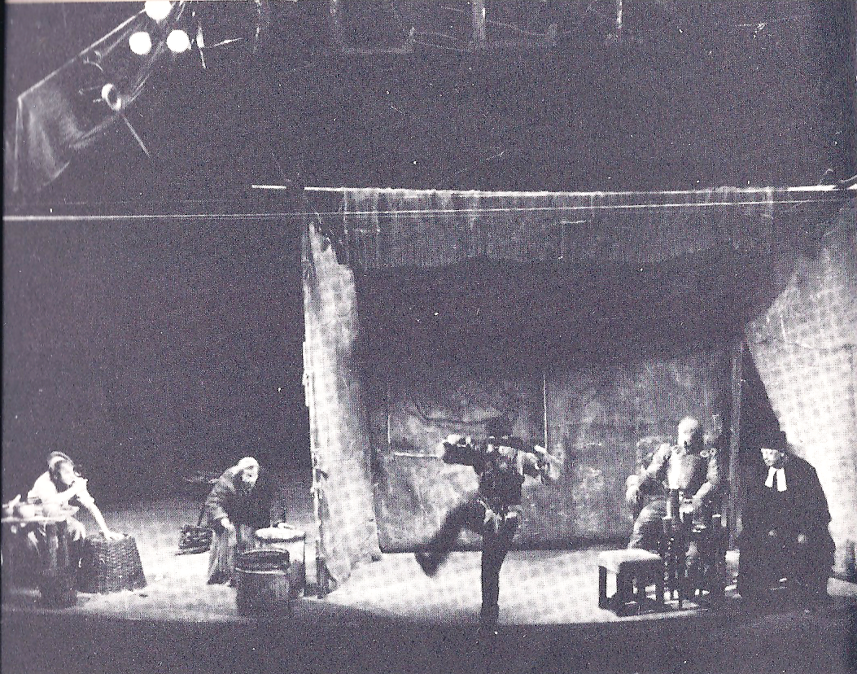
“Fatal” Values and Fatal “Virtues”:
Brecht’s Question: “What is a performance of Mother Courage and her Children primarily meant to show?”
Brecht’s Answer (BRECHT’s THESIS!): “That war is a continuation of business by other means, making the human virtues fatal even to those who exercise them.” (Couragemodell, 1949)
Eilif Dancing and Singing “The Song
About the Solider and his Wife” (Scene
Two, p. 25) / Berlin production, 1949

Slide 15
Virtue #1: “Heroism” in Mother Courage and her Children
What happens to the virtue of heroism (the traditional source of epic kleos)?
The General (to Eilif): “You’re a hero…” (“Heldentat,” the act of a hero)
Eilif: “You really work up an appetite, butchering peasants” (Scene Two, pp. 20-21)*
And what happens to such a “hero”? (p. 82)*
Mother Courage asks the Cook about Eilif: “Any more heroism?” (“Heldentaten” Scene Eight, p. 84)*
For Brecht, it’s not that the characters are “unvirtuous” (have a flaw); rather, it’s that under these conditions, their virtues are corrupted.

Slide 16
What does heroism, boldness, bravery achieve?
Commentary in the ballads…
“The Ballad of the Famous”
The Cook: “A lecture in the form of a song, the Song of Solomon, Julius Caesar and other men possessed of a gigantic spirit (“große Geister”), which proved to be of little use” (Scene Nine, pp. 88-91)*
Solomon / Julius Caesar / Socrates / St. Martin
Second stanza → → →
“Then Julius Caesar, mighty one, //…So brave ( or bold, “kühn”) he tore the world apart, // So they voted and changed their Caesar to a God, // Then drove a dagger through his heart, //… So brave, but screaming out in fear he ends. // Brave hearts (“Kühnheit”) are grand! We’re fine with none” (p. 89)
“Our virtues led us to our wretched ends. // And folk do better who have none.” (p. 91)*

Slide 17
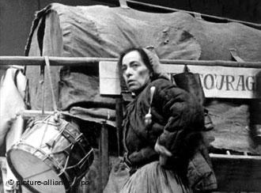
No need for any kind of “heroism” when war is a “continuation of business by other means”...
The confines in which they operate:
Political “business as usual”
Mother Courage: “Think the war will end now?”
The Chaplain: “There will be brief pauses…But the Emperor or the King or the Pope reliably provides what’s necessary to get it going again. This war’s got no significant worries as far as I can see…” (Scene Six, pp. 62-3)
Business “business as usual”
Mother Courage: “What else is war but a profit-making competition, / A profit-building enterprise” (Scene Seven, p. 70)
What are values in such a world?
Helene Weigel as Mother Courage (Berlin
production, 1949)

Slide 18
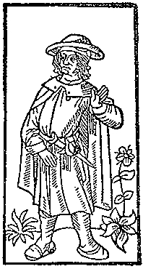
Sidebar: Brecht’s Hidden Inter-Texts and the Politics of Cribbing
“The Ballad of the Famous” (Scene 9)
Based on a ballad by the late medieval poet, François Villon (1431-c. 1463)…
Villon wrote mostly about men destined for the gallows, indulged in parody and lewd jokes; some of his poems use Parisian thieves' slang. His verse is mostly about his own life, a life of poverty and run-ins with the authorities…
Good choice by Brecht—another view of “Small people”?
German translation of Villon by K.L. Ammer (1879-1956) – Des Meisters Werk (1907)
Brecht basically plagiarized Ammer’s work in this ballad.
Ammer only got royalties after the ‘borrowings’ had been pointed out in reviews...
Woodcut illustration from Le Grand Testament
de Maistre François Villon (Paris, 1489)

Slide 19
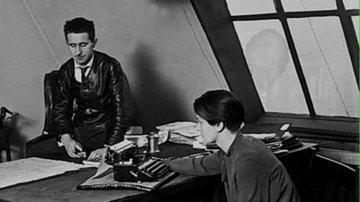
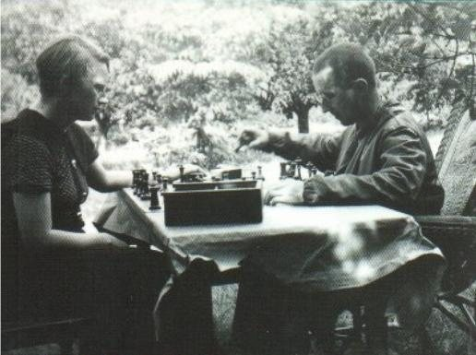
Brecht notoriously
used the work of many
authors under his
own name, most
prominently scenes and
songs written by his
lovers, Elisabeth
Hauptmann (1897-1973)
and Margarete Steffin
(1908-41), without giving
them credit…
Brecht and Elisabeth Hauptmann
Brecht and Margarete Steffin
We’ll return to Brecht as a person and canny individual in a few minutes.

Slide 20
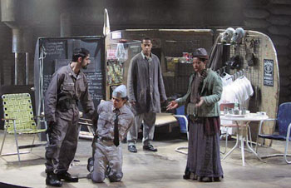
Back to Brecht’s thesis on the “virtues” as “fatal” in the world of war / Virtue #2: (Real) Honesty in Mother Courage and her Children -- The Case of Swiss Cheese
Swiss Cheese and the cash box (Scene Three)
Mother Courage: “They made you paymaster because you’re honest, you’re not brave like your brother, they like it that you’re too feeble-minded to get your mind around the idea of stealing it.” (p. 28)*
Swiss Cheese: “It’s the regimental cash box…It’s my responsibility.” (p. 37)
“Your conscientiousness is terrifying” (39).
The wages of honesty in the world of Mother Courage and her Children?
We know what happens to Swiss Cheese….
Mother Courage and her Children – Production
by the Classical Theater of Harlem (2004) –
Mother Courage: “Why should I know him?”
(p. 43)

Slide 21
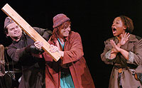
Virtue #3: Compassion in Mother Courage and her Children
Mother Courage: “You can’t be so kind, Kattrin” (Scene One, p. 16)
Later, she shows an act of kindness:
Stage directions: “Kattrin emerges from the rubble, carrying an infant.”
Mother Courage: “Oh what luck, who’s found herself another suckling to haul around? You give it back to its mother one-two-three before you get attached and I have to spend hours pulling it away, you hear me?” (Scene Six, p. 60)
Compassion as a viable value in this world?
Kattrin threatens Mother Courage (Scene Five,
p. 59) – Cal Poly Pomona production of Mother
Courage and her Children (2006)

Slide 22
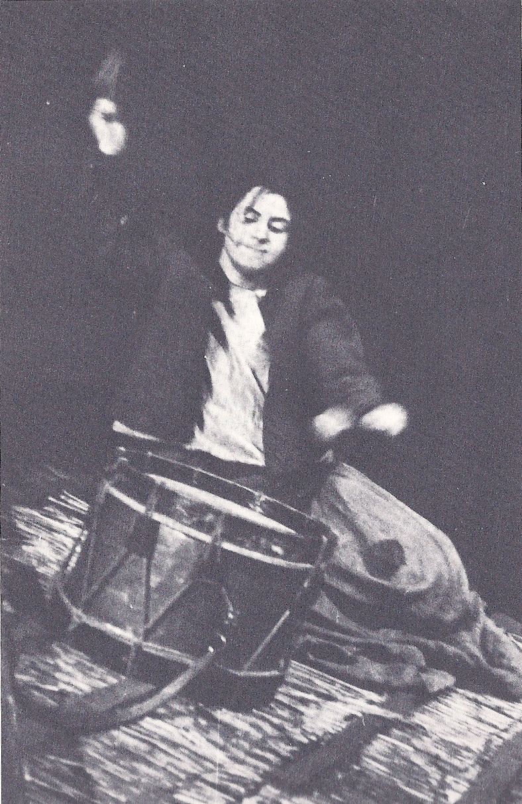
Doubling up the “Fatal Virtues”:
Kattrin’s Compassionate Heroism
Scene Eleven / The Attack on Halle
“The stone begins to speak” (p. 93) (NB: This line isn’t in the German original…!)
The Farmer’s Wife: “Remember her mother, Lord, who’s gone there…and protect my brother-in-law and the four kids my late sister’s left him…save the four kids who never did nothing wrong.” (p. 96) “Kattrin groans” (97) [NOTE: Be sure to read the stage directions for Kattrin!]
She is moved to action.
First Soldier: “Listen. It worked. She did it.” (p. 102)
Did it “work”? / What are the wages of compassion in the play?
Mother Courage and her Children /
Berlin production (1949) / Scene Eleven

Slide 23
Even in this scene, however, our compassion as spectators…
…is interrupted by Brecht via comedy… (we saw this last time as well when Courage/Streep defended her family but was “friendly”)
The Lieutenant (calling up to Kattrin): “You don’t believe him, you aren’t stupid, you know we’re not friends and anyway, who’d trust someone with a face like his?” (p. 99)
Look for how Carl Weber describes the additional “comedy” of this scene in the Berlin production of 1949 in the film, “Theater of War”…
Epic theater, alieation effect, breaking our identification.

Slide 24
To take stock of the argument for now: Where does being “virtuous” get you in this world?
The individual characters do what’s expected of them and yet find themselves caught in impossible positions.
That’s sad!
But, for Brecht, feeling sad isn’t enough….

Slide 25
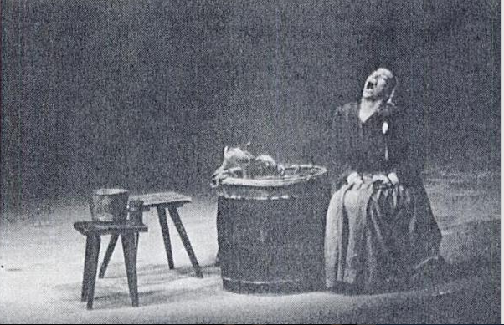
Virtue #4: Empathy in
Mother Courage and her Children
Brecht: “The scene with the drum [Scene Eleven] particularly stirred the spectators…Members of the audience may identify themselves with dumb Kattrin in this scene; they may get into her skin via empathy and enjoy feeling that they have the same latent strength...” (Couragemodell, 1949)
But does/should the audience have empathy with Mother Courage in the next scene (Scene Twelve)?
“The Lullaby” (p. 102)*
Undoubtedly a sad song/situation.
But it also reveals Mother Courage as a creature of her world—competitive, caring for her family, but at the expense of others. – And that destroys the family.
The Farmer points to her dilemma: “You had to go hunt for bargains….” (103).
EPIC THEATER—wants to break our empathy
Helene Weigel as Mother Courage /
Mother Courage and her Children /
Berlin production (1949)

Slide 26
These “virtues” are “fatal” in the play (sometimes they are not even “virtues”…) – and pointless…
Is the problem here one of individual virtuous actions?

Slide 27
The Individual’s “Despair”:
Mother Courage Caught between an Ethics of Care and a Politics of Self-Interest / Survival
We already saw how she looses Eilif over the sale of a buckle. But why does she want to make the sale? It’s her support of her family.
Mother Courage: “I don’t care if I’m ruined. At least two of my children survived the war, I saw to that.” (Scene Eight, p. 73)
vs.
“Peace is finished! The war’s been back on three whole days…Thank God!” (Scene Eight, p. 83)
In the play, Brecht leaves her “without any alternative”… (Couragemodell, 1949). But not because Brecht is mean….
She is to be a “warning” / “Courage has learnt nothing.” - (Brecht, Theater Work, 1952) – Recall the German clip on the 1949 production.
So that the audience can learn →(AGAIN) EPIC THEATER!

Slide 28
If the individuals act “virtuously” in this world of war as business (the “military industrial complex”), and their acts lead to tragic consequences, what are we to think?

Slide 29
Brecht is thus arguing that in a world in which the state and the military-industrial complex are in bed with one another (so to speak), individual actions are not enough…
There must be collective resistance to the conditions that enable war…
Or at least this is one of the theses of “Theater of War” (dir. Walter) (2008)…

Slide 30
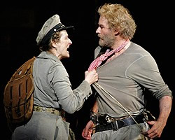
Pure Self-Interest: The Cook
Yvette: “The nastiest fish ever to wash up on the Flanders shore” (Scene Eight, p. 80)
Indeed…
The Cook: “[Y]ou can’t bring [Kattrin to Utrecht]…who’d want to look up from supper and see that waiting to clear the table?” (Scene Nine, p. 89)
But Brecht leaves him alone both on stage and in the world in the end… (p. 92)
The message?
Maybe in this world, such a person survives—also at a price.
Pedagogical theater, indeed!
Meryl Streep as Mother Courage / Kevin Kline
as The Cook / Mother Courage and her
Children / NYC production (2006)

Slide 31
What does Brecht want his AUDIENCE to think about Mother Courage’s agency / her “choices”?
Brecht does not want us to pity Mother Courage, or blame her.
Rather, he wants us to think about how and why she acts!
Of course he makes it difficult not to pity her at times.
Swiss Cheese’s death (Scene Three,pp. 43-52), esp. her denial of him.
Why does he die?
Her “haggling” (p. 51)? Why?
Brecht asks: Does she have to haggle? Does he have to die?
What are the “conditions of determination” under which he dies and Mother Courage acts and “despairs” (p. 50*)?
Brecht wants us to think about these conditions – and not just get swept up in her and our grief…
Mother Courage and her Children – Production
by the Classical Theater of Harlem (2004) –
Mother Courage: “Why should I know him?”
(p. 43)

Slide 32
Theater, thought, action
Recall the line from the soldiers at the end:
“You march in line, but never wonder,
How it began and where it ends.”
It’s precisely this position of not knowing about and therefore not being able to change the conditions under which we live that Brecht attacks with his theater.
He wants us, the audience, to see, understand, and act.

Slide 33
Epic Theater as
Pedagogical Theater
Actually, REVOLUTIONARY theater.
One of the goals of EPIC THEATER is to interrupt our pity, doing so by de-naturalizing the dramatic event going on on stage…
Helene Weigel (Brecht’s wife) as Mother Courage
(Berlin production, 1949)

Slide 34
So the audience can think about the role of the state, the role of the “military-industrial complex”…
…and think about its own role in the ‘making’ of un-natural worlds of war…
…and be provoked to “un-make” those worlds…

Slide 35
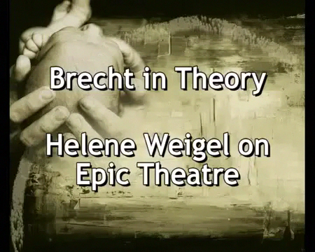
The World of the Play (vs. the World in the play):
The Audience Should Become a Collective of “Thinking Human Beings”…

Slide 36
The audience of the play should become a collective of “thinking human beings” by reflecting on – and “casting [their] vote” (Brecht on Theater, p. 39) on—the world in the play and on the values of this world…
“It’s got to stop!” (Brecht on Theater, p. 71)
One small problem…

Slide 37
Yes, it’s complicated…
Can we distance ourselves from the action? Are there aspects of the play and (some of) its productions, that make it difficult not to identify with the characters?

Slide 38
Epic theater in Translation / Un-realism and 21st-century Cussing
Tony Kushner’s English translation contains quite a bit of profanity…
Intensified even over Brecht’s profanity…
Cussing updated, made natural for us (2006).
The Young Soldier: In German: “Leck mich am Arsch” (Kiss my ass)→ Kushner’s version (Scene Four, p. 57*)?
Brecht’s German → → →
Brecht’s original German is a mix of
  Regional, southern German dialect (he was from southern Germany)
  Anglicisms (English-derived or -based words when there were perfectly good German words to use / “Fakt” for “Tatsache” (“fact”)
  Anti-metaphorical speech / concrete images
  Bureaucratic jargon
  Brecht’s “popular style seeks to imitate less the reality than the ‘idea’ of natural speech.” Something a bit artificial about it.

Slide 39
Is there a problem with making the language of the play sound more “real” / bringing it closer to us, even “flattening” it out?
Isn’t this exactly the opposite of Brecht’s epic theater?
How do different versions/productions produce different effects on the audiences?
This is something we’ll also consider next week when we discuss the film about the production.
But let’s consider three examples:

Slide 40
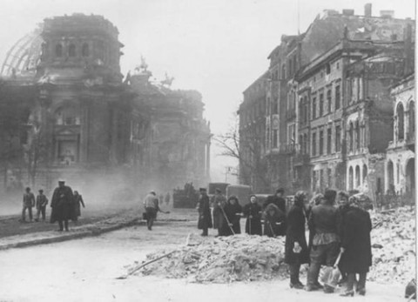
Also,
Does the Audience Always Learn?
1941 / 1949 /1950
The “conditions of determination” were different for the two different audiences (as they are for all audiences and agents…)
Zurich, Switzerland (1941) – Swiss neutrality, still during the war
Berlin,(East) Germany (1949) / four years after the Battle for Berlin
Munich, (West) Germany (1950) / five years as the economy is growing
These conditions are both material and psychological…
Berlin, Germany / May, 1945 / Streets
around the Reichstag

Slide 41
Brecht’s Response to the Audience’s Responses in 1941 (Zurich) / 1950 (Munich)
The Munich production appears to have elicited the same response…
The audience should ask: Why does she go back to war/“business”? Isn’t that war/business the problem?
But the audience didn’t.
So, in 1950, Brecht added the line: “I must get back into business” (Scene Twelve, p. 103) to interrupt and de-naturalize that audience response (hit them over the head).
AGAIN: “Courage has learnt nothing.” - (Brecht, Theaterarbeit, 1952)
“It sounds from the press notices and spectators’ reports as if the Zurich premiere, while attaining a high artistic level, simply represented a picture of war as a natural disaster, an unavoidable blow of fate…[and] Courage’s business activity, her keenness to get her cut…as ‘perfectly natural’…”
- Brecht, Theaterarbeit, 1952)

Slide 42
(East) Berlin, 1949
The Rape of Kattrin / Mother Courage: “No husband for her now” (Scene Six, pp. 68-70)
Brecht doesn’t play the scene for empathy.
But….
Mass Rape of German Women by Soviet soldiers in 1945 / Most widespread in Berlin…
The women in the 1949 audience would have remembered…
Caused (much to Brecht’s dismay) an intensely emotional reaction.

Slide 43
Your / Our Response to Brecht’s Response?
Heartless? Cold?
Yes, Brecht’s goal in his pedagogical theater was to make the audience members into “thinking human beings” who challenge the corrupting conditions of our world.
Ironically, he was also such a good playwright, that he could even undermine his own goal.

Slide 44
We’re not done yet, because I want to talk more about Brecht himself.
But, I’m done with my argument about my/Brecht’s thesis and the corollary I mentioned last time. I offered evidence of the world in the play as one of war and business and evidence of the way agency and values of individuals are corrupted by the conditions of the world. Thus, we need to change the world. (Though Brecht couldn’t always control the effects the play produces.)
Could you reformulate my thesis to bring out something else in the play? Could you provide other evidence? Could you find counter-evidence?

Slide 45
Brecht’s “Heroism”?
Surviving the War → Surviving the Peace

Slide 46
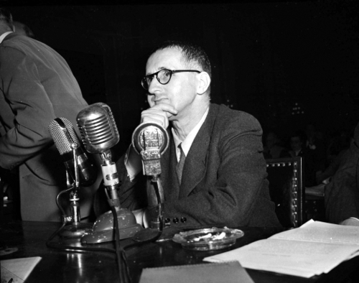
Brecht in the post-war U.S.
The Intellectual in the Face of Authority / Deceit and Deception /
Watching out for himself…
A committed Marxist, Brecht fled Hitler’s Germany for the U.S. (via Denmark , Sweden, Finland, Moscow) in 1933, arriving in U.S. in 1941…
Brecht then fled the U.S. the day after he is interrogated by the House Un-American Activities Committee (HUAC) in 1947 as a suspected Communist sympathizer
The Cold War-era McCarthy Hearings / Hollywood Blacklist hearings / The “Hollywood Ten” refuse to testify and go to jail. But he does testify. And denies that he was ever a communist…
He leaves the US THE NEXT DAY!
Brecht returns to Communist East Berlin, East Germany, via Austria and Switzerland, after 1949.
- Produces Mother Courage and her Children in 1949 partially to curry favor with the Communist East German government, that was suspicious about his political reliability…
Brecht testifying in front of HUAC, 1947

Slide 47
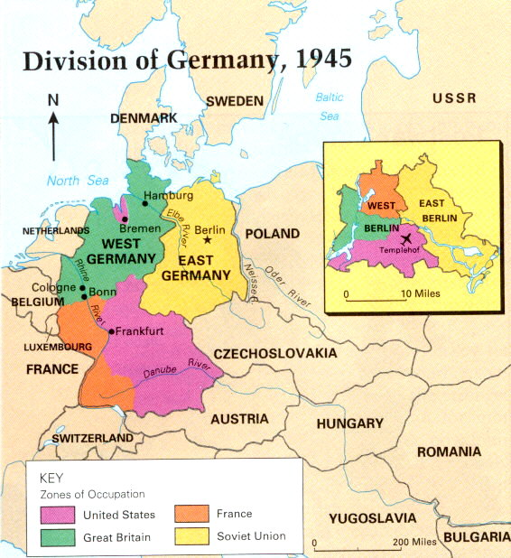
Two Germanies
(1945-1989)
- East Germany
(under Soviet
Russian
influence)
- West Germany
(under western
European /
NATO influence)
- The Fall of Berlin Wall:
9 November, 1989
(this Sunday is 15th
year celebration!)
- Reunification
(1989/90)

Slide 48
Both in the US in 1947, and then in the (communist) German Democratic Republic, Brecht was in a precarious position.
How does he respond?
Not unlike a modern picaro, a wily individual who has to learn to navigate dangerous situations.

Slide 49
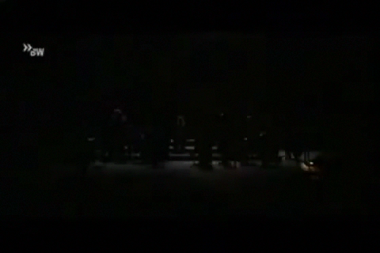
Brecht as “Simplicius” in the 1947 Cold War U.S.
The HUAC Hearings…
Deceit and / or Prudence?

Slide 50
Back in communist East Germany after 1949, he receives Austrian citizenship and keeps Swiss bank accounts and copyrights for his work.
He was both a canny commercial writer, but also seemed to be ready in case he needed to leave again.
Can we blame him, given what he had gone through?

Slide 51
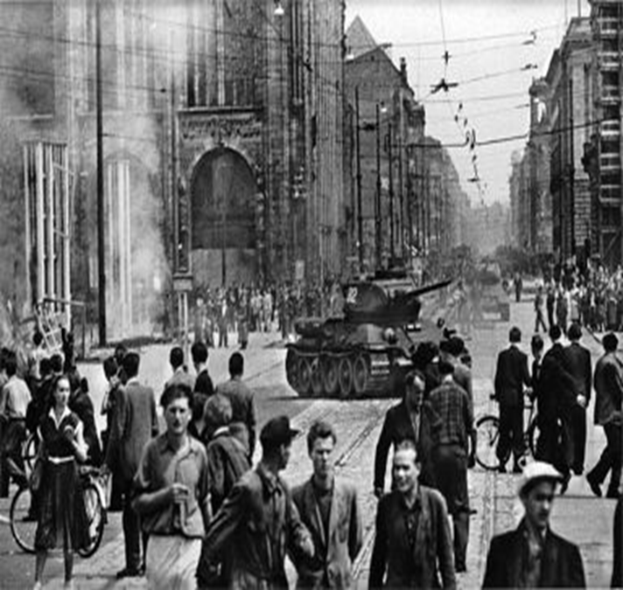
Fast forward six years / More Dissemblance?
Hero or Villain? Bertolt Brecht in Cold War East Berlin, East Germany /
Workers’ Uprising (June, 1953)
Popular uprising against the East German government because of increased work hours / quotas imposed by the central government under pressure from the Soviet Union
400,000 people demonstrated
150-1,000 casualties (still debated) as a result of the government’s crackdown.
Brecht publicly supports the crackdown of the regime!!!!

Slide 52
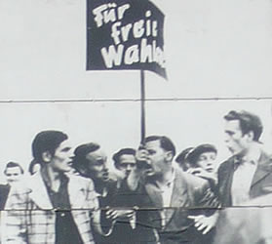
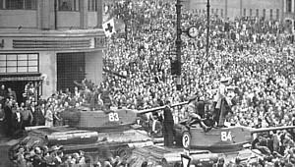
Brecht’s Reaction to the Workers’ Uprising, East Berlin, 1953 / Surviving the Post-War Peace…
Brecht:
"History will pay its respects to the revolutionary impatience of the Socialist Unity Party of Germany. The great discussion [exchange] with the masses about the speed of socialist construction will lead to a viewing and safeguarding of the socialist achievements. At this moment I must assure you of my allegiance to the Socialist Unity Party of Germany.“
- published in East German (state-run) newspaper, Neues Deutschland (New Germany) 1953
Did he mean it?
Still too risky – or too risky again in Germany, as it had been in the U.S. - to say the truth?

Slide 53
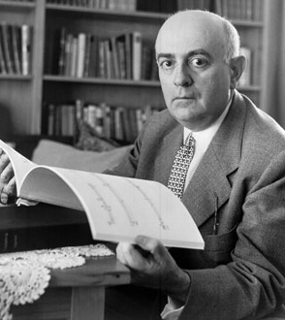
A fellow leftist intellectual (who also spent the war in Los Angeles), Theodor Adorno, called the Brecht who moved back to East Germany / East Berlin a “eulogist for complicity” who “championed” not an “imperfect socialism but a tyranny”
An intellectual traitor who had abandoned the very workers / “small people” for whom he claimed to speak?

Slide 54
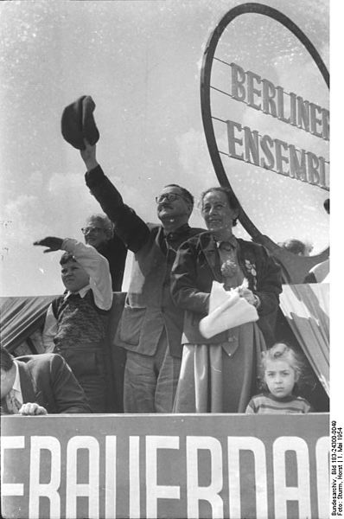
In his defense…
Brecht’s later (ironic) poetic commentary on the uprising…
“The Solution” (1953)
“After the uprising of the 17th of June
The Secretary of the Writers’ Union
Had leaflets distributed in the Stalinallee
Stating that the people
Had forfeited the confidence of the government
And could win it back only
By redoubled efforts. Would it not be easier
In that case for the government
To dissolve the people
And elect another?”
Brecht and Weigel on roof of Berliner Ensemble
theater on 1 May, 1954 (International Workers’ Day)

Slide 55
Was Brecht merely dedicated to the survival of his theater, the Berliner Ensemble, as an institution of Pedagogical / Epic Theater in the Post-War World that the East German government had allowed him to establish and that it supported?
Was he acting “virtuously” in a difficult world?
Was he trying to “stay in business”—the business of epic theater?

Slide 56
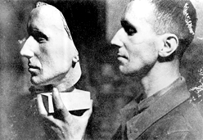
Brecht, like Simplicius and Mother Courage, also had to be a wily individual in dangerous times.
And though people are often divided over their sympathies for him as a person, we’ll see next time that his work does live on in our time of war.

Slide 57
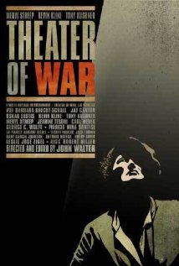
What’s ultimately interesting about the play and Brecht’s life, is that they turn out to be richer and more complex than can be expressed in a single thesis.
And that will be clearer when you watch the film for next week….

