Slide 1
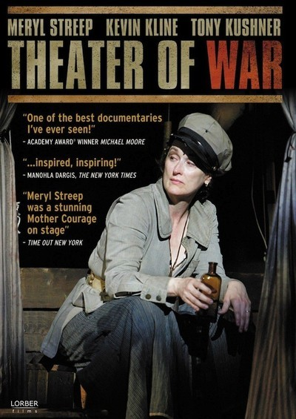
Theater of War
The “Essay Film”

Slide 2
First, the most hardest quiz ever on Mother Courage
Given what spectators see on the stage, they should (according to Brecht):
a) feel bad.
b) laugh.
c) think about the conditions under which the characters can act.

Slide 3
2. If, given the conditions, the characters’ values lead to fatal consequences, the audience (acc. to Brecht) should:
a) feel bad.
b) feel resigned.
c) think about how to change those conditions.

Slide 4
3. If the power structure is perverted, an individual under precarious conditions might:
a) resist heroically and suffer.
b) go along (be complicitous with evil powers).
c) find a way to survive in order to resist in another way.
d) all of the above.
3*--How did we see Brecht respond?

Slide 5
4. Given the options presented to individuals in the situation of question 3, the only real option (acc. to Brecht) is:
a) act collectively to change the conditions.
b) act collectively to change the conditions.
c) act collectively to change the conditions.
d) all of the above.

Slide 6
5. Mother Courage as epic theater can be
a) alienating for the audience.
b) moving.
c) pedagogical.
d) revolutionary.
e) not as effective as Brecht wanted.
f) all of the above depending on the production and context of performance.

Slide 7
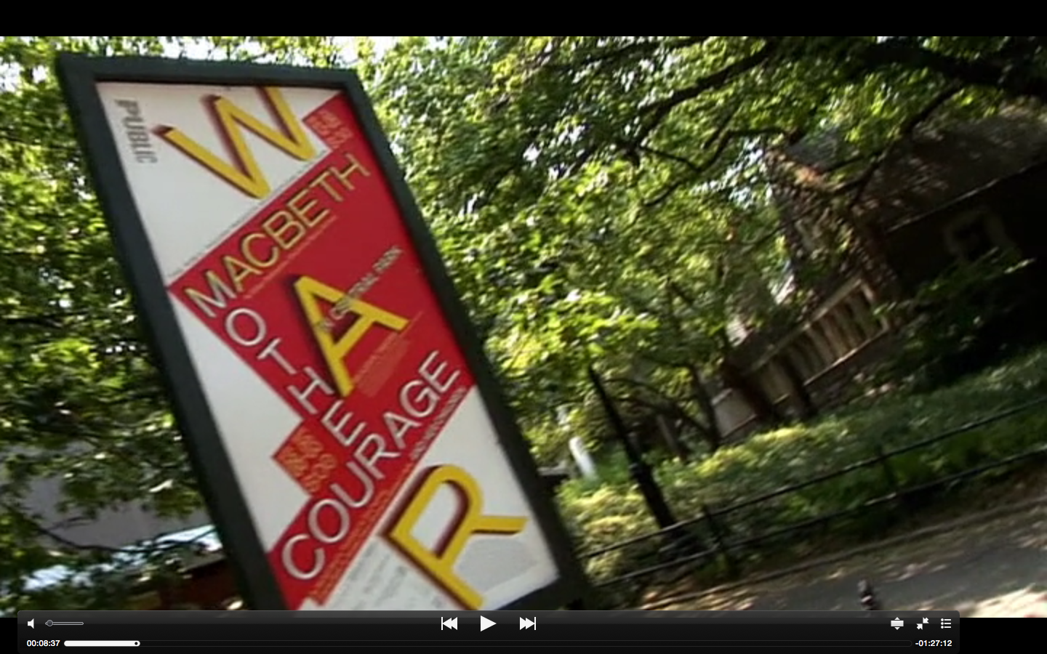
The answer to question 5 prepares us for the Theater of War as an “essay film,” assembled by the “guiding intelligence” of the director, to give us a multiplicity of contexts, interpretations, and possibilities for action for us to think about.

Slide 8
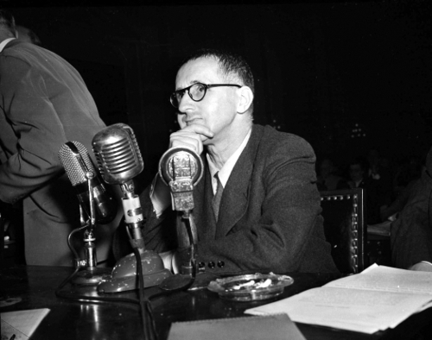
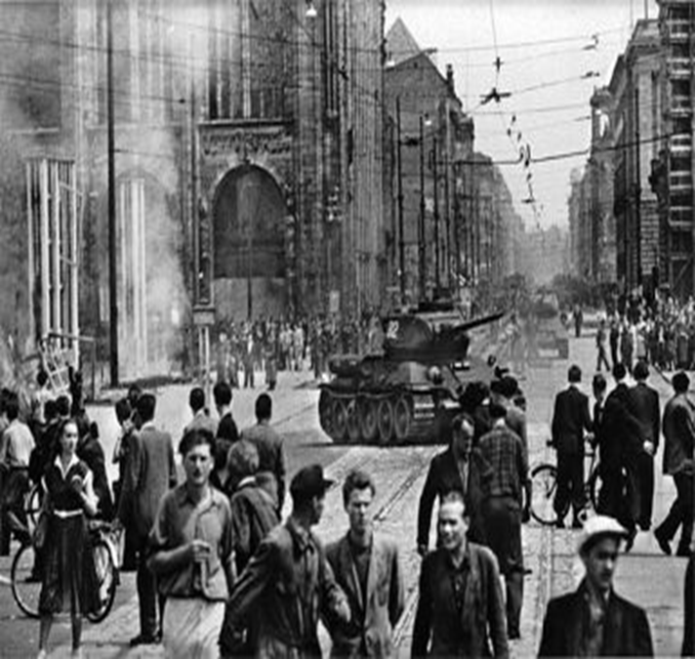
From last time: Brecht’s Agency
Brecht’s “epic theater” as a pedagogical theater
And thus also as political theater!
WE SAW: The political impact of epic theater – its power to make the audience into a collective of “thinking” and ACTING “human beings” off stage – may have been worth the apparently deceptive / devious behavior in which Brecht engaged – in 1947in the US and in 1953 and in East Germany…
Canny “performance” in his testimony (HUAC / 1947) …
And the letter to the newspaper supporting the regime.
Double-talk in the interest of continuing to produce “epic theater” in Berlin?
Brecht
testifying
In front of
HUAC / in
1947
Brecht’s response
to the 1953 workers’
uprising in East Berlin

Slide 9
That is:
Brecht’s “political theater” in 1947 (HUAC) and 1953 (East Berlin):
The individual (Brecht) performing “Simplician” Double-Talk as a Form of Not-Just-Personal Survival in the Post-war World
Brecht’s 1953 Letter to Neues Deutschland newspaper
"History will pay its respects to the revolutionary impatience of the Socialist Unity Party of Germany. The great discussion [exchange] with the masses about the speed of socialist construction will lead to a viewing and safeguarding of the socialist achievements. At this moment I must assure you of my allegiance to the Socialist Unity Party of Germany.“
- published in East German newspaper, Neues Deutschland (New Germany) 1953
Brecht’s 1953 Poem / “The Solution”
“After the uprising of the 17th of June
The Secretary of the Writers’ Union
Had leaflets distributed in the Stalinallee
Stating that the people
Had forfeited the confidence of the government
And could win it back only
By redoubled efforts. Would it not be easier
In that case for the government
To dissolve the people
And elect another?”

Slide 10
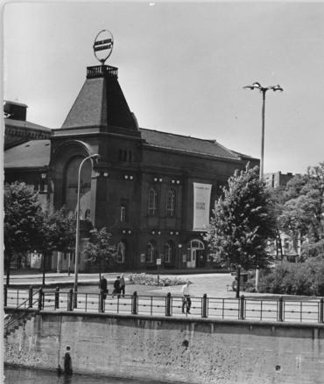
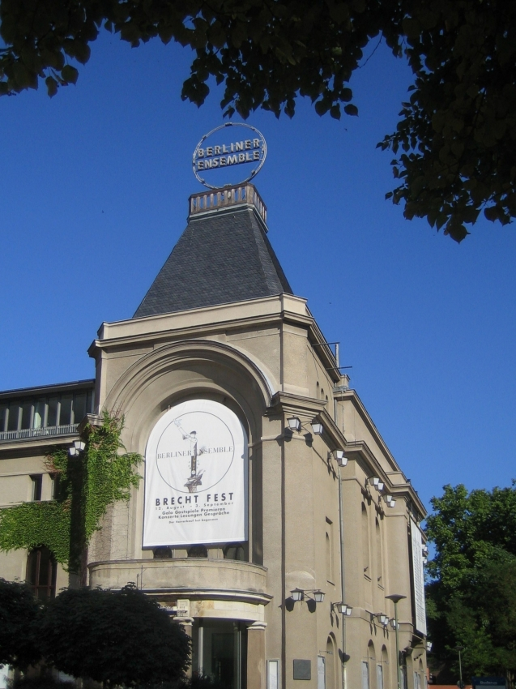
What was at stake?
The Survival of Brecht’s Theater →The Berliner Ensemble / Company established, with the support of the East German government, in 1949
Moved into Theater am Schiffbauerdamm in 1954, where it still is today!
Berliner Ensemble today
Theater am Schiffbauerdamm / 1964

Slide 11
MUTTER COURAGE UND IHRE KINDER von Bertolt Brecht
Musik: Paul Dessau
Mit: Carmen-Maja Antoni (Mutter Courage), Karla Sengteller(Doppelbesetzung Kattrin), Anna Graenzer (Kattrin), Gudrun Ritter (Die Bäuerin, Die Bauersfrau), Marko Schmidt (Der Soldat, Rufer, Der junge Bauer), Martin Seifert (Der Feldprediger), Veit Schubert (Der Feldwebel), Martin Schneider (Der Werber, Der alte Obrist, Erster Soldat, Fähnrich), Peter Miklusz (Schweizerkas),Axel Werner (Der General, Der Bauer),Michael Kinkel (Der mit der Binde, Soldat), Manfred Karge (Der Koch),Roman Kaminski (Der General, Der andere Feldwebel, Der Bauer; Der Feldprediger), Ursula Höpfner-Tabori(Yvette Pottier), Raphael Dwinger (Eilif)
Musiker: Matthias Erbe/Michael Yokas (Violine), Cathrin Pfeifer (Akkordeon), Silke Eberhard (Altsaxophon, Klarinette, Baßklarinette), Claudia Burckhardt (Gesang)
Inszenierung: Claus Peymann
Bühne: Frank Hänig
Kostüme: Maria-Elena Amos
Dramaturgie: Jutta Ferbers
Musikalische Leitung: Rainer Böhm
Dauer: 3 h (mit Pause)
05.11.2015 um 19:30 Uhr
17.11.2015 um 19:30 Uhr
03.01.2016 um 20:00 Uhr

Slide 12
From Week 5: Brecht’s “Epic Theater” (1930s-1950s) → Week 6: John Walter’s “Essay Film,” “Theater of War” (2008)
“We need a type of theater which not only releases the feelings, insights and impulses possible within the particular historical field of human relations in which the action takes place, but [also] employs and encourages those thoughts and feelings which help transform [that] field [of human relations] itself.”
- Brecht, Small Organon for Theater (1948 / 1949)
Where is political agency in the case of epic theater?
In the case of Mother Courage, the characters have agency, but given the corrupt nature of the world (“military industrial complex”) individual acts of virtue have tragic consequences.
Thus, ideally… → the play calls for agency off-stage = in the audience’s response in a directed way.

Slide 13
OUR QUESTIONS THIS WEEK (and next):
Where is – and what is – (political) agency in the “essay film”?
Our answer will be related to issues of genre and to what we are encouraged to think about.
2. What kind of history do we see in the essay film? Whose history? From which point of view? How is it “staged”?
(A continuation from Week 4)
3. Is the act of thinking critically about history itself a form of agency?
I am interested in the agency of the “cultural worker” (the playwright / poet / film maker / the student…)

Slide 14
In sum, we’re examining the relationship between art and politics, reflection and action, in our world…
…and the kind of political agency the artist, the actor, the playwright, the film-maker, the film audience, the professor, the student can have.

Slide 15
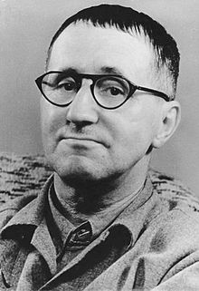
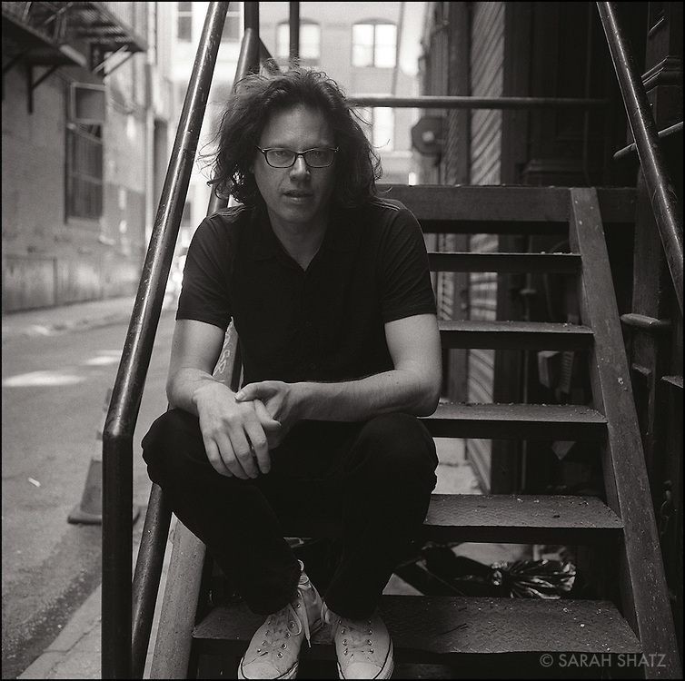
The Cultural Worker: From Brecht to Walter /
Is filmmaker / director John Walter difficult to see in this film?
→
Bertolt Brecht (1898-1956)
John Walter (b. 1961)

Slide 16
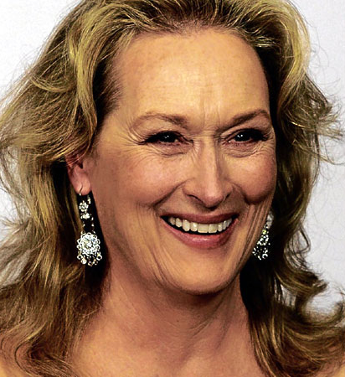
Yes! (1) because of of Star Power….
→
Bertolt Brecht
(1898-1956)
→
MERYL STREEP (b. 1949)
John Walter (b. 1961)

Slide 17
But also… (2)
The director seems to take the back seat to the “talking heads” and the performance(s) and history/histories presented in the film.
You might want to count/list the number of interviewees, performances, wars, demonstrations, etc. that are presented.
Nonetheless, ask: What holds them together?
What determines their order of presentation?

Slide 18
Thus, we have to pay special attention to Walter’s “shaping hand” in “Theater of War” (2008) / His “staging” in the film of “dialogues”
“Those protests were happening a couple of blocks away from the theater. We would shoot a rehearsal and then walk two or three blocks to Union Square, so they were happening on the street right outside the theater. I’d always imagined in the film that we’re watching what’s happening inside the theater and then we would go to the window and see what’s happening on the streets too.”
1. between the theater and the streets
- JOHN WALTER, “Interview,” Filmmaker Magazine (December, 2008)

Slide 19
Dialogues…
“I was trying to create a dialogue between the 21st century production and the 1949 production…”
2. between productions of Mother Courage and her Children (1949 → 2006)
- JOHN WALTER, “Interview,” Filmmaker Magazine (December, 2008)

Slide 20
Destruction of Berlin (WW2)
Vietnam War (1955-1975)
US Second Iraq War (2003)
Israel’s invasion of Lebanon (2006)
(among others)
3. between the “histories” (of war and the state) being told both in and by this essay film!

Slide 21
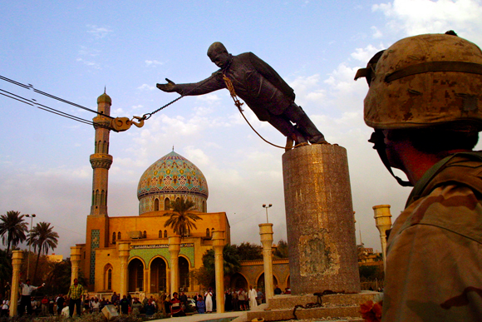
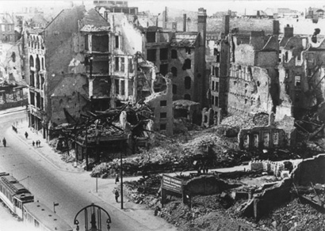
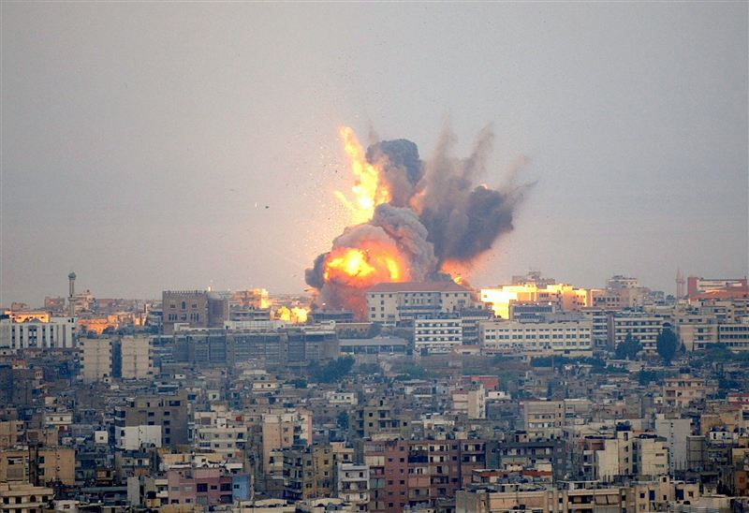
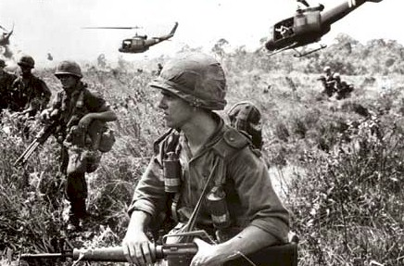

Slide 22
In sum…
I wanted a dialogue “between what’s going on inside the theater and outside the theater, between the ideas that influenced Brecht and Brecht influencing other artists, the balance between learning and entertaining. Also, for myself, I was wanting to explore what I could do as a filmmaker, how much I could fit into a movie.”
- JOHN WALTER, “Interview,” Filmmaker Magazine (December, 2008)
Keep this notion of Walter juggling/staging multiple dialogues in mind.

Slide 23
I referred to Theater of War as an “essay” film….
“What the heck is an ‘essay film’?”

Slide 24
From Stage Play → Cinema (Film / Movies)
An important shift in medium. The story and history will be “mediated” in a different way.
READ “Analyzing Film” (Kurt Buhanan) in HCC “Writer’s Handbook”!

Slide 25
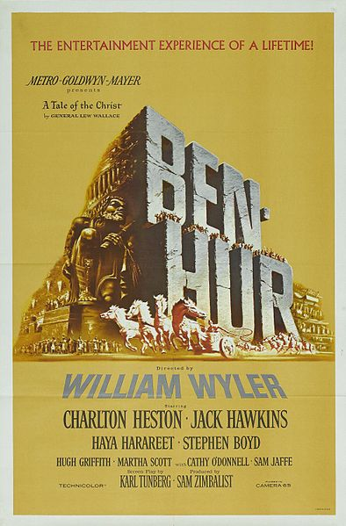
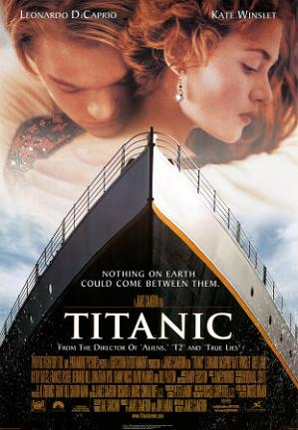
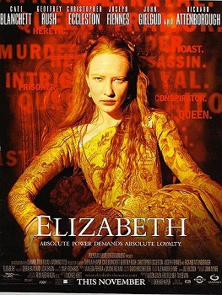

Film Genres #1
Just as there are different genres of literary texts (epic, elegy, picaresque, “epic theater”), there are different film genres…
You know them → action films, romantic comedies, science fiction, anime, the western, horror, noir, the musical…
There are also several “historical” film genres that “mediate” our access to the res gestae of the past as “story”…
“Epic historical drama” - “Ben Hur” (dir. Wyler) (1959)
“Epic romantic disaster” - “Titanic” (dir. Cameron) (1997)
“Biopic” – “Elizabeth” (dir. Kapur) (1998)
“Picaresque” – “Forrest Gump” (dir. Zemickis) (1994)

Slide 26
Film Genres #2
“Epic historical drama” / “Epic romantic disaster” / “Biopic”…
These are all forms of narrative cinema in which the events of the past unfold as story, as part of a coherent plot in which the characters act with clear motivation in a given context and in an apparently “realistic” way, “as if” this were really how these events played themselves
“Illusionism”
In these kinds of “history” films, history really does appear as story (usually dressed up in period dress, thus “costume drama”)
Mostly studio films / commercial feature films…
NOT “Brechtian”!

Slide 27
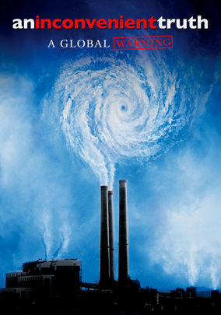


Another genre of “history” film → Documentary
Documentaries “aim to present factual information about the world”
Via direct filming of events / additional stagings of events / “charts, maps, and other visual aids”
In order to “take a stand, state an opinion, or advocate a solution to a problem”
(Bordwell and Thompson, Film Art)
“Facts” are re-presented from a specific point of view – both cinemagraphically and politically / ideologically!
They can still be debated, but generally there is a dominant point of view.
“An Inconvenient
Truth” (2006)
(dir. Guggenheim)
“The Cove” (2009)
(dir. Psihoyos)
“March of the Penguins”
(2005) (dir. Pacquet)

Slide 28
The “Essay Film” as History Film
Disclaimer: You can read an interview with John Walter about the making of his film, “Theater of War” here:
http://filmmakermagazine.com/1348-john-walter-theater-of-war/
His claims there (and in other interviews) notwithstanding…
And the Wikipedia article on “Theater of War” notwithstanding…
And Jay Cantor’s explanation to his students in “Theater of War” (2: 22 = 2 minutes, 22 seconds) and Streep’s reference to the film as a “documentary” (19: 31) notwithstanding…
I would situate this film – “Theater of War” – not just in the genre of documentary, but also in the genre of the “essay film”…

Slide 29
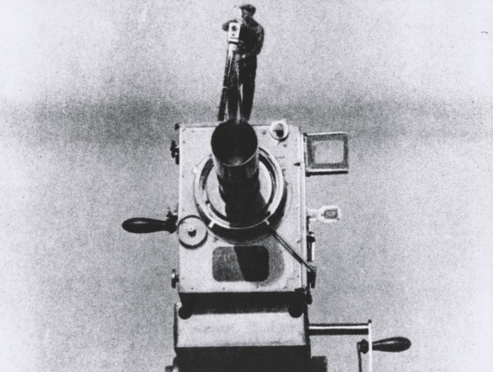
The “Essay Film”
A newly ‘invented’ film genre.
That has created its own canon out of films of the past…
“Elastic” and “porous” genre that is “cheerfully impure” and “poaches on the territory of other…forms of film”
It has its roots in Russian montage films: “random, yet concentrated” focus, with “forceful instruction”... (Brechtian epic theater also montage…)
“Man with a Movie Camera” (still)
(dir. Vertov) (1929)

Slide 30
Essay film vs. documentary
But the essay film is more “digressive” and “playful” and contains “multi-angled perspectives” (Andrew Tracy, “The Essay Film,” 2013)
Like documentaries, essay films are guided by a “directing intelligence” but here, by a “meandering intelligence that tries to multiply the entries…into the material it has elected” (Jean-Pierre Gorin)
Like documentaries, essay films are guided by a “directing intelligence” but here, by a “meandering intelligence that tries to multiply the entries…into the material it has elected” (Jean-Pierre Gorin)

Slide 31
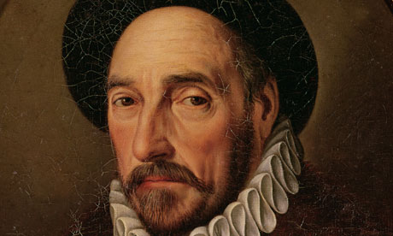
Sidebar: Michel de Montaigne, Essais
(Essays) (1580 / 1588)
One of the founders of the genre of the written “essay” understood in this way…
…is the 16th century French philosopher, Michel de Montaigne
One of my heroes…
His Essays are…
…a mix of serious intellectual reflection with numerous anecdotes...
…a mix of political, social, and philosophical observations…
Often prompted – and supplemented – by what he had read…
Usually a skeptical analysis of what Montaigne himself saw as men’s (and women’s) motivations for action in a difficult and complex world, a 16th century France consumed by Wars of Religion and political and class strife…
Montaigne’s own “directing intelligence” was the “mediator” of what he saw, read, analyzed, and assessed.
His Essays provided multiple “entries” into the issues of his day.
READ THEM SOME DAY!
Montaigne (1533-1592)
“I am myself the matter of my book.”
One of the “new individuals” of modernity.

Slide 32
An example: Scene 1 in the film
Last time we concentrated on the play on the stage. We’re still interested in that. But now we really want to see the way the film structures this moment.
Ultimately, it raises questions about the priority of any one interpretation.
Think not just about the alienation effects of the play but also about the techniques of the film.

Slide 33
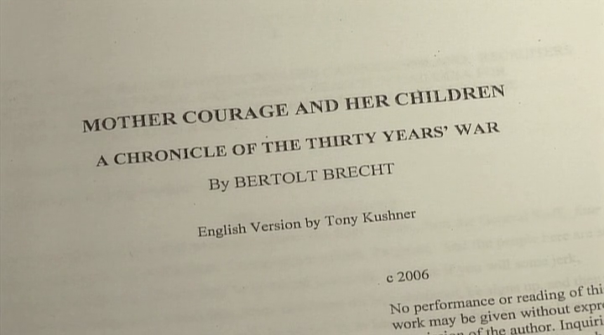
Scene 1

Slide 34
How is the film scene constructed?
Brecht’s “alienation effects”—actor speaking to audience, inconsistencies of tone and character….
The film’s “alienation effects”--jumping from rehearsal to performance, from one performance to another, from performance to talking heads.
“Montage”—more on this in a moment….
More Brechtian than Brecht? But to what end? Hold that question….

Slide 35
Let’s reflect on the title….
How so, “Theater of War”?
It means many things and signals the multiple things going on for us.

Slide 36
“Theater of War” → The area where military operations are “staged” on the ground
Weird overlap of theater vocabulary and words used to talk about the conduct of war.
Origins of phrase go back to Carl von Clausewitz (1780-1831), On War (posthumous, 1832).
More on this in the next lectures and quarter.

Slide 37
The content of the film is in large measure about wars that take place in different “theaters” around the world at different times.
War as theater fought on “stages”/ battlegrounds → Theater about war → Theater as war/politics

Slide 38
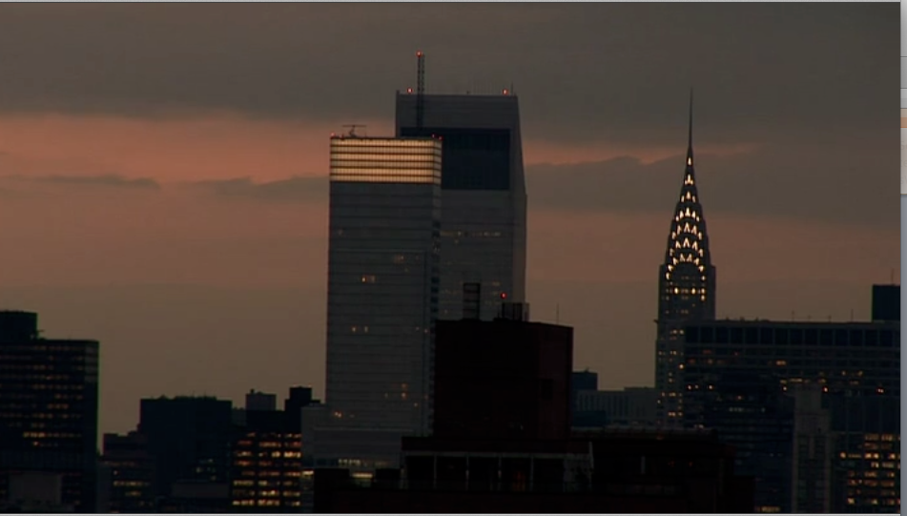
“The Theater of War” as seen through John Walter’s
“essayistic” eyes and his “directing intelligence”…
The Delacorte in NYC as a “theater” of war?
About the rehearsals and production of Tony Kushner’s new translation of Brecht’s war play, Mother Courage and her Children (1939), staged in NYC in the summer of 2006
But to reduce the film to just a “the-making-of” film would leave quite a bit of the movie unexamined…
And neglect both its “made-ness,” its “artifactuality,” and Walter’s “directing intelligence”…
And the multiple “entries” into its “material” that he models for us as ways of understanding history…
Jeanine Tesori (Composer) (47: 07)
“The cloak of fear lay over the city” / “The
actors were depleted” / the heat wave /
“We were on our own death march.”

Slide 39
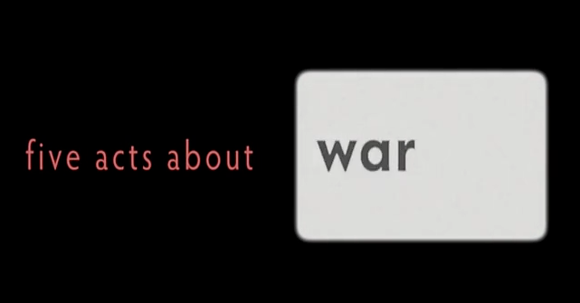
Walter’s film as “theater of war”?
Content: What the film is “about”
But what about its FORM?
Five Acts about…
War
History
Art
Politics
Brecht
Marx
Theater
Death
Performance

Slide 40
A Film in Five Acts—presented as a kind of theater
act 1: “Theater”
act 2: “Marx and Coca Cola”
act 3: “War Stories”
act 4: “In Search of Bertolt Brecht”
act 5: “The Triumph of Death”
What kind of “theater” is this film?
Is it a tragedy? A comedy?
Rising action? Resolution?
What is its shape? Is its shape its message?
(Hint: I think it is neither “traditional” nor “epic” theater. It is “essayistic.”)

Slide 41
So how does this film not just depict “theaters” of war but present and organize a cultural product about wars?
To see this film as a special kind of “theater” we need to “slow down” our viewing and concentrate on its how it is made.
Films are (obviously) made objects, artifacts. Attend to their made-ness. (And take a course in the Department of Film and Media Studies!)

Slide 42
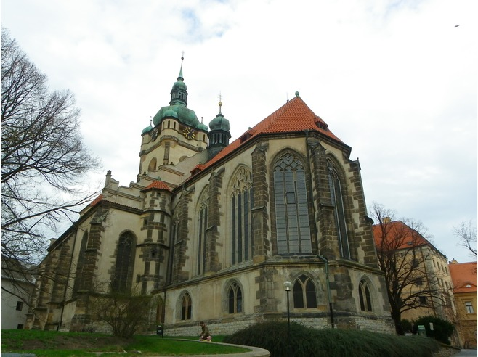
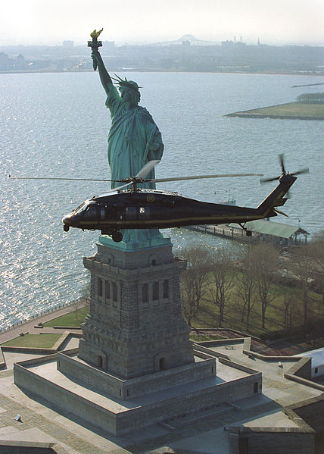
Slowing it Down
Which wars? / “Theater of War” (2008) as History?
The wars in historical sequence…
The Thirty Years’ War (1618-48) (Streep’s trip to Mēlník / Czech Republic)
WWII (1939-45) (Brecht / Carl Weber / archival footage of battles / Berlin in 1945 / The Holocaust)
The Cold War (1946-89) (HUAC hearings / FBI files on Brecht / archival footage of 1949 production / “Duck-and-cover” school drill for Jay Cantor
Viet Nam War (1955-75; U.S. troops deployed after 1965) (archival footage / anti-war protests)
The “War on Terror” (2001 - ) (helicopters over NYC)
Israeli-Lebanon (July) War (2006) (Protests / Kushner’s despair)
Iraq War (Second Gulf War) (2003-2011) (anti-war protests / “July 21, 2006”)
Church of St. Peter
and St. Paul (Mēlník,
Czech Republic) –
with Ossuary in
crypt
Bureau of
Immigration and
Customs
Enforcement
Office of Air and
Marine
Interdiction / NYC
(2003)

Slide 43
Are these wars actually presented sequentially in the film?

Slide 44
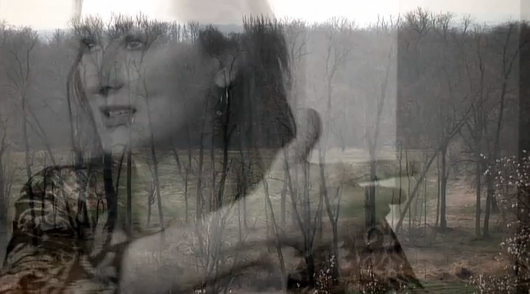
The Title Sequence: Montage of Wars

Slide 45
So, which wars appear in this sequence?
HOW are they presented?
In a rapid succession/juxtaposition.
What could be the message of this presentation of different scenes NOT in historical sequence?
Are all wars the same? / Is that the message?
Or are they all different? (color / black and white)
Brecht asked his audience to see the parallels between the Thirty Years’ War and WWII, and to respond in a concerted way.
Is this what Walter is asking his viewer to do?
Or is he offering different entries for us to think about possible ways to think about wars?

Slide 46
Walter presents the sequences of archival war footage using the “montage technique”…
Montage is the process of selecting, editing, and piecing together separate sections of film to form a continuous whole.
“A technique in film editing in which a series of short shots are edited into a sequence to condense space, time, and information.”
A relatively rapid succession of different shots. The juxtaposition of different images create a “third” idea for the viewer to experience.
Origins in the Soviet cinema of Sergei Eisenstein (1898-1948).
HERE the technique raises questions: Which wars? Which sequence? Black and white vs. color?
“Theater of War” (dir. Walter) ( 2008) –
Opening Titles / Montage Sequence

Slide 47
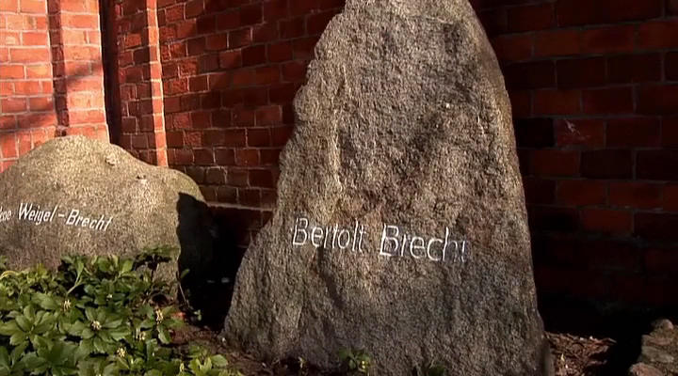
Editing as the Message!
What is the impact on the audience of this montage technique, especially in the “selecting” and “piecing together” of the montage sequences?
What does Meryl Streep see in this (endless?) sequence of wars? →
The “universality” of maternal suffering → the inevitability of war (“Over and over…”) That’s not Brechtian (to see war as inevitable)!
MY QUESTION: Does Walter want us to think about war the same way Streep does? Or does Streep offer just one “entry” into the material?
Montage is one way to introduce these questions. This scene comes juxtaposed with and played against others….
Streep’s final speech, “Theater of War”
(dir. Walter) (2008)

Slide 48
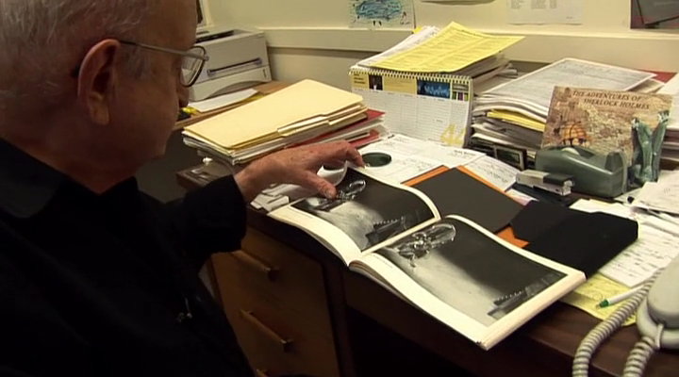
Montage also used by Brecht
(Carl Weber)

Slide 49
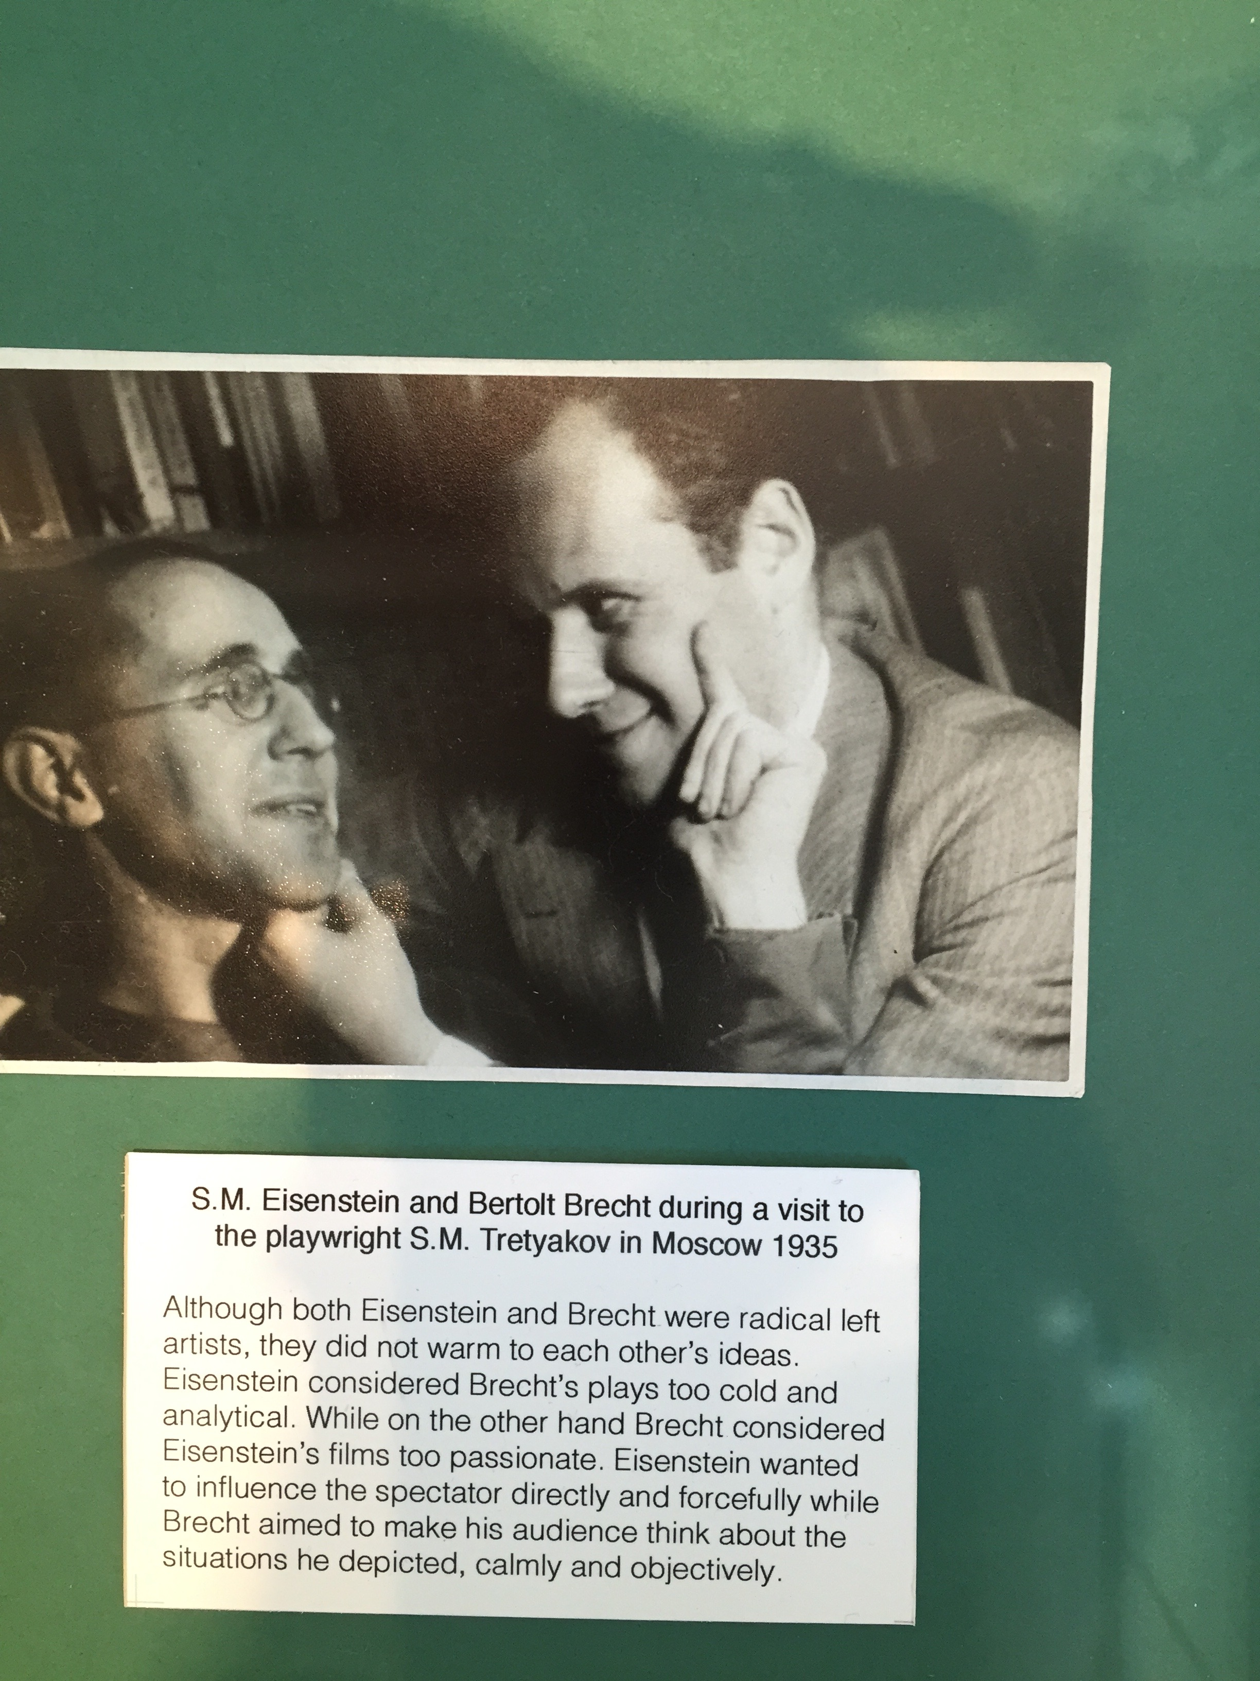
Picture of Brecht and Eisenstein from an exhibit at the City University of New York

Slide 50
In sum….
Walter uses the montage technique of the credit sequence (and in general) to offer the viewers different “entries and exits” to the question: Do we think of all wars as the same, or do we emphasize the differences? Is any one perspective the perspective of the film?
He does not answer that question for us.
He may be using a Brechtian technique to a different, perhaps non-Brechtian end.

Slide 51
From wars to witnesses….
In general: Does filmmaker Walter agree with the way his “witnesses” read Brecht’s play?
Does he ever state what he thinks?
How would we find his opinion?
Perhaps in the very juxtaposition of “talking heads.”
The very plurality of voices, orchestrated by Walter, is the point.

Slide 52
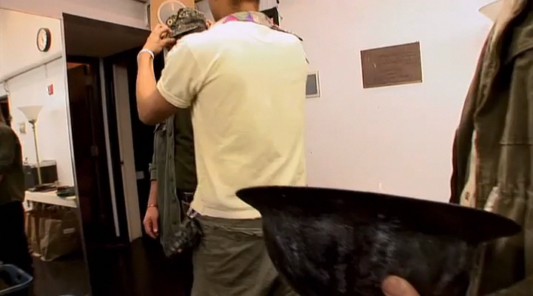
Look for Walter’s shaping hand….
Wolfe to Costume Designer, Marina Draghici: “We shouldn’t make any specific references” / “Fuse everything” (27: 35-38) →
Here again the “message” might be: “All wars are interchangeable” / “all the same”…
War is inevitable! (Recall Zurich, 1941)
Or is that just the position of this particular (stage) production in 2006?
Walter’s 2008 film may actually be saying this is just one way understand war.
The essay film tells multiple ways of telling the history of war.
Marina Draghici / Costume Designer / Mother
Courage and her Children (NYC production, 2006)

Slide 53
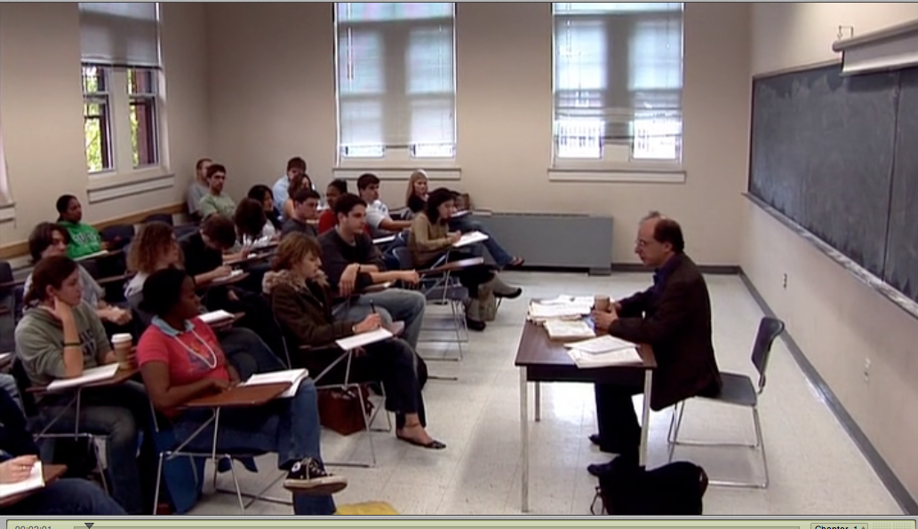
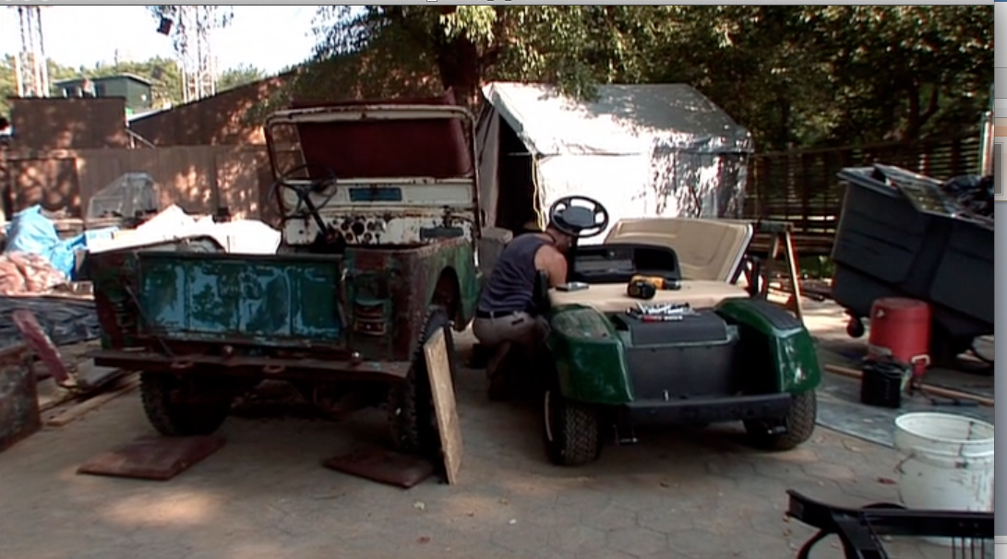
Teaching in and by “Theater of War” (2008)
act 2: “Marx and Coca Cola”
Jay Cantor—Novelist, teaches in the Department of English of Tufts University (Boston, MA)
Content of his teaching Marx. Class: “How you earn your living” / “What forces make the personality”
Literal teaching (Cantor in the classroom)
3. But the film also teaches us Marx; Marina Draghici (Costumes) and Jeremy Lydic (Props) embody labor theory of value in the world of the production of the play in 2006…
The scenes of teaching draw our attention figuratively to the kind of teaching that the essay film can do.
Understood this way, the essay film is “pedagogical,” but perhaps not like “epic theater.”

Slide 54
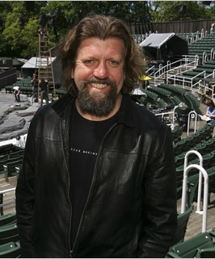
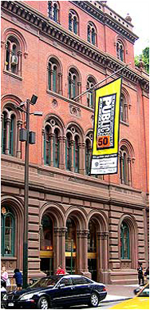
Public Theater as Teaching in “Theater of War”
Oskar Eustis (b. 1958) / Artistic Director / The Public Theater (NYC)
Walter films Eustis articulating a very strong interpretation of Brecht (via Marxism) “putting himself in the service of something much larger than himself…” (33: 01 - 35)
Eustis is channeling a certain almost “heroic” version of Brecht.
But there are others. Compare his version to the version we get in act 4: “In Search of Bertolt Brecht”…
What about the ambivalence of Brecht, his cunning “theater” before HUAC?
The film offers us many “entries” to teaching Brecht.

Slide 55
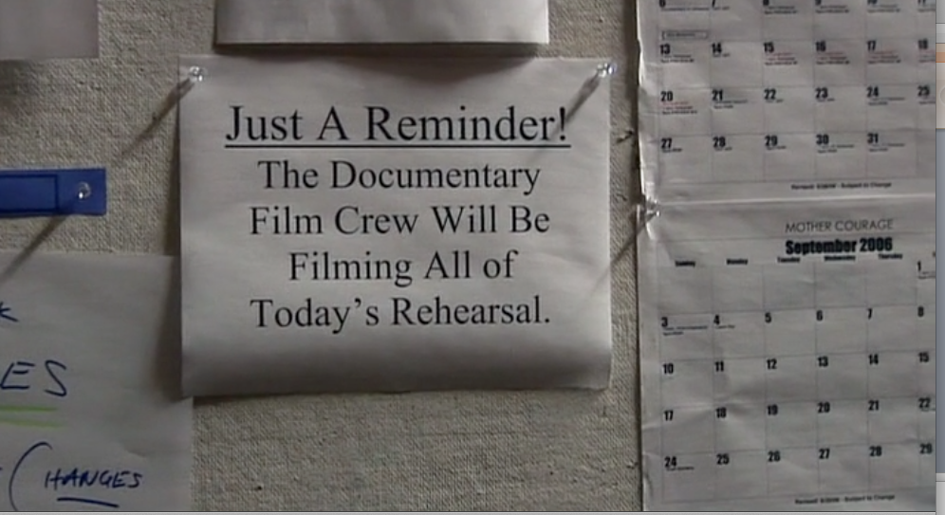
A THESIS about Jay Cantor’s Teaching, Oskar Eustis’ and the Public Theater’s Teaching, and the Teaching Done by the Essay Film, “Theater of War” (dir. Walter) (2008)…
By showing us so many versions of teaching, the “Theater of War” film wants us to know that the film is self-conscious about what it is doing.
It knows that it is “staging” history – “making” history as “story” – from a particular point of view in order to teach.
Part of the lesson the film wants us to learn is that we as individuals can undertake the project of understanding the multiple histories of war – and the re-presentations of the past – from different perspectives in our own world today.

Slide 56

The Humanities Core Course as “essay pedagogy”?
The “guiding intelligence” of the Director (Prof. Carol Burke) offers a number of possible approaches to teaching and learning (different lecturers, different section leaders, reading, writing, discussing) so that you can also reflect on teaching and learning.
And you have to write essays!

Slide 57
Each of us can attempt (“essay”) this understanding…
“Essayer” (French: to try)
The individual can/must “try” and understand him- or herself as embedded in the complexities of the history of war(s)…
Complexities that it may be the task of the cultural worker today to re-present in a particular way…
The “guiding intelligence” of the essay film and “essay classroom” presents these complex possibilities in all their complexity.

Slide 58
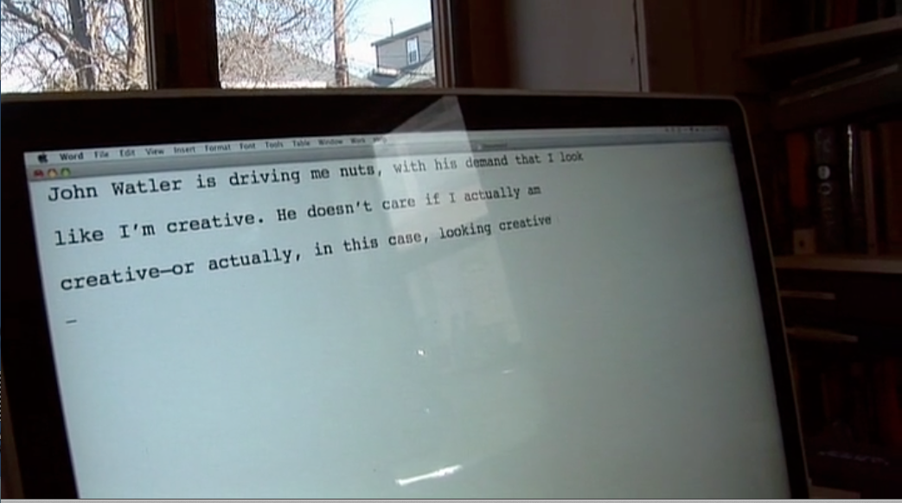
Think, then, about John Walter’s individual “mediating intelligence” as it is (in)visible in “Theater of War” (2008)…

Slide 59
Brecht was living through “dark, dark times” and in his art tried get the audience to think through an alternative position (collective action).
Walter’s (our) times may also be dark, but they are confusing in a different way. There are many options for understanding and acting.
The film help us work through possibilities, “multiple entries” to the material of war.

Slide 60
What kind of work do we as individuals do as we “try” to understand history and war as they are re-presented in different genres (in epics, picaresques, on stage, in the movies)?
How does Walter’s film model for us a certain kind of “humanistic inquiry” that we—we, here, in this room—are engaged in?

Slide 61
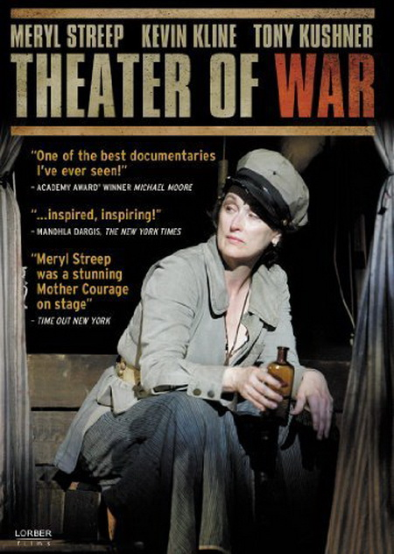
Questions…
Resisting War / Resisting the State: History as Repetition of the Same? / History as Change?
Whose History?
- Whose Brecht?
- Black-and-White vs. Color and the Authority of “Talking Heads”
The Agency of the Cultural Worker in Times of War: Brecht, Streep, Kushner, and Walter
The Essay Film: Pathos, Humanistic Inquiry, and Understanding War

