Slide 1
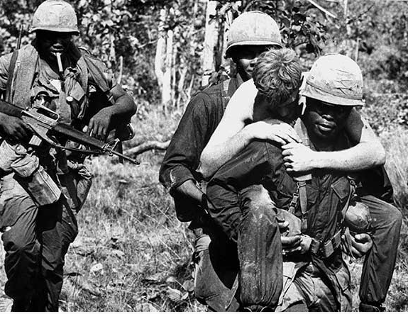
Lecture Three
A Brief History of the Vietnam War
Context for a Discussion of the Returning Soldier

Slide 2
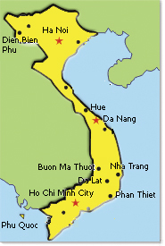
Vietnam War Facts
World War II backdrop
July, 1945 – the Germans are defeated
August, 1945 – the Japanese surrender and remove troops from Vietnam
September 2, 1945 – Declaration of Independence
September 22, 1945 – Colonial French troops
reasserted their control of Vietnam beginning
the First Indochina War
1954 – French defeated at the battle of Dien Bien Phu.
That same year, at a conference in Geneva, the
country divided into North Vietnam and
South Vietnam with a demilitarized
zone in between

Slide 3
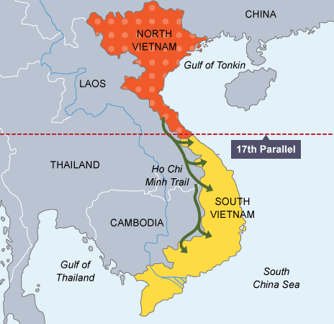
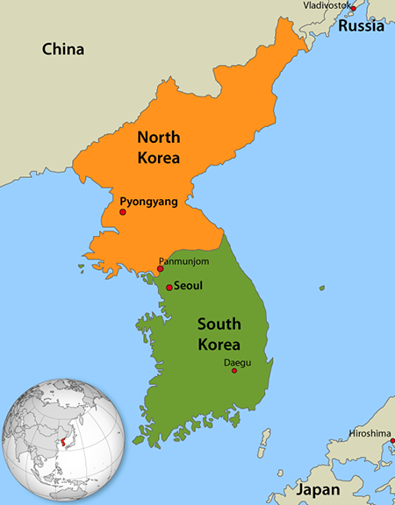

Slide 4
American involvement
1956 – 64 “Advisory Period of the War”
1965 – 1975
2.7 million Americans served in Vietnam (25% were draftees—in WWII it was 65%)
3.5 million Americans served in the greater S E Asian theater (Vietnam, Cambodia, Laos and Thailand)
North Vietnam – backed by China and the Soviet Union
South Vietnam – by America (joined by forces from Australia, New Zealand, Korea, Philippines, and Spain)
(http://www.va.gov/opa/publications/factsheets/fs_americas_wars.pdf)

Slide 5
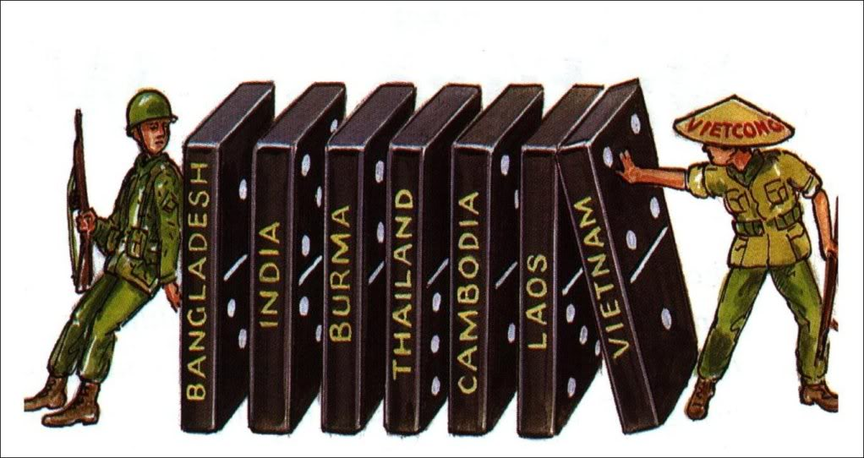
“domino theory”

Slide 6
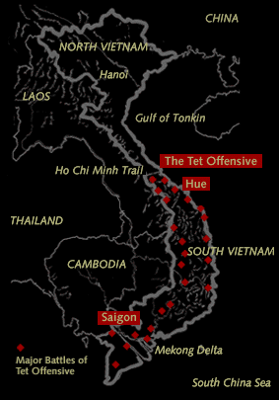
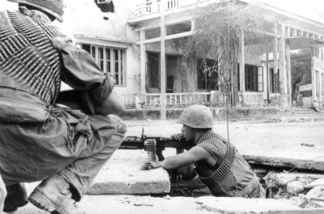
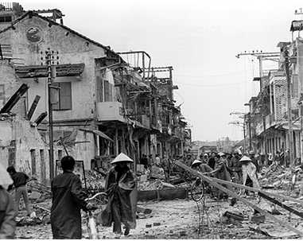
Tet Offensive, 1968

Slide 7
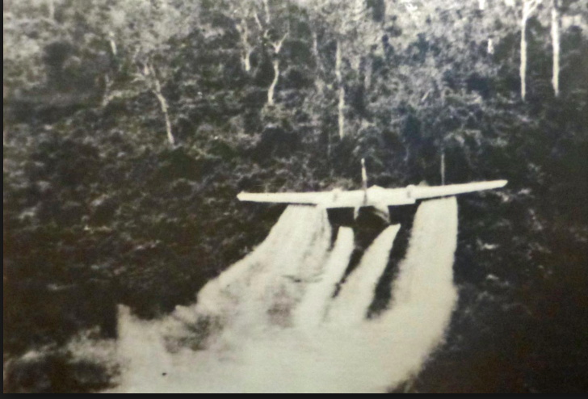
When it was all over….
58,202 American soldiers killed
2-3 million Vietnamese killed
6.7 million tons of ordnance dropped on Indochina
2.5 million tons on neighboring Laos alone
(compare with WWII – 1.6 million tons dropped by American planes)
3.5 million acres sprayed with 19 million gallons of defoliants

Slide 8
140,000 Vietnamese evacuated in April 1975. That number escalated in the 2 decades following the war to 2 million.
(http://www.va.gov/opa/publications/factsheets/fs_americas_wars.pdf)

Slide 9
What story do we tell about this war?
What kind of war was it? What do we call it? The Vietnam War, the Second Indochina War, the War in Southeast Asia that extended into Laos, Cambodia, and Thailand, or the American War.
A proxy war between the Soviet Union and the U.S.
A war not of controlling territory but of body counts.
Even within that proxy war, we were fighting two kinds of wars: a conventional ground and air war and a counterinsurgency—a war to win “the hearts and minds” of the Vietnamese
An extension of a war of independence—first against the French, then against the U.S. occupiers
North was fighting for a unified country; the south to maintain its independence as the Republic of Vietnam
A war to demonstrate new weapons of war: cluster bombs, napalm, Agent Orange

Slide 10
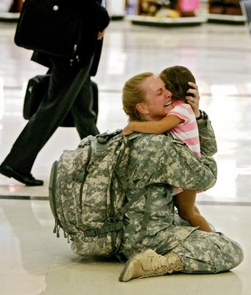
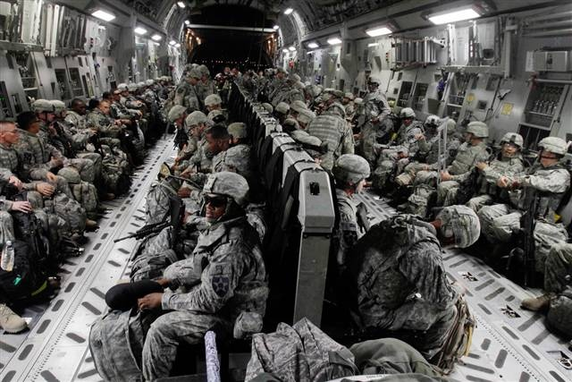
Coming Home

Slide 11
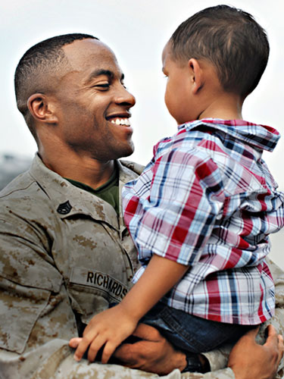
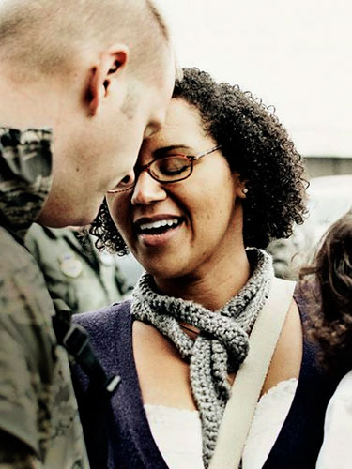
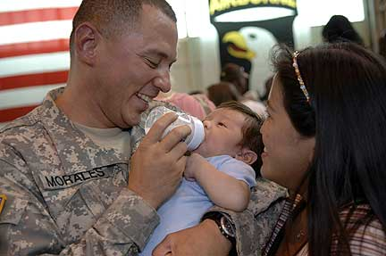
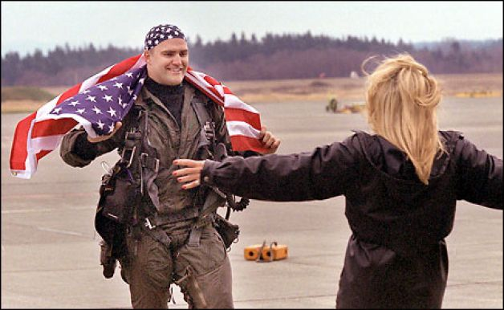
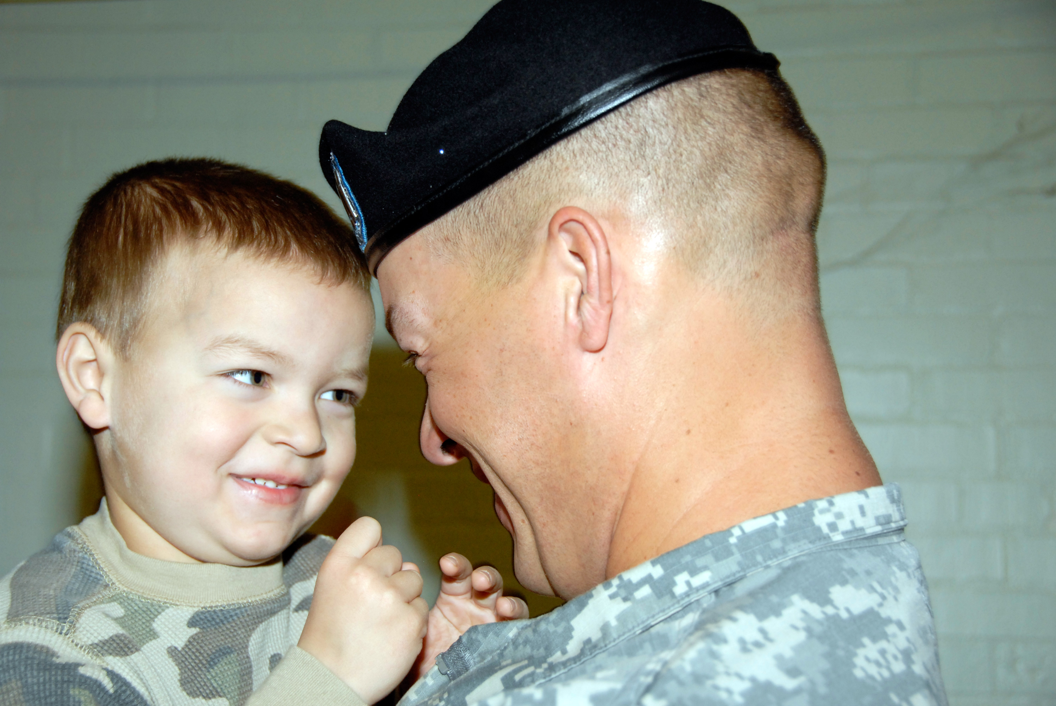

Slide 12
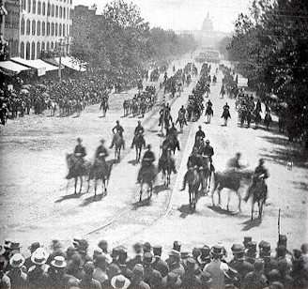
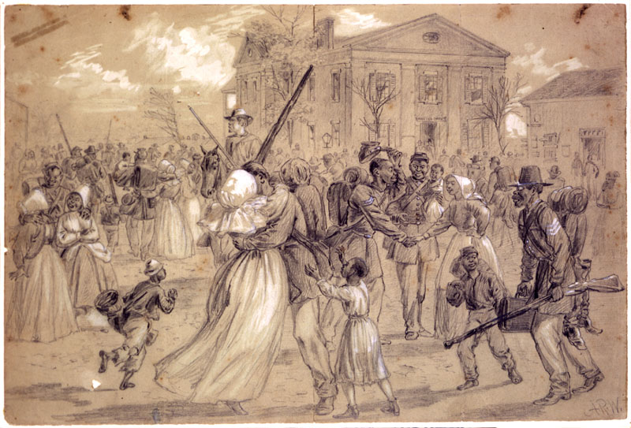
Civil War Soldiers Return
618,222 died

Slide 13
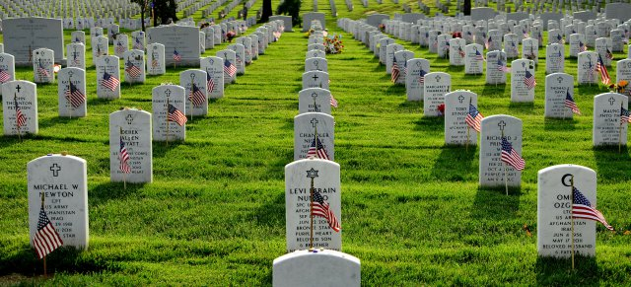
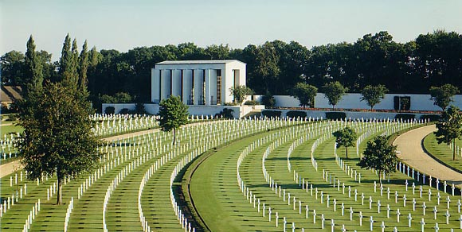
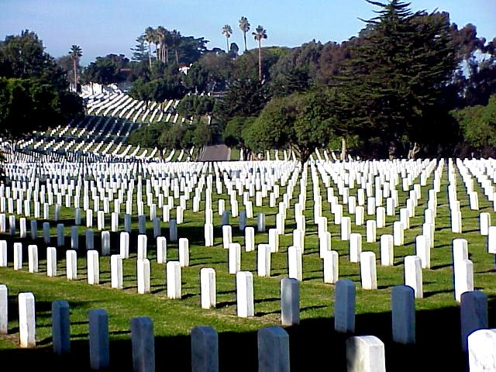
National Cemeteries were designed and built to honor the dead.
Arlington
Cambridge, UK
San Diego

Slide 14












Handful of the over 150 Religious/belief Signs that can appear on headstones today.

Slide 15
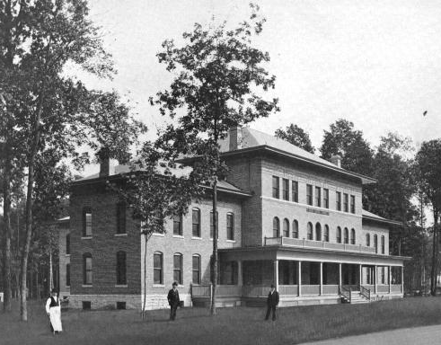
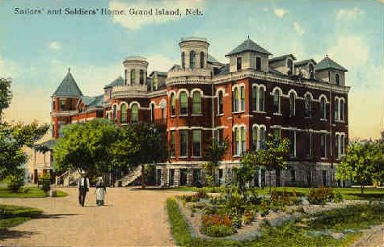
Old Soldiers’ Homes: Although individual states built homes for veterans who could not be taken care of at home before the Civil War, the federal government takes over many of these after the war.

Slide 16
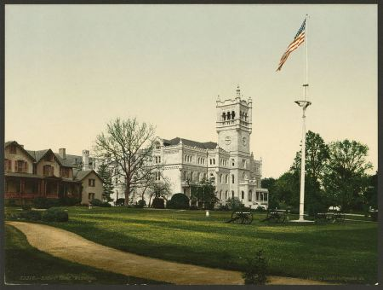
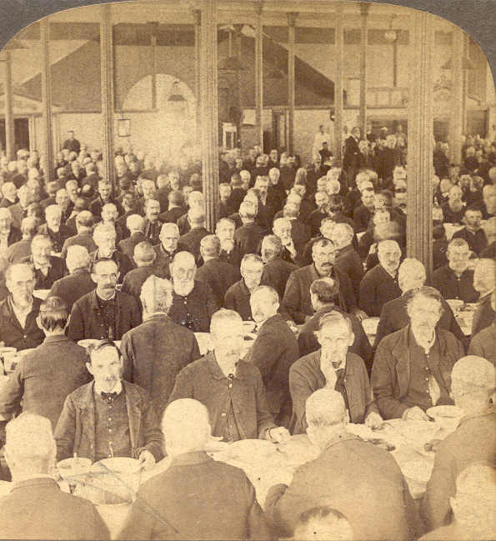
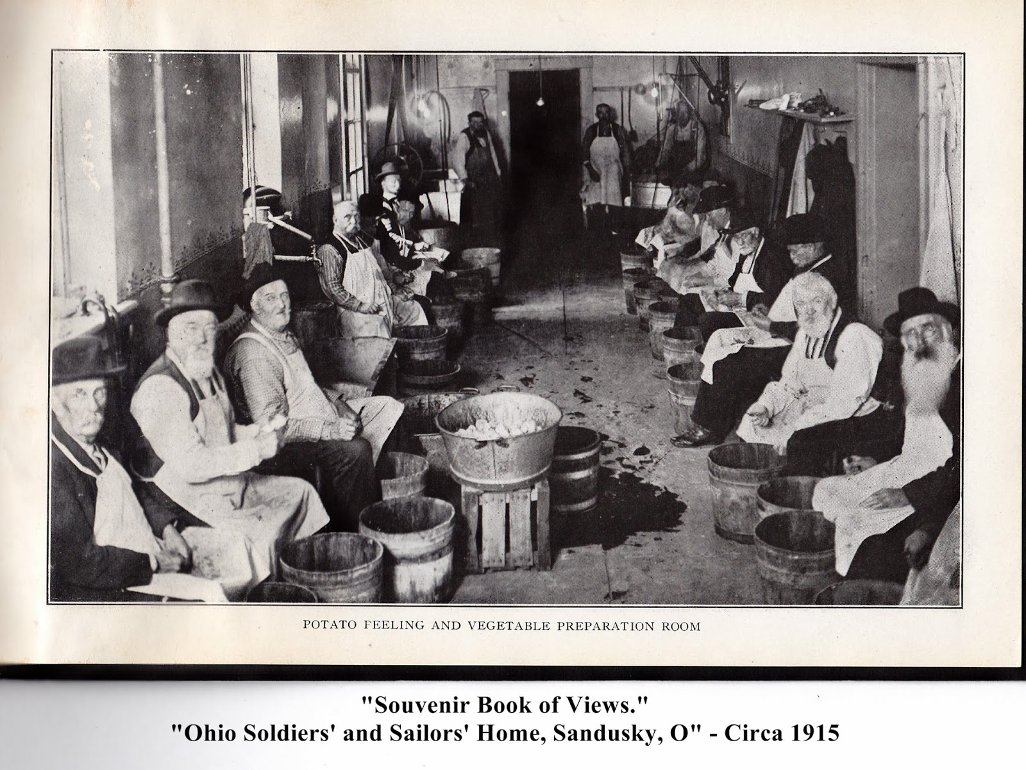

Slide 17
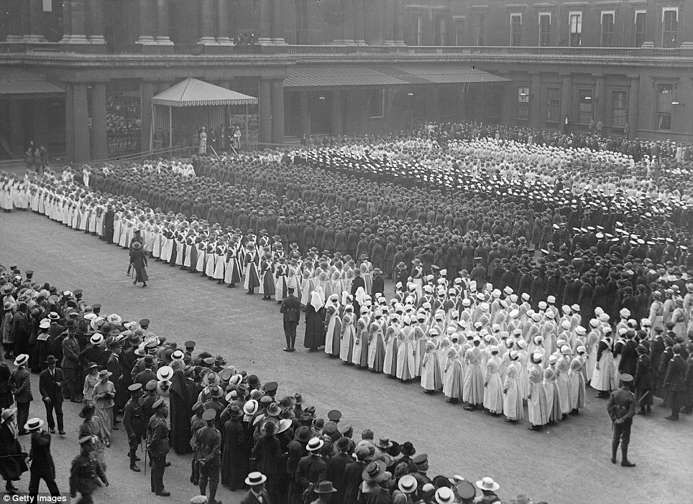
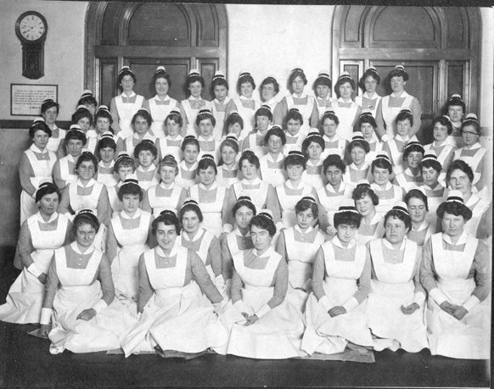

Slide 18
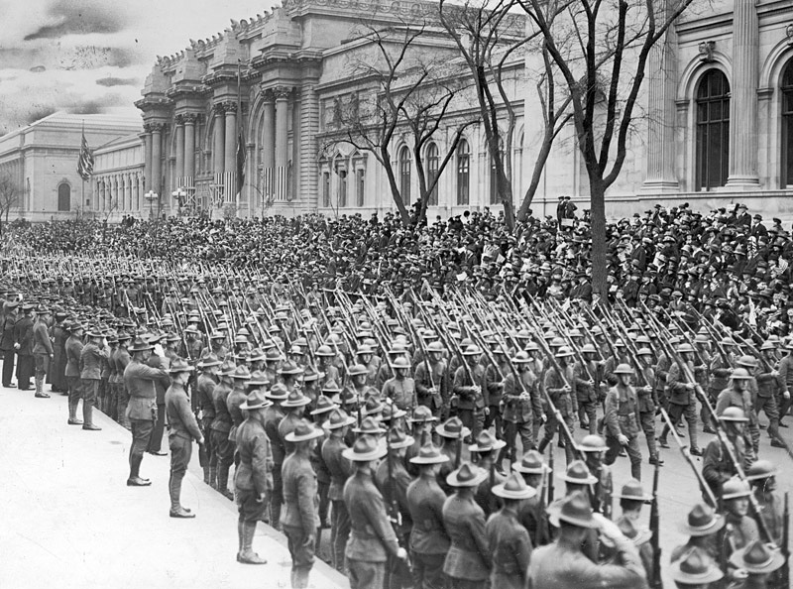

Slide 19

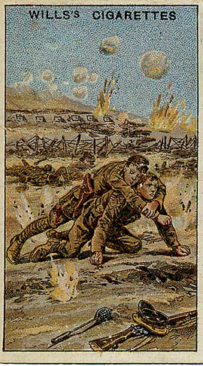
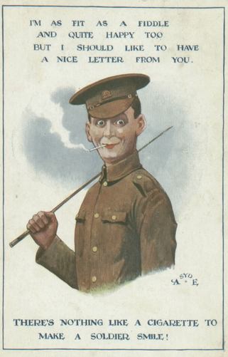

Slide 20
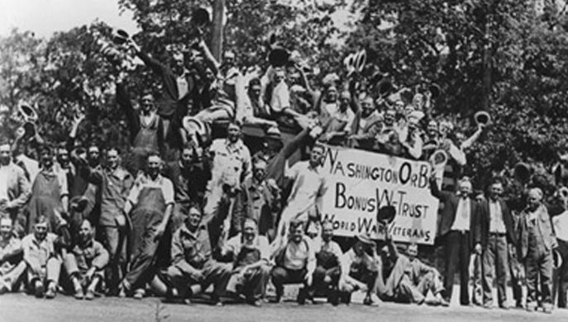
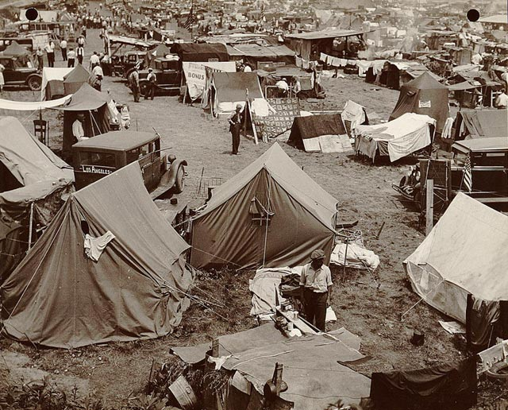
1932, WWI vets gathering in D.C. to demand promised bonuses
They came as far away as the West Coast
Set up their tents, some brought families
20,000 veterans camped out + 20,000 family members and supporters

Slide 21
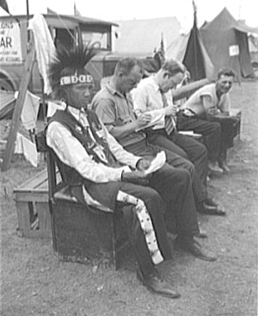
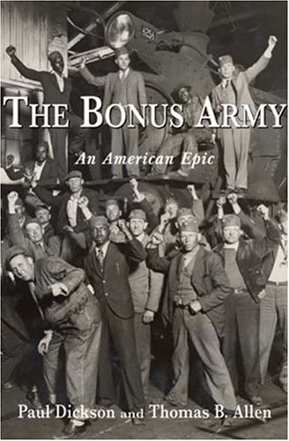
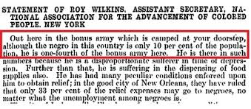
They included representative of all groups who had served.
From Nebraska
From the Baltimore Sun, July, 1932

Slide 22
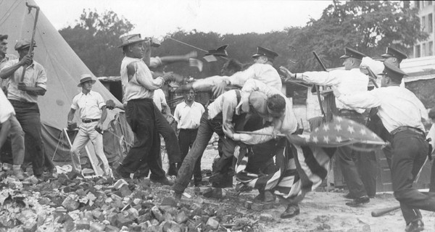
The end of the Occupation, July 29, 1932

Slide 23
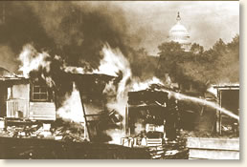
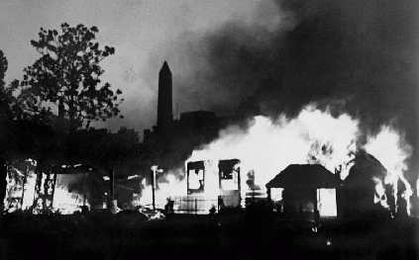
America’s war heroes were being tear-gassed within sight of the nation’s capitol building.

Slide 24
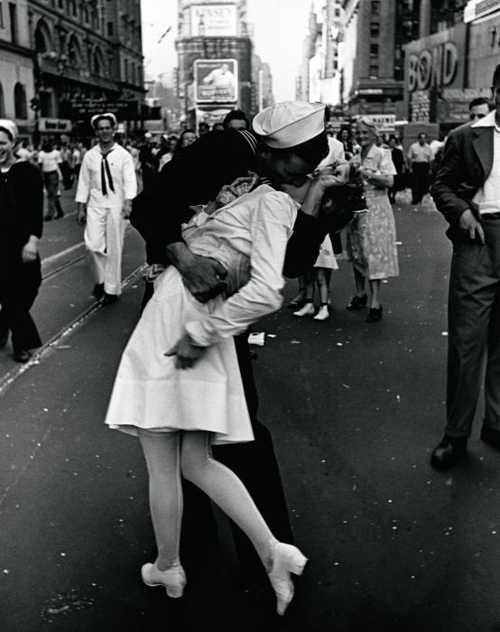
World War II Veterans
12 Million returned from overseas
Returned to a booming economy
To a GI bill to pay for full tuition and living expenses as well as low interest mortgages
College campuses filled over night
Many returned changed.

Slide 25
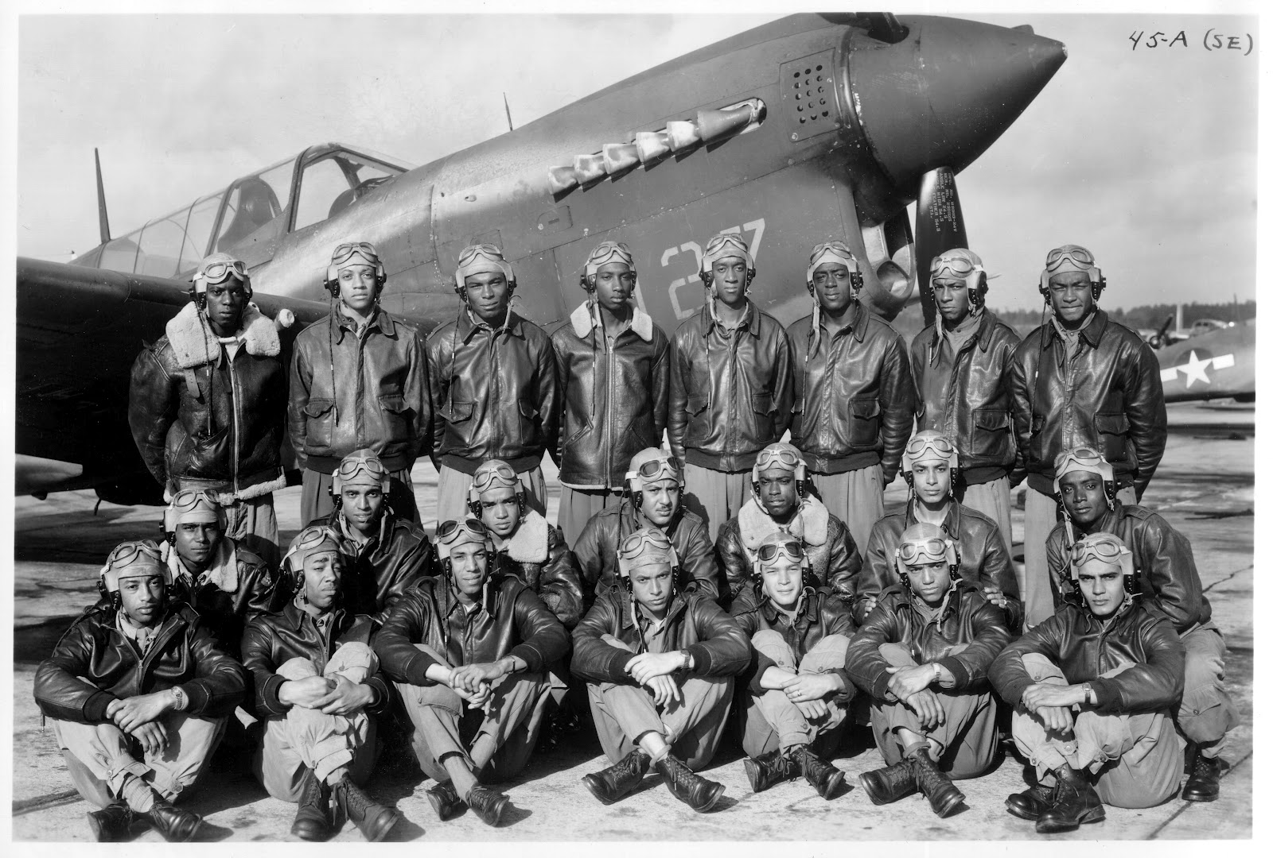
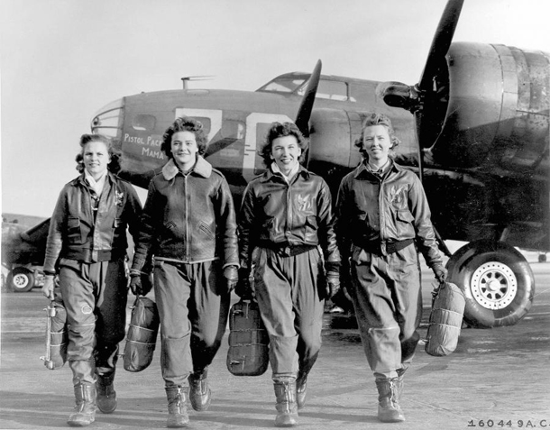
For others, the economic prospects were not so sunny.
Tuskeegee Airmen had one of the most successful flying records in WWII
No African American pilot was allowed to fly commercially for 20 years after the end of the war.
The U.S. military not officially integrated till 1948.
Women pilots flew as trainers stateside.
Not till 1973, would the first female pilot be hired by a commercial airline.
Women were expected to return to the home and hearth after the war.

Slide 26
As you think about the returning veteran……
Think about his or her expectations
Think about what others expect of the veteran
Consider the challenges that some veterans face upon their return
Think about the differences between life stateside and life in a combat zone
Ask what a fairy tale (“Bearskin”) might have to tell us about the returning soldier.

