Slide 1
Coming Home
Part II
Lecture 4

Slide 2
Today’s lecture
Will conclude our discussion of the soldier’s return after war or after deployment.
As I highlight issues related to that return, please keep in mind the two portraits of the returning veteran offered in the film Coming Home:
  The enlisted Marine, Luke Martin
  The Marine officer, Bob Hyde
  Ask yourselves which character might illustrate the issues that I will cover: a) the veteran discovering political power, b) the visible wounds of war, c) the invisible wounds of war, and d) challenges to military masculinity

Slide 3
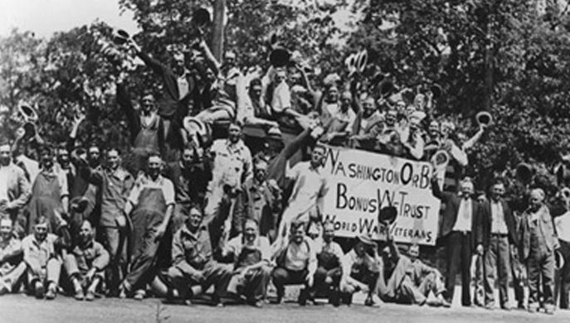
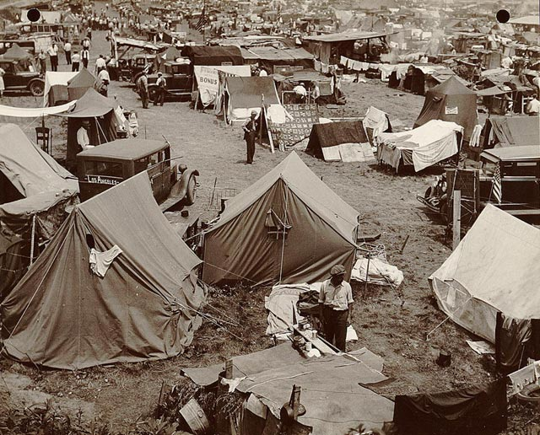
1932, WWI vets gathering in D.C. to demand promised bonuses
They came as far away as the West Coast
Set up their tents, some brought families
20,000 veterans camped out + 20,000 family members and supporters

Slide 4
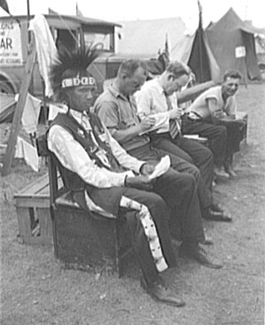
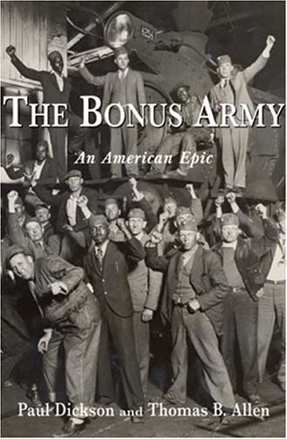
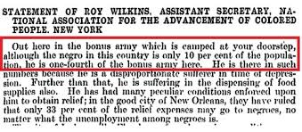
They included representative of all groups who had served.
From Nebraska
From the Baltimore Sun, July, 1932

Slide 5
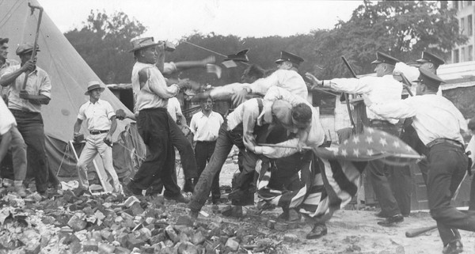
The end of the Occupation, July 29, 1932

Slide 6
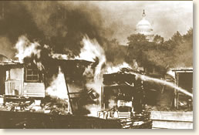
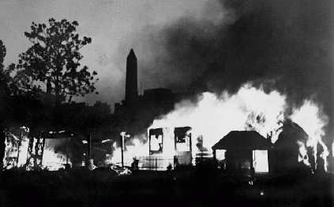
America’s war heroes were being tear-gassed within sight of the nation’s capitol building.

Slide 7
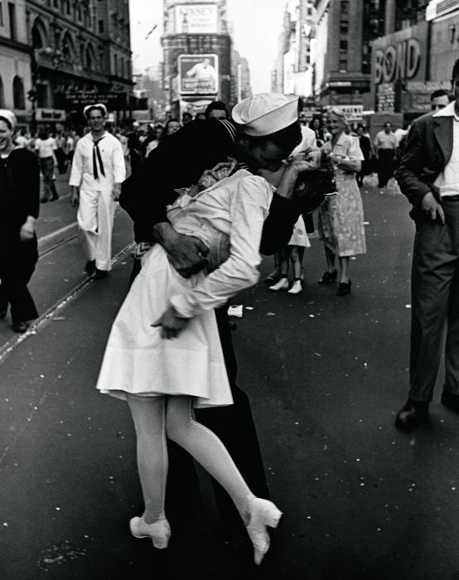
World War II Veterans
12 Million returned from overseas
Returned to a booming economy
To a GI bill to pay for full tuition and living expenses as well as low interest mortgages
College campuses filled over night
Many returned changed.

Slide 8
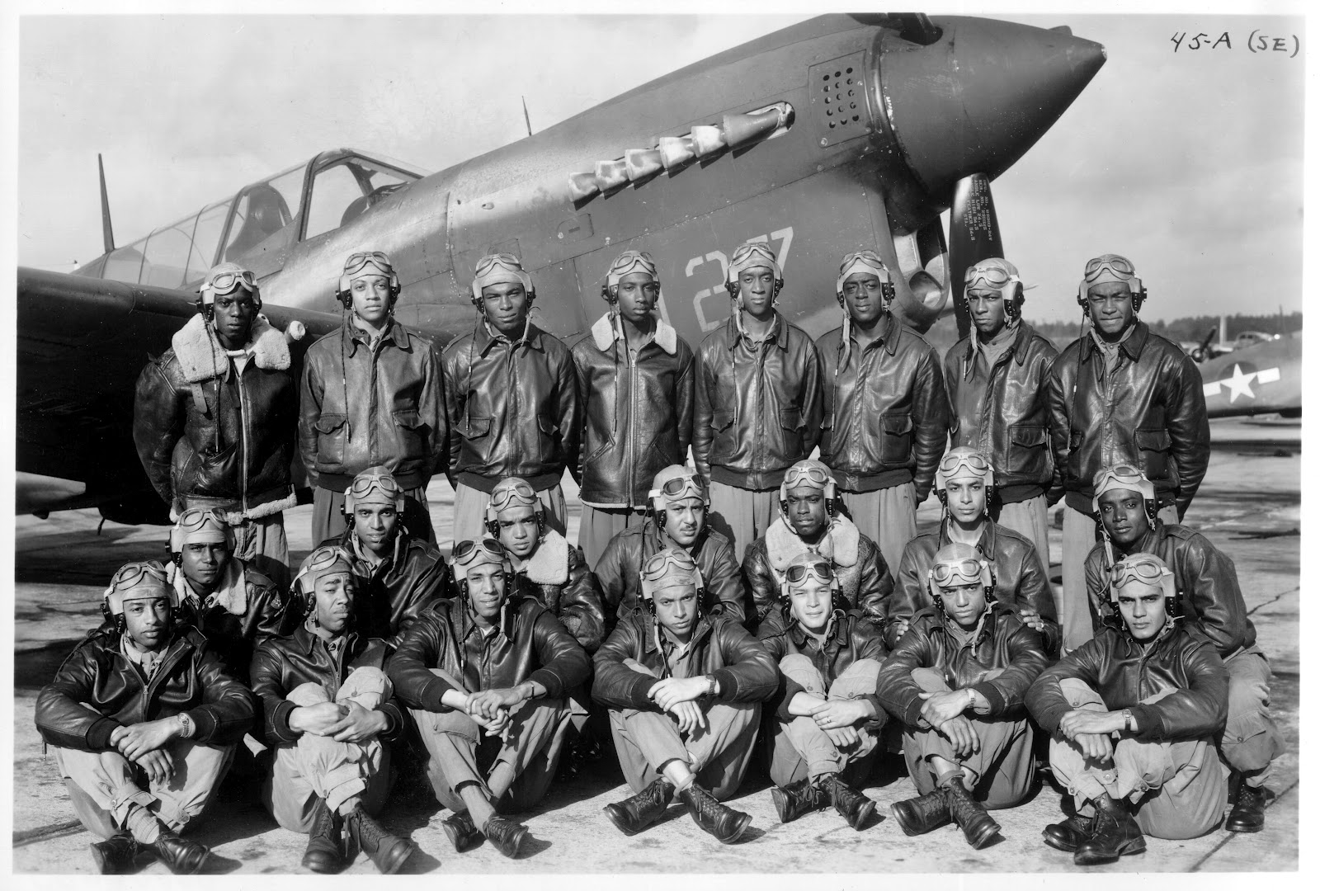
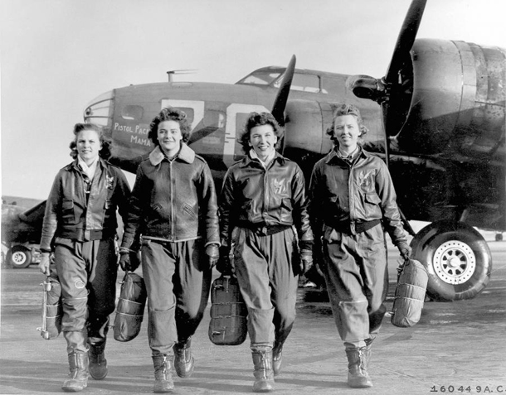
For others, the economic prospects were not so sunny.
Tuskeegee Airmen had one of the most successful flying records in WWII
No African American pilot was allowed to fly commercially for 20 years after the end of the war.
The U.S. military not officially integrated till 1948.
Women pilots flew as trainers stateside.
Not till 1973, would the first female pilot be hired by a commercial airline.
Women were expected to return to the home and hearth after the war.

Slide 9
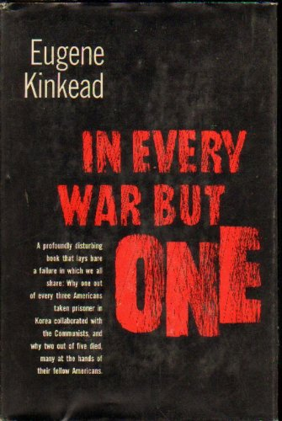
Korean war veterans
The Korean War was never a popular war – never more than 40% of Americans expressed support for the war. It was regarded by many as the war that was impossible to win.
Not even called a “war,” Truman called it a “police action.”
As would be in the case in the Vietnam War, soldiers returned after 12 months one-by-one.
Eugene Kinkead’s book that looked at “brainwashing” endured by American GI’s.
Conditions in POW camps were dreadful. 38% died in captivity (compare to 11% in WWII, 14% in Vietnam War)

Slide 10
Vietnam War Veterans
All returned after 12 months in Vietnam singly, not to cheering civilians or parades, but just to the sense that the war was over, at least for them.
Knowing the divided public opinion about the war, many didn’t even mention their service.
Some felt as if they were returning like ghosts
They often sought the companionship of other groups
“Rap groups” gave vets a chance to be with others who had some sense of what they had experienced.
Others felt trapped between their own generation and their parent’s generation, belonging to neither.

Slide 11
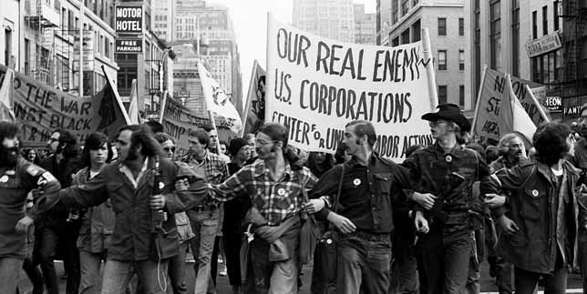
Some vets joined the antiwar movement. Never before had veterans organized in open opposition to a war, their war, while it was going on and questioned not just the war but the corporate interests that they felt were fueling it.

Slide 12
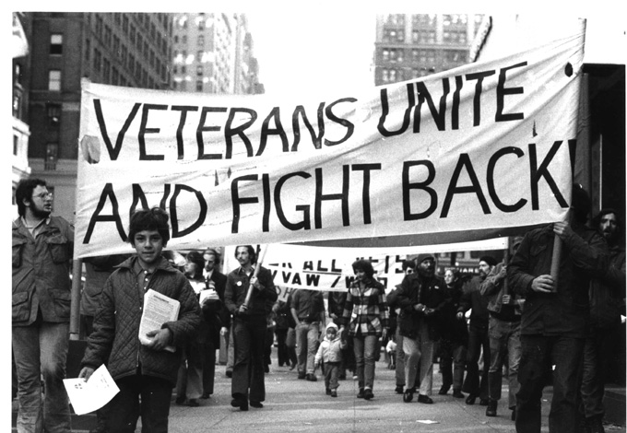
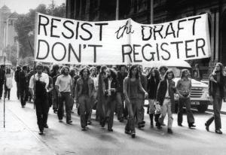
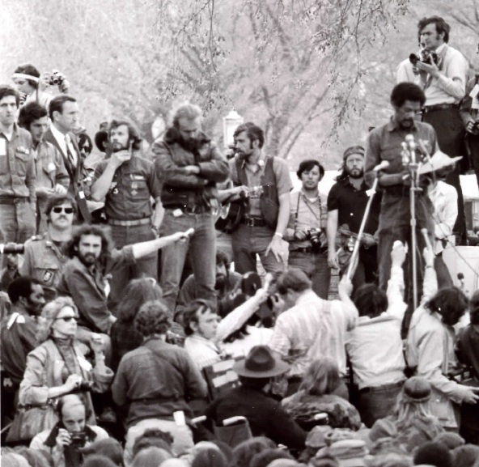
They burned draft cards, encouraged others to resist or flee to Canada, and they demonstrated a distrust of institutions and authorities.

Slide 13

Operation Homecoming

Slide 14
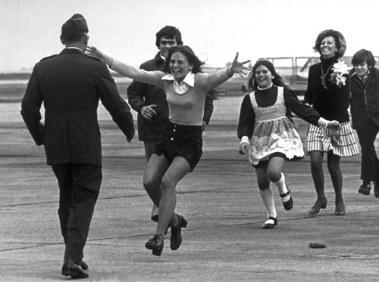
Prisoners of War

Slide 15
Iraq and Afghan War Vets
They have returned as units
Many have endured 5, 6, 7 deployments
Many are returning as disabled vets with serious physical wounds
Survival rates have increased:
Civil War – 66%
WWI – 79%
WWII – 70%
Korean War – 75%
Vietnam War – 76%
First Gulf War – 76%
Second Iraq War – 90%
Afghan War – 91%
(U.S. Department of Veterans Affairs, Dept. of Defense)

Slide 16
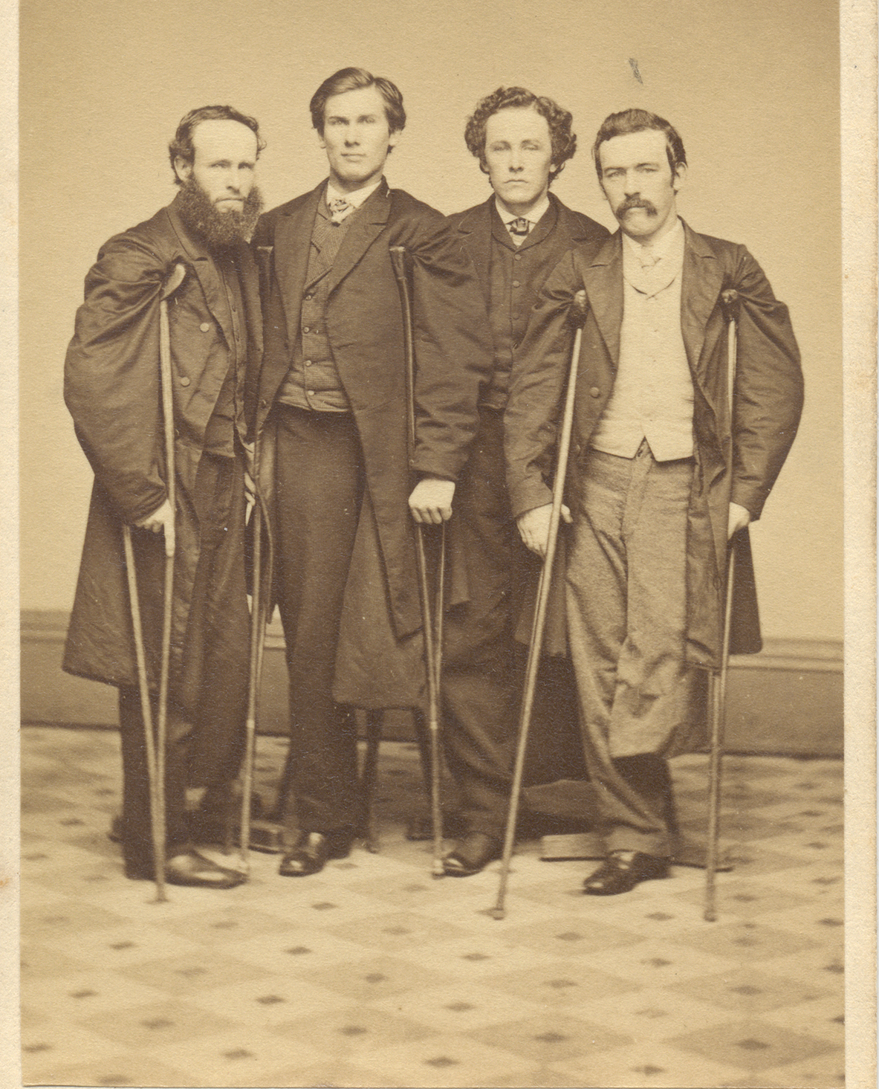
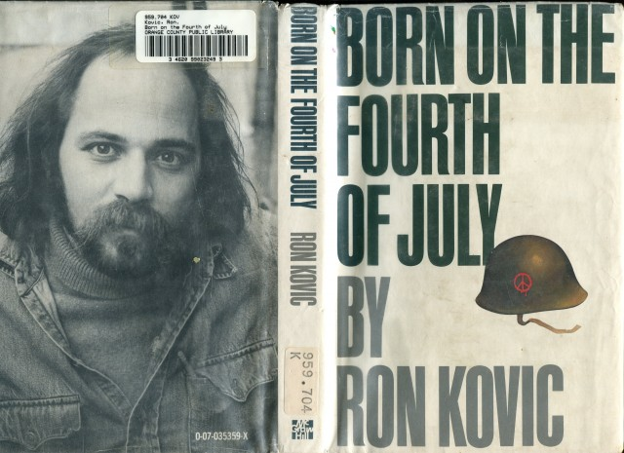
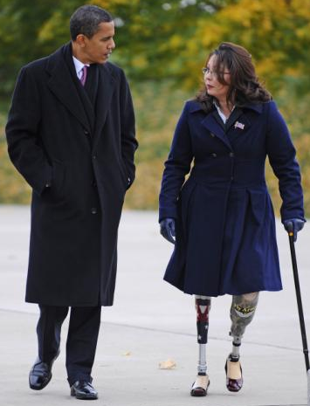
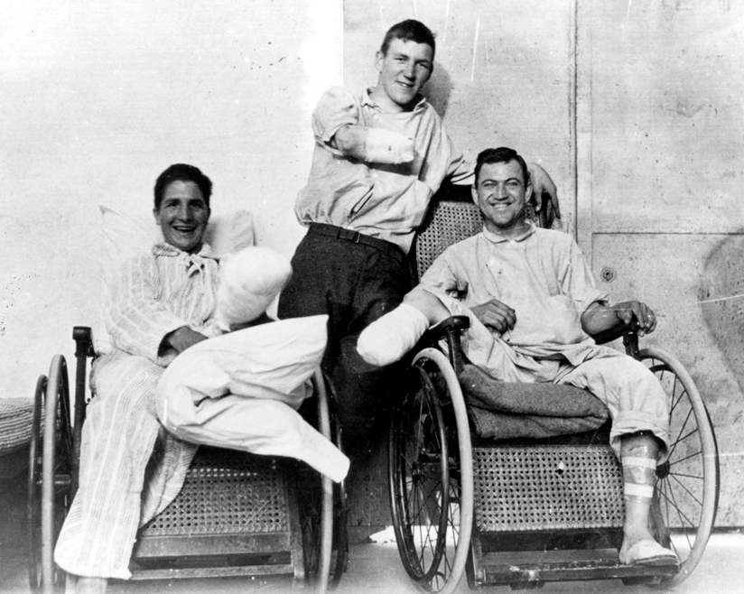
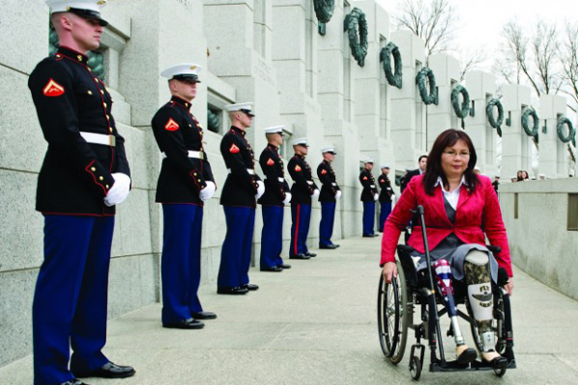
From every war, some soldiers return carrying permanent signs of war on their bodies.
Civil War Veterans
Civil War Vets
Tammy Duck-worth
World War 2
Veterans

Slide 17
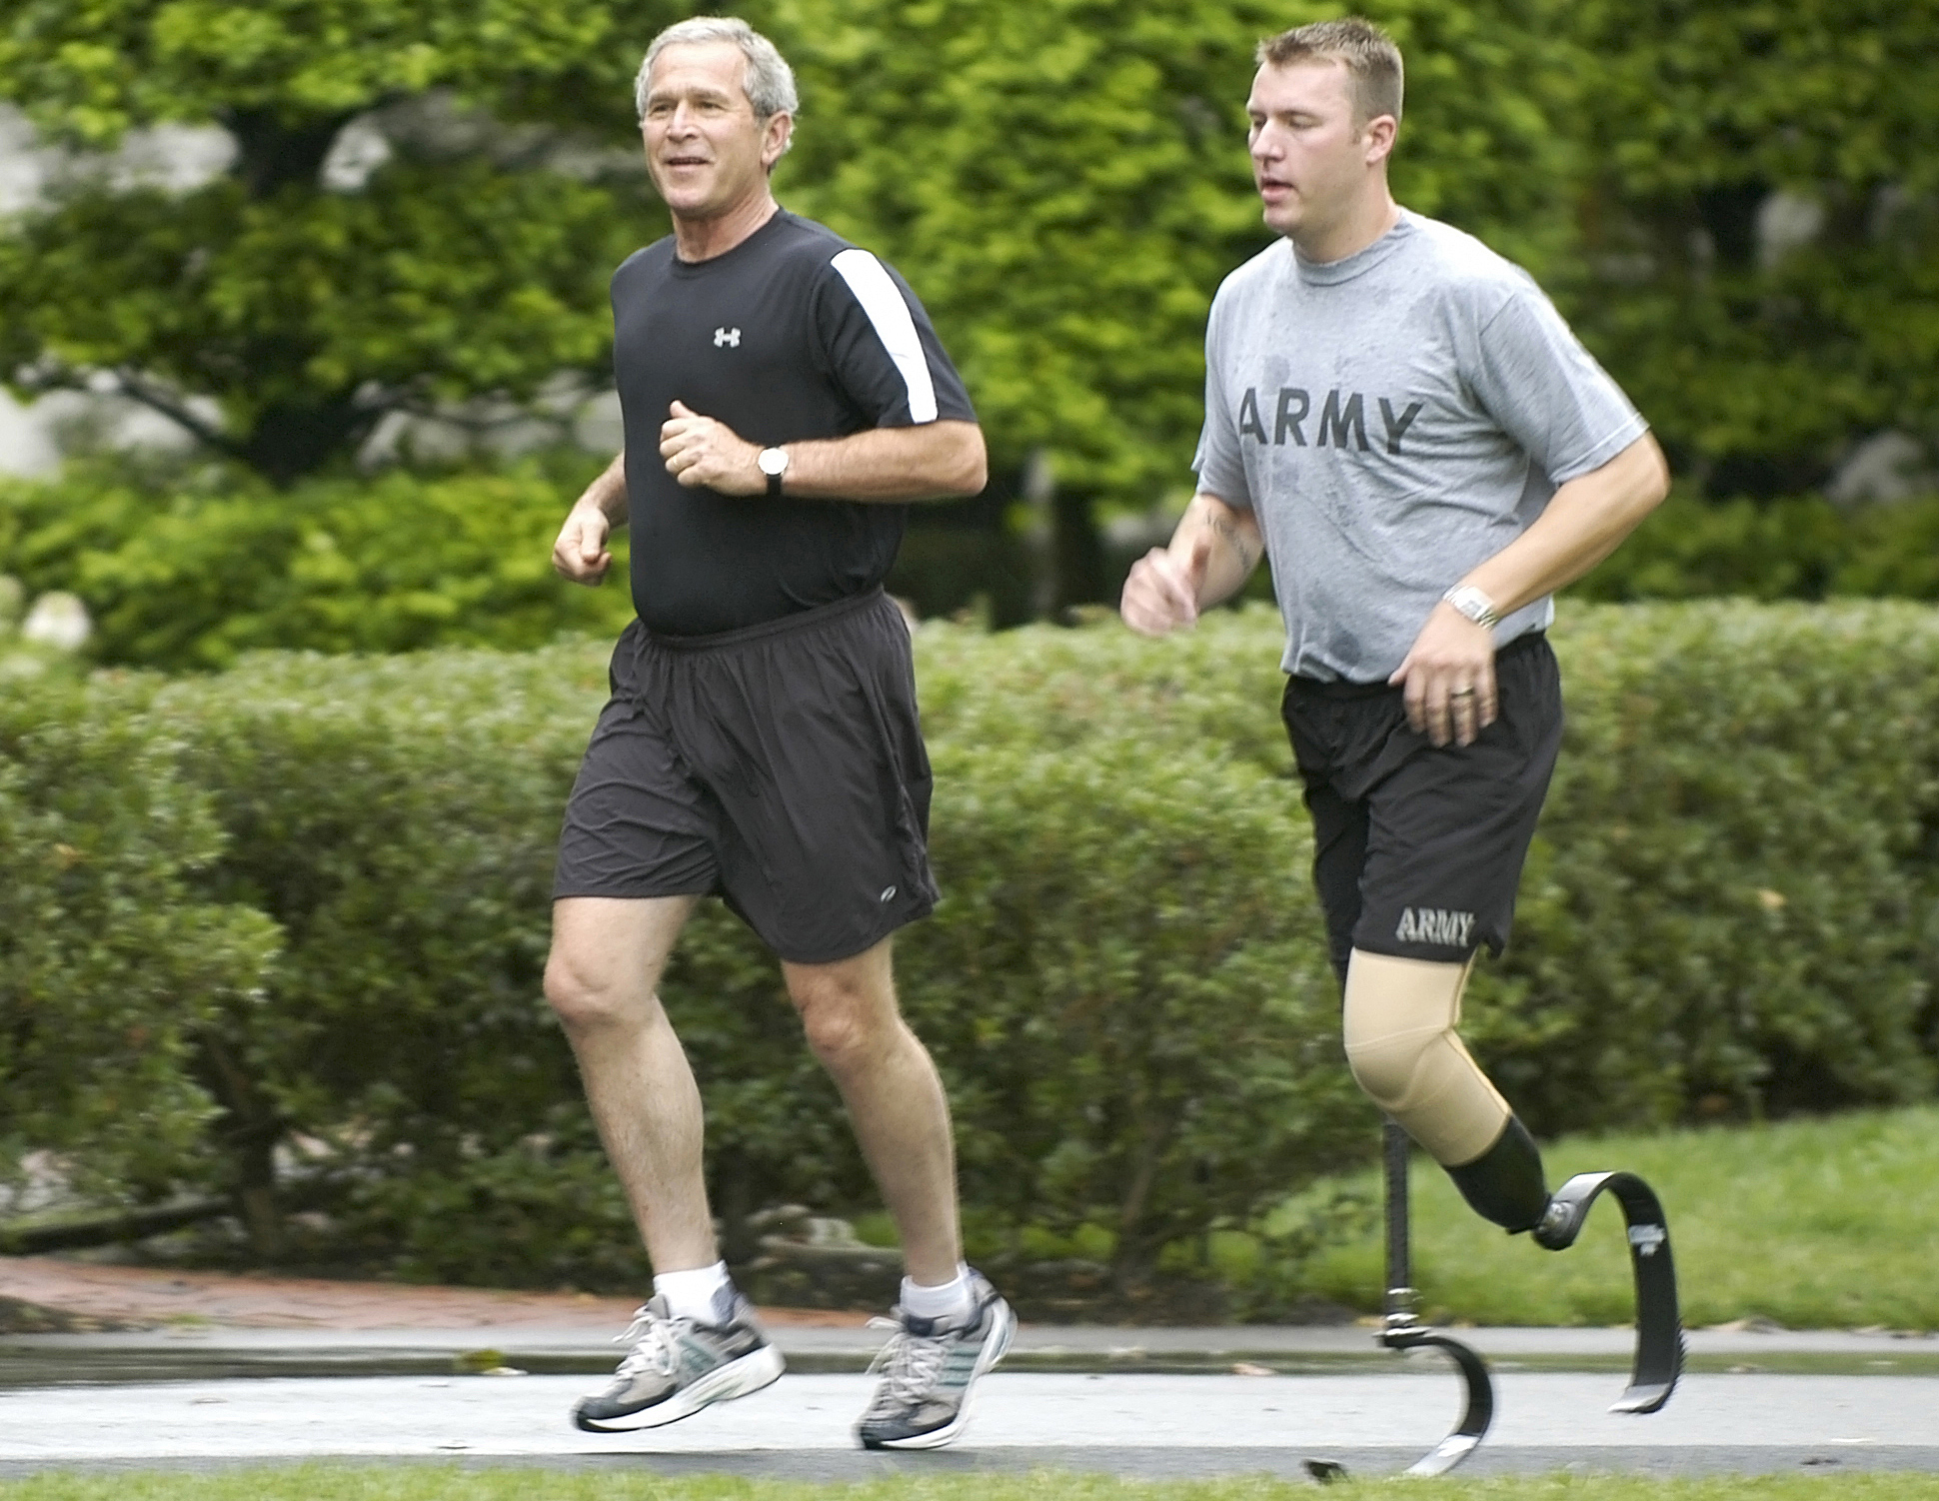
The Amputee as the Athlete.

Slide 18
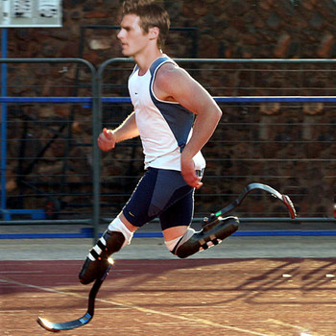
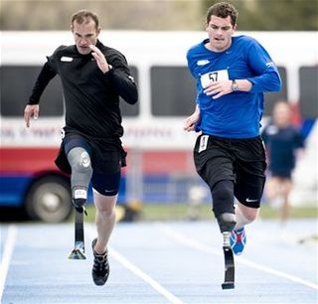
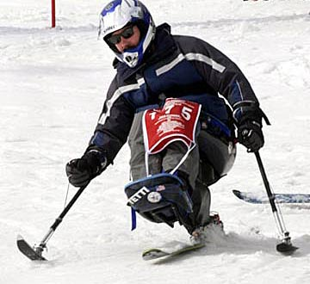
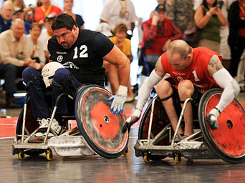

Slide 19
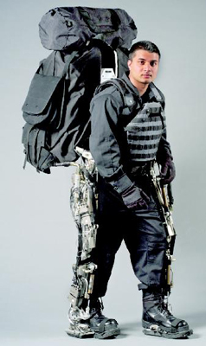
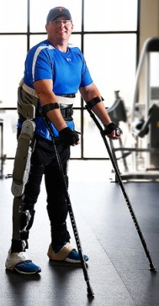
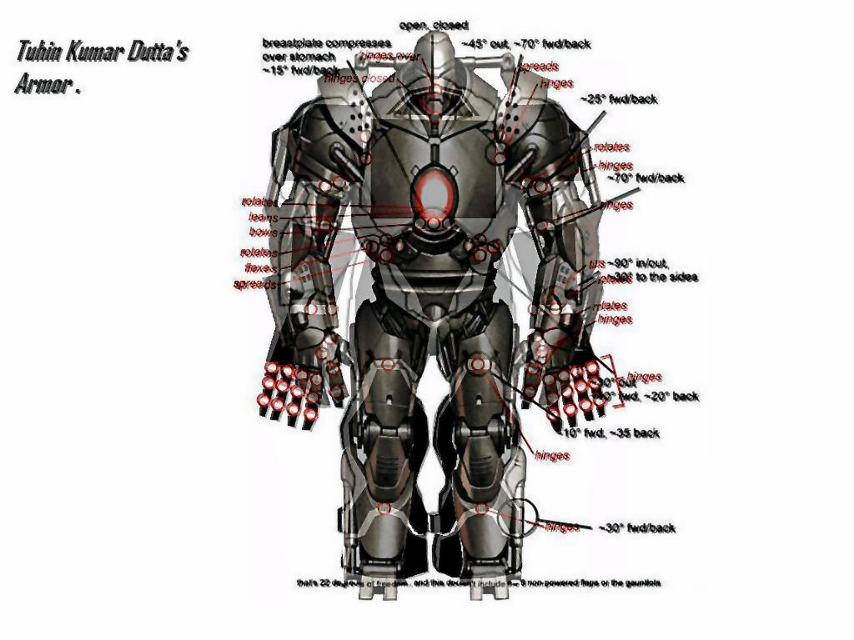
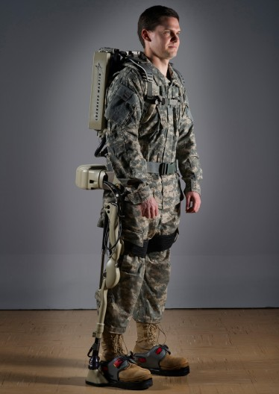
We live in an era in which not only avatars and other fantastic creatures run around cyber space in their exoskeletons, but engineers are now developing these devices for military use. When strapped on, they permit a 120 lb person to walk around with a 200 pound load.
We have met the cyborg, and it is us.

Slide 20
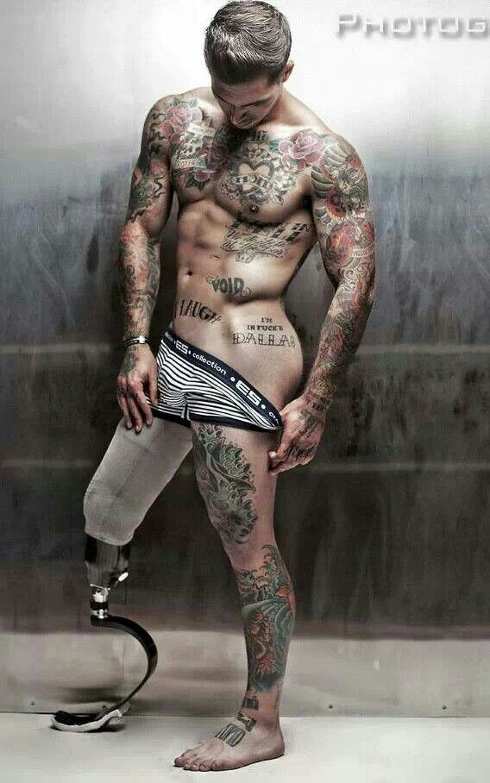
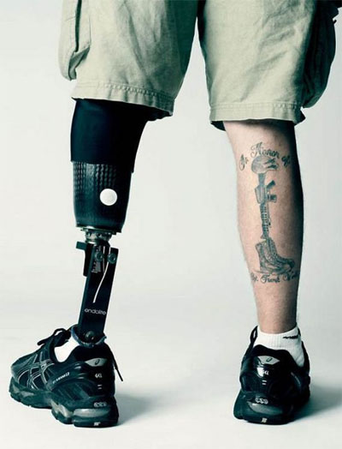
Alex Minsky, veteran turned model

Slide 21
The Invisible Wounds of War
Others suffer from chronic non-visible wounds (PTSD and TBI)
Treatments for these are still works in progress. Everything from conventional talk therapy to prescription drugs to marijuana to “digital homeopathy” is being tried.
The Veterans Administration medical system is overloaded.
Many return to problems on the home front.
- a spouse who has changed
- children who don’t show the response that the veteran craves
- financial problems
- sexual dysfunction: In a recent survey reported in the Journal of Sexual Medicine, 7/14, 3 times more active duty soldiers report erectile disfunction than their civilian counterparts of the same age.
DOD spends $84 on Viagra and related drugs used to treat ED

Slide 22
The return from war requires not just adjustments of the veteran but also of his or her family
During World War II, the War Dept hired psychiatrists and psychologists to a) prescribe ways of ensuring good morale among the troops, and b) to offer advice on the return home.
Military psychiatrist Herbert Kupper advised women “to submerge their own feelings and drives,” to be responsive but not assertive, nurturing but not domineering, and to display the qualities of both sexual partner and mother.
  (Michel, Sonya. “Danger on the Home Front,” Gendering War Talk, ed by Miriam Cook & Angela Voolacott. Princeton, 1993. p261-2)

Slide 23
The Transition from War to Home
In old wars, warriors carried a shield and wore a protective set of armor that kept them alive in war. Today they carry an M-16 and a 45 lb set of body armor. Returning from war requires that the weapon and the armor be put away and that one transform back into a former identity—either civilian or the soldier in garrison biding time till the next war or the next deployment. That requires, according to Stephanie Belanger that the soldier “reconcile the two moralities that form a key part of the soldier’s identity.” (“Military Ethics and Well-being: a Soldier’s Journey,” Journal of Military, Veteran, and Family Health 1 (1) 2015)
Note the Grimms Brothers story of the returning soldier

Slide 24
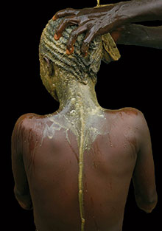
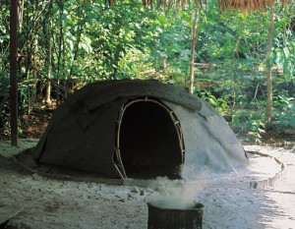
Cultural practices that aid in the transition
Ritual bathing intended to wash off
the pollution of war
Native American healing ceremonies
intended to rebalance the soldier upon
return
Sweat lodges for Native Americans
and for others

Slide 25
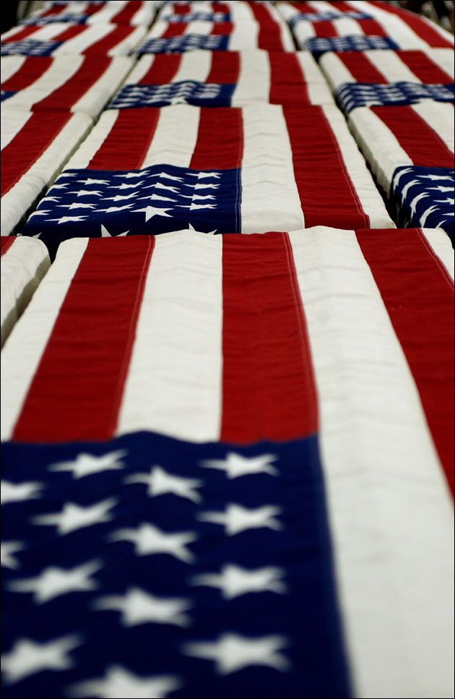
And for some, the return home is their final journey

Slide 26

Death is something that is prepared for.

Slide 27
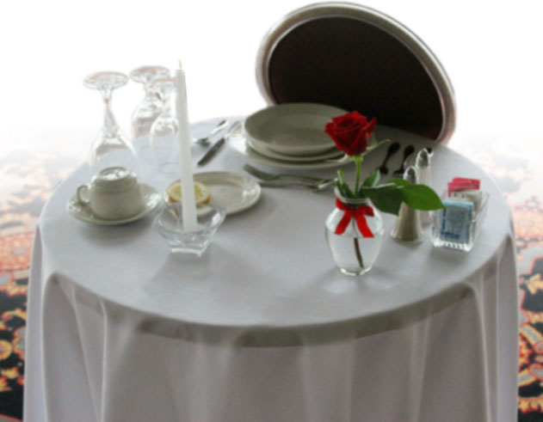
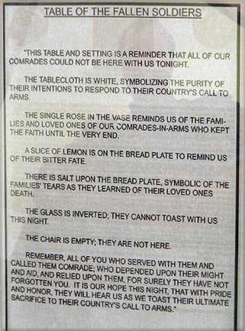
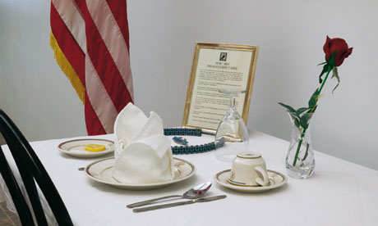
Table for the Fallen

Slide 28
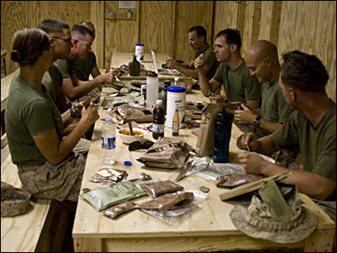

Slide 29
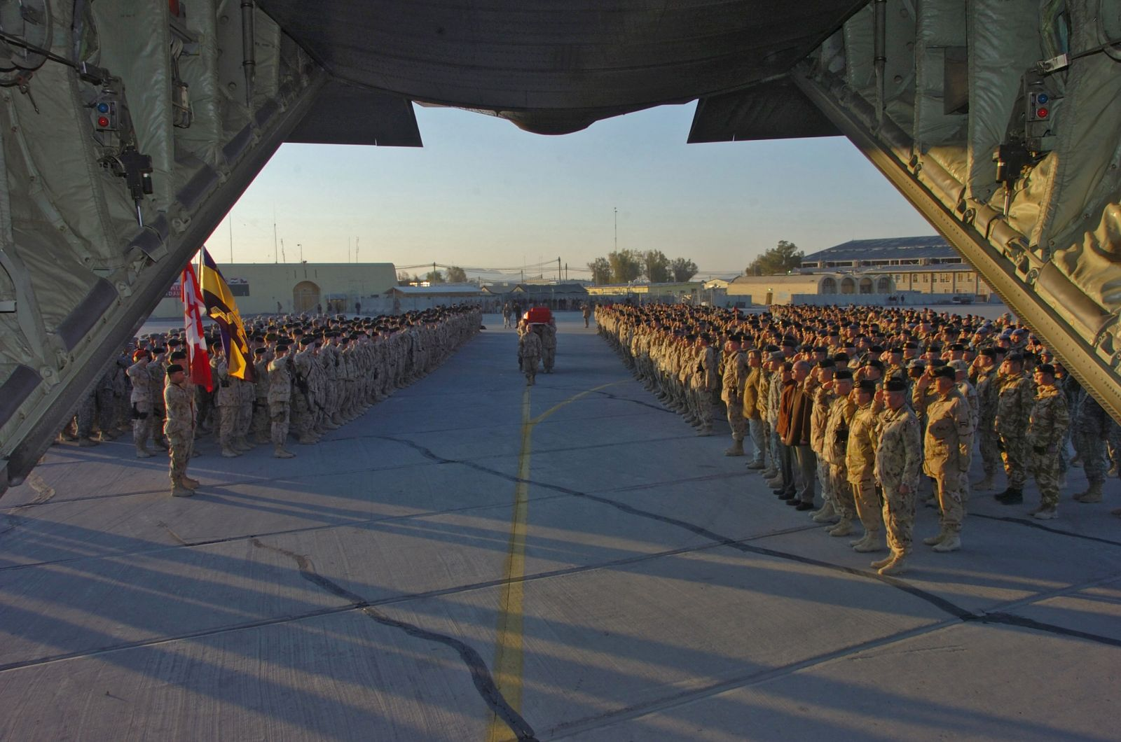
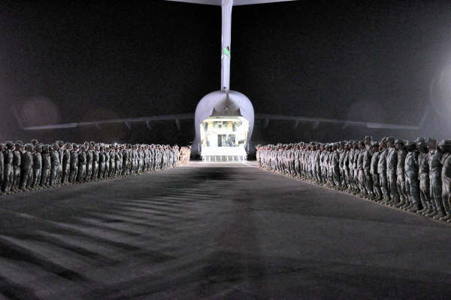
Commemeration of the Fallen
Ramp Ceremonies

Slide 30
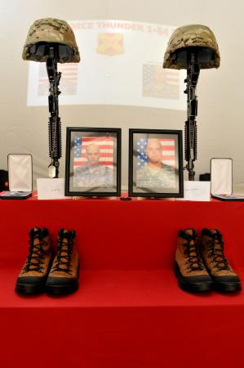
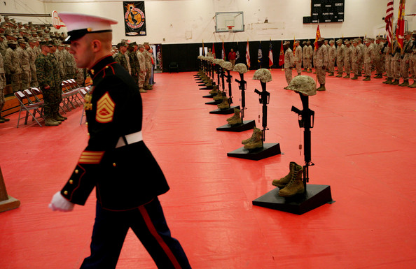
Unit Memorial Services
Sergeants Lammerts and Burgess

Slide 31
Today
I’ve talked about the history of soldiers returning from America’s wars
the ways in which they are or are not welcomed home
veterans asserting their political power
those who return with bodies permanently transformed by war
those who return with invisible injuries
about the need for a nation to shoulder the moral responsibility of a war it has asked some citizens to fight on its behalf
about rituals marking the transition from warrior to civilian

Slide 32
Next lecture
I will be arguing that women have always aided in America’s wars
That their roles have been limited by design
That the full integration of women in the armed services was ardently resisted for most of the 20th C
That in the last decade women have made major contributions to the combat arms

