Slide 1
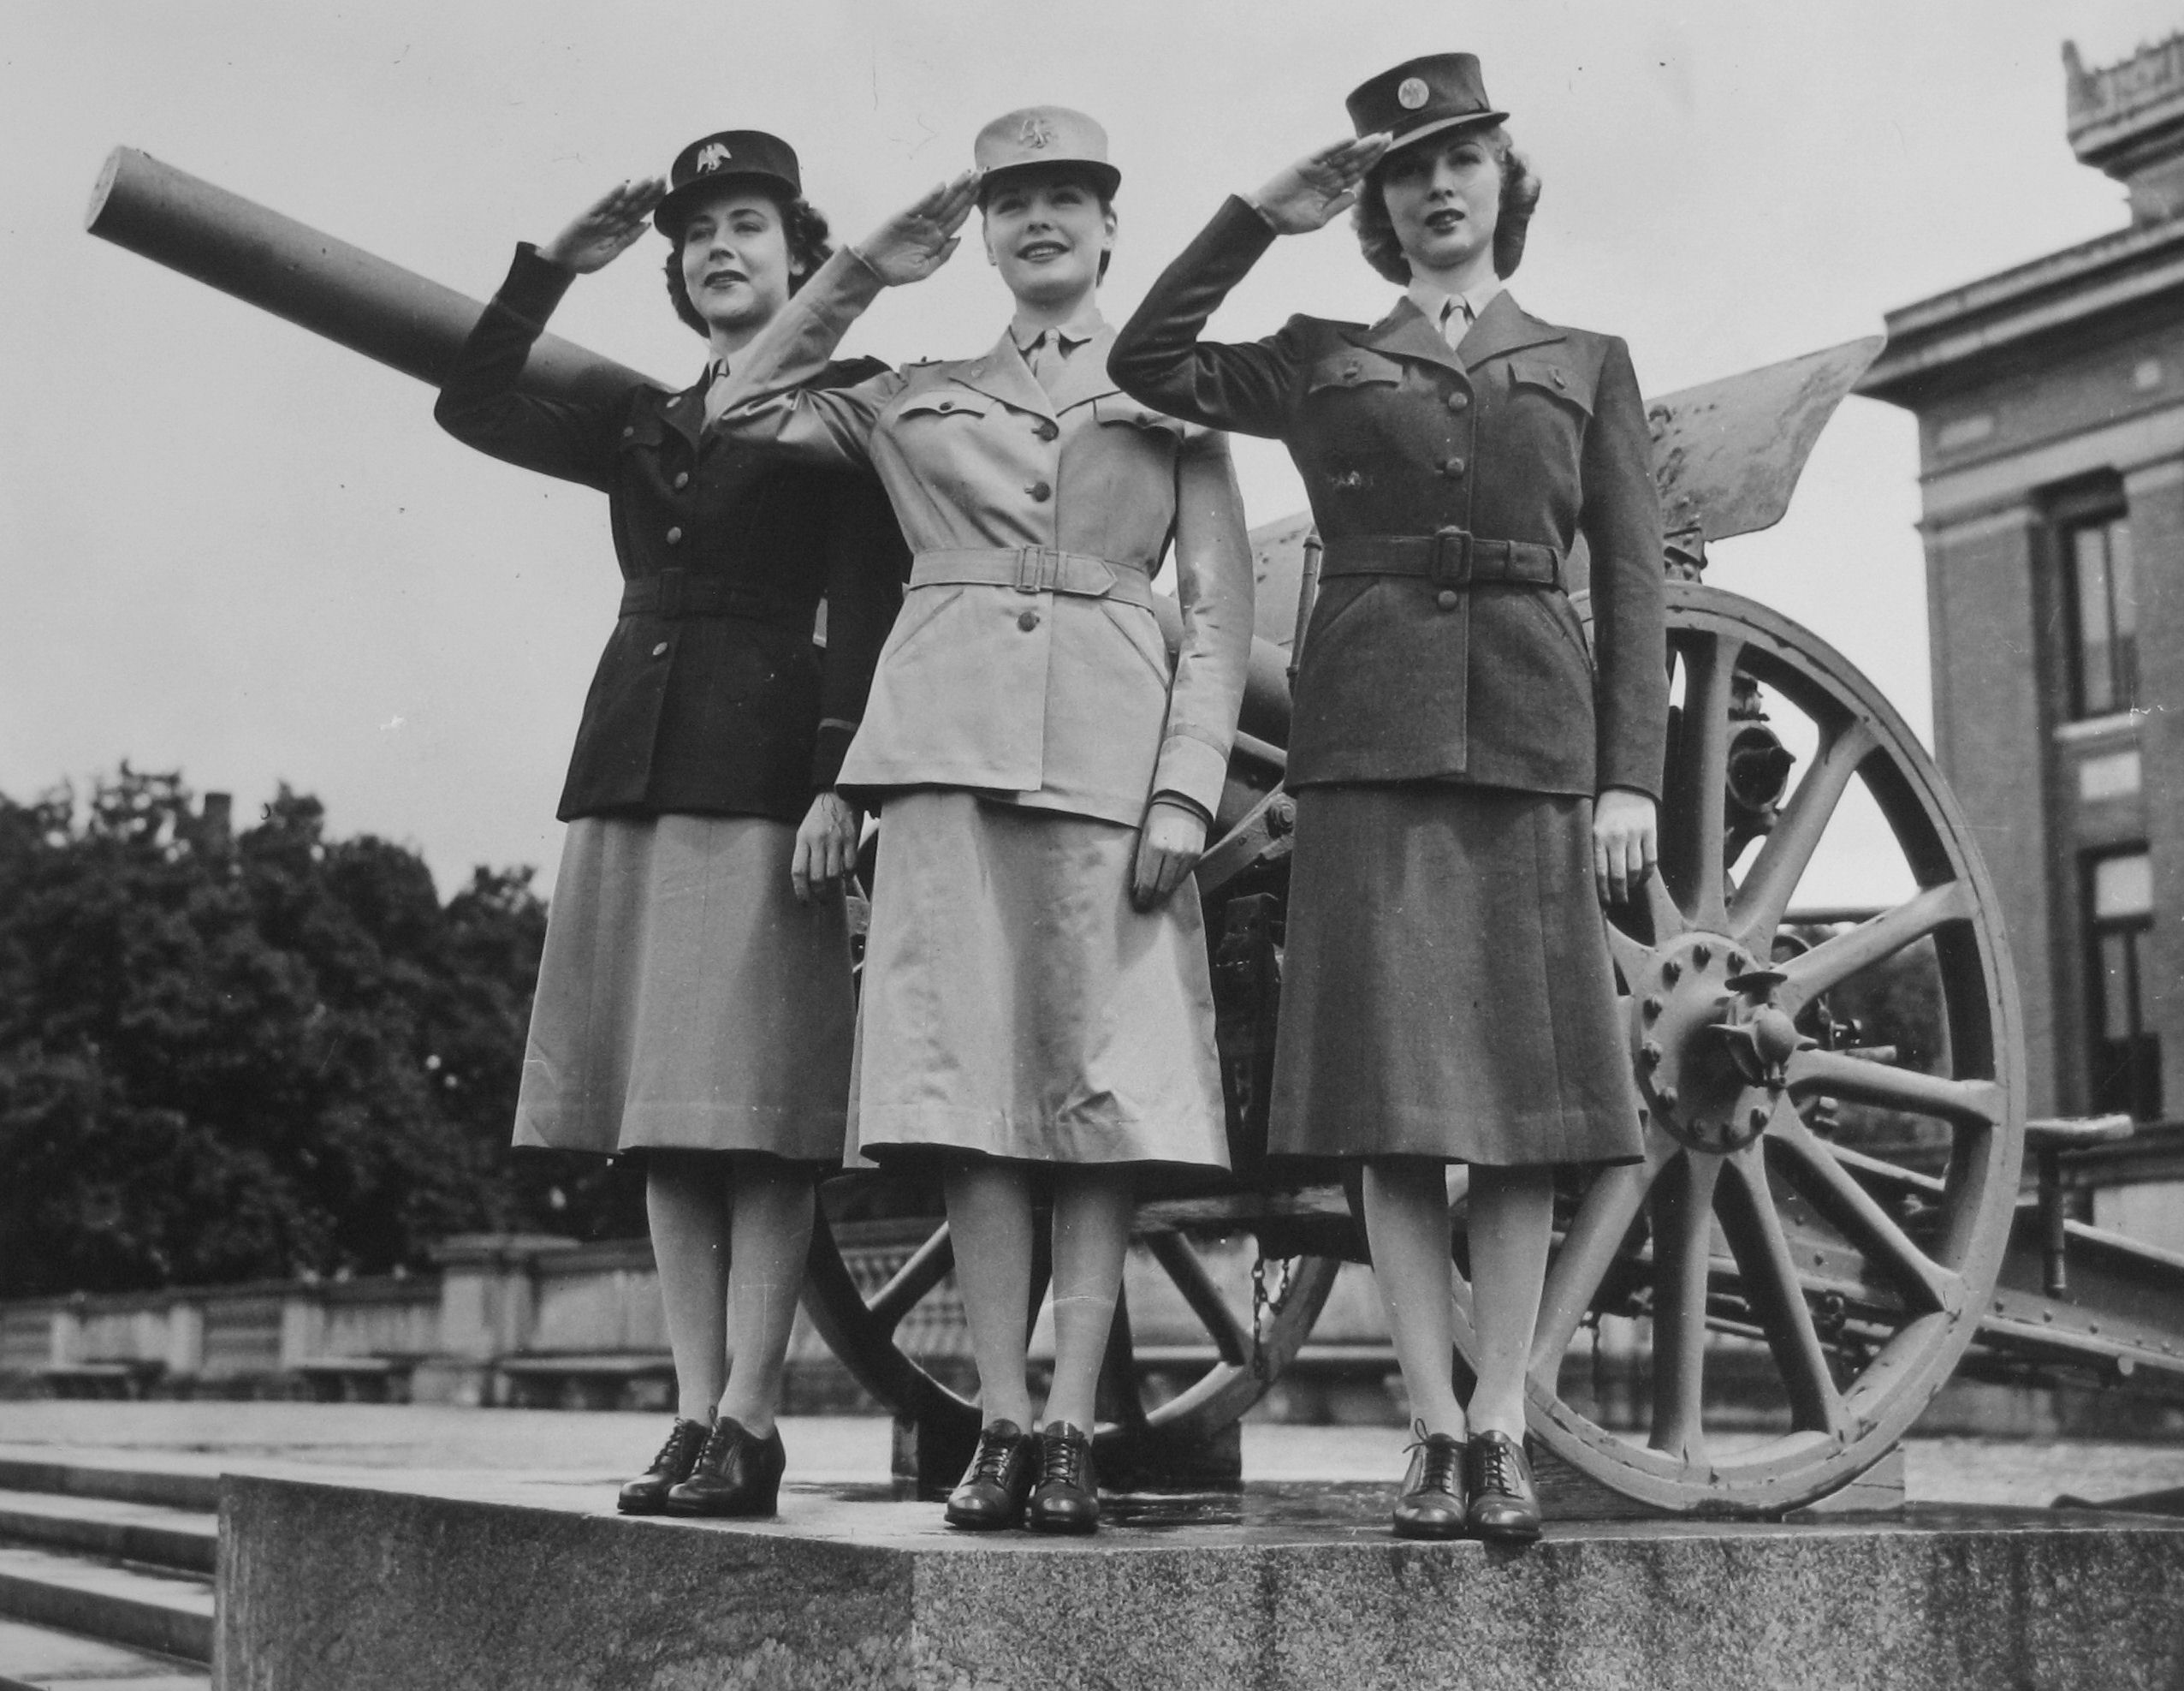
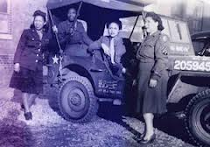
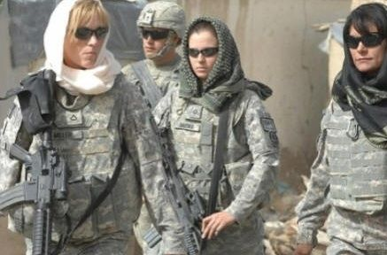
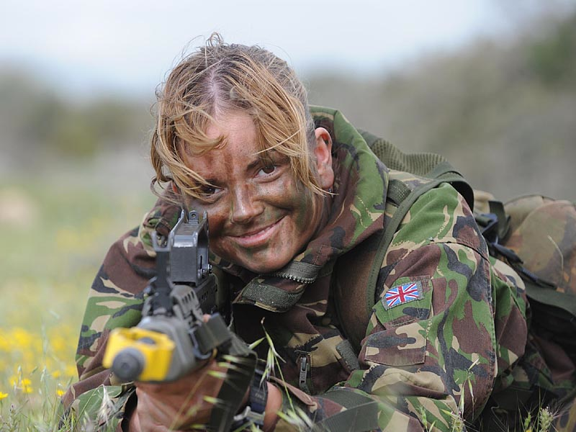
Women in the Military
Lecture 5

Slide 2
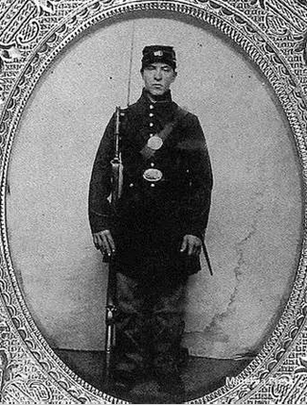
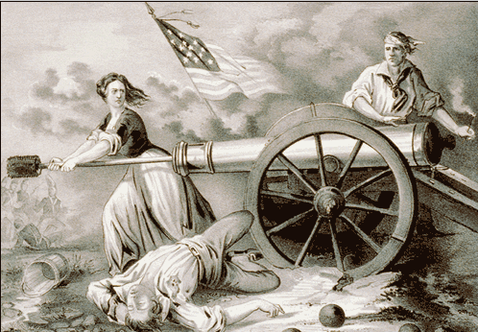
Women Have Served in Every American war
They served as nurses, cooks, spies, even soldiers.
Some even dressed the part of soldiers and fought:
Deborah Sampson as Robert Shurtleff in the Rev.War (1775-83)
SarahElizabeth Newcom as Bill Newcom
in the Mexican War (1846-48)
Sarah Wakeman as Lyons Wakeman in the Civil War (1861-65)
Dr. Mary Walker, Civil War physician was taken prisoner and is still the only woman to receive the National Medal of Honor.
Sarah Wakeman
Revolutionary War folk hero Molly Pitcher was really several women. (see http://www.archives.gov/publications/prologue/1999/summer/pitcher.html)

Slide 3
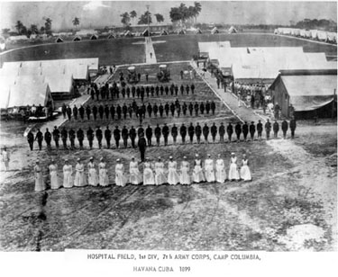
1500 women volunteered in the Spanish American War (1898)
1901 Army Nurse Corps established
1908 Navy Nurse Corps established

Slide 4
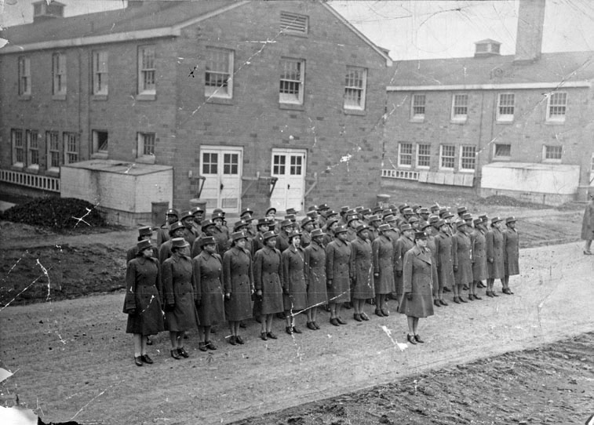

36,000 in World War I (1917-1918)
(400 of these die in line of duty)

Slide 5
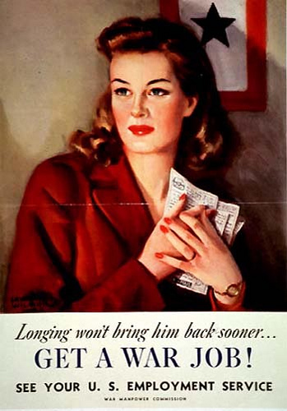
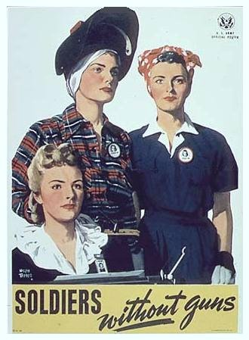
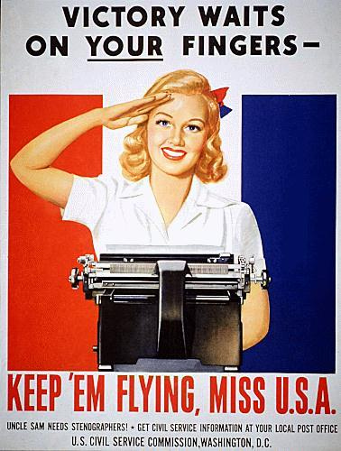
The Government Organizes a Massive Effort to Attract Women into the Workforce.

Slide 6
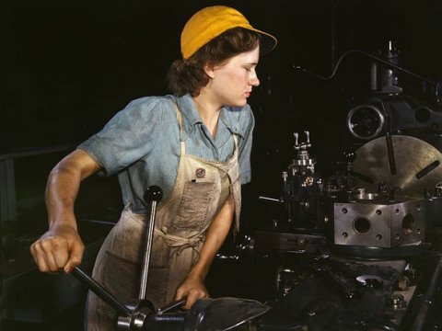
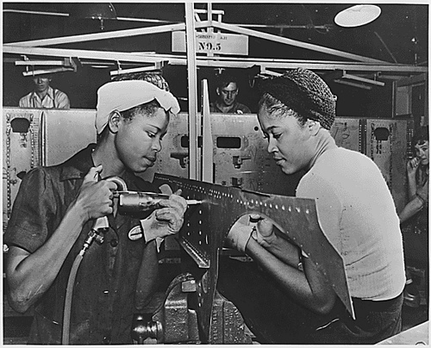
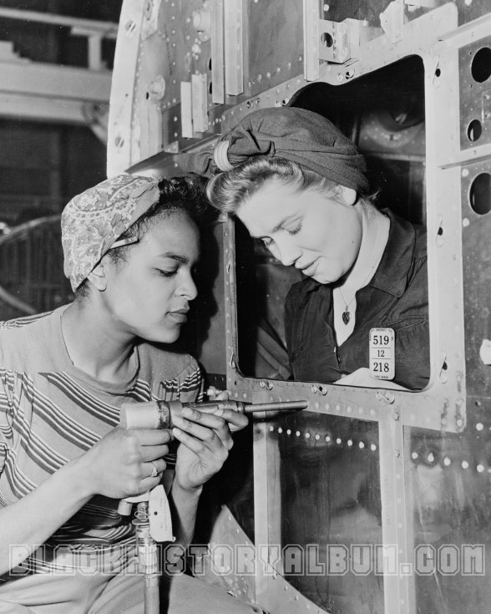
Women Flocked to the Factories producing the planes, jeeps, and bombs for the war

Slide 7
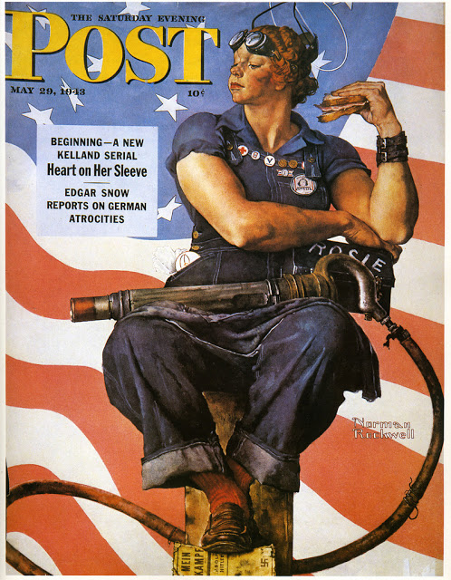
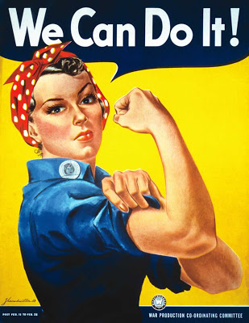
J. Howard Miller of Westinghouse
Norman Rockwell, May 29, 1943

Slide 8

Rosie the Riveter song, precursor to Rockwell’s Image

Slide 9
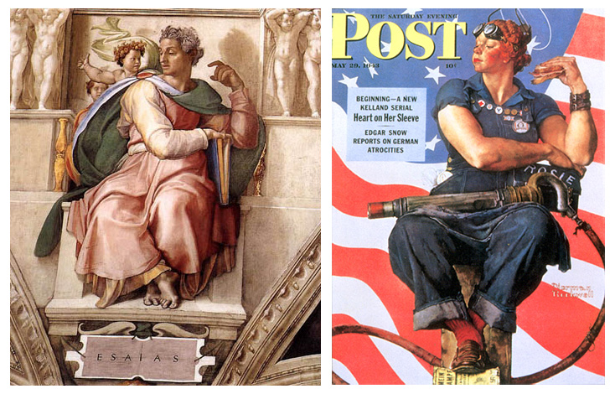
Michelangelo’s Isaiah
Rockwell’s Rosie
For more on this, see Sheridan Harvey’s research (http://www.loc.gov/rr/program/journey/rosie.html

Slide 10

Ford Motor Recruitment Film

Slide 11
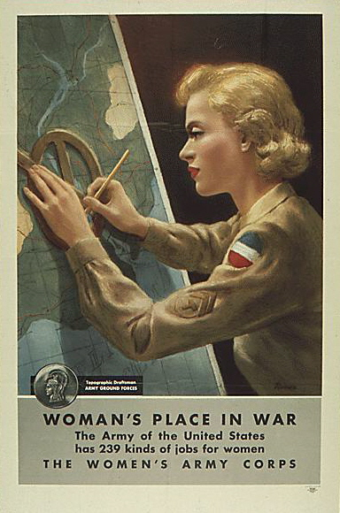
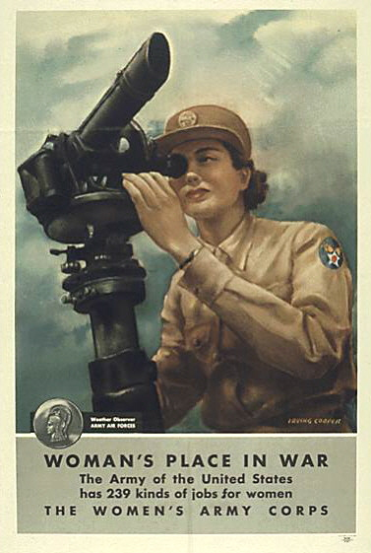
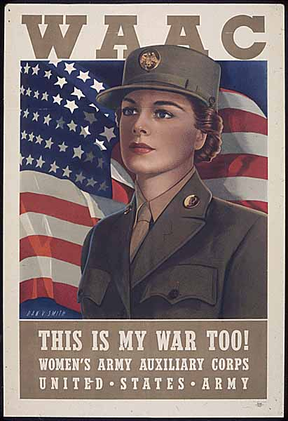
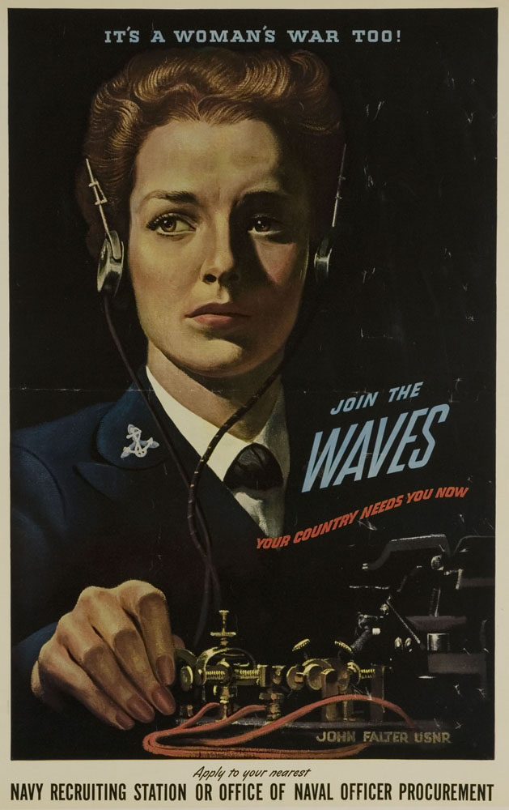
400,000 women enlist in the WACs, WAVES, SPARs, & the Marine Corps Women’s Reserve

Slide 12

As women showed that they could excel in jobs they had never before done, their counterparts who enlisted showed their expertise as well in order to “free a man to fight”

Slide 13
Over there, over there
Send the word to the boys over there
That the WACs are coming,
the WACs are coming
To get in everybody’s hair.
We will aid in the raid
That our men make to win in Berlin.
We’ll be over, we’re coming over
And we won’t be back
Till they crack up over there.
Petticoat soldiers marching
In step to victory.
Petticoat soldiers marching
With heart and spirit free;
Er there’s been an army
To fight off every foe;
Now we have joined the forces
And go where ‘er they go.
And you can bet we’ll do
Our part for Uncle Sam,
For we’re all set and keeping fit,
Yes Sir! Yes Ma’am!
We’ll always serve our country
In every cause it backs.
We don’t tote guns or bayonets.
Our powder comes in compact sets.
We’re petticoat soldiers,
Wacky WAACs.
This is the song of a G.I. Muse
Lumbering along in G.I. shoes
Sung to a sort of G.I tune
Under the G.I. southern moon
Gee I’m loaded with G.I. clothes,
Gee I’m tired of G.I. hose,
Gee Hon, I’m sick of G. I. issue
And, oh my darling, G. I miss you.

Slide 14
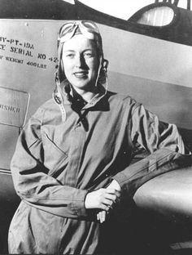
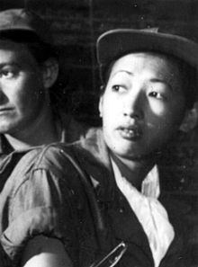
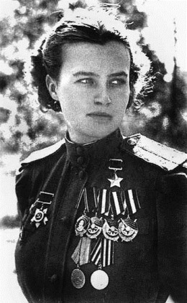
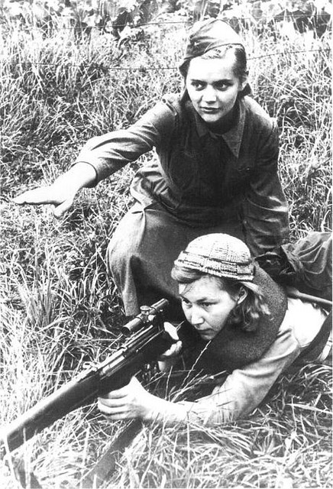
Women Air Force Service Pilots (WASPs)
Hazel Ying Lee flew new, untested planes, including combat planes.
Natalya Meklin, Russian WWII pilot who flew 980 combat missions. Member of the “Night Witches,” 3 regiments of women pilots who flew 24,000 combat missions
Cornelia Foot, WASP, first female aviator to die while on active duty

Slide 15
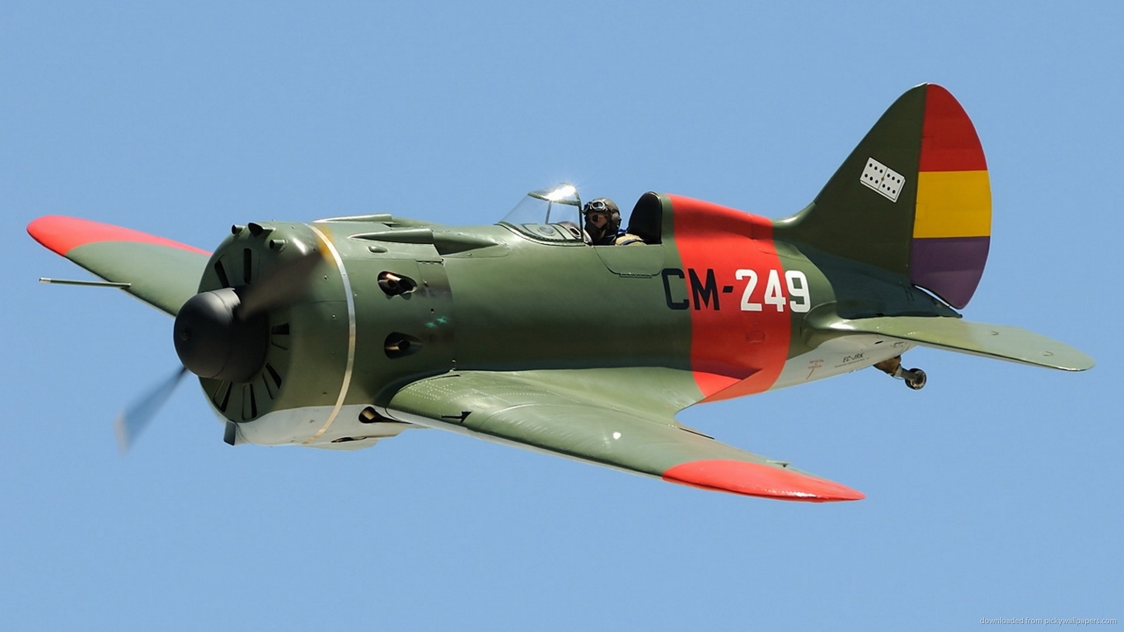
The “Polikarpov” Planes were flown by Russia’s “Night Witches”
At the end of WWII, the Russian female pilots were told not to speak about their achievements.

Slide 16
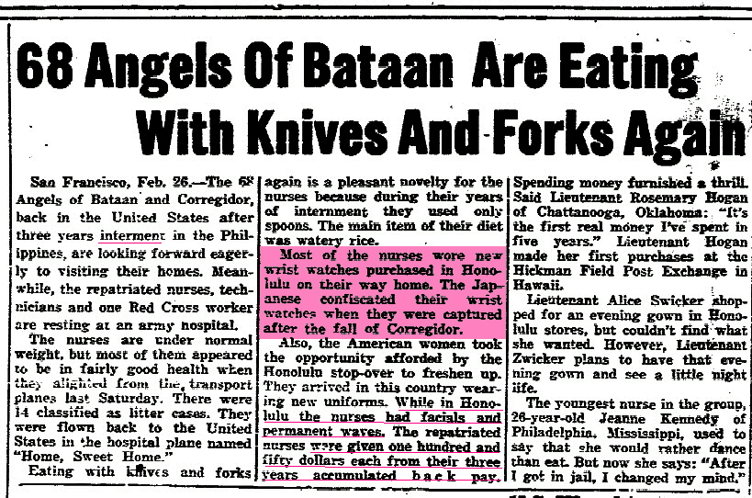
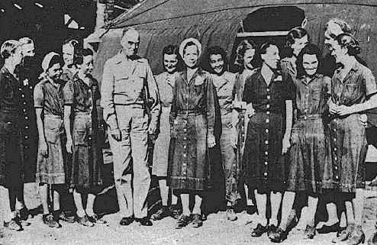
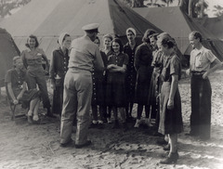
WWII Women were taken prisoners: 68 Army nurses in the Philippines, 5 Navy nurses in Guam, 11 Navy nurses in the Philippines

Slide 17
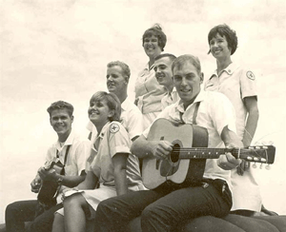
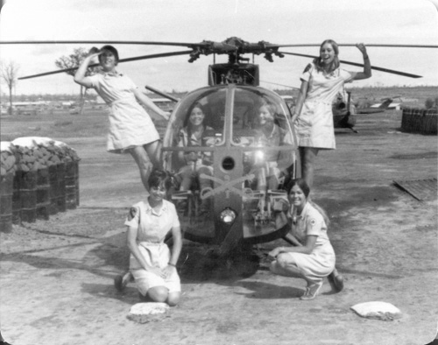
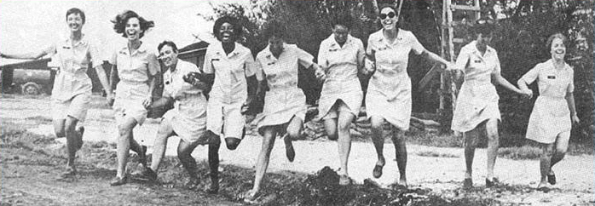
50,000 women volunteered during the Korean War (1000 deployed; the rest in support positions stateside)
265,000 during the Vietnam war (7500 were deployed)
As in WWI and WWII, civilian Red Cross and USO workers, called “Donut Dollies” also went to war.

Slide 18
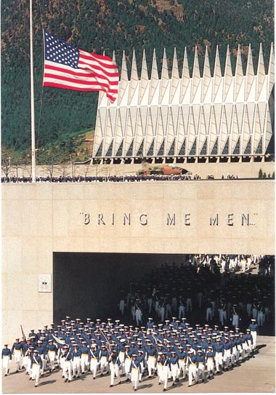
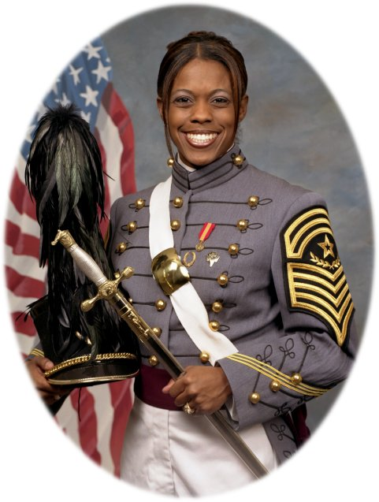
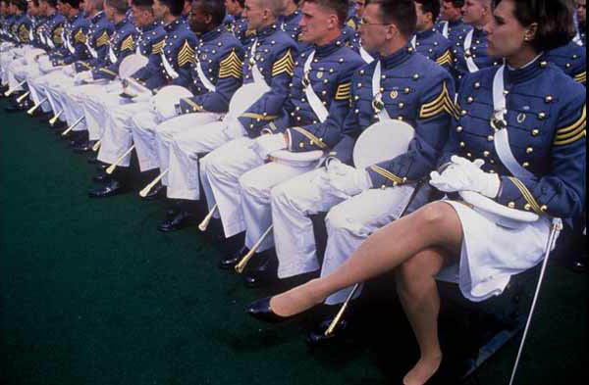
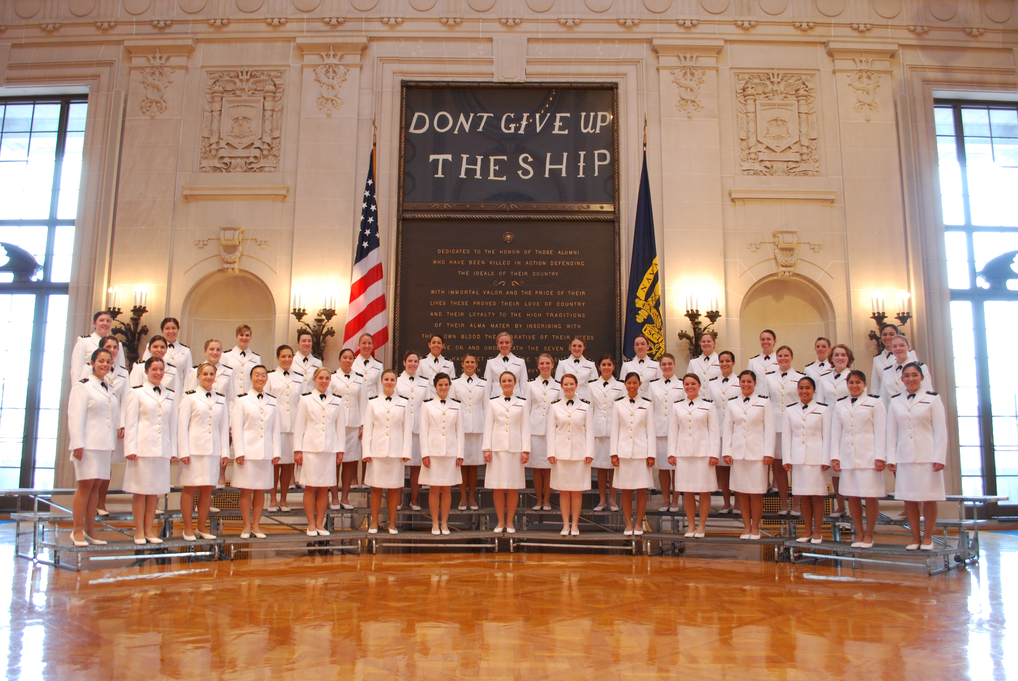
1976 - Service Academies open to women
Emily Perez, 1983- - 2006
“BRING ME MEN”
USNA Women’s Glee Club

Slide 19
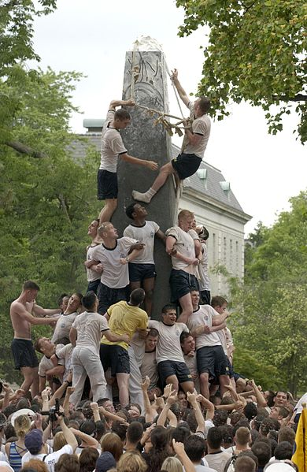
Herndon Monument

Slide 20
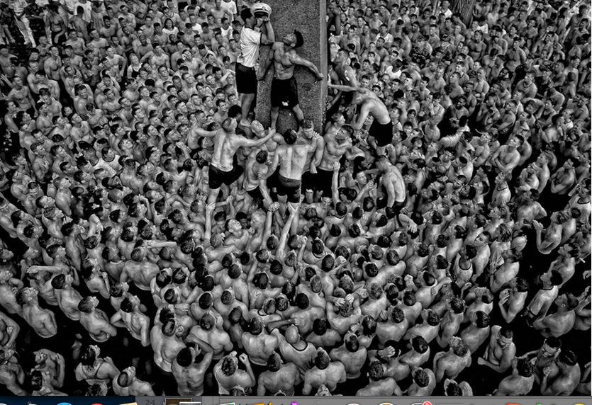

Slide 21
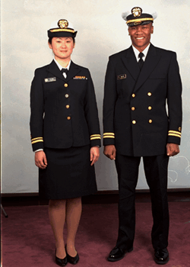
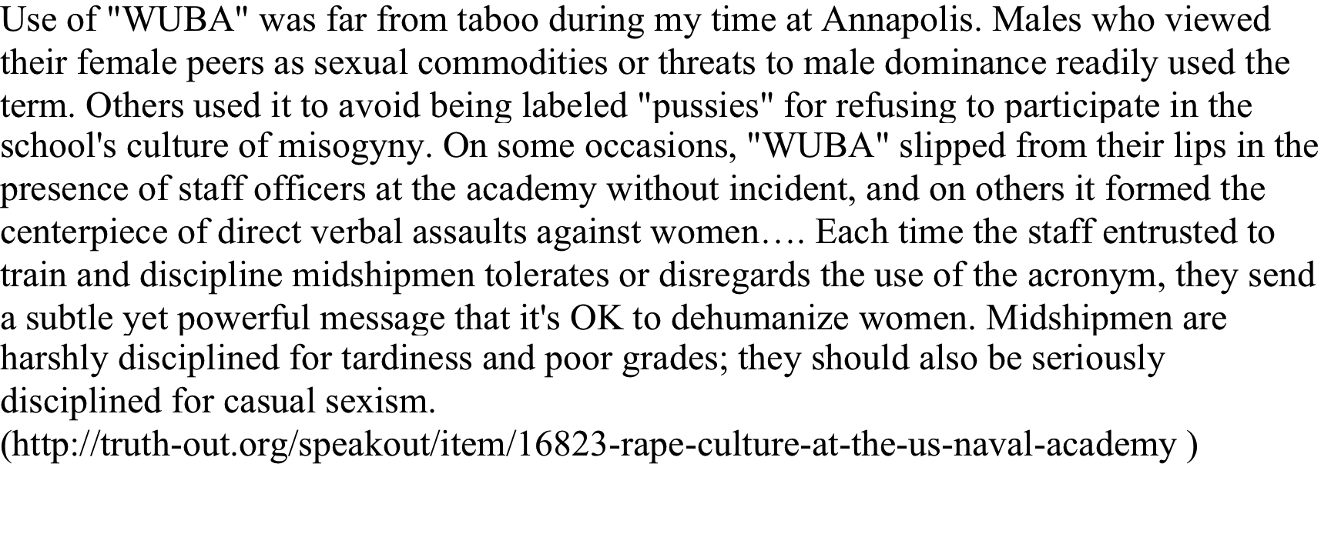
WUBA, Working Uniform Blue Alpha

Slide 22
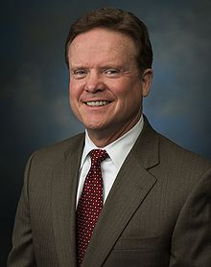
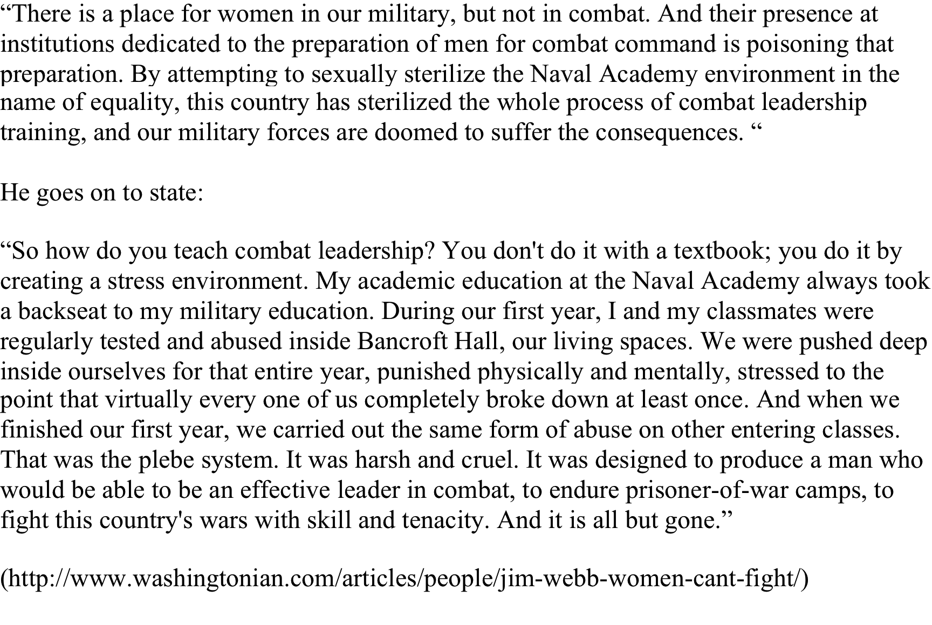
James Webb, former Sec. Navy and U.S. Senator

Slide 23
Reactions to Webb
- Supporters argue that women at the Service Academies were “feminizing” the Pentagon, that their very presence was corrosive to the essential esprit de corps or male bonding necessary for forging warrior leaders.
- Critics called his stress-is-fungible thesis simply wrong.
- Still others staged their own protest.

Slide 24
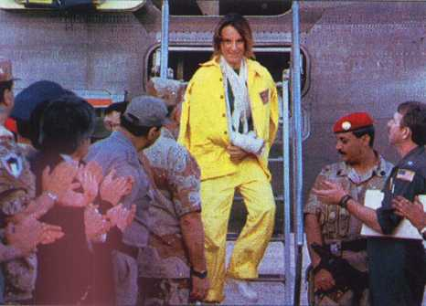
33,000 were deployed in Desert Storm (13 were killed and 2 taken POW)

Slide 25
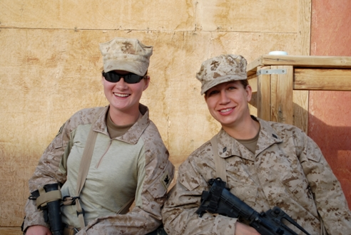
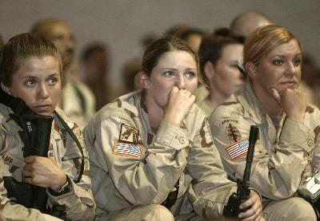
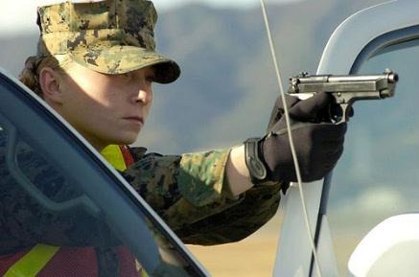
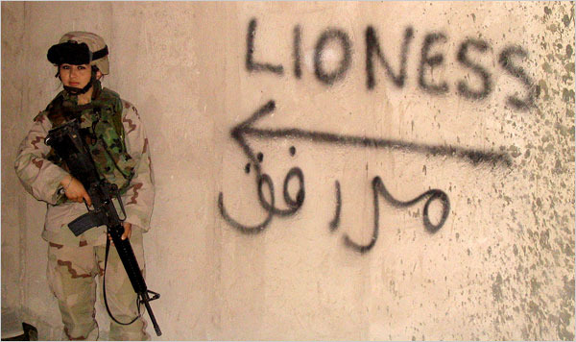
Over 300,000 women deployed since 2001 to Iraq and Afghanistan

Slide 26
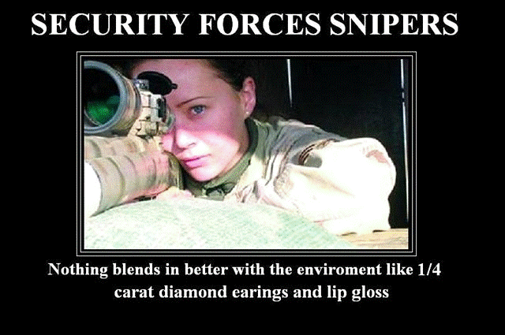
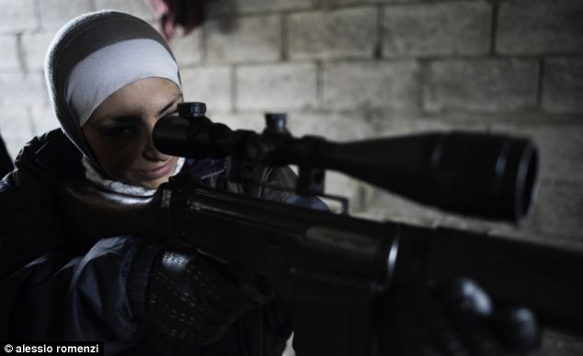
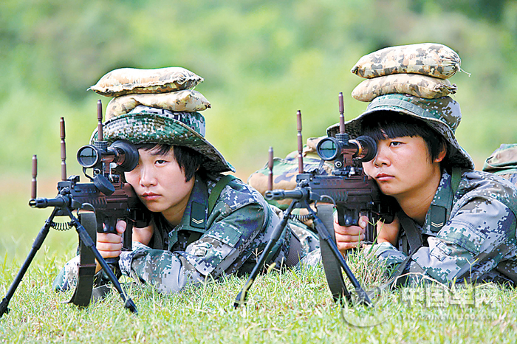
Military Snipers
Comments by Army Guard Sgt 1st Class Ben Dolan, former Marine sniper and the sniper school’s chief instructor:
“Frankly, women are better suited mentally for this job than most men….Women can shoot better, by and large, and they’re easier to train because they don’t have the inflated egos that a lot of men bring to these programs…Women will ask for help if they need it, and they will tell you what they think”
http://userpages/aug.com/captbarb/sniper.html

Slide 27
Review
1976 – Opening of Service Academies to Women
1993 – Women allowed to fly fighter jets and serve on combat ships, while at about the same time prohibited from serving in units whose primary role was direct ground combat
2001- Women deployed to Iraq and Afghanistan have found themselves in combat. Some have been wounded; some have died
2013 – All ground combat positions would be open to women but the services would have 3 years to present rationale for exceptions
August, 2015 – two women graduate from Army Ranger School
Dec 3, 2015 – Sec of Defense Ashton Carter announces that no exceptions will be made.
There are currently 2 cases making their way through the courts that argue that because all positions are now open to men and women, so women as well as men should register for the draft

