Slide 1
Witnesses to War
Ruth Kluger: Still Alive Lecture Two
Kluger’s appeal to common experience: watching a Disney Film in Hitler’s
Vienna
Snow White 1937
Nuremberg Laws 1935 in Germany
Went into effect in Austria after the Anschluss
Wikipedia English Translation:
http://en.wikipedia.org/wiki/Nuremberg_Laws
Further, more detailed prohibitions for Jews included special shopping hours,
restrictions on public transportation, not allowed in public swimming pools…

Slide 2
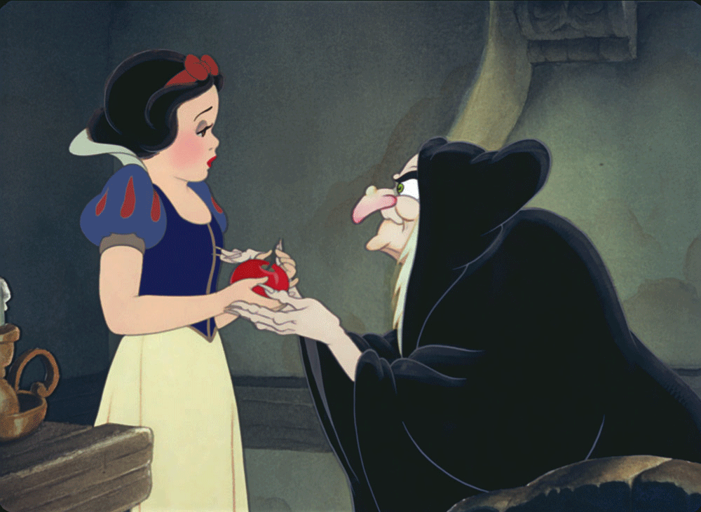

Slide 3
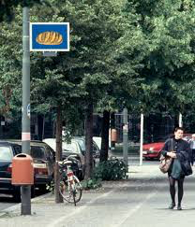
The Bayerische Platz Memorial in Berlin (Renate Stih, Frieder Schnoch)
http://fcit.coedu.usf.edu/holocaust/photos/laws1/laws1.htm
Restrictions included movie theaters

Slide 4
Reach of Nazi Propaganda
Jud Süss Directed by Veit Harlan 1940 Commissioned by Josef Goebbels
Starring Ferdinand Marian
Scene 3
Cues that we get as viewers.
How do you view this? Possibly you see Stuttgart’s lifting the ban on Jews
as a positive development
How did its intended audience view it? Differently
Nazi Ideology provides different cues—as does the poster

Slide 5
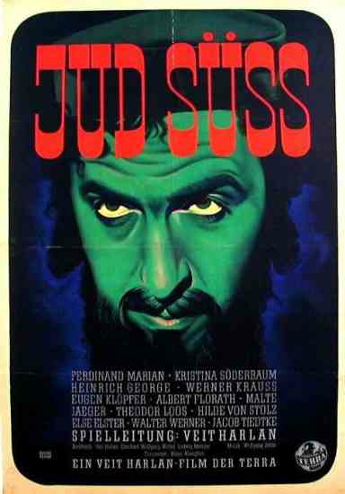

Slide 6
Monuments and Memorials and Museums and Centers
Monument: A statue or other structure that commemorates
A famous person or event. monere= to remind
Memorial: Often a synonym for monument but emphasizes the
mental exercise of memory. Of or belonging to memory.
Museum: Latin and Greek derivation= library, study, place of learning
Learning Center, Resource Center, Research Center
All of the above have been used to commemorate the Holocaust
Debates about the appropriateness of specific monuments and memorials

Slide 7
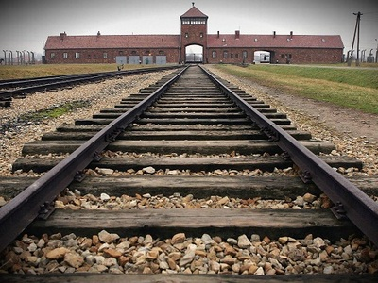
http://en.auschwitz.org/m/
Website of the camp memorial

Slide 8
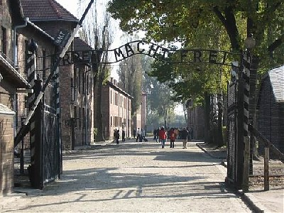
Gate of Auschwitz

Slide 9
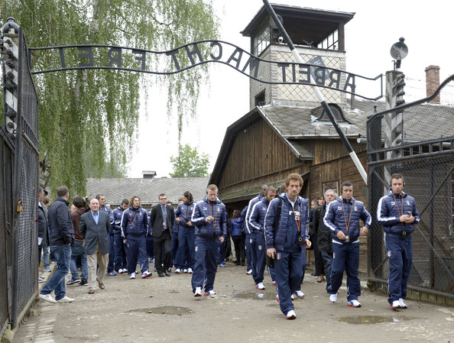
Italian Soccer Players entering the camp museum site:

Slide 10
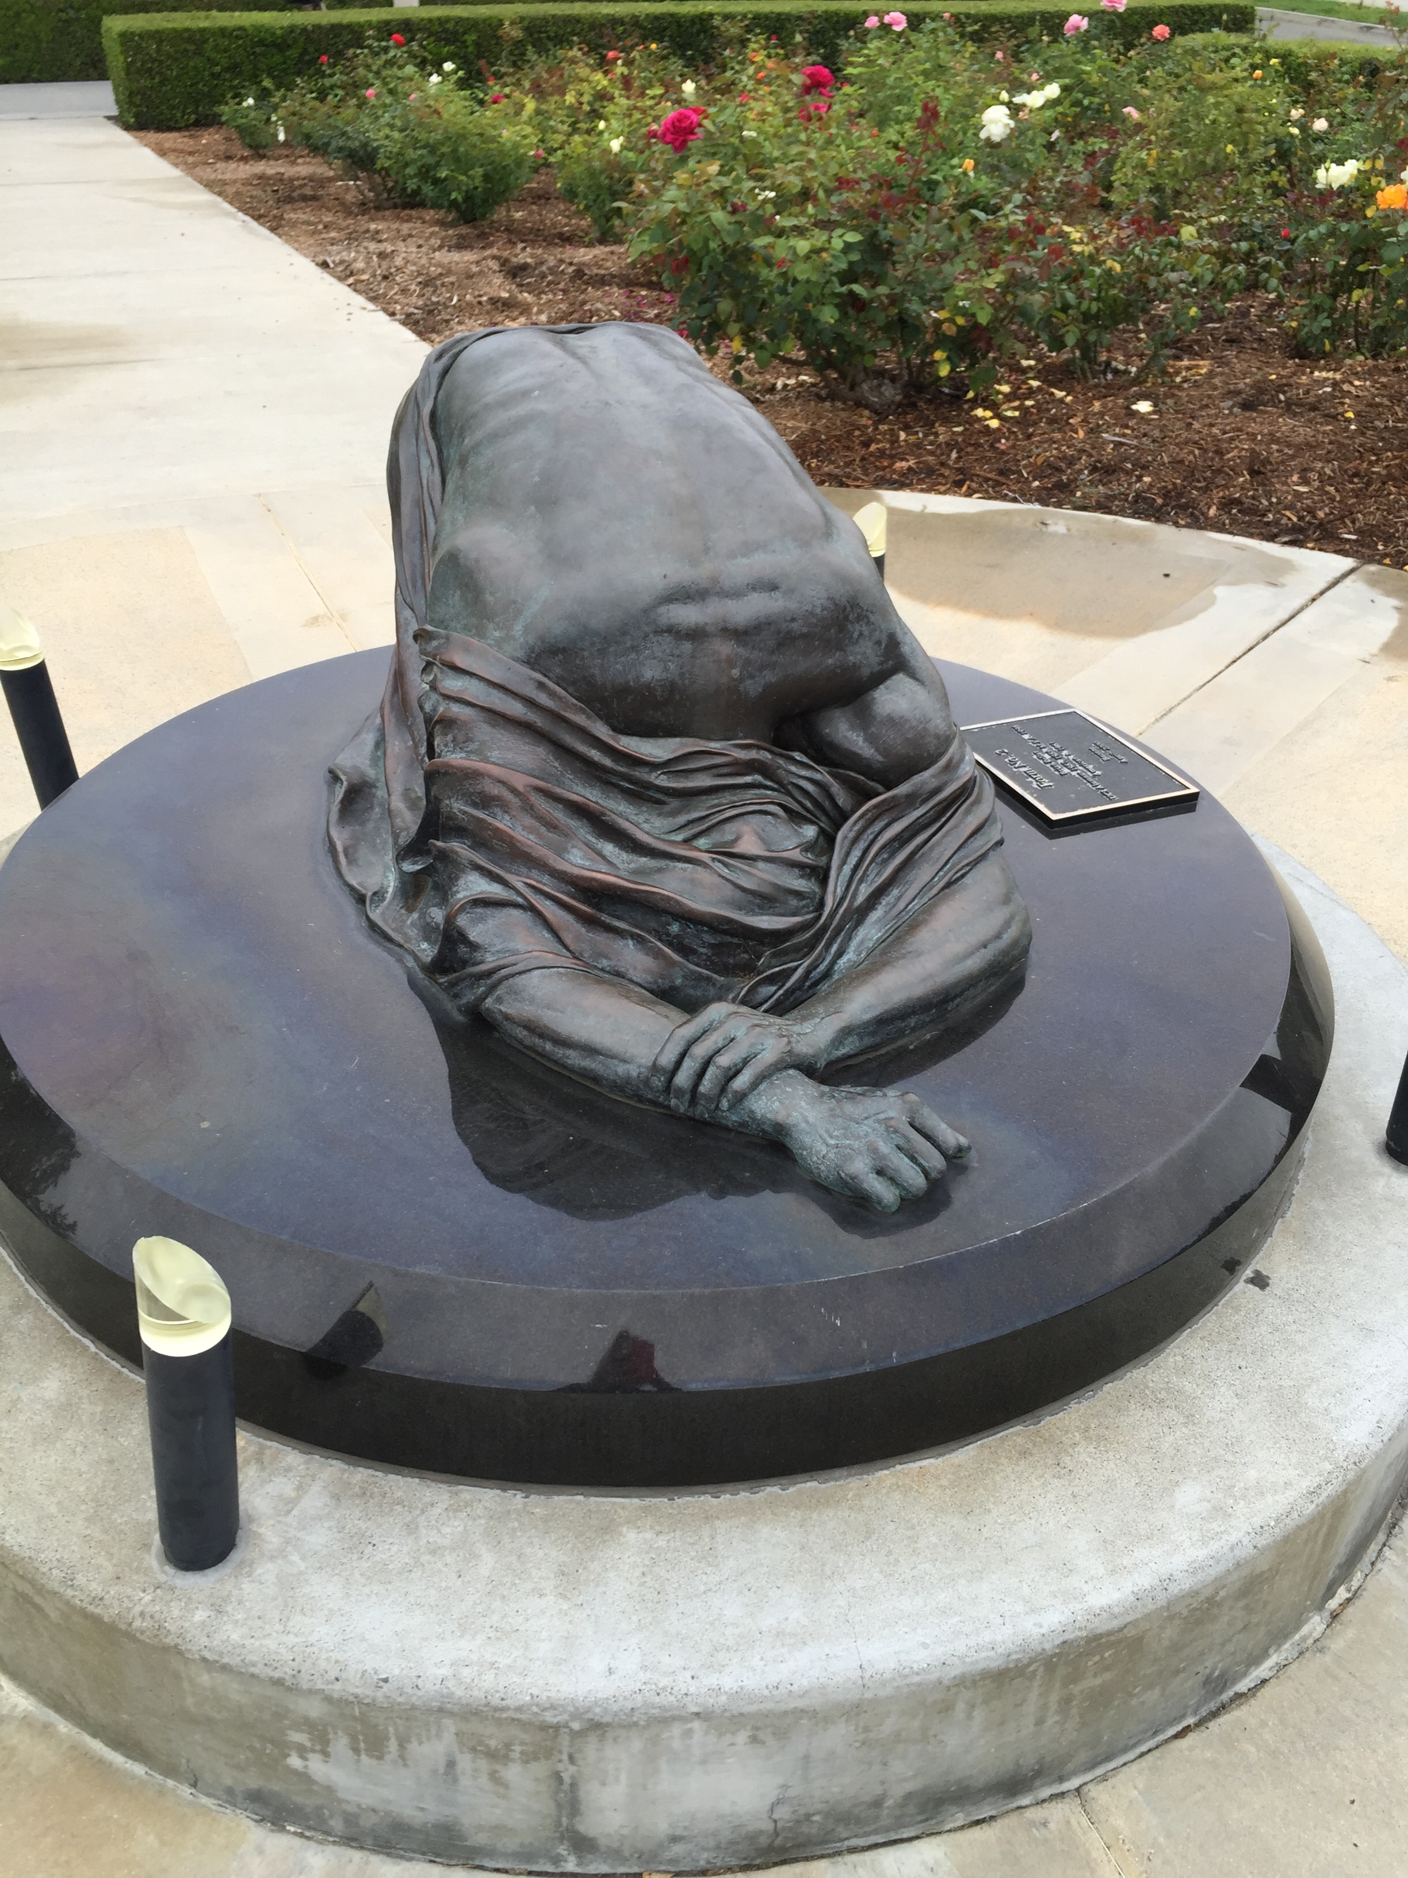

Slide 11
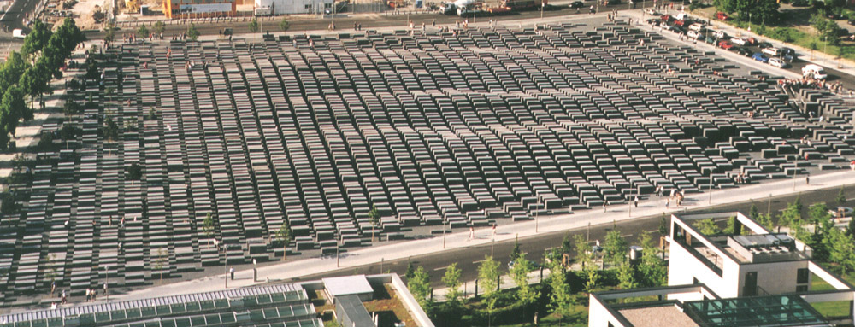
The Berlin Memorial to the Murdered Jews of Europe 2005 Peter Eisenman

Slide 12
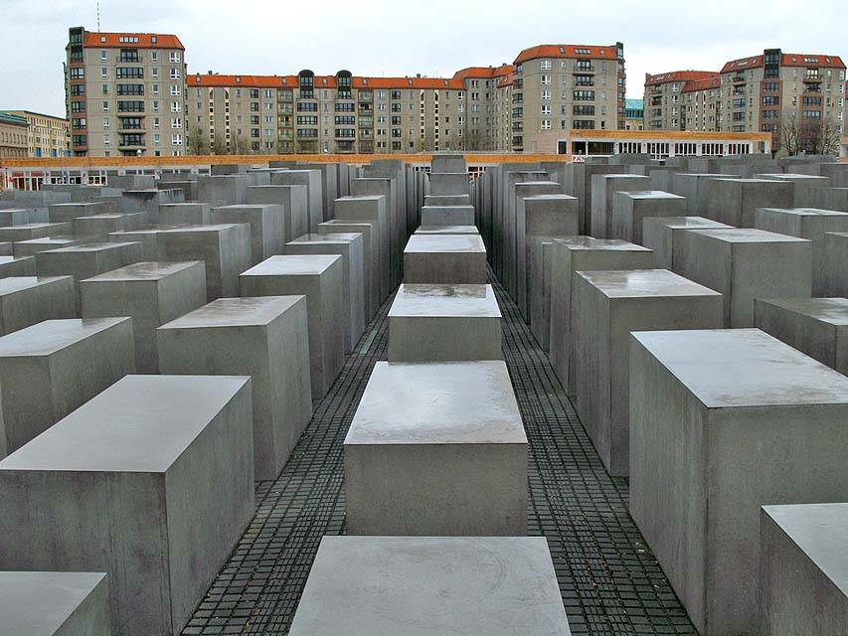
View from the ground

Slide 13

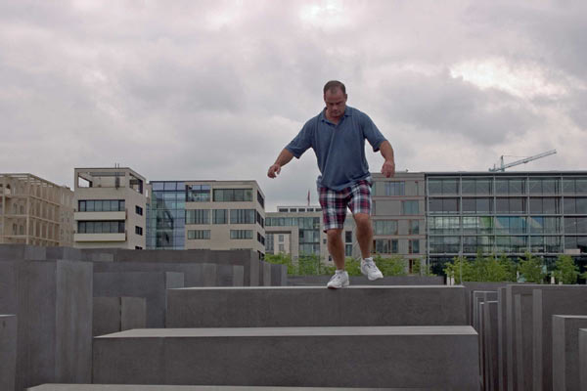

Slide 14
The Good Deed
And so one might argue that in the perverse environment of Ausschwitz
absolute goodness was a possibility, like a leap of faith, beyond the humdrum chair
of cause and effect. I don’t know how often it was consummated. Surely not
often. Surely not only in my case. But it existed. I am a witness.

