Slide 1
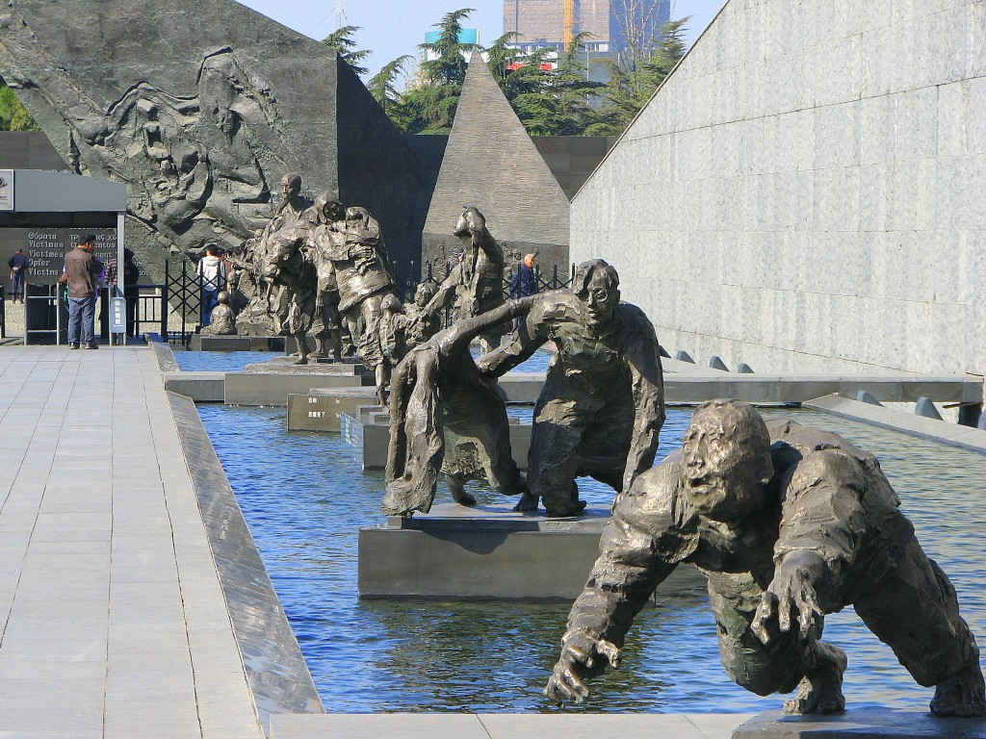
The Nanking Massacre
December 13, 1937 Japanese army enters the walled city
Estimates of 200,000-300,000 soldiers and civilians killed
20,000 women raped during a 6-week period beginning on December 13th

Slide 2
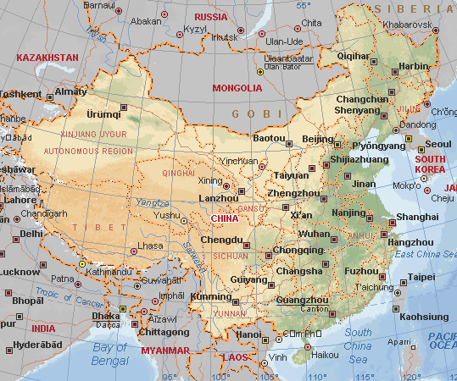

Slide 3
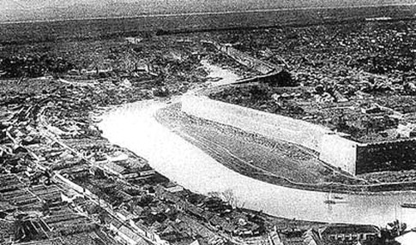
Founded 495 B.C.E Capital of China in 1937
City wall of Nanking

Slide 4
Why? Historians have suggested various reasons:
--The Japanese had expected Shanghai to fall much more quickly and easily
And they were angry at the Chinese as they reached Nanking. Nanking also
refused to surrender at first.
--Education, military training, and samurai tradition had taught the men disdain
for those who surrender rather than fight to the death. Most Japanese soldiers in the
war had chosen death over surrender.
--There were too many Chinese soldiers remaining. Once they had conquered the
city, the Japanese had to immobilize them or court retaliation. There was not enough
food available to maintain the Chinese soldiers as Prisoners of War.
--One of the commanders, Prince Asaka, had allegedly given the order :
Kill all captives.

Slide 5
BATTALION BATTLE REPORTER, AT 2:00 RECEIVED ORDER FROM
THE REGIMENT COMMANDER: TO COMPLY WITH ORDERS FROM
BRIGADE COMMANDING HEADQUARTERS, ALL PRISONERS OF
WAR ARE TO BE EXECUTED.
METHOD OF EXECUTION:
DIVIDE THE PRISONERS INTO GROUPS OF A DOZEN. SHOOT TO
KILL SEPARATELY.
Iris Chang. The Rape of Nanking: The Forgotten Holocaust of World War II. p. 41.
Prisoners were executed in much larger groups and large numbers of civilians were also killed.

Slide 6
How to explain this?
“Inhuman” ?
Human behavior in need of correction?
OR do we repress and forget?
------------------------------------------
Rarely discussed in Peoples Republic of China until the 1980s
Victimization as an affront to the national spirit *and*
need to maintain friendly economic relations with Japan
In Japan, Nanking was left out of the history books and even
denied by many—though many protested against denial.
Germany processed war guilt differently.

Slide 7
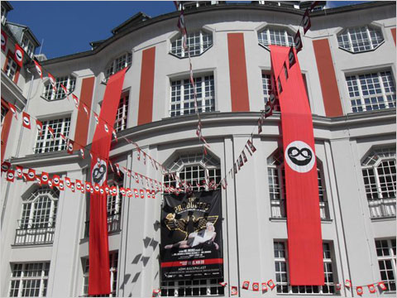

Slide 8
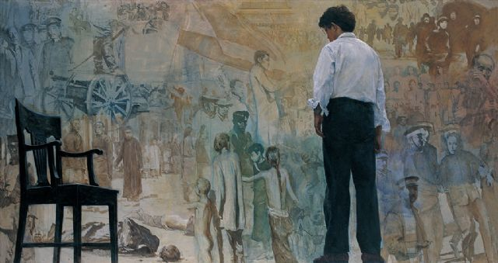

Slide 9

Iris Chang 1968-2004
The Rape of Nanking: The Forgotten Holocaust of WW II (1997)

Slide 10
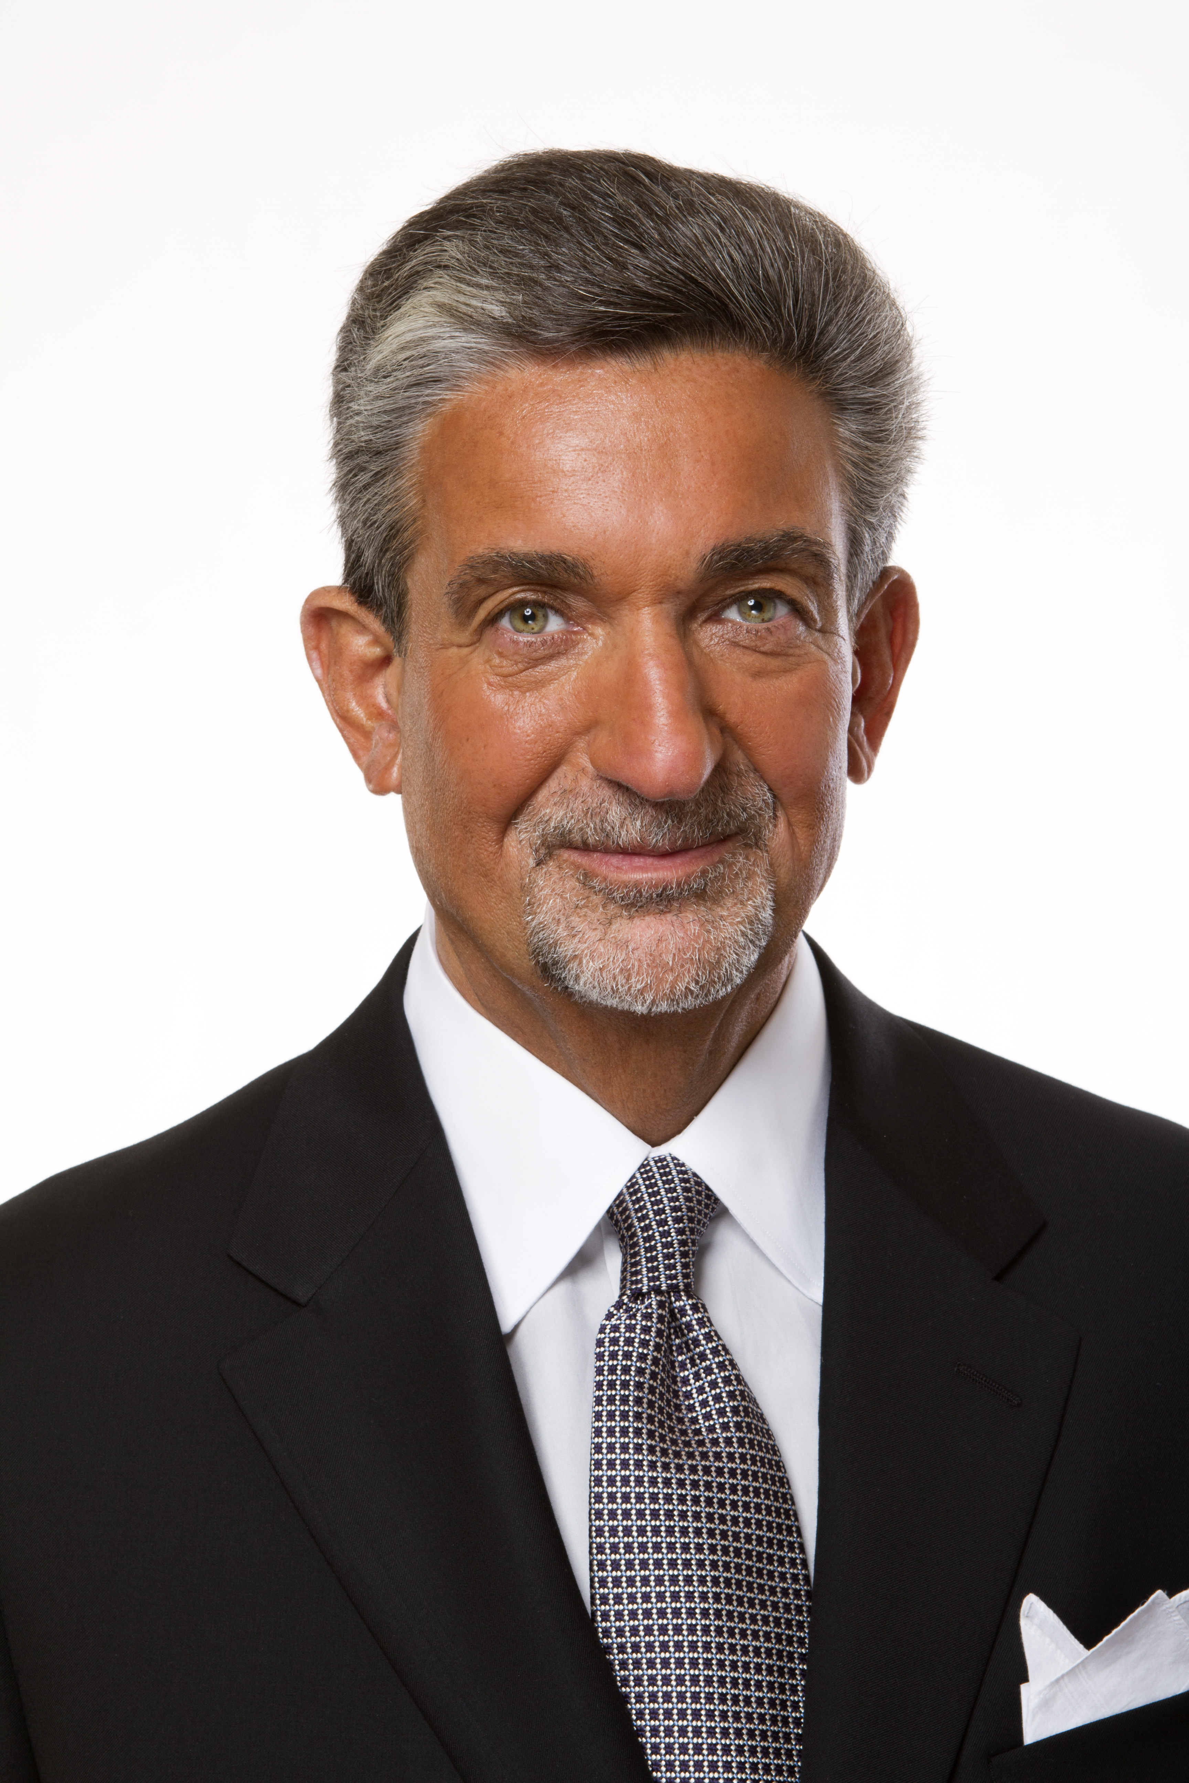
Ted Leonsis

Slide 11
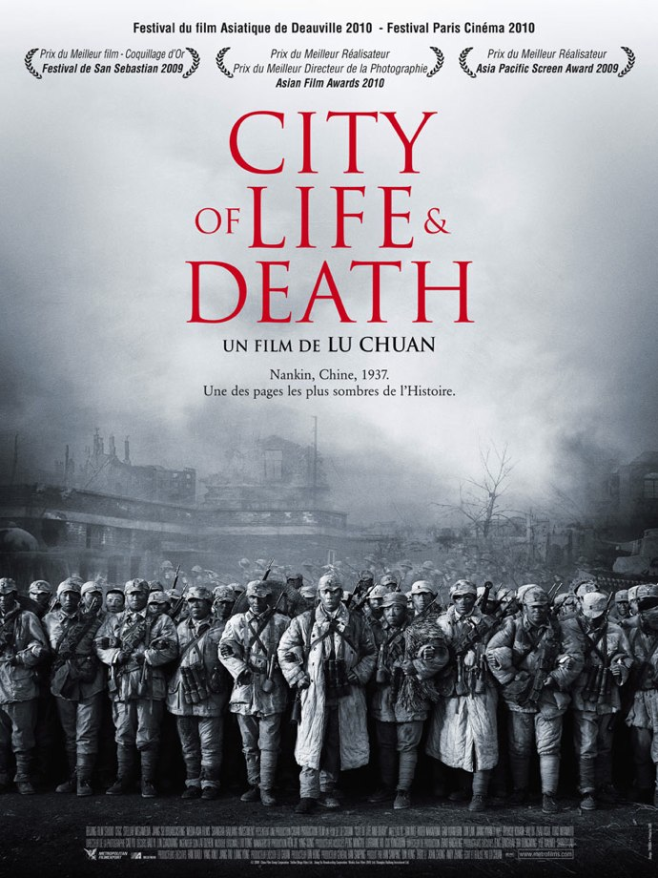
Leonsis engaged filmmakers Bill Guttentag and Dan Sturman
Nanking
ALSO assigned:
City of Life and Death 2009 for other, multiple perspectives

Slide 12
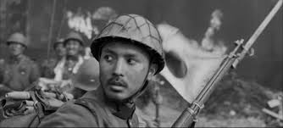
City of Life and Death
Shows the devastation from Chinese, Japanese, and western perspectives
Lu is constructing a different argument that involves the question:
WHAT WOULD YOU DO?
Richard Pena: “I think everybody is the Japanese soldier.”

Slide 13
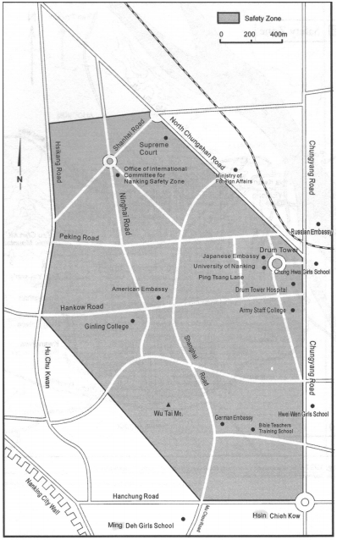
Internatl
Safety Zone

Slide 14
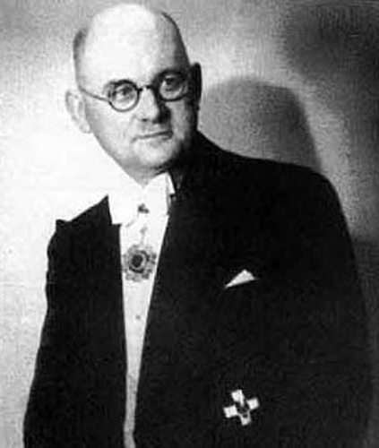
John Rabe 1882-1950
1882-1950

Slide 15
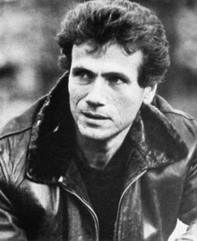
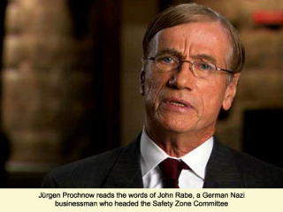
Jürgen Prochnow

Slide 16
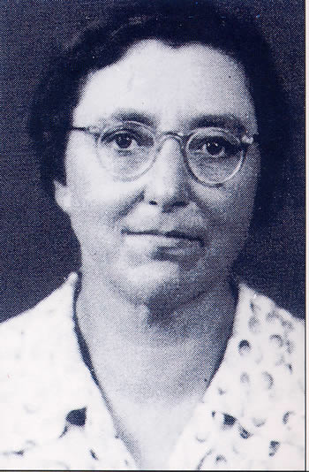
Minnie Vautrin 1886-1941
Dean of Studies at Ginling Women’s Arts and Science College in Nanking

Slide 17

Mariel Hemingway

Slide 18
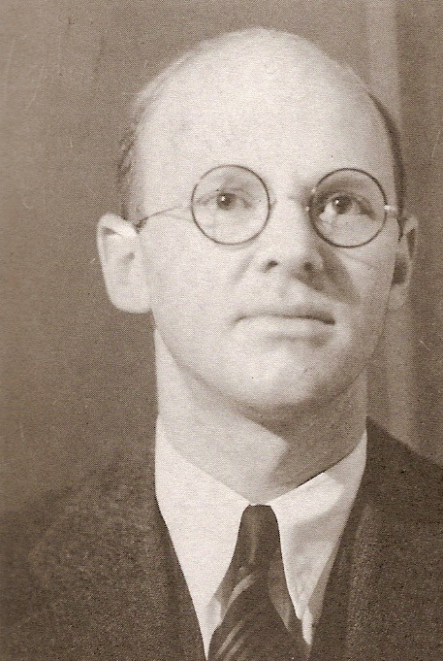
Robert O. Wilson 1904-1967 “The Only Surgeon in Nanking”

Slide 19
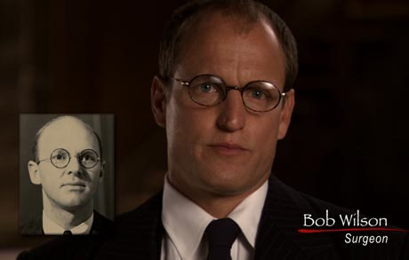
Woody Harrelson

Slide 20
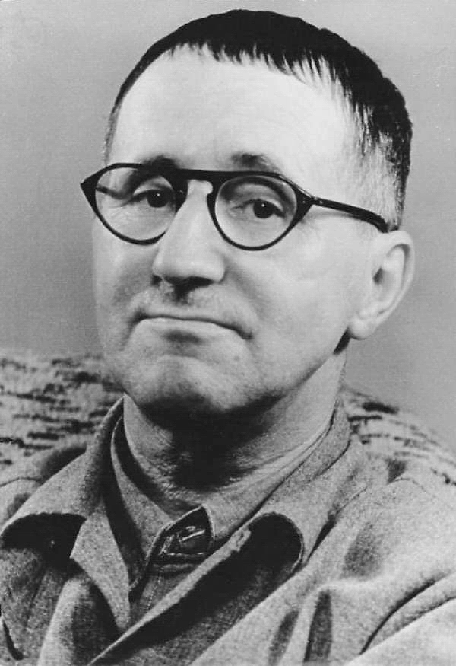
Bertolt Brecht 1989-1956
Remember Brecht and Mother Courage from Fall Quarter?
Theater of Alienation Alienation Effect
vs. Aristotelian Theater that involves identification and catharsis

Slide 21
