Slide 1
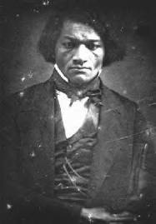
Contingency and History:
Frederick Douglass’s War on Slavery

Slide 2
To be “contingent”
“depending on something else that might or might not happen”

Slide 3
Historical contingency
The idea that historical events are dependent (or contingent) on multiple causes that shape when, how, and why an event occurs
The ways culture, history, and environment shape human character, beliefs, and values at specific moments in time
The opposite of inevitability

Slide 4
The Antislavery Movement
The emergence of radical abolitionism in the 1830s: why then?
1. Influence of evangelical Christianity
2. Rebellions in the Caribbean
3. Influence of British antislavery and the Slavery Abolition Act of 1833
4. Growing understanding of the South's commitment to slavery
5. William Lloyd Garrison and the founding of the Liberator in 1831 and the American Anti-Slavery Society in 1833

Slide 5
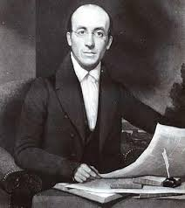
William Lloyd Garrison

Slide 6
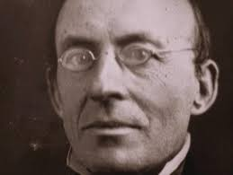
William Lloyd Garrison

Slide 7
The Liberator, Jan. 1, 1831
I am aware that many object to the severity of my language; but is there not cause for severity? I will be as harsh as truth, and as uncompromising as justice. On this subject, I do not wish to think, or to speak, or write, with moderation. No! no! Tell a man whose house is on fire to give a moderate alarm; tell him to moderately rescue his wife from the hands of the ravisher; tell the mother to gradually extricate her babe from the fire into which it has fallen; -- but urge me not to use moderation in a cause like the present. I am in earnest -- I will not equivocate -- I will not excuse -- I will not retreat a single inch -- AND I WILL BE HEARD. The apathy of the people is enough to make every statue leap from its pedestal, and to hasten the resurrection of the dead.

Slide 8
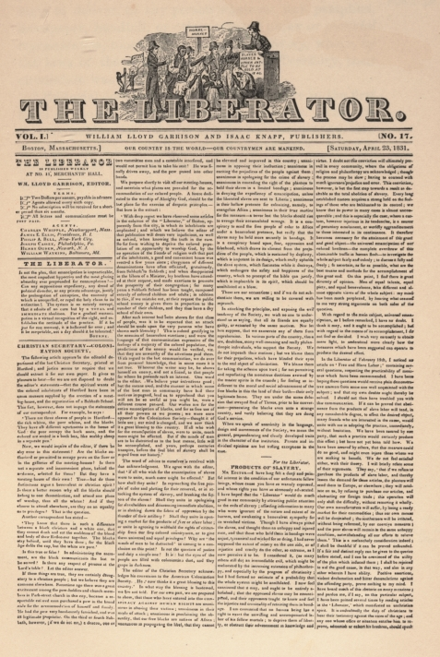

Slide 9
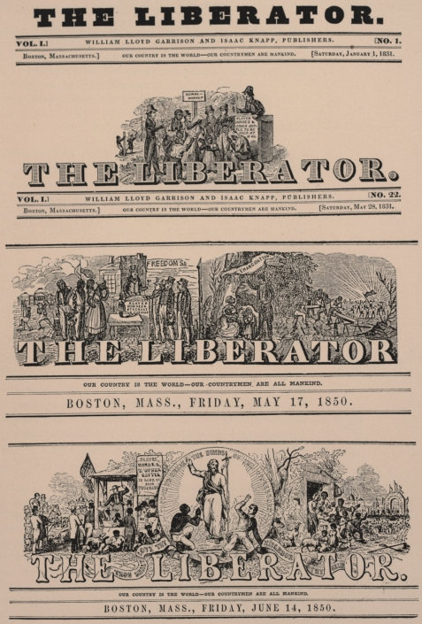

Slide 10
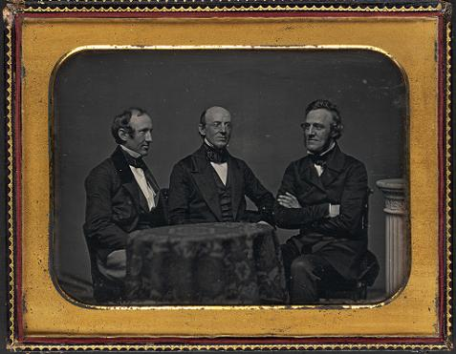
Wendell Phillips, William Lloyd Garrison, George Thompson

Slide 11
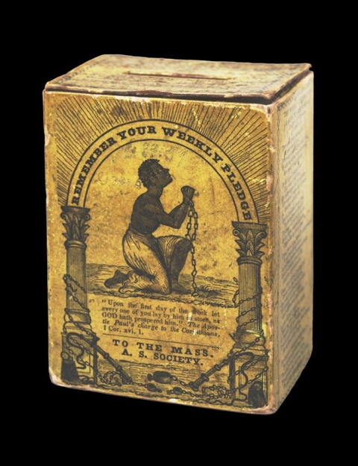

Slide 12
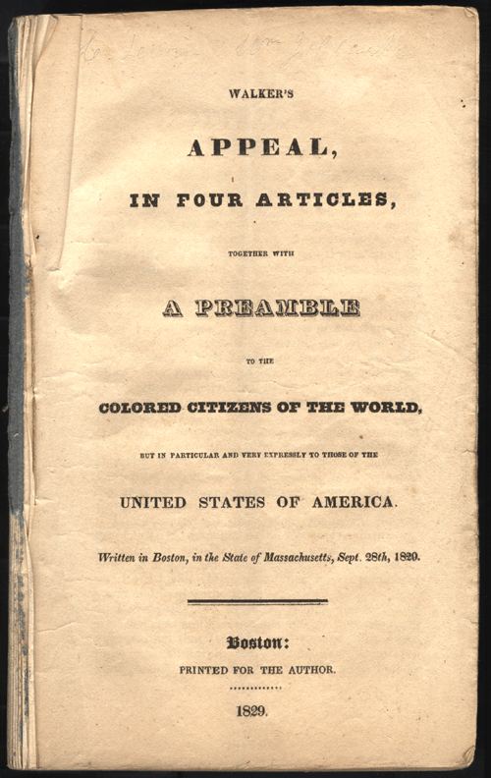

Slide 13
“Remember Americans, that we must and shall be free and enlightened as you are.
Will you wait until we shall, under God, obtain our liberty by the crushing arm of power?
Will it not be dreadful for you? I speak Americans for your good. We must and shall be free I say, in spite of you. You may do your best to keep us in wretchedness and misery, to enrich you and your children; but God will deliver us from under you.
And wo, wo, will be to you if we have to obtain our freedom by fighting.”
David Walker, Appeal to the Colored Citizens of the World, 1829-1830

Slide 14
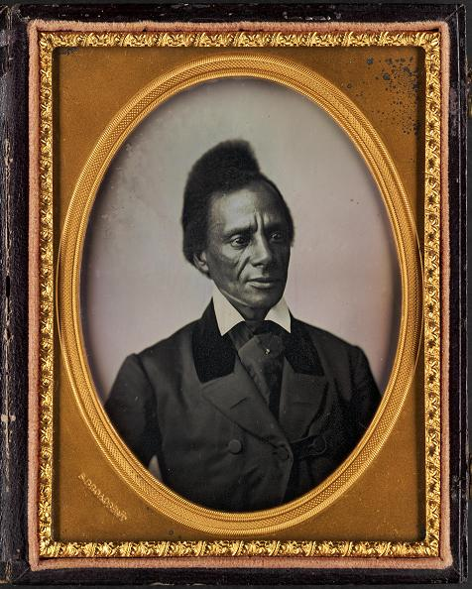
Charles Lenox Remond

Slide 15
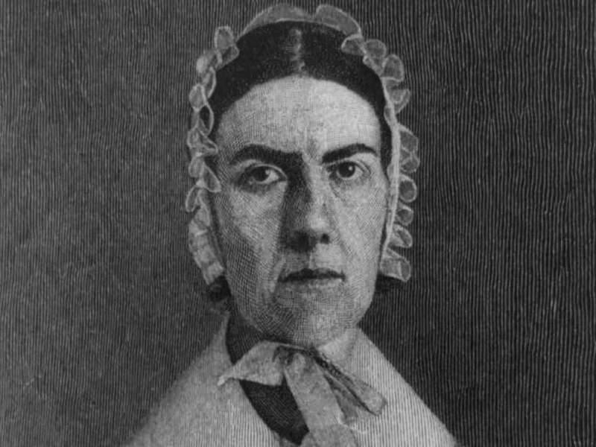
Angelina Grimke
“As a Southerner I feel that it is my duty to stand up here to-night and bear testimony against slavery.”

Slide 16
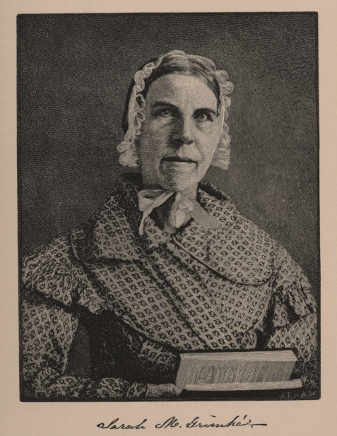

Slide 17
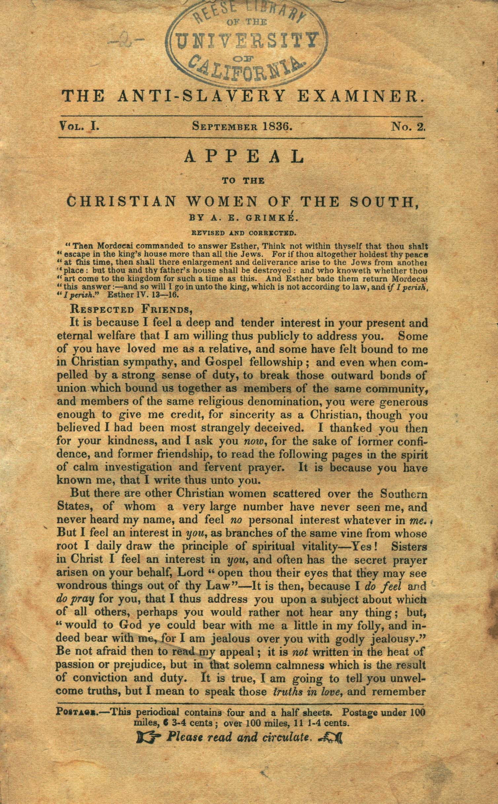

Slide 18
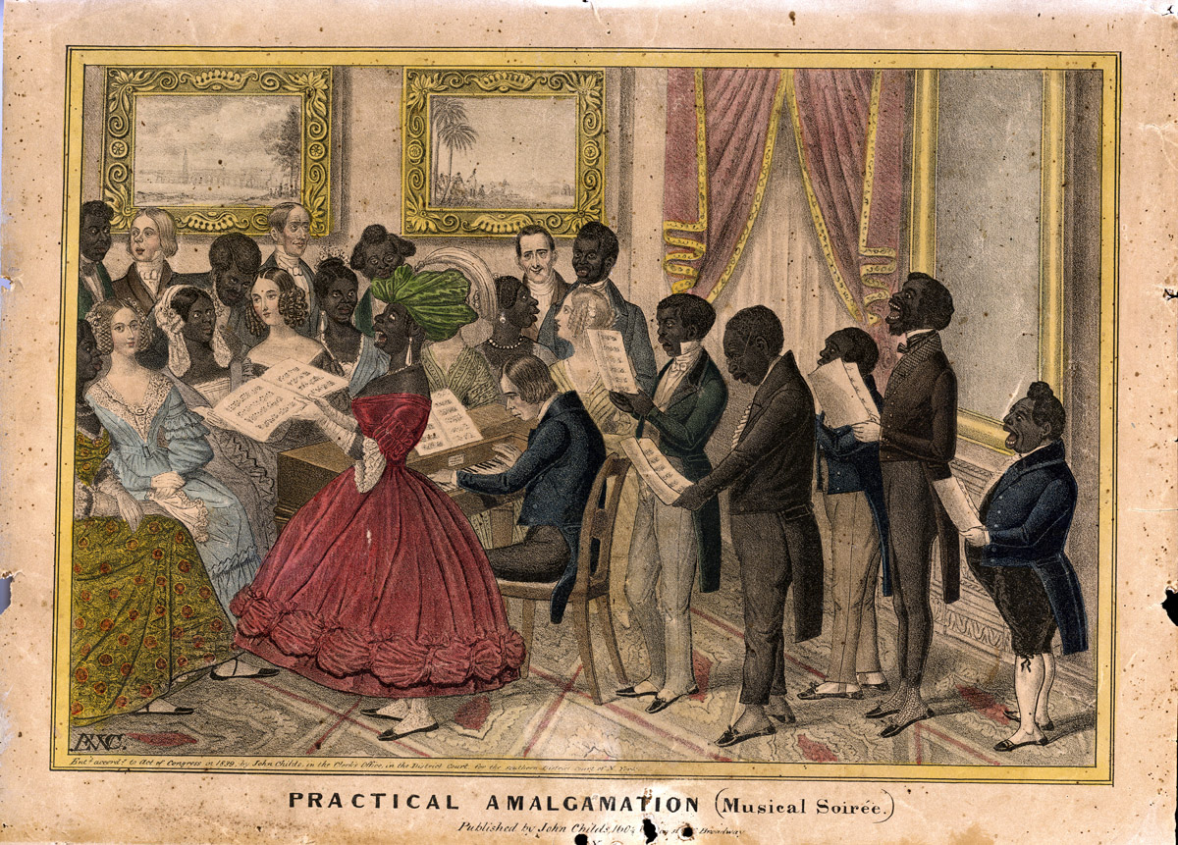
Satirical racist print, part of the “Practical Amalgamation Series,” created by Edward Williams Clay in 1839 and illustrating white fears of a mixing of the races.

Slide 19
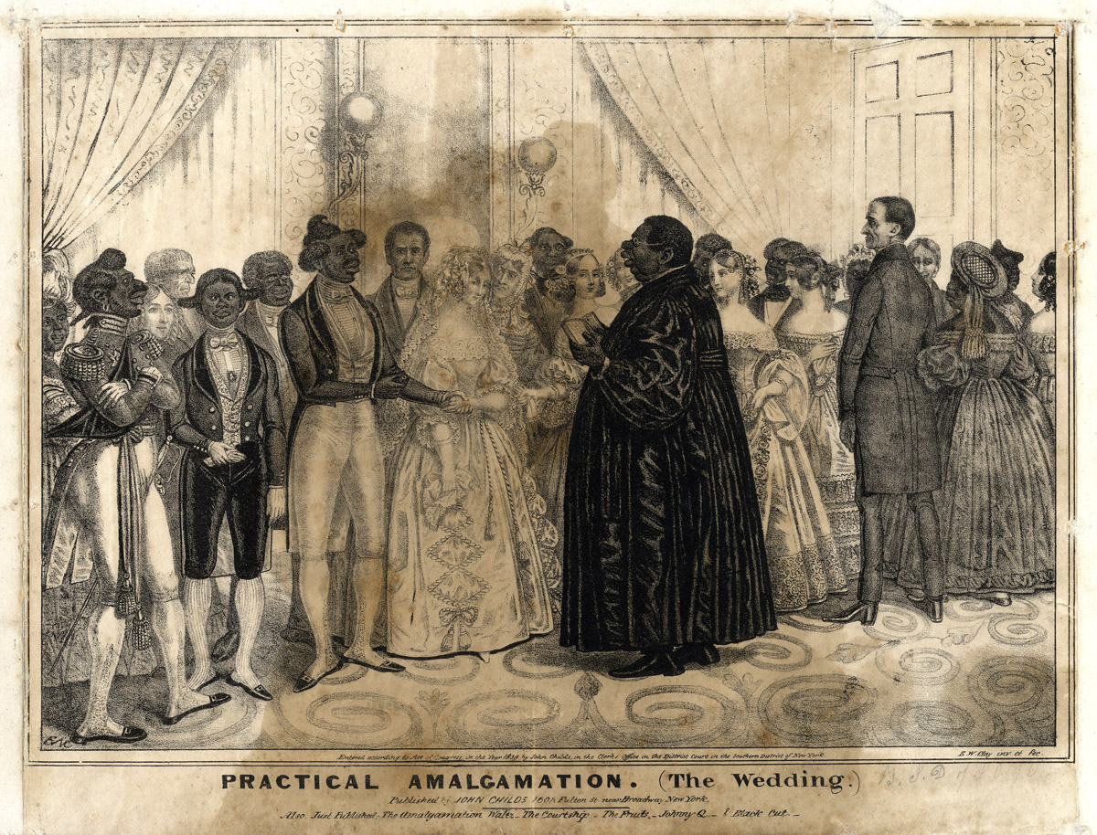

Slide 20
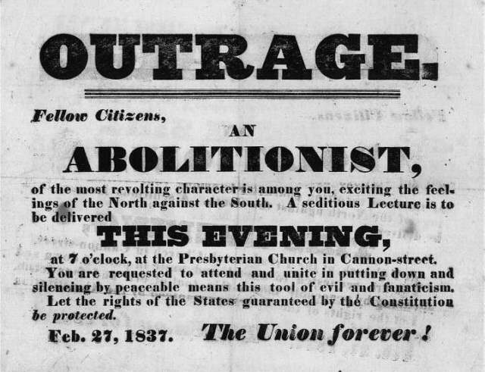

Slide 21
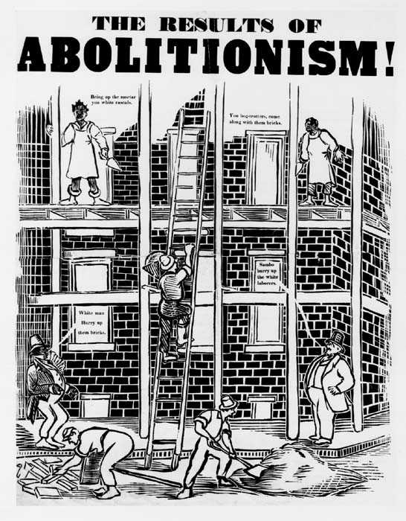
Notes:
From 1835, Library Company

Slide 22
Slave Narratives
Slave narratives as autobiographies with a purpose
  --Published in a propaganda war
  -- A form of literature
--Stories involving selection: we need to be attentive to what told, what left out
--Offering a rebuttal of racist and proslavery arguments

Slide 23
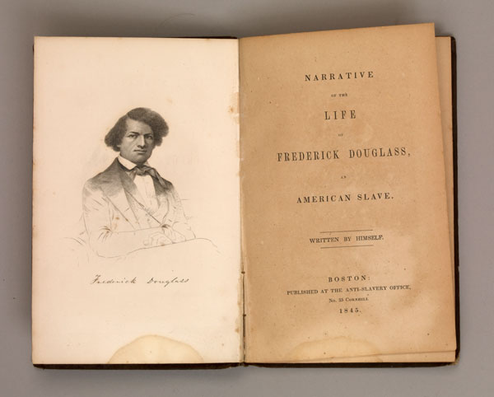

Slide 24
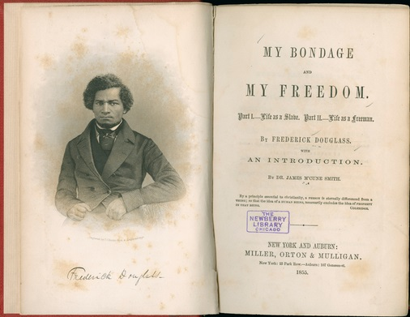

Slide 25
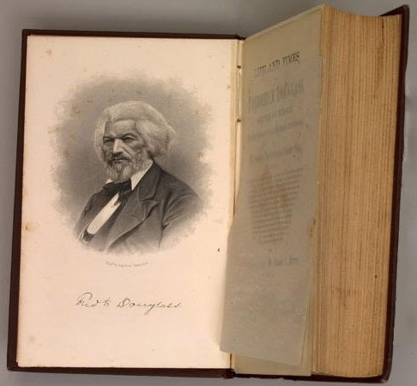

Slide 26
Frederick Douglass

Slide 27
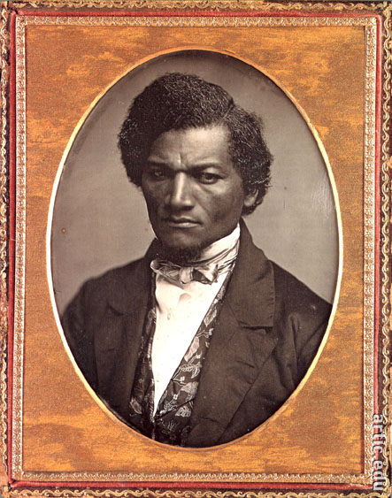

Slide 28
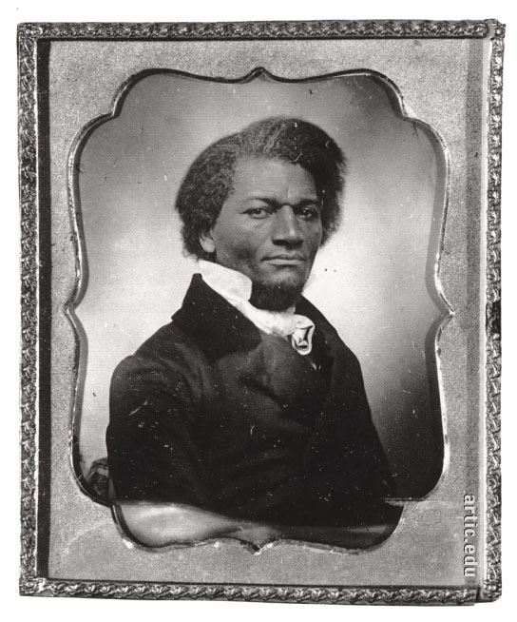

Slide 29
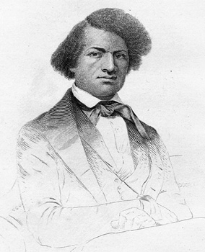

Slide 30
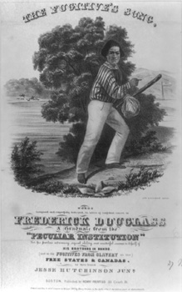

Slide 31


Slide 32
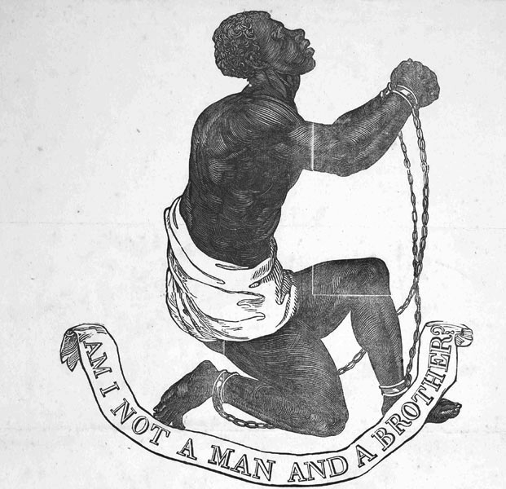

Slide 33
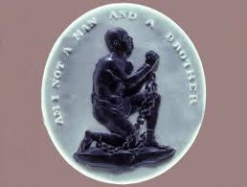

Slide 34
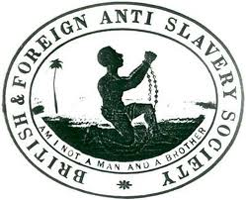

Slide 35
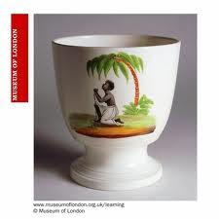

Slide 36
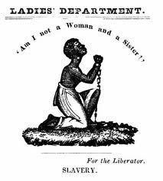

Slide 37
Female slave narratives and the question of gender
1. Heroic male individuals vs. mothers and daughters
2. Mary Prince's THE HISTORY OF MARY PRINCE (1831)
3. Lucy Delaney's FROM THE DARKNESS COMETH THE LIGHT (1891)
4. Harriet Jacobs and INCIDENTS IN THE LIFE OF A SLAVE GIRL (1861

Slide 38
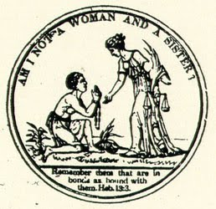

Slide 39
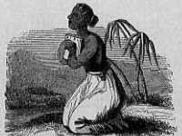

Slide 40
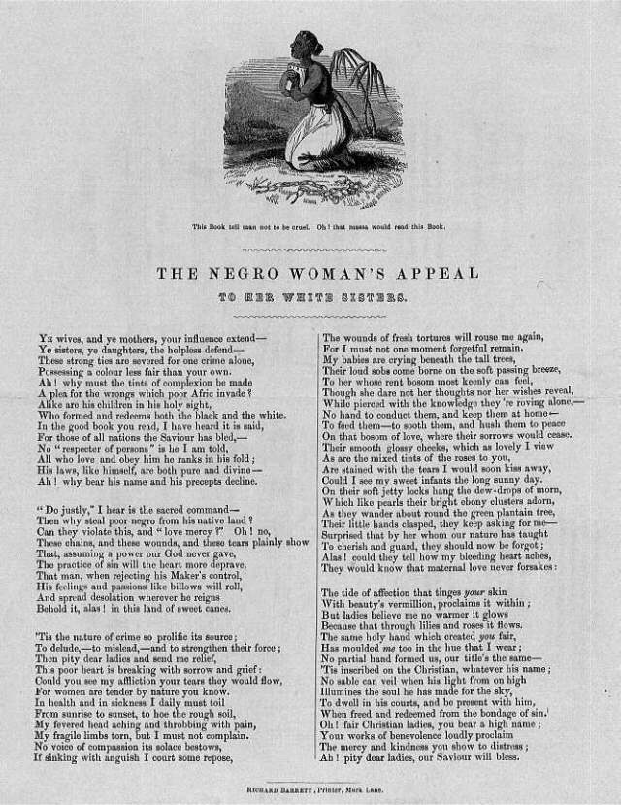

Slide 41
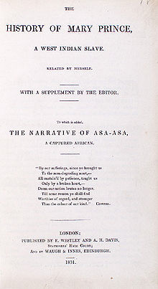

Slide 42
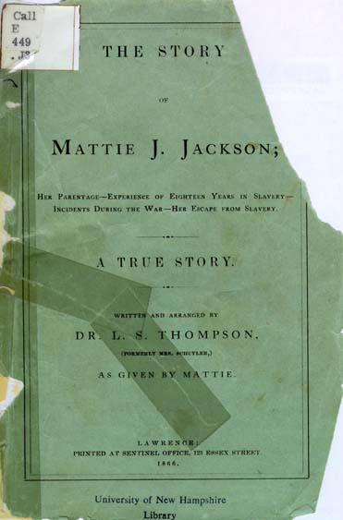

Slide 43
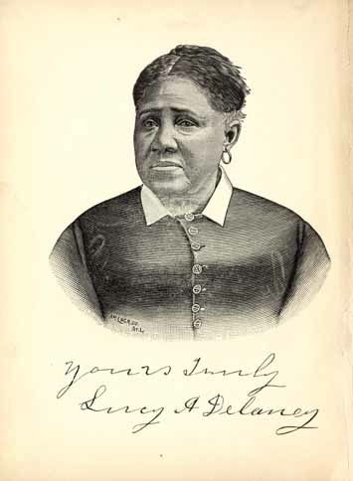

Slide 44
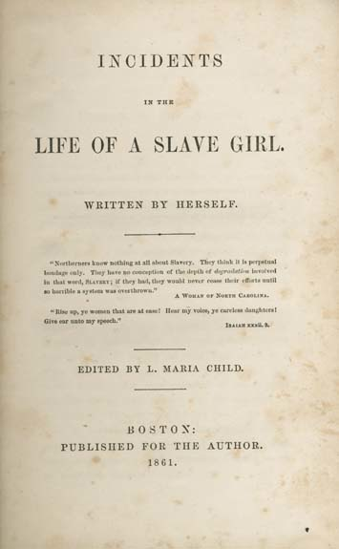

Slide 45
Lucy Delaney, FROM THE DARKNESS COMETH THE LIGHT OR STRUGGLES FOR FREEDOM (1891)

Slide 46
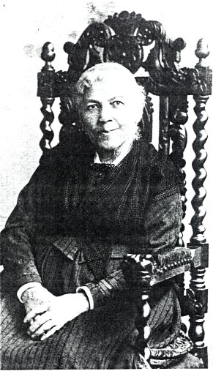

Slide 47
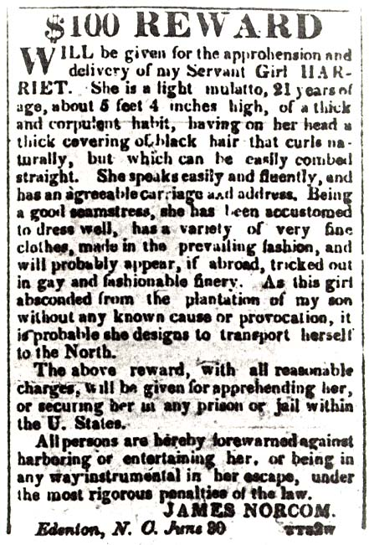
Notes:
Adverstisement for the capture of Harriet Jacobs, American Beacon (daily newspaper), Norfolk, Va., 1835

Slide 48
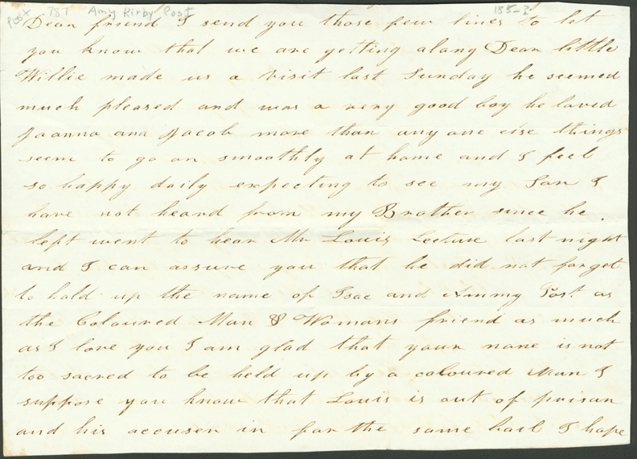
Excerpt from a letter from Harriet Jacobs to abolitionist Amy Post

Slide 49
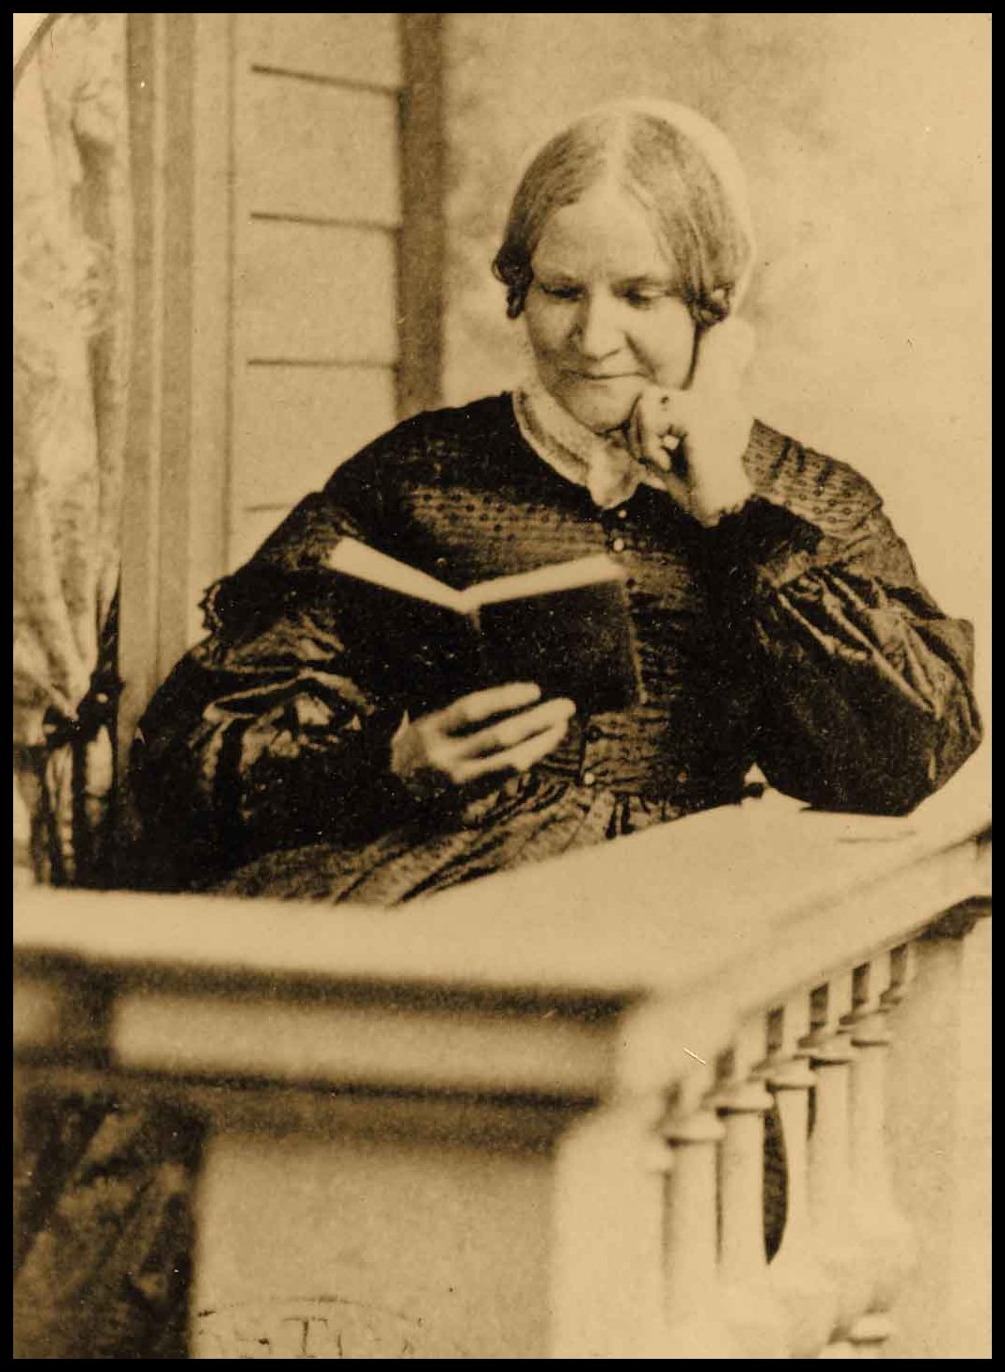
Lydia Maria Child

