Slide 1
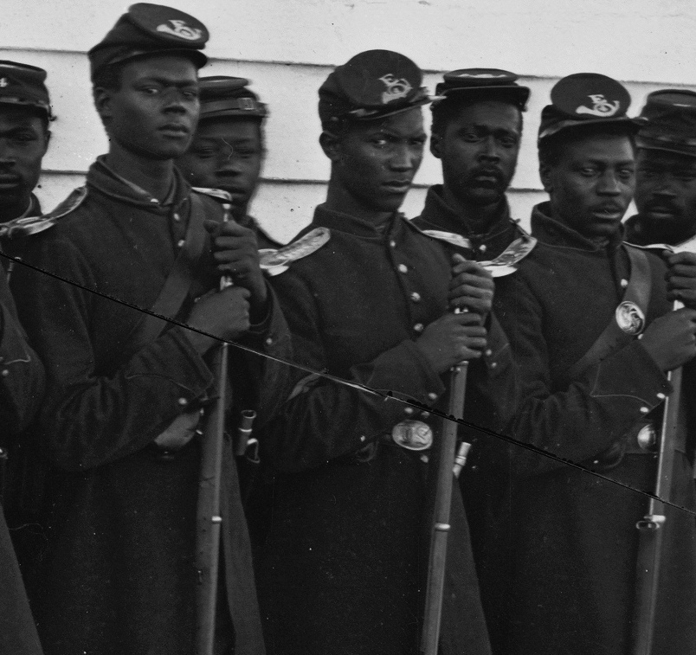
The Civil War and Historical Contingency: Emancipation and Black Soldiers

Slide 2
Questions for Consideration
Why did many Northerners, who were against both emancipation and black soldiering at the beginning of the Civil War, change their views during the course of the war?
What evidence—and what sources--can we use to understand changing Northern views?
How is that evidence related to a process of historical contingency—to the complicated ways in which social, cultural, economic and political factors intersect, often in unpredictable ways?

Slide 3
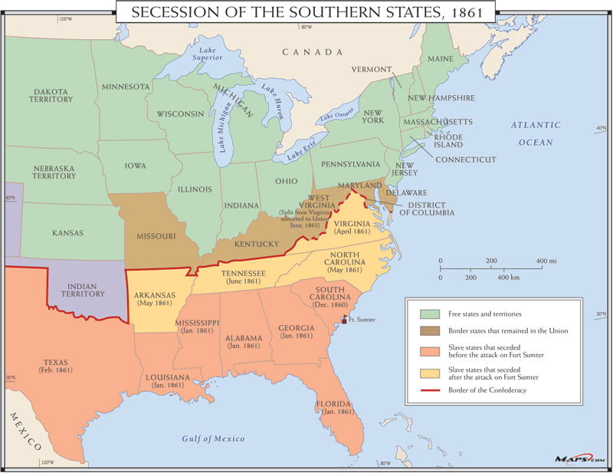

Slide 4
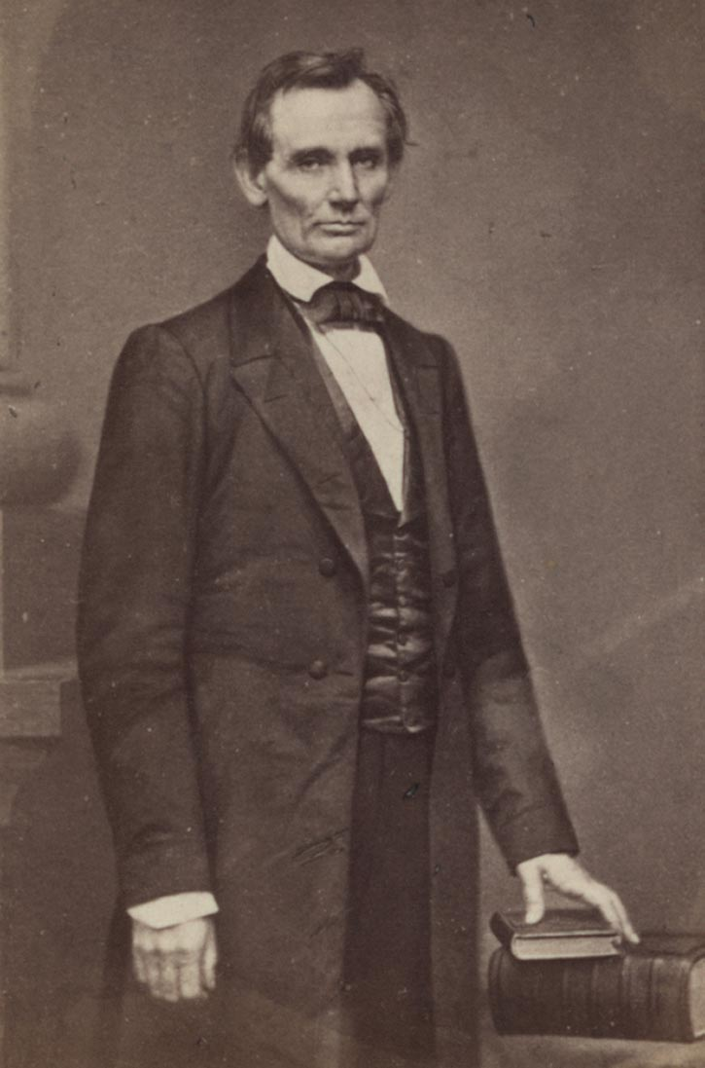
Lincoln in 1860

Slide 5
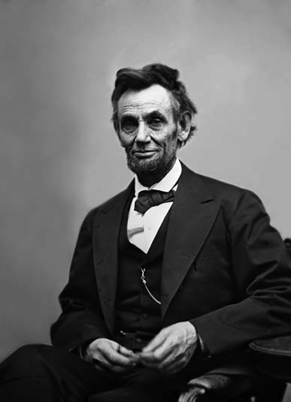
Lincoln in 1865

Slide 6
Lincoln’s First Inaugural Address
I am loth to close. We are not enemies, but friends. We must not be enemies. Though passion may have strained, it must not break our bonds of affection. The mystic chords of memory, stretching from every battle-field and patriot grave, to every living heart and hearthstone, all over this broad land, will yet swell the chorus of the Union, when again touched, as surely they will be, by the better angels of our nature.

Slide 7
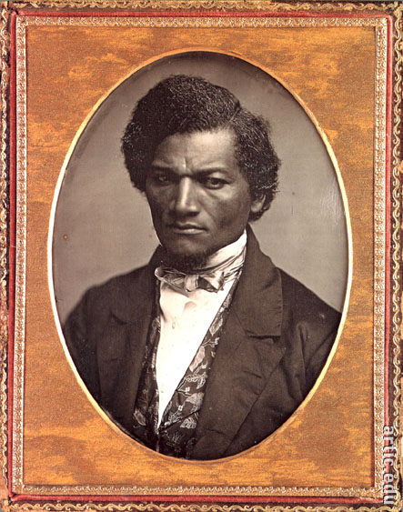

Slide 8
Paths to Emancipation by Enslaved Men and Women
Slaves who free themselves as "contrabands" in the Upper South
The actions of enslaved men and women: rumor, “voting with their feet,” and other forms of resistance
C. The Civil War as a war within a war: slaves resisting masters in the Lower South

Slide 9
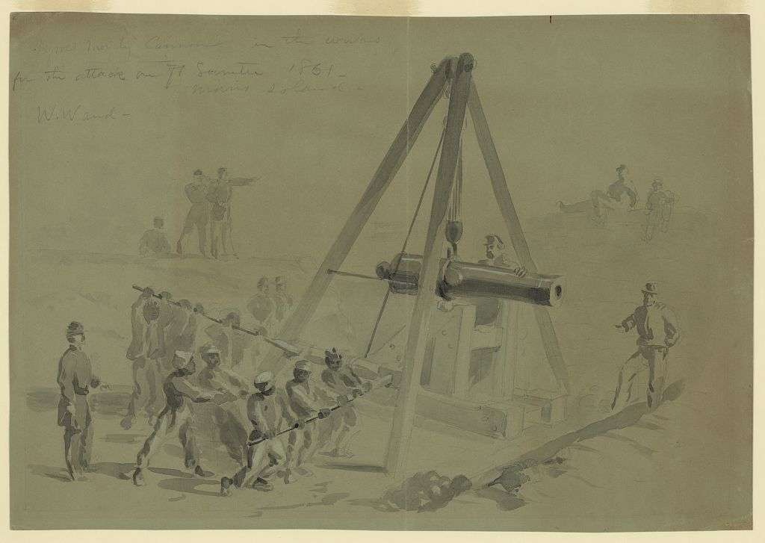
"Negroes mounting Cannon in the works for the attack on Ft. Sumter 1861--Morris Island" William Waud, April 12, 1861. Source: Library of Congress

Slide 10
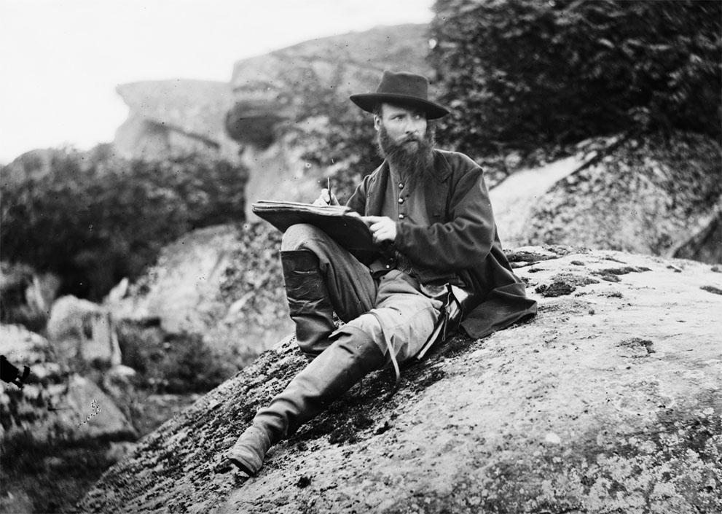
Artist Alfred Waud sketching in July 1863, at Gettysburg. Photograph by Timothy O’Sullivan.

Slide 11
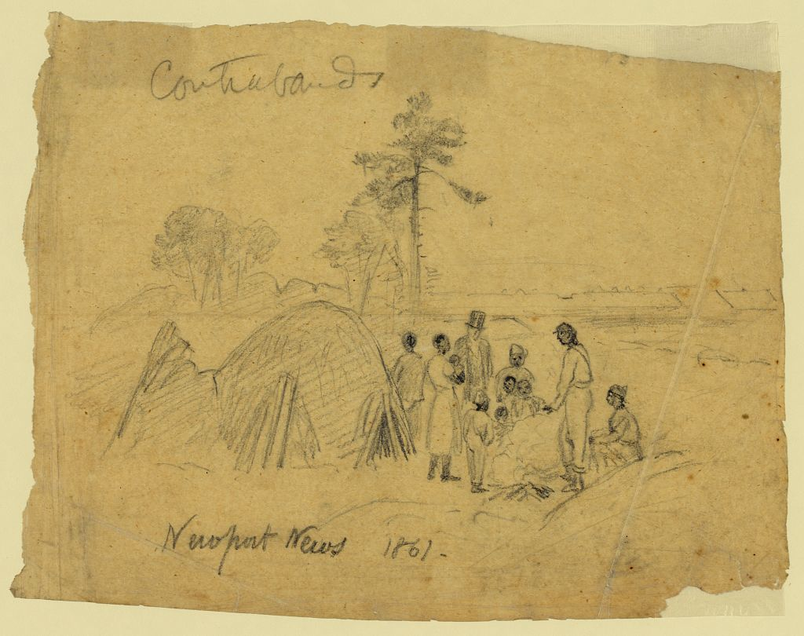
Contrabands, Newport News, 1861. Alfred R. Waud. Source: Library of Congress

Slide 13
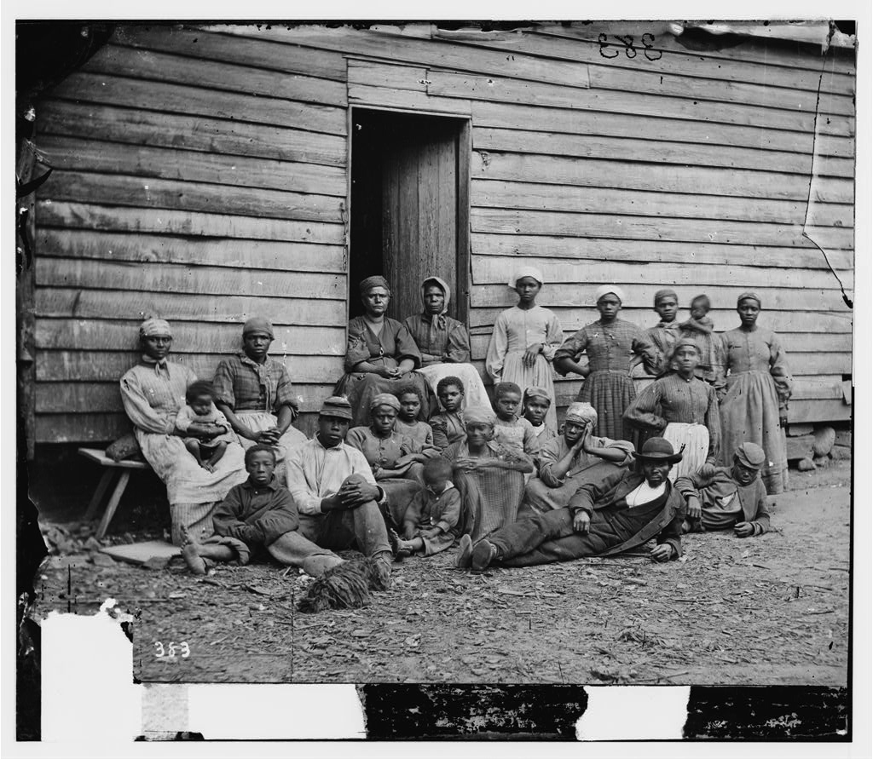
Cumberland Landing, Va. group of "contrabands", May 14, 1862, James F. Gibson, photographer. Source: Library of Congress

Slide 14
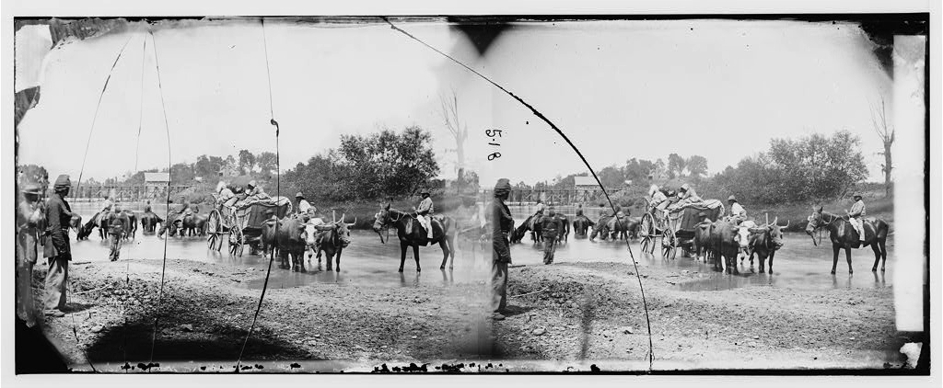
Fugitive slaves fording the Rappahannock River, August 1862. Photographer: Timothy O'Sullivan. Source: Library of Congress

Slide 16
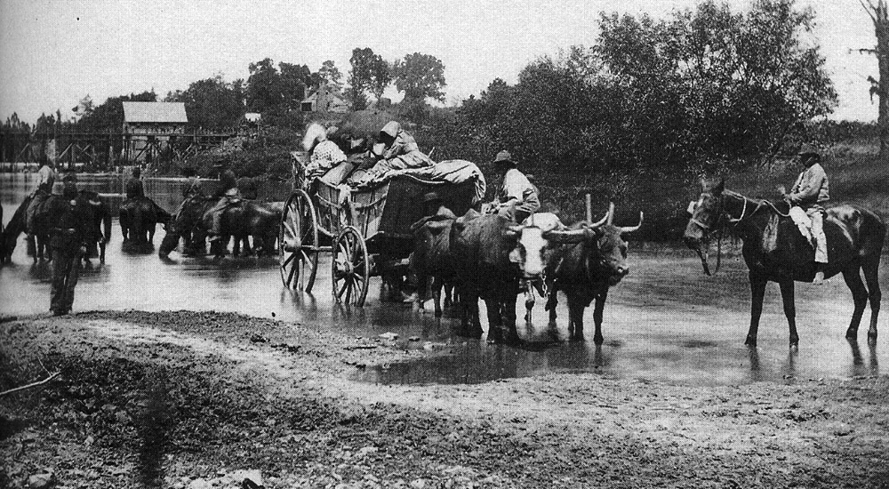

Slide 17
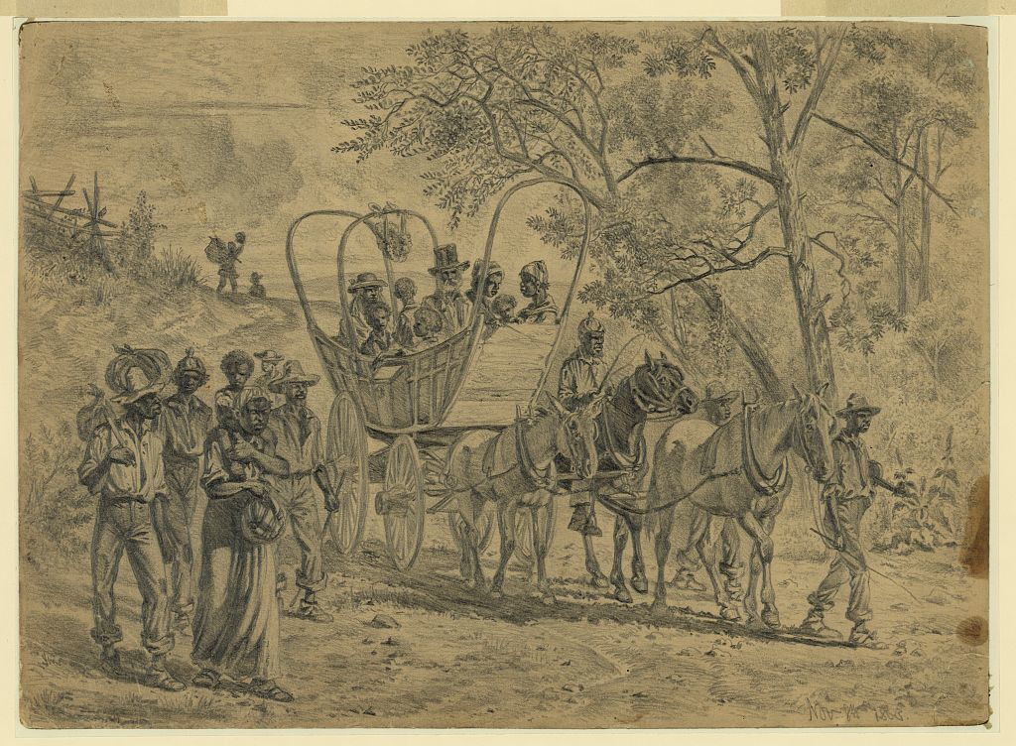
African American refugees coming into the Union Lines near Culpepper Court House, Va. Edwin Forbes, Nov. 8, 1863. Source: Library of Congress

Slide 19
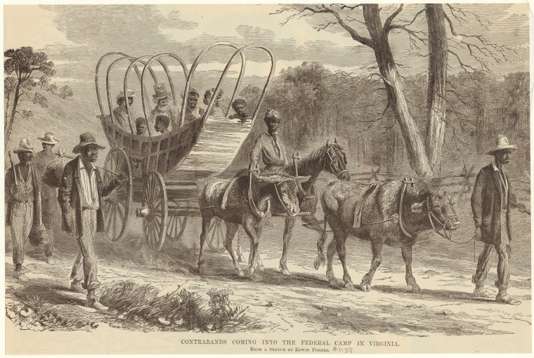
"Contrabands Coming into the Federal Camp in Virginia. From a Sketch by Edwin Forbes"

Slide 20
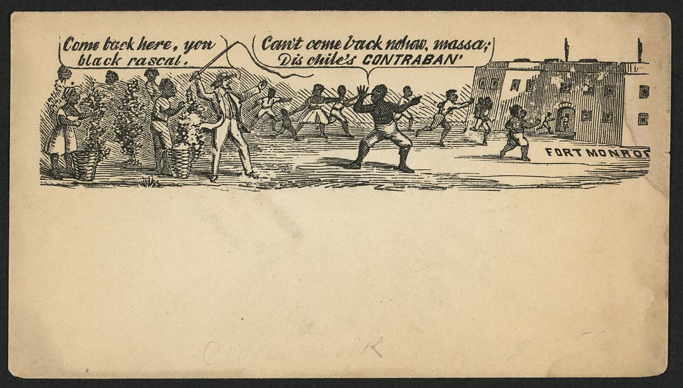
Contraband envelope

Slide 21
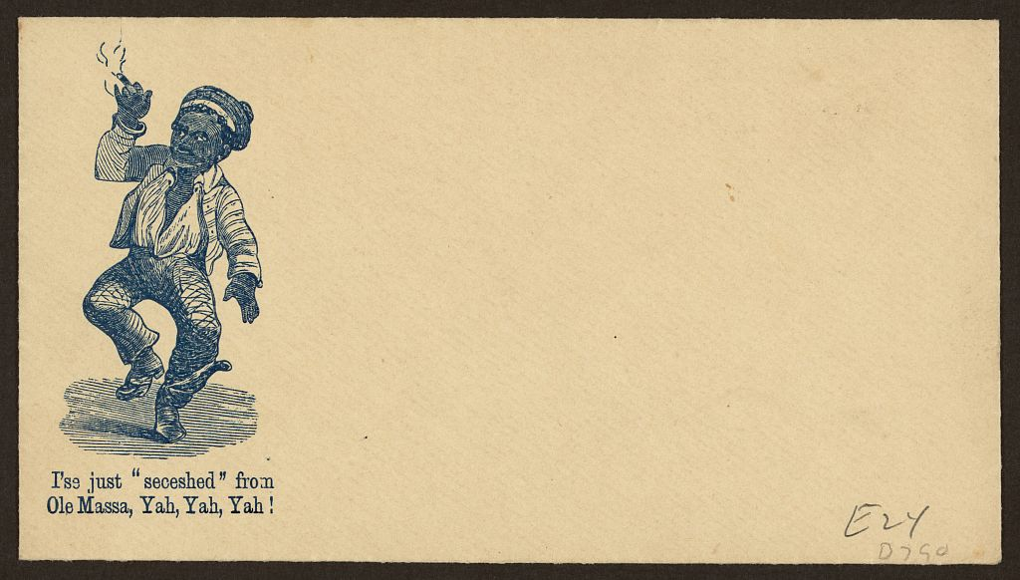
Contraband envelope

Slide 22
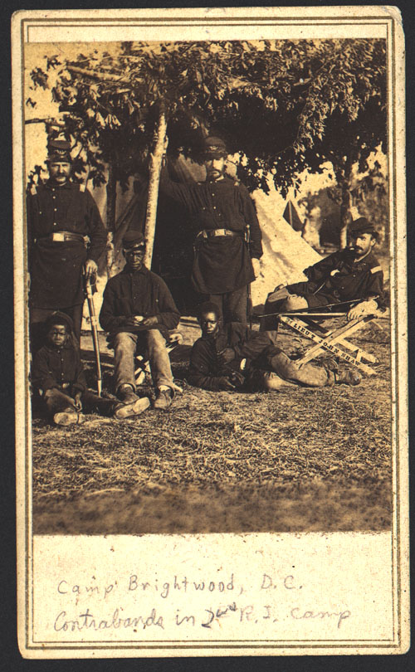

Slide 23
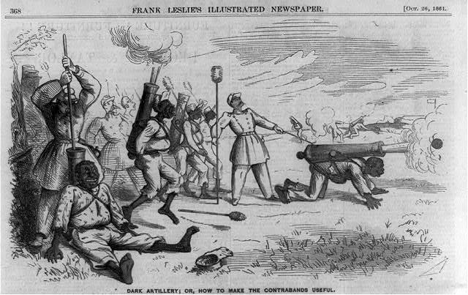
“Contraband” cartoon, October 1861

Slide 24
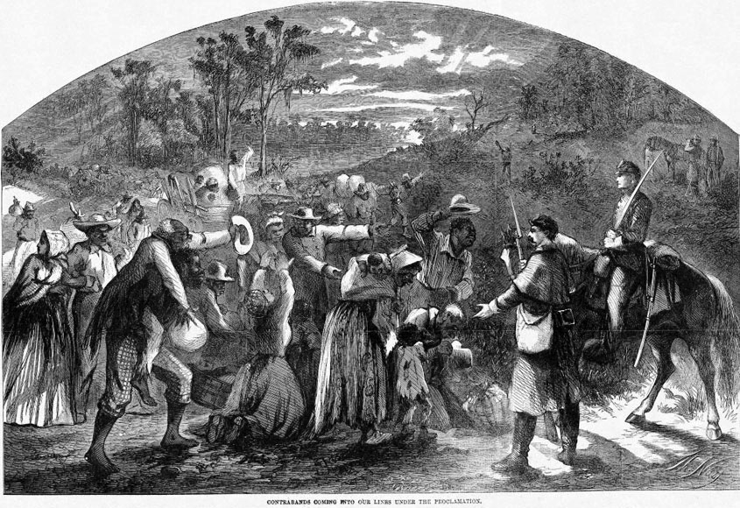

Slide 25
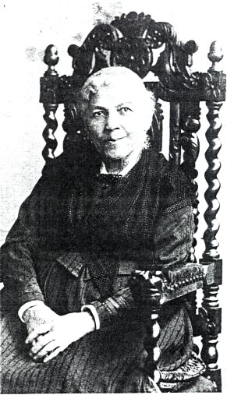
Harriet Jacobs
Author of “Life Among the Contrabands,” The Liberator, Sept. 5,
1862
Author of Incidents in the Life of a Slave Girl, Written by Herself, 1861

Slide 26
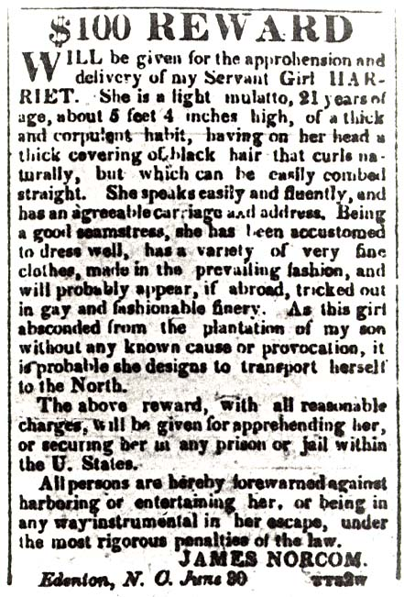
Advertisement for the Capture of Harriet Jacobs, 1835
Notes:
Adverstisement for the capture of Harriet Jacobs, American Beacon (daily newspaper), Norfolk, Va., 1835

Slide 28
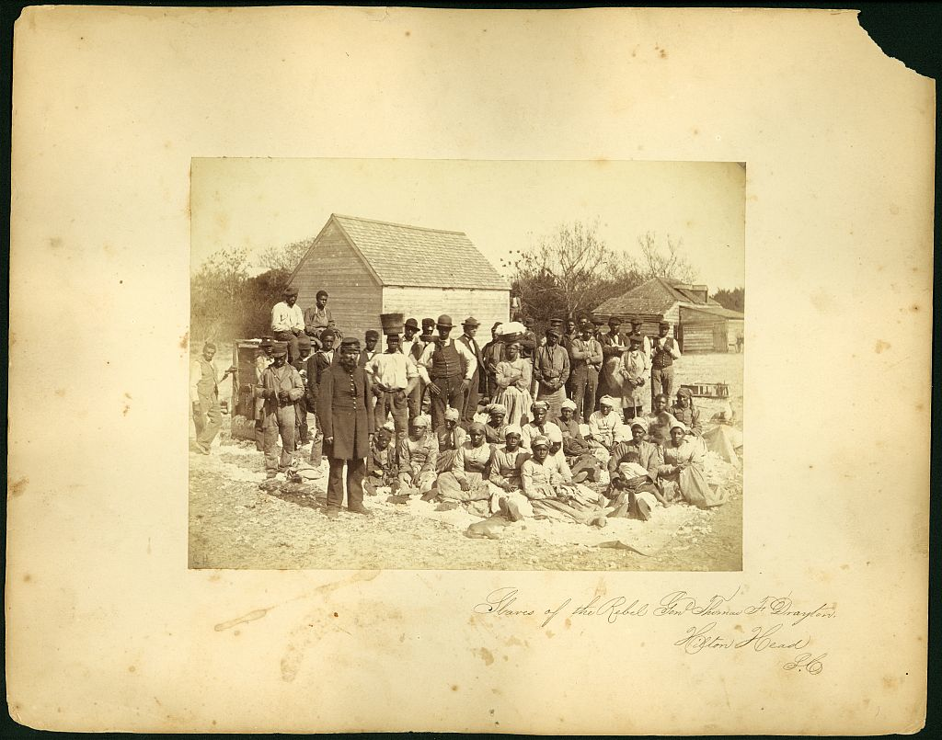
Slaves of the Rebel General Thomas F. Drayton, Hilton Head, South Carolina, May 1862. Henry P. Moore, photographer

Slide 29
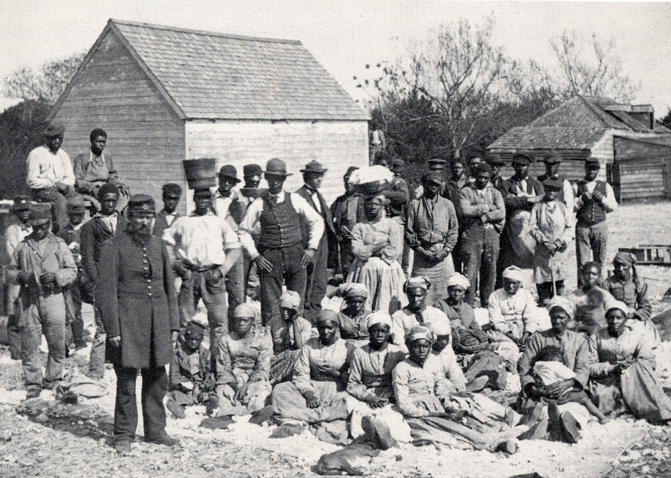

Slide 30
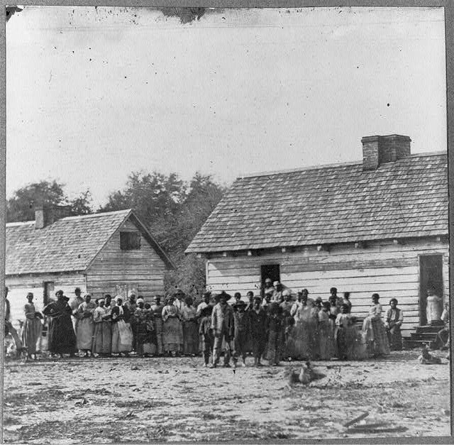
"Large group of slaves standing in front of buildings on Smith's Plantation, Beaufort, South Carolina." Timothy O'Sullivan, photographer. Source: Library of Congress

Slide 31
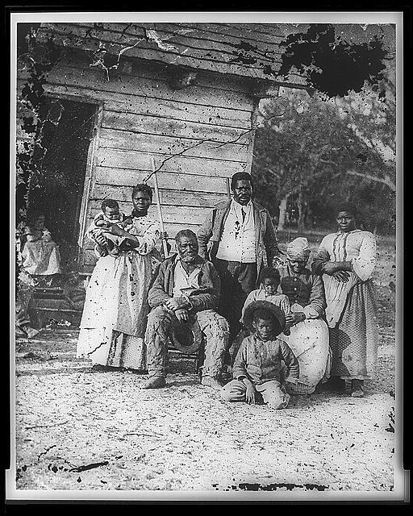
Five generations, Smith's Plantation, Beaufort, South Carolina, 1862

Slide 32
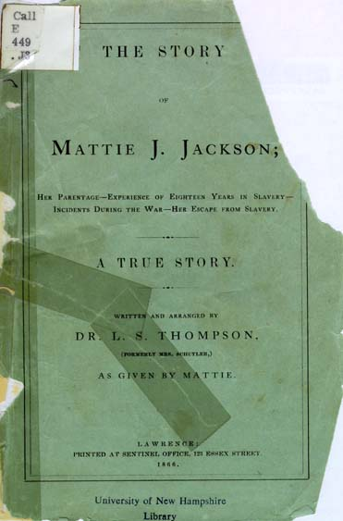
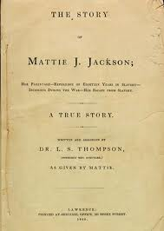

Slide 33
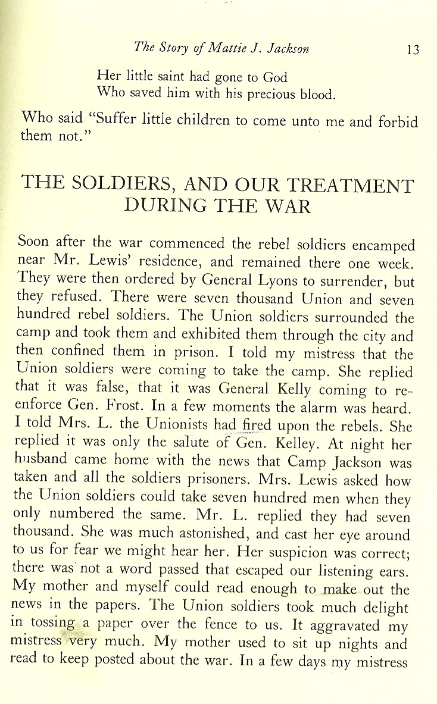
Excerpt from Mattie J. Jackson, The Story of Mattie J. Jackson, 1866

Slide 34
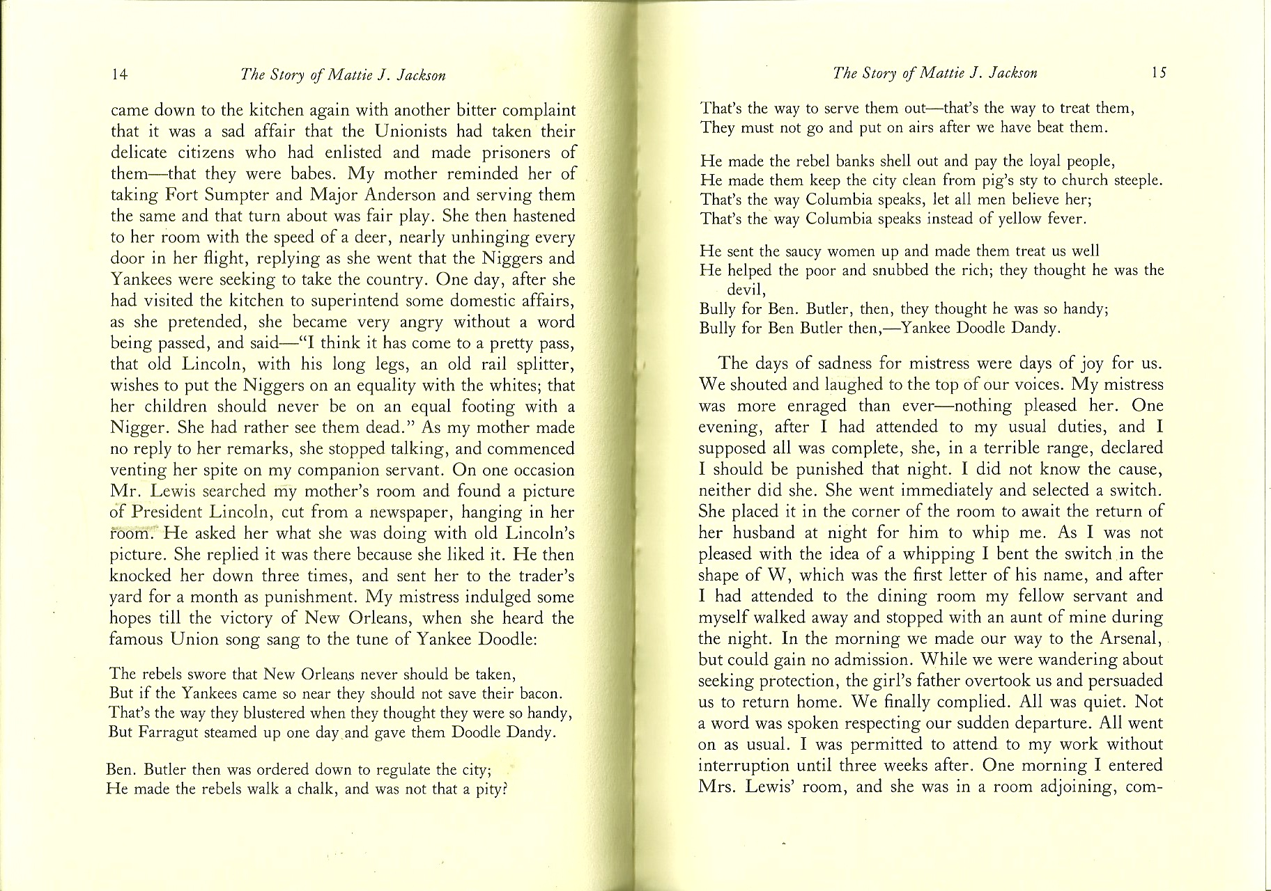
Excerpt from Mattie J. Jackson, The Story of Mattie J. Jackson, 1866

Slide 35
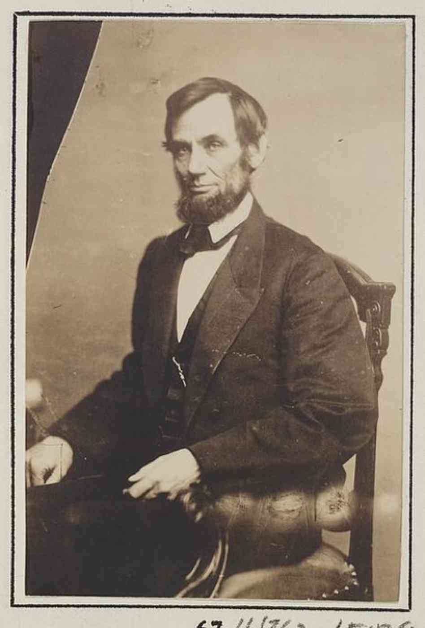
Lincoln and Emancipation
In 1862

Slide 36
Preliminary Emancipation Proclamation, September 22, 1862
That it is my purpose, upon the next meeting of Congress to again recommend the adoption of a practical measure tendering pecuniary aid to the free acceptance or rejection of all slave States, so called, the people whereof may not then be in rebellion against the United States and which States may then have voluntarily adopted, or thereafter may voluntarily adopt, immediate or gradual abolishment of slavery within their respective limits; and that the effort to colonize persons of African descent, with their consent, upon this continent, or elsewhere, with the previously obtained consent of the Governments existing there, will be continued.

Slide 37
Preliminary Emancipation Proclamation, September 22, 1862
I, Abraham Lincoln, President of the United States of America, and Commander-in-Chief of the Army and Navy thereof, do hereby proclaim and declare that hereafter, as heretofore, the war will be prosecuted for the object of practically restoring the constitutional relation between the United States, and each of the States, and the people thereof, in which States that relation is, or may be, suspended or disturbed.
That it is my purpose, upon the next meeting of Congress to again recommend the adoption of a practical measure tendering pecuniary aid to the free acceptance or rejection of all slave States, so called, the people whereof may not then be in rebellion against the United States and which States may then have voluntarily adopted, or thereafter may voluntarily adopt, immediate or gradual abolishment of slavery within their respective limits; and that the effort to colonize persons of African descent, with their consent, upon this continent, or elsewhere, with the previously obtained consent of the Governments existing there, will be continued.
That on the first day of January in the year of our Lord, one thousand eight hundred and sixty-three, all persons held as slaves within any State, or designated part of a State, the people whereof shall then be in rebellion against the United States shall be then, thenceforward, and forever free; and the executive government of the United States, including the military and naval authority thereof, will recognize and maintain the freedom of such persons, and will do no act or acts to repress such persons, or any of them, in any efforts they may make for their actual freedom.

Slide 38
Print-Friendly Version
The Emancipation Proclamation
January 1, 1863
A Transcription
By the President of the United States of America:
A Proclamation.
Whereas, on the twenty-second day of September, in the year of our Lord one thousand eight hundred and sixty-two, a proclamation was issued by the President of the United States, containing, among other things, the following, to wit:
"That on the first day of January, in the year of our Lord one thousand eight hundred and sixty-three, all persons held as slaves within any State or designated part of a State, the people whereof shall then be in rebellion against the United States, shall be then, thenceforward, and forever free; and the Executive Government of the United States, including the military and naval authority thereof, will recognize and maintain the freedom of such persons, and will do no act or acts to repress such persons, or any of them, in any efforts they may make for their actual freedom.
"That the Executive will, on the first day of January aforesaid, by proclamation, designate the States and parts of States, if any, in which the people thereof, respectively, shall then be in rebellion against the United States; and the fact that any State, or the people thereof, shall on that day be, in good faith, represented in the Congress of the United States by members chosen thereto at elections wherein a majority of the qualified voters of such State shall have participated, shall, in the absence of strong countervailing testimony, be deemed conclusive evidence that such State, and the people thereof, are not then in rebellion against the United States."
Now, therefore I, Abraham Lincoln, President of the United States, by virtue of the power in me vested as Commander-in-Chief, of the Army and Navy of the United States in time of actual armed rebellion against the authority and government of the United States, and as a fit and necessary war measure for suppressing said rebellion, do, on this first day of January, in the year of our Lord one thousand eight hundred and sixty-three, and in accordance with my purpose so to do publicly proclaimed for the full period of one hundred days, from the day first above mentioned, order and designate as the States and parts of States wherein the people thereof respectively, are this day in rebellion against the United States, the following, to wit:
Arkansas, Texas, Louisiana, (except the Parishes of St. Bernard, Plaquemines, Jefferson, St. John, St. Charles, St. James Ascension, Assumption, Terrebonne, Lafourche, St. Mary, St. Martin, and Orleans, including the City of New Orleans) Mississippi, Alabama, Florida, Georgia, South Carolina, North Carolina, and Virginia, (except the forty-eight counties designated as West Virginia, and also the counties of Berkley, Accomac, Northampton, Elizabeth City, York, Princess Ann, and Norfolk, including the cities of Norfolk and Portsmouth[)], and which excepted parts, are for the present, left precisely as if this proclamation were not issued.
And by virtue of the power, and for the purpose aforesaid, I do order and declare that all persons held as slaves within said designated States, and parts of States, are, and henceforward shall be free; and that the Executive government of the United States, including the military and naval authorities thereof, will recognize and maintain the freedom of said persons.
And I hereby enjoin upon the people so declared to be free to abstain from all violence, unless in necessary self-defence; and I recommend to them that, in all cases when allowed, they labor faithfully for reasonable wages.
And I further declare and make known, that such persons of suitable condition, will be received into the armed service of the United States to garrison forts, positions, stations, and other places, and to man vessels of all sorts in said service.
And upon this act, sincerely believed to be an act of justice, warranted by the Constitution, upon military necessity, I invoke the considerate judgment of mankind, and the gracious favor of Almighty God.
In witness whereof, I have hereunto set my hand and caused the seal of the United States to be affixed.
Done at the City of Washington, this first day of January, in the year of our Lord one thousand eight hundred and sixty three, and of the Independence of the United States of America the eighty-seventh.
By the President: ABRAHAM LINCOLN
WILLIAM H. SEWARD, Secretary of State.

Slide 39
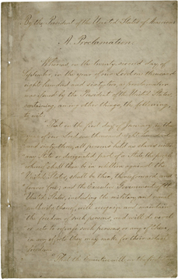
The Emancipation Proclamation

Slide 40
Colored Volunteers
How revolutionary was the employment of African American soldiers in the Civil War, according to Frederick Douglass?
Black regiments in the South, made up of freed slaves.
The rise of black regiments in the North
Changing views of African American men: war and manhood
The 54th Massachusetts and Fort Wagner, July 18, 1863
“Transformation images” of black soldiers

Slide 41
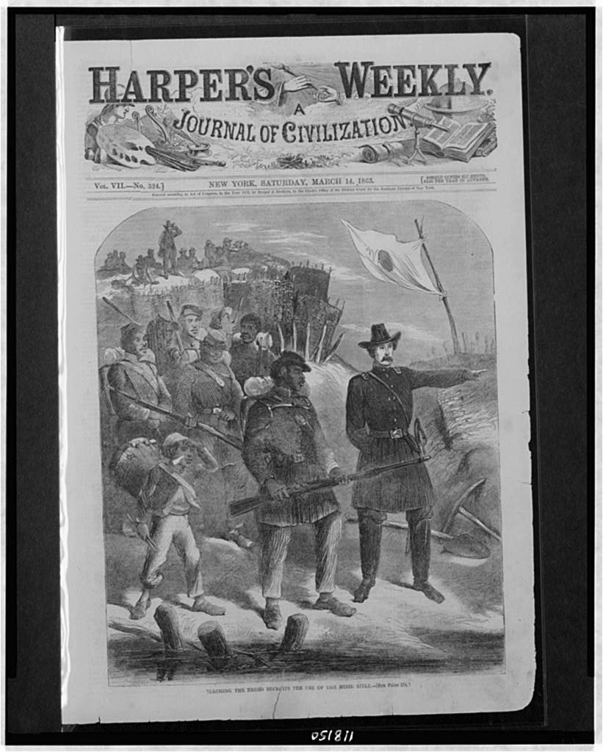
"Teaching the Negro Recruits the Use of the Minie Rifle," March 14, 1863

Slide 42
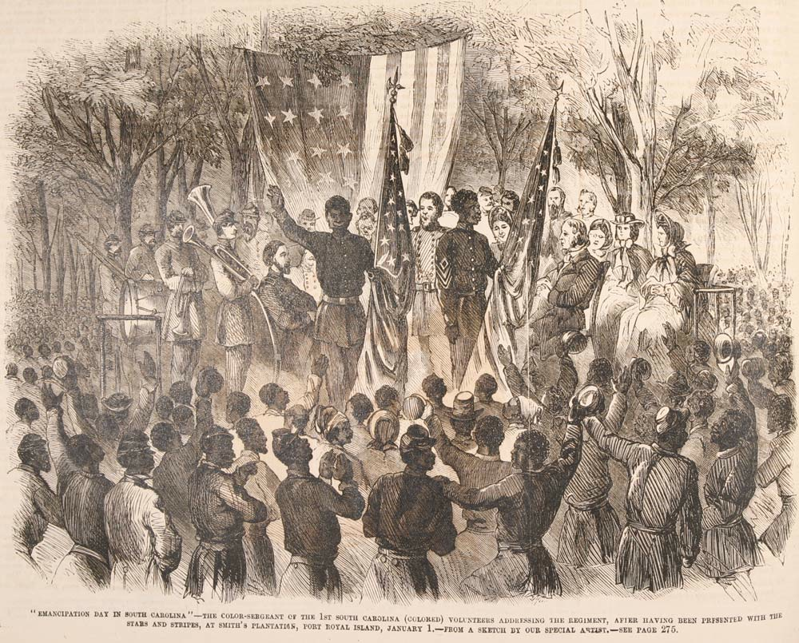
1st South Carolina Colored Volunteers, "Emancipation Day in South Carolina." Source: Frank Leslie's Illustrated Newspaper, January 24, 1863

Slide 45
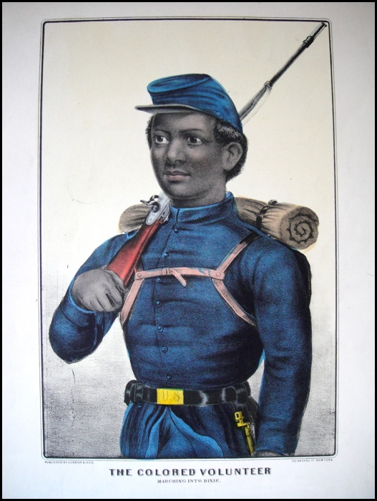
Currier & Ives, "The Colored Volunteer: Marching into Dixie"

Slide 46
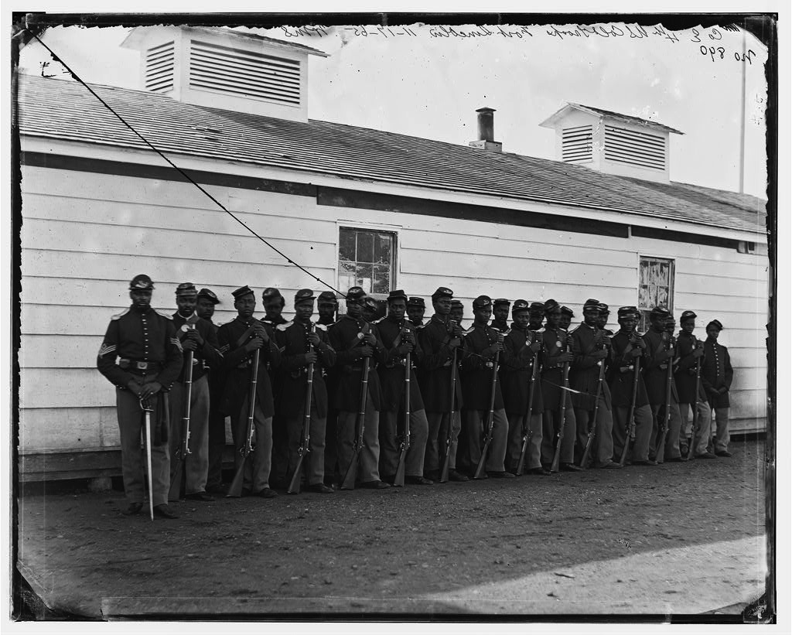
Company E, 4th U.S. Colored Infantry. Organized in July 1863, with most men former slaves from North Carolina.

Slide 48
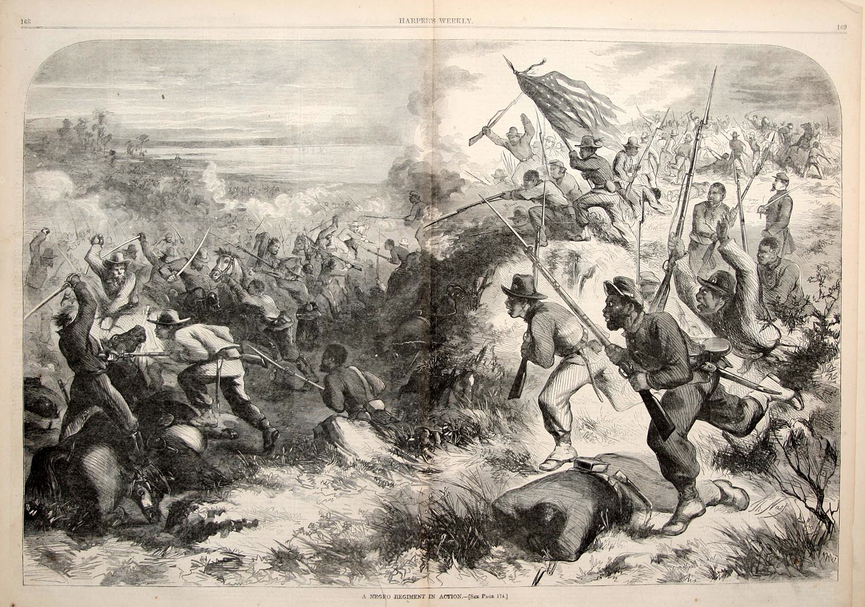
First Kansas Colored Volunteers, Harper's Weekly, March 14, 1863

Slide 49
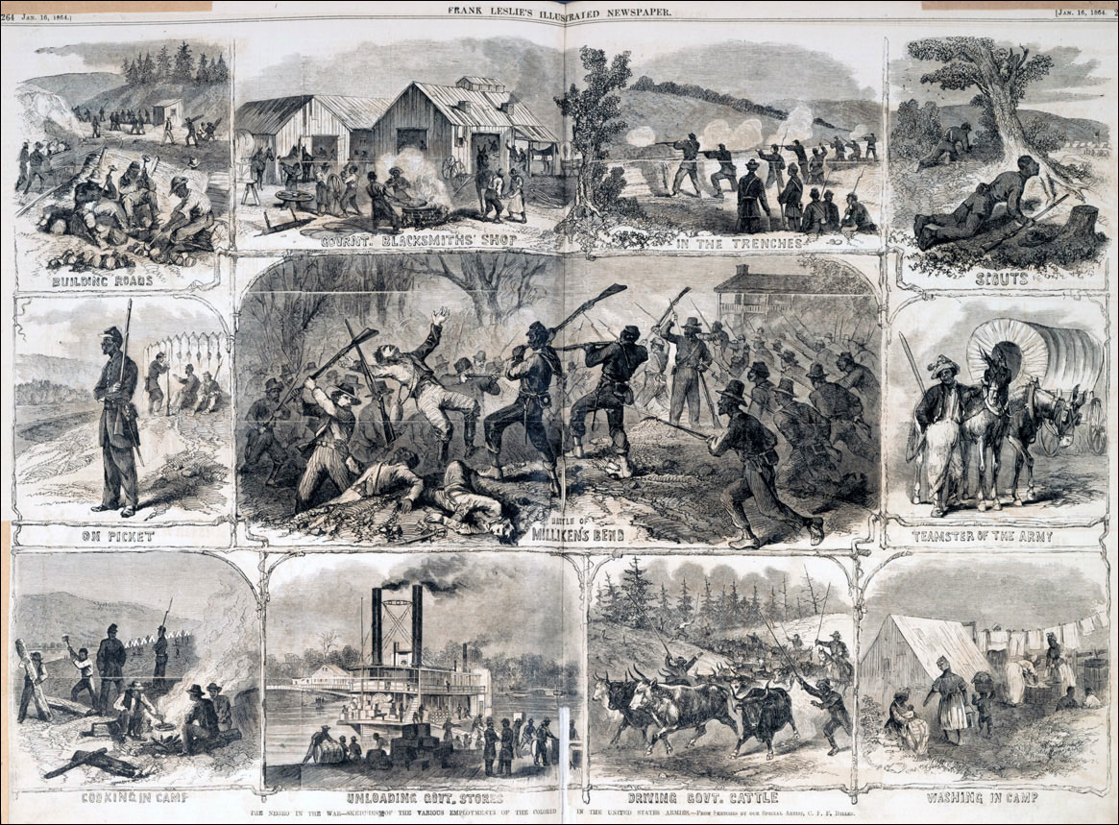
Frank Leslie's Illustrated Weekly, Jan. 16, 1864

Slide 50
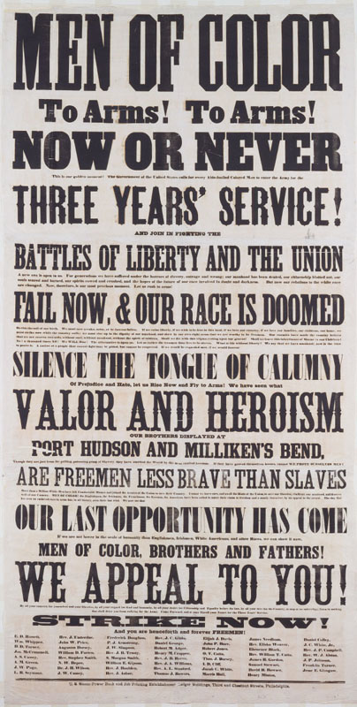
Recruiting Poster

Slide 51
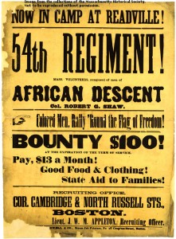
Recruiting Poster, 54th Regiment

Slide 52
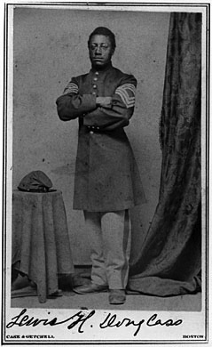
Lewis Douglass

Slide 53
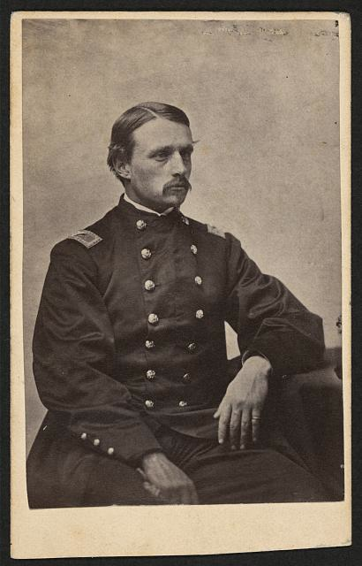
Robert Gould Shaw

Slide 54
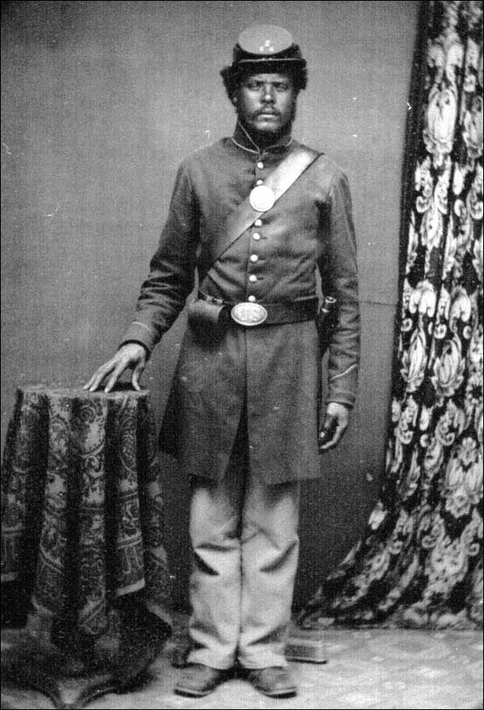
Soldier, 54th Massachusetts

Slide 55
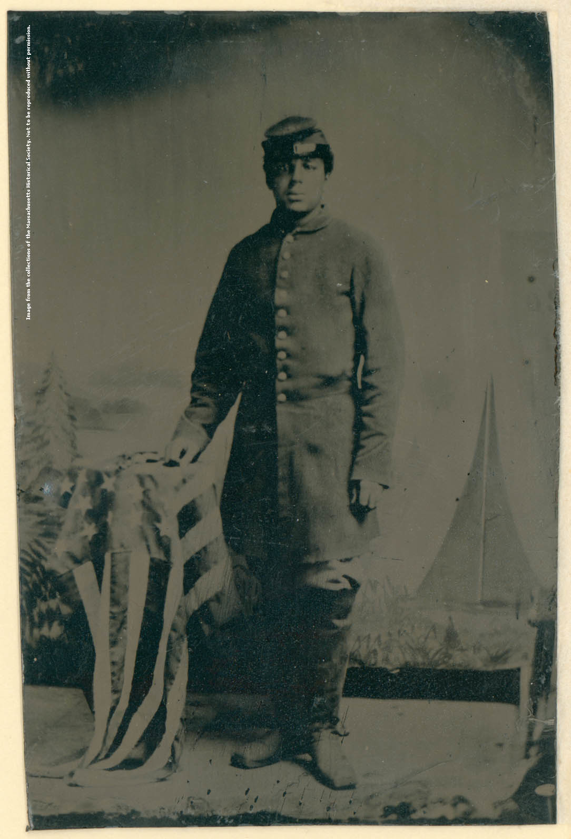
Private Charles H. Arnum

Slide 56
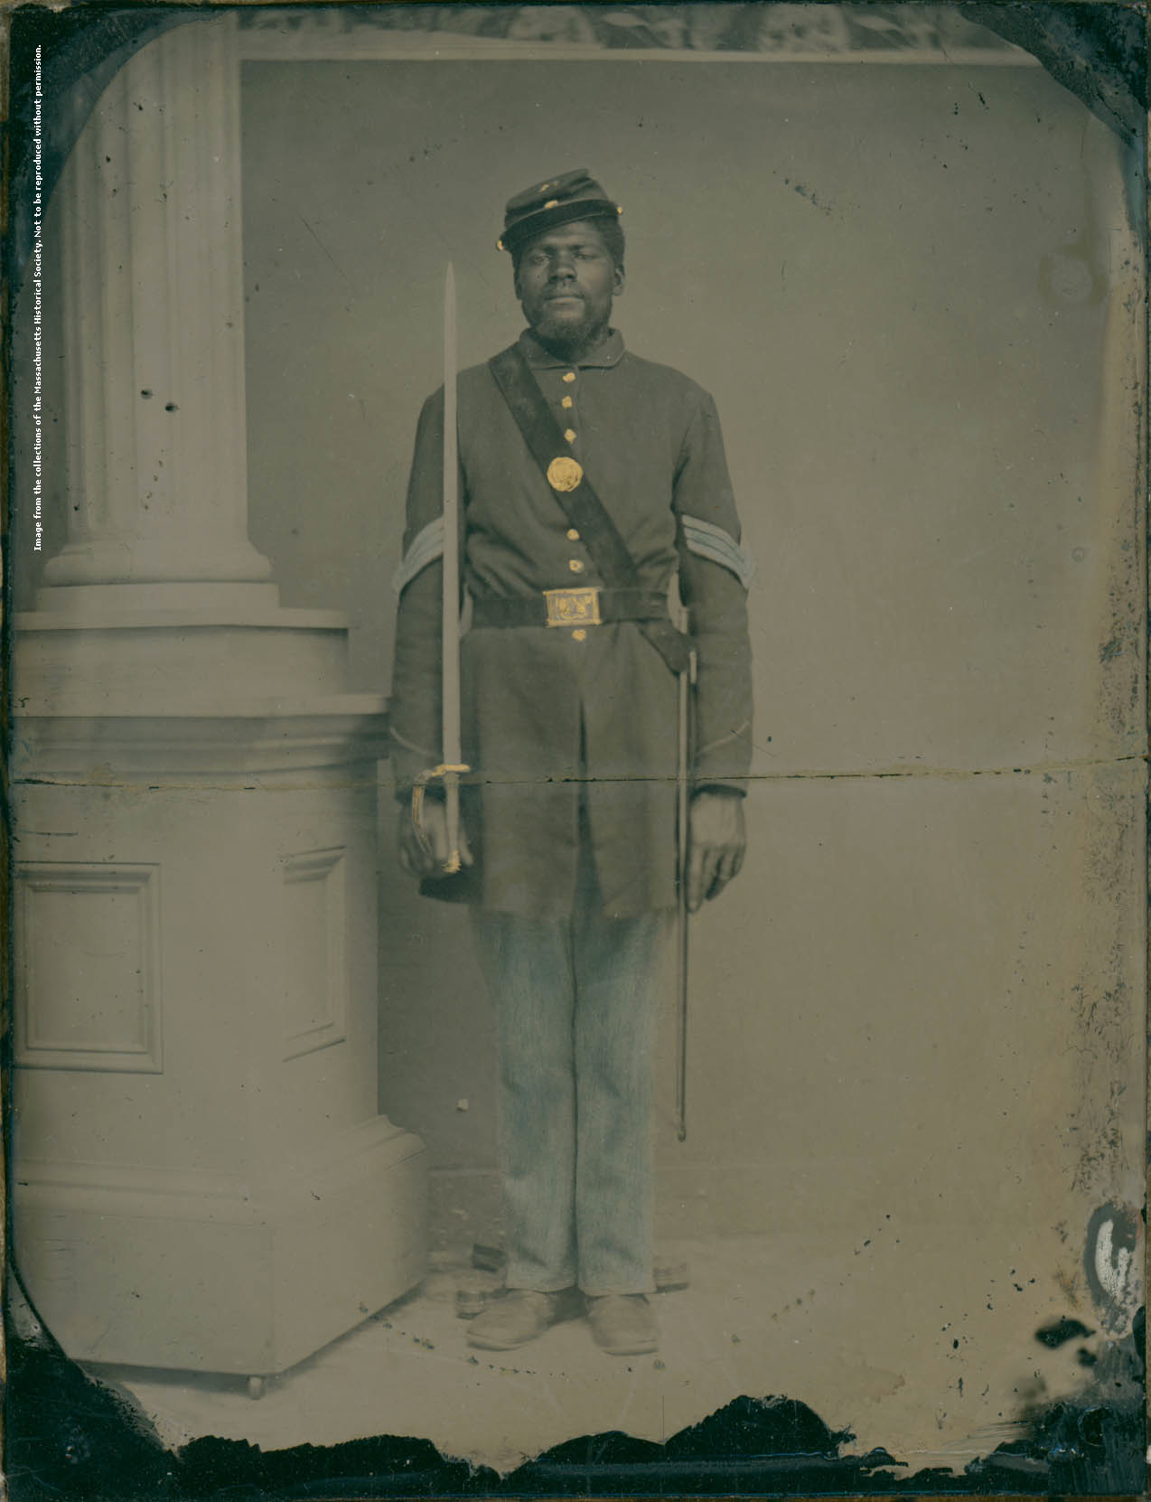
Sgt. Henry Stewart, Company E, 54th Massachusetts Infantry

Slide 57
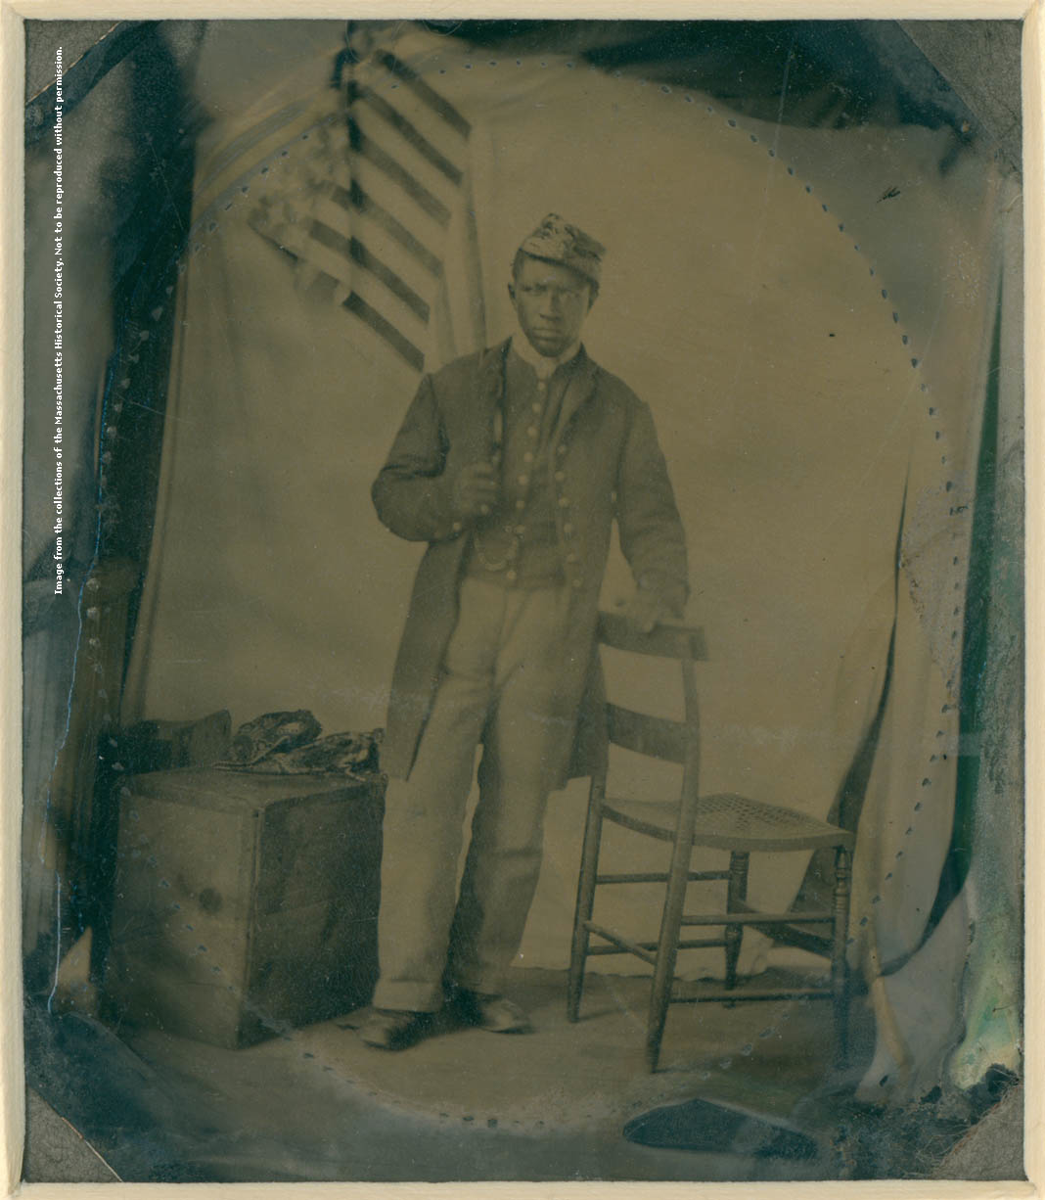
Private Abraham F. Brown

Slide 58
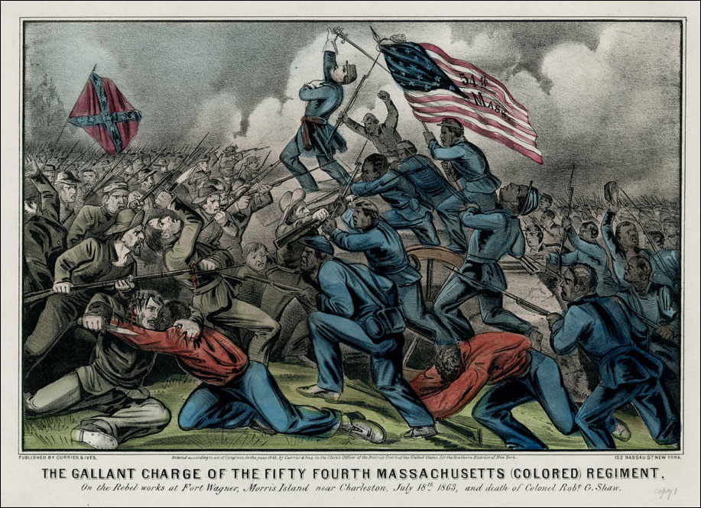
Currier & Ives print: "The Gallant Charge of the Fifty Fourth Massachusetts (Colored) Regiment," 1863

Slide 59
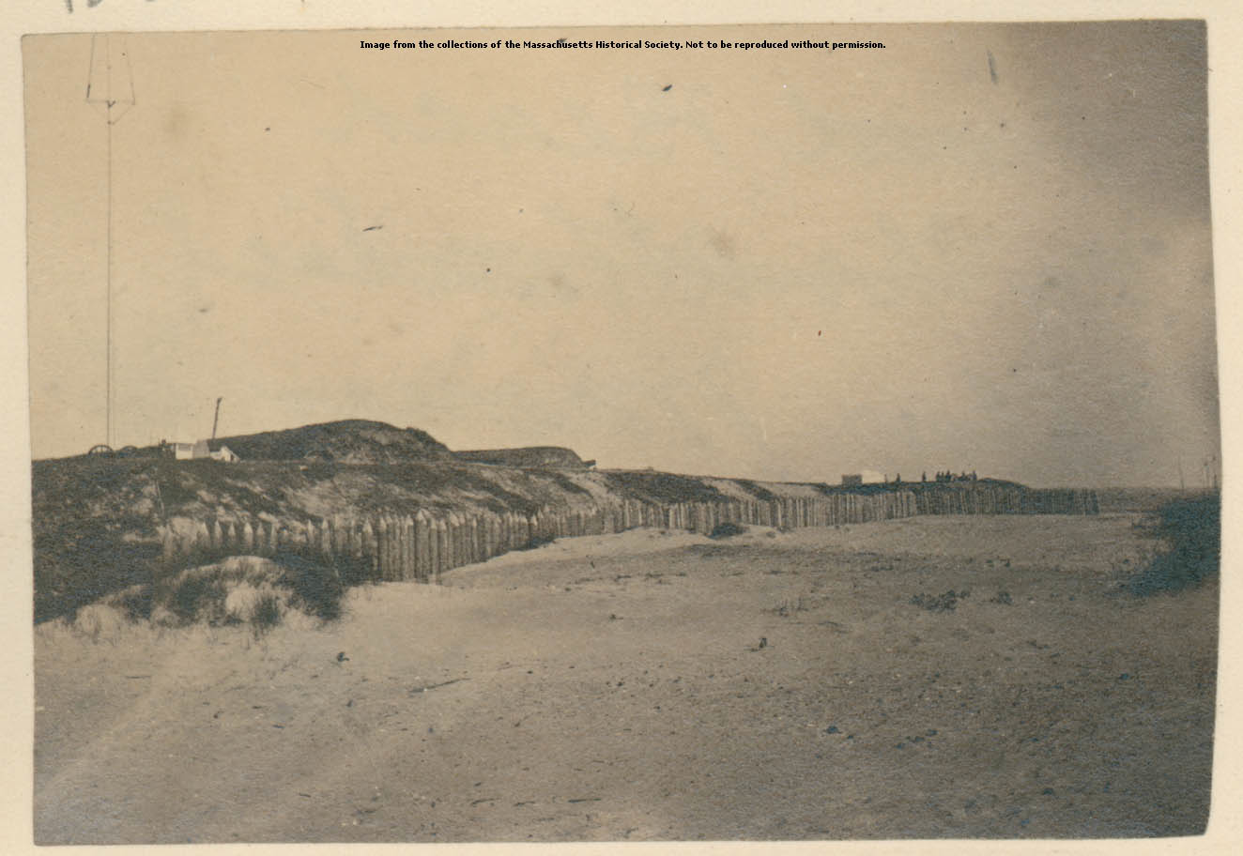
Fort Wagner

Slide 60
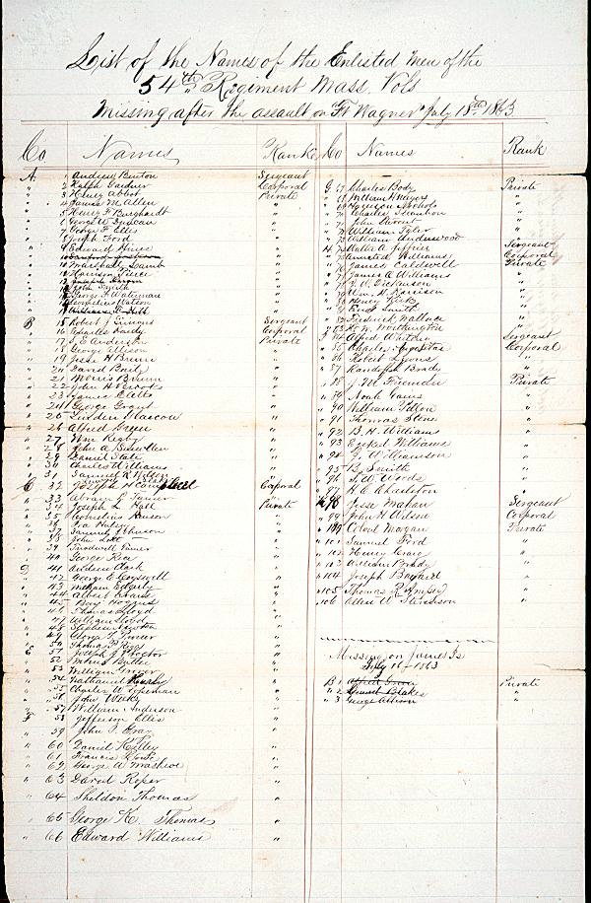
Casualty list of the 54th Massachusetts Infantry Regiment after the assault on Fort Wagner, July 16-18, 1863

Slide 62
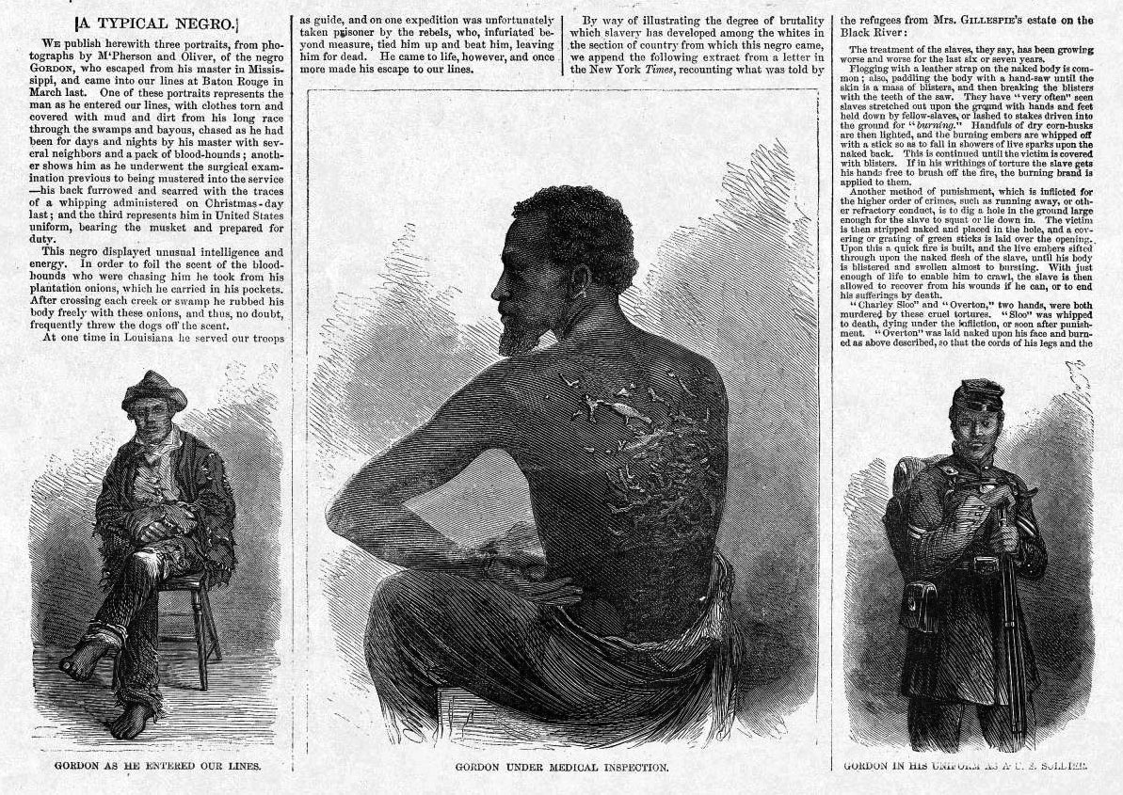
"A Typical Negro," Harper's Weekly, July 4, 1863

Slide 63
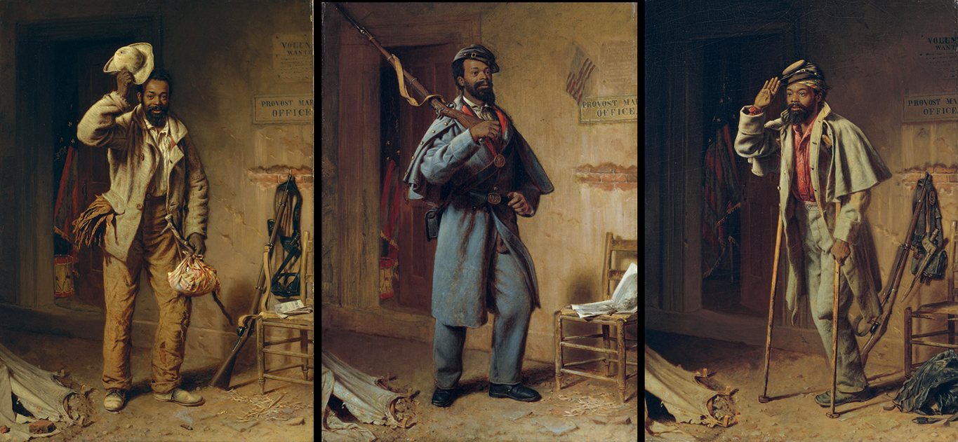
A Bit of History: The Contraband; The Recruit; the Veteran, by Thomas Waterman Wood, 1865

Slide 67
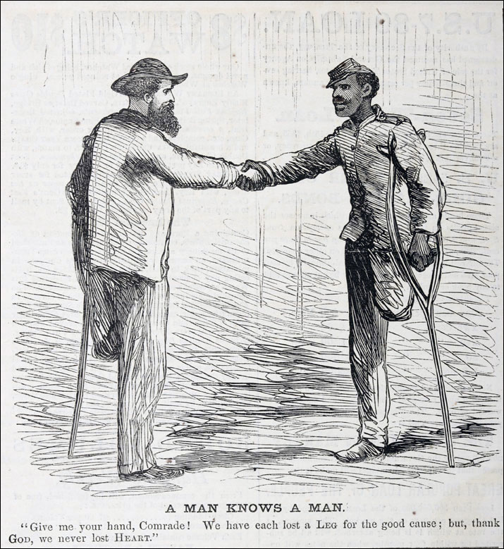
Harper’s Weekly, April 22, 1865

