Slide 1
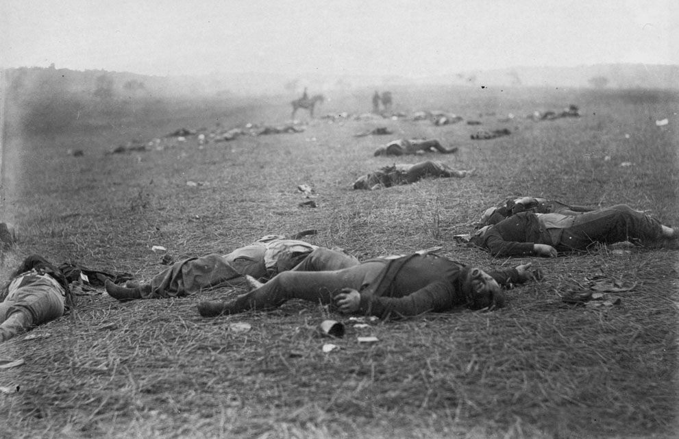
“A Harvest of Death”:
the Civil War as a Crisis in Meaning

Slide 2
An important cultural task attached to war--
--to give terrible loss cultural meaning, at both the personal and societal level.
--especially true in a home front war, in which support from the civilian population required.

Slide 3
Questions for consideration
How did Americans make sense of their catastrophic losses during the Civil War? What cultural and social resources did they draw upon?
How might we write a cultural and social history of death in wartime? How have attitudes toward death been similar or different in other wars?
What seems universal about attitudes to death during the Civil War? What seems particular to the Civil War?

Slide 4
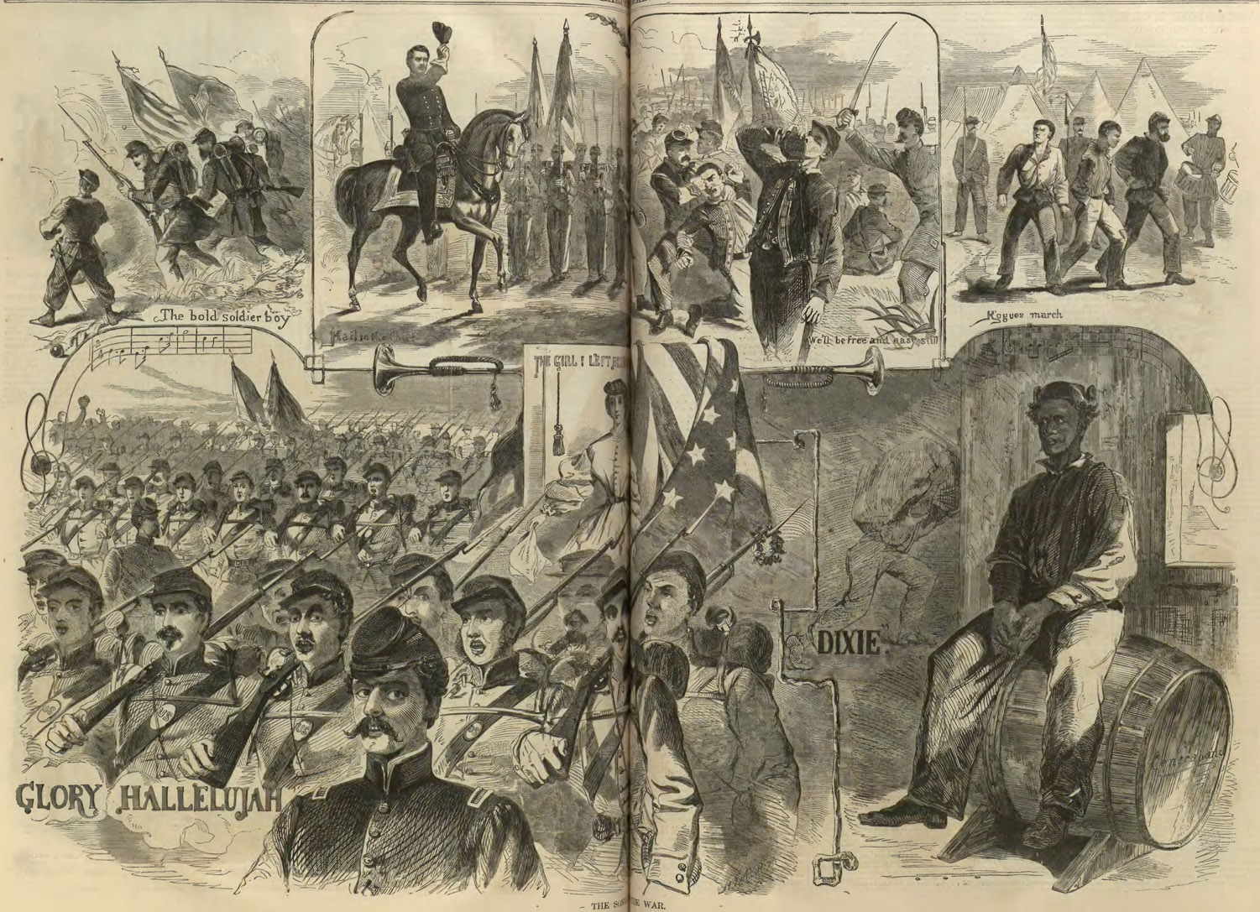

Slide 5
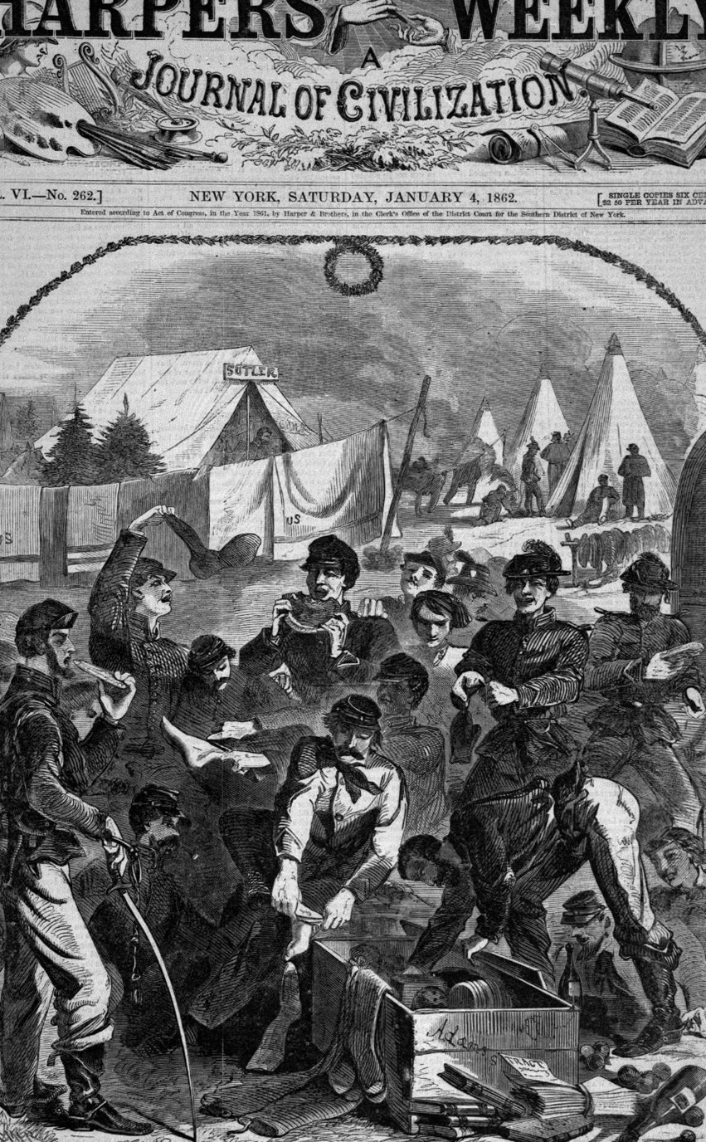


Slide 6
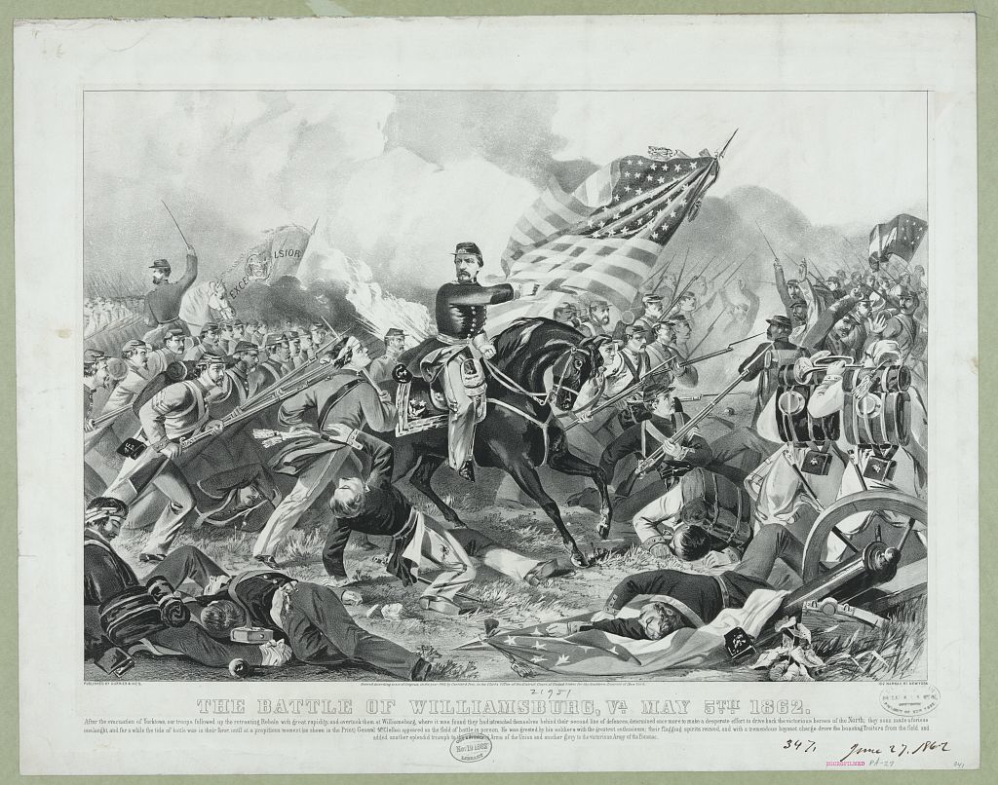

Slide 7
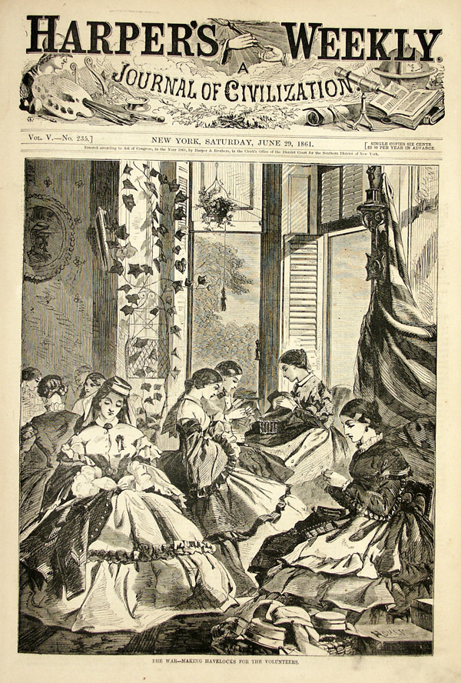
"The War--Making Havelocks for the Volunteers," Winslow Homer in Harper's Weekly, June 29, 1861

Slide 8
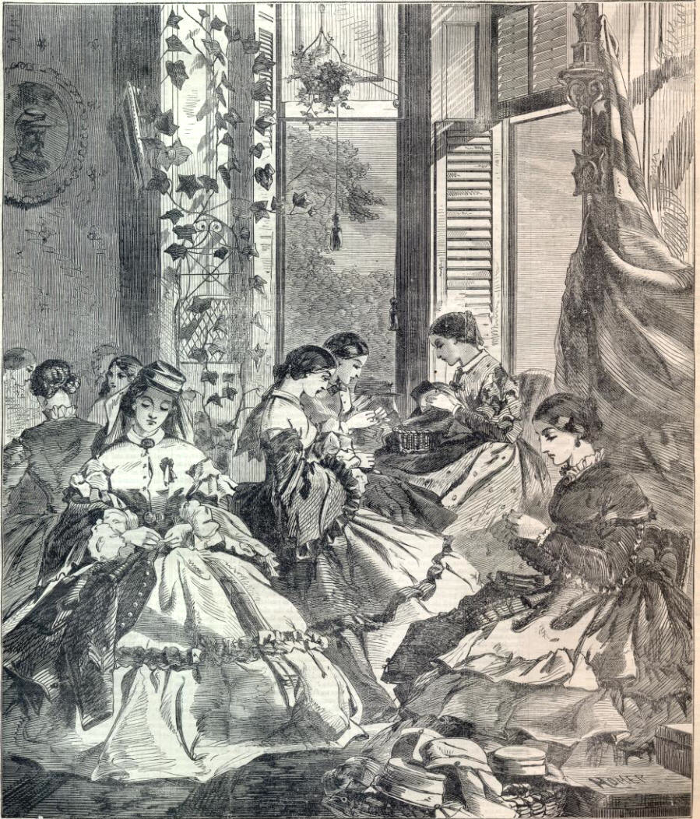

Slide 9
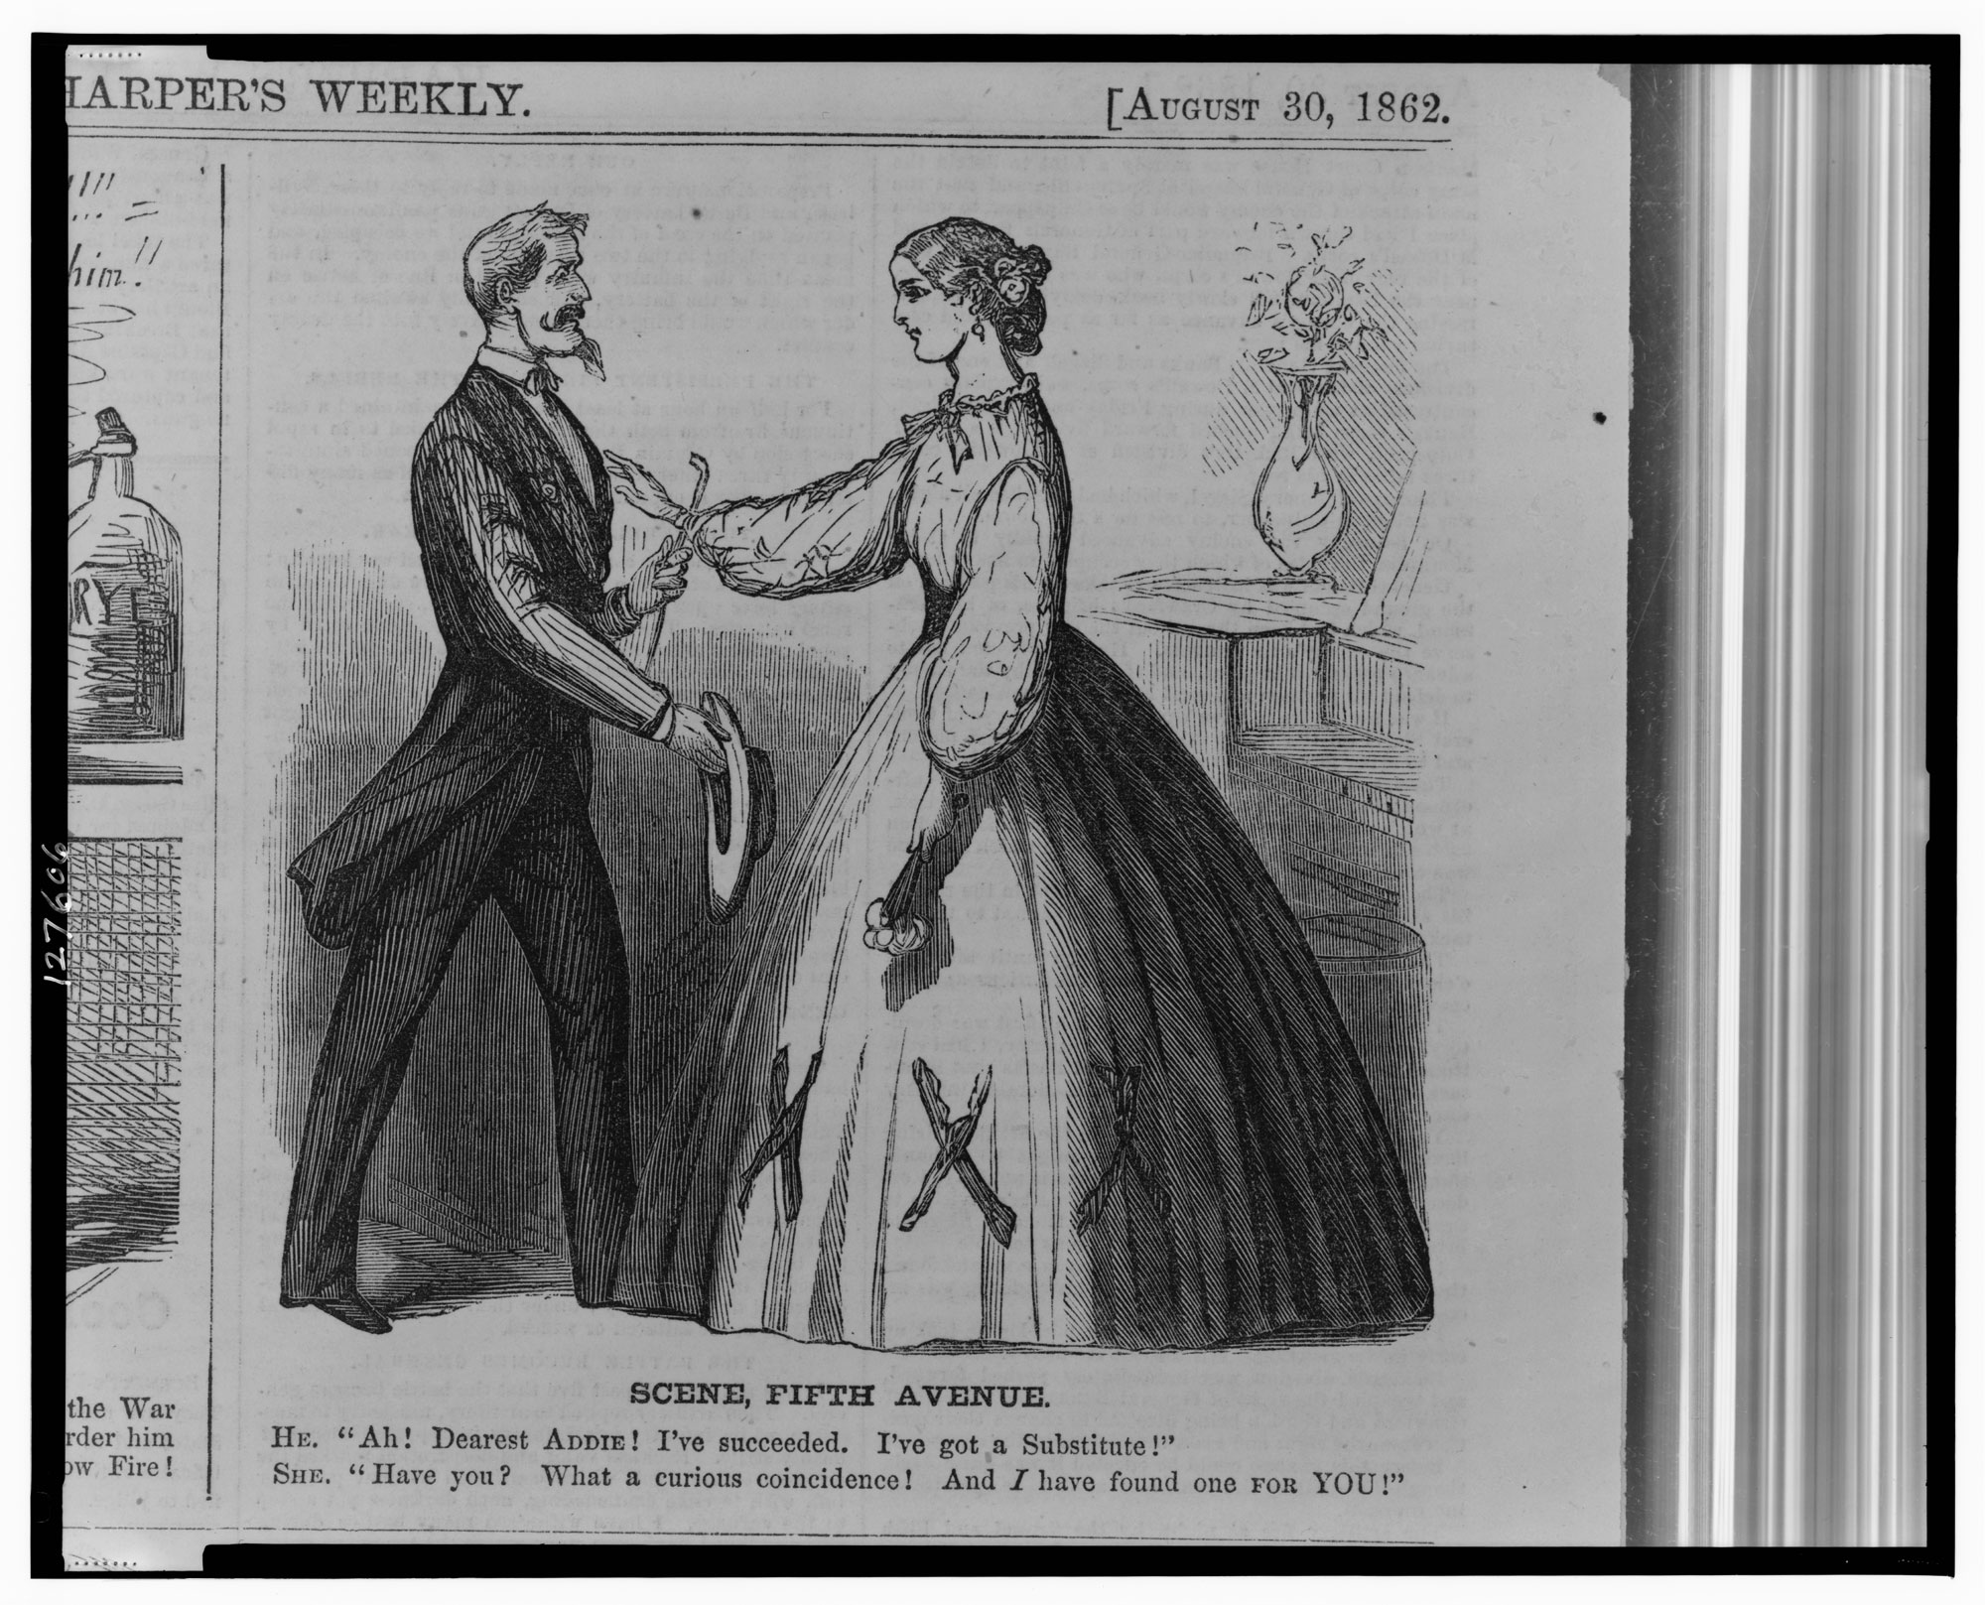

Slide 10
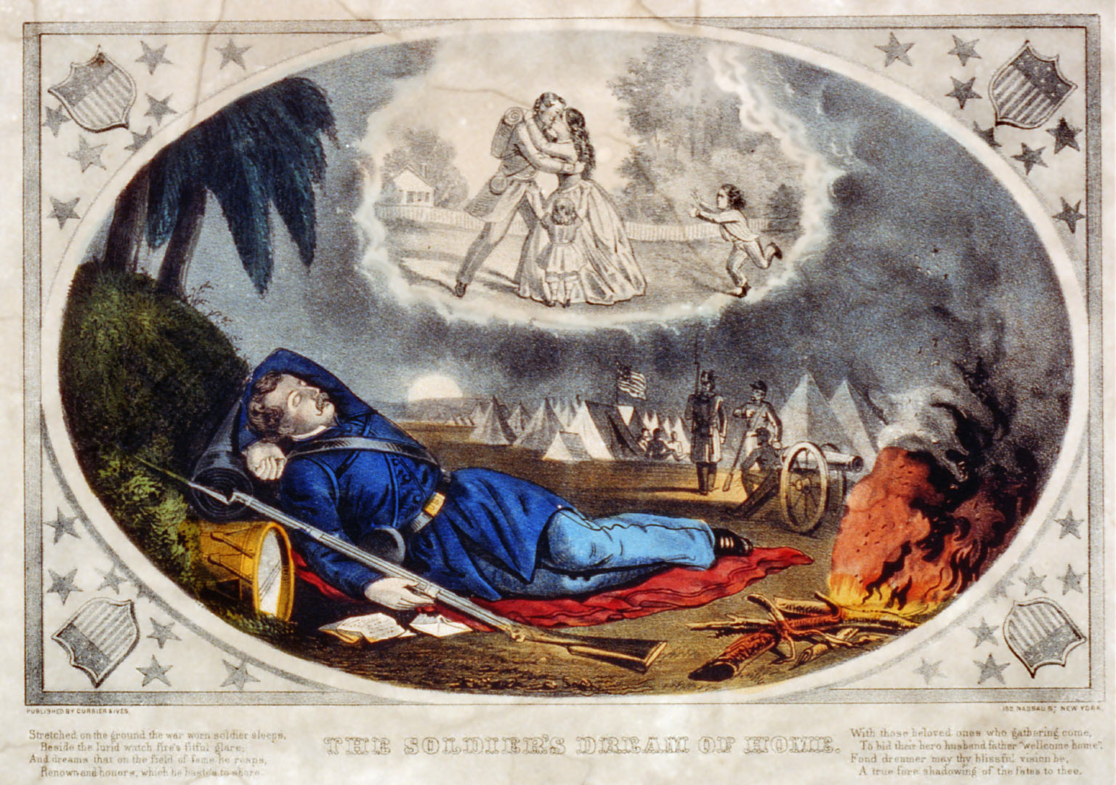
The War and Sentimental Domesticity

Slide 12
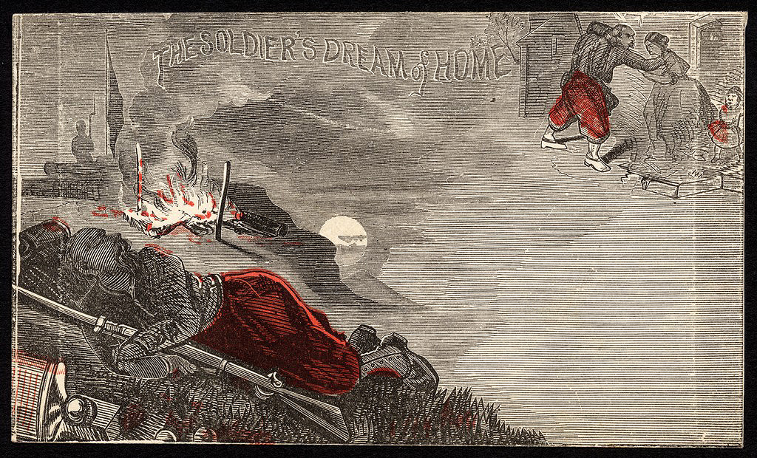
“The Soldier’s Dream of Home” envelope

Slide 13
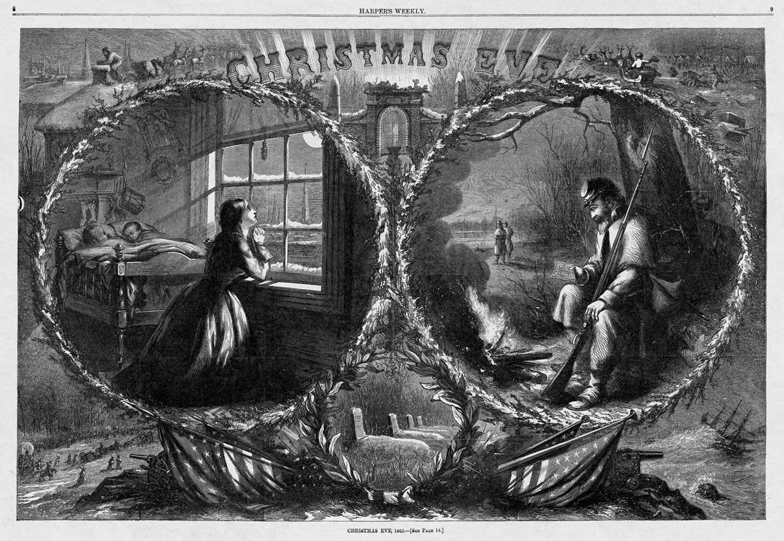
Christmas Eve, 1862, by Thomas Nast. Harper’s Weekly

Slide 14
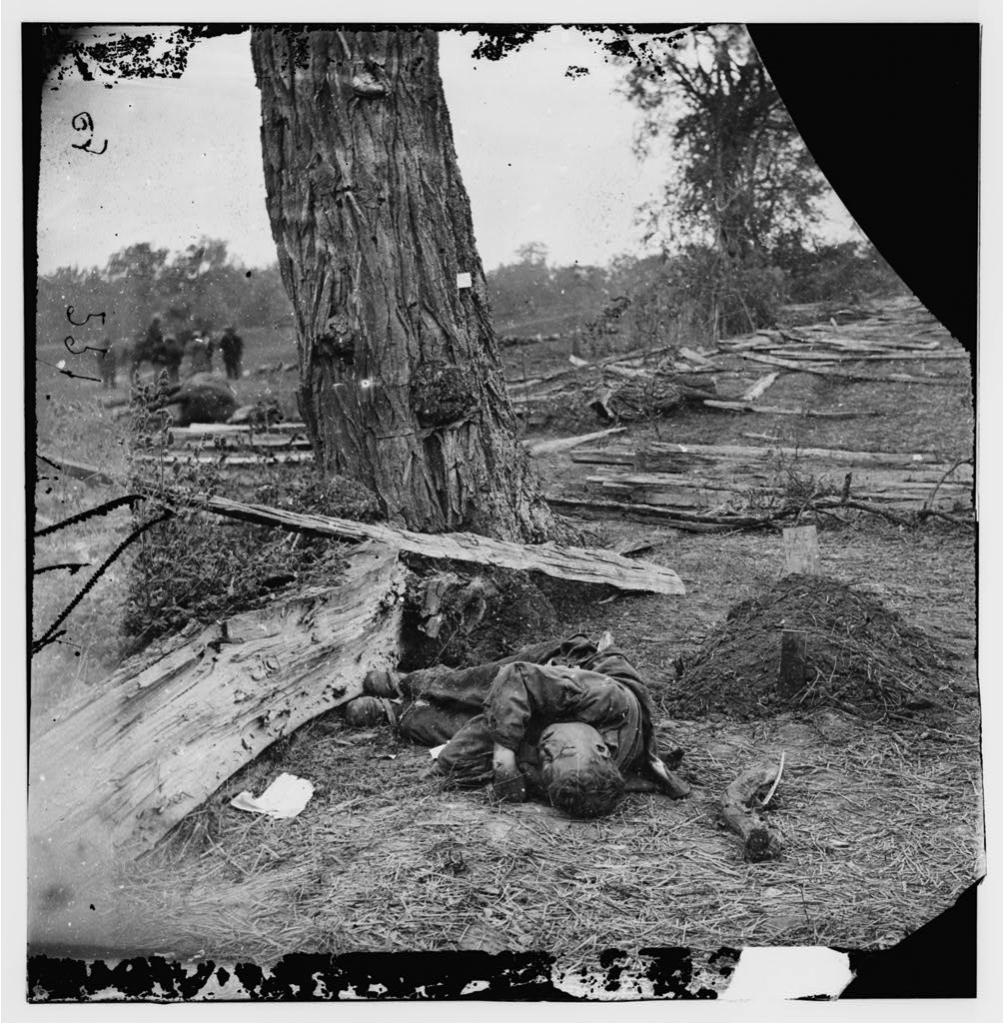
Photography as a Rupture in the Sentimental War
Antietam, Maryland. Federal buried, Confederate unburied, where they fell. September 1862. Alexander Gardner, photographer.

Slide 16
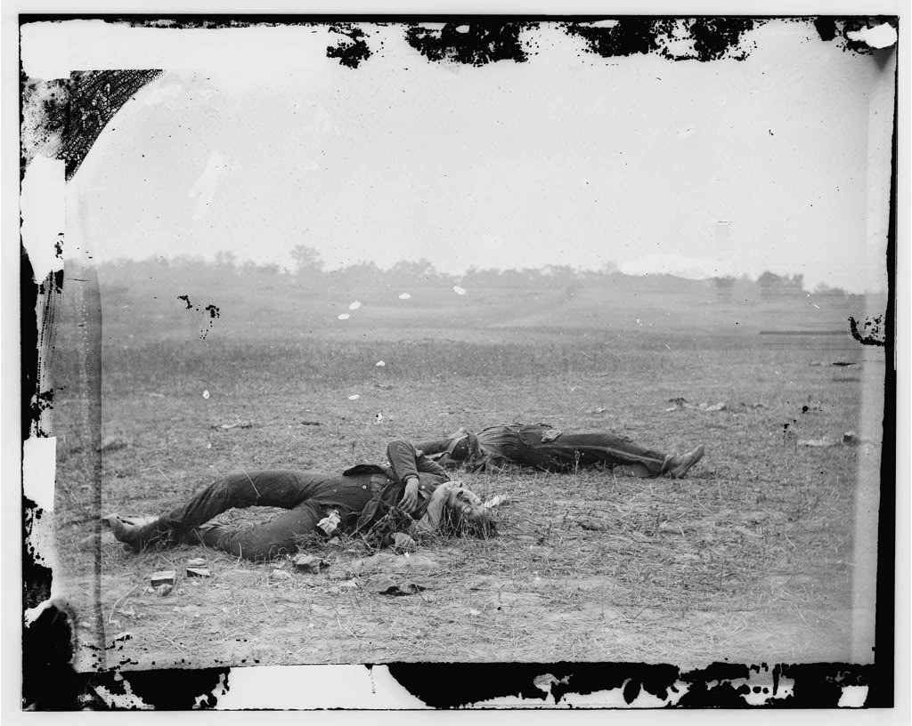
Antietam, Md. Confederate soldiers as they fell near the Burnside Bridge. September 1862. Alexander Gardner, photographer.

Slide 17
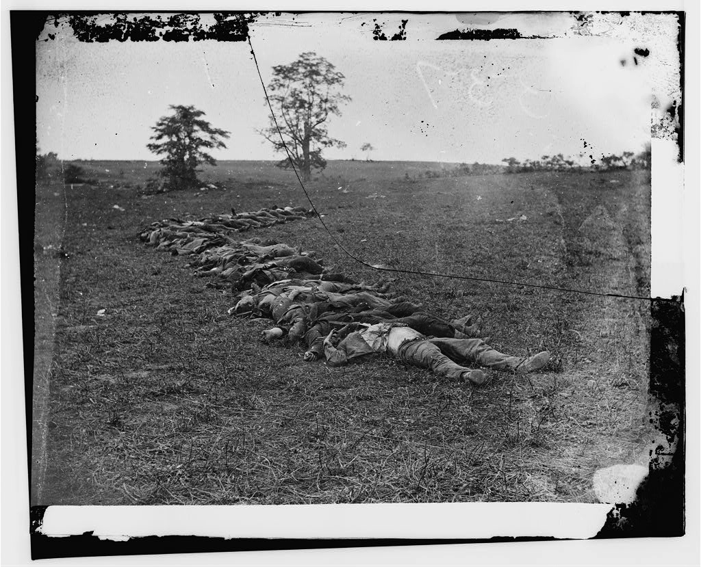
Antietam, Md. Bodies of Confederate Dead gathered for burial. Alexander Gardner, photographer. September 1862

Slide 18
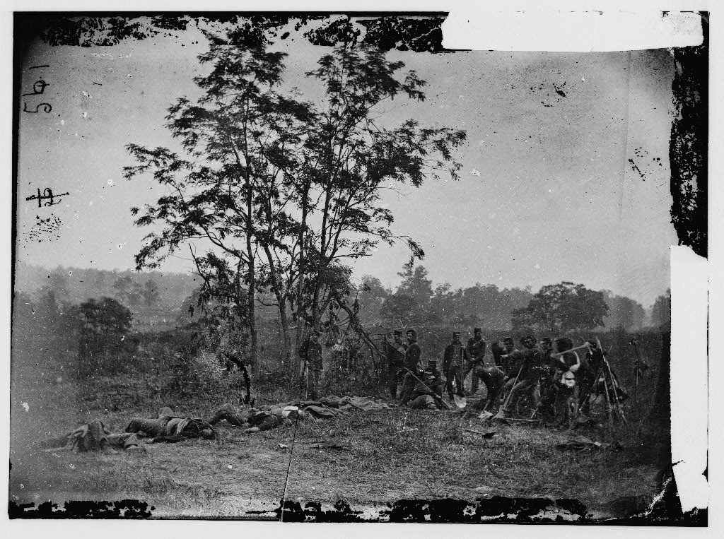
Antietam, Md. Burying the dead Confederate soldiers. September 1862. Alexander Gardner, photographer.

Slide 19
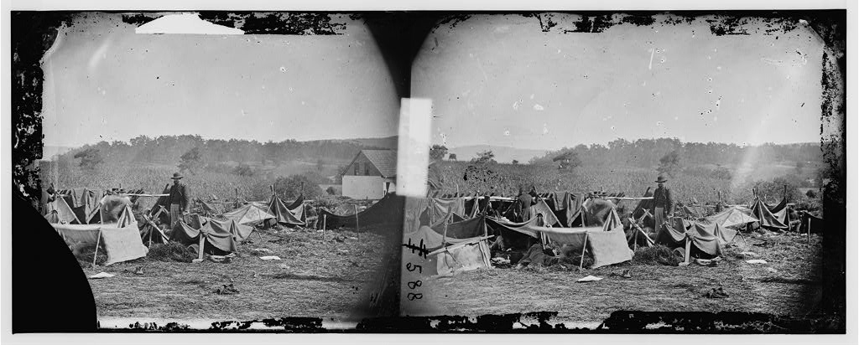
Confederate wounded at Smith's Barn, with Dr. Anson Hurd, 14th Indiana Vounteers, in attendance. September 1862. Alexander Gardner, photographer.

Slide 21
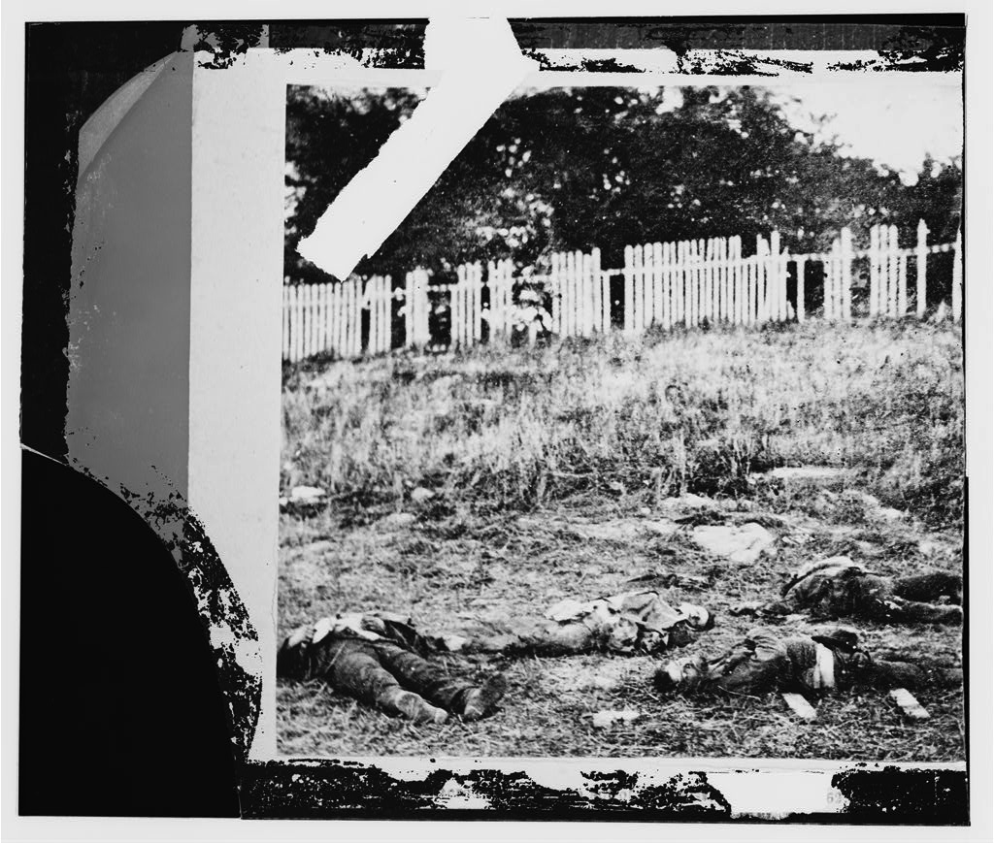
Antietam, Md. Dead soldiers on battlefield. September 1862. Alexander Gardner, photographer.

Slide 22
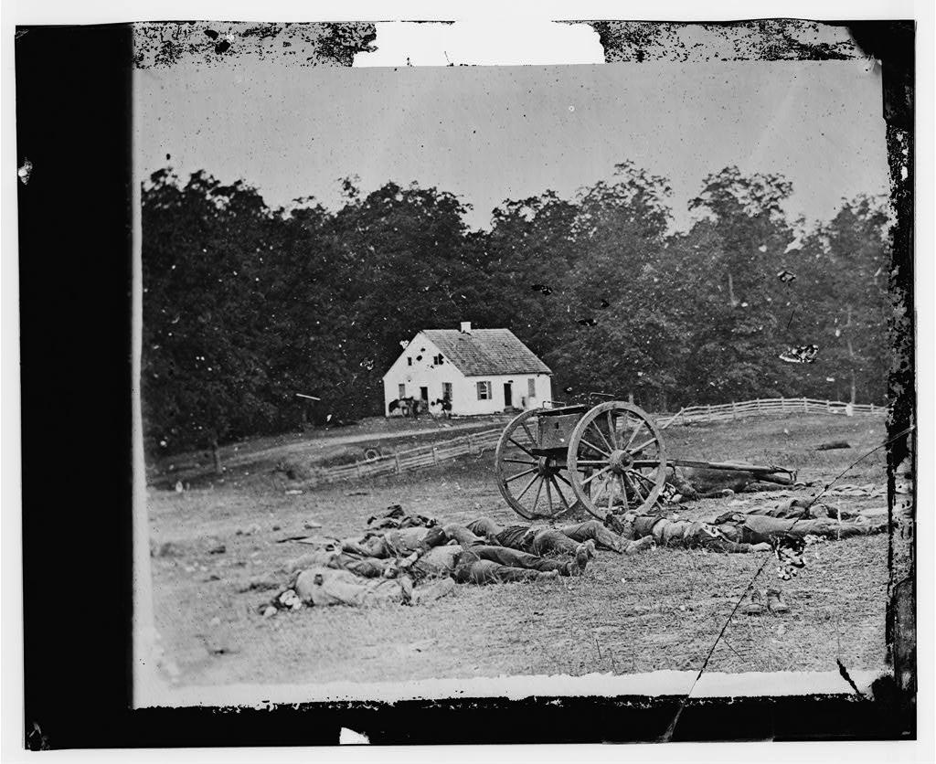
Antietam, Md. Bodies in front of the Dunker church. September 1862. Alexander Gardner, photographer.

Slide 24
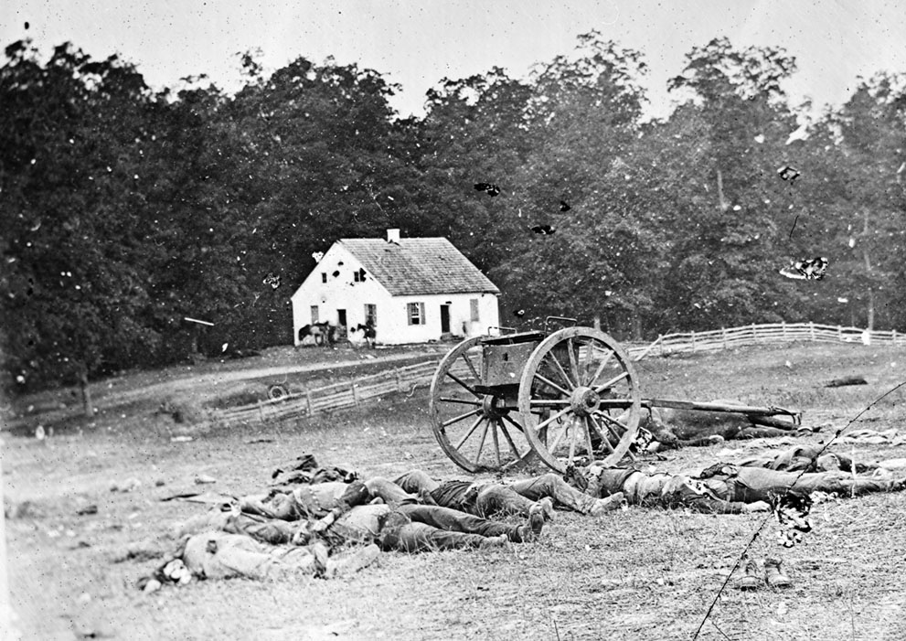

Slide 25
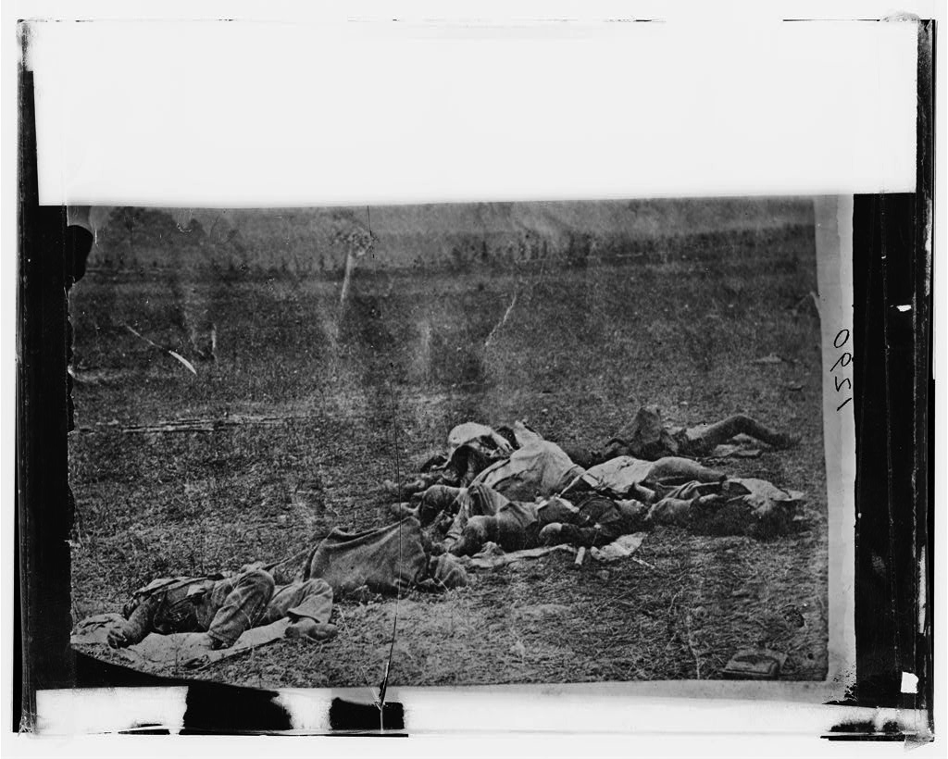
Antietam, Md. Dead on battlefield. September 1862. Alexander Gardner, photographer.

Slide 26
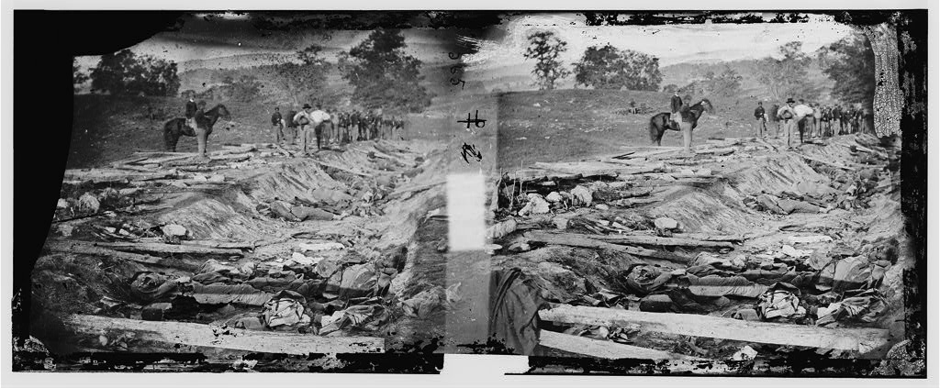
Antietam, Md. Confederate dead in a ditch on the right wing used as a rifle pit. September 1862. Alexander Gardner, photographer.

Slide 27
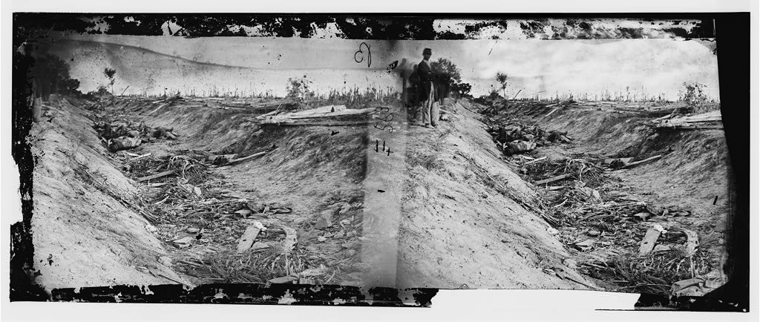
Antietam, Md. Confederate dead in a ditch on the right wing. September 1862. Alexander Gardner, photographer.

Slide 28
“Mr. Brady has done something to bring home to us the terrible reality and earnestness of war. If he has not brought bodies and laid them in our dooryards and along the streets, he has done something very like it. At the door of his gallery hangs a little placard, ‘The Dead of Antietam.’ Crowds of people are constantly going up the stairs; follow them, and you find them bending over photographic views of that fearful battle-field, taken immediately after the action. Of all objects of horror one would think the battle-field should stand preeminent, that it should bear away the palm of repulsiveness. But, on the contrary, there is a terrible fascination about it that draws one near these pictures, and makes him loth to leave them. You will see hushed, reverent groups standing around these weird copies of carnage, bending down to look in the pale faces of the dead, chained by the strange spell that dwells in dead men’s eyes. It seems somewhat singular that the same sun that looked down on the faces of the slain blistering them, blotting out from the bodies all semblance to humanity, and hastening corruption, should have thus caught their features upon canvas and given them perpetuity forever. But so it is.” --NY Times, October 20, 1862

Slide 29
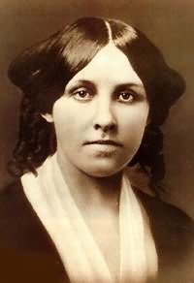
Finding the Meaning of the Nation in the Hospital: Louisa May Alcott and Women Nurses during the Civil War

Slide 30
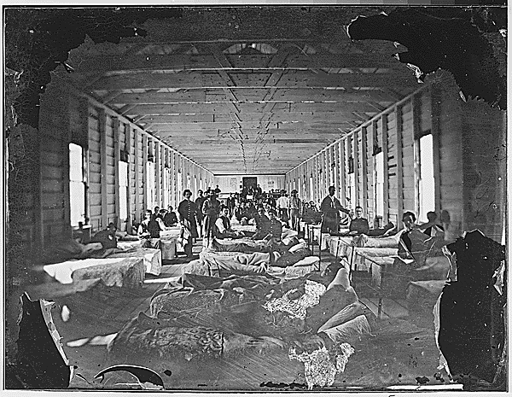
Hospital Scene

Slide 31
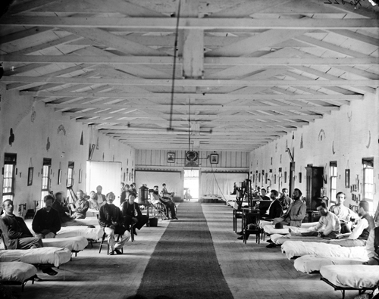
Hospital Scene

Slide 32
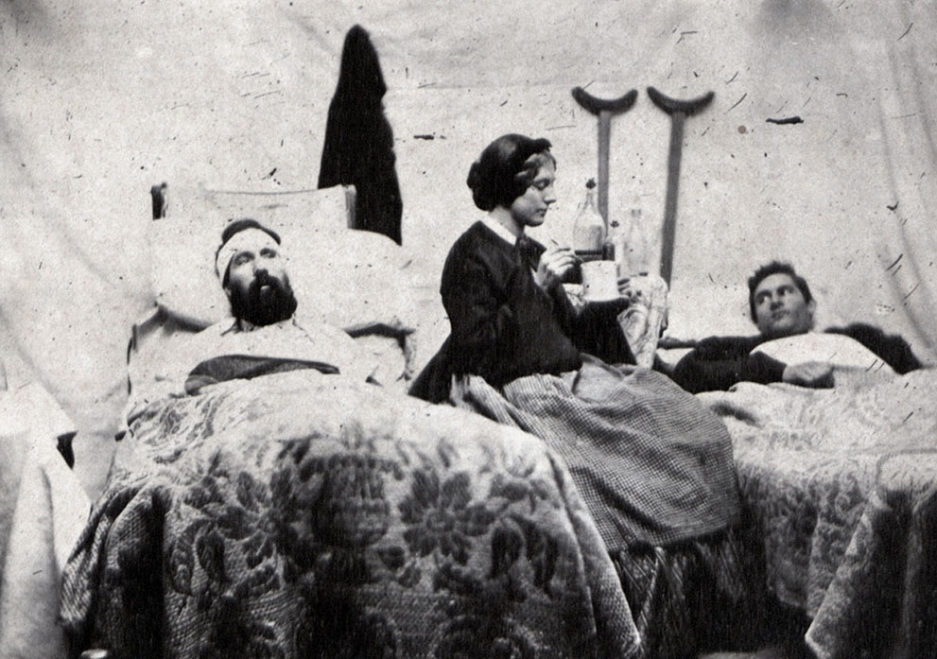
Nurse Anne Bell with wounded soldiers in a Union hospital, c. 1863.

Slide 33
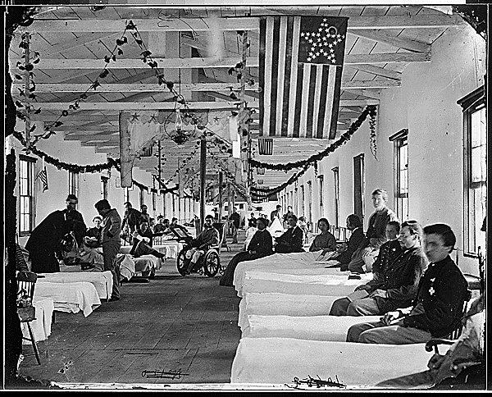
Hospital Scene

Slide 34
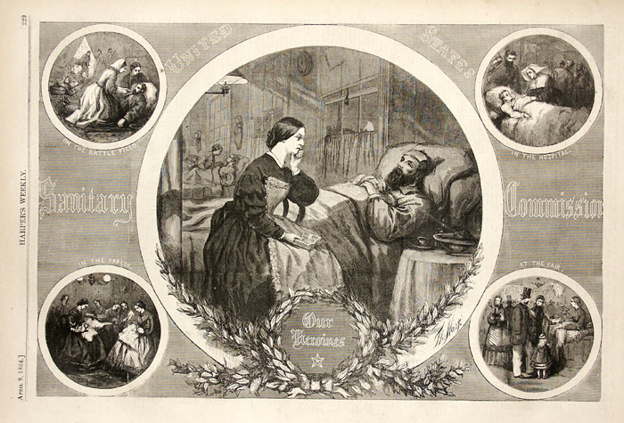
"Our Heroines," Thomas Nast in Harper's Weekly, April 9, 1864

Slide 35
Some Elements of a “Good Death” during the Civil War
Being able to communicate “last words”;
Having loved ones at one’s bedside;
Having a chaplain help in a final reconciliation with God;
Dying at home.

Slide 36
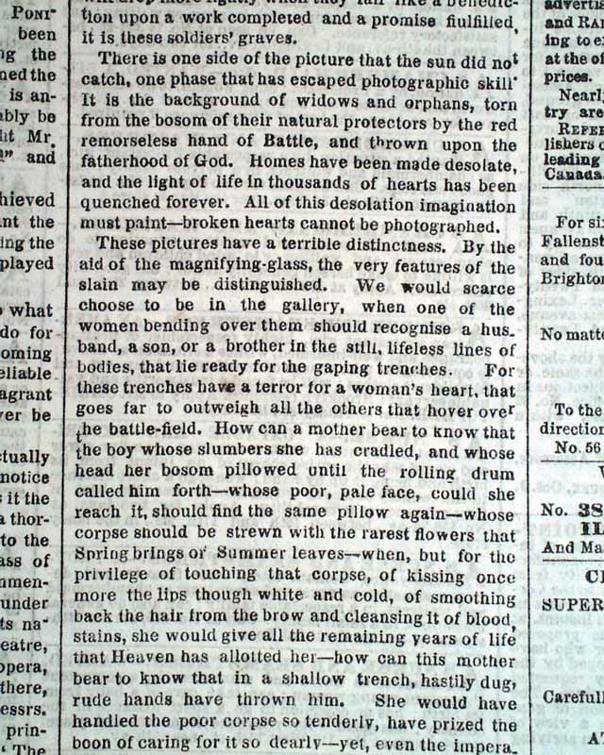
THE NEW YORK TIMES, New York, October 20, 1862

Slide 37
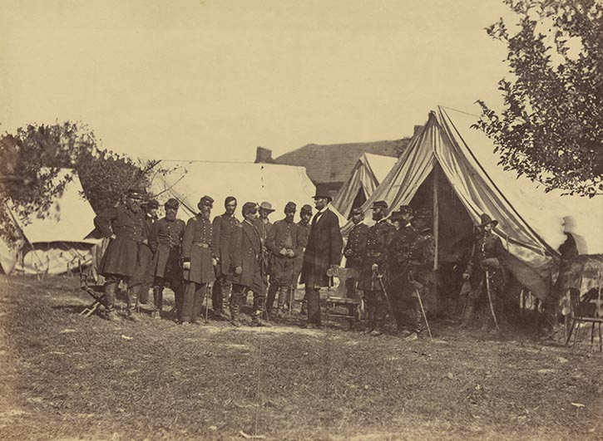
Abraham Lincoln at Antietam,1862

Slide 38
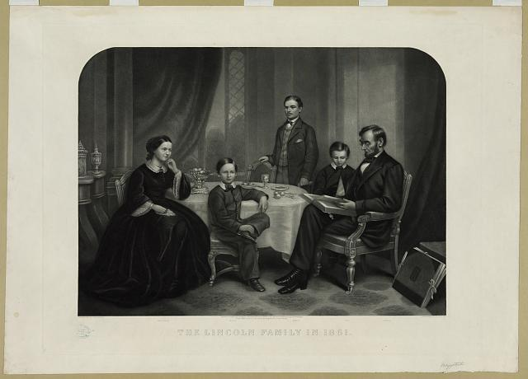

Slide 39
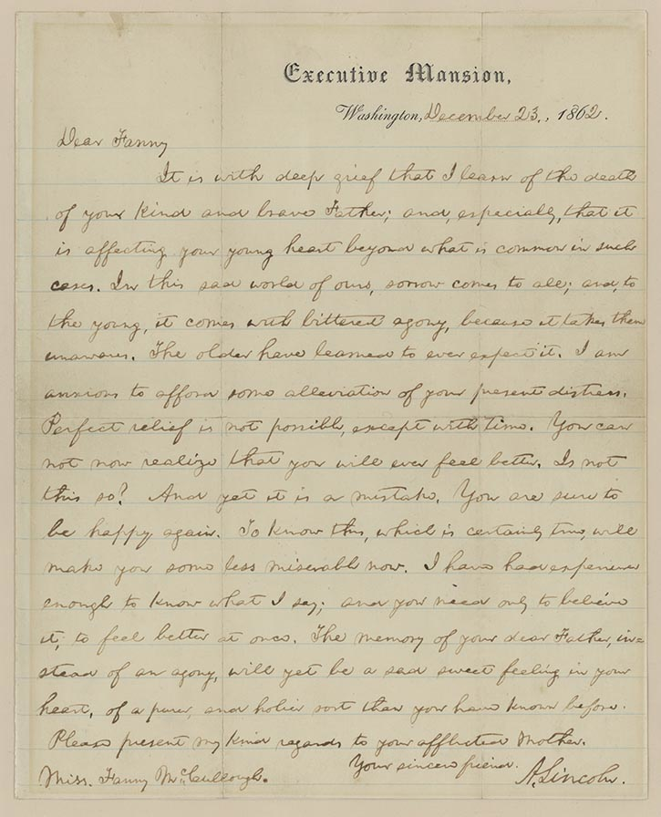
Abraham Lincoln to Fanny McCullough of Bloomington, Illinois, December 23, 1862.

Slide 40
Dear Fanny
It is with deep grief that I learn of the death of your kind and brave father; and, especially, that it is affecting your young heart beyond what is common in such cases. In this sad world of ours, sorrow comes to all; and, to the young, it comes with bitterest agony, because it takes them unawares. The older have learned to ever expect it. I am anxious to afford some alleviation of your present distress. Perfect relief is not possible, except with time. You can not now realize that you will ever feel better. Is not this so? And yet it is a mistake. You are sure to be happy again. To know this, which is certainly true, will make you some less miserable now. I have had experiences enough to know what I say; and you need only to believe it, to feel better at once. The memory of your dear Father, instead of an agony, will yet be a sad sweet feeling in your heart, of a purer, and holier sort than you have known before. Please present my kind regards to your afflicted mother.
Your sincere friend,
A. Lincoln

Slide 41
The Gettysburg Address
Four score and seven years ago our fathers brought forth on this continent a new nation, conceived in liberty and dedicated to the proposition that all men are created equal. Now we are engaged in a great civil war, testing whether that nation or any nation so conceived and so dedicated can long endure. We are met on a great battlefield of that war. We have come to dedicate a portion of that field as a final resting-place for those who here gave their lives that that nation might live. It is altogether fitting and proper that we should do this. But in a larger sense, we cannot dedicate, we cannot consecrate, we cannot hallow this ground.The brave men, living and dead who struggled here have consecrated it far above our poor power to add or detract. The world will little note nor long remember what we say here, but it can never forget what they did here. It is for us the living rather to be dedicated here to the unfinished work which they who fought here have thus far so nobly advanced. It is rather for us to be here dedicated to the great task remaining before us — that from these honored dead we take increased devotion to that cause for which they gave the last full measure of devotion—that we here highly resolve that these dead shall not have died in vain, that this nation under God shall have a new birth of freedom, and that government of the people, by the people, for the people shall not perish from the earth.

Slide 42
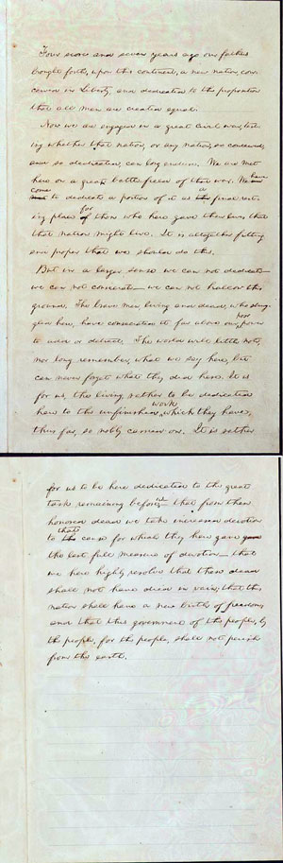

Slide 44
Consolation and the Civil War
The emergence of a culture of consolation;
The assumption that the main meaning of the war “sacrifice”;
Challenges to a providential view of war;
The impossibility of meaninglessness: clinging to meaning during the Civil War

