Slide 1
The Memory of the Civil War in American Culture

Slide 2
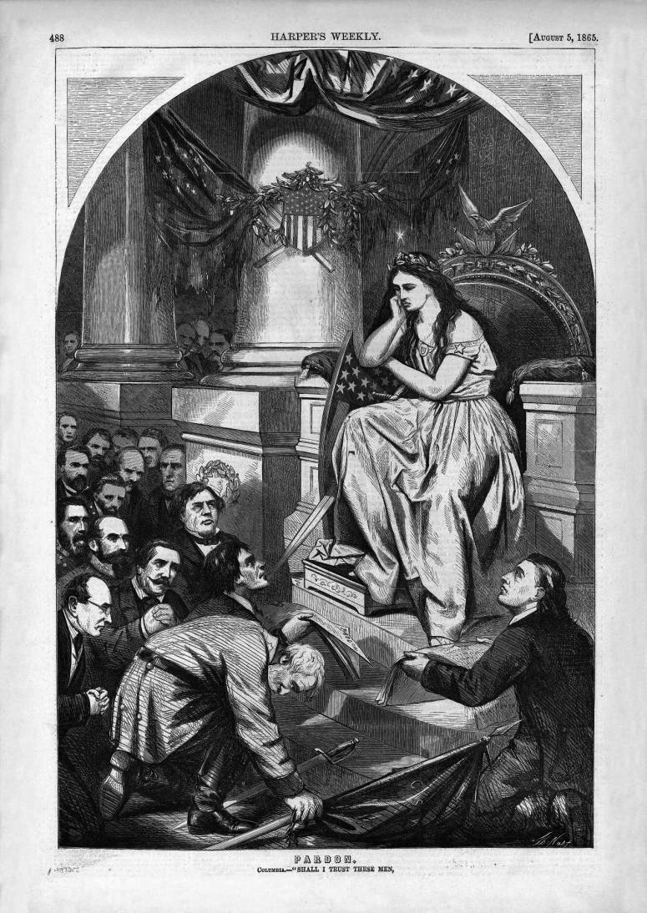
Reconstruction and the Politics of Race
Thomas Nast’s Reconstruction.
Caption: Pardon.
Columbia: “Shall I Trust These Men…. Harper’s Weekly, August 5, 1865

Slide 3
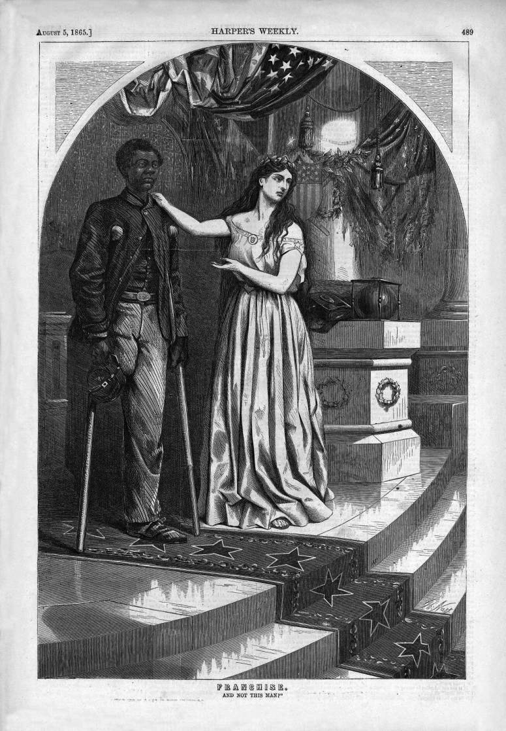
Franchise. ….And Not This Man?” Harper’s Weekly, August 5, 1865

Slide 4
Mississippi Black Code of 1865—Excerpt on “vagrancy”
Vagrancy Law
Section 1. Be it enacted by the legislature of the state of Mississippi, that all rogues and vagabonds, idle and dissipated persons, beggars, jugglers, or persons practising unlawful games or plays, runaways, common drunkards, common nightwalkers, pilferers, lewd, wanton, or lascivious persons, in speech or behavior, common railers and brawlers, persons who neglect their calling or employment, misspend what they earn, or do not provide for the support of themselves or their families or dependents, and all other idle and disorderly persons, including all who neglect all lawful business, or habitually misspend their time by frequenting houses of ill-fame, gaming houses, or tippling shops, shall be deemed and considered vagrants under the provisions of this act; and, on conviction thereof shall be fined not exceeding $100, with all accruing costs, and be imprisoned at the discretion of the court not exceeding ten days.
Section 2. Be it further enacted, that all freedmen, free Negroes, and mulattoes in this state over the age of eighteen years found on the second Monday in January 1866, or thereafter, with no lawful employment or business, or found unlawfully assembling themselves together either in the day or nighttime, and all white persons so assembling with freedmen, free Negroes, or mulattoes, or usually associating with freedmen, free Negroes, or mulattoes on terms of equality, or living in adultery or fornication with a freedwoman, free Negro, or mulatto, shall be deemed vagrants; and, on conviction thereof, shall be fined in the sum of not exceeding, in the case of a freedman, free Negro, or mulatto, 150, and a white man, $200, and imprisoned at the discretion of the court, the free Negro not exceeding ten days, and the white man not exceeding six months.

Slide 5
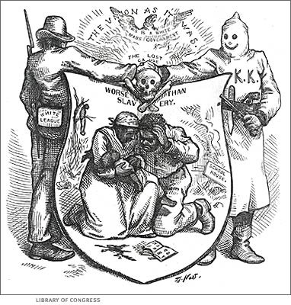

Slide 6
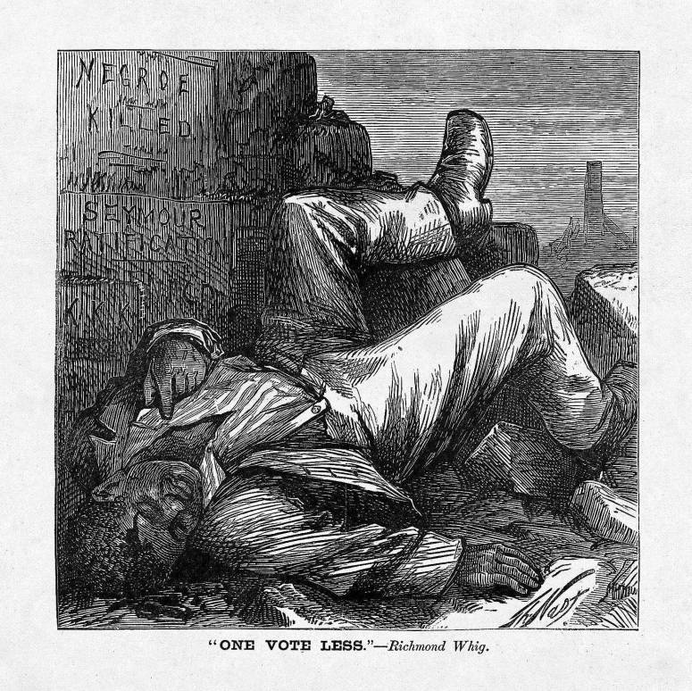
Harper’s Weekly, August 8, 1868

Slide 7
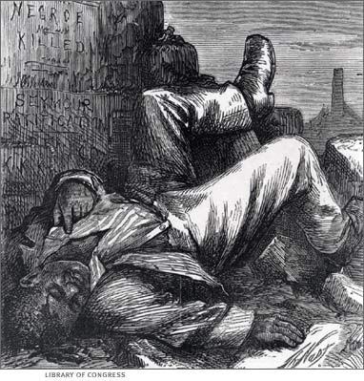

Slide 8
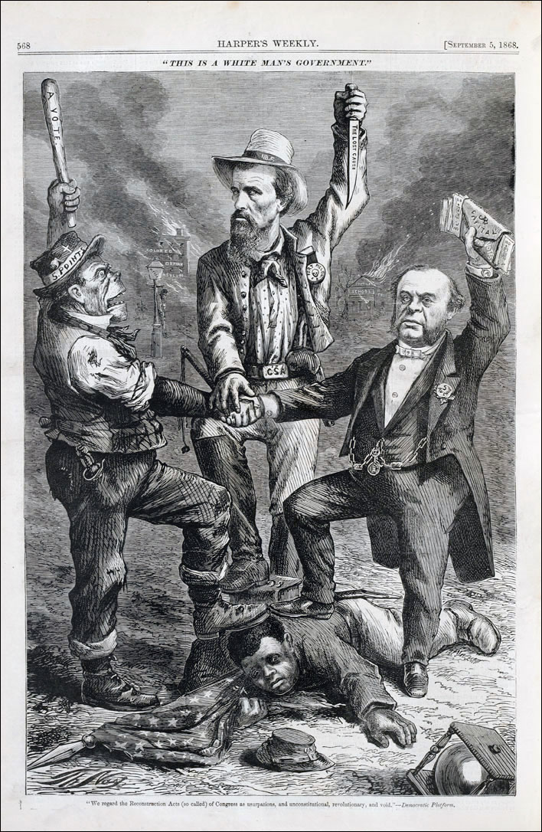

Slide 11
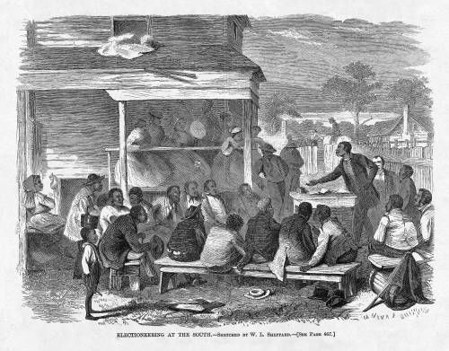
Reconstruction and Black Political Activism
Electioneering at the South, July 25, 1868

Slide 12
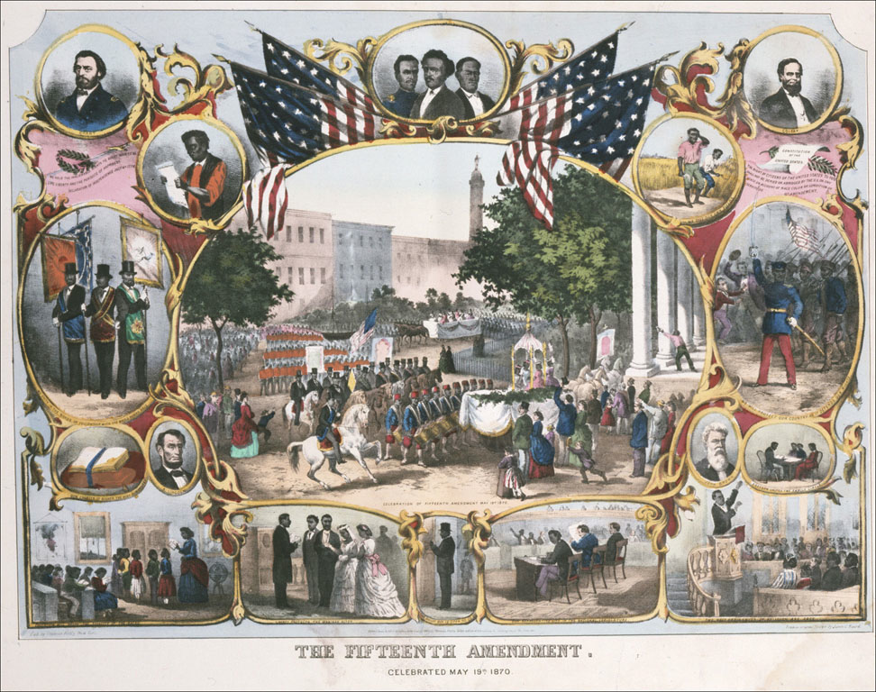

Slide 13
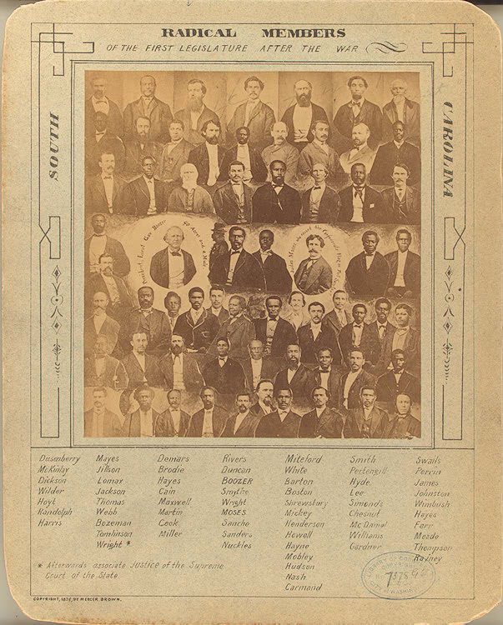

Slide 14
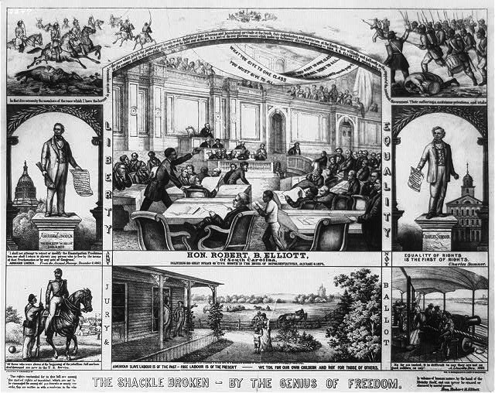

Slide 15
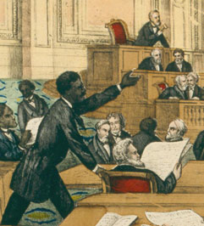
Robert Elliott of South Carolina

Slide 16
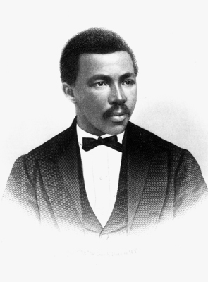
Robert Elliott

Slide 17
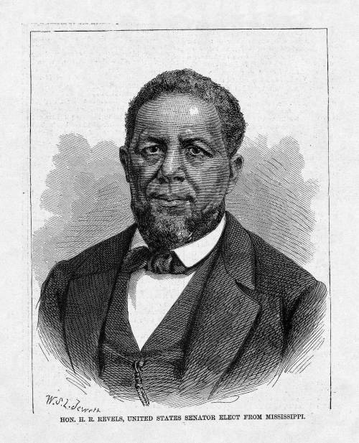
Hiram Revels
From Harper’s Weekly, February 19, 1870

Slide 18
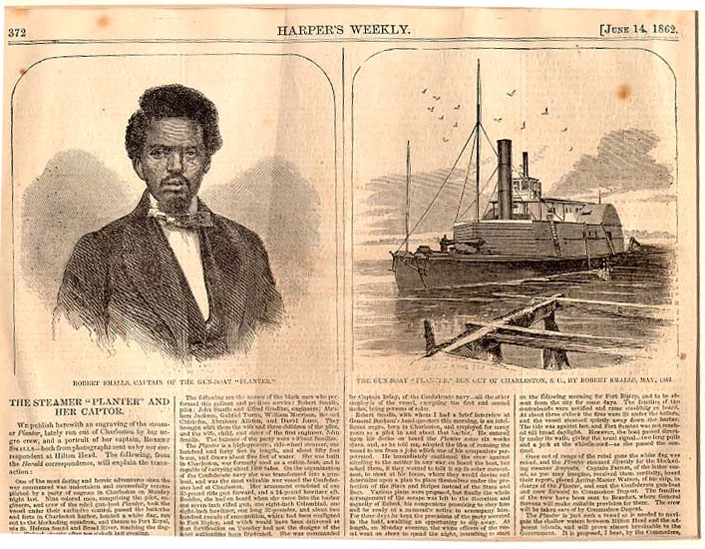

Slide 19
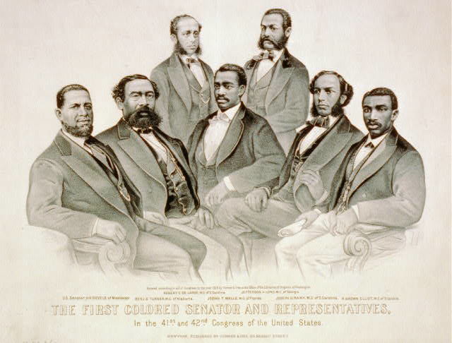

Slide 20
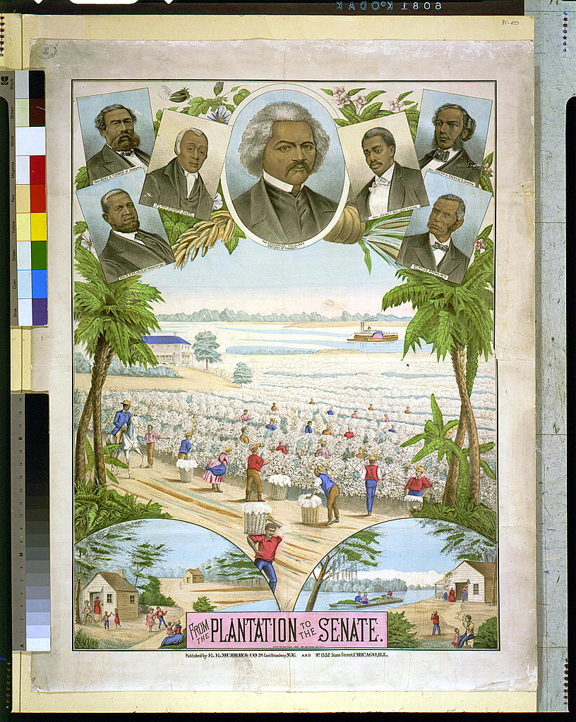

Slide 21
Civil War Memory and the Re-imagination of Slavery
The “Lost Cause”
Uncle Tom Shows
Thomas Dixon and The Clansman (1905)
D. W. Griffith and The Birth of a Nation (1915)

Slide 22
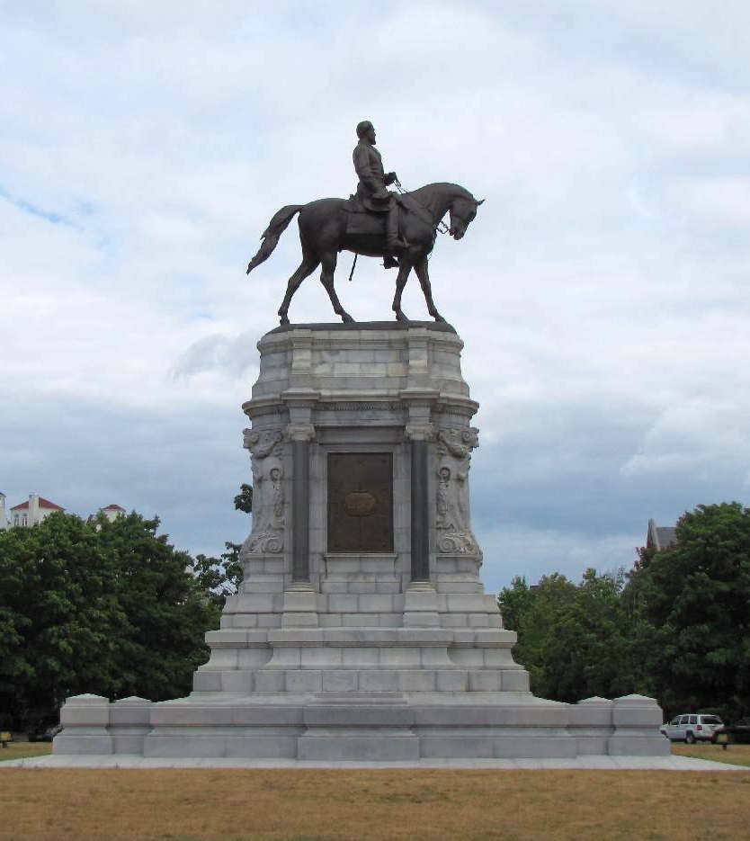
Monument to Robert E. Lee, Richmond, Va.

Slide 23
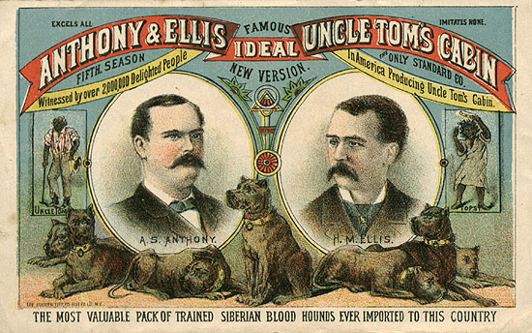

Slide 24
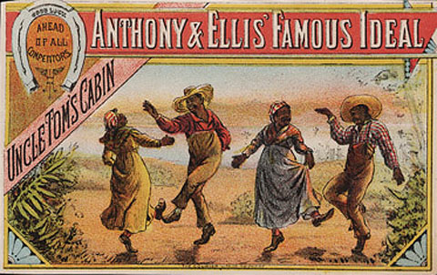

Slide 25
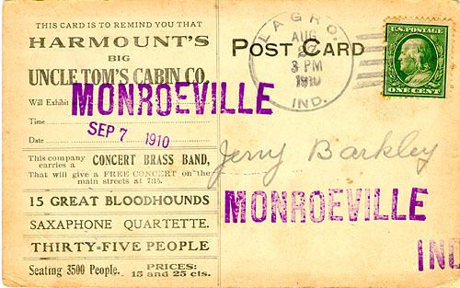

Slide 26
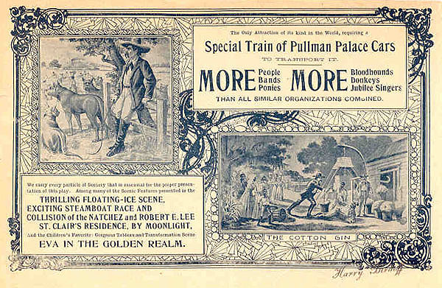

Slide 27
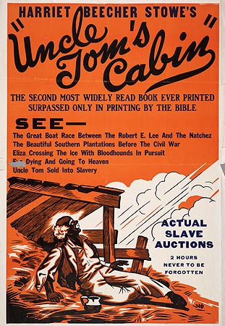

Slide 28
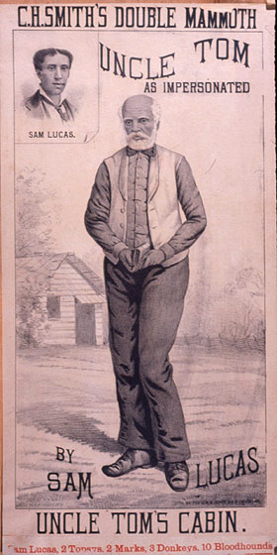

Slide 29
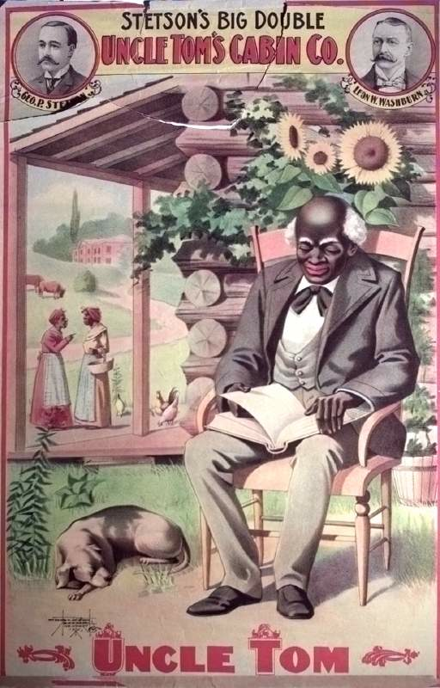

Slide 30
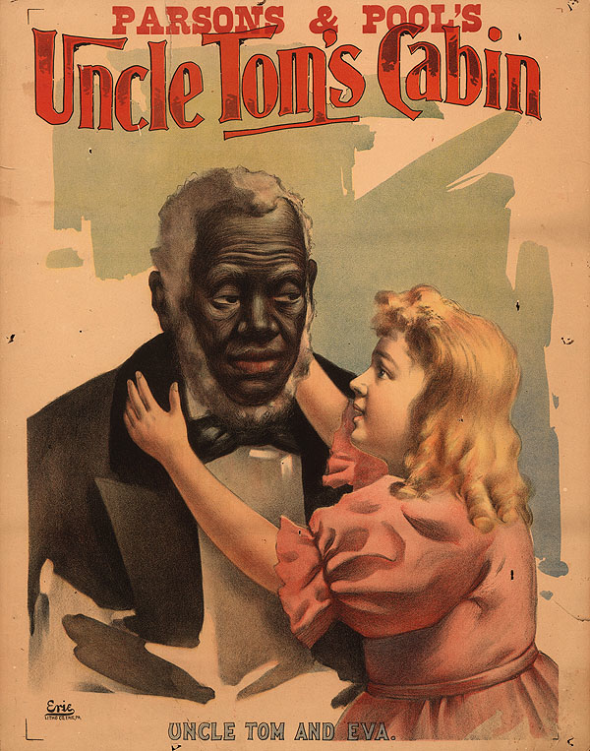

Slide 31
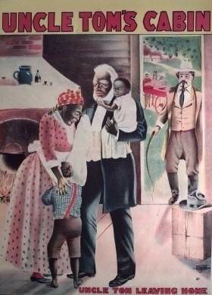

Slide 32
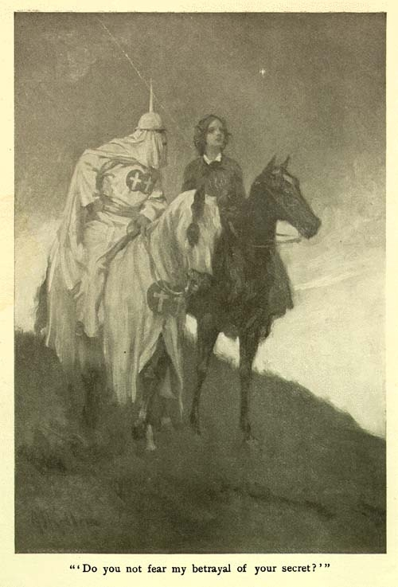
Thomas Dixon, The Clansman
Illustration from 1905 edition

Slide 33
Dissenters against emerging modes of Civil War Memory
Winslow Homer
Ambrose Bierce and dissent against “Reunionism”
W. E. B. Du Bois

Slide 34
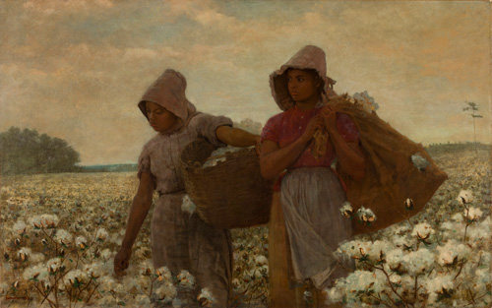
The Cotton Pickers
Winslow Homer, 1876

Slide 35
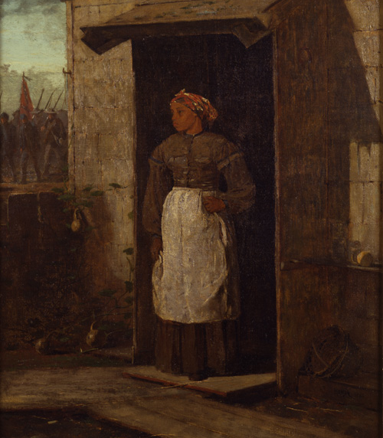
Near Andersonville
Winslow Homer, 1865-1866

Slide 36
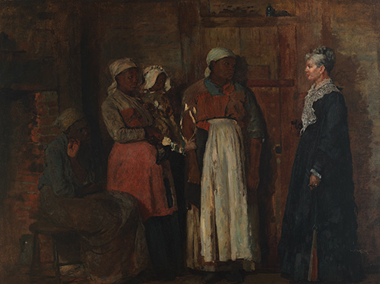
A Visit from the Old Mistress
Winslow Homer, 1876

Slide 37
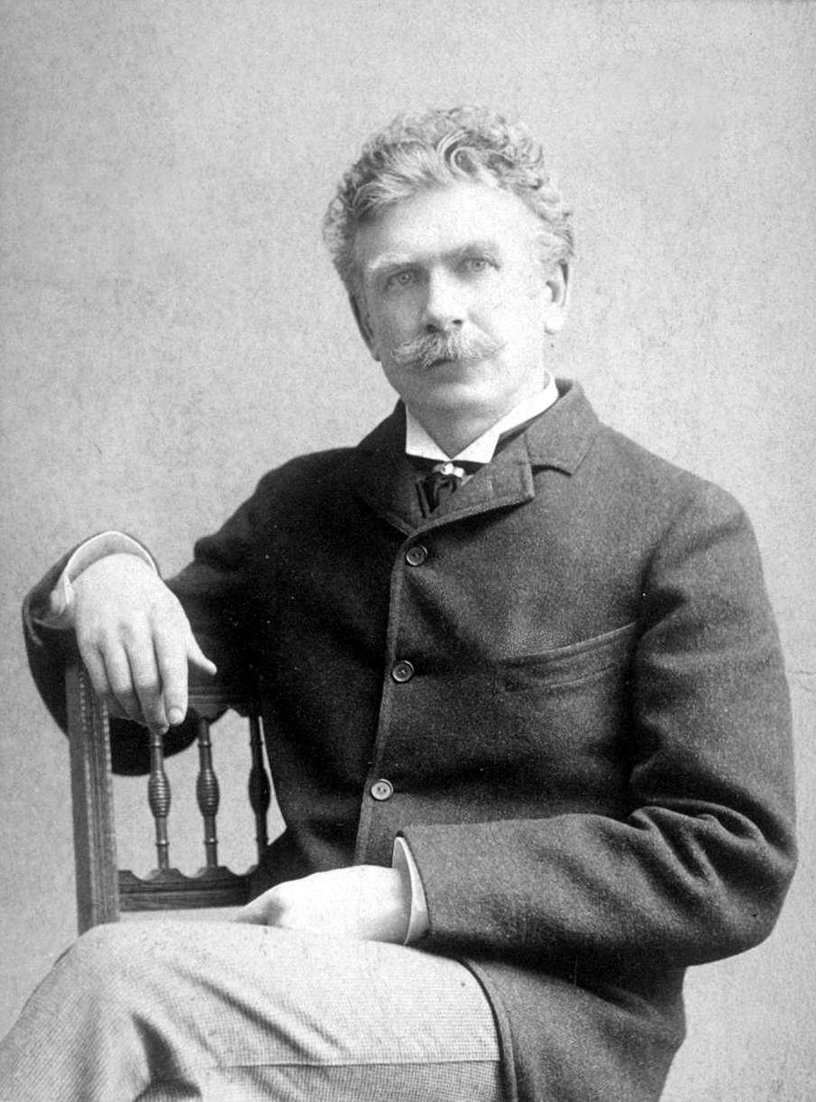
Ambrose Bierce and Dissent against
Reunionism
(b. 1842- d.1914?)

Slide 38
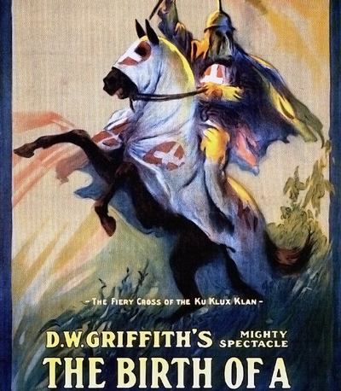
D. W. Griffith
BIRTH OF A NATION
(1915)
https://archive.org/details/dw_griffith_birth_of_a_nation

