Slide 1
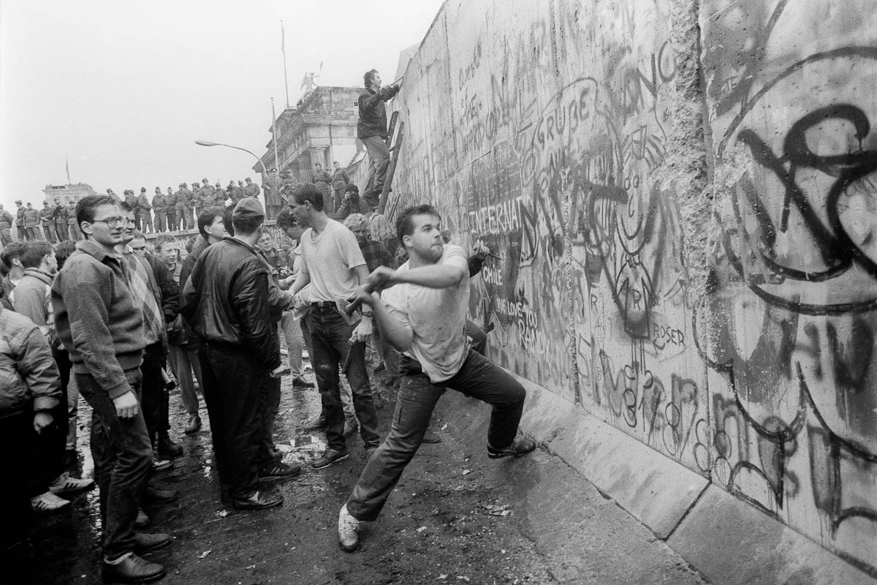
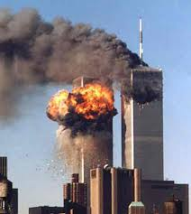
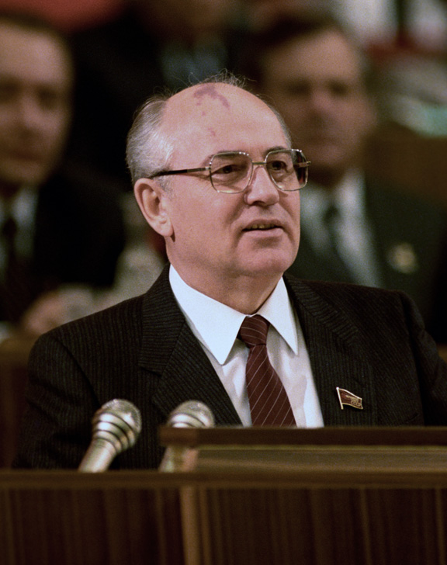
1989: The Fall of the Berlin Wall
Dec. 25, 1991: Soviet Premier Mikhail Gorbachev declares an end to the Soviet Union
September 11, 2001:
Al-Qaeda launches four attacks on targets in New York and Washington, D.C.

Slide 2
From the Cold War to the “War on Terror”
Containment and “Blowback”:
A militant Islamist group, al-Qaeda has its origins in the CIA sponsored battle against the Soviet Occupation of Afghanistan (1979- 1989). Osama Bin Laden works with the CIA and the Saudi Royal family to fund the mujahedeen (a resistance group), many of which later join al-Qaeda.
During the last decades of the 20th century, the U.S. supports Saddam Hussein and the Ba-ath Party (Arab Nationalists) in Iraq in an effort to check the influence of the Islamic Republic of Iran

Slide 3
Two Fronts of the War on Terror
The War in Iraq (2003-2011)
The U.S. and coalition forces launch a “shock and awe” air and land campaign in an effort to topple Saddam Hussein and the Ba-ath Party, and to uncover “weapons of mass destruction.”
The War in Afghanistan (2001-2014)
Initiated by the U.S., and later supported by N.A.T.O. forces, the invasion seeks to topple the Taliban (Islamic fundamentalists), which the U.S. accused of providing safe harbor to al-Qaeda factions responsible for the 9/11 attacks.

Slide 4
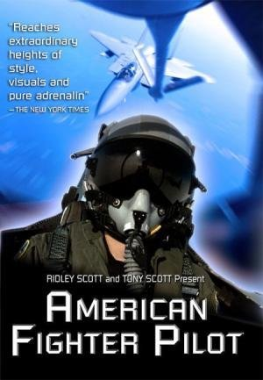
A New Theater of War: Military-Television Collaborations
Discovery’s “The Military Channel” (1999)
MTV’s “Road Rules” (2001)
TBS’s “War Games” (2001)
Fox’s “Boot Camp” (2001)
USA’s “Combat Mission” (2002)
CBS’s “American Fighter Pilot” (2002)
VH1’s “Military Diaries” (2002)
“The Pentagon Channel” (2004)

Slide 5
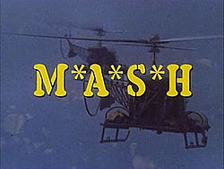
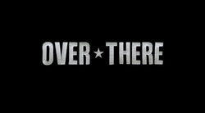
Simultaneous Entertainments
“For the first time in 2005, a US TV drama set in wartime [“Over There”] was produced and shown while [that war] was still being fought” Daya Thussu, “News as Entertainment”
Unlike earlier TV series set during wartime, like M*A*S*H, the series was pro-war.
“These days, there is an unwillingness to criticize individual servicemen and women, which was quite common to the Vietnam era. Americans are very disinclined to do that now, and we’re very glad this attitude tends to pervade all entertainment.”
        Phil Sturb, head of the Pentagon’s film liaison office, quoted in Thussu
1972-1983
2005

Slide 6
Hollywood and the Pentagon
One of the first war films, Birth of a Nation (1915), used artillery pieces loaned from West Point to give it the air of authenticity. The first Academy Award for Best Picture went to 1929's Wings, a movie about aerial combat during World War I that used Army Air Corps pilots to shoot all its dogfights.
“In 1948, the Pentagon formally set up a special movie liaison office, as part of the Office of the Assistant secretary of Defense for Public Affairs. Filmmakers who wanted access to military equipment, locations, personnel, or Department of Defense archival footage, had to agree to their work being vetted by the Pentagon”
        Daya Thussa

Slide 7
Rupert Murdoch's Fox network is among the US media giants accused of tailoring its war coverage to curry favor with Michael Powell, the George Bush-appointed chairman of America's media regulator.
Powell, the son of US secretary of state Colin Powell, is under intense lobbying pressure from the US broadcasting industry to abolish safeguards that restrict limits on the number of TV and radio stations a company can own in a market.
"It is likely that decisions about how to cover the war on Iraq - especially on television - may be tempered by a concern to not alienate the White House," said Jeffrey Chester. "These media giants stand to make untold billions if the FCC safeguards are eliminated or weakened” (The Guardian, 14 April 2003)
Were media companies motivated to believe in the existence of “Weapons of Mass Destruction”?

Slide 8
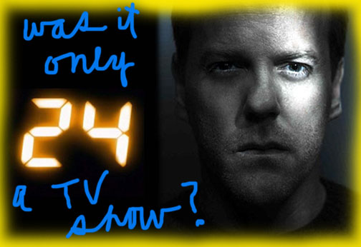
Fox Television’s 24 (2001-2014) and its “Agency”

Slide 9
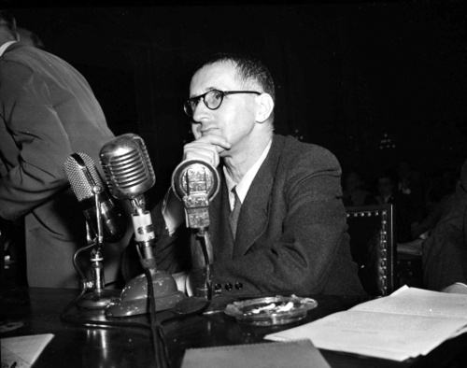
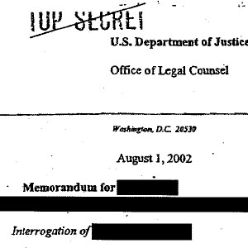
The impact of “24 was absolutely stunning. Everyone from Rush Limbaugh to Bill Clinton would talk about it, and we knew they were among our fans.”
Howard Gordon, Executive Producer (and co-creator of Homeland)
“The staff judge advocate general who gave legal approval to 18 controversial new interrogation techniques including water-boarding, sexual humiliation, and terrorizing prisoners with dogs, [said] … Bauer ‘gave people lots of ideas.’”
“John Yoo, the former Justice Department lawyer who produced the so-called torture memos—simultaneously redefining both the laws of torture and logic—cites Bauer in his book War by Other Means.”
  Dahlia Lithwick, Slate Magazine, July 26, 2008
24 "reflects real life.”
Michael Chertoff (Secretary of Homeland Security, 2005-2009)

Slide 10
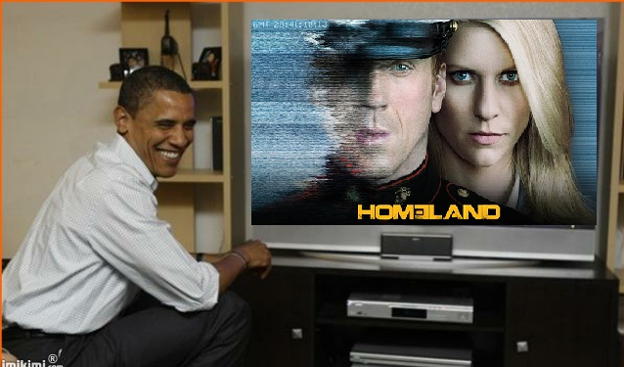
Homeland’s Reach
“Not only has Obama been watching it, but his aides have been calling up going, ‘We need to see it,”’ star Damian Lewis said. “So he’s been getting entire state departments, the top of the U.S. government, asking to see it because their boss watches it and they feel they need to know what their boss has been watching.”
      Daily News, July 12, 2012

Slide 11
Uneasy Alliances
“On September 9, 2013, the CIA invited the producers and cast of the hit Showtime series Homeland to its secure Langley headquarters for a two hour sit-down with senior officials, including the director of the CIA . . . . Alex Gansa, co-creator and producer of the series, noted the uncanny ‘parallels’ between the entertainment business and the intelligence business: ‘We both build sets. We both play roles. And we both brainstorm, about operations on their side and storylines on ours.’”
Timmothy Melley, “Covert Spectacles and the Contradictions of the Democratic Security State”

Slide 12
Entering Official Discourse
“Pakistani officials recently lashed out at the Showtime series Homeland for its portrayal of the Southwest Asian nation as a friend to terrorist groups, among other complaints, but according to former U.S. officials and Pakistan experts, it could be a case of a fictional show hitting just a little too close to home.
“Last week the press attaché for Pakistan’s embassy in Washington released a statement saying it was ‘very unfortunate that the underlying theme of Homeland Season 4 is designed to create a negative perception of both the U.S. and Pakistan.’”
ABC News, 2 January 2015

Slide 13
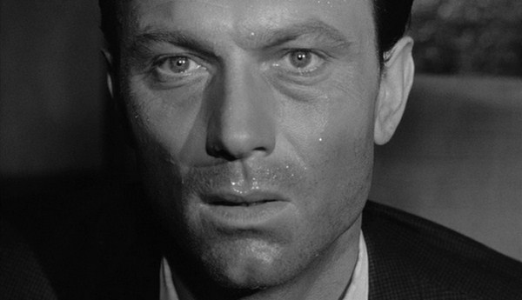
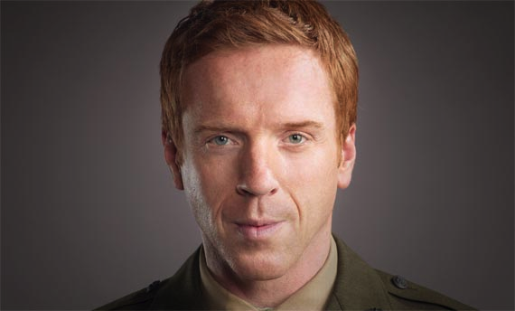
How are The Manchurian Candidate and Homeland Similar? Are Raymond Shaw and Nicholas Brody the same kind of agents? What’s the difference between Shaw’s “brainwashing” and Brody’s?
Raymond Shaw is not converted to any belief system.
Brody converts to Islam and comes to believe in Abu Nazir’s cause. Or does he?

Slide 14
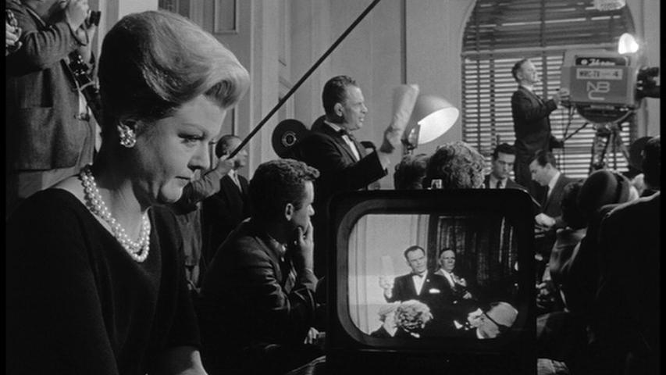
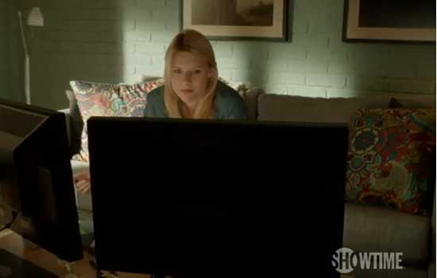
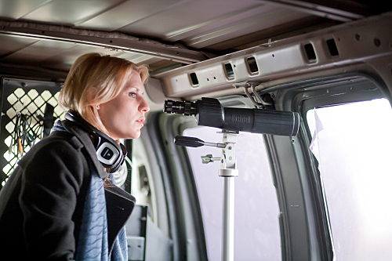
“Eyes and ears in every room”
How does Homeland understand cameras and screens?
Eleanor Shaw orchestrates “official history.” Carrie spies on Nick’s home life.

Slide 15
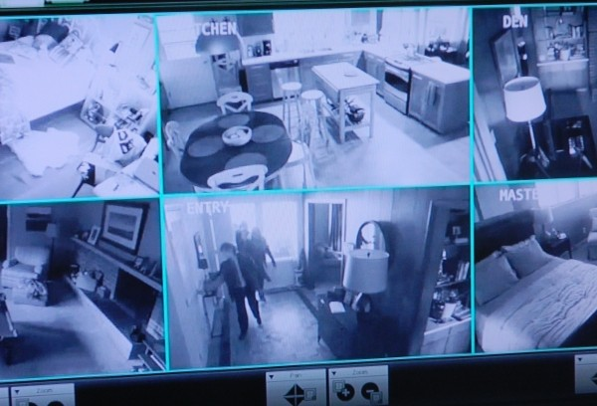
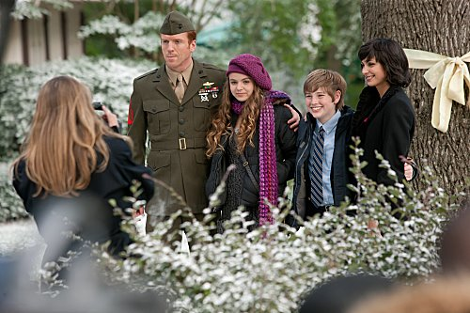

Homeland and
domestic surveillance

Slide 16
Debating Carrie Mathison
“Homeland is, I think, doing something new: While anti-hero shows often end up as sly critiques of masculinity (think Tony Soprano), Homeland actually offers a defense of Carrie's emotionalism, turning it into a superpower rather than a feminine weakness.”
Alyssa Rosenberg, “In Praise of Carrie Mathison’s Feminine Instincts,” Slate, 2012
Carrie “embodies the ugliest stereotypes about women in the workplace: that they're hysterical, brittle, rude, entitled, inefficient, and governed by emotions rather than logic. Instead of earning her promotions, Carrie either fails her way up the CIA ladder (after practically everyone else is killed by the Langley car bomb) or threatens people into giving her what she wants.”
Sophie Gilbert, “The Case Against Carrie, The Atlantic, 2014

Slide 17
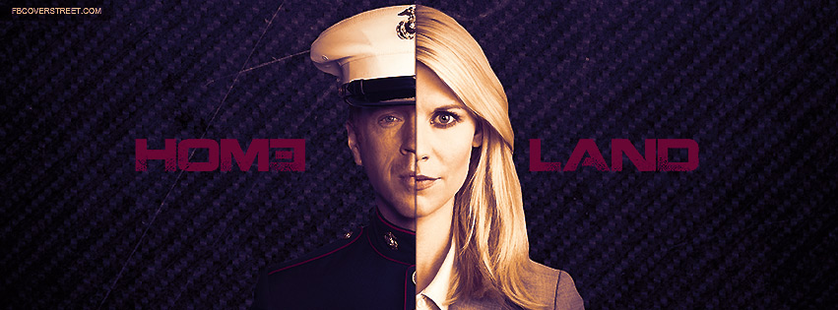
Why Bi-Polar?
In Homeland, the Raymond Shaw Ben Marco duo become the Carrie/Nicholas duo.
In what way does Carrie’s mental disorder extend Ben Marco’s dual role as his own agent and a foreign agent? If that disorder is a metaphor, what is a metaphor for?
Doubled Double Agents: In what way is Tom Walker Nicholas Brody’s Double?

Slide 18
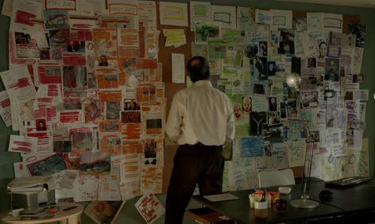
Carrie’s “Paranoid Style” (Double Vision)
While manic, Carrie sees connections that she cannot normally see, and that others cannot see. Her mania gives her the ability to picture and visualize conspiracy.

Slide 19
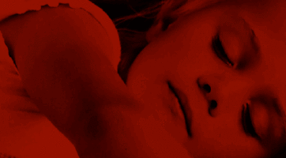
The Opening Credits
“The most evident feature of the sequence is its discontinuity and lack of consistent narrative unfolding. Not only is it difficult to assign coherence to it, when they attain narrative continuity (because of an internal recurrence of subject and motif), some shots literally jump before the eye, while others fade in a blur of aberrant chromaticism, or are superimposed to other ones. This editing choice draws attention to the precarious status that, in the series, images and sounds have as objects of knowledge: the spectatorial mastery of the object of vision is bracketed by an overabundance of sensorial stimuli, like the insistent superimposition of diegetic sounds (sirens, fragments of presidential addresses on terrorism, helicopters and voices speaking in muffled Arabic) on a piercing jazz soundtrack.”
Enrica Picarelli, “Aspirational Paratexts: the Case of ‘Quality Openers’ in TV Promotion,” Frames Cinema Journal

Slide 20
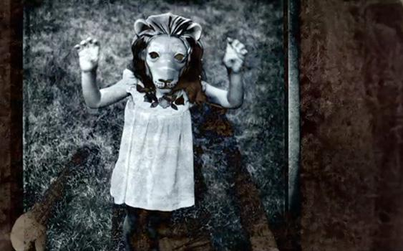
Back to the Unconscious
Opening: http://videos.nymag.com/video/Opening-Credits-Homeland#c=GPW04R137JDPW6CY&t=Opening%20Credits:%20%27Homeland%27
What logic organizes this montage?

Slide 21
Recall Prof. Lazo:
“How do the types of perspectives that Said associates with Orientalism become intertwined with US racial visions and racism, particularly in the wake of 9/11 and the Bush Administration’s arguments about terrorism?”

Slide 22
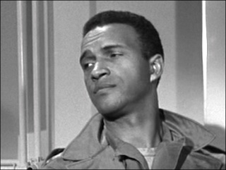
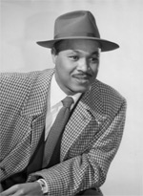
What role do African Americans (and jazz) play in The Manchurian Candidate?
“Here we are, in 1962, and a black man is playing a professional, a thinker, and it’s not commented on, it’s not an issue, but it’s still a shock. The man is just doing his job, and no one pays it any mind. How many other American movies use a black actor to play what audiences expect to be a white character without even bothering to point it out, to pat themselves on the back, to congratulate themselves?” (Greil Marcus, The Manchurian Candidate, 58)
James Edwards
“In scoring the adaptation of Richard Condon's political psychodrama, David Amram used a broad stylistic compass. For "Unrequited Love," Coplandesque strings, a moody sax, an ominous bass clarinet and unsettling bongos underpin the doomed romance between Laurence Harvey and Leslie Parish. In "Slightly Manchurian Blues," Harold Land sails through an aptly augmented blues, while in "Cantina Latina, Korea, 1952," Amram's haunting French horn leads to a tumultuous jam.” (Chuck Berg, Jazz Times)
Joe Adams

Slide 23
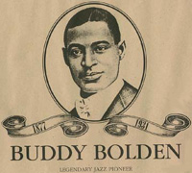
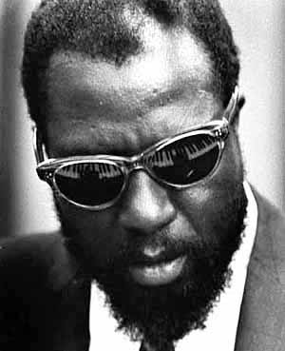
What role does jazz in particular play in Homeland?
Carrie listens “to a version of Thelonious Monk's standard ‘Straight, No Chaser,’ while driving to a meeting at CIA headquarters in Washington. Monk was hospitalized at various points in his career due to an unspecified mental illness and there has been some debate about whether he could have had a schizophrenic or bipolar disorder. (In fact, jazz and schizophrenia have long been linked. It is argued that New Orleans cornetist Buddy Bolden, the ‘inventor of jazz,’ improvised the music he played as his schizophrenia did not allow him to read music.)”
The Guardian, 4/26/12
Thelonious Monk

Slide 24
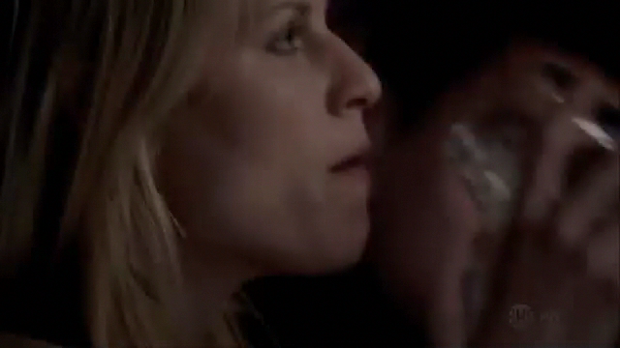
Jazz Codes

Slide 25
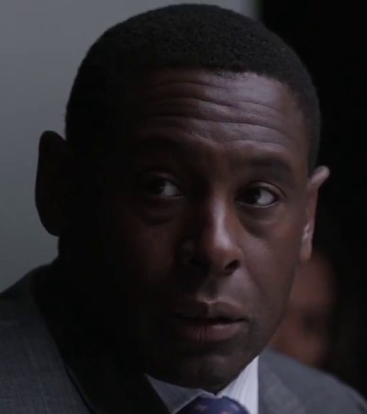
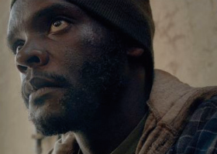
Does Homeland suggest these equations?
Jazz Phrasings = A Terrorist’s code?
Appreciating Black culture = Sympathizing with Radical Islam?
African Americans = Jihadists?
Tom Walker
David Estes

Slide 26
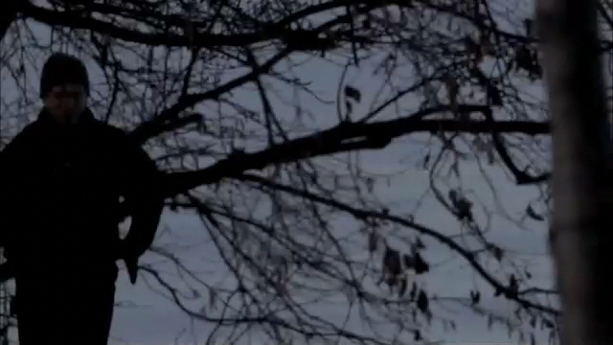
Final Sequence

Slide 27
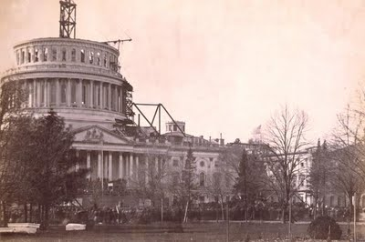
1) Abu Nazir compels Nick Brody to assault Tom Walker
2) Brody does, and releases his rage.
3) Nazir comforts Brody; they are now united.
4) Brody contemplates Congress

